Slide 1
BGP monitoring
The whys and hows

Slide 2
NETWORK OBSERVABILITY: The ability to answer any question about your network
When will we be at capacity?
Are we under attack?
Is the network the problem?
What’s driving latency in the east?
What should I be performance testing?
What will my cloud costs be in…?
Notes:
[MANDATORY]
As our industry seeks to address the issues of network complexity, criticality, and customer expectations, we think the answer is in knowledge - the ability to answer any question about your network, whether corporate, cloud, or internet. Wherever your traffic travels or your data reside, you need to see and know about it.
[Discovery question] Do you have network questions that you can’t answer, or can’t answer quickly and easily?
[Discovery drill down]

Slide 3
Kentik is the Network Observability Company
300+
ENTERPRISE CUSTOMERS
EVERY
NETWORK
EVERY
COUNTRY
95%+
CSAT
>25%
INCREASED UPTIME
TRILLIONS
RECORDS/DAY
Notes:
[OPTIONAL. MIX OF ENT AND SP.]
Kentik is the network observability company. We serve 300 enterprise and service provider customers. We are proud to operate on a global scale, ingesting trillions of records of network telemetry per day in virtually any format across nearly every network worldwide.
Customer success is everything to us. Our 95%+ CSAT and top NPS scores - scores that usually only organizations like Southwest and Nordstrom are known for - are evidence of our commitment to our customers. Among other metrics our customers care about, perhaps the most critical is uptime since it most closely correlates to their top line. Most of our customers see a greater than 25% improvement using Kentik.
Organizations at the top of their game - whether they run a network for a revenue-generating service, are responsible for keeping enterprise employees productive, or operate one of the world’s biggest networks - they rely on Kentik. And we’re incredibly proud of that.

Slide 4
BGP monitoring: More questions to answer about your network

Slide 5
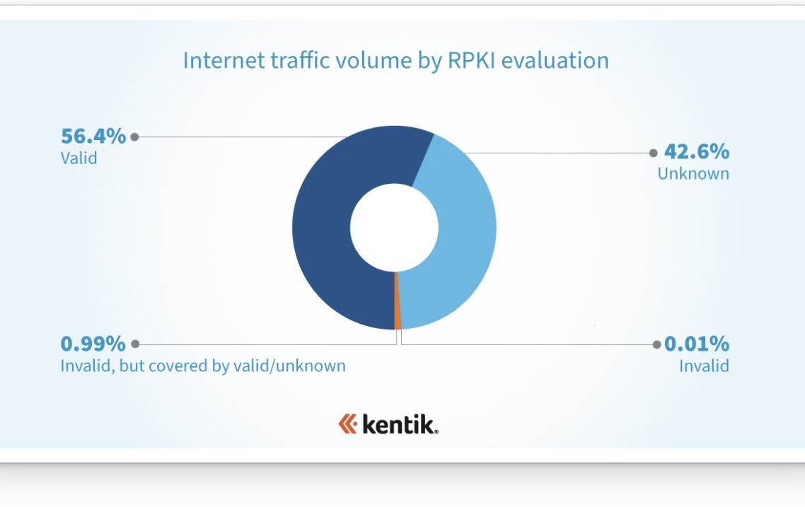
RKPI is here - are we done caring about BGP monitoring then?
Doug Madory and Job Snijders have shown us that we are reaching critical mass when looking at traffic routed to RKPI signed prefixes. So if we sign our prefixes and drop the invalids we are all done, right?
Create ROAs
Reject invalids
Do NOT change local pref base on invalid status
Do NOT set/remove communities based on invalid status
Notes:
No - we are not RKPI status is just another thing to monitor

Slide 6
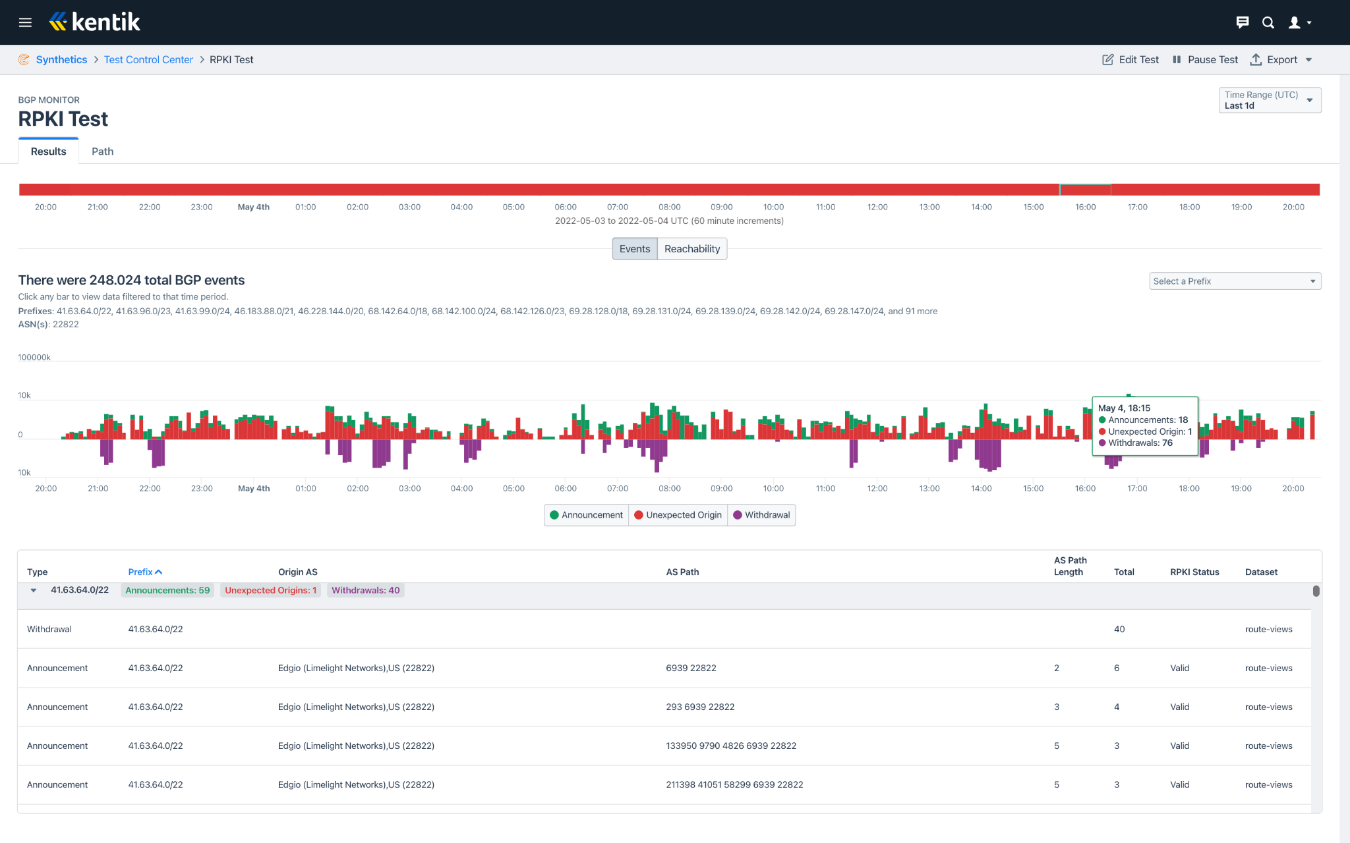
What can we monitor?
Withdrawals
Announcements
Reachability
Leaks
Origin changes
RKPI status
Path and path changes
Illustration from Kentik BGP monitoring tool

Slide 7
Why would we monitor
Withdrawals/Announcements
… happens all the time at a base level, but large numbers of withdrawals and announcements creates instability that could affect the quality of traffic to the prefix(es)
Reachability
We want our prefixes to be globally reachable all the time.
Makes the announcements of new address space easier
Leaks
Someone else’s config errors can disrupt our service so we want to know about it as soon as they happen
You can prevent leaking yourself, but not other networks mistakes
Notes:
Leaks - for example - a dual homed customer announces the full table learned from one provider to their other provider - or the routes learned via peering to their upstream - local pref kicks in since customers are preferred over peers and a lot of traffic destined to big networks will suddenly be routed to the customer - Happened recently in india and disrupted service for comcast customers

Slide 8
Why would we monitor
Origin changes
If we or our customers are using a service that is critical for us or them, we want to make sure we are sending traffic to the right place. Unexpected origins could be caused by a hijack or config errors
RKPI status
Resource Public Key Infrastructure (RPKI) is a best practice for securing BGP route announcements, but the improper configuration of ROAs can cause reachability issues. Knowing when these occur and getting alerted is a crucial part of monitoring BGP
Path and path changes
Frequent changes in the path that BGP route announcements take between ASes can be a sign of instability. Monitoring for these changes and getting alerted as soon as they occur is a key part of ensuring service reliability.
Notes:
Mention it could be interesting to know if there is a valid covering prefix when an invalid is detected

Slide 9
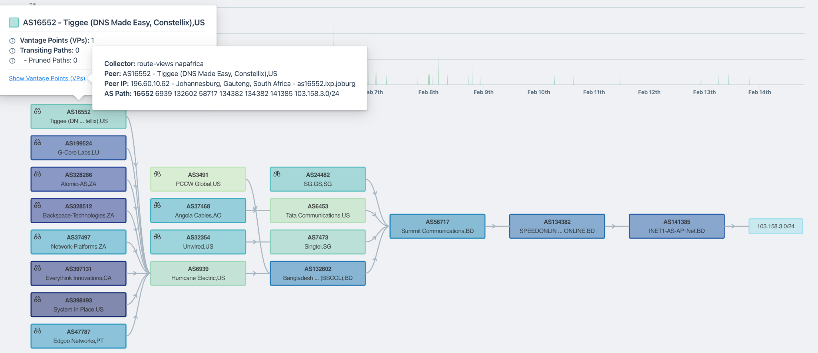
How can we monitor
Datasources
Route views
RIS
Peers
Ingest and process large datasets
Detect the monitoring Events
Store enough data to give context to events
Present the data
Alert when anomalies happen
Visualizations are a great way to present a lot of information at a glance

Slide 10
Comparison Item 1
Routing Information Service(RIS)
Route views
Operated by the RIPE NCC
Collects and stores BGP data using Remote Route Collectors typically at Internet Exchanges Points throughout the world
RRCs peer with volunteers at the IXes
RIS provides access to data and tools on their website
Anyone can can get access to the data and use it to improve their network operations.
If comercial services are sold, RIS have requirements that must be met.
Operated by University of Oregon
Collects and store BGP data from Collectors around the world
Collectors peer with volunteers at Xes or sometimes using multihop peerings
Routeview provides access to data and tools on their website
Routeviews data is licensed under creative commons license v4
Notes:
Share — copy and redistribute the material in any medium or format
Adapt — remix, transform, and build upon the material for any purpose, even commercially.
Attribution — You must give appropriate credit, provide a link to the license, and indicate if changes were made. You may do so in any reasonable manner, but not in any way that suggests the licensor endorses you or your use.
No additional restrictions — You may not apply legal terms or technological measures that legally restrict others from doing anything the license permits.

Slide 11
BGP monitoring is also Network Observability
Kentik’s view on Network Observability

Slide 12
Questions?

Slide 13
Kentik is the network observability company.

Slide 14
Thank you!
Nina Bargisen
Tech Evangelist
nina@kentik.com

