Slide 1
Text Parsing Strategies for Network Devices
Ruairí Carroll
DKNOG13

Slide 2
Intro
Titled this talk to sound boring (Sorry, PC!)
Cookbook style approach
GitHub repo accompaniment

Slide 3
Some phrases
Regex: Regular Expressions
Parser: Takes lexer and makes data structure
Lexer: Convert sequence of characters into “words” aka tokeniser
Grammar: Combination of Lexer and Parser
DSL: Domain Specific Language. For this talk, vendors CLI

Slide 4
Historical Context
Devices managed by hand
  This is generally regarded as a bad move
Automation starting to take off
Paraphrasing someone smart
  db -> network is easy
  network ->db is very hard

Slide 5
Current state of affairs
NetCONF, RestCONF, gRPC, OMGWTFBBQ
Many options, but…
Still got devices needing console/SSH

Slide 6
So Why This Talk?
Outline some options
Not exhaustive or authoritive
Hopefully helpful to someone

Slide 7
Substring matching
Is X contained in Y
Simple
Fragile

Slide 8
Regex
Allows match via meta language
Lets you abstract and describe desired match
Often used as wrong tool
Perl-esque
Bad rep, however still useful

Slide 9
Regex - Named Capture Groups
Can make regex more readable (!!)
Extract multiple variables from text blobs

Slide 10
ZA̡͊͠͝LGΌ ISͮ̂҉̯͈͕̹̘̱ TO͇̹̺ͅƝ̴ȳ̳ TH̘Ë͖́̉ ͠P̯͍̭O̚​N̐Y̡ H̸̡̪̯ͨ͊̽̅̾̎Ȩ̬̩̾͛ͪ̈́̀́͘ ̶̧̨̱̹̭̯ͧ̾ͬC̷̙̲̝͖ͭ̏ͥͮ͟Oͮ͏̮̪̝͍M̲̖͊̒ͪͩͬ̚̚͜Ȇ̴̟̟͙̞ͩ͌͝S̨̥̫͎̭ͯ̿̔̀ͅ

Slide 11
TextFSM
Named Capture Groups on Speed
Can auto map command to parser
Comes in Go and Python versions
Excellent templates available via NTC

Slide 12
Antlr4
A complete grammar/lexer/tokeniser!
Compiles into various languages (Go/Python)
Grammar needs to be “compiled” to code
Import generated code, build on top of it
Notes:
Tutorials:
https://tomassetti.me/antlr-mega-tutorial/
https://github.com/antlr/antlr4/blob/master/doc/getting-started.md

Slide 13
Pulling it all together
Why even give this talk?
You were promised something useful
Well, here goes nothing…

Slide 14
Vendor Neutral Code
Let's build a vendor neutral class!
  IN PYTHON
Why?
  Nobody showed me how to
  Now I’m showing you

Slide 15
Setup and boilerplate
abc for modelling the API
Implement each strategy in a method
Code is on GitHub

Slide 16
Sketch API
Picking 5x interactions
Sketch out via abc
  isUserConfigured
  fetchModel
  fetchRunningVersion
  fetchARPTable
  fetchISISAdjacency

Slide 17
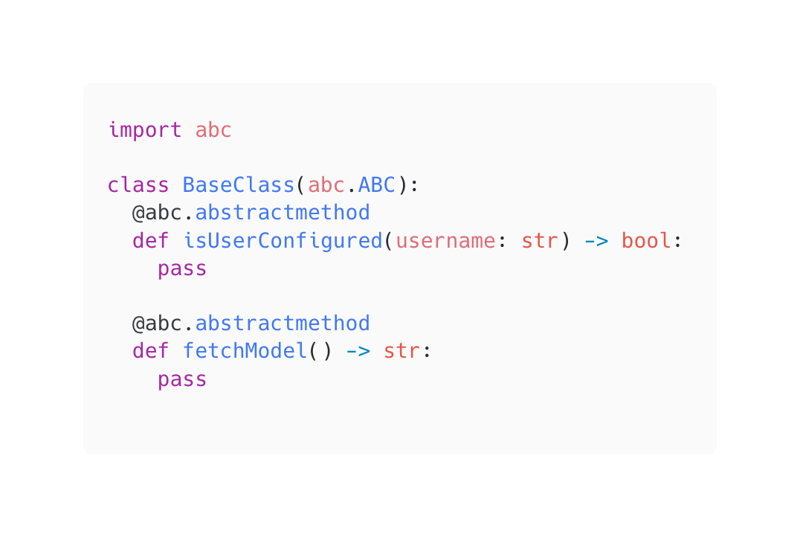
abc
Use decorator abc.abstractmethod

Slide 18
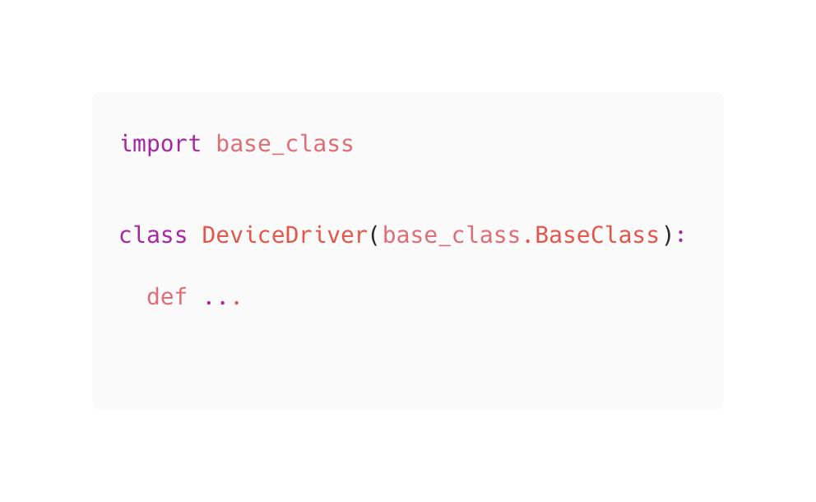
Getting Started

Slide 19
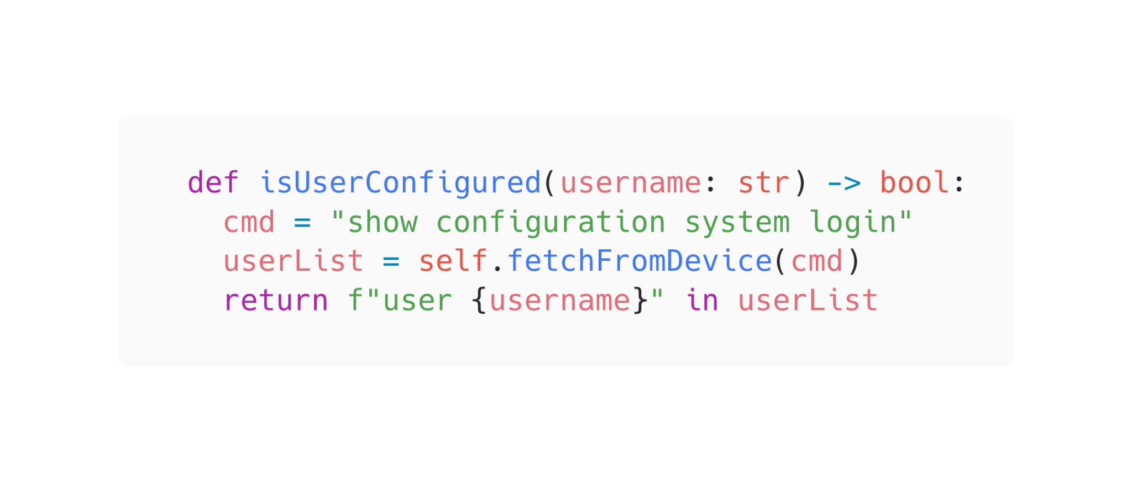
isUserConfigured

Slide 20
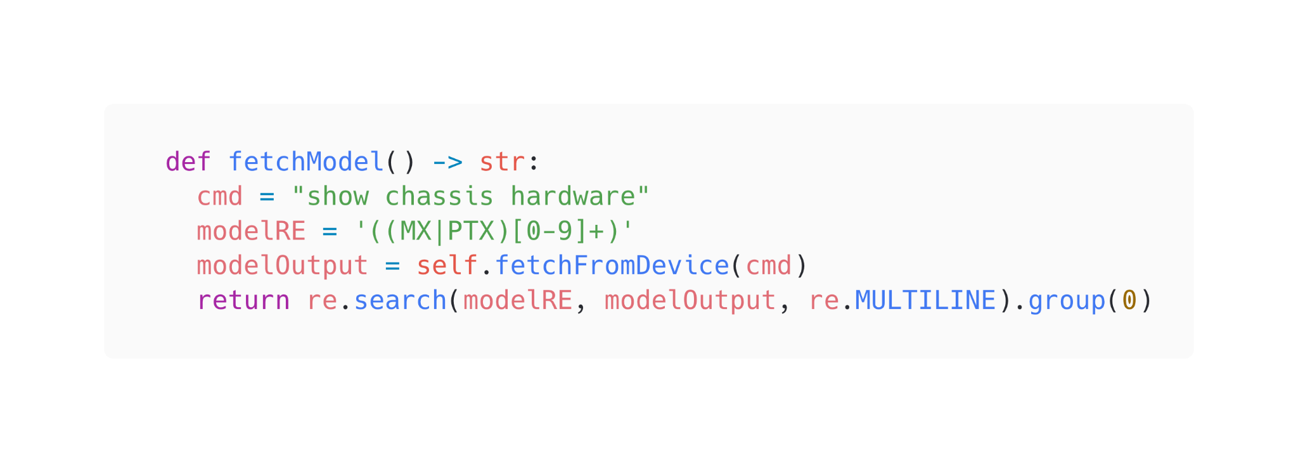
fetchModel

Slide 21
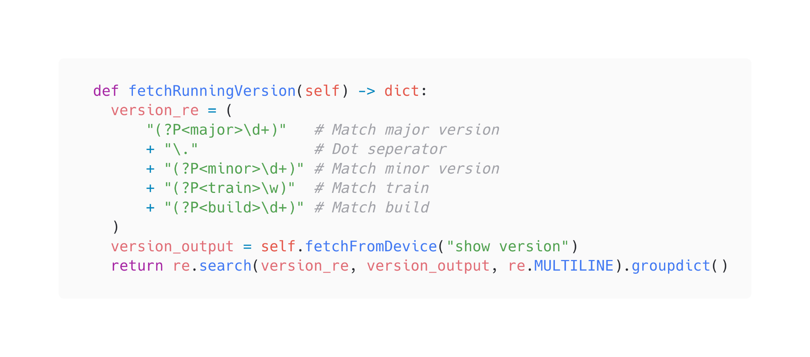
fetchRunningVersion

Slide 22
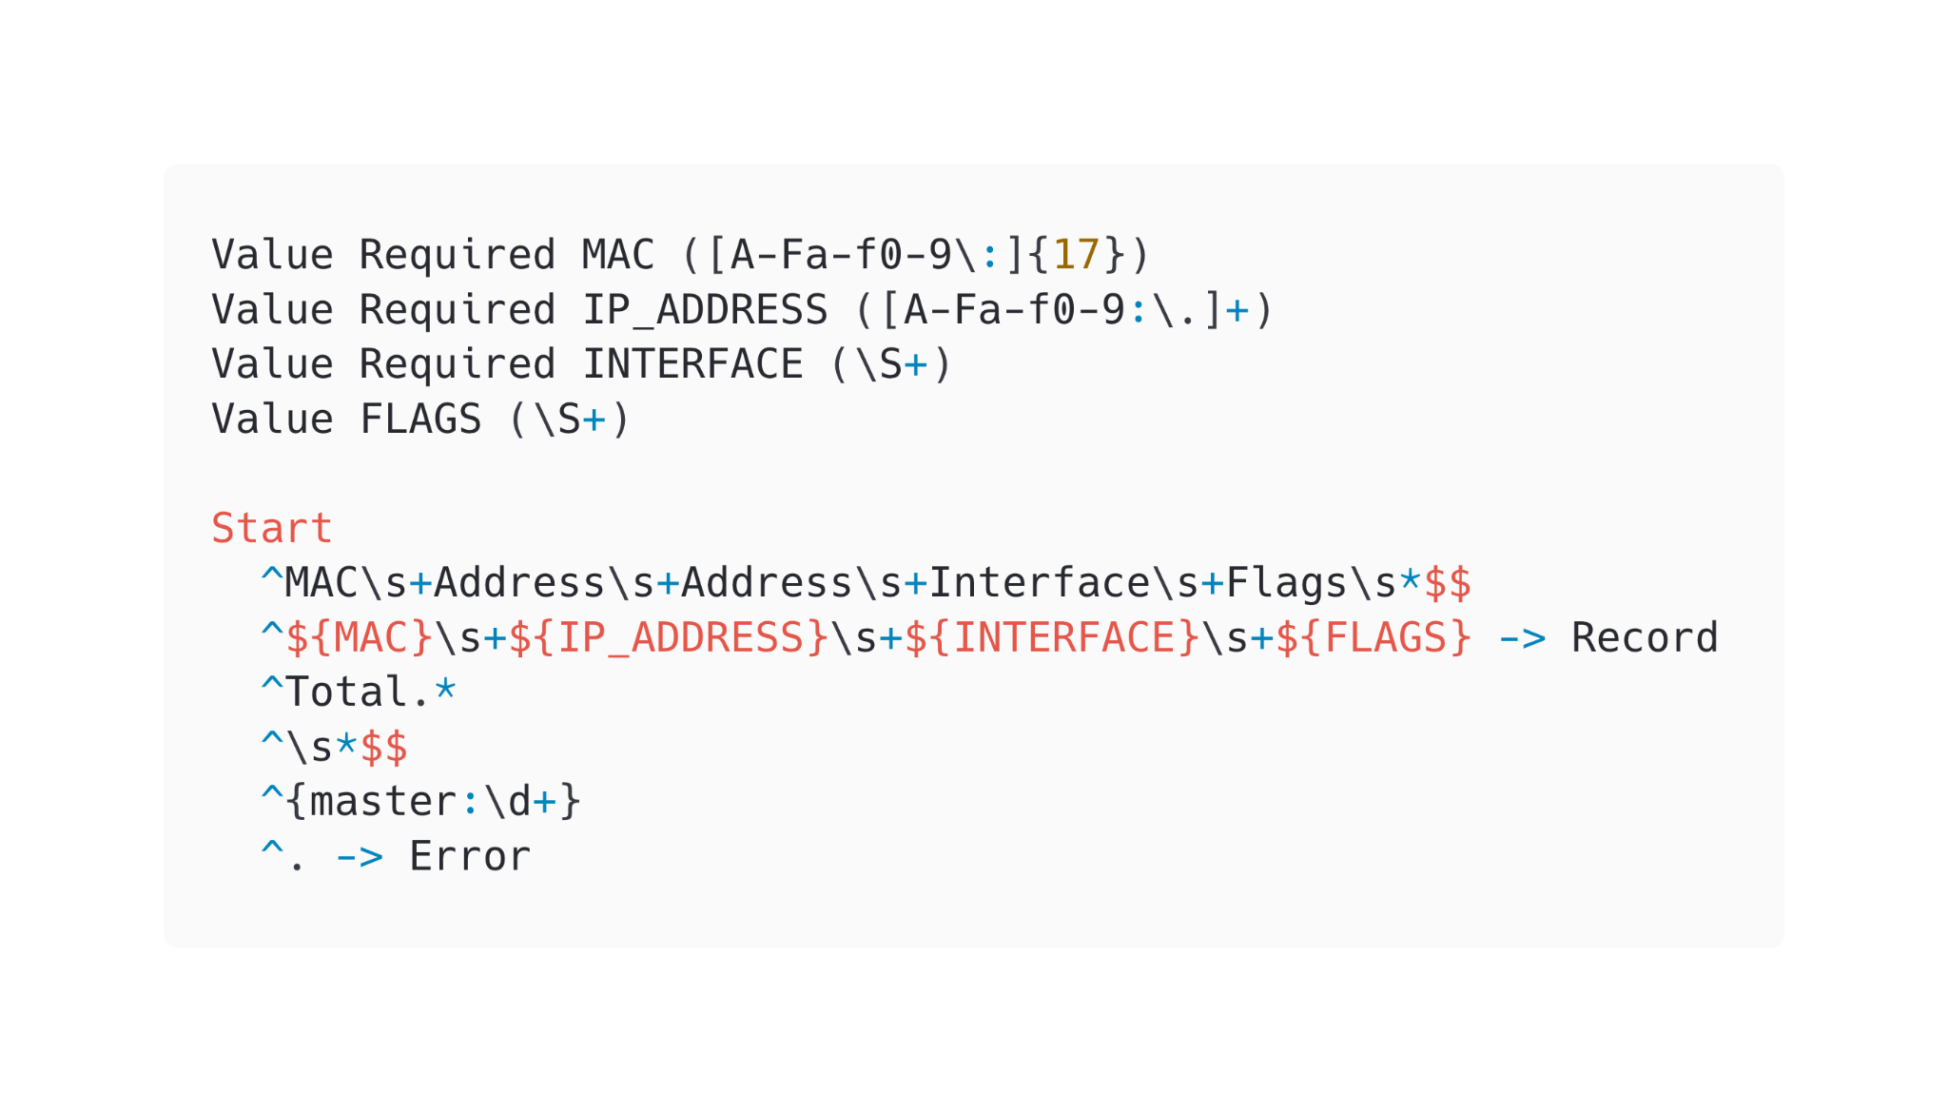
fetchARPTable Template

Slide 23
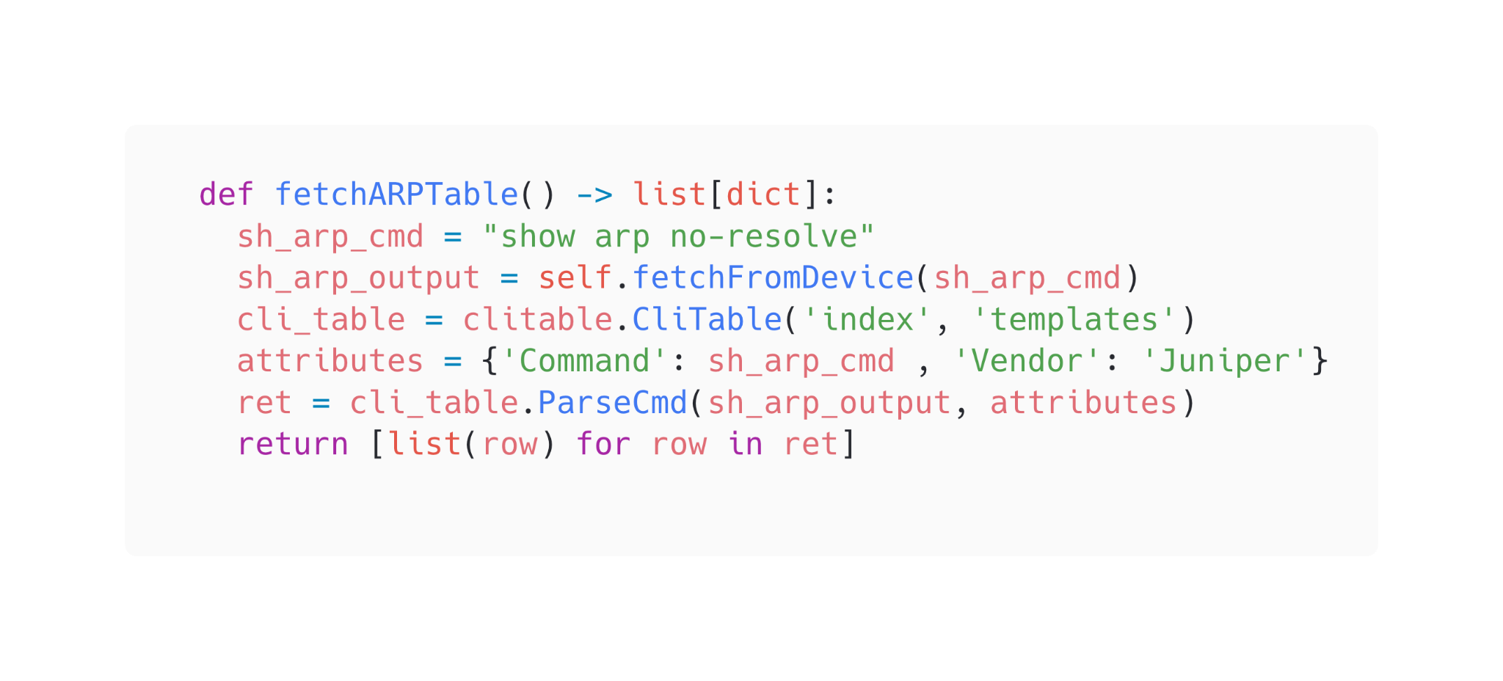
fetchARPTable

Slide 24
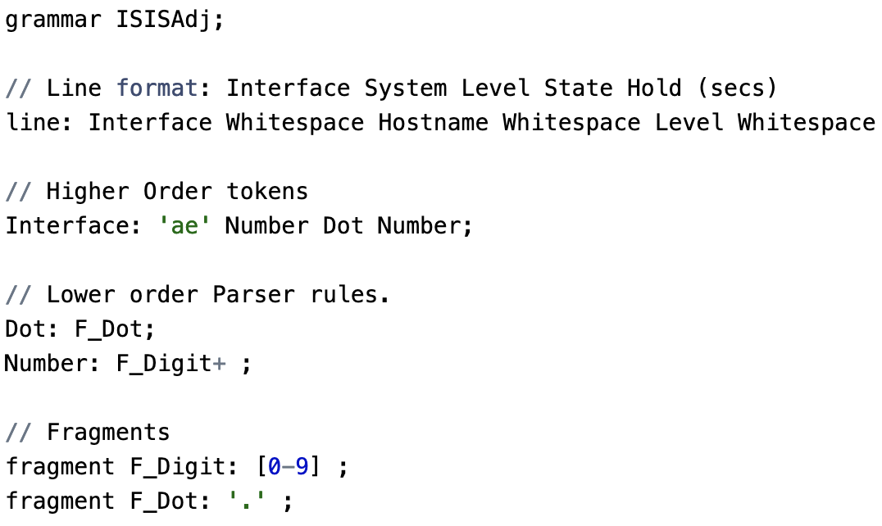
fetchISISAdjacency

Slide 25
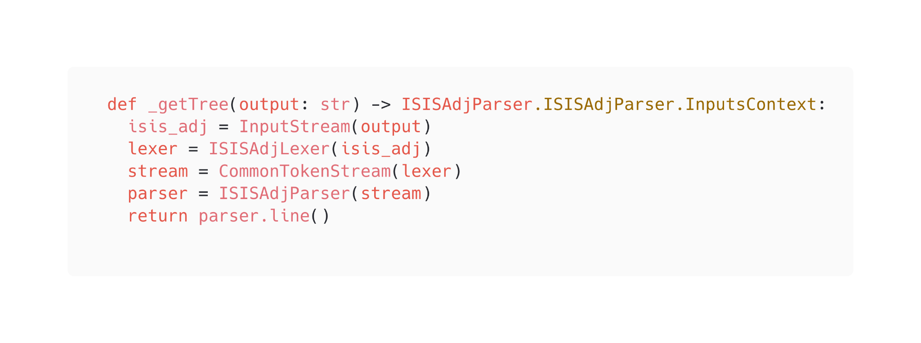
fetchISISAdjacency

Slide 26
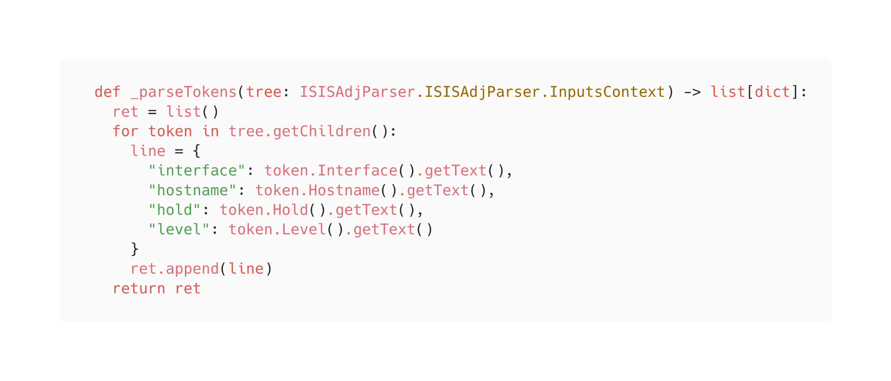
fetchISISAdjacency

Slide 27
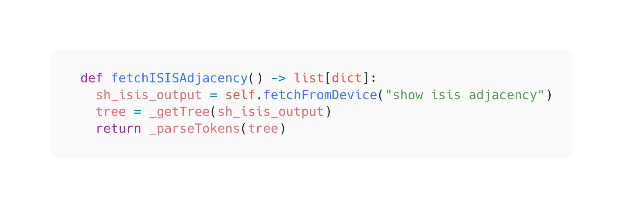
fetchISISAdjacency

Slide 28
What did we learn?
Never
Gonna
Give
You
Up
Notes:
Never rely on output being consistent
Gonna be hard to support large regex
Give your regex capture groups to break them up
You dont need to get it perfect, just working
Up to you how to implement features

Slide 29
Questions?

Slide 30
Penultimate Slide
2023 has been an uncomfortable year in tech
Maybe I have a job in a month, maybe not
Is my skillset interesting to you? Are you hiring?
  Lets talk!

Slide 31
Kamelåså

