Slide 1
An intuitive gNMI CLI and
a feature-rich telemetry collector*
Roman Dodin
ntdvps
* Fully open source

Slide 4
June 27, 2018, NANOG 73
https://youtu.be/McNm_WfQTHw
SNMP is
💀

Slide 5
From Monitoring to Telemetry
TCP
Network size
High data definition
CPU-friendly
Push-based mode
Reliable delivery
Notes:
Explain a shift happening in modern networks where network monitoring is transitioning from monitoring to telemetry stacks
A few distinctive and ubiquitous change patterns can be seen in modern networks which take traditional monitoring technologies hostage
Growth in network size poses a critical impact to monitoring stacks that were designed for use on networks with a much smaller scale
Due to an increased application scope of a monitoring stack (alerting, closed-loop automation) we demand a finer grained data to be collected
An immediate and unpredicted mode that SNMP operates in puts CPU under a lot of stress. Streaming telemetry instead uses a push based, subscription initiated mode that allows a CPU to make optimizations to the streamed out data
Finally, as we approach closed-loop automation systems based on data injected via streaming telemetry we require a reliable transport such as TCP to deliver it.

Slide 6
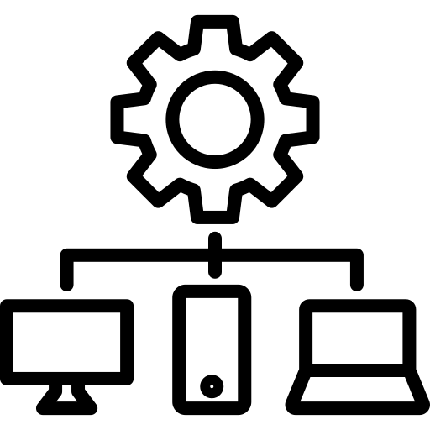
gRPC Network Management Interface
Streaming Telemetry
Network Management
The intention is that a single gRPC service definition can cover both configuration and telemetry

Slide 7
gNMI wasn’t the only option, wasn’t it?
RFC 8641
RFC 8641 (sept 2019) Subscription to YANG Notifications for Datastore Updates (aka YANG Push)
Has all there is, but lacks adoption.
gNMI
SNMP
RFC 8641

Slide 8
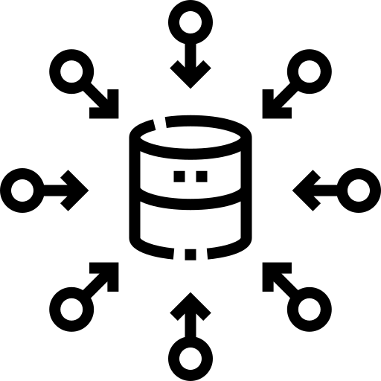
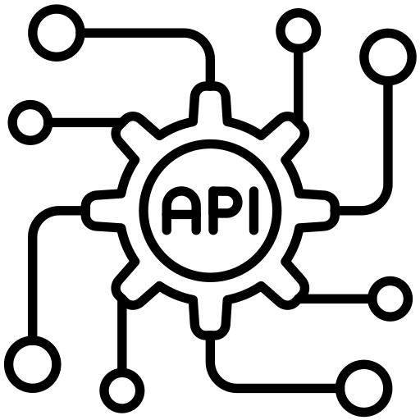
What is gNMIc to gNMI?
Command Line Interface for gNMI
Highly Available and flexible collector
Go API for gNMI with a human touch

Slide 9
Rich CLI to explore and test gNMI enabled targets
RPC commands
Utility commands
Capabilities
Set
Prompt
Diff
Get
Subscribe
Generate

Slide 10
Configure the way you want
CLI flags
gnmic [global-flags] [command] [local-flags]
gnmic --address 10.0.0.1:57400 \
--username admin --password admin\
--skip-verify \
get --path /interfaces/interface[name=mgmt0]

Slide 11
Configure the way you want
CLI flags
Env variables
export GNMIC_ADDRESS=10.0.0.1:57400
export GNMIC_USERNAME=admin
export GNMIC_PASSWORD=admin
export GNMIC_SKIP_VERIFY=true
gnmic [global-flags] [command] [local-flags]

Slide 12
Configure the way you want
CLI flags
Env variables
File configuration
$ cat .gnmic.yaml
address: router1
username: admin
password: admin
insecure: true
encoding: json_ietf
get-path:
- /interfaces/interface[name=mgmt0]
$ gnmic --config .gnmic.yaml get

Slide 13
Get / Set / Subscribe from the comfort of your terminal
Get
gnmic –a leaf1 \
–u admin –p admin \
--encoding json_ietf \
get \
--path /system/state/hostname

Slide 14
Get / Set / Subscribe from the comfort of your terminal
Set
gnmic –a target.address \
set \
--update-path "/interface[name=ethernet-1/1]/admin-state" \
--update-value "enable" \
--encoding json_ietf

Slide 15
Get / Set / Subscribe from the comfort of your terminal
Subscribe
gnmic –a target.address \
subscribe \
--path "/interface[name=ethernet-1/1]/statistics/in-octets" \
--encoding json_ietf

Slide 16
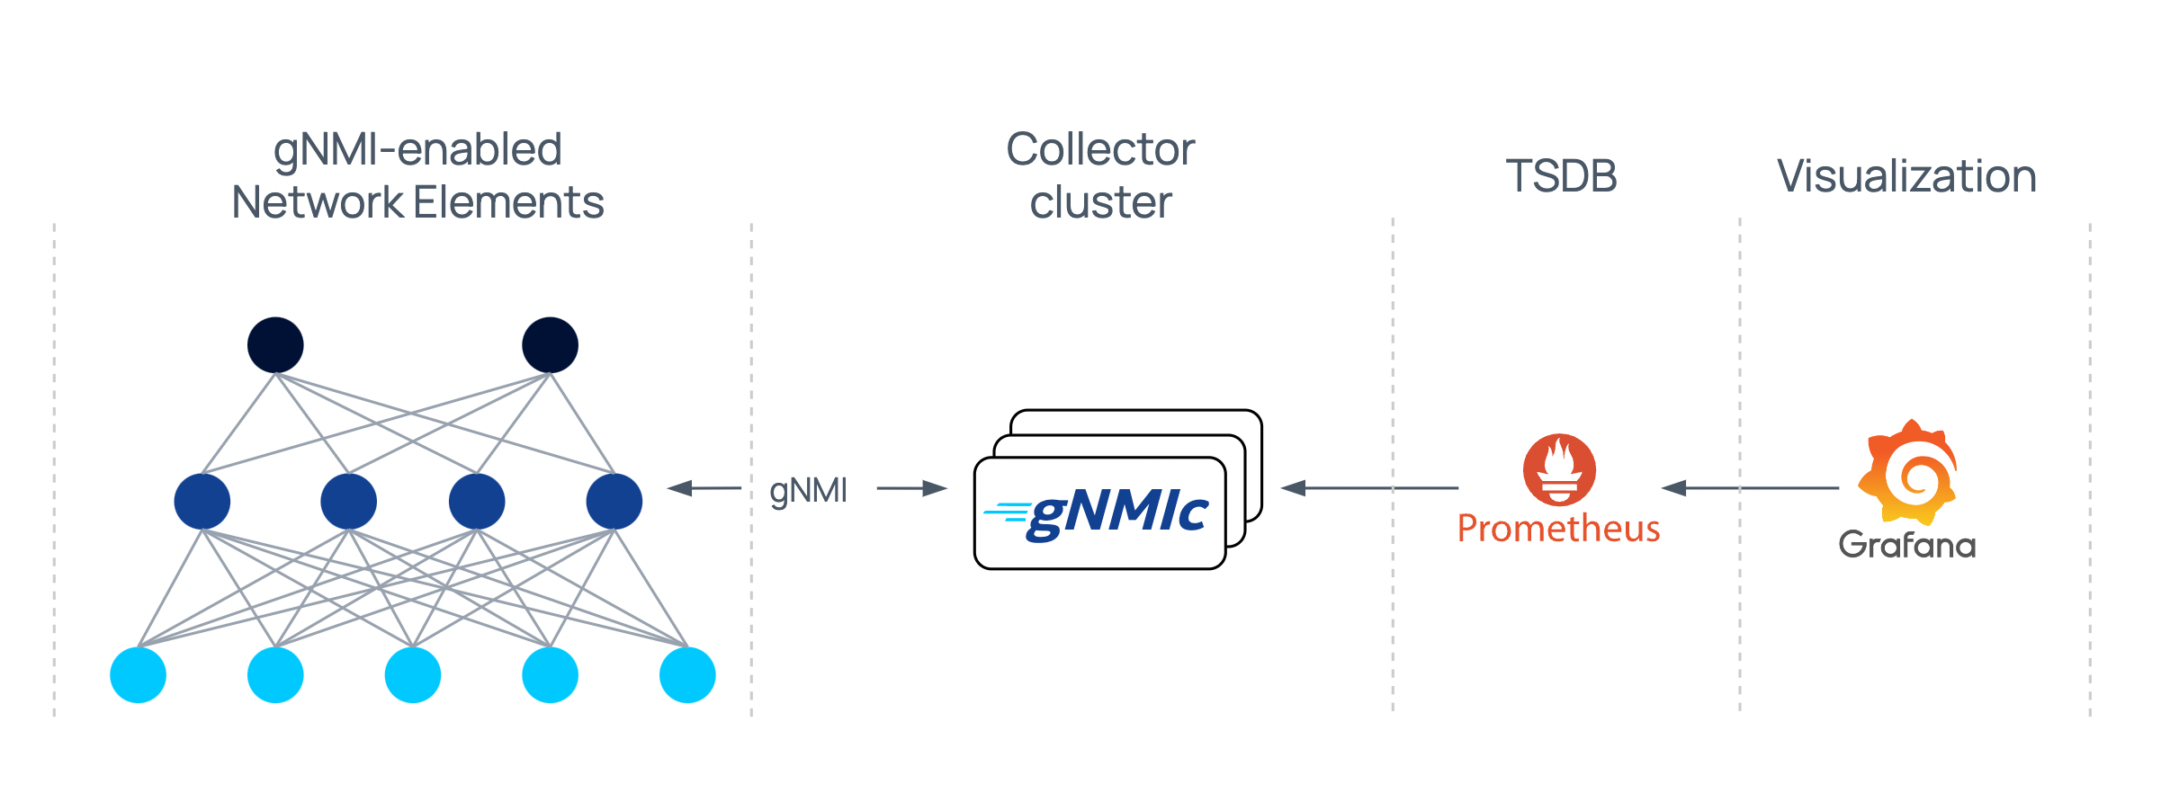
A performant and highly available gNMI collector

Slide 17
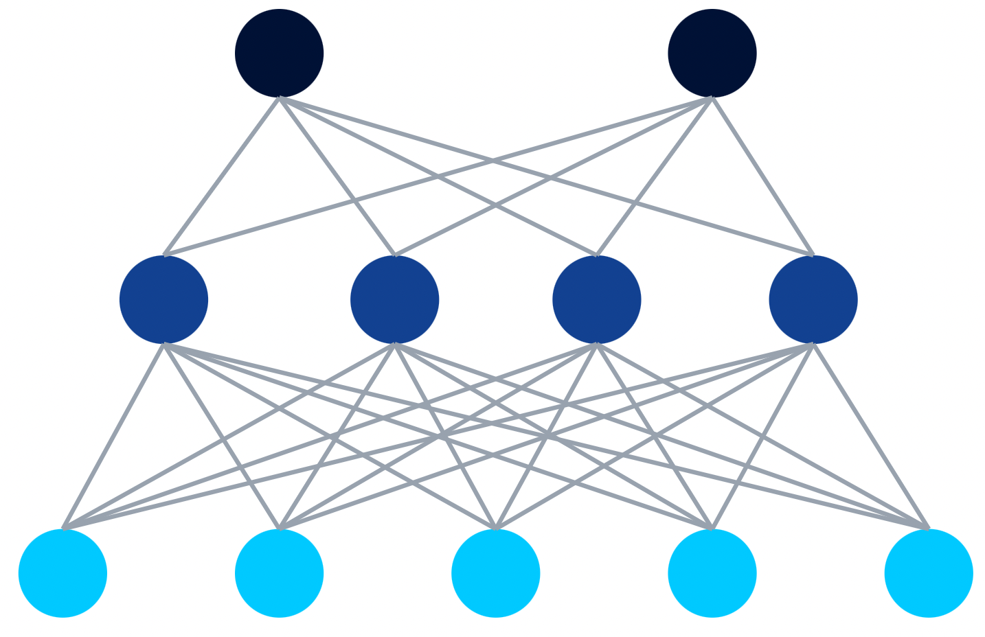
Defining targets
targets:
leaf1:
...: ...
subscriptions:
- ...
outputs:
- ...
Define per target connection options
Bind specific subscriptions
Bind specific outputs
subscriptions: ...
outputs: ...
gnmic.yaml

Slide 18
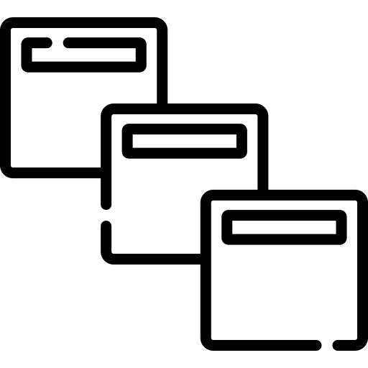
Collector outputs
Targets
Collector
Outputs
Database
gNMI
Message queue
Terminal/File

Slide 19
Processors
Data manipulation
Type conversion
Grouping
Message enrichment
Filtering (allow/deny lists)
Trigger (gNMI, HTTP, script, template)
outputs:
output1:
event-processors:
- proc1
- proc2
processing pipeline
scrape
gNMI
Processor
Collected telemetry metric
Changed/processed metric
Notes:
JQ and starlark
Topology clone example

Slide 20
Clustering: The more the merrier
High availability
Scaling
Automatic cluster formation
Automatic target redistribution
gNMIc cluster

Slide 21
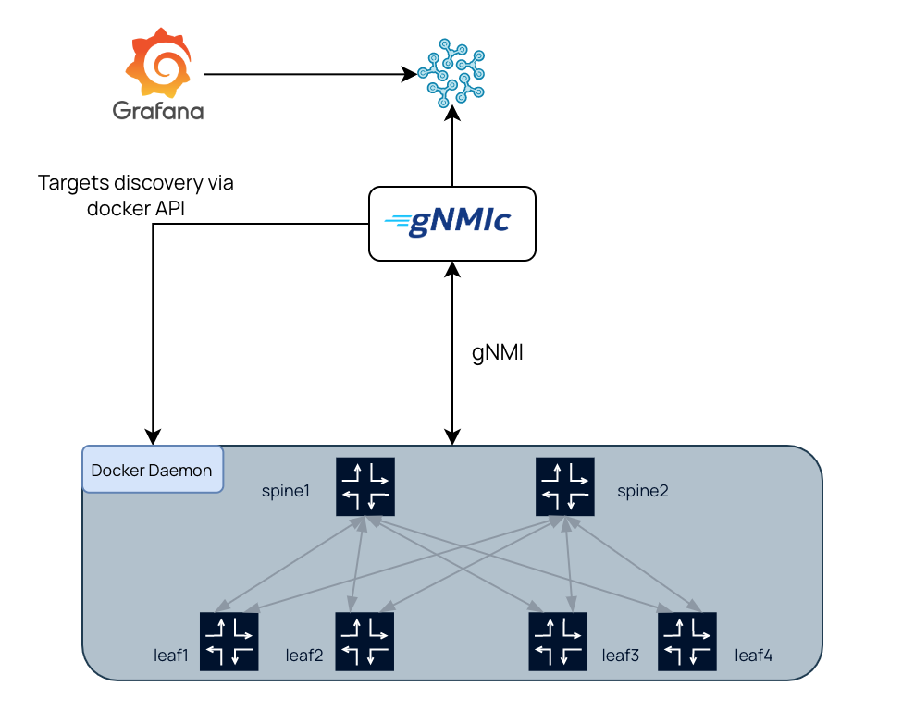
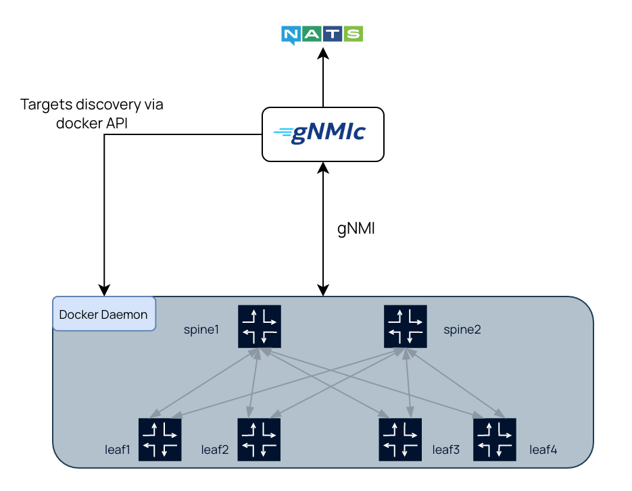
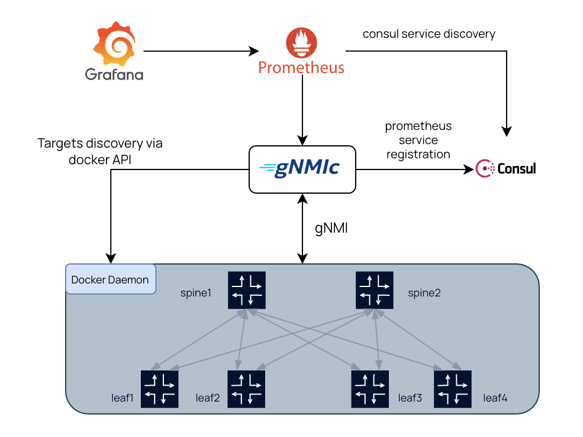
Deployment examples
deployment examples

Slide 22
Nokia donated gNMIc to Openconfig
/
openconfig/gnmic

Slide 23
Sounds interesting, what’s next?
1 Explore gnmic.openconfig.net documentation portal
2 Try out the deployment examples
3 Missing feature, a problem, a nice idea? Reach out to us via Github Issues/Discussions
4 Give gNMIc repo a ⭐ and grab a sticker

