Slide 1

High-performance Synchronization Transport Challenges and Solutions
Martin Wahlsten Senior Director Product Line Management
2023-03-08
DKNOG13

Slide 2
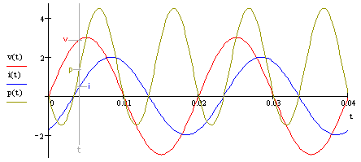
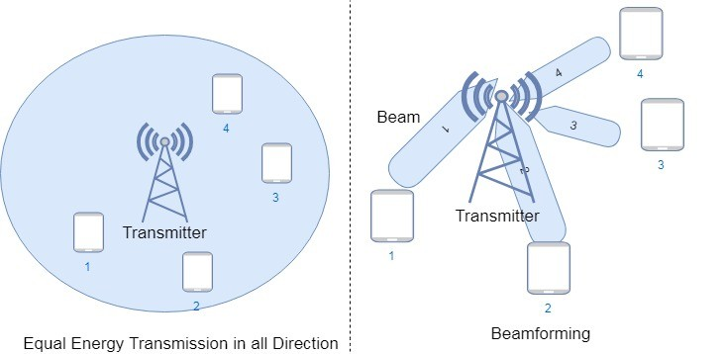
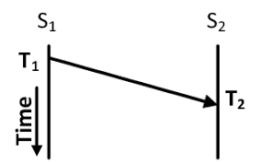
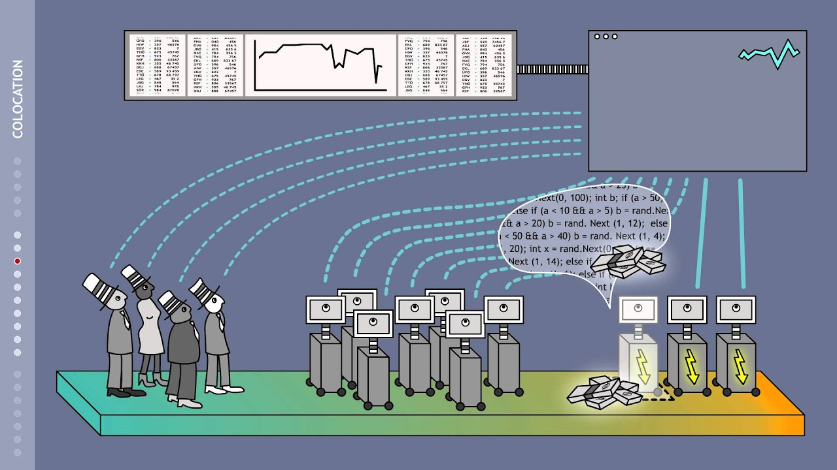
What is driving the need for time?
High accuracy data aquisition and timestamping
Telecom: Software controlled virtual antennas
Media distribution
Mobile networks
Power and utility networks
Industrial Automation
TaaS (Time as a service)
Audit based applications (who did what when?)

Slide 3
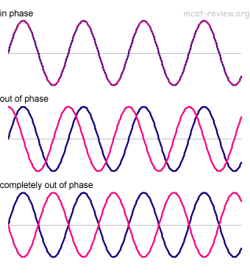
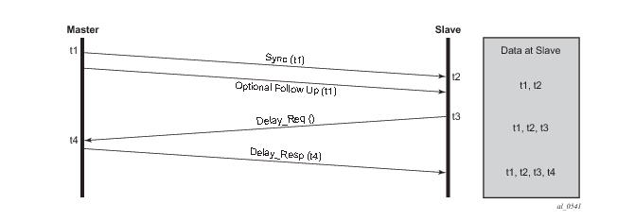
What is time in the transport network?
Target of 1588v2
SyncE G.8262 and G.8262.1
*Hardware timestamped systems dows not utilize optional follow-up message
The obvious question? Why are we spending 30 minutes of our lives on this topic today? Problems seems solved to me?

Slide 4


Example Causes of Asymmetry in Optical Transport
OTN Mapping
Coherent Optics
Optical Devices
Fiber
Optical Devices
Coherent Optics
OTN Mapping
Class C T-BC
Ethernet Switch
Class C T-BC
Ethernet Switch
Contributor | Fiber | Optical Devices (Dispersion Comp, OA/ILA, ROADM) | Coherent Optics | OTN Mapping | IP Routing and Ethernet Switching
Source | Asymmetry in fiber lengths, jumper cables, etc. 2.5 ns/m (vs 5 ns/m latency) | Random asymmetry in fiber lengths used in each direction | FIFO buffers in DSP Varies on restarts | Deep FIFO buffers in OTN mapping Varies on restarts | Traffic/buffering asymmetry and timestamping inaccuracy
Impact | Large but static | Very large but static | Varying and random | Large and random | Tight requirements to control impact
Range | Fixed cTE of ±5 to 1000+ ns | Fixed cTE of ±5 to 20,000 ns | Random cTE of ±20 to 130 ns on restart | Random cTE of ±20 to 1000 ns on restart | Class A/B/C specifications Max(TE) of 30 to 100 ns cTE of 10 to 50 ns dTE (low-pass filtered) of 10 to 40 ns
Fixed cTE components
Random cTE components
Random cTE components

Slide 5






5G Drives Vast Majority of High-accuracy Synchronization Requirements
3GPP TS 38.104 Time Alignment Error
ITU-T G.8271.1 Network Limits
ITU-T G.8273.2 PTP T-BC Class C
ITU-T G.8273.2 PTP T-BC Class B/C
IP Router or Ethernet Switch with inbuilt T-BC
ITU-T G.8275.1 Full Onpath Support
ITU-T G.8275.1 Full Onpath Support
ITU-T G.8262.1 eEEC Synchronous Ethernet
ITU-T G.8262.1 eEEC Synchronous Ethernet
4G
DU
BBU
CU
Fronthaul
Network
Midhaul
Network
CU
MEC
Backhaul
Network
CPRI
MEC
MEC
eCPRI
5G
T-TSC
CPRI
PRTC/T-GM
5G
T-TSC
eCPRI
Ethernet
4G
IP/MPLS Metro DWDM
IP/MPLS Core DWDM
IP/MPLS Access DWDM
5G
Network Budget
Max|TE|
Fronthaul
Midhaul and Backhaul
eRE
eCPRI Transport
60 ns - 190 ns
eREC
Transport Network 1000 ns
ePRT/PRTC
15 ns - 100 ns
Inter antenna relative phase alignment
TDD/LTE-A and 5G macro phase services traceable to UTC

Slide 6

1588 clock types
Boundary Clock
Transparent Clock
Master
Boundary clock
Boundary clock
Master
PTP
PTP
PTP
PTP
UDP
UDP
UDP
Transparent Clock
UDP
IP
IP
IP
IP
MAC
MAC
MAC
MAC
MAC
MAC
Phy
Phy
Phy
Phy
Phy
Phy
Boundary clocks interacts on the application layer
A Transparent clock justifies for resident time from Rx to Tx utilizing hardware timestamping into the 1588 frames
Type | Max time error | Configuration
Class A | 100 ns | Significant
Class B | 70 ns | Significant
Class C | 10 ns | Significant
Class D | 5 ns | Significant
Type | Resolution | Configuration
EMXP/IIE | 8 ns | Trivial
XH800 | 2 ns | Trivial
Transparent clock resolution does not define E2E max time error, that is still also a property of the boundary clock and the PTP servos.
Boundary clocks helps scale 1588 domains by hiding clients befind BCs

Slide 7
Viable strategies for building cost efficient national synchronization distribution

Slide 8
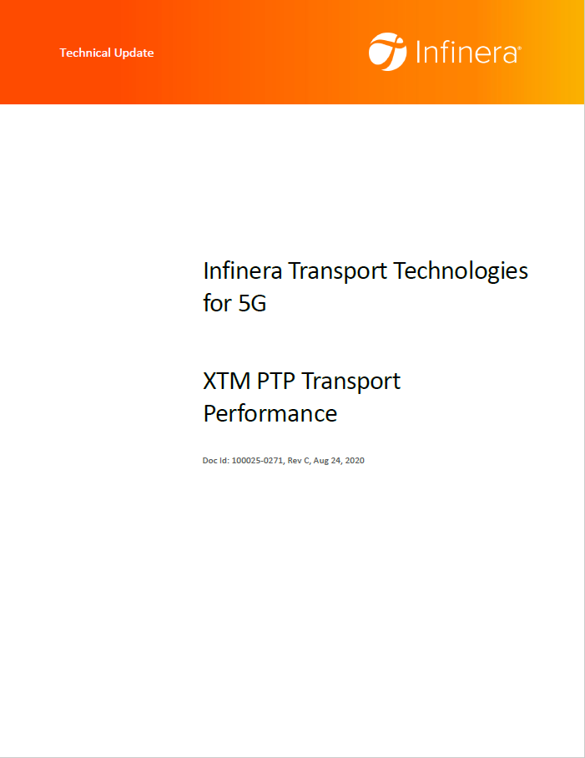
Viable strategy #1 choose good electronics
Deep service mapping OTN cards are unsuitable for inline transport of 5G synchronization transport in mobile networks. Optimized technology, such as the OTN Flexponder, Fronthaul Flexponder or EMXPs works just fine.
Card | Function | Client | cTE (ns) | dTE LF (ns) | Phase sync
FXP400GOTN | Dual 2x 100/200G OTN Flexponder | 100G | 20 | 0 | OK
FXP400G-E | 4x 100 / 400G OTN Flexponder | 100G/ 400G | 12 | 0 | OK
MXP200GOTN | 100/200G OTN Muxponder. | 10G / 100G | 670 | 0 | No
EMXP440/III | 10G and 100G/200G Packet Optical Muxponder | 10G / 100G | 37 | <5 | OK
XH800 | 10G/25G/100G/200G Packet Optical Transport Switch | 10G, 25G / 100G | 28 | <5 | OK
TPHEX10GOTN | 6x 10G OTN Transponder | 10G | 372 | <5 | No
FHAU/I | 6x10G iWDM Flexponder | 10G | 10 | 0 | OK
TPMRHEX-L/16G | 6x MultiRate Lite Transponder | 10G, GbE | 0 | 0 | OK
Summary table of some XTM cards and Time Errors
Some cards use highly optimized Infinera technology that does Ethernet and ethernet only. Laserfocus on sync performance, both SyncE and PTP.
Other use OTN technology built with merchant silicon offering a wide variety of client formats and services (Ethernet, SDH, Fibre Channel, etc).

Slide 9

The importance of understanding the full synch stack
Transport System
Transport System
100G Coherent
1588-BC
1588-BC
Customer wanted to know why there was line re-synch events (glitches) when 1588 protocol was starting up and was accuring phase/synch?

Slide 10
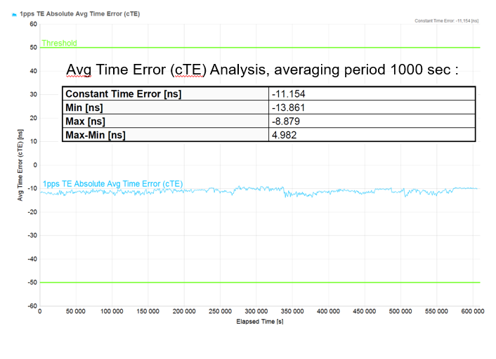
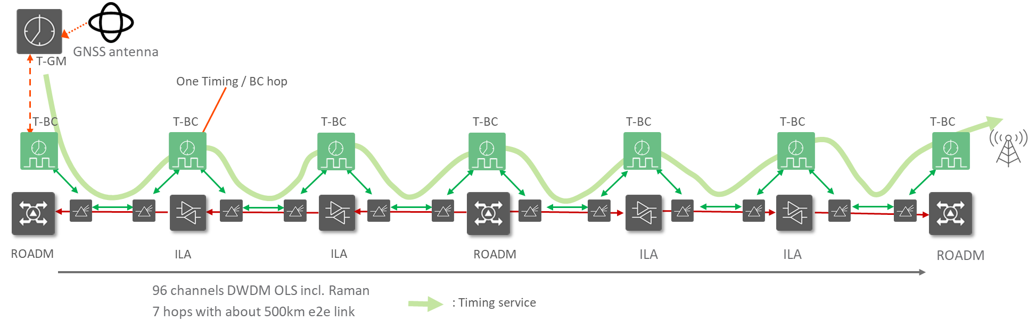
Viable strategy #2 Optimize linesystem or bypass assymetries using OTC
Utilize single fiber operation to eliminate errors from line system assymetries
Utilize direct-detect optics (GbE/FE/10G/HD-CWDM) optics to eliminate processing time error from a coherent dataplane
3rd party T-BC or T-TC can be utilized with INFN XTM linesystem
Time Error margin 7 hops
Excellent e2e cTE performance 11 ns, 1 week Test Case

Slide 11
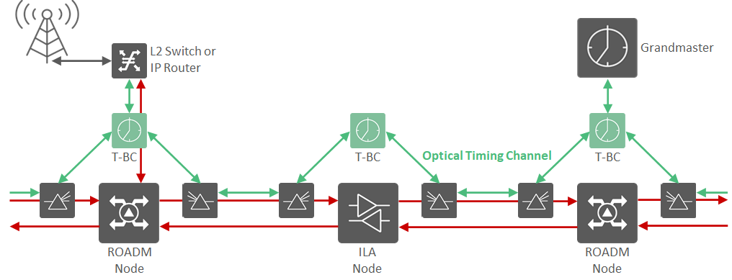
Building High-Performance Optical Timing Channels
SYNC LAYER CONSIDERATIONS:
High performance boundary clock operation
vPRTC / Timing cloud architecture
Demanding performance/feature requirements:
  Class D cTE within ± 5 ns, max. |TE| <5 ns
  Hop-by-hop local clock recovery, OCXO holdover
  Resiliency mechanisms
  GNSS/Grandmaster options
Supporting optical layer interoperability:
  BiDi single fiber working optics
  Large (up to 6) number of degrees/directions
Optical Layer Foundation
OPTICAL LAYER CONSIDERATIONS:
Fiber topology and resiliency – Ring, Linear, Tree, Mesh
Analogue domain – many factors to balance:
  Managing fiber effects – asymmetry, non-linear effects, dispersion etc.
  Optical add/drop – ROADM / Fixed add/drop
  Amplification options – EDFA / Raman
  Bandwidth – C Band / C+L Bands
Optical Timing Channel Toolkit:
  Timing channel options – O/E/L-band
  Sync/Retiming options – High performance T-BC, Integrated T-BC (Router) or optical 3R
Notes:
Key messages:
Infinera way to operationalize disaggregation on complex nodes

Slide 12

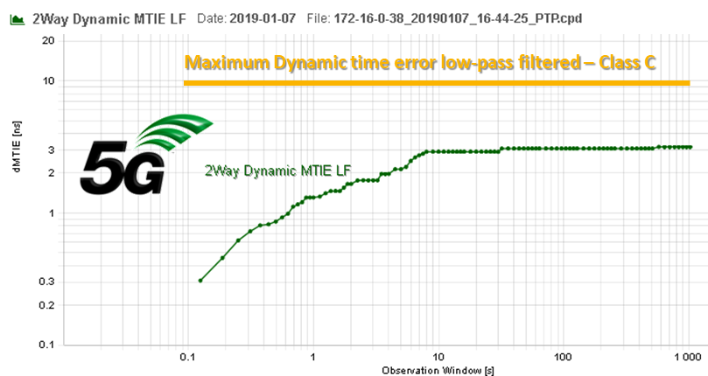

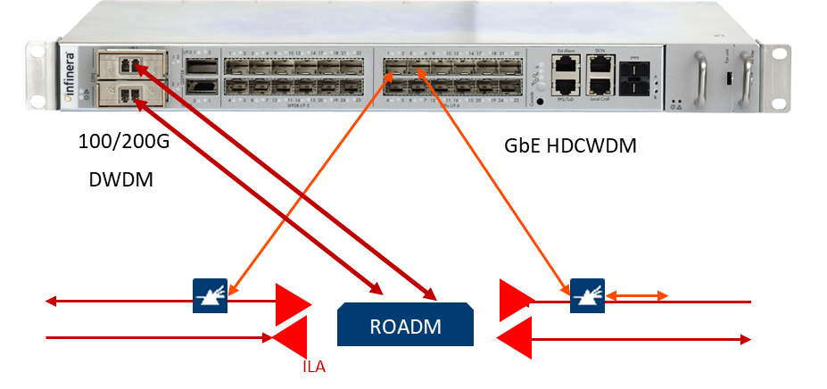
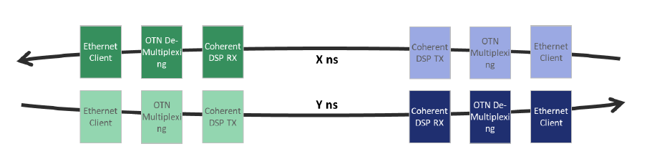
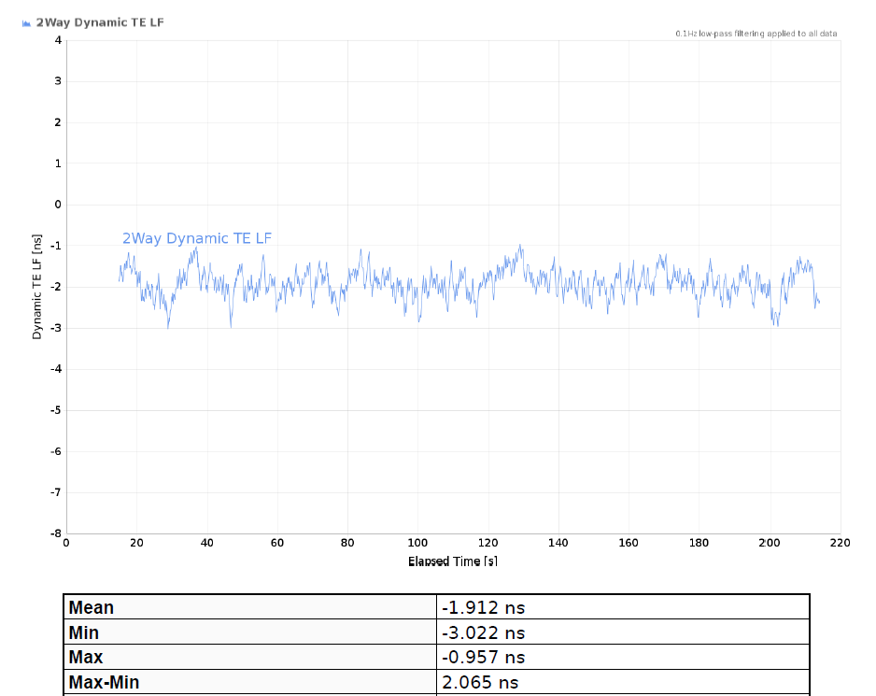
1588 PTP High Accuracy Clocking with XH800
and DAA requirements
XH800 T-BC uses SyncE assisted high performance functionality, performing better than T-BC Class C requirements.
XH800 T-BC has Stratum 3E holdover performance
Full implementation of G.8275.1 PTP Telecom Profile
  1 ns timestamping T-TC function.
XH800 supports the enhanced EEC requirements
Fiber asymmetry compensation
XTM/XH800 can use single fiber CWDM Optical Timing Channel for time sync, eliminating static errors
ITU-T G.8273.2 Timing characteristics of telecom boundary clocks
PTP T-BC Class C
T-BC
ITU-T G.8275.1 PTP Telecom Profile for phase/time synchronization with full timing support from the network
Optical Timing Channel overlay
ITU-T G.8262.1 Enhanced EEC Synchronous Ethernet
TRX100176/01U
Fiber and network asymmetry
1588-TC performance utilizing 2ns hardware time-stamping for suitable for transport of even Class-D clocks

Slide 13
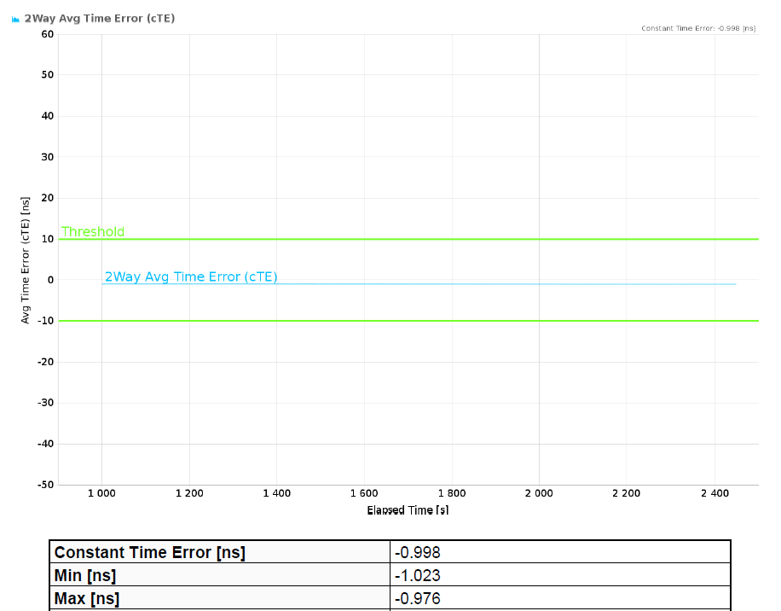
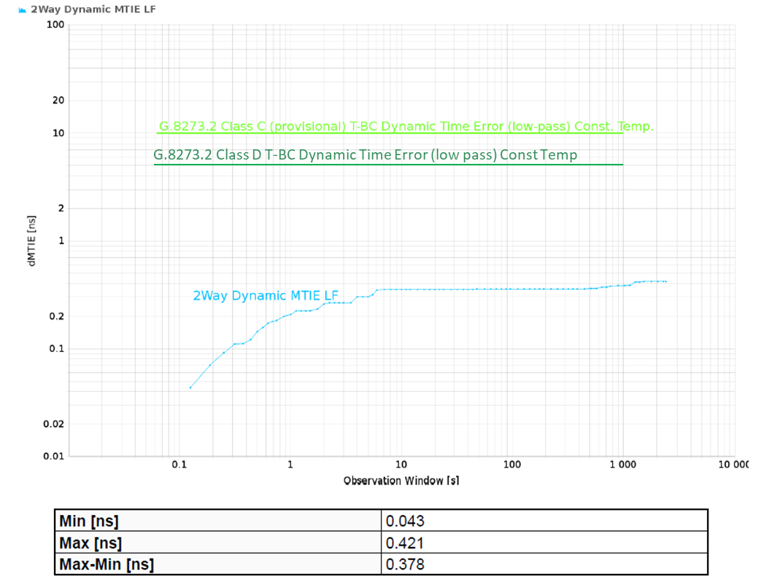
Performance performance performance
Ideal TC-output
Ideal TC-performance
Ideal BC-performance
Specifications are over lifetime, temperature, supported operational conditions

Slide 14






Sychronization Distribution Strategies
T-BC
T-BC
T-BC
In-band delivery of synchronization
Transponder synchronization performance
Coherent synchronization performance
High-performance PTP 1588 and SyncE delivery
In-band Delivery (XTM Series)
T-GM
Out-of-band delivery of synchronization
Single-fiber HD-CWDM and O/E/L-band overlay
Very high-performance PTP 1588 and SyncE
OTC network elements:
  OTC 2.0 T-BC Class D or XH800 Class C boundary clocks
  High accuracy T-TC
  Optical 3R regeneration via HEX-LIGHT card
Optical Timing Channel (XTM/OTC2.0)
T-BC
T-BC
T-BC
T-BC/3R
T-BC/3R
T-GM
Hybrid use of in-band and OTC mechanisms
Interoperable and interchangeable
All high-performance 1588 PTP, not proprietary
Use the appropriate solution for the best fit
  In-band delivery perfect for metro-access
  OTC widely used as core distribution
Hybrid Sync Distribution
T-BC
T-BC
T-BC
T-BC/3R
T-GM

Slide 15

Creating an OTC-enabled vPRTC/Timing Cloud
vPRTC (Timing Cloud) with every DWDM node capable of delivering timing/synchronization
36.2 km
53.7 km
9 km
13 km
56.6 km
OTC-ENABLED vPRTC:
Provides GNSS-like omnipresent timing, overcoming GNSS security/reliability/accessibility issues
Uses secure and reliable optical network to deliver highly-accurate timing/synchronization:
  Predictable, traceability to UTC and PRC
  Reliable and secure
  Highly-accurate
Flexible and independent
Every DWDM node capable of delivering timing/synchronization
Preserves timing budget for access/aggregation networks
Simplifies timing/synchronization planning and ongoing operations
5G Fronthaul /Midhaul
16 km
39 km
24.3 km
6 km
9 km
10 km
48.3 km
5G Fronthaul /Midhaul
58.2 km
56.2 km
53.3 km
54 km
100 ns
72 km
81 km
53.6 km
54.5 km
38.1 km
50 km
Redundant GNSS spoofing hardened GM/ Cesium source
65 km
60 km
35.3 km
71 km
53 km
44 km
51 km
58 km
72 km
60 km
Other timing critical applications (power distribution, scientific)
Range of 100 ns vPRTC (Timing Cloud) resilient timing service

Slide 16
Takeaways
Key messages
Synchronization is not trivial and have a wide range of optimization points in cost/performace
Multilayer understanding is required to build a viable and good performant synch network
  Synch performance can be heavilly impacted by many factors
Recommendations
Work with people and suppliers that knows what they are doing in this space
Ask one question to much rather one to little

Slide 17
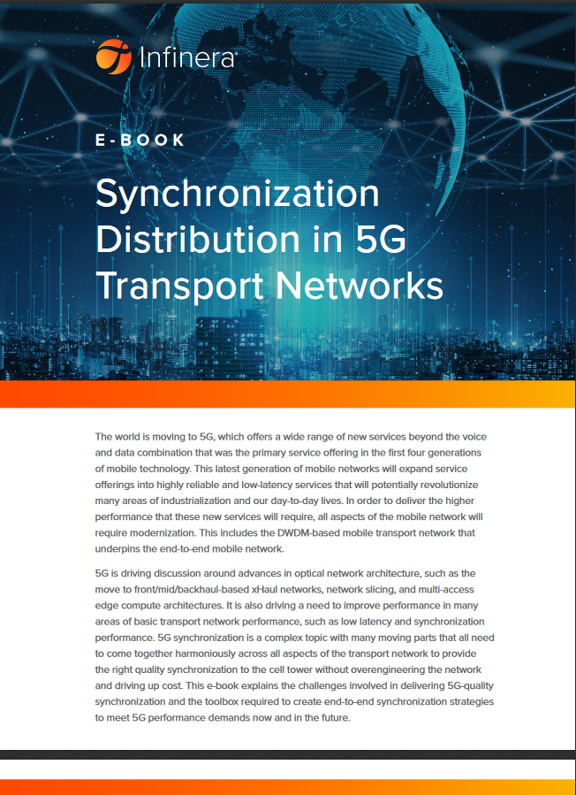
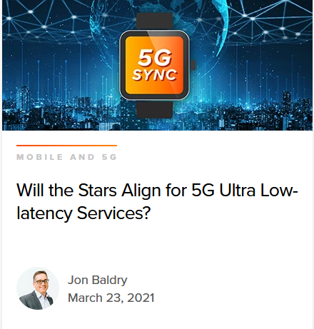
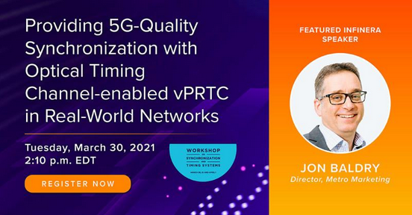
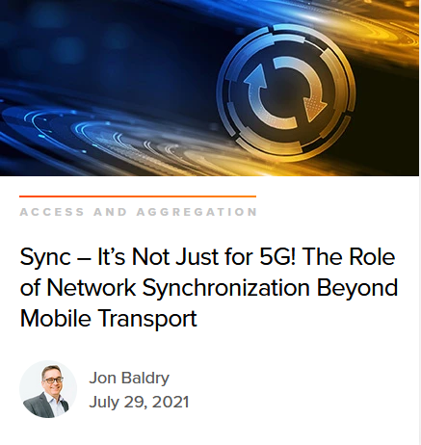

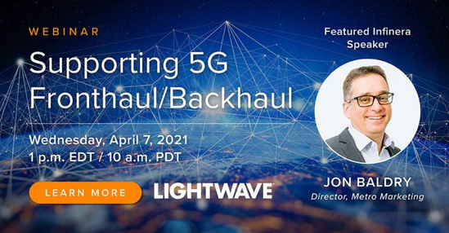
Resources for further reading
INFINERA SYNC E-BOOK
(CLICK HERE)
SYNC BLOGS ON
INFINERA.COM
EVENTS (ITSF & WSTS)
https://infinera.sharepoint.com/:f:/s/COR-RDPO/Eji2UW1E15NLv_IB_D1XxycB01moob2fwFhcmkdpHO5K9A?e=dvJVF0
WEBINARS

