Slide 1
Dive deep on AWS edge networking infrastructure
Fredrik Korsbäck
Senior Infrastructure Business Developer
AWS – AS16509

Slide 2
Evolution of infrastructure networking

Slide 3
Phases of evolution
Create
Consume
Innovate
Notes:
If I look back on the past, I think we’ve had 3 major shifts in networking technology that influence how we think about growing and operating the network.
First, we consumed what was already assembled and available in the market.
Then we created our own devices and designs out of the core components available, building the foundational systems we needed to grow.
Finally we’ve moved to innovate in directions that specifically meet our needs. As time goes on, this has been for scale, availability, repeatability, consistency and operations purposes. That list just keeps getting longer BTW.

Slide 4
Owning a large network
James Hamilton: “Datacenter Networks are in my Way” https://perspectives.mvdirona.com/2010/10/datacenter-networks-are-in-my-way/
AWS blog post, 2010-07-13 “New Amazon EC2 Instance Type – The Cluster Compute Instance”
Within this network you can create one or more placement groups of type “cluster” and then launch Cluster Compute Instances within each group. Instances within each placement group of this type benefit from non-blocking bandwidth and low latency node to node communication.
Notes:
This was related to the release of the first Cluster Compute instance type - CC1 This was the press release from 2010 (pause to read) This was a turning point for AWS Infrastructure as it represented the first of what is now our new normal. We moved away from buying refrigerator sized devices from Network Vendors, and built a network for a targeted purpose.
This was to enable placement groups for Cluster Computing which provided non-blocking bandwidth between any two hosts in that group. James’ expectation still resonates today, as we focus on making a network so secure, reliable and performant that our cloud customers don’t have to worry about it. We were building a great big bus that is constantly growing, improving and being maintained with the minimal of external awareness.

Slide 5
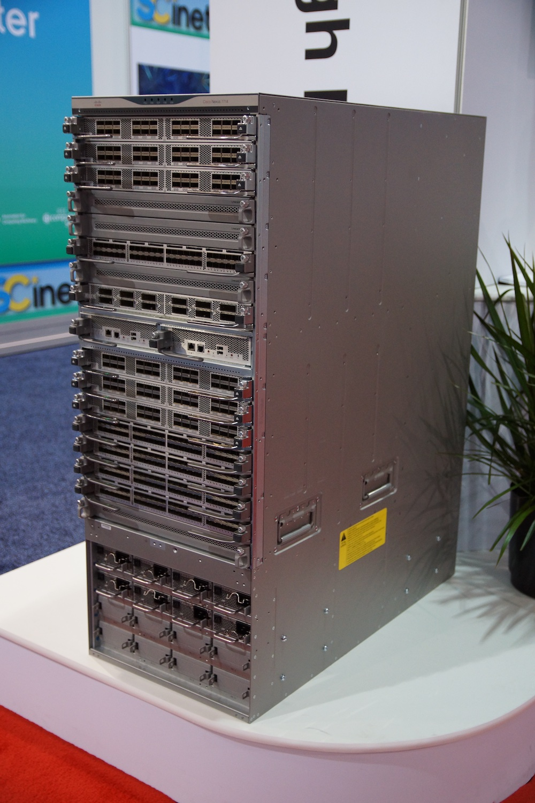
Consume
Industry hardware and software
Basic automation
Pushed beyond design intentions
Large chassis backplane/midplane
CC Patrick Finnegan
Notes:
To begin with, we purchased hardware and software from the big names of the networking world. We used thousands of their large platforms, and built basic automation to ensure we could generate config, deploy it safely and take rudimentary actions like move traffic around without human intervention. However, our problems began when we became some of the largest consumers of these platforms, and started pushing the hardware and software far beyond the other customers.
We also had concerns with the complexity and blast radius of a single device in this role.
Hundreds of ASICs in an opaque system was tricky to diagnose.
Maintenance too, with the potential for bent pins on the backplane meant Chassis swaps.
While rare, they are incredibly painful to orchestrate and manage, and left us running with reduced redundancy for unacceptable amounts of time.

Slide 6
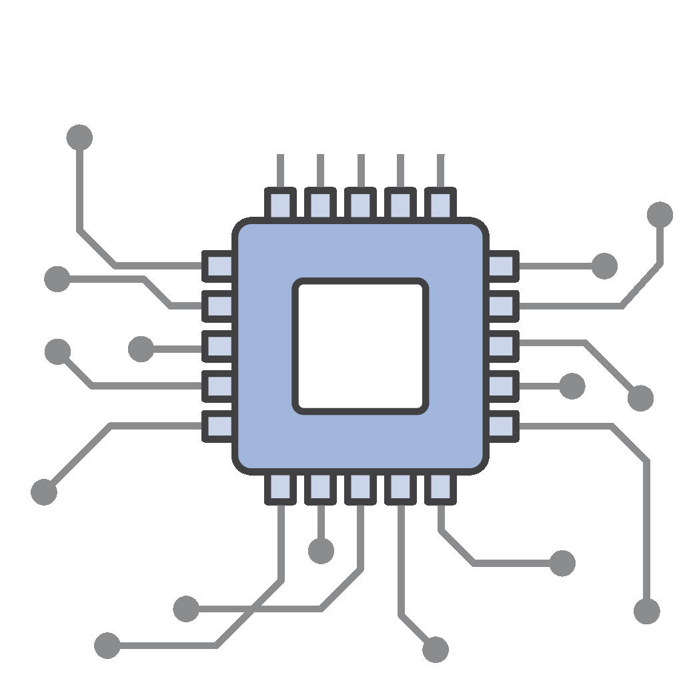
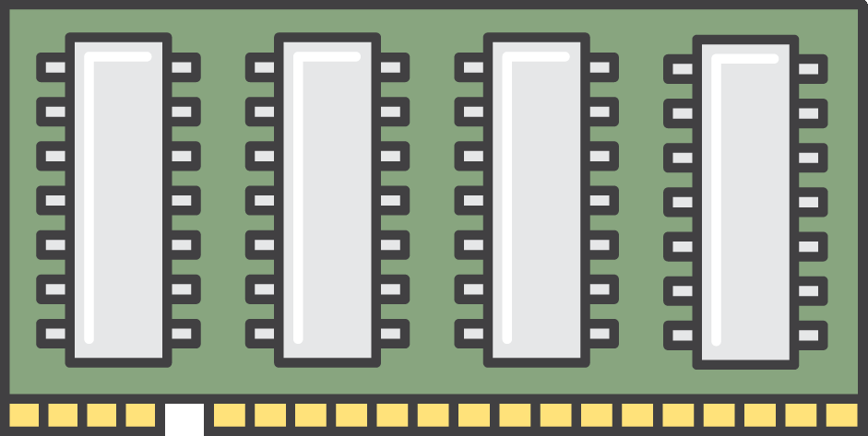
Chassis platforms
Control plane CPU
Control plane CPU
Line card
Forwarding
ASIC(s)
Ports
Switch fabric
Line card
Forwarding
ASIC(s)
Ports
Switch fabric
Line card
Forwarding
ASIC(s)
Ports
Switch fabric
Line card
Forwarding
ASIC(s)
Ports
Line card
Forwarding
ASIC(s)
Ports
Switch fabric
PSU / FAN
PSU / FAN
PSU / FAN
PSU / FAN
PSU / FAN
Notes:
In general, we dislike chassis platforms. They are cumbersome operationally, have failure characteristics we don’t like, and it takes a lot of tightly coupled effort to create a new one. They also have many discrete components that are largely abstracted from operations.
I’ve lost count of the number of Switch Fabric errors that are unactionable, other than reboot the box.
And rebooting a chassis is a LARGE task.

Slide 7
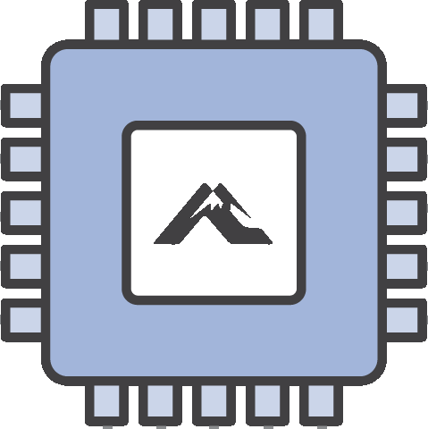
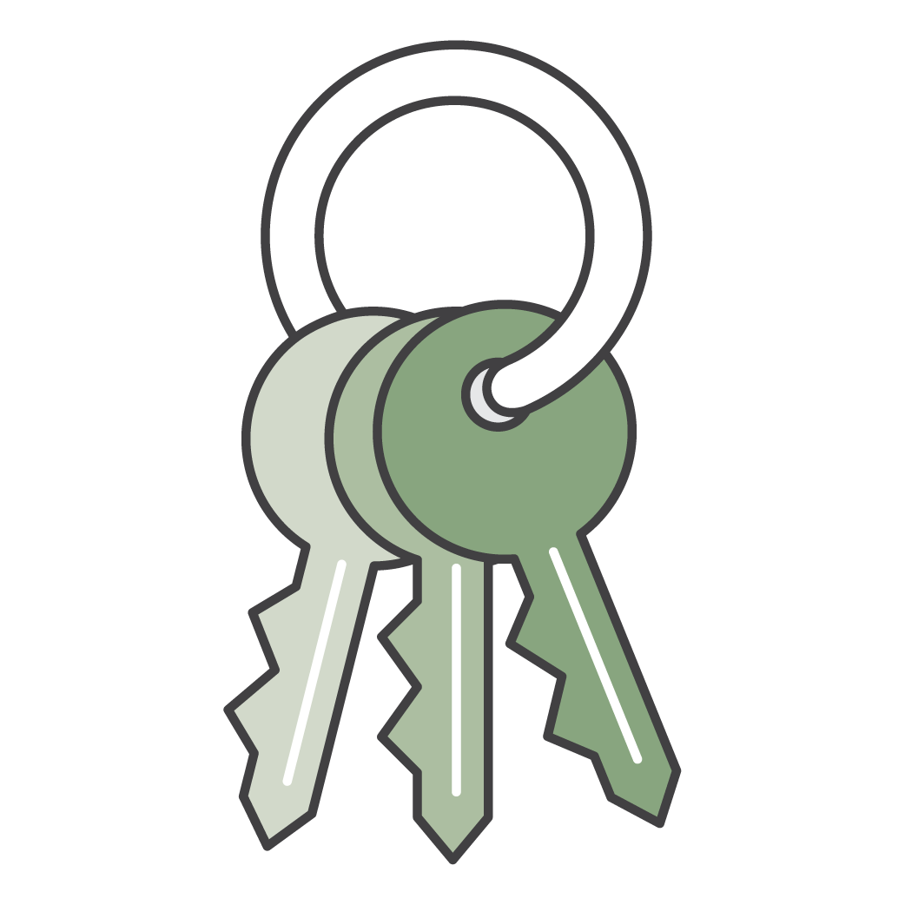
Single chip–based platforms
Single chip network device
PSU / FAN
Control plane CPU
PSU / FAN
Forwarding ASIC
Ports
Notes:
So - we extensively use single chip platforms. These are typically 1 rack unit tall, and have all their ports at the front, and we can mix/match different flavors when needed We classify these devices based on their capabilities. Typically speed based: so 3.2T, 12.8T class and so on. We multi source most of the components so we can swap between our ODMs or ASICs. One thing that I think it a little special to AWS. We use the same class of device in nearly every layer of our network. A single device may be used for Top of Rack, Access, Core, Edge, Datacenter, Backbone, Peering, Transit etc. Some specialization exists where it brings us benefit - such as switches with hardware encryption modules when the fiber leaves a building, but it’s a small set. We also productize our devices into full racks. We’re not deploying a single router here, or there, but instead we have our system integrators create an entire rack of switches, cabled together as a single deployment unit.
The same deployment unit could be used in a number of our network types.

Slide 8
Phases of evolution
Create
Consume
Innovate

Slide 9
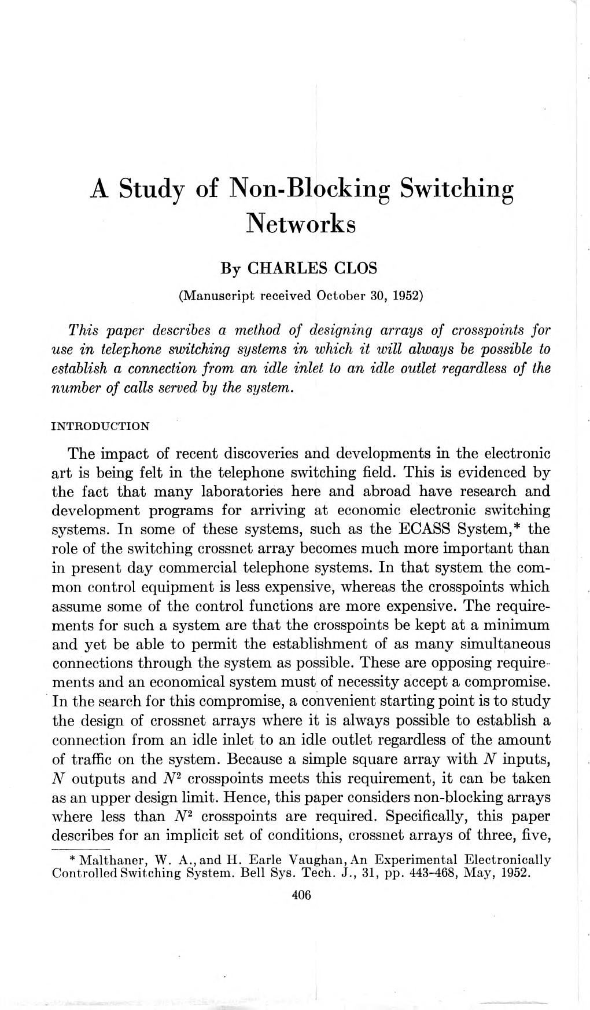
Create
Topology and Hardware
Clos fabric
Notes:
So how do we use these racks? The basis of of our modern network harks back to the 1940s and 1950s.
Engineers in Bell Labs were looking for a way to create a large, non blocking telephone switch that could be made of smaller component switches.
First patented in 1941, and subsequently formalized in 1953 by a French Engineer names Charles Clos.

Slide 10
Create
Topology and Hardware
Clos fabric
32 to 5,120 devices
Merchant silicon
Internal software
Optimized network design
6 x 4-port switches = 8-port switch
Notes:
We first used this architecture, also called a folded Fat Tree design, in 2010 to solve the Cluster Compute network requirement.
Key to this is the ability We also wanted incremental growth.
Anywhere from 32 devices (a single rack) to 5000, a fully built out fabric in a single placement group. To do this, we were purchasing merchant silicon. Something akin to buying your Intel or AMD CPU from any of a plethora of system integrators. We then added our own software stack on top and tweaked the network design to the use cases. At one layer, we want lots and lots of ports, but not that much bandwidth. At others, we want maximum bandwidth and optimize for space, power and cooling. is to use lots of our small and simple switches to build a fabric across multiple racks.

Slide 11
Create
Network Operating System
Linux-based
Multi-sourced manufacturing
Multi-ASIC
Management
Routing protocols
Telemetry
Linux kernel
SDK
Network ASIC
Notes:
In those Core Concepts to the Create phase was the ownership of our own code and the ability to iterate.
We created basic component building blocks and developed an operating system that could work with our hardware strategy. There are plenty of Network OS platforms that do this today, but when starting this in 2010, we had to pick a model to get us started on this journey, and allow us to experiment and iterate freely.

Slide 12
Create
Network Operating System
Linux-based
Multi-sourced manufacturing
Multi-ASIC
OSPF/BGP ++
Management
Routing protocols
Telemetry
Linux kernel
SDK
Network ASIC
Notes:
An example of this is where we began with externally provided implementations of standard routing protocols. such as BGP. Initially we optimized our designs within the boundaries of standard protocols. However as we grew, and operated the network, we weren’t happy with that. We knew we could get a lot of benefit by changing some timers to sub-second, add new features etc.

Slide 13
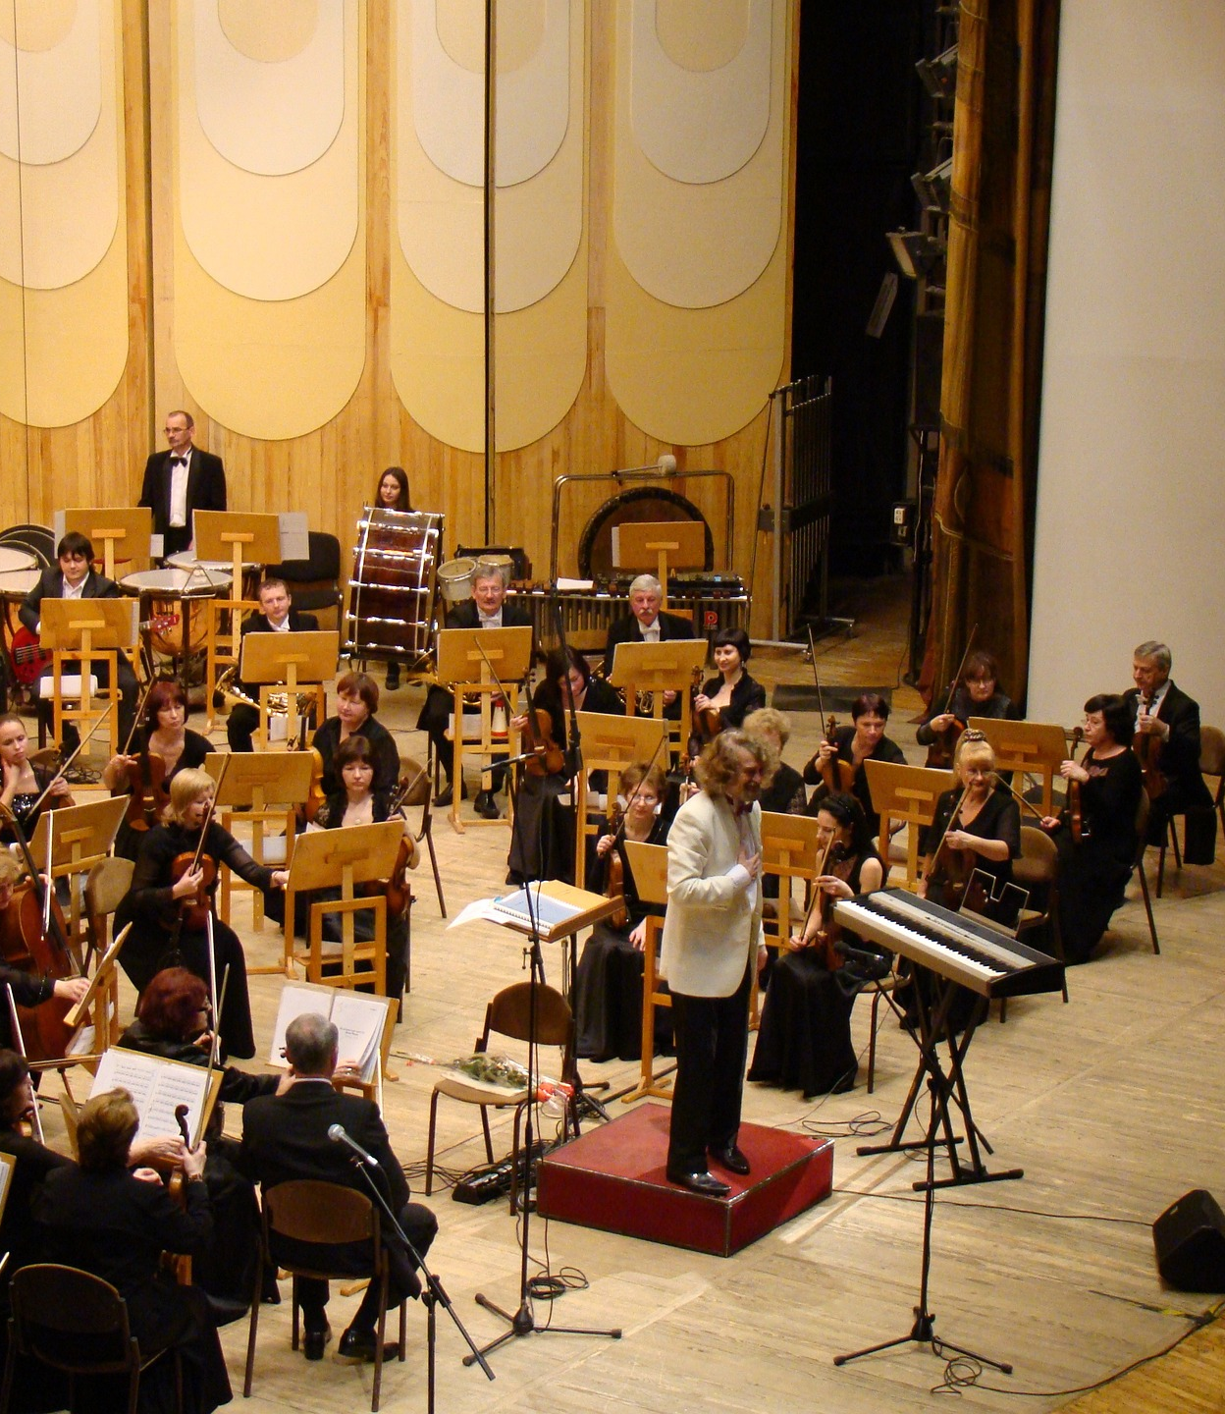
Create
Config generation
Deployment coordination
Active telemetry
Auto-remediation
NOC-less
Notes:
In order to maintain these new fabrics, with many orders of magnitude more devices than we had before, we also had a large automation system to build. Config generation, coordinating fast and safe deployments were all improved by taking humans out of the loop. This required some automated processes to ensure we were keeping the network perpetually consistent. Building fabrics of smaller devices also meant we had many more cables, and so we advanced our active telemetry, alarming and triangulation systems to pinpoint faults faster and respond with auto remediation systems. These systems avoided us needing hundreds of people just to maintain our network and meant that we remain NOC-less today. This orchestration also helped us double our global region count in the mid-2010s. New regions went from a rare bespoke thing, to something that for some software teams was just another step in a pipeline.

Slide 14
Phases of evolution
Create
Consume
Innovate
Notes:
On my timeline, we’re up to around 2013 and we had the first iterations of nearly all the systems we have today. However we had not yet moved to the third phase which was to break away from the Assembly of networks from standard building blocks and into the true innovation of components that make sense to us, but perhaps not everyone else.

Slide 15
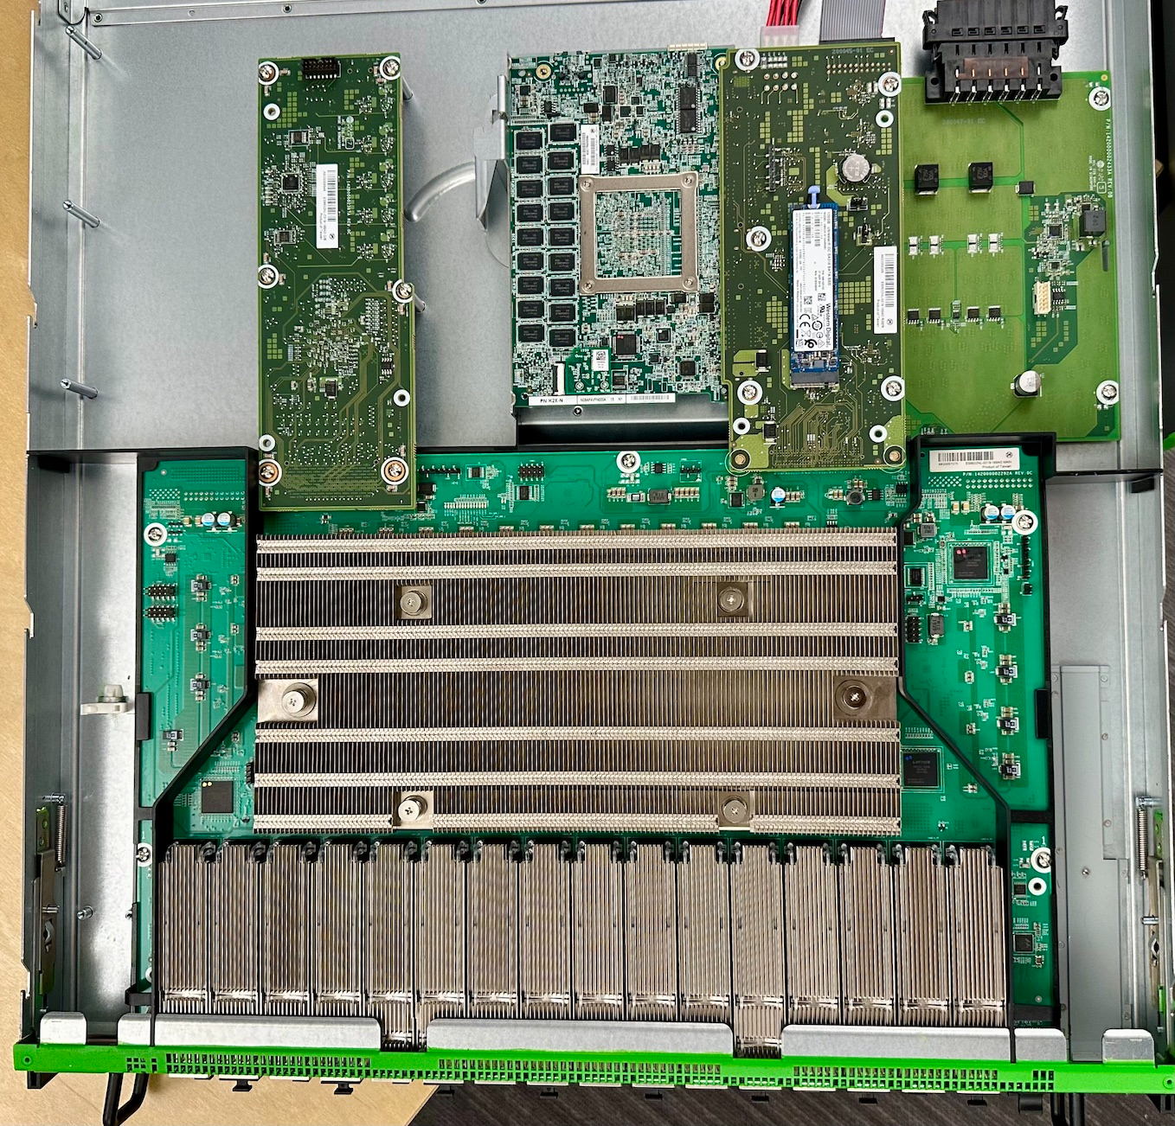
Innovate
Present Day
Freedom to examine trade-offs
Custom hardware
Multi-domain applications
Focus on the benefit
Notes:
I remember vividly working with a Hardware engineer on the design of a proposed network ASIC, and when I asked for the typical speeds and feeds I was given an answer which made me stop and rethink. “What would you like them to be?” More memory or backwards compatibility was now an engineering tradeoff for us to consider and not predetermined. Until that point, we were working with what others had designed before us. In the mid 2010’s we were now innovating beyond what was for the mass market. We developed fully custom hardware, some of which we’ll talk about later, and embraced new technologies earlier, and with more control than possible before. Similar things can happen when you fully control the software across multiple domains. We could now elect to resolve a fiber cut at the optical layer, rather than the network layer by adding some link damping to our routers. Because we controlled the full stack, we could tune them beyond what a regular network device would do, and resolve the conflict where it made sense for us. Core to making these decisions are those core set of Tenets that guide our teams to make consistent decisions. We never wanted to get into the place of doing something just because we could. There had to be tangible benefits to the work. An example of this phase is when we set out to meet our network encryption needs - ensuring that any traffic that left our physical control was encrypted with MACSec. We initially tried using commercial encryption platforms, but we struggled with their limitations and their use in the network was short lived. The flexibility we had in those early Innovate days meant we could create a custom Encryption module in an otherwise mostly standard router and create a variant device to meet that customer security promise. This device also integrated some innovative optical modules, which we’ll touch on later.

Slide 16
Innovate
Choice + Scale = Complexity
High
Frustrated
Overwhelmed
Complexity
Restricted
Delighted
Low
High
Innovation
Notes:
One thing that’s at constant tension with innovation is - complexity. We always want to be innovating, improving the customer experience, enabling new opportunities, and make it so the great big bus never becomes a problem to our customers. [1] In the consume world, our innovation levels were low. We were working within the design limits, but were restricted. [2] However, as we grew, and started exceeding those limits we became frustrated. Complexity was on the rise, without much payoff. Rare events happened too often, and we were responding to each one uniquely. [3] If you innovate from a complex world, and don’t reduce that complexity, you can end up overwhelmed. This might be because you can’t deploy quickly enough, or that you’re spending more time on fighting fires instead of preventing them. If every opportunity has a new answer across multiple fronts, then you end up with so many combinations that you’re running to stand still. [4] The sweet spot is the lower right quadrant. High levels of innovation without complexity, without the burden of combinatorial failures and unwanted interactions between systems. Efficiencies of scale come from having decisions made in advance. We strive to live in that lower right. To do so, we look for patterns, be they in design, or in operations. Doing failure analysis, and going deep when a system doesn’t make it easy to do the right thing. Keeping complexity at bay is an ongoing effort.

Slide 17
Innovate
Simplicity scales
Complexity creates technical debt. A complex network is one that creates decisions during deployment, introduces uncertainty in operations and has corner cases in design. Simple systems are more robust. We think hard before adding features, functions, options or variations.
Notes:
This balance is typified by one of the Datacenter Network team’s Core Principles “Simplicity Scales”. This phrase has been around for many years now, and it’s my personal favorite. I lifted this directly from the internal wiki. (break to read)
What’s important to consider is that our Tenets are often at tension with one another. Alone, this might lead you to a single path that limits innovation and removes any flexibility from meeting the requirements.
However, couple this with another of “Never Constrain the Customer”, and we have a purposeful tension that seeks to meet a need, enable innovation and constant improvement, whilst also considering the complexity, not just for today, but throughout the full lifecycle of the network.

Slide 18
Hardware deep dive

Slide 19
How we do it
“A complex system that works is invariably found to have evolved from a simple system that worked. The inverse proposition also appears to be true: A complex system designed from scratch never works and cannot be made to work. You have to start over, beginning with a working simple system.”
John Gall, General Systemantics: An essay on how systems work, and especially how they fail, 1975
Source: Nathan Sawaya brickartist.com
Notes:
We found out long ago that no one piece of hardware would scale to meet our needs and no one software application can cover all of our functionality...
thus we build our systems by utilizing relatively simple, well defined building blocks...
let’s take a look at some of these components

Slide 20
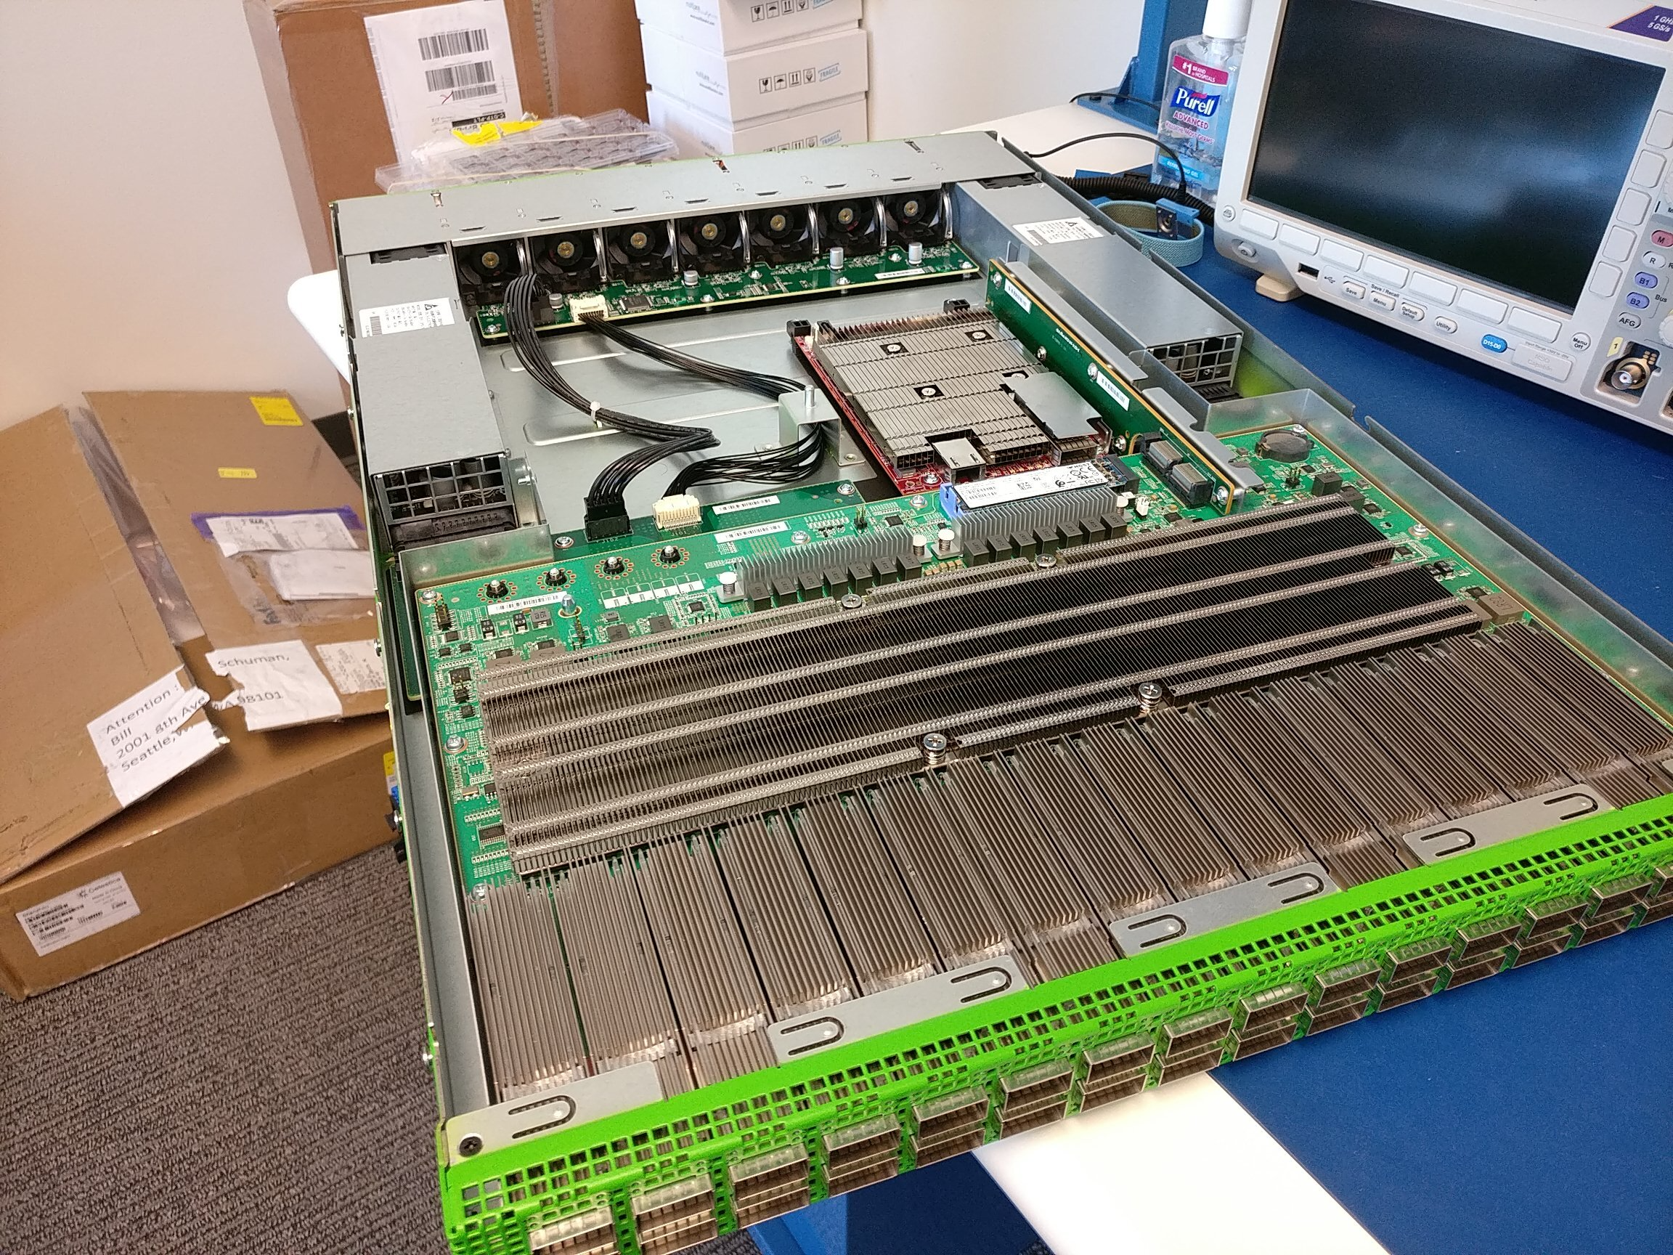
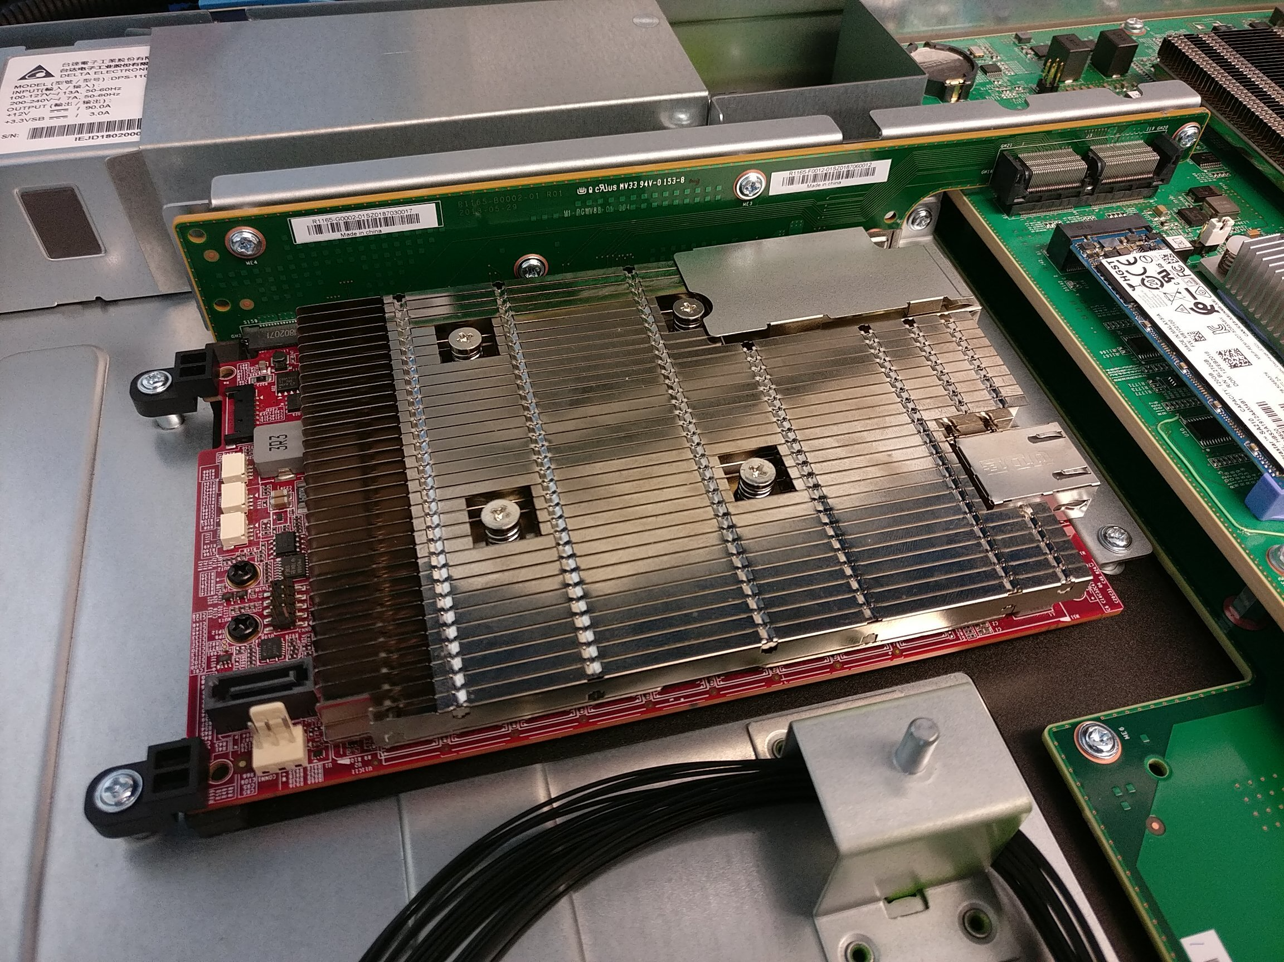
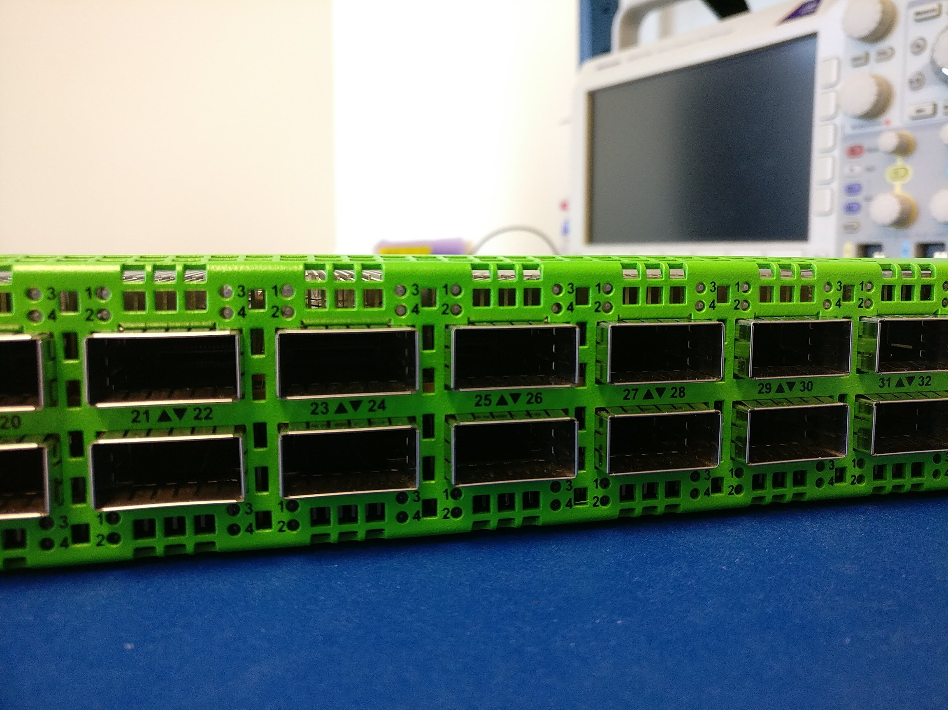
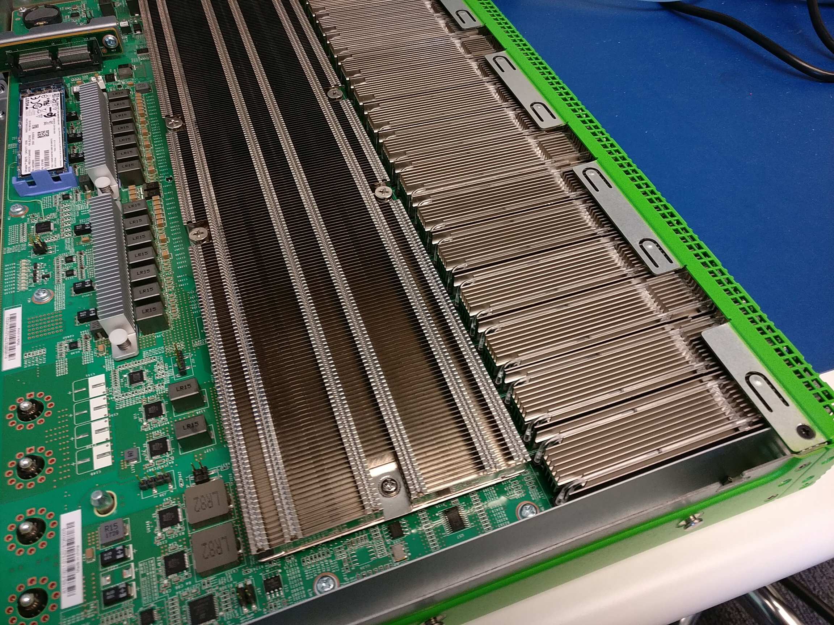
How we do it
we’ve come a long way
Notes:
today the AWS network is constructed with 12.8 tera bit per second switches, each with ports speeds of 400 gigabits per second,
that translates into 1000’s of links per data center
this a allows customers to leverage AWS for high volume data and high performance computing workloads as well as host streaming video, interactive business, and gaming applications
needless to say, we apply a lot of technology to ensure the AWS network meets our performance expectations, but these switches embody more than finely tuned bit moving machines.
we design and build them using a diverse supply chain from the lowest level component and up through rack integration… this discipline ensures that we are able to deliver capacity when and where we need it…
as you can see from the pictures, the underlying hardware is pretty impressive; however, these switches start off with a relatively simple block diagram...

Slide 21
How we do it
Network system on a
chip
CPU
Ethernet
hw
“bmc”
Console
Module access
offload
QSFP
QSFP
QSFP
QSFP
32 optical modules
Notes:
our engineers designed “module access offload” element that has a direct, dedicated i2c bus for each module allowing us to access them all at the same time
the offload engine also takes on some of the tasks that had typically been executed by software on the CPU, freeing up compute cycles
this mechanism allows us to capture detailed operating data and update firmware as we continuously improve link reliability… imperceptibly to customers

Slide 22
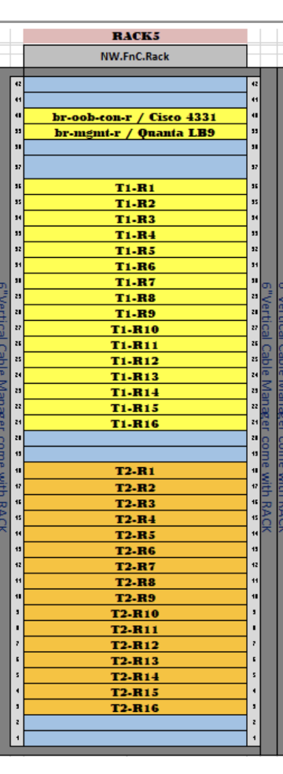
How we do it – 102.8T router
16+16 32x400G Devices
1024x400G ports total
256x400G ports for Consumers (peering, transit, CDN, backbone, cloud etc)
1x30.8kVa rack

Slide 23
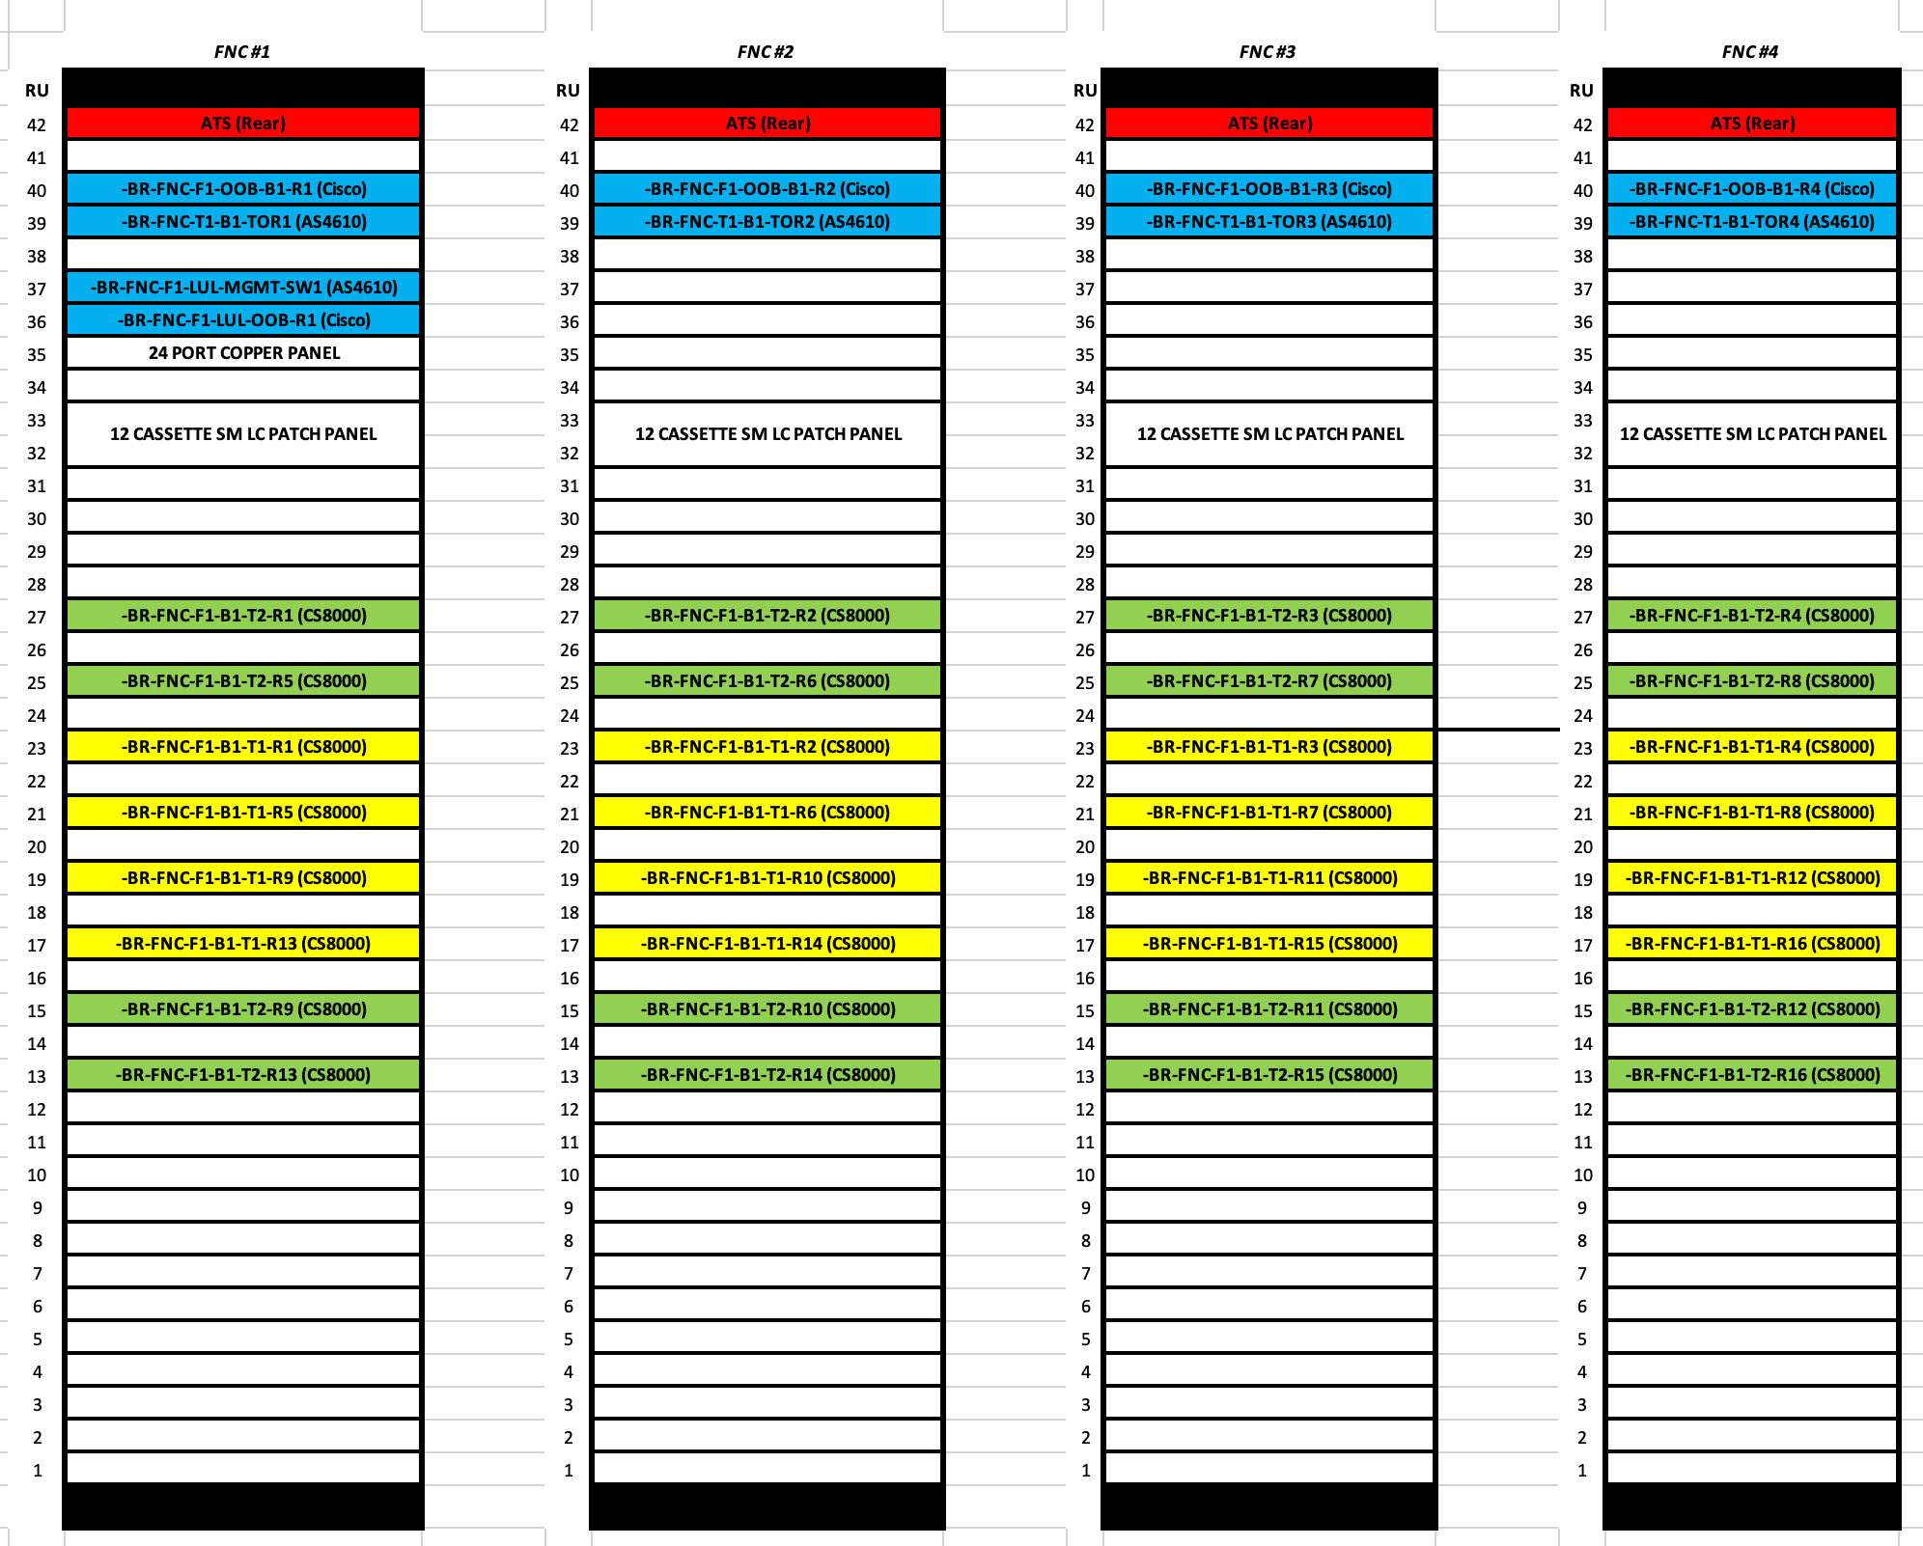
How we do it with less power – 102.8T router
16+16 32x400G Devices
1024x400G ports total
256x400G ports for Consumers (peering, transit, CDN, backbone, cloud etc)
4x9.6kVa rack

Slide 24
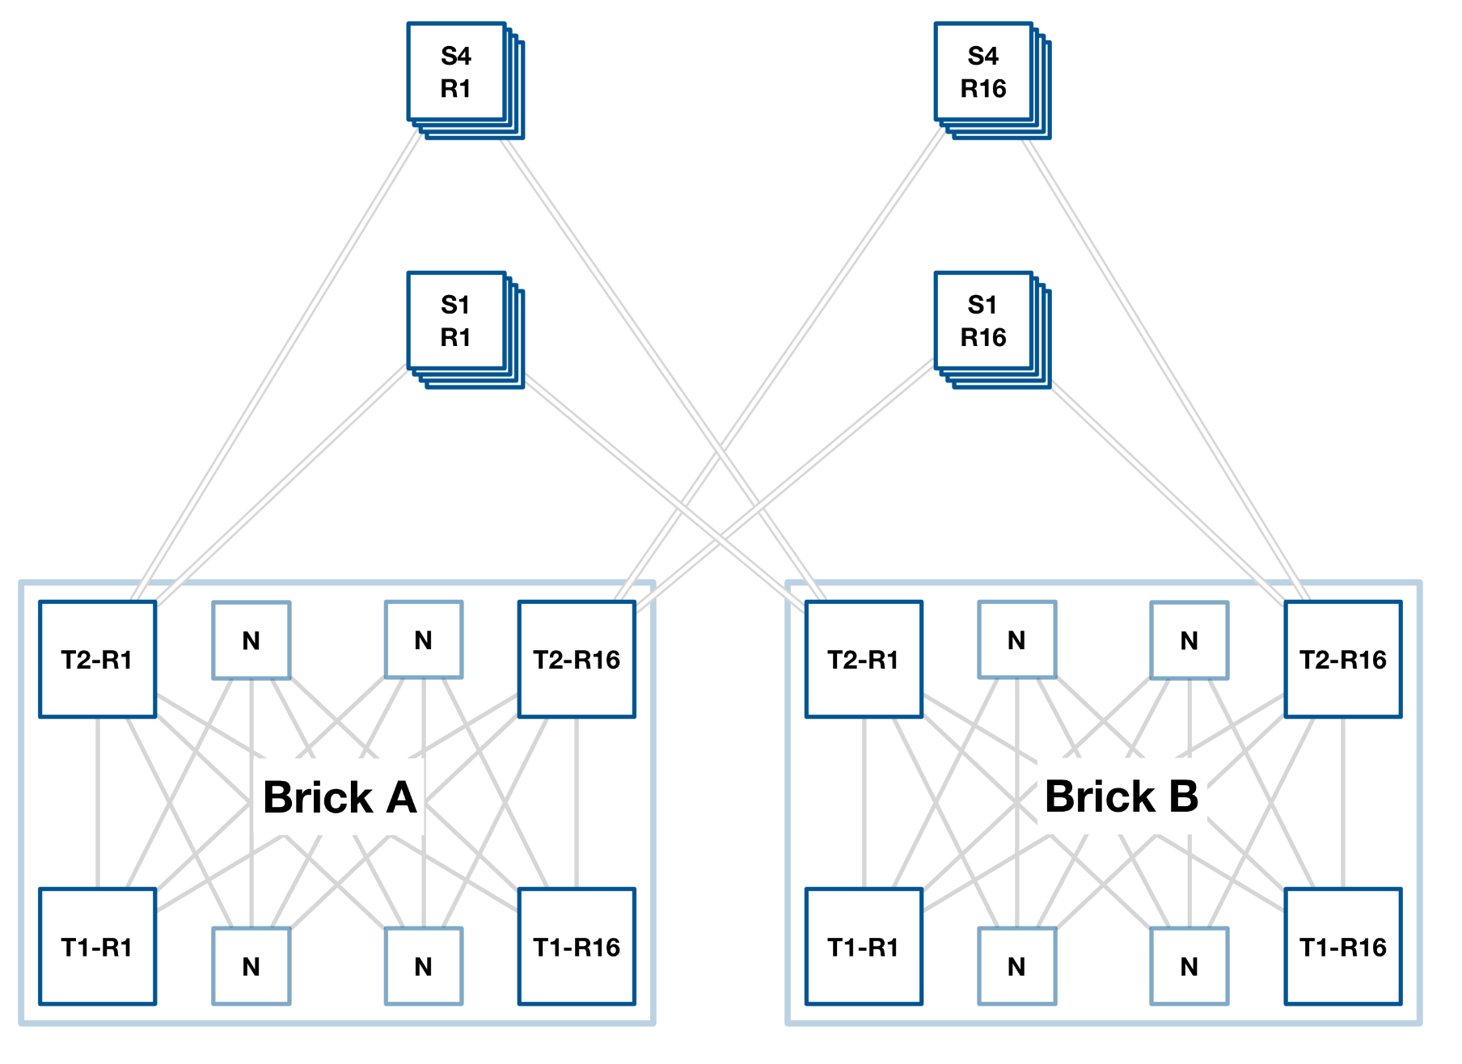
Scaling up!
4 Racks
Two Bricks
Two spine rack
204.8T Client
Non-blocking

Slide 26
How we do it – In rack
Direct-attach copper (DAC) cabling
100G 6.7mm OD at 2.5m
400G 11mm OD at 2.5m
Our Biggest enemy? Cable diameter.
Active DAC with retimers to reduce cable area
Notes:
Aside from the network devices themselves, by moving to Clos network, we’ve shifted a lot of the complexity into the interconnect. Since the break from 10gig, the Networking industry has been moving at pace through the 40Gig, 100Gig and now 400Gig generations.
These regular speed increases were mostly a tweak to our design each year, and a new rev of the cable type. However, at 400G we had another interaction with the physical world. These are not your regular cables.
Within a standard rack we may have 32 network devices, half to connect up, half down, meaning 256 cables between the top half and the bottom half. For performance and reliability purposes, we like Direct Attach Copper cables.
However, as link speed has increased, so have the requirements of the signals on those cables, meaning thicker cables. At 100G while our devices were happy to run 2.5 M cables at 6.7mm Outside Diameter, at 400G we would need a cable that’s almost 3 times the size (11 mm OD).
Each of them is as thick, and as more importantly as stiff as the electrical supply cable to most North American homes.
Not a fun task when we gobble up racks like the cookie monster. There are alternatives options to try - Active Optical Cables use fiber, but they also introduce a little more latency and aren’t as reliable. The same is true of optical transceivers and patch cables. This relatively simple problem of the stiffness of these new cables could require us to redesign how we build one of the fundamental building blocks of the AWS Network - a rack of routers.
To minimize the impact of this, we started working with our industry partners and sought out Active Electrical Cables which have retimers and enable thinner cables without the Optical conversion.
This took some time, but when available, we could swap them in for the chunky cables there, to make it a net win. I’m skipping the part about having to power them... as that had yet another knock on effect, which we’ll touch on later.

Slide 27
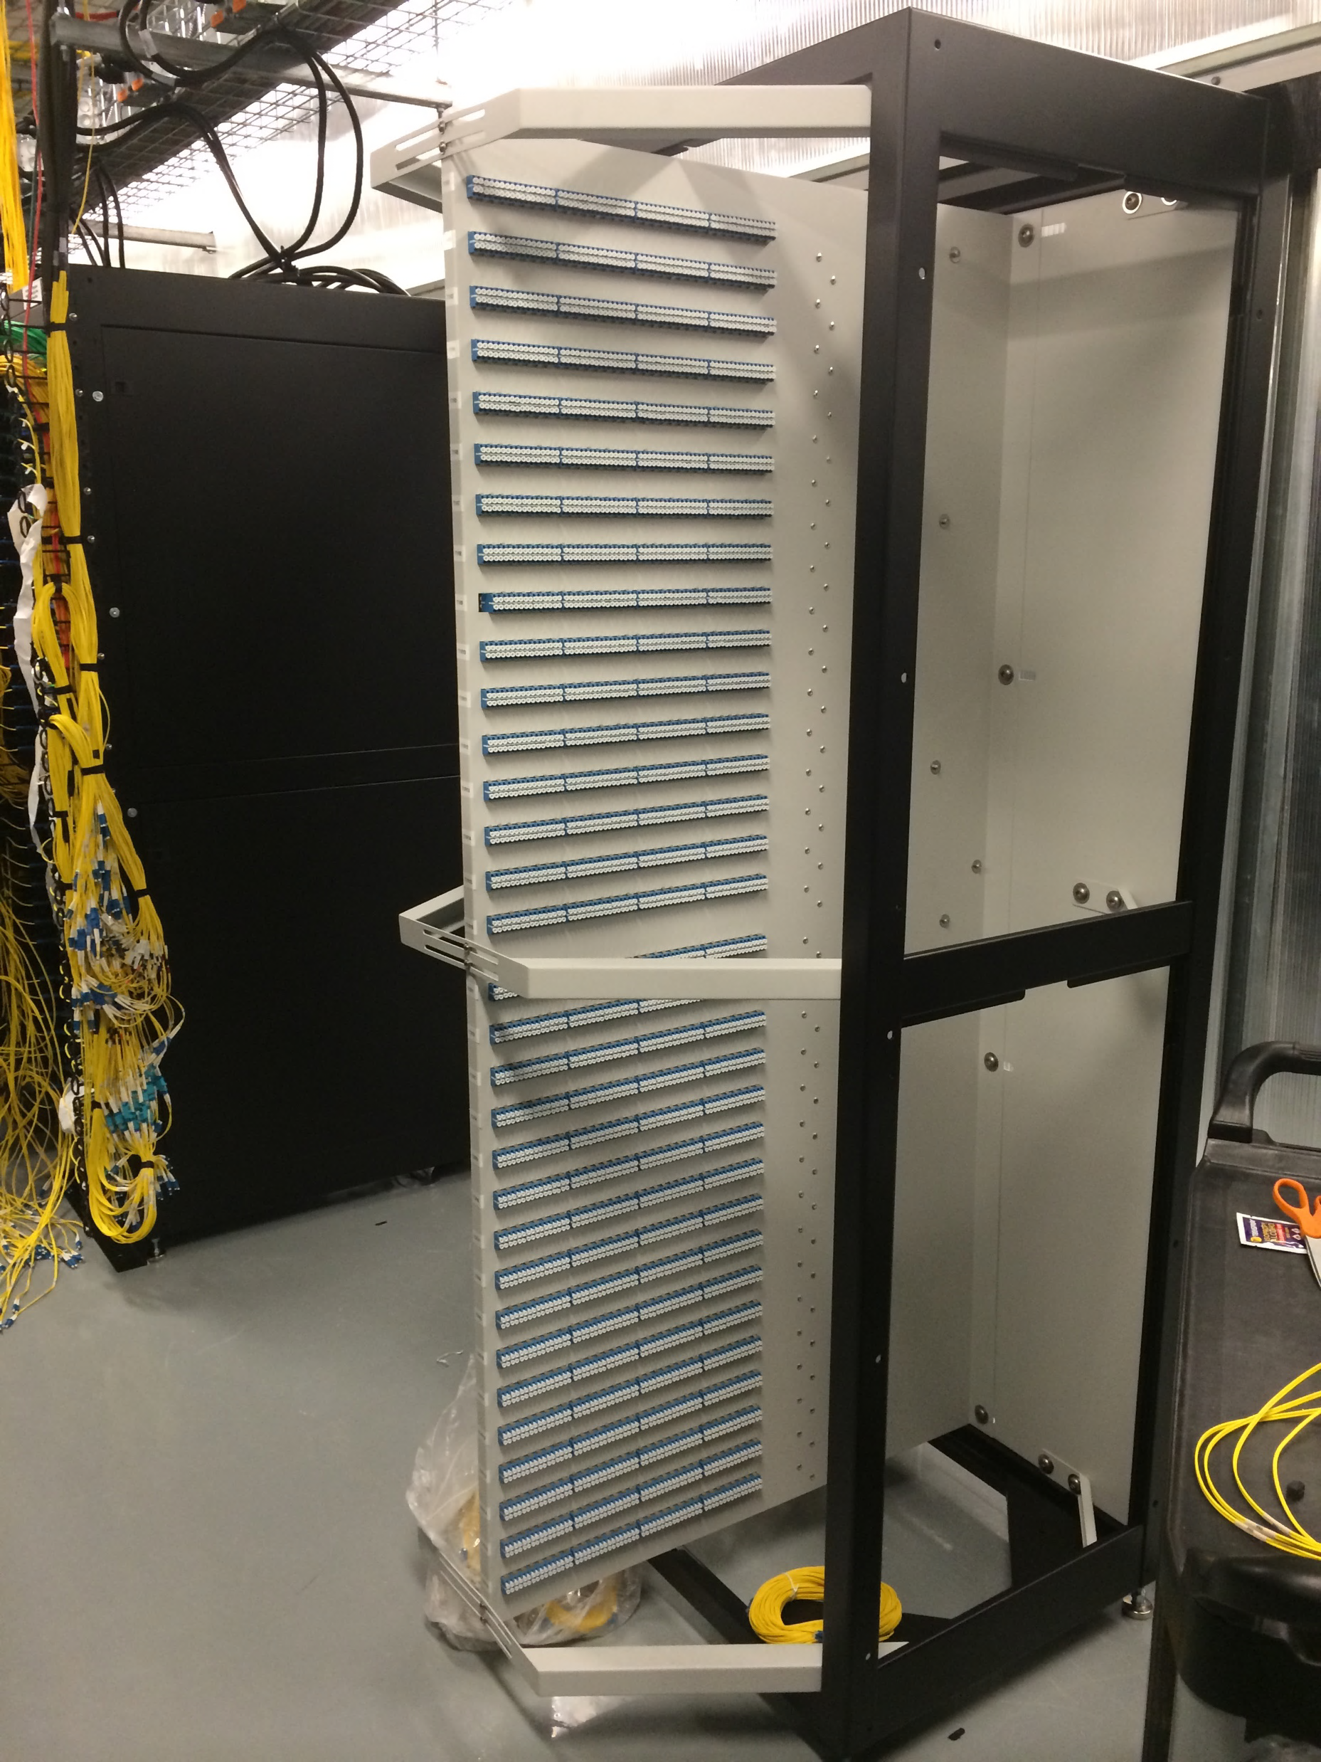
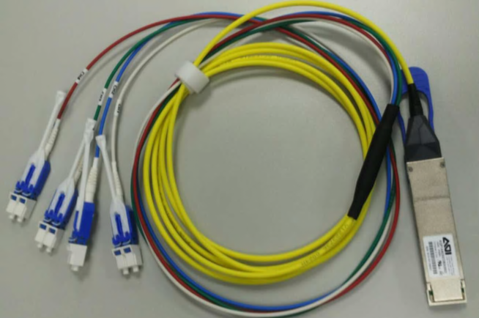
How we do it – Short reach
Notes:
Another example of innovation we came up with in a problem you may only see at scale are our optic connectors, when we make connections throughout the Datacenter building. For the past several years we have QSFP interfaces that can run at either a single connection, or a breakout connection. This started for us around 2012 with either 40G or 4x10Gbps speeds. Coming up to modern times, we have 400G interfaces, but at times we want to connect at 4x100G.
The Industry standard is to use a break out cable and a patch rack, purely to handle these connectors. These patching racks are problematic for our datacenter folks. They are passive racks, located right beside the routers.
Meaning there’s no power coming in, and no heat coming out.
That’s not great for thermal management when you consider the network rack beside it may emit 40KW of heat.
This patch rack is also taking up a lot of valuable datacenter space. Over an entire building, that might add up to an entire aisle of the datacenter.

Slide 28
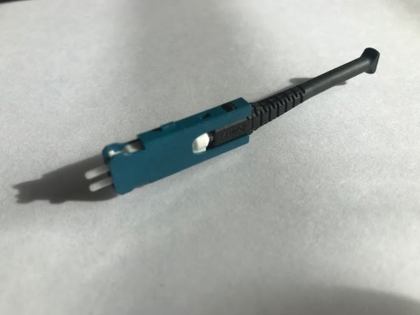
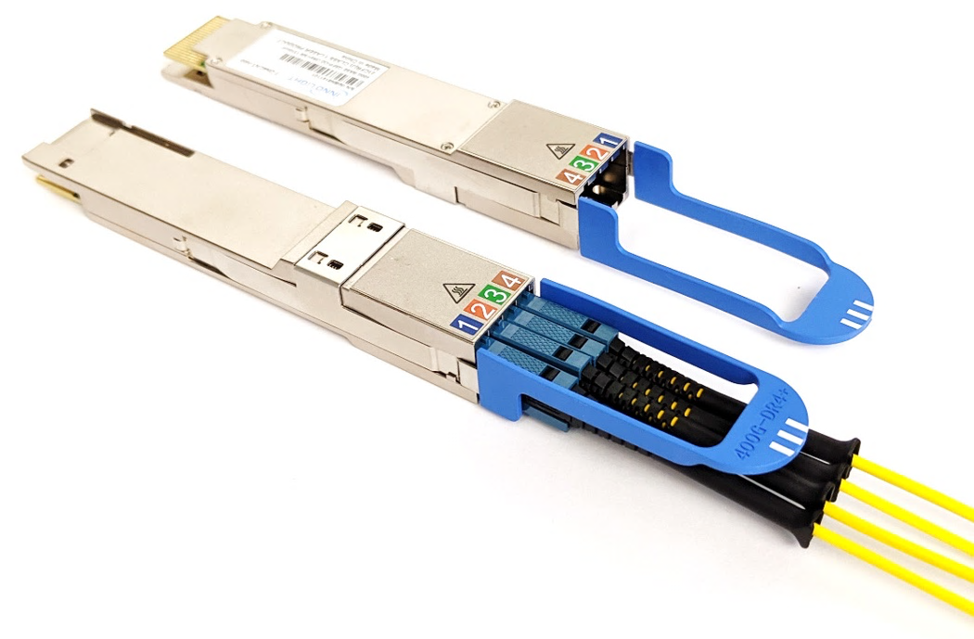
How we do it – SN connector
Notes:
To tackle this we created a connector type that allowed 4 standard single mode fiber cables to connect directly into a single QSFP interface.
This allows us to eliminate the patch rack. While the space savings are nice, we also eliminated one more connector in the chain, increasing reliability and reducing potential for signal loss.
In working with one of our connector providers, who manufactured the initial components, we’ve also made these available commercially on the market for others that have similar problems.

Slide 29
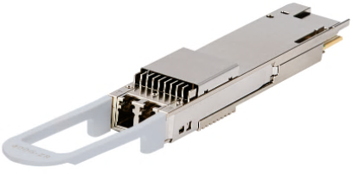
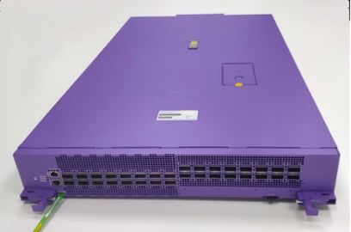
How we do it
Medium Haul
Data center interconnect (DCI)
OIF 400G ZR
400G – ZR+ 400km
Integrated routing, DWDM, encryption
Notes:
Moving up the stack one more time to the Datacenter InterConnect, connecting buildings to each other in a metro area. We spend a lot of time thinking and optimizing in this space as it’s a large source of complexity for us. Early adoption is also key for us here. We know that investing early on in a given direction will drive up reliability and increase part availability. We were super-early on the ZR technology for 400G. This enables us to put a long reach tunable optic directly in a router. Tunable optics mean we can removing the need for separate DWDM systems, and thus simplify the network further. We also identified early on that the target reach of 80 km for 400G-ZR was not providing the optimum coverage in our network. We worked with the OIF (Optical Innovation Forum) members to deliver a longer reach version of the coherent pluggable covering up to 400 km. That proved to be the right decision as the longer reach ZR (now called 400G-ZR+) is becoming widely adopted. You might be able to spot some of the fun technical challenges we had in terms of the module - mostly in that extra little heatsink you can see on the top diagram - power consumption and heat dissipation go hand in hand, and we crammed a lot of electronics and optics into that package. To handle this, we even had to change our network device. The traditional 1 rack unit element is now 2 RU so we can account for the extra cooling. This device also houses the embedded encryption module I mentioned earlier, hence so many extra speed holes on the left side vs the right. There is likely a whole talk in itself about how we think about owning our datacenter interconnect space. For those at the show, I recommend the Infrastructure booth in the AWS Village as we have some devices with us, with experts that will open the lids and happily get into a lot more detail.

Slide 30
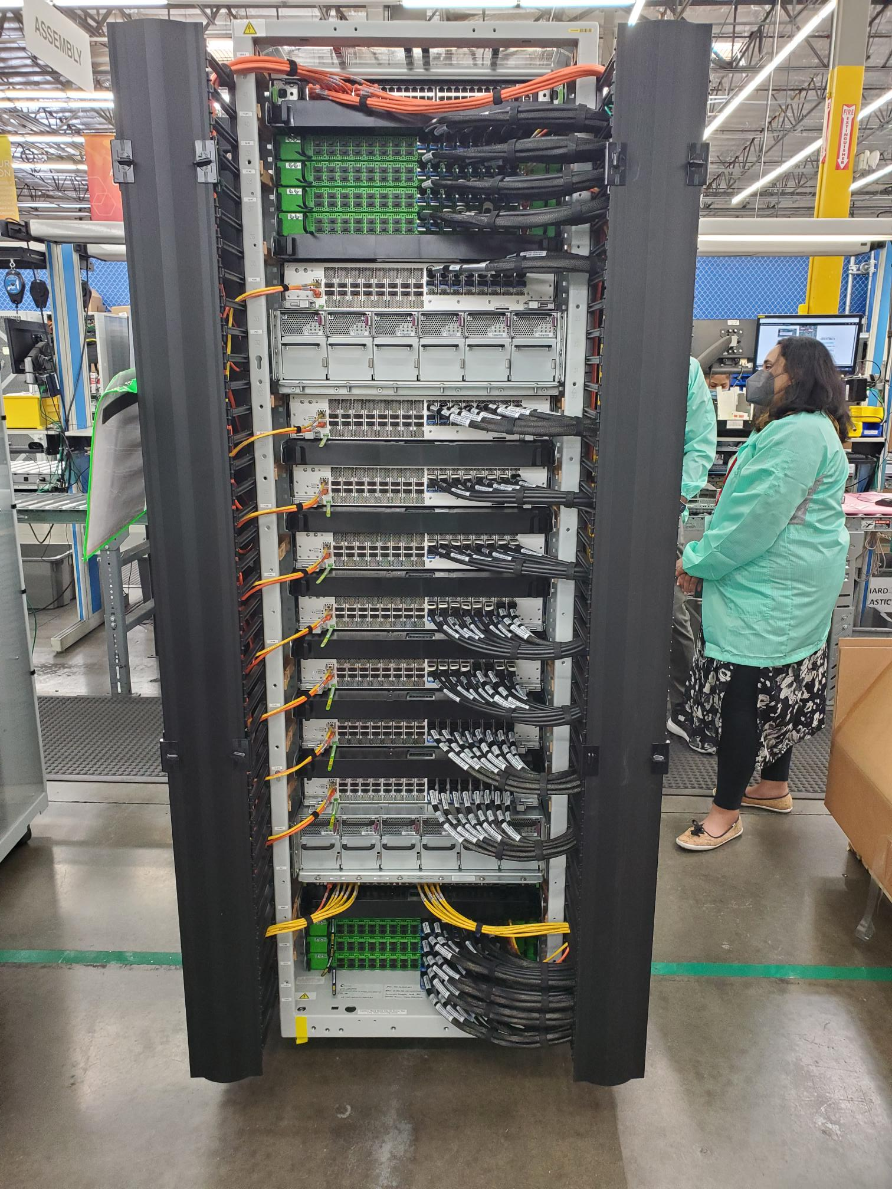
How we do it
Medium Haul
DWDM Brick
8x 12.8Tbit/s T1 Devices
8x 12.8Tbit/s DWDM Switches
8x16x400G ZR(+) (51.2T)
Notes:
Moving up the stack one more time to the Datacenter InterConnect, connecting buildings to each other in a metro area. We spend a lot of time thinking and optimizing in this space as it’s a large source of complexity for us. Early adoption is also key for us here. We know that investing early on in a given direction will drive up reliability and increase part availability. We were super-early on the ZR technology for 400G. This enables us to put a long reach tunable optic directly in a router. Tunable optics mean we can removing the need for separate DWDM systems, and thus simplify the network further. We also identified early on that the target reach of 80 km for 400G-ZR was not providing the optimum coverage in our network. We worked with the OIF (Optical Innovation Forum) members to deliver a longer reach version of the coherent pluggable covering up to 400 km. That proved to be the right decision as the longer reach ZR (now called 400G-ZR+) is becoming widely adopted. You might be able to spot some of the fun technical challenges we had in terms of the module - mostly in that extra little heatsink you can see on the top diagram - power consumption and heat dissipation go hand in hand, and we crammed a lot of electronics and optics into that package. To handle this, we even had to change our network device. The traditional 1 rack unit element is now 2 RU so we can account for the extra cooling. This device also houses the embedded encryption module I mentioned earlier, hence so many extra speed holes on the left side vs the right. There is likely a whole talk in itself about how we think about owning our datacenter interconnect space. For those at the show, I recommend the Infrastructure booth in the AWS Village as we have some devices with us, with experts that will open the lids and happily get into a lot more detail.

Slide 31
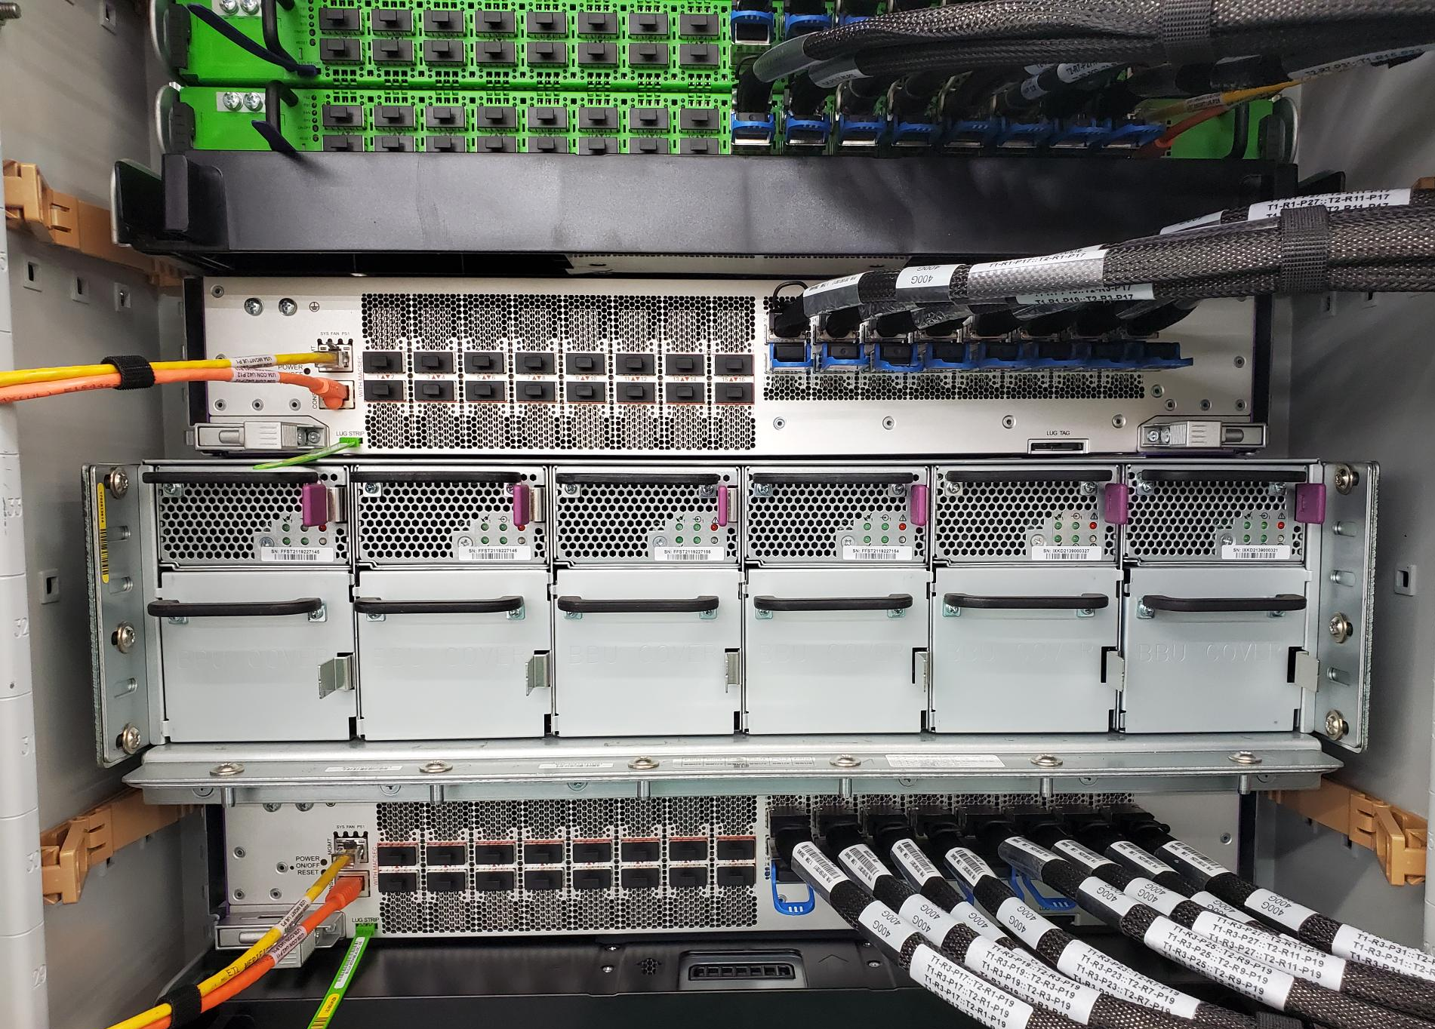
Notes:
Moving up the stack one more time to the Datacenter InterConnect, connecting buildings to each other in a metro area. We spend a lot of time thinking and optimizing in this space as it’s a large source of complexity for us. Early adoption is also key for us here. We know that investing early on in a given direction will drive up reliability and increase part availability. We were super-early on the ZR technology for 400G. This enables us to put a long reach tunable optic directly in a router. Tunable optics mean we can removing the need for separate DWDM systems, and thus simplify the network further. We also identified early on that the target reach of 80 km for 400G-ZR was not providing the optimum coverage in our network. We worked with the OIF (Optical Innovation Forum) members to deliver a longer reach version of the coherent pluggable covering up to 400 km. That proved to be the right decision as the longer reach ZR (now called 400G-ZR+) is becoming widely adopted. You might be able to spot some of the fun technical challenges we had in terms of the module - mostly in that extra little heatsink you can see on the top diagram - power consumption and heat dissipation go hand in hand, and we crammed a lot of electronics and optics into that package. To handle this, we even had to change our network device. The traditional 1 rack unit element is now 2 RU so we can account for the extra cooling. This device also houses the embedded encryption module I mentioned earlier, hence so many extra speed holes on the left side vs the right. There is likely a whole talk in itself about how we think about owning our datacenter interconnect space. For those at the show, I recommend the Infrastructure booth in the AWS Village as we have some devices with us, with experts that will open the lids and happily get into a lot more detail.

Slide 32
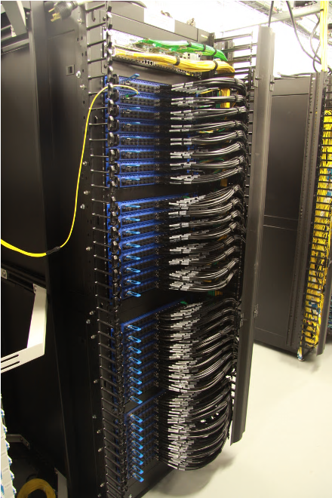
Metal boxes and a lot of cables
Small number of rack variations
Rack and cable switches for burn-in
Collect inventory and compare with bill of materials
Reprogram with AWS controlled binaries
Notes:
we’ve discussed many of the components that make up the network; however, a key part of delivering capacity is securely and reliably getting those components from the manufacturing shop floor into the network
in keeping with the concept of simple building blocks, we build fabrics of different sizes and functions with a small number of rack configurations,
we are able to do this because our 12.8T switches are used at all layers of our network from the top of rack switches that directly connect to servers, through the core, and out to our border and backbone networks.
this commonality simplifies our manufacturing and deployment processes, and it has another important characteristic…. it allows us to late bind where racks are sent so that we can scale capacity where we need it the most
we work with rack integrators who mount the switches into racks, wire them up, and perform burn-in testing to prove that the hardware is robust…
when these racks hit a data center, we inventory the rack and most of the switch sub-components, validating them against the “as-built” BOM from our suppliers… this makes sure that nothing was modified during integration or shipping
at this point, all software, firmware, and programmable hardware elements are loaded AWS controlled binaries
we then re-test all of the rack-local links and extend the testing to the links that reach outside of the rack
once we are satisfied with the quality of all connectivity, our deployment tooling pushes operational configuration to the devices and voila, another 400 tera bit per second of raw switching capacity becomes available

Slide 33
Software

Slide 34
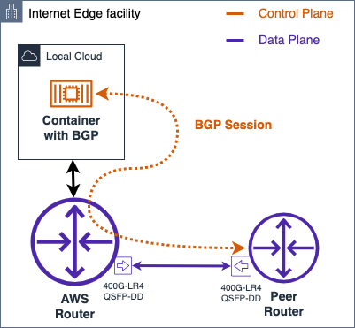
ARN RR
OSL RR
*** RR
CPH Inet RR
Inet Route Controller * Netflow * TE (Local) * TE (Global) * Overrides * CDN Data
Route Programmer
Full Table Router
CPH Hot Route RR
CPH Hot Routes 99% Traffic
Consumer

Slide 35
AWS backbone
Notes:
While our examples have been Datacenter focused, almost all of the areas we’ve spoken about inside AWS regions are also true of our Backbone, Border and Internet Edge locations.
This means the same drivers of security, performance, availability and scale are as true for Cloudfront, Global Accelerator and Route 53. However, on the AWS Backbone, the problem of traffic management is slightly different. While latency variation in the DC is typically in the order of 10% with similar capacity levels, the Backbone can have paths with wildly different latencies and capacity levels.
This is most easily understood as comparing a very long, relatively narrow network, vs the short hop, very wide network in the datacenter.

