Slide 1
Text Parsing Strategies for Network Devices
Ruairí Carroll
DKNOG13

Slide 2
Intro
Titled this talk to sound boring (Sorry, PC!)
Cookbook style approach
GitHub repo accompaniment

Slide 3
Some phrases
Regex: Regular Expressions
Parser: Takes lexer and makes data structure
Lexer: Convert sequence of characters into “words” aka tokeniser
Grammar: Combination of Lexer and Parser
DSL: Domain Specific Language. For this talk, vendors CLI

Slide 4
Historical Context
Devices managed by hand
This is generally regarded as a big mistake
Very little automation
Paraphrasing someone smart
db -> network is easy
network ->db is very hard

Slide 5
Current state of affairs
NetCONF, RestCONF, gRPC, OMGWTFBBQ
Many options, but…
Still got devices needing console/SSH

Slide 6
So Why This Talk?
Outline some options
Not exhaustive or authoritive
Hopefully helpful to someone

Slide 7
Substring matching
Is X contained in Y
Simple
Fragile

Slide 8
Regex
Allows match via meta language
Lets you abstract and describe desired match
Often used as wrong tool
Perl-esque
Bad rep, however still useful

Slide 9
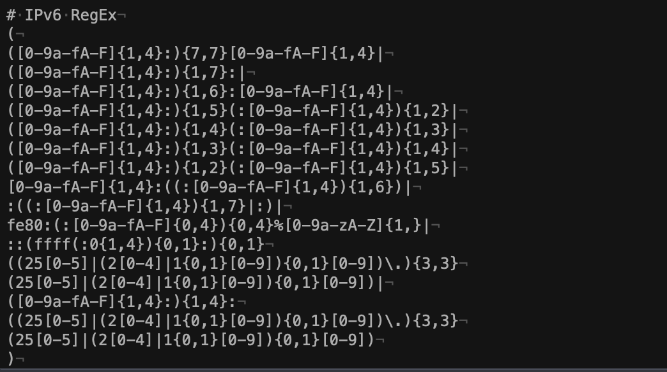

Slide 10
Regex - Named Capture Groups
Can make regex more readable (!!)
Extract multiple variables from text blobs

Slide 11
ZA̡͊͠͝LGΌ ISͮ̂҉̯͈͕̹̘̱ TO͇̹̺ͅƝ̴ȳ̳ TH̘Ë͖́̉ ͠P̯͍̭O̚​N̐Y̡ H̸̡̪̯ͨ͊̽̅̾̎Ȩ̬̩̾͛ͪ̈́̀́͘ ̶̧̨̱̹̭̯ͧ̾ͬC̷̙̲̝͖ͭ̏ͥͮ͟Oͮ͏̮̪̝͍M̲̖͊̒ͪͩͬ̚̚͜Ȇ̴̟̟͙̞ͩ͌͝S̨̥̫͎̭ͯ̿̔̀ͅ

Slide 12
TextFSM
Named Capture Groups on Speed
Can auto map command to parser
Comes in Go and Python versions
Excellent templates available via NTC

Slide 13
Antlr4
A complete grammar/lexer/tokeniser!
Compiles into various languages (Go/Python)
Grammar needs to be “compiled” to code
Import generated code, build on top of it
Notes:
Tutorials:
https://tomassetti.me/antlr-mega-tutorial/
https://github.com/antlr/antlr4/blob/master/doc/getting-started.md

Slide 14
Pulling it all together
I said a bunch of words
You were promised something useful
Well, here goes nothing…

Slide 15
Vendor Neutral Code
Let's build a vendor neutral class!
IN PYTHON
Why?
Nobody showed me how to
Now I’m showing you

Slide 16
Setup and boilerplate
abc for modelling the API
Implement each strategy in a method
Code is on GitHub (If it’s still up)

Slide 17
Sketch API
Picking 5x interactions
Sketch out via abc
isUserConfigured
fetchModel
fetchRunningVersion
fetchARPTable
fetchISISAdjacency

Slide 18
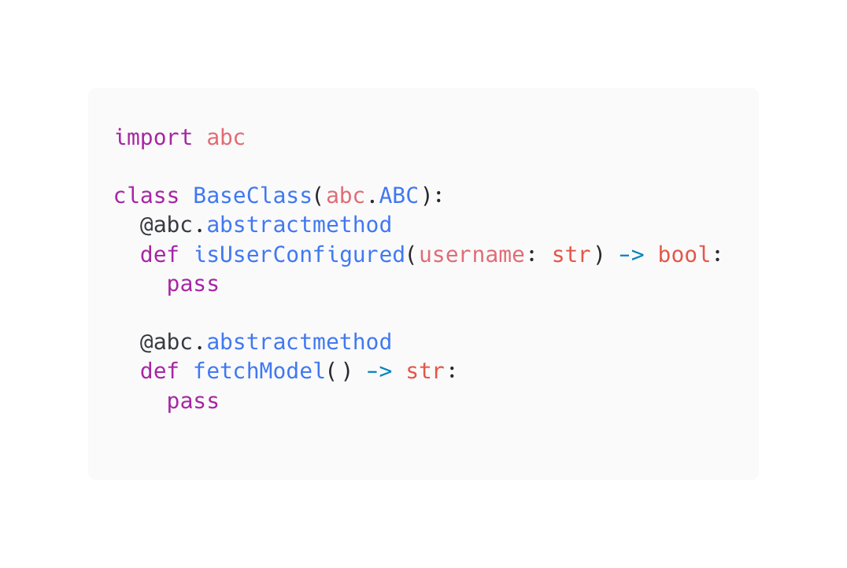
abc
Use decorator abc.abstractmethod

Slide 19
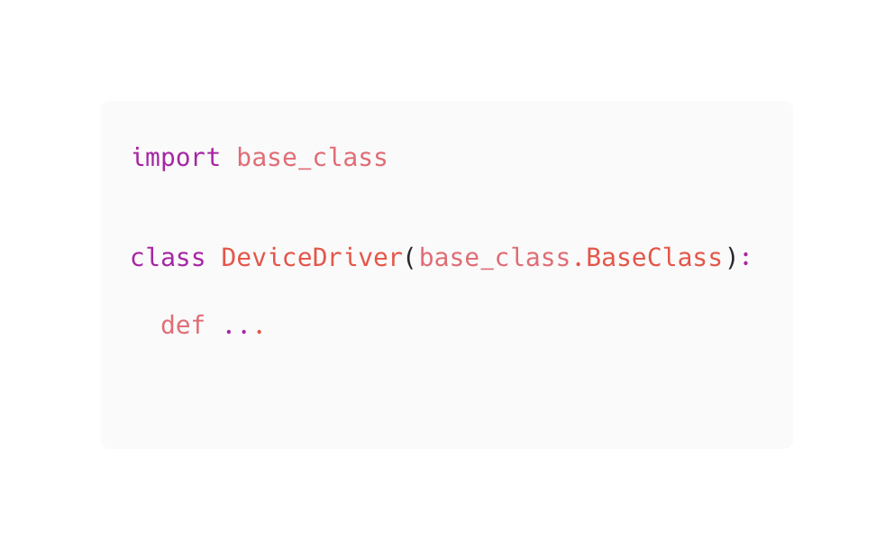
Getting Started

Slide 20
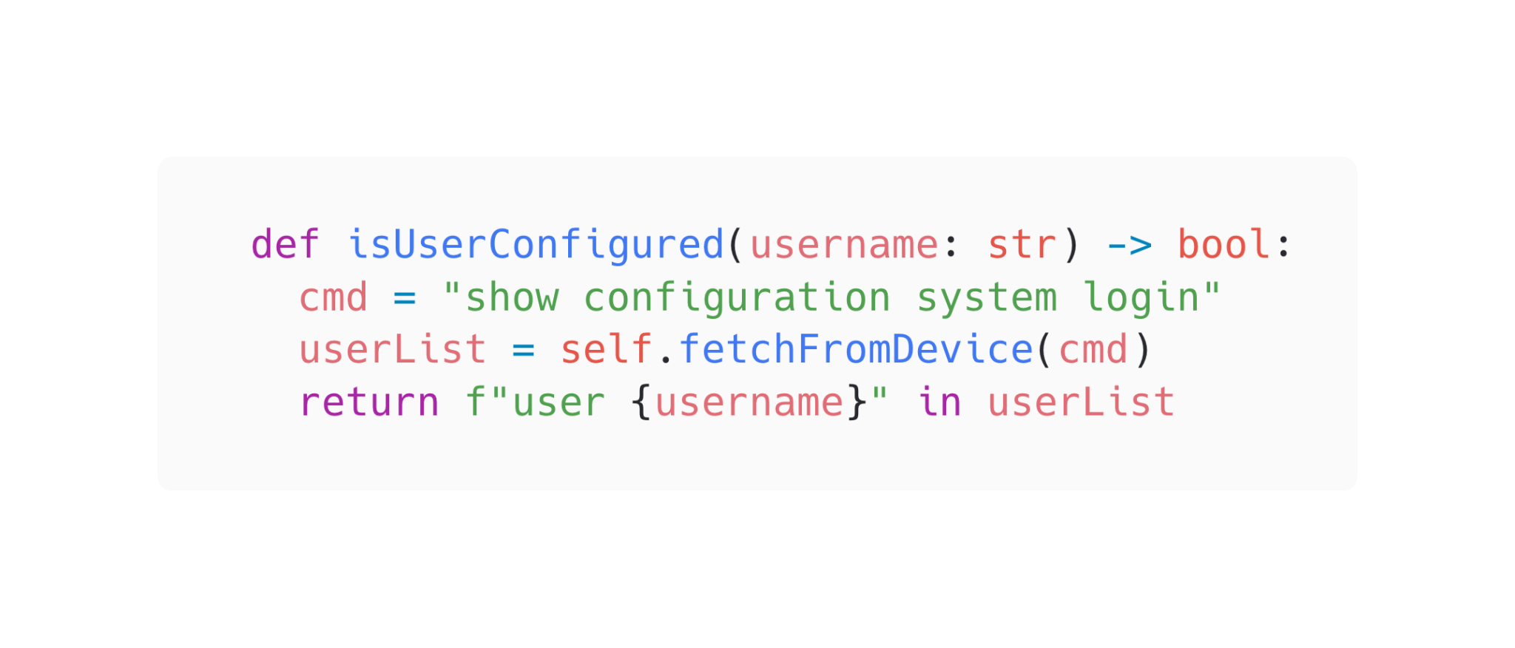
isUserConfigured

Slide 21
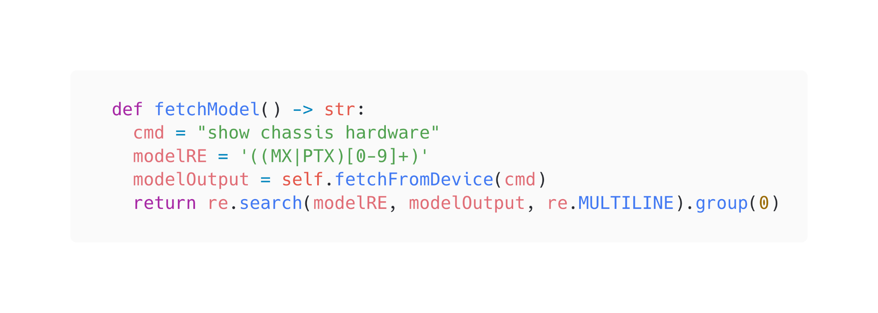
fetchModel

Slide 22
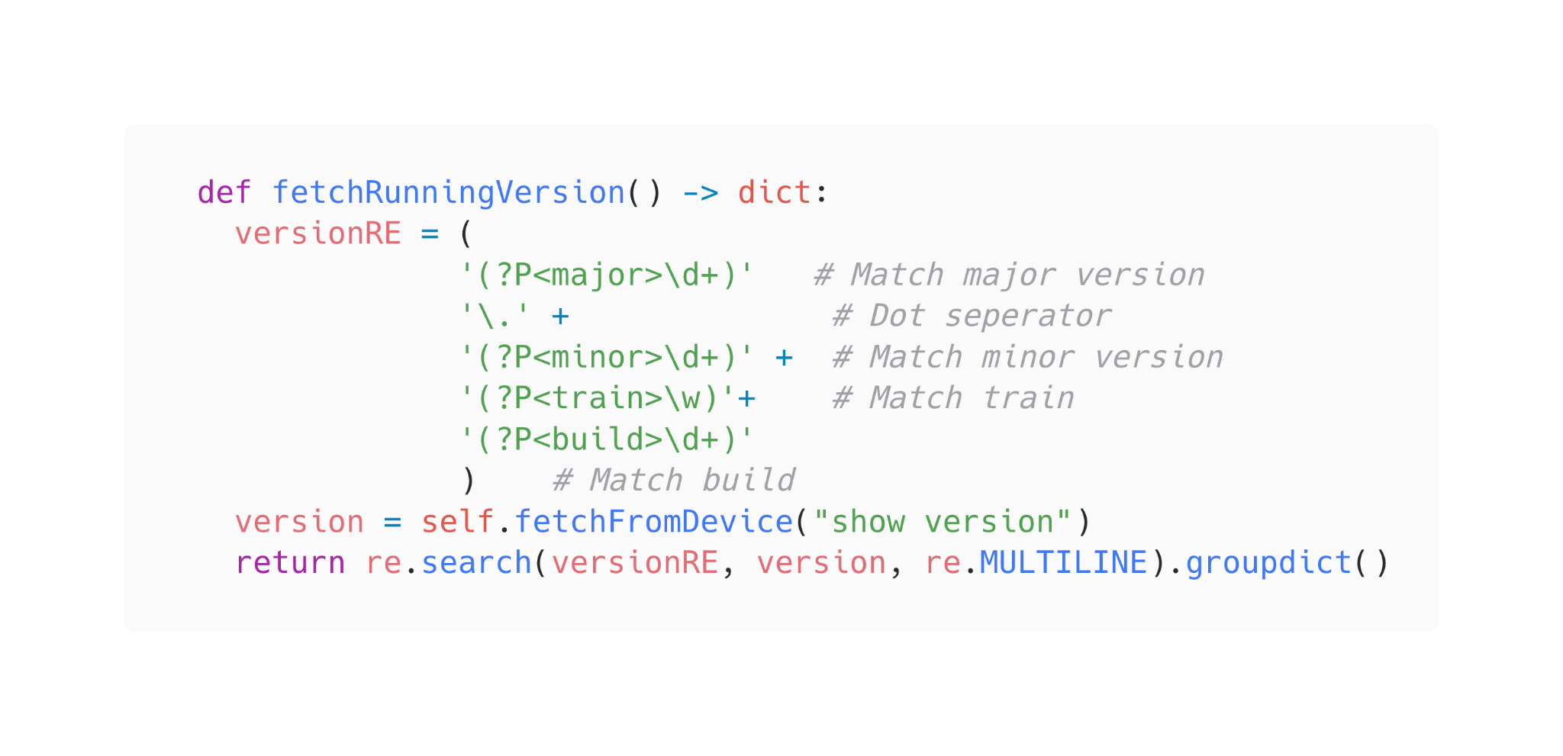
fetchRunningVersion

Slide 23
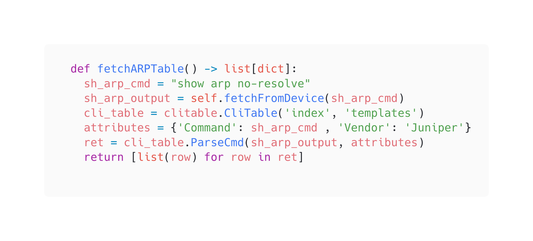
fetchARPTable

Slide 24
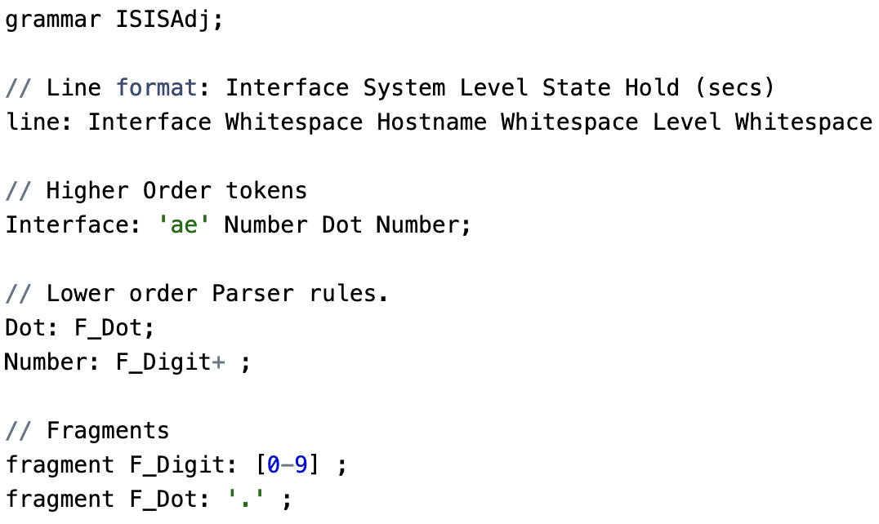
fetchISISAdjacency

Slide 25
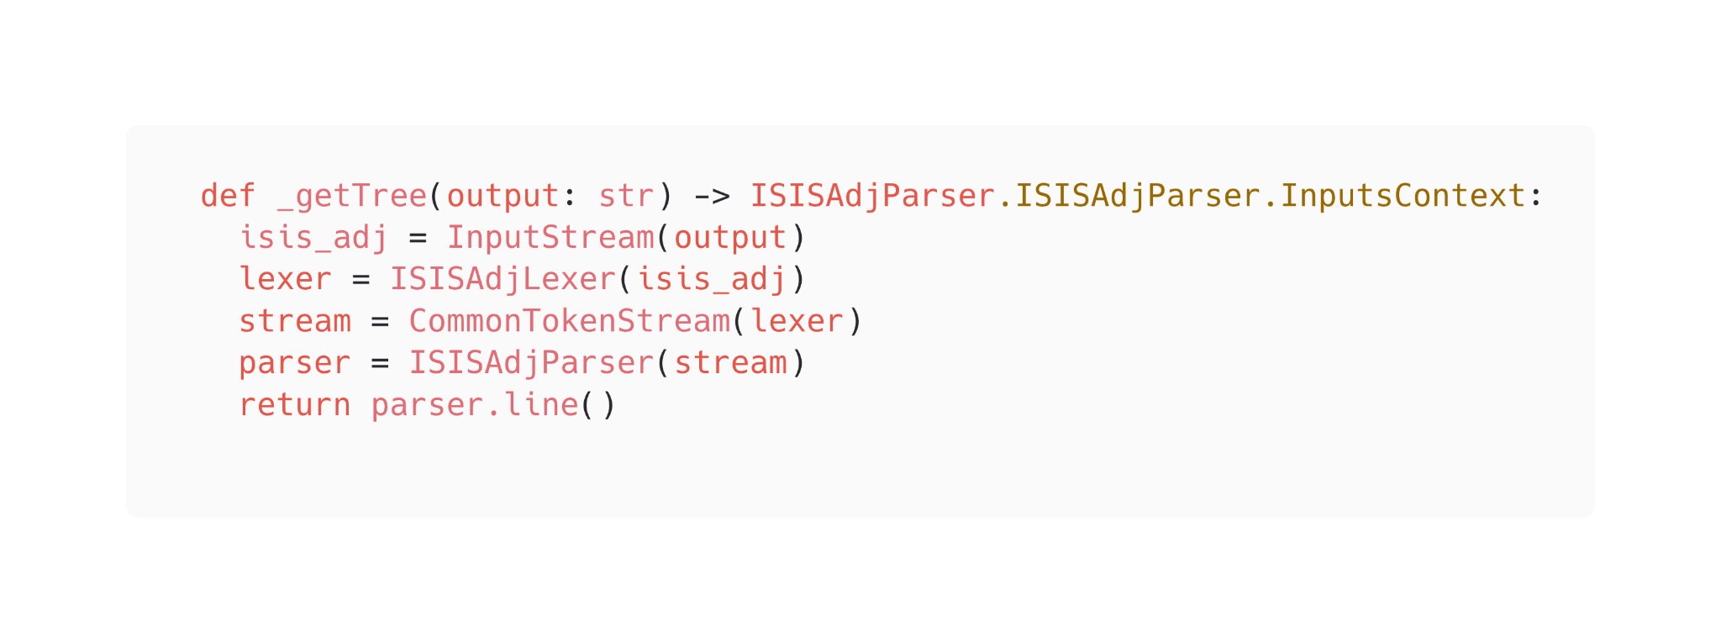
fetchISISAdjacency

Slide 26
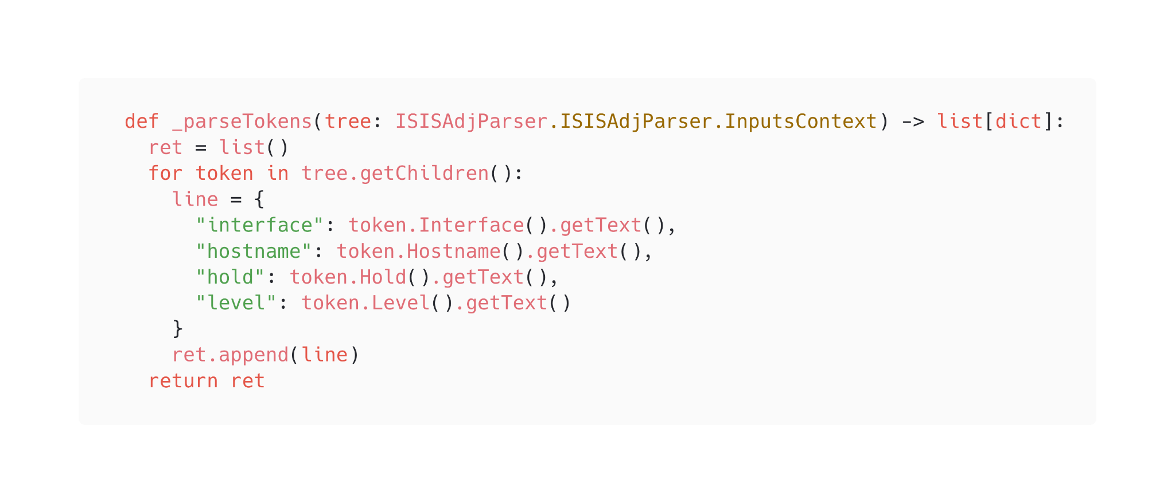
fetchISISAdjacency

Slide 27
fetchISISAdjacency

Slide 28
What did we learn?
Never
Gonna
Give
You
Up
Notes:
Never rely on output being consistent
Gonna be hard to support large regex
Give your regex capture groups to break them up
You dont need to get it perfect, just working
Up to you how to implement features

Slide 29
Questions?

Slide 30
Penultimate Slide
Normally it’s “We’re hiring!”
Layoffs at work
Is my skillset interesting to you? Are you hiring?
Lets talk!
ruairi@unicast.network - or anywhere you see me

Slide 31
Kamelåså

