Slide 1
Embedded CDNs in 2023
﹣A status
Nina Bargisen
March 2023
Notes:
Context about the panel in 2012 at NANOG

Slide 2
What is a CDN?
Embedded servers are when some of the CDNs servers are located within ISPs networks and intended to only serve end-users in that network. The servers will use address space originated in the ISPs network and not in the CDNs ASN(s).
Clustering is when a number of servers share their storage. This means that the content is distributed over the servers in the cluster and will not be present at all of them. Sometimes servers in different sites can be clustered together.
A collections of geographically distributed servers
A method to place content on the servers
A method to steer end-users to the closest servers

Slide 3
A bit about the CDN market
Growth in the market based on the increased consumer demand for entertainment and OTT services and in the later years on increased demand for e-learning and work from home solutions.
The traditional players like Akamai, Lumen, Tata, Edgio etc are well established as reliable and with global reach.
The newer major CDNs like Cloudflare, Fastly and Stackpath are offering a more diverse and specialised set of services like security services and DDOS protection, high performance real time delivery services etc.
Which btw is also offered by Akamai
Large content producers who use comercial CDNs often use multiple CDNs. This both to support their different types of content, to leverage different geographical scope of the CDN, create resilience and finally - more than one provider means better leverage when negotiating contracts…
Notes:
Edgecomputing = on the road to be a cloud

Slide 4
A bit about the CDN market
The giant content producers like Netflix, Apple, Microsoft, Amazon, Facebook and Google have all build their own specialised CDN to support their core services ( and some also sell CDN services…)
Building a CDNs on a global scale is not small task, so this solution is only for the largest and most resourceful content producers with enough demand for traffic to make the business case work.
The cloud providers allmost all have a CDN to fron their content
The CDNs are almost all also offering compute and other cloud services
So in the end they end up offering the same services but with different specialities and strengths
Notes:
Might want to make the point that in the early days of CDN it was all about traffic volume (gave you leverage in the market) - In the last 10 years there's been more focus on value added services such as security.

Slide 5
Who offers embedded servers?
Akamai
Netflix
Google
Amazon
Facebook
Cloudflare
CDN77
Microsoft
Apple
Qwilt
And more to come

Slide 6
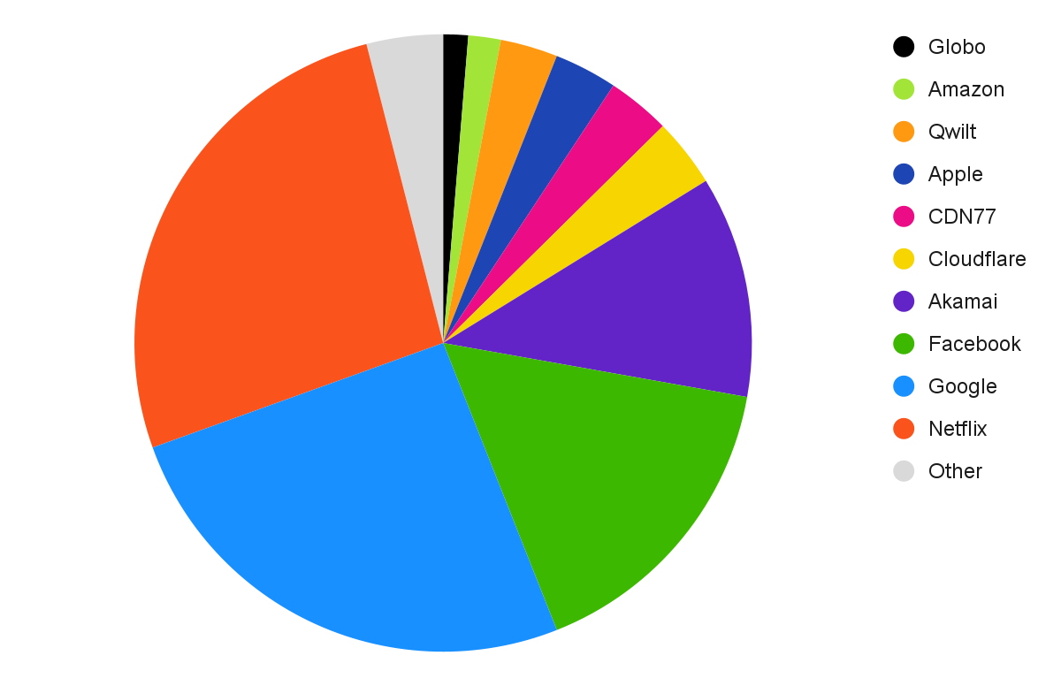
Statistics
Most ISPs in the sample have 6 or less embedded CDNs
95 percentile is 6
The top 6 are:
Google (25.5%)
Netflix (26.5%)
Facebook (16.2%)
Akamai (11.6%)
Apple (3.3%)
CDN77 (3.3%)
Not quite FAANG but almost ;)
Percentages of the ISPs in the sample that have embedded servers from the CDN
Notes:
Data source for this is netflow data from a sample of the internet that consist of Kentik customers that have deployed embedded servers (any provider)
Top 5 when counting number of customers they are embedded into - new kids on the block are Facebook, Apple, CDN77, Cloudflare and Amazon ( not Twitch or AWS)

Slide 7
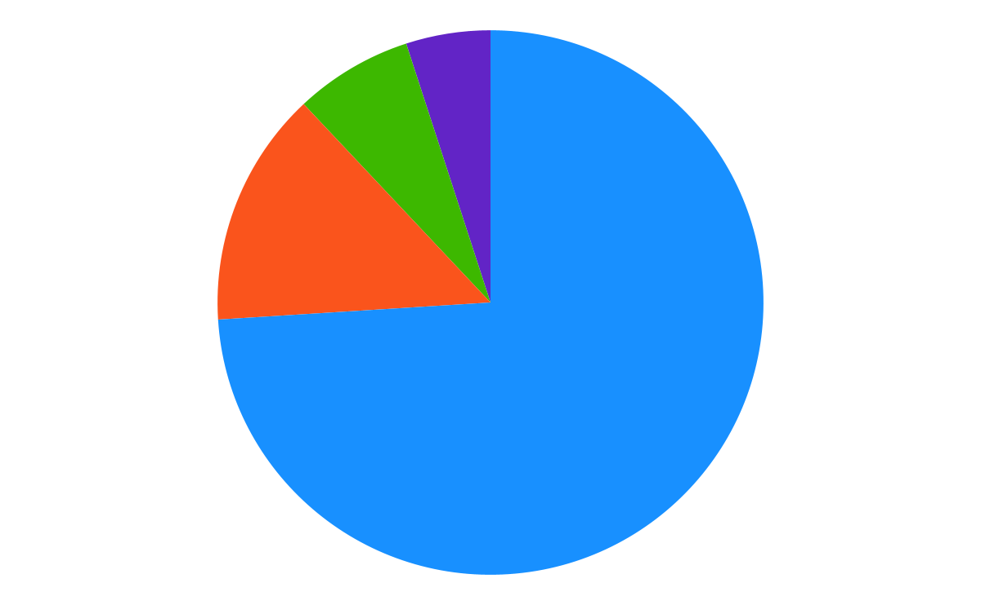
Total distribution of traffic marked as CDN traffic
~74% over the external network border
~14% from embedded servers
~7% embedded to embedded internally in the networks
~5% Externally to embedded
Average traffic over 24 hours that includes a sunday evening.
Notes:
Data source for this and the next slide is a netflow data from sample of the internet that consist of Kentik customers.

Slide 8
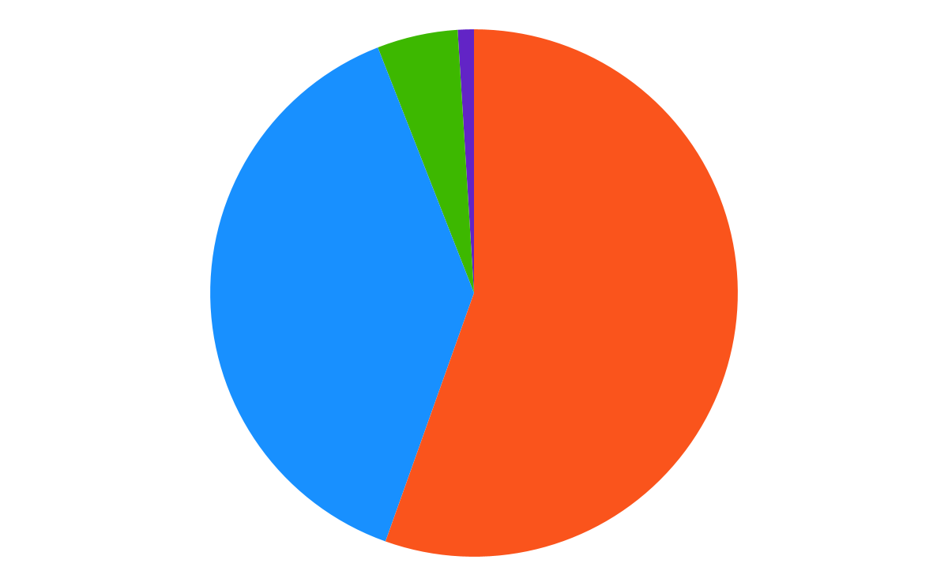
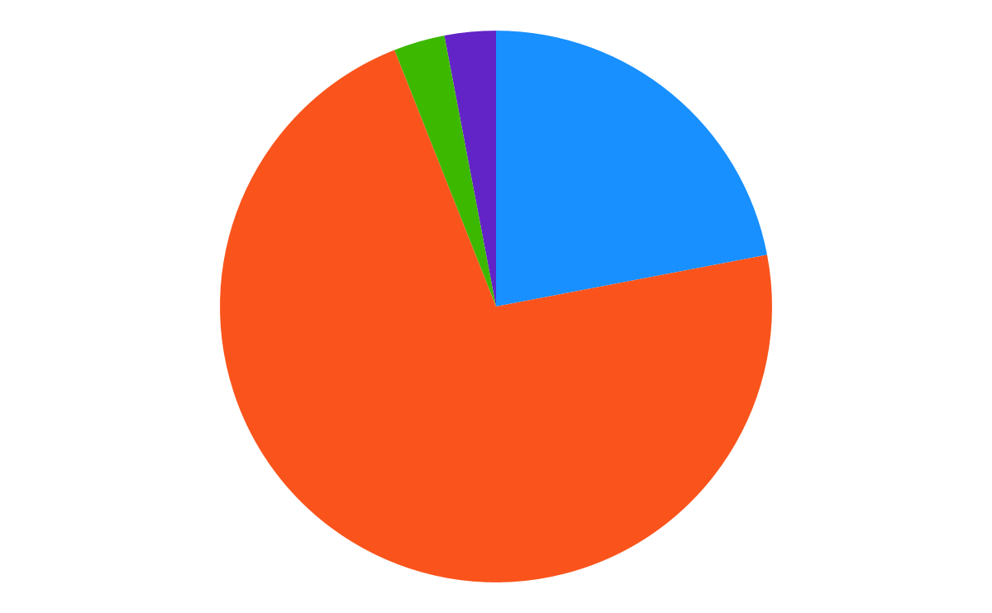
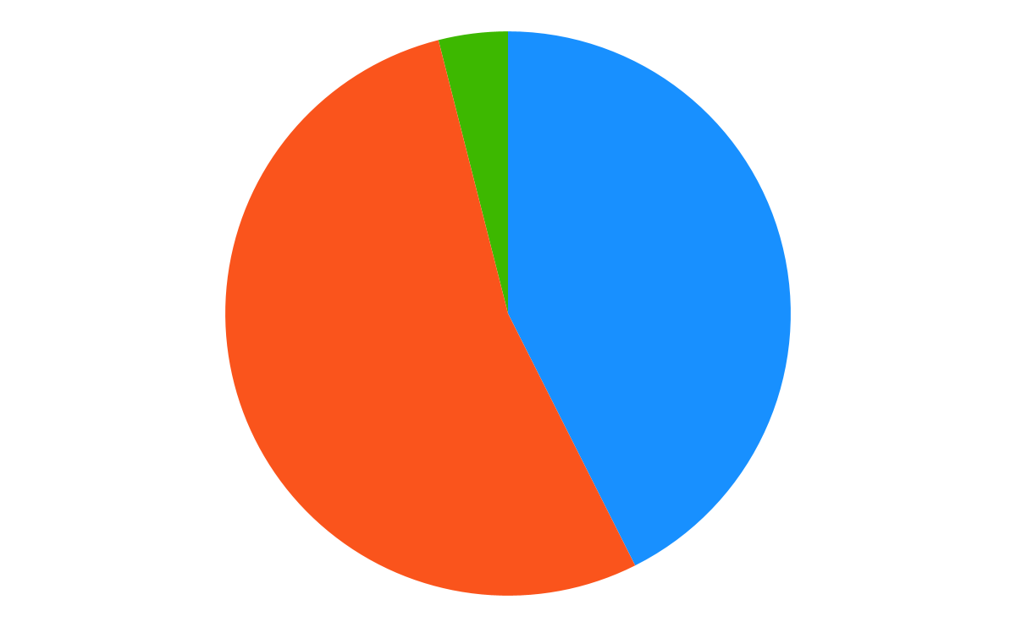
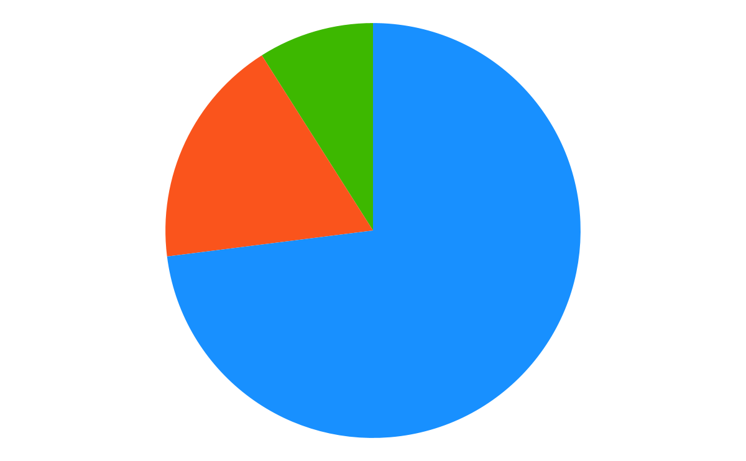
Statistics
Google
Netflix
Facebook
Akamai
Outside to end-users (39%)
Embedded to end-users (56%)
Outside to embedded (5%)
Embedded to embedded (1%)
Outside to end-users (22%)
Embedded to end-users (72%)
Outside to embedded (3%)
Embedded to embedded (3%)
Outside to end-users (43%)
Embedded to end-users (54%)
Outside to embedded (4%)
Embedded to embedded (0%)
Outside to end-users (73%)
Embedded to end-users (18%)
Outside to embedded (9%)
Embedded to embedded (0%)
Notes:
Looking at the average traffic from the 4 biggest CDNs that use embedded servers, we see very different traffic patterns - ( note these statistics includes networks that have deployed embedded caches in their network from that CDN)

Slide 9
Steer to the closest cache
BGP
DNS Server
Geolocation
BGP is used to signal the subnets that a cache or cluster should serve
The most control is given for the systems where every cache has a BGP session and the steering system respects common BGP parameters.
A setup where all Servers have an identical session will work for most deployments.
Prefixes are sent from the ISP to the cache
End-users are mapped to a cluster based on the DNS server they are using to request the content
Geolocation is used by some as the primary way if mapping an end-user to a cluster. Some use the geolocation of the end-user IP address, but some rely on the geo location of the DNS server the end-user is using to request the content.
Anycast
Anycast addresses are announced from the caches and the ISPs routing decides which is the closest
Notes:
The different methods also defines how much the host ISP can influence which end-user groups gets to use which Servers.

Slide 10
BGP
x.y.z.0/24 is announced to A
x.y.w.0/24 is announced to B
Give me movie
Go to B and get movie
Give me movie
Movie
This works really well for ISPs who have a very strict regional address plan. It does not work for ISPs where they do not have control over IP address assignments or who do not have regional aggregation
A
1
2
B
3
x.y.z.0/24
x.y.w.123
4
x.y.w.0/24
Notes:
Only Netflix do this cleanly. Google and Facebook allow some BGP parameters to influence their mappings but since their mappings involve quality measures ( check this with google)

Slide 11
DNS
Where is site.com?
Where is site.com?
site.com is site.com.cdnsomething.com
Where is site.com.cdnsomething.com
site.com.cdnsomething.com is A for you
Site.com is A
Give me Site.com
Site.com
1
2
6
3
User in Mumbai
Local DNS
Authorized DNS
7
8
4
5
CDN node in Mumbai
IP address “A”
CDN
CDN node in Singapore
IP address “B”
Notes:
Only Netflix do this cleanly. Google and Facebook allow some BGP parameters to influence their mappings but since their mappings involve quality measures ( check this with google)

Slide 12
And then some of the magic
Latency and other QoS data
Load
Content
The CDN creates a mapping of ISP DNS servers to POPs or clusters based on latency measurements
Some CDNs include internet connectivity from the cluster to the DNS servers or IP addresses in their mapping algorithm
The content owned CDNs also include signals from the content clients in the algorithm
The load of the individual servers or clusters is part of the decision of exactly which server the end-user will end up using.
Load balancing can take place in the cluster or in the CDN response to (where is?)
Not all content is on all servers
Content that is pushed out is distributed according to CDN magic
Not all content from a CDN will be cached when the content is pulled
This means where the content is/can be is also part of the steering decision.
Notes:
The different methods also defines how much the host ISP can influence which end-user groups gets to use which Servers.

Slide 13
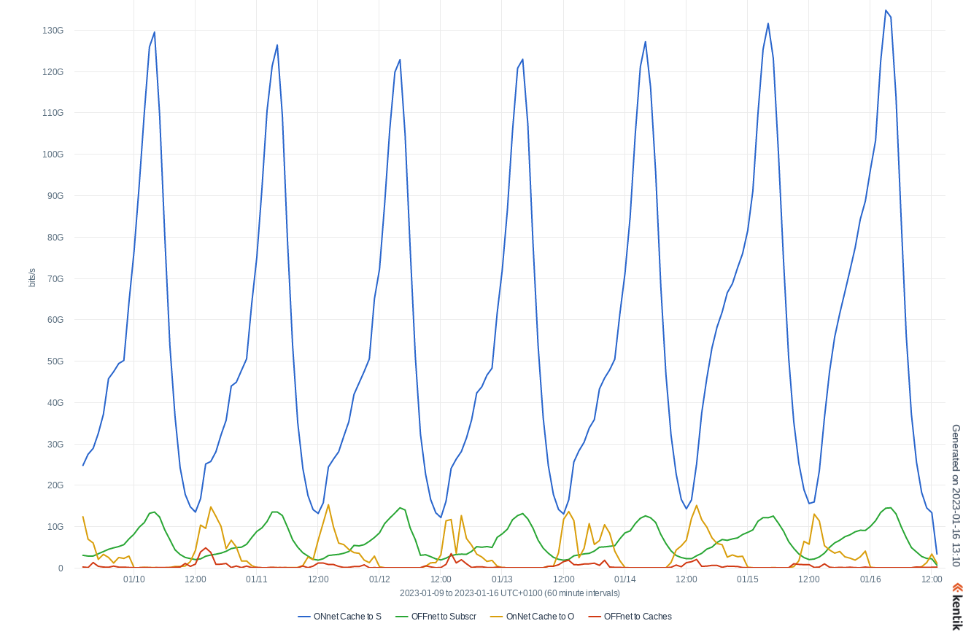
Traffic profiles for different ways of placing content
Centrally calculated placement
Fill window
Optimized to reduce edge fill traffic as much as possible
Typical Netflix traffic profile in well dimensioned deployment

Slide 14
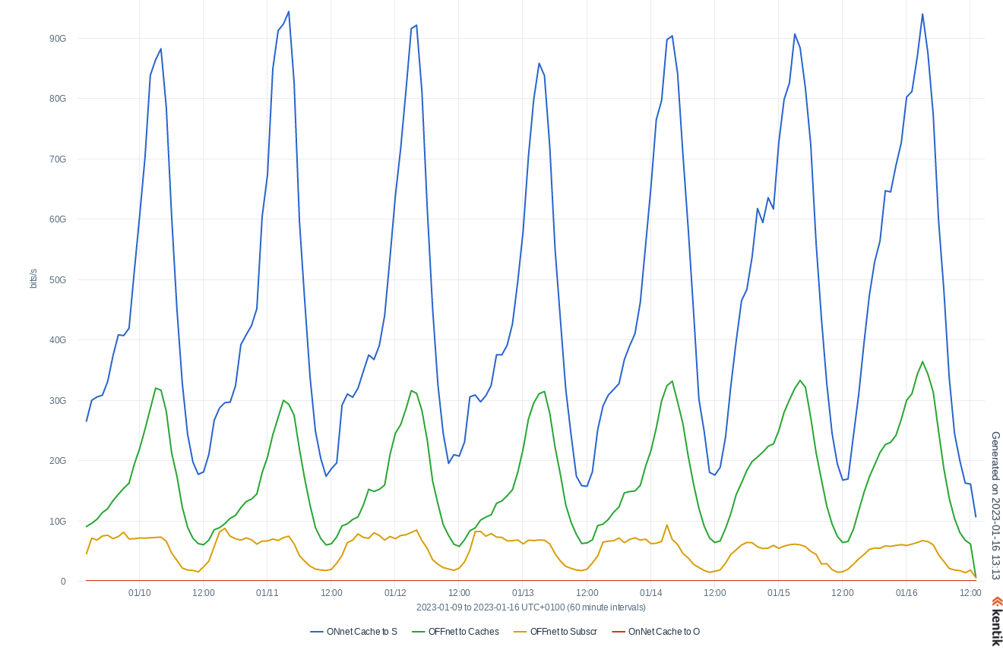
Traffic profiles for different ways of placing content
Proxy and akamai magic
Relatively dynamic content
Not all content will be at the embedded servers
Typical Akamai traffic profile in well dimensioned deployment

Slide 15
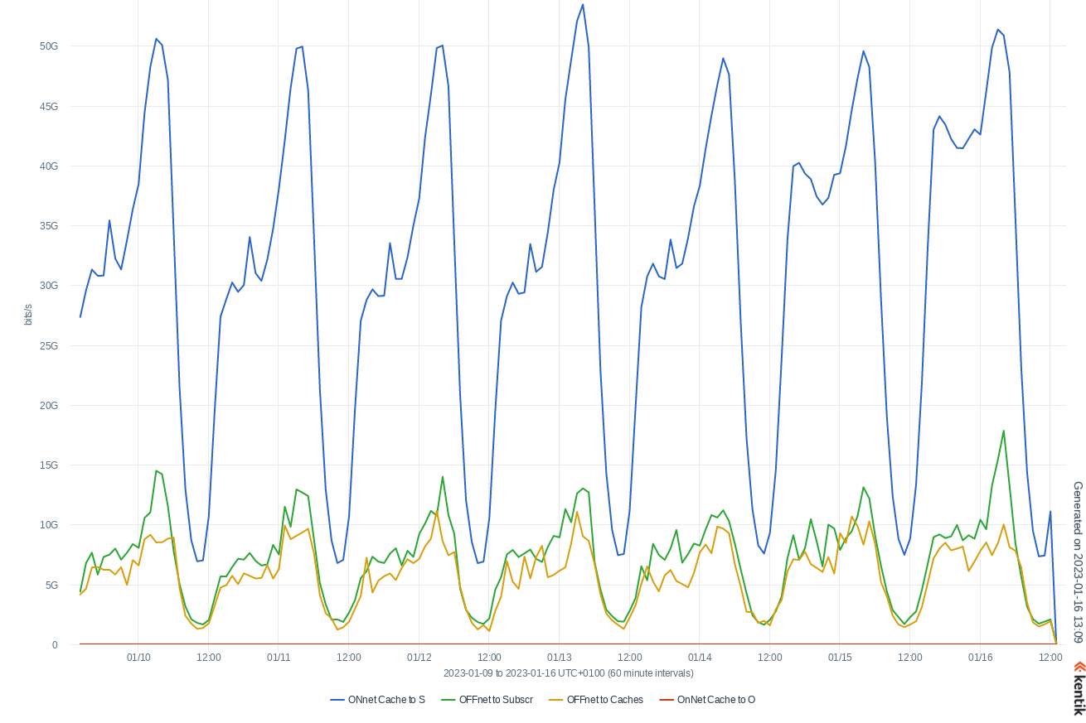
Traffic profiles for different ways of placing content
Proxy and Facebook magic
Relatively dynamic content
Only the static is cached
Not all content will ever be at the embedded servers
Feeds
Likes
Anything that needs to be globally consistent
Typical Facebook traffic profile in well dimensioned deployment

Slide 16
Limit who can use the Servers
Most embedded Servers will have access list that limits who will be served by the cache
The common source to generate these is a BGP feed from the host ISP
Some will use one single feed per ISP, other per cluster or per cache.
There must be consistency between the user-group that can be mapped to a cluster or server and the user-group that are allowed to use the cluster or server.
This means there is a requirement for the CDNs where each server has a BGP sessions that the announcements to each server in a cluster is identical.

Slide 17
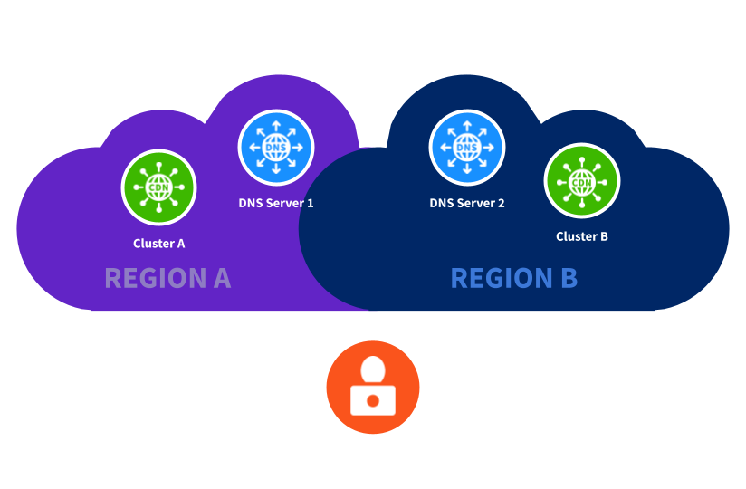
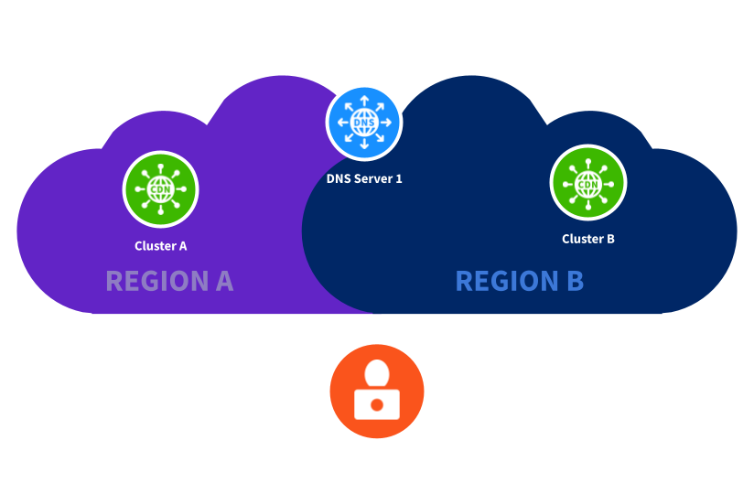
Deploying embedded servers deep into the network
Understand if the end-user mapping is supported by your network implementation
DNS servers
IP address plan
Use of CGN
Be aware of clustering
Off load/hit rate for the local cluster might be lower than for a big cluster because of less disk space in the cluster

Slide 18
And what about the hardware?
Evolves continuously: less space, more throughput, more and faster storage Interfaces supports the industry standard at any given time
1-2U
10G /50G/100G Interfaces
Choice of AC and DC power
It varies whether a CDN managed switch is required optional or not applicable.
Installation process are more/or less automated, but some still require the ISP tech to do basic configuration of the CDN equipment.

Slide 19
CONCLUSION
Is it easier or harder in 2023 compared to 2012?
2012
2023
Large boxes
Off load unpredictable
Few players
No CGN support
Small boxes
More predictable offload
More predictable and flexible end-user mapping
Many players
Some CGN support

Slide 20
What do you experience?

Slide 21
THANK YOU
Nina Bargisen
Peering Person
nina@kentik.com

