Slide 1
How Sweden developed one of the most advanced and secure time distribution networks in the world
Karin Ahl, Technical Product Lead, Netnod

Slide 2
Netnod background
A neutral organisation with more than 25 years working at the core of the Internet
Operates the largest Internet Exchange (IX) in the Nordics
Manages I-root, one of world’s 13 root name DNS servers
Provides DNS services to enterprises and some of the largest Top Level Domains in the world
Develops Time and frequency services with the highest levels of accuracy and security

Slide 3
Netnod: working for the good of the Internet
Netnod is a neutral organisation formed and fully owned by the non-profit Stiftelsen för Telematikens Utveckling (TU-Stiftelsen).
We are focused on contributing to the development of the Internet by:
providing rock solid, best-in-class services at the core of the Internet
ensuring full redundancy and the highest level of service availability
playing a role in standards and governance activities important for Netnod’s services and customers

Slide 4
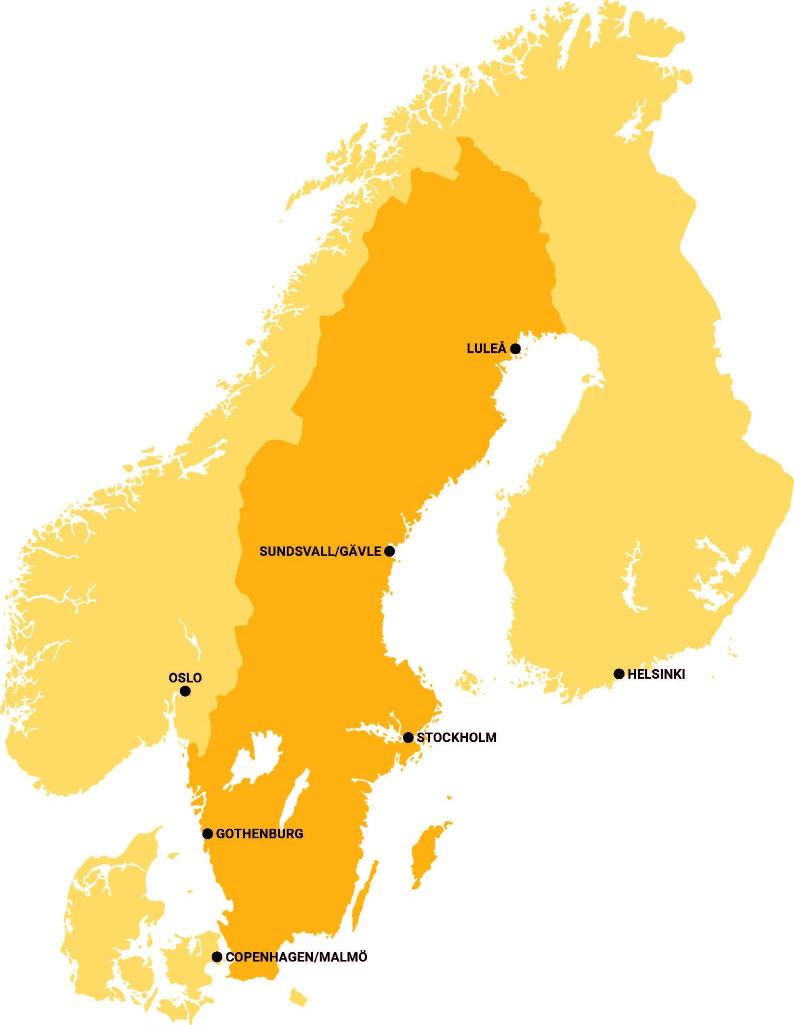
Netnod IX platform
Peak traffic ~2 Tbps
200+ connected ASNs
100% uptime since 2002

Slide 5
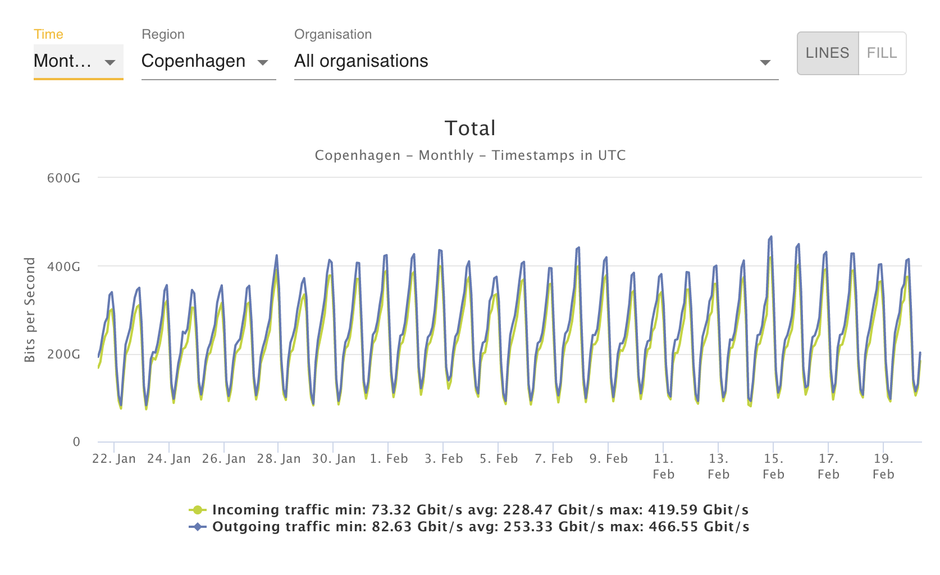
Netnod IX Copenhagen
Fastest growing IX in the Nordics
60+ networks
460+ Gbps peak traffic
Malmö / Copenhagen interconnected with multiple, redundant paths
Now you can also get Netnod Time Direct (guarantees 30µs accuracy from UTC)
Notes:
Netnod IX CPH: established in 2014, and now the biggest IX in CPH

Slide 6
We always know what time it is
Sweden trusts Netnod to distribute national time.

Slide 7
1997
2014
2020
Netnod start an NTP service using Rubidium clocks
Netnod start building national time distribution system on assignment from PTS
Network Time Security (NTS) standard becomes RFC 8915

Slide 8
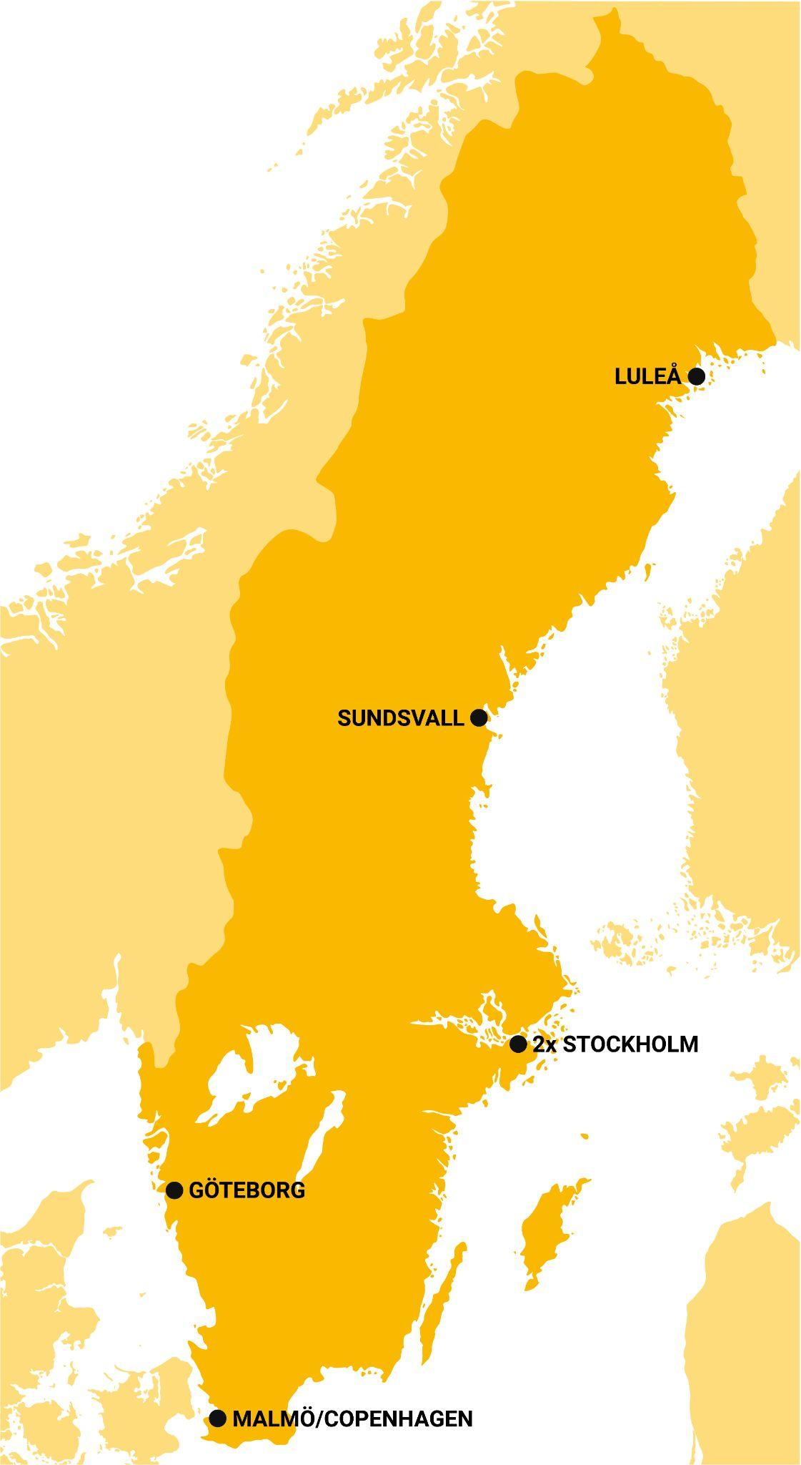
Why a national time distribution system
Citizens and critical community services are dependent on the availability of electronic communications
Electronic communications have a dependency on correct time and frequency
Time and frequency distributed by GNSS can be easily spoofed or interrupted
Given these factors we identified a public need which is not delivered by the market

Slide 9
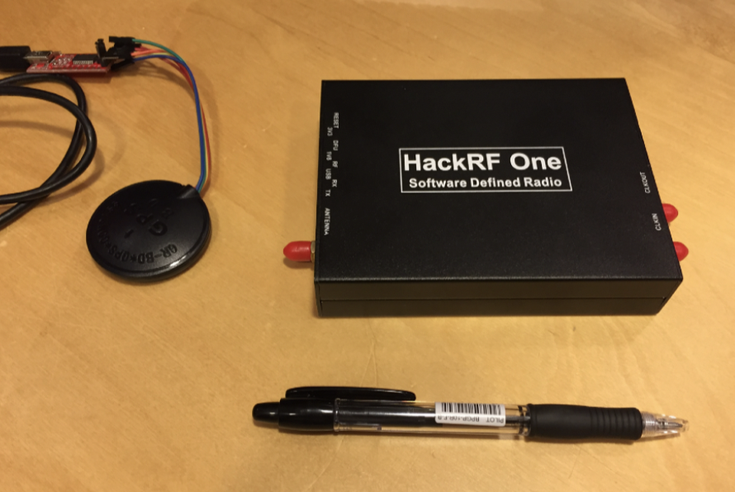
GNSS - good, cheap but easily compromised GPS - GLONASS - Galileo - BeiDou
Common even in critical infrastructure
Easy to disrupt with cheap equipment (jamming)
Easy to “fake the time” (spoofing)
Not available all the time
Signal interference
Outdated equipment and infrastructure problems
Sabotage - “not peacetime”
€10 GNSS receiver
€250 software based radio that can be used to manipulate the receiver

Slide 10
A national time distribution system
A system without GNSS dependency which, from a national perspective, can guarantee robust and secure time
The system must be robust and available throughout the country
The services delivered from the system must be affordable for operators of networks so that the price is not a barrier for use of the services
The government must have visibility and direct input regarding the infrastructure, which means it must be located in, and operated from, Sweden
Notes:
Last bullet = This is a general requirement for the sector Electronic Communication in Sweden

Slide 11
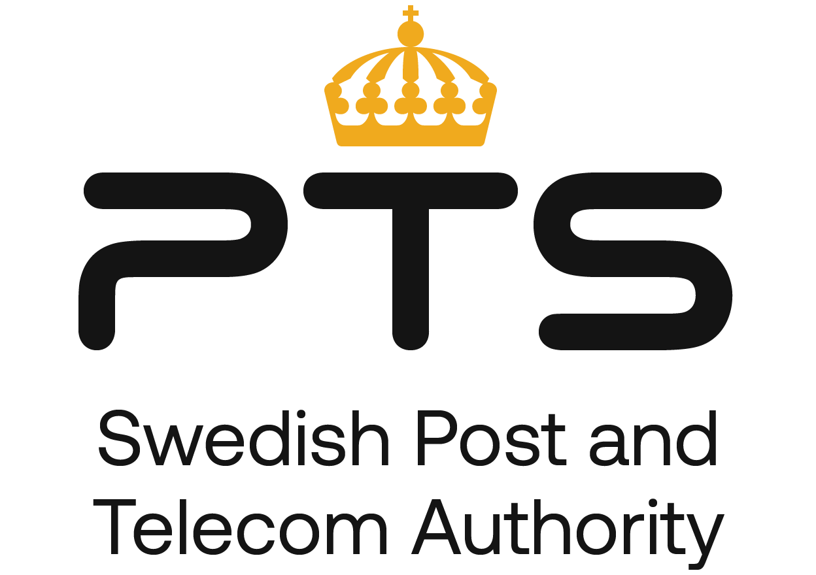
Robust funding
Money
Telecom
Operator
1ppm of the turnover
Swedish government
Fund for robust infrastructure
We need
Robust Network
Redundancy
2nd Power
Sync/time
You need

Slide 12
Funding of extraordinary initiatives
The SGEI regulation (Service of General Economic Interest) is an EU decision which can be an alternative to procurement
Utilizing SGEI gives PTS and Netnod the opportunity to work in a more long term context
ISPs in Sweden need redundant and robust time infrastructure as a complement to GNSS to be able to provide electronic communication. This is why PTS stepped in and initiated this initiative.
State sponsored through what is termed “Robust funding”, which PTS can use to secure critical infrastructure such as time and other infrastructure initiatives.
For example:
Extra cost for establishment of robust fibre as compared to what market is prepared to pay
Subsidy for for batteries and generators

Slide 13
How did Netnod and PTS make it happen?
Success factors:
Transparent cooperation between Netnod and PTS
Dynamic requirements: in order to succeed a very close cooperation is needed between the parties
A long term approach to ensure stability in maintenance and development of the service
Dedicated resources working with the services so that stability and predictability is ensured
The services delivered from the system must be affordable for network operators so that the price is not a barrier for use and implementation

Slide 14
Netnod’s quality parameters and time activities include:
PRTC to operators (30 ns during normal operating conditions, 100 ns in holdover mode during a 14 day period)
Time and sync to the energy sector (100 ns)
Precision Time Protocol (PTP) service Time is delivered over a dedicated fibre so that an accuracy at the level of nanoseconds can be achieved.
Network Time Protocol (NTP) and Network Time Security (NTS) Time is delivered over the Internet, which is a simple and effective way to set your local time. Connect for free to NTP servers around the world. For more security, you can also use NTS.

Slide 15
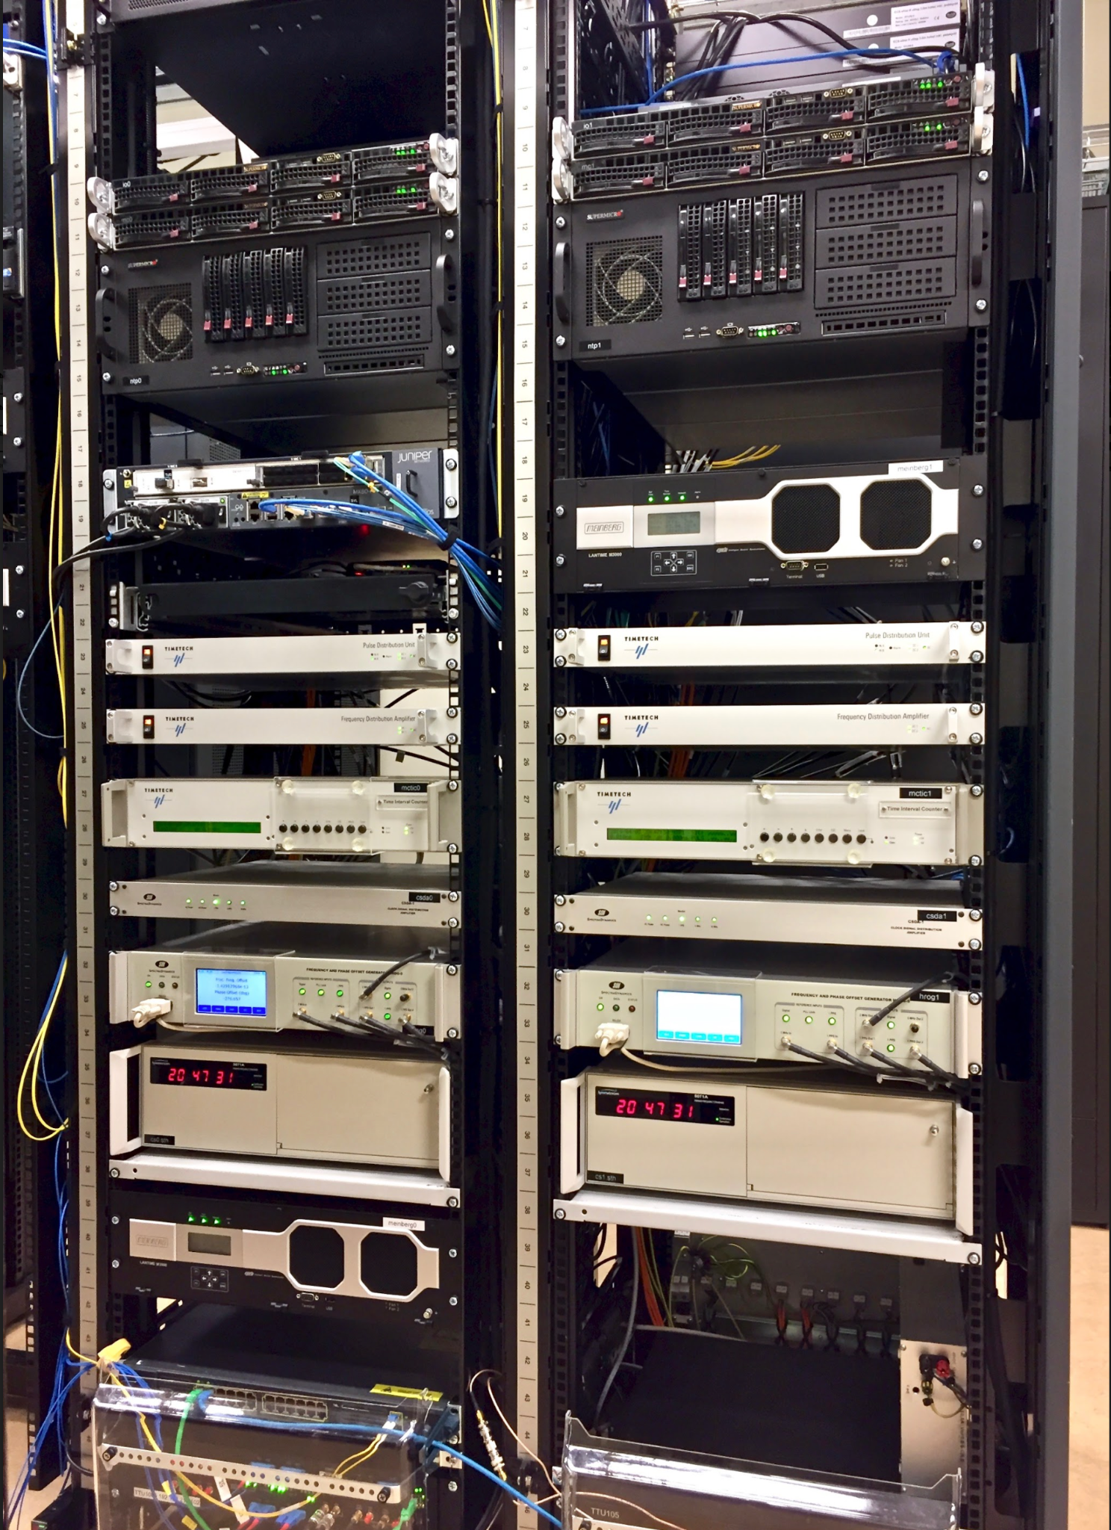
Netnod’s clock nodes - accurate and secure time
Dual nodes with all critical equipment duplicated for redundancy (2x caesium clocks)
Dedicated battery backup for all time components
NTP/NTS servers use a custom-built FPGA-based hardware implementation

Slide 16
Swedish distributed time service
Operated by Netnod, monitored by RISE and financed by PTS
6 time nodes placed in secure bunkers throughout Sweden (Stratum-1 time servers)
Time traceable to UTC
Free and commercial service with SLA

Slide 17
NTP service
NTS service
Connect for free to one of the most advanced and secure NTP services available which also includes…
Connect for free to ensure you are receiving secure and accurate time from a trusted source

Slide 18
Netnod PTP
Netnod Time Direct
Netnod Time Remote
Ensure your network nanosecond level accuracy with the most robust, reliable and accurate source of time available without running your own atomic clock.
Get the most accurate and reliable time available over an IX port with a fully-managed, secure time service that guarantees 30µs accuracy from UTC.
Get accurate and reliable time securely delivered wherever you are located in Sweden with a guaranteed accuracy of 1ms from UTC.

Slide 19
Netnod Time Direct - time-as-a-service
A fully managed time service with SLA that guarantees 30µs accuracy from UTC
Delivered over cross-connect or IX port
Immediate provisioning and easy integration with current setup

Slide 20
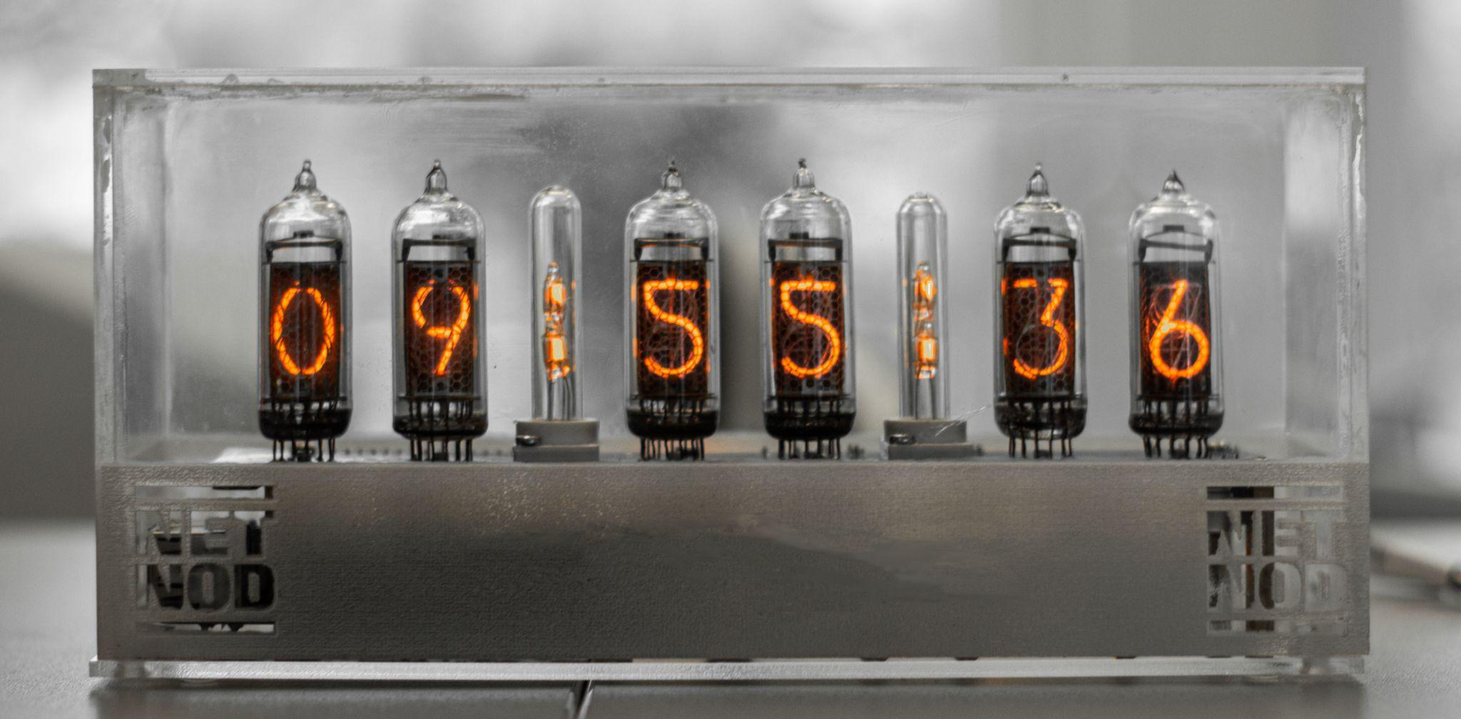
nts.netnod.se

Slide 21
Benefits of NTS
Network Time Protocol (NTP) services are vulnerable to a range of attacks including:
packet manipulation
replay attacks
amplification attacks
spoofing
Inaccurate or tampered time = disaster!
Notes:
With many of today’s most important security processes dependent on accurate time, the consequences of receiving time from a malicious source are serious. By using Network Time Security (NTS), you can be sure your devices are receiving accurate time from a reliable source

Slide 22
NTS sites
Six nodes throughout Sweden with Stratum-1 NTS servers
Luleå
Sundsvall
Stockholm x2
Göteborg
Malmö/Copenhagen

Slide 23
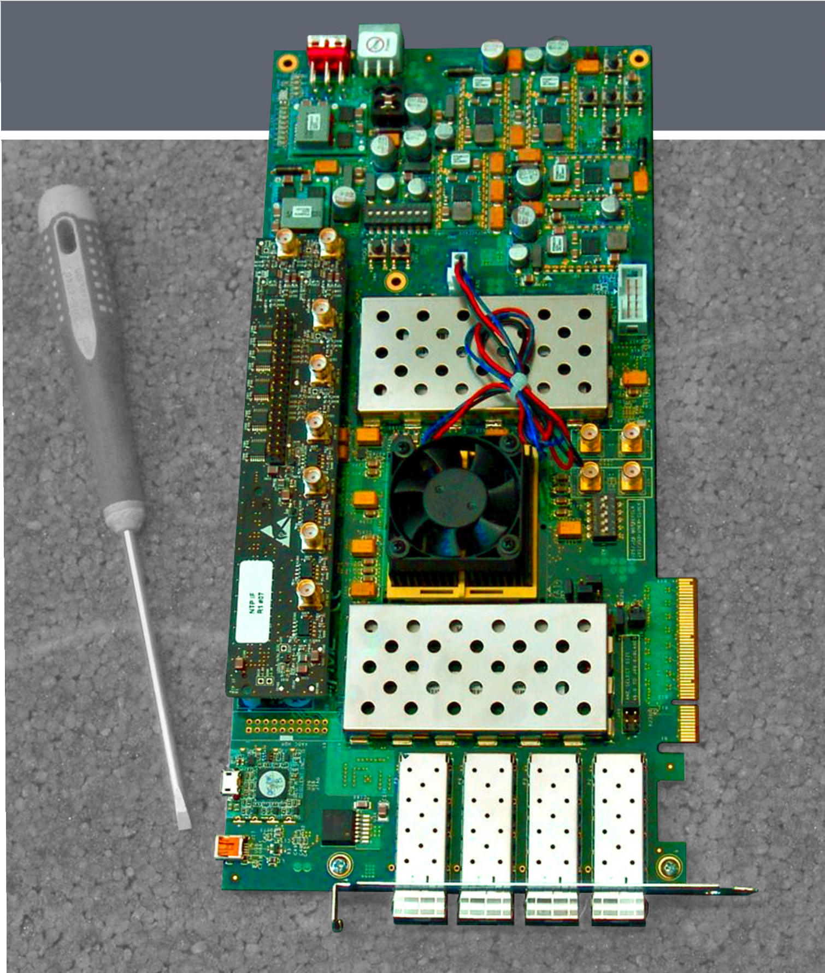
Hardware NTP server in FPGA
Public Internet service
4 x 10 Gb/s full wire speed
IPv4 and IPv6
Secure - NTP traffic stays in the FPGA
Standard FPGA board, with custom interface for time input and output (1 PPS & 10 MHz)
Open source FPGA code

Slide 24
Hardware NTP with NTS server in FPGA
NTP with Network Time Security
RFC 8915
Public Internet service
Our implementation runs in a commercial vendor’s box (white box), many other variants possible
Open source FPGA code

Slide 25
How to connect to NTS
Most LINUX distributions allow you to run Chrony or NTPsec which supports NTS
Install Chrony/NTPsec or similar as NTP client
Configure NTS [point at Netnod’s NTS servers]
Verify
Full how to available here: https://www.netnod.se/netnod-time/how-to-use-nts

Slide 26
Why get time from a trusted source?
Avoid a range of problems like:
authentication problems, attacks and issues with authentication security measures
issues with cryptographic signatures and establishing encrypted sessions such as Transport Layer Security (TLS)
DNS Security (DNSSEC) failing to work if the client doesn’t have accurate time
incorrect timestamps on logs and transactions

Slide 27
National distribution of Swedish time
Sweden has one of the most advanced and secure national time distribution infrastructures in the world
An excellent example of public/private cooperation
Main players: Netnod, PTS and RISE
Benefit: Organisations can ensure they are getting accurate and secure time for free from time servers that ensure low latency and full redundancy. Sectors such as telco, energy and finance can use commercial time service with an SLA guaranteeing the highest level of accuracy on market.

Slide 28
Conclusions
Even if we at Netnod started our first baby steps with NTP back in 1997, establishing Time and Frequency takes time!
Establishing a national distribution network for T & F demands both heavy investments and sharp brains.
Private public partnership and cooperation is a huge success factor.
The customer doesn’t always know what they need.
Listen to different needs in different sectors and you will find your solution.

Slide 29
References
NTS white papers
How does NTS work and why is it important?
How we developed the world’s first hardware implementation of Network Time Security
NTS proposed standard (RFC8915)
Best practice for connecting to NTP servers
How to set up an NTS client
List of Netnod time services
Notes:
Johanna att uppdatera bild så lättare att läsa!

Slide 30
Thanks for
listening!
Visit us at: netnod.se

