Slide 1
Welcome!
IRC channel: #DKNOG
Server: irc.oftc.net
https://slack.dknog.dk/
https://dknog.dk/about/irc-channel-guidelines/
Join the fun.

Slide 2
Fourteen years of DKNOG

Slide 3
More than half of us are here for the first or second time
Don’t feel intimidated
Yes, there are some really smart people here
Learn from them
Go ahead and ask your question.
The person next to you, will likely be grateful

Slide 4
Don’t feel intimidated
Yes, there are some really smart people here
Learn from them
Go ahead and ask your question.
The person next to you, will likely be grateful

Slide 5
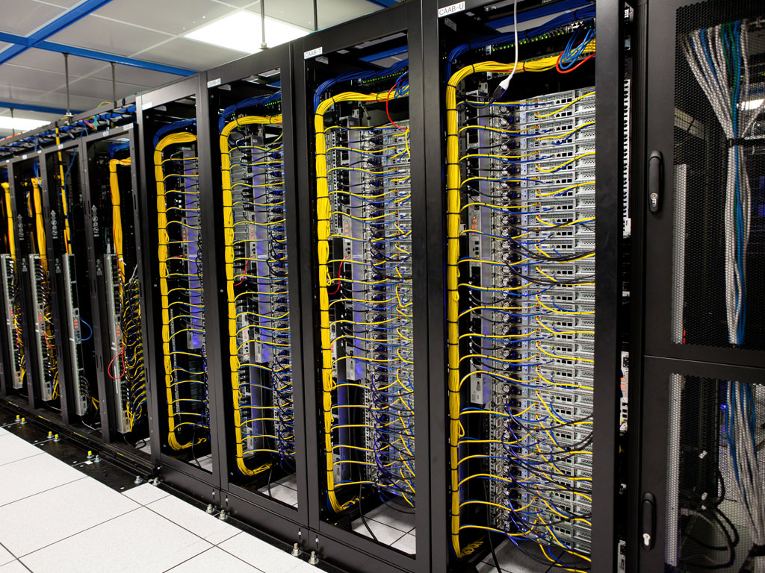
Two purposes of DKNOG
Networking!
Networking!
Notes:
Let’s hear it for the programme committee!
The rest is up to you!

Slide 6
A challenge for you
Breaking Cliques at Events
The Snowball Rule
For every year you have attended the event, you should try to meet that many new people each day.
Courtesy of https://www.ericholscher.com/

Slide 7
Including new-comers
The Pac-Man Rule
When standing as a group of people, always leave room for 1 person to join your group
stand like Pac-Man!
Also courtesy of https://www.ericholscher.com/

Slide 8
IRC channel: #DKNOG
Server: irc.oftc.net
https://slack.dknog.dk/
https://dknog.dk/about/irc-channel-guidelines/
Join the fun.

Slide 9
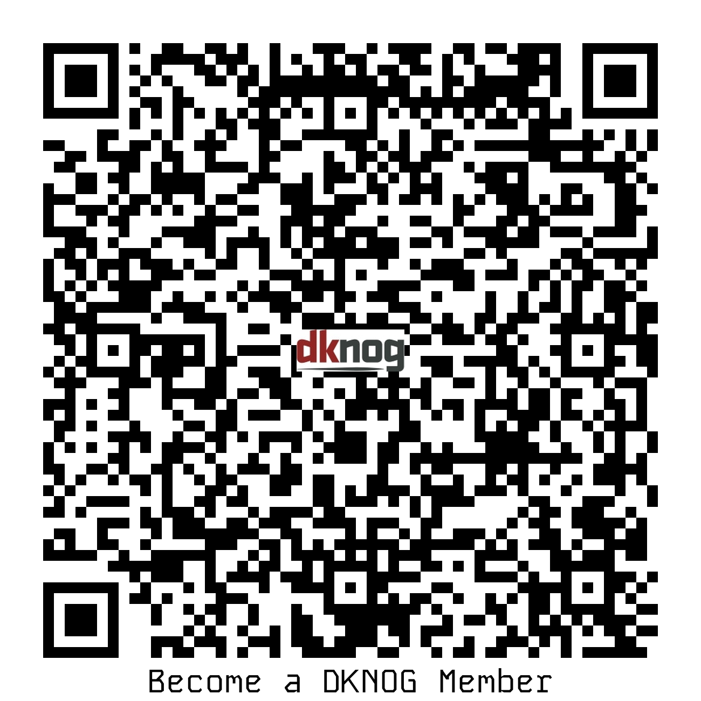
DKNOG membership
An association needs members
Your DKNOG ticket covers the membership fee
Memberships are valid from now until 2025
General meeting
Thursday 23 May 2024, 18:00
Online or in-person
https://events.dknog.dk/event/27/

Slide 10
IRC channel: #DKNOG
Server: irc.oftc.net
https://slack.dknog.dk/
https://dknog.dk/about/irc-channel-guidelines/
Join the fun.

Slide 11
Sponsors
Platinum

Slide 12
Sponsors
Gold

Slide 13
Sponsors
Silver

Slide 14
Sponsors
Associate

Slide 15
IRC channel: #DKNOG
Server: irc.oftc.net
https://slack.dknog.dk/
https://dknog.dk/about/irc-channel-guidelines/
Join the fun.

