Slide 1
IRC channel: #DKNOG
Server: irc.oftc.net
https://slack.dknog.dk/
https://dknog.dk/about/irc-channel-guidelines/
Join the fun.

Slide 2
Sponsors
Platinum

Slide 3
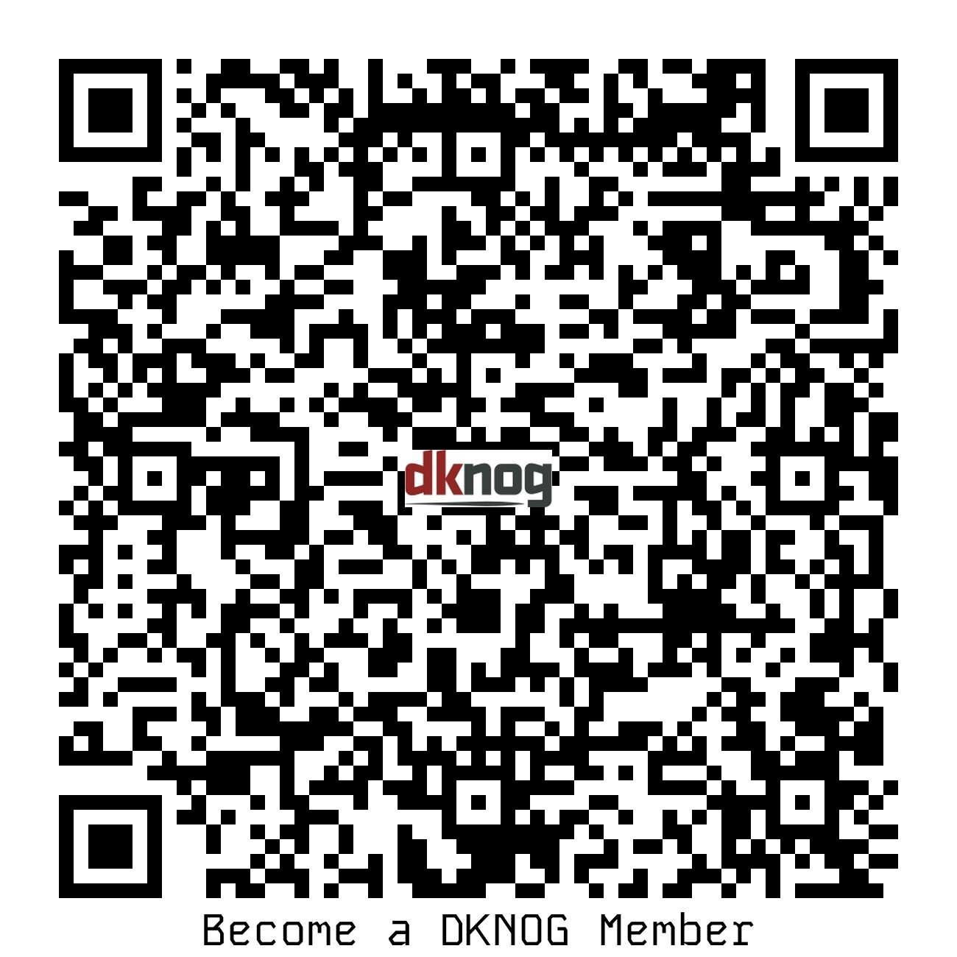
Become a member of DKNOG

Slide 4
Sponsors
Gold

Slide 5
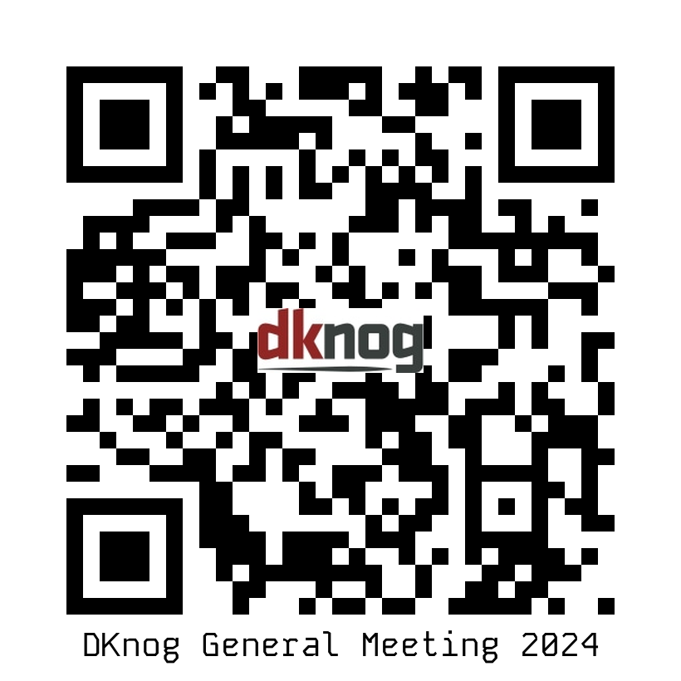
DKNOG General Meeting
Thursday 23 May 2024, 18:00 → 20:00
Online or in-person
https://events.dknog.dk/event/27/

Slide 6
Sponsors
Silver

Slide 7
IRC channel: #DKNOG
Server: irc.oftc.net
https://slack.dknog.dk/
https://dknog.dk/about/irc-channel-guidelines/
Join the fun.

Slide 8
Sponsors
Associate

