Slide 1
Fighting DDoS at the Source
Nina Bargisen

Slide 2
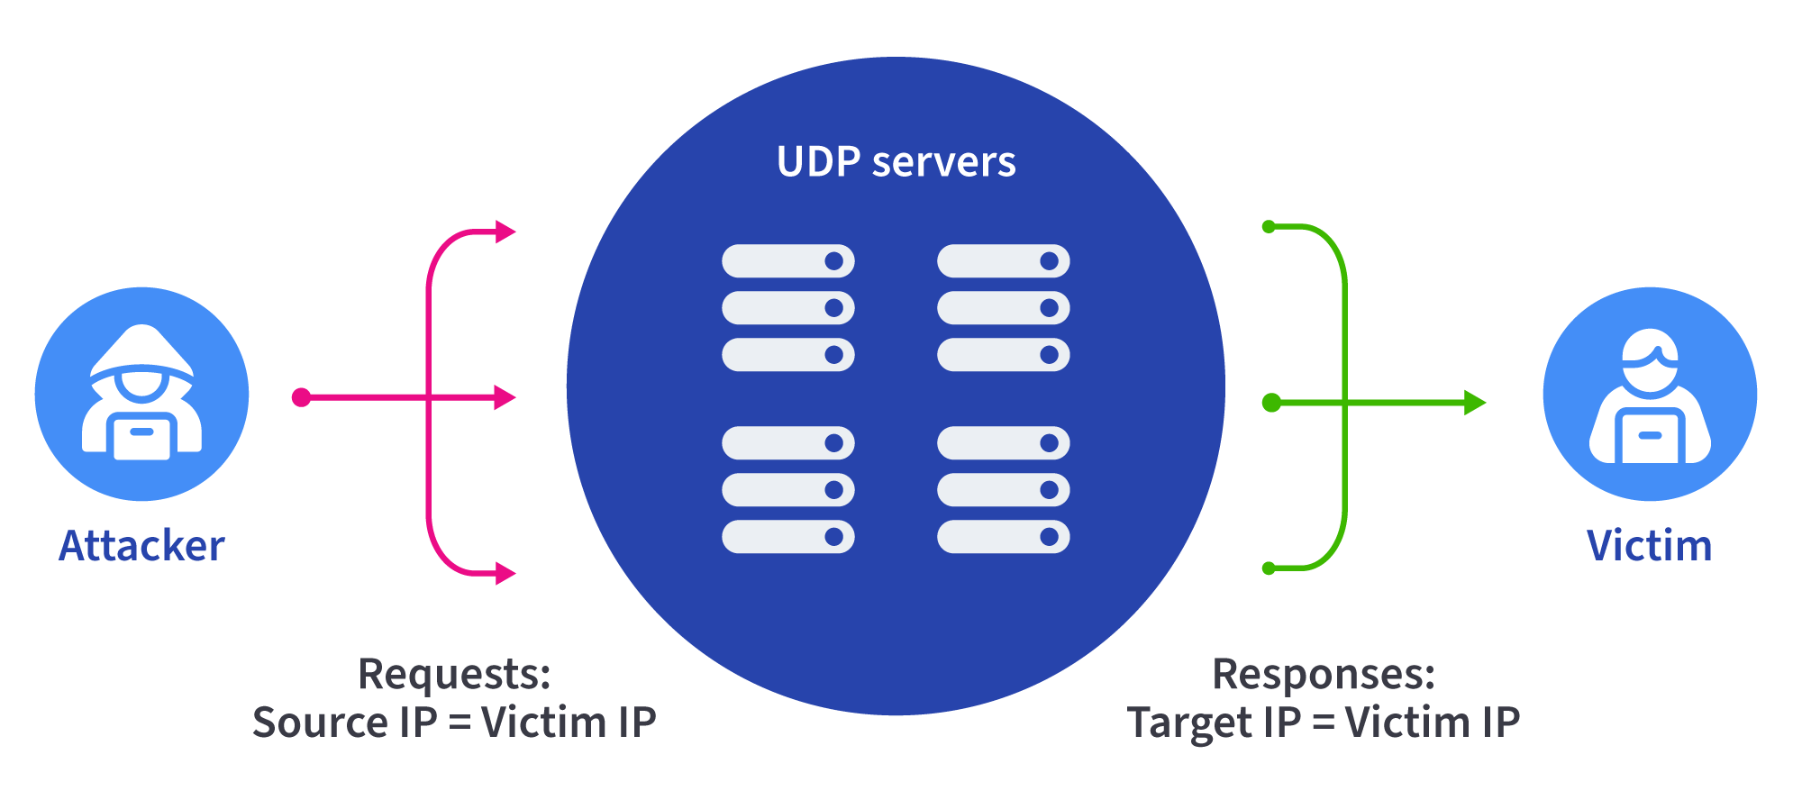
Fighting DDoS at the Source
Distributed denial of service (DDoS) attacks continue to plague the Internet.
One of the most common forms of DDoS attack is the reflection attack.
Reflection attack

Slide 3
We can stop these if we work together

Slide 4
Reflection attacks
The attacker sends thousands of requests with “spoofed” source IP addresses.
The requests are sent to DNS, NTP etc servers who replies
The target address is flooded with the replies
The service becomes degraded or unavailable
Reflection attack

Slide 5
Reflection attacks
One of the largest reflection attacks was targeted Google Cloud in 2017
The attack originated in 4 chinese networks ((ASNs 4134, 4837, 58453, and 9394)
The attackers used the networks to spoof 167 Mpps (millions of packets per second) to 180,000 exposed CLDAP, DNS, and SMTP servers
The attack peaked at 2.54 Tbps
Reflection attack
Source: https://www.zdnet.com/article/google-says-it-mitigated-a-2-54-tbps-ddos-attack-in-2017-largest-known-to-date/

Slide 6
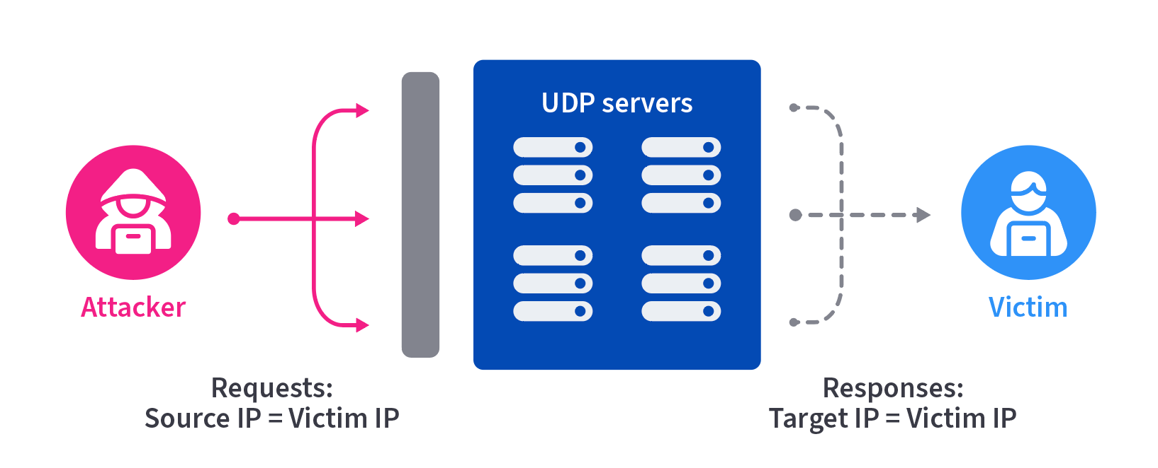
Addressing the problem
Secure internet devices from responding to UDP queries from the Internet
Eliminate spoofed traffic via technical means (BCP38)
Identify and engage networks originating spoofed traffic

Slide 7
BCP 38 & 84
Source IP verification
Checks source IPs of packets against permitted addresses.
Implementation varies by network type:
Access Network: At the point of interconnection with a single customer
Enterprise Network: At the edge routers connected to neighbors.
Transit Provider: At the provider-edge router connected to customers.
Methods of Implementation
Strict Reverse Path Forwarding (sRPF):
Drops packets arriving on incorrect interface.
Requires symmetric routing
Feasible Reverse Path Forwarding (fRPF):
Considers all paths to the source address.
Risk of blackholing
Ingress Access Control Lists (ACLs)
Requires manual maintenance.
Considered bulletproof if maintained properly.
Best fit for non-dynamic configurations and few used prefixes.

Slide 8
Using NetFlow to traceback DDoS sources
A backbone provider uses a customized workflow to identify customer networks which are sending traffic in violation of BCP38.
Methodology boils down to two steps:
1
2
Find spikes of packets from customer networks to a large set of unique destination IP addresses using commonly abused UDP ports.
For any suspicious spikes in packets to those selected UDP ports, investigate the source IPs of these packets coming from that customer.

Slide 9
Using NetFlow to traceback DDoS sources
1
Run a query that captures the following:
Only traffic from an external source
Only packets directed to commonly abused reflection ports.*
Set metrics to
Packets/sec (not bps)
Unique number of destination IPs
Group by customer and device
* 19, 53, 123, 161, 389, 427, 1900, 3283, 3702, 10001, 10074, 11211, 37810, 32414

Slide 10
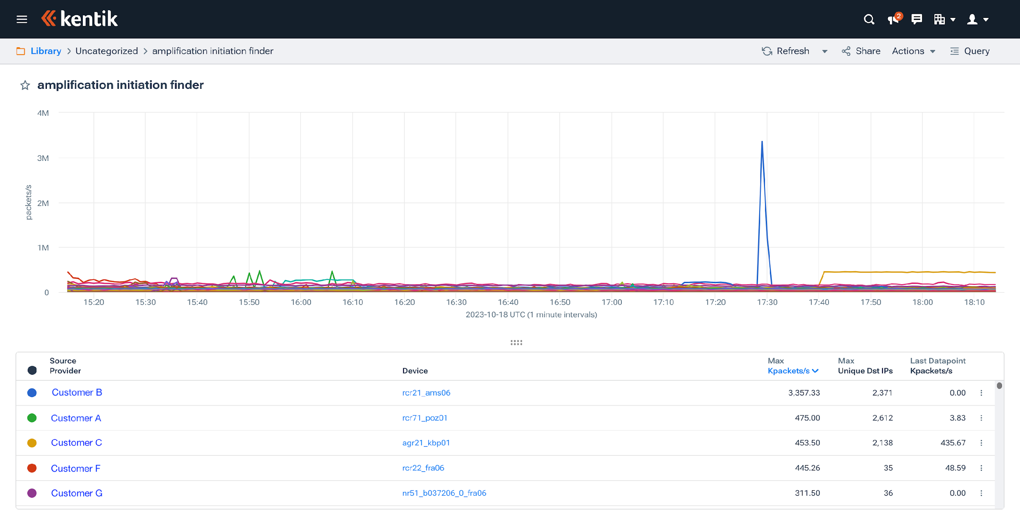
Using NetFlow to traceback DDoS sources
1
Customer B is sending a large number of packets to a large number of unique destination IPs.
Strong evidence of a reflection attack.

Slide 11
Using NetFlow to traceback DDoS sources
2
Now we want to investigate the source IPs of these packets coming from that customer by running a query that captures the following:
Only packets to abused UDP ports from the customer interface.
Group by destination IP/ASN
Group by source port
Still set metrics to
Packets/sec (not bps)
Unique number of destination IPs

Slide 12
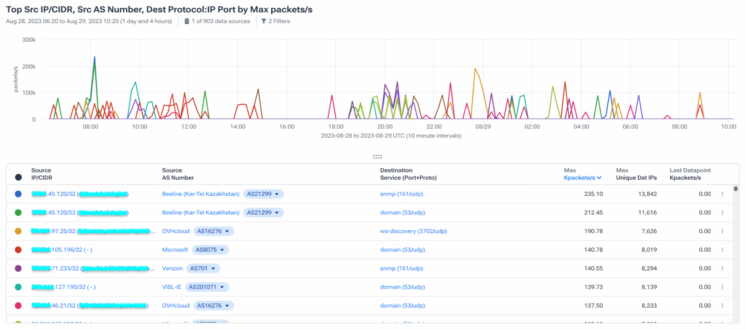
Using NetFlow to traceback DDoS sources
2
Question to ask yourself:
Do these source IP/ASNs make sense for this customer port in this location?

Slide 13
Check the downstreams of the customer
Use your favorite tool or looking glass

Slide 14
Now the fun begins — contacting customers!
Service providers could simply refer the traffic to the abuse team to take action (e.g. disconnect).
Customer would just continue activity with another provider.
A service provider’s objective should be to get the customer’s netops team to understand the issue and address it.
A very time-consuming process:
Language barriers
Network engineers who are either overworked or poorly trained
Unfortunately, networking teams who are simply uninterested in fixing the problem
Other reasons…

Slide 15
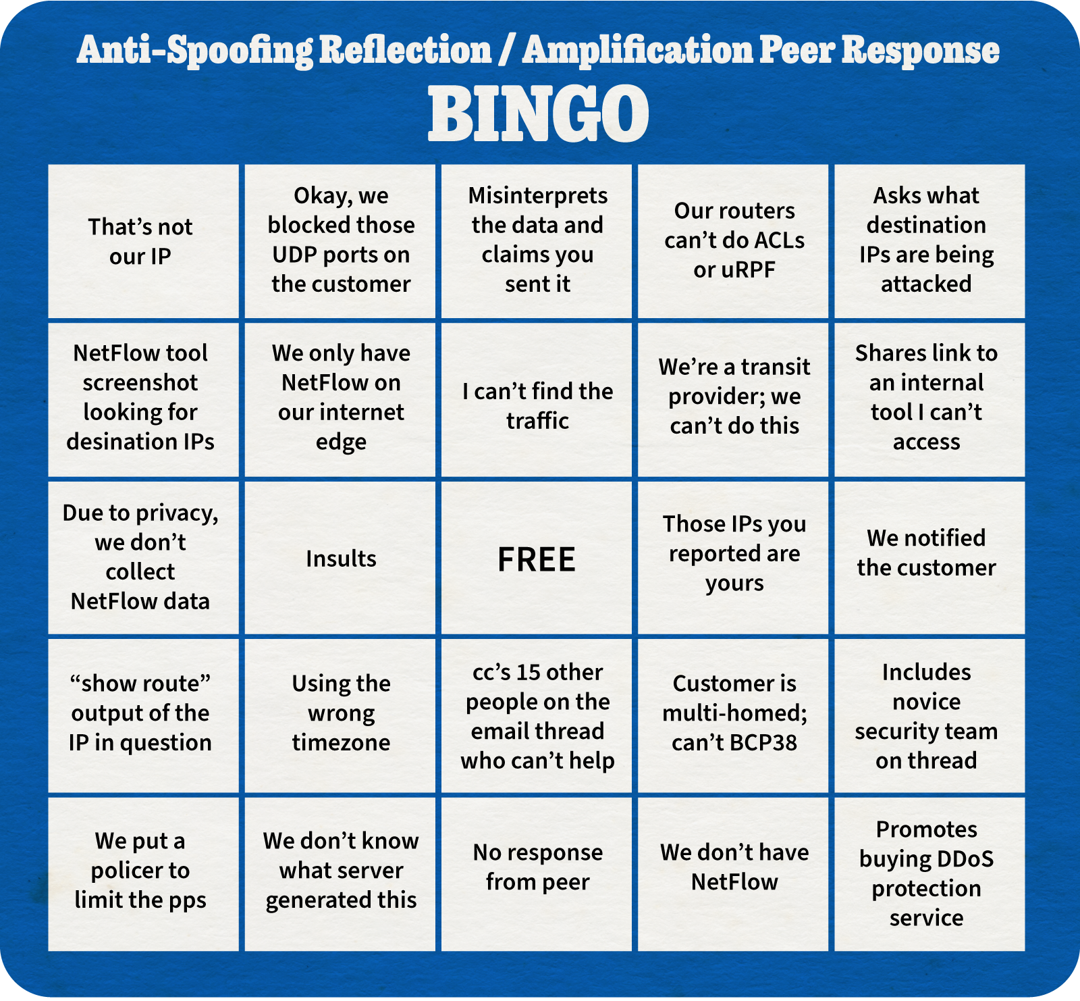
Source: a certain cat at a cloud provider

Slide 16
Call to action
If your network is allowing spoofed traffic, someone is probably using your infrastructure to launch DDoS attacks against victims around the world.
If you run a network that operates as a service provider, you have a responsibility to the rest of the Internet to actively look for and eliminate spoofed traffic.
If contacted, you need tools in place to investigate and address the claims
Don’t want to be the one to complete someone’s anti-spoofing response bingo card.

Slide 17
Thank you!
Your name
nina@kentik.com
@nissen333
in/ninabargisen
Join Kentik on Slack

Slide 18
Identifying spoofed traffic with pmacct
Label flows coming in from customer networks, using an external inventory (pre_tag_map)
Define ports of interest in a list of ports (ports_file)
Aggregate flows as < label, src_host, dst_host, dst_port >
Perform the equivalent of a "SELECT label, ip_src, COUNT(ip_dst),COUNT(port_dst), SUM(packets) FROM <table> WHERE stamp_inserted = <timeframe of interest> GROUP BY label, ip_src;" on the output data
Points a, b and c refer to pmacct configuration files (examples below)
For additional questions, contact Paolo Lucente <paolo@pmacct.net>
== nfacctd.conf == ! < .. snip snip .. > ! pre_tag_map: /path/to/pre_tag.map ! plugins: kafka[ddos] ! pre_tag_label_filter[ddos]: customer_X, customer_Y, customer_Z aggregate[ddos]: label, src_host, dst_host, dst_port ports_file[ddos]: /path/to/ports.lst ! ! < .. snip snip .. >
== pre_tag.map == ! Label customers basing on <ip, in> ingress interface (ie. 1) of a given router (ie. 10.0.0.1) set_label=customer_X ip=10.0.0.1 in=1 set_label=customer_Y ip=10.0.0.1 in=2 set_label=customer_Z ip=10.0.0.2 in=1 set_label=customer_Z ip=10.0.0.2 in=2
== ports.lst ==
53
161
< .. other relevant ports .. >

