Slide 1
Issues and Impacts in BGP Peering Configurations
DKNOG14 - 2024.03
Bernd Spiess

Slide 2
44 internet
exchanges
115+ Tbit capacity
500+ data centers
3,000+ connected networks
About us:
Asia Pacific (x9)
Brunei, Chennai, Delhi, Kuala Lumpur, Kolkata, Johor Bahru, Manila, Mumbai, Singapore
North America (x5)
Chicago, Dallas, New York, Phoenix, Richmond
EMEA (x30)
Aqaba, Athens, Baghdad, Barcelona, Berlin, Bucharest, Copenhagen, Dubai, Dusseldorf, Esbjerg, Frankfurt, Hamburg, Helsinki, Istanbul, Kinshasa, Kristiansand, Lagos, Leipzig, Lisbon, Madrid, Marseille, Munich, Oslo, Palermo, Prague, Ruhr region, Tripoli, Warsaw

Slide 3
1. Full Ports
Cases:
Repeated – easy to see
Single happening – challenging (?)
Ultra short peaks (not shown) – nasty …
Problems:
End-Customers annoyed – mistrust – service ceases
Throughput problems – depeering – loss of revenue with End-Customers

Slide 4
2. Packet Drops
How to detect these at your side?
How to detect these at the other interface side?
How to alert these?
Problems:
End-Customers annoyed – mistrust – service ceases
Throughput problems – depeering – loss of revenue with End-Customers

Slide 5
3. Prefix Amount Unbalanced by Design or Mistake?
Example:
Problems:
Loss of Revenue with End-Customers
missed opportunities for better End-Customer satisfaction etc…
Ok in Frankfurt:
But ca. 70% of these are missing in NYC!

Slide 6
4. Partial or Reduced Advertisements
Example: Customer in Frankfurt:
Loss of Revenue with End-Customers
missed opportunities for better End-Customer satisfaction etc…

Slide 7
5. Forgetting Prefixes Add and Import at Routeserver
Loss of Revenue with End-Customers
missed opportunities for better End-Customer satisfaction etc…

Slide 8
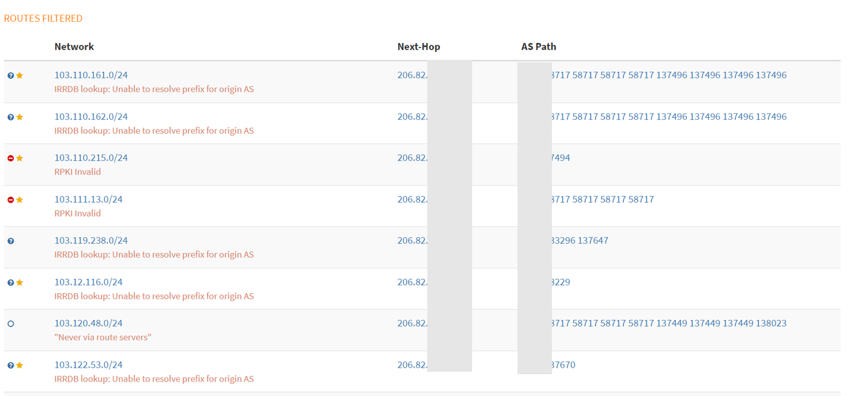
6. IRR/RPKI Blockings
Problems:
Loss of Revenue with End-Customers
missed opportunities for better End-Customer satisfaction etc…

Slide 9
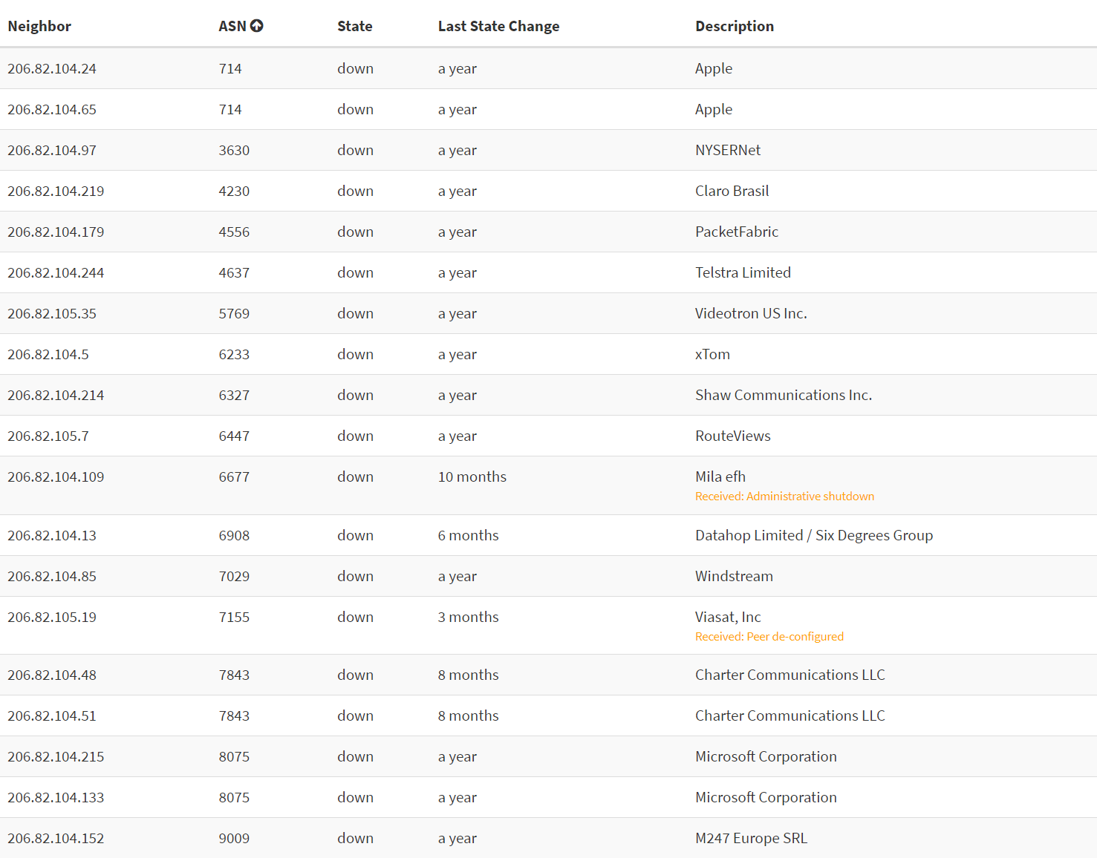
7. No Routeserver Session
Ok:
No routeserver by design
Problems:
No routeserver by forgotten
No routeserver by not having time
No routeserver by not having known
No routeserver by not knowing how
…

Slide 10
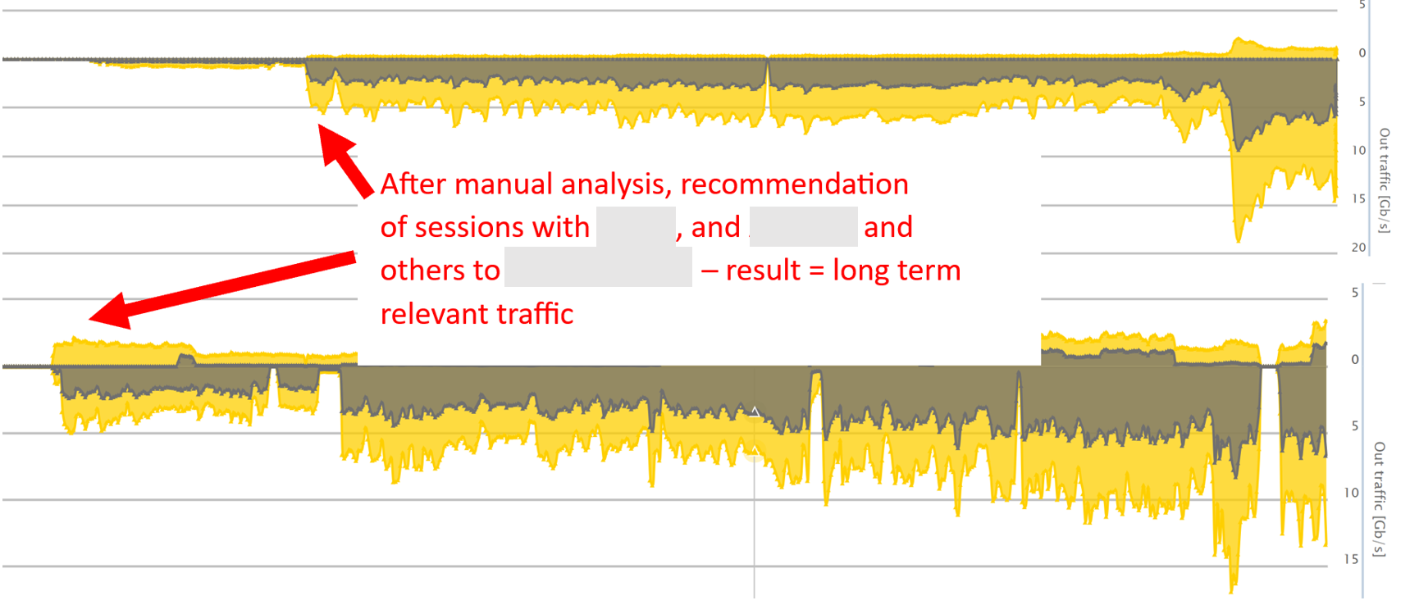
8. Not configured major sessions.
ASNs not using the routeserver
= ASK FOR SESSION NEEDED
No session = No nice/better peering traffic
Problems:
Loss of Revenue with End-Customers
missed opportunities for better End-Customer satisfaction etc…

Slide 11
9. Peering downturns
Interventions/Changes with forgotten checks/follow-ups
Problems:
Loss of Revenue with End-Customers
missed opportunities for better End-Customer satisfaction etc…

Slide 12
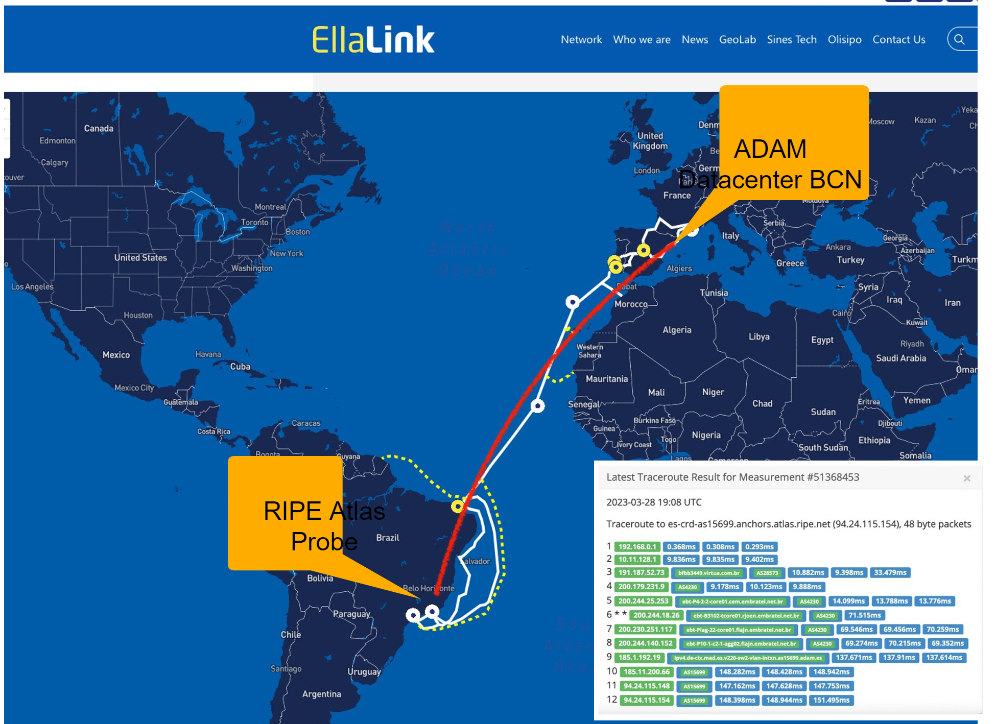
10. Opportunity: Measure Results
Have RTT/… measures in place
Measure improvements on peering/transit before and after
Support Measurement Platforms like e.g.: RIPE Atlas by running probes in your networks!

Slide 13
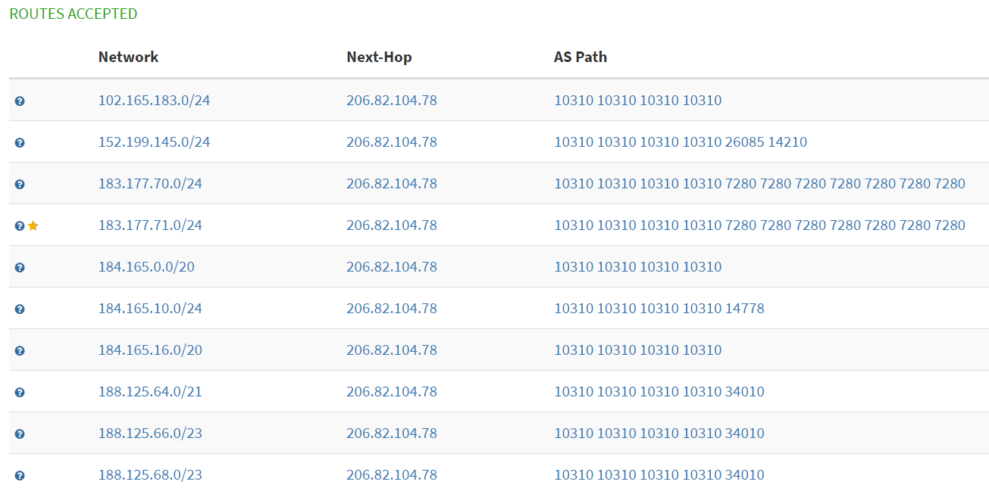
11. Prepends/Med/BGP-Community
Have an eye on the looking glasses:
Do you really want to send prepends?
Do you really want to send med > 0?
Do you really want to send hindering BGP communities? (0:6695 ?)
Problems:
Loss of Revenue with End-Customers
missed opportunities for better End-Customer satisfaction etc…

Slide 14
12. Wild Mix of Supernets, Multi-More-Specifics
Problems:
Does anyone know what you want with sending /22 + same /23 + /24 partially different everywhere?
Expect others to give up and do some random decisions
Credit: Jegi at flickr: https://www.flickr.com/photos/92501682@N00/5067471752

Slide 15
Thank you for your attention! Questions: bernd.spiess@de-cix.net
DE-CIX Management GmbH, Lindleystr. 12, 60314 Frankfurt, Germany
Phone + 49 69 1730 902 0, sales@de-cix.net, www.de-cix.net

