Slide 1

Software defined Networking in Disaggregated Open Optical Networks
March 8, 2024

Slide 2

Agenda
Open & Disaggregated Optical Solutions
  Definition of Open & Disaggregated Optical Solutions
  Why is this a strong trend?
  Challenges
  Industry Initiatives for disaggregation
Software defined Networking (SDN)
  Full Disaggregation
  Partial Disaggregation – Single Domain
  Partial Disaggregation – Multi Domain
  Commercial Use Cases
  Way Forward

Slide 3

Open & Disaggregated Optical Solutions

Slide 4
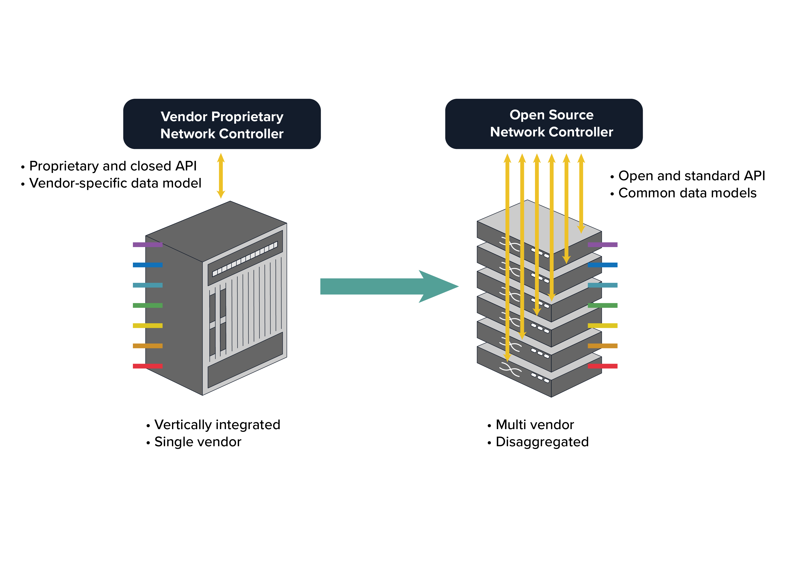
Definition of Open & Disaggregated Optical Solutions
Traditional building practice
Disaggregated building practice
Notes:
Everything is vendor specific.
The open line system (OLS) should support any combination of embedded DWDM, transponder and muxponder traffic.
No extra licensing fees, Open management solution to manage disaggregated networks.

Slide 5





Why is Network Disaggregation a Strong Trend?
Faster Innovation – Independent HW & SW design cycles
Cost saving – Competing vendor -> lower Capex & lower opex
Best in class functions – Cherry-pick suppliers/technologies
Flexibility - Limited vendor lock-in
Simplicity – Control & integration with one SDN system
Notes:
Ots & OLS can be provided by different vendors and be managed independently.

Slide 6
Disaggregation: Challenges
More interoperability tests needed.
Solid track record from real world deployments.
Integrational challenges
Operational efforts required on the customer side

Slide 7
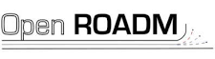



Examples of Industry Initiatives for Disaggregation
OpenRoadm
Telecom Infra Project
Defines interoperability specifications for ROADMs, Transponders & Optics
Specifications consist of both Optical interoperability as well as YANG data models
Consortium consist of both vendors and operators
Several project groups, Open Optical & Packet Transport group most interesting for optical transport
Defines open technologies, architectures and interfaces n Optical and IP Networking
Consortium consist of both vendors and operators
OpenConfig
Optical Internetworking Forum
Initial focus of OpenConfig was to development YANG based vendor-neutral data models
Subscription based Streaming telemetry is a focus area in which data is streamed from devices continuously
Consortium only consist of operators
Focused on electrical, optical and control interoperability, to enable more efficient and reliable network
400ZR and pluggable coherent standards
Consists of 130+ network operators, system vendors, component vendors and test equipment vendors
Notes:
For disaggregation to work in a network, you need to be able to use open and standard device APIs.
ODTN: OpenConfig for transponders and TAPI for OLS
SDN for control, management and automation

Slide 8


Smartoptics definition on a true Open Line System
No licenses or hidden fees
Compliant with IP over DWDM
Open and stardized API’s
Full monitoring capability of all wavelengths
Standard data models (YANG)
Full provisioning capability of all wavelengths

Slide 9
Software Defined Networking (SDN)
Optical Transport SDN: Why shouldn’t networking devices be programmable?
Using software controllers driven by application programming interfaces (APIs) to communicate with network elements for network configuration, monitoring and management.
Open source (ONOS, ODL etc.) and proprietary (vendor specific) controllers for SDN solutions.
Standard and open-source data models are mapped to disaggregated networks and open systems to allow SW based control, management and automation.
Open source SDN controllers utilize open protocols and open APIs (northbound and southbound) to control the flow of data.
Notes:
SDN decouples the control plane from the forwarding plane in the network infrastructure and applies automation and programming to the control plane, enabling administrators to dynamically adjust network-wide traffic.
With the help of programmability, SDN controllers implement automated network configuration, control, protection, and resource adjustment.
Considered case: Optical layer .i.e. DWDM transport, apply SDN protocols, data models and APIS to open OLSs and disaggregated WDM platforms.
Multilayer cases: packet-optical transport and IP over wdm
Application of T-SDN in multi domain networks

Slide 10
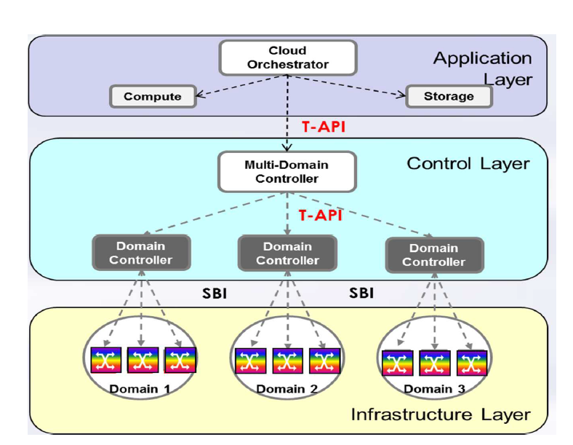
ONF SDN Transport Framework
OIF/ONF Whitepaper: SDN Transport API Interoperability Demonstration, February 10, 2017.

Slide 11

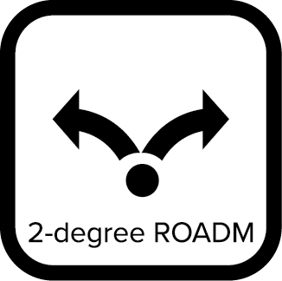

Open Disaggregated Transport Networks: Full Disaggregation
Hierarchical Controller
Hierarchical SDN Controller
NBI
Open API’s
Network controllers
SDN Domain Controller
SBI
Open API’s
SBI
Open API’s
SBI
Open API’s
Disaggregated Network
Notes:
SDN controller manages each individual network element including O-OTs and all the NEs belonging to an OLS, i.e., ILA, Mux/Demux and ROADM/FOADMS.

Slide 12
Open Disaggregated Transport Networks : Partial Disaggregation
Hierarchical Controller
Hierarchical SDN Controller
NBI
Open API’s
NBI
Open API’s
NBI
Open API’s
Network controllers
Open Terminal
Controller
OLS SDN Domain Controller
Open Terminal
Controller
SBI
Open API’s
SBI
Open API’s
SBI
Open API’s
Disaggregated Network
Notes:
Ots & OLS can be provided by different vendors and be managed independently.
Compared to a fully disaggregated system, the partially disaggregated system is expected to be less complex to manage
Decoupling the lifecycles of Ots and OLS

Slide 13


Partial Disaggregation – Single Domain
Hierarchical SDN Controller
Hierarchical SDN Controller
RESTCONF/YANG
RESTful APIs
RESTCONF/YANG
Open Terminal
Controller
OLS SDN Domain Controller
Open Terminal
Controller
Domain Controller
Vendor specific
NETCONF
gNMI
Vendor specific
Network Elements
Modelled in Yang
ROADM Nodes
Transponders/Muxponders
Open ROADM
Notes:
Ots & OLS can be provided by different vendors and be managed independently.
The Optical/O-OLS SDN domain controller is able to manage the 3rd party O-OTs from a resource discovery, provisioning, operation, fault and performance monitoring perspectives.

Slide 14
Partial Disaggregation – Multi Domain - I
Hierarchical SDN Controller
NBI
NBI
Open API’s
NBI
NBI
Open API’s
Open API’s
NBI
Open API’s
Open API’s
Open API’s
NBI
Open Terminal
Controller
OLS SDN Domain Controller
Open Terminal
Controller
Open Terminal
Controller
OLS SDN Domain Controller
Open Terminal
Controller
SBI
Open API’s
SBI
Open API’s
SBI
Open API’s
Open API’s
SBI
SBI
Open API’s
SBI
Open API’s
Notes:
Ots & OLS can be provided by different vendors and be managed independently.
The Optical/O-OLS SDN domain controller is able to manage the 3rd party O-OTs from a resource discovery, provisioning, operation, fault and performance monitoring perspectives.

Slide 15
Partial Disaggregation – Multi Domain - II
Hierarchical SDN Controller
RESTCONF/YANG
RESTful APIs
RESTCONF/YANG
Domain Controller
Domain Controller
Domain Controller
Network Elements
Network Elements
Network Elements
Modelled in Yang
Modelled in Yang
Modelled in Yang
Open ROADM
Open ROADM
Open ROADM
ROADM Nodes
Transponders/Muxponders
ROADM Nodes
Transponders/Muxponders
ROADM Nodes
Transponders/Muxponders
8 March 2024
15

Slide 16
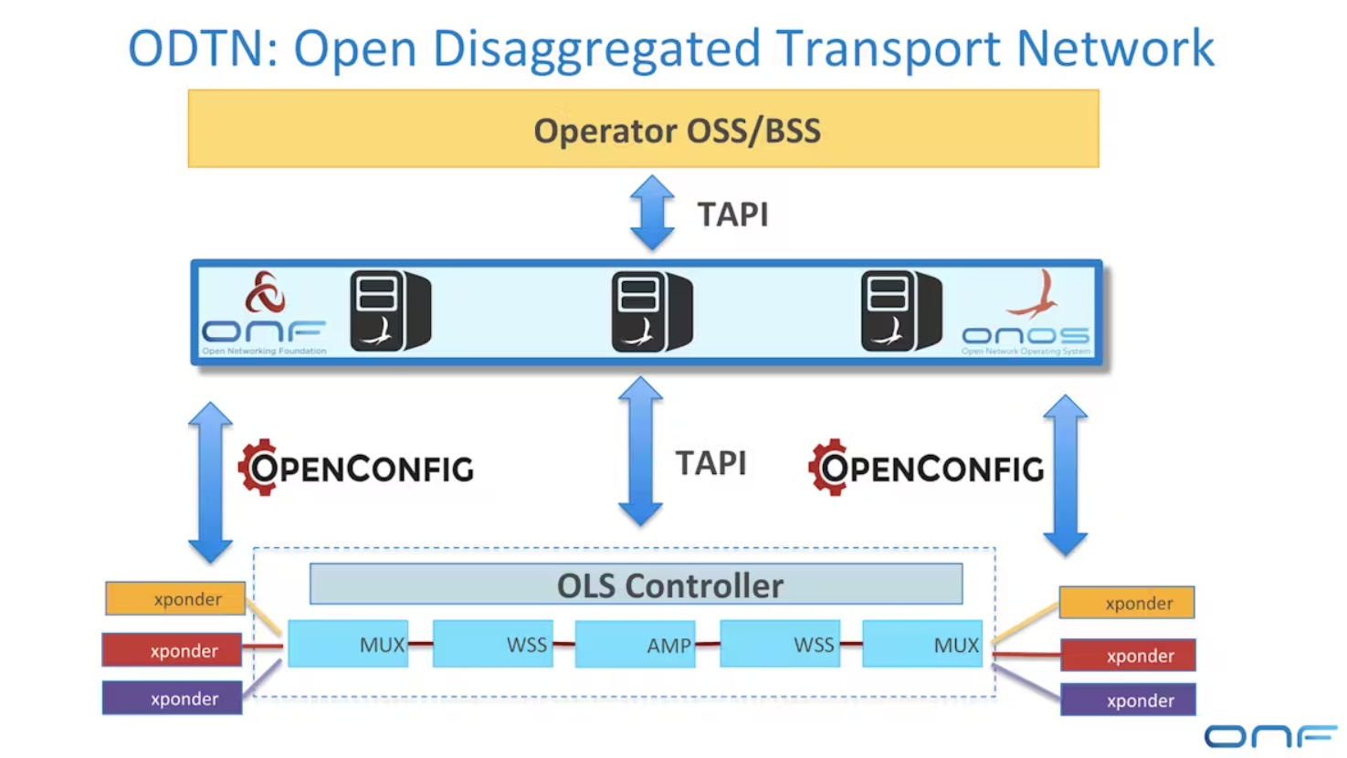
ODTN: Open Source SW Platform (control & management)
Std and open APIs
Notes:
OpenConfig for transponders and TAPI for OLS
ONOS: network operating system. Provides control plane for SDN , managing and configuring NE as switches and links but also provides comm. Services to end hosts and networks
Low commercial pervasion

Slide 17
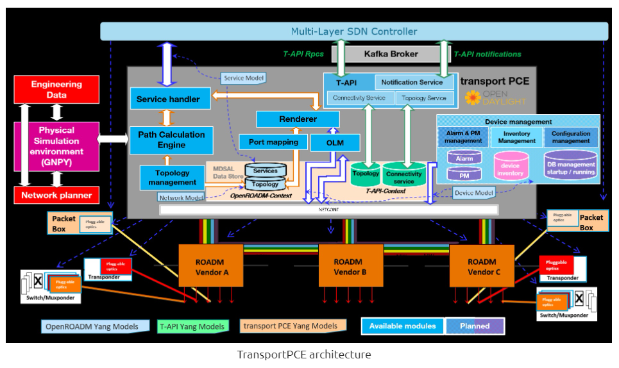
OpenDayLight: Network Management & Automation
Notes:
Mention ODL and ONAP too: open platforms
ODL: modular open platform for managing and automating networks → network programmability focus and valid for commercial cases. Part of LFN
TPCE is the open source controller in ODL for open roadm control application
primary function is to control an optical transport infrastructure using a non-proprietary South Bound Interface (SBI).
ontrol includes the capability to configure the optical equipment, and to provision services according to a request coming from a higher layer controller and/or an orchestrator.

Slide 18
Commercial Use Cases – multivendor SDN collabs
SDN ecosystem: Open APIs with SBI and NBIs with open source and commercial orchestrators for multi-vendor interoperability
Partially disaggregated optical networks with separate terminal and OLS control
Collaborations between vendors to align APIs and integrate solutions
All the above is key for SDN operability.

Slide 19
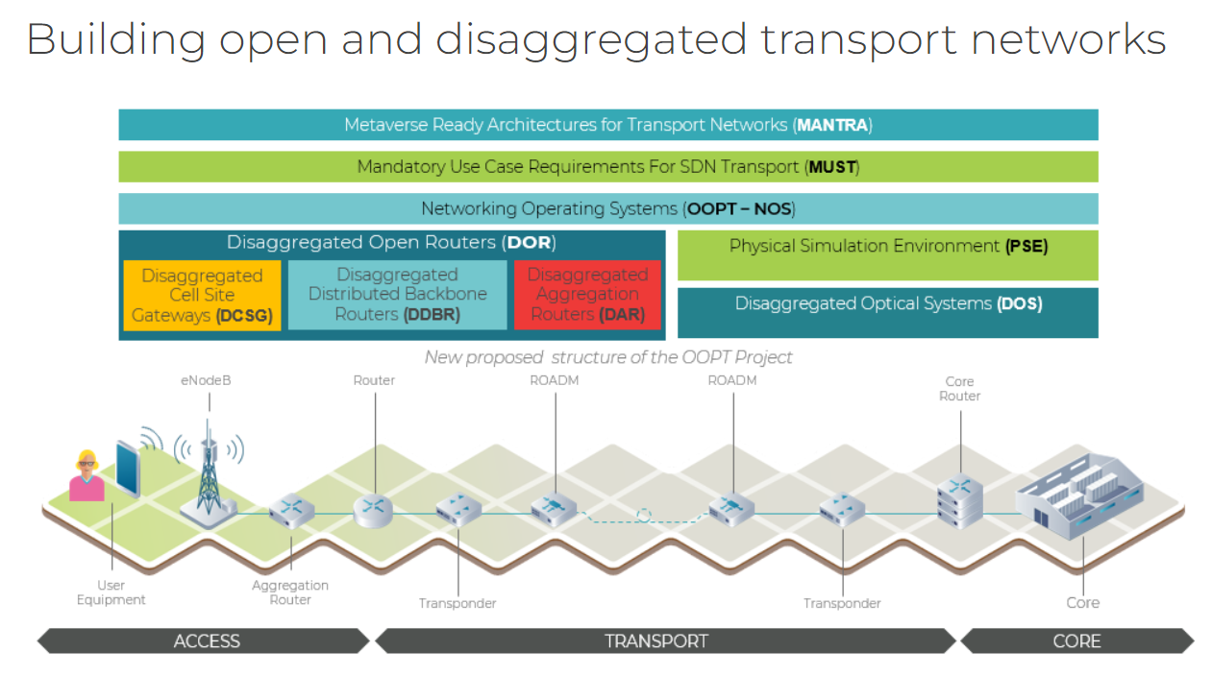
TIP: Open Optical & Packet Transport
Notes:
Mention ODL and ONAP too: open platforms
ODL: modular open platform for managing and automating networks → network programmability focus and valid for commercial cases. Part of LFN
TPCE is the open source controller in ODL for open roadm control application

Slide 20
SDN – Way Forward – Network Automation
Network automation requires ZTP
AI/ML enhanced network control & automation
Network analytics & telemetry
  Transmission performance optimization
  Failure prediction
  Traffic prediction
  Network maintenance
  Performance monitoring and optimization
Notes:
Building blocks for net auto. Open apis, stand data models, ZTP, streaming telemetry

