Slide 1
NaWas Anti-DDoS
Frank Dupker
DKNOG14
https://www.nbip.nl/nawas/

Slide 2
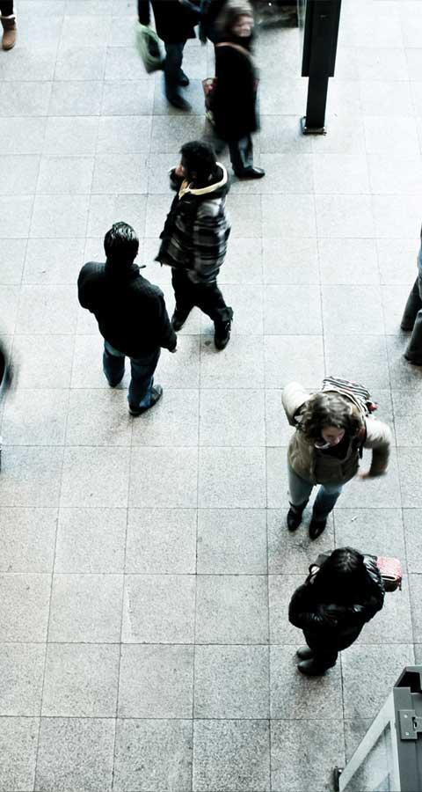
whois ORG-SN292-RIPE
org-name: Stichting NBIP - https://www.nbip.nl/en/
Independent non-profit foundation
Sector initiative started in 2002
Services for Internet Providers
Lawful Interception
Clean Networks Platform – www.cleannetworks.net
DDoS Scrubbing Center – NaWas
Mitigation
Reporting
Research and cooperation

Slide 3
whois ORG-SN292-RIPE
In 2013 request for anti DDoS solution
Started POC 2nd ½ 2013
NaWas operational in 2014
NaWas connected to LINX in 2019
NaWas connected to Italian IX and Netix in 2020
6,5 M .nl domains protected by NaWas (2020)
Aprox 1,6 M websites

Slide 4
DDoS Reporting
Every quarter
nbip.nl/ddos-report

Slide 8
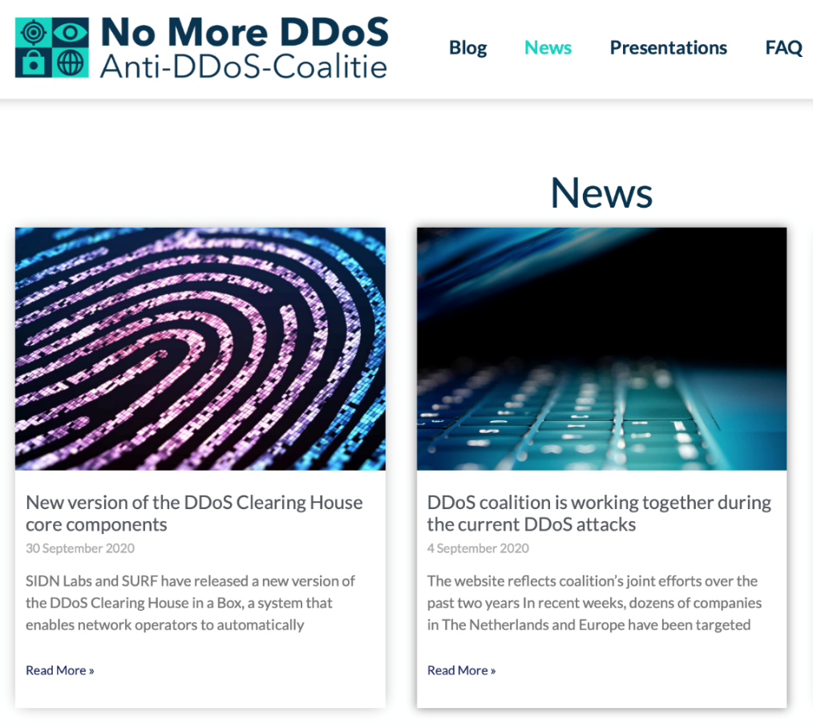
Anti-DDoS-Coalitie
Cooperation on knowledge sharing about DDoS attacks (2018)
Universities, IX’s, ISP’s, banks, goverment, law inforcement
National Cyber Security Centre (NCSC) facilitator

Slide 9
NaWas
Scrubbing Center

Slide 10
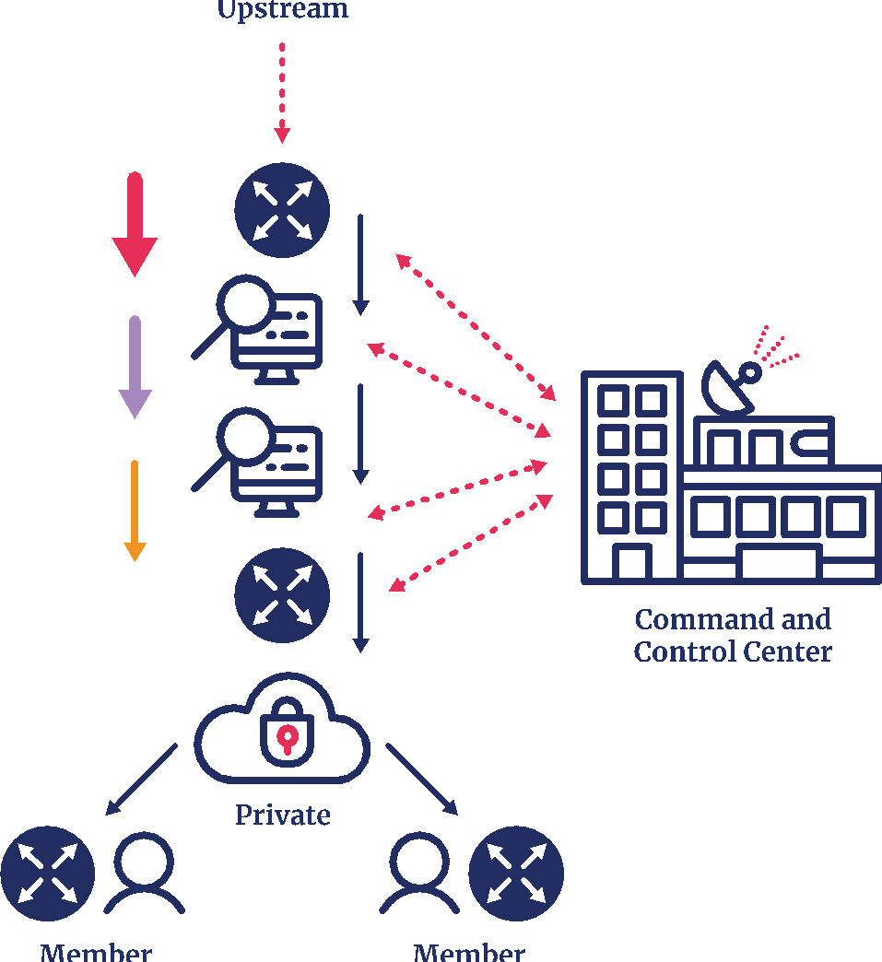
NaWas
North: Internet
Several Tier-1 Transit
Public peering on Internet Exchanges
Amsterdam as one of major hubs in Europe
West – East: 3-stage scrubbing
Multiple vendors
Fail-over on multiple sites
Prefiltering with NaWas filters (migrating to FlowSpec)
South: Clean Traffic
private connections
Only reachable through NaWas
PoP’s via AMS-IX, NL-IX, Dcspine, Linx, Mix, Top-IX, Namex, Netix

Slide 11
Future plans

Slide 12
R&D NaWas
DDoS Detectie as a Service (DaaS)
Web Application Firewall (WAF-dp)
Clearing House (Anti-DDoS coalition)
DDoS Pattern Recognition - generate filter rules (Dissector)

Slide 13
Together
Smarter and Stronger
https://www.nbip.nl/nawas/
f.dupker@connect.nbip.nl

