Slide 1
SRv6 uSID Introduction DKNOG
Jakub Horn
Principal Technical Marketing Engineer
Mar 2024

Slide 2
Understanding Today’s Service Creation
Limited Cross-domain Automation, Cumbersome Service Assurance
Legacy Central Office
Complex E2E Quality of Service (QoS)
Metro Network Domain
Core Network Domain
Data Center Domain
L2VPN
L3VPN
VXLAN
VNF
VNF
Aggregation
Ethernet
MPLS
IP
Access
Centralized Services Delivery
Hardware Appliances
End-to-end service provisioning is lengthy and complex
Multiple network domains under different management teams
Manual operations
Heterogeneous underlay and overlay networks
Notes:
Let me walk you through how services are instantiated today. For that, we need to look at the network infrastructure from an End-to-End perspective.
Service Providers’ networks are composed of multiple domains – Access, Metro, Core and Data Center.
These domains are most of the time operated by different teams and are using different underlay and overlay protocols. Here are some examples of Underlay and Overlay protocols that are commonly used in these domains:
- Metro domain: Underlay – Ethernet / Overlay – L2VPN
- Core domain: Underlay – MPLS / Overlay – L3VPN
- Data Center domain: Underlay – IP / Overlay - VXLAN
As a consequence, cross-domain orchestration is complex and limited.
To deliver new services, Services Providers have made great usage of purpose-built HW appliances rolled out in Central Offices. This mode of operation is obviously not sustainable for the following reasons:
- It requires truck-roll and onsite installation resulting in OpEx increase
- Every HW appliance comes with its own management system and hence requires custom integration into OSS/BSS. Moreover, each of these HW appliances have their own lifecycle making the upgrade of the overall Central Office a tedious planning exercise.
To overcome these limitations, Service Providers have started to deliver new services from centralized Data Centers, leveraging compute infrastructure and VNFs. Straightforward Benefits are Time-To-Market and On-demand service instantiation.
Delivering services from centralized Data Centers comes with its own set of challenges though. This mode of operation requires to construct E2E connectivity across the network - from Central Offices up to Data Centers. This is actually a lengthy and complex task:
- As underlay and overlay protocols are different across network domains, protocol translations have to take place across domains. This brings complexity and sometimes requires network devices to maintain states hindering cloud scale scalability.
- These “stitching” operations are still largely manual and require coordination between operations teams
By and large, this creates a dichotomy between the on-demand service instantiation in Data Centers and the lengthy procedures required to update the network infrastructure to support those new services.

Slide 3
SR-MPLS: SDN ready “Network as a Fabric” for Service Creation
Homogenous Cross-domain Automation & Assurance
SDN
Control
Cloud Scale Networking
Central Office
SDN
Metro Network Domain
SDN
Core Network Domain
SDN
Data Center Domain
Access
VPN L2/L3
VNF
VNF
VNF
Aggregation
Segment Routing
VNF
Compute
Leaf
Spine
Centralized Services Delivery
End-to-end service provisioning is simple
Multiple network domains under same management teams
Automated operations
Homogenous underlay and overlay networks

Slide 4
SRv6: SDN, NfV, 5G ready “Network as an API” for Service Creation
Homogenous Cross-domain Automation & Assurance
SDN
Control
Cloud Scale Networking
Central Office
SDN
Metro Network Domain
SDN
Core Network Domain
SDN
Data Center Domain
Access
Segment Routing v6 (transport, services and programmability)
VNF
VNF
VNF
Aggregation
VNF
Compute
Leaf
Spine
Centralized Services Delivery
End-to-end service provisioning is integrated with NfV, SDN
Multiple network domains under same management teams
Automated operations
Integrated underlay and overlay networks (NfV)
Network as API (NfV)
Hyper Scale (5G)

Slide 5
Content:
uSID Technology
SRv6 DataPlane
SRv6 Network Programming
SRv6 ISIS
SRv6 BGP

Slide 6
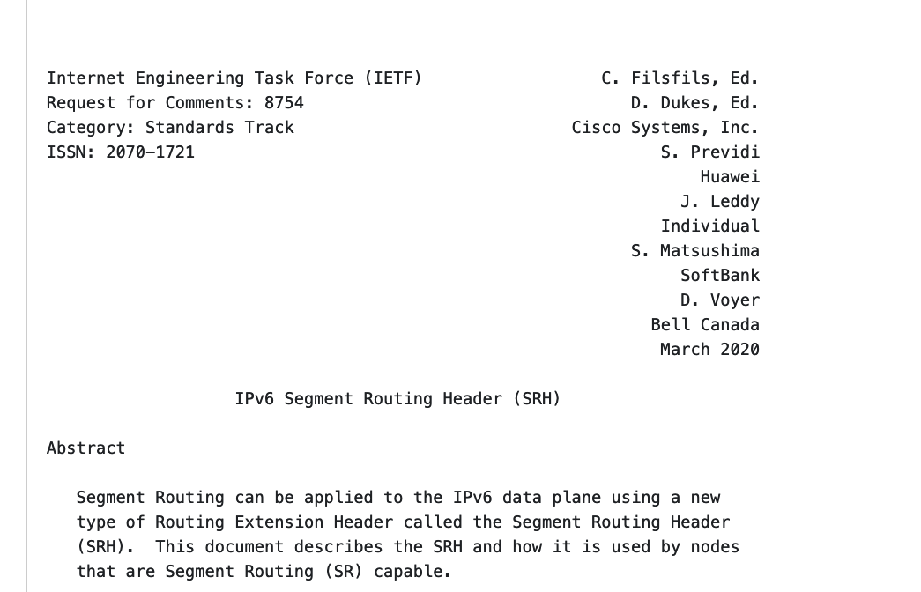
SRv6
IPv6 Segment Routing Header (SRH)

Slide 7
ver
tc
flow label
SRv6
payload length
next header
hop limit
6
4
143
source address
IPv6 Header
IPv6 Header
Destination IP address
destination address
hl
tos
length
source port
destination port
ver
TCP data
destination MAC
IP data
L2 Payload
Next header field:
TCP, UDP, ICMP....
id
flags
fragment offset
sequence number
destination MAC
source MAC
IPv4, IPv6, L2
IPv4, IPv6
protocol
ttl
header checksum
acknowledgment number
source MAC
TCP Header
source IP address
hlen
reserved
code bits
window
ether type
destination IP address
checksum
urgent
options
L2 Frame
IP Packet

Slide 8
ver
tc
flow label
SRv6
payload length
next header
hop limit
source address
IPv6 Header
IPv6 Header
Destination IP address
destination address

Slide 9
ver
tc
flow label
SRv6
payload length
next header
hop limit
6
source address
IPv6 Header
IPv6 Header
Destination IP address
Next header field:
TCP, UDP, ICMP....
destination address
source port
destination port
TCP data
sequence number
acknowledgment number
TCP Header
hlen
reserved
code bits
window
checksum
urgent
options

Slide 10
ver
tc
flow label
SRv6
payload length
next header
hop limit
4
source address
IPv6 Header
IPv6 Header
Destination IP address
Next header field:
TCP, UDP, ICMP....
IPv4, IPv6
destination address
ver
hl
tos
length
IP data
id
flags
fragment offset
ttl
protocol
header checksum
source IP address
destination IP address
IP Packet

Slide 11
ver
tc
flow label
SRv6
payload length
next header
hop limit
143
source address
IPv6 Header
IPv6 Header
Destination IP address
Next header field:
TCP, UDP, ICMP....
IPv4, IPv6, L2
destination address
destination MAC
L2 Payload
destination MAC
source MAC
source MAC
ether type
L2 Frame

Slide 12
ver
tc
flow label
SRv6
payload length
next header
hop limit
51
source address
IPv6 Header
IPv6 Header
Destination IP address
Next header field:
TCP, UDP, ICMP....
IPv4, IPv6, L2
Hop by Hop, Dest. Options, Fragmentation, Authentication Header …
destination address
next header
payload len
reserved
6
security parameters index
sequence number
AH
authentication data
source port
destination port
TCP data
sequence number
acknowledgment number
TCP Header
hlen
reserved
code bits
window
checksum
urgent
options

Slide 13
ver
tc
flow label
SRv6
payload length
next header
hop limit
43
source address
IPv6 Header
IPv6 Header
Destination IP address
Next header field:
TCP, UDP, ICMP....
IPv4, IPv6, L2
Hop by Hop, Dest. Options, Fragmentation, Authentication Header …
Routing Header
0 Source Route (deprecated)
1 Nimrod (deprecated)
2 Type 2 (RFC 6275)
3 RPL (RFC 6554)
destination address
next header
hdr ext len
routing type
segments left
Routing Header

Slide 14
ver
tc
flow label
SRv6
payload length
next header
hop limit
43
source address
IPv6 Header
RFC 2460
IPv6 Header
Destination IP address
Next header field:
TCP, UDP, ICMP....
IPv4, IPv6, L2
Hop by Hop, Dest. Options, Fragmentation, Authentication Header …
Routing Header
0 Source Route (deprecated)
1 Nimrod (deprecated)
2 Type 2 (RFC 6275)
3 RPL (RFC 6554)
4 SRH (RFC 8754)
destination address
next header
hdr ext len
routing type
segments left
4
last entry
flags
tag
SID[0]
SID[1]
SRH
RFC 8754
SID[n-1]
Optional TLVs

Slide 15
ver
tc
flow label
SRH
payload length
next header
hop limit
43
source address
IPv6 Header
Segment Routing Header
First Segment
Pointer to very first SID
destination address
next header
hdr ext len
routing type
segments left
4
last entry
flags
tag
SID[0]
SID[1]
SRH
SID[n-1]
Optional TLVs

Slide 16
ver
tc
flow label
SRH
payload length
next header
hop limit
43
source address
IPv6 Header
Segment Routing Header
First Segment
Pointer to very first SID
Segments left
Pointer to Active SID
Active SID always in destination addr
destination address
ACTIVE SID
next header
hdr ext len
routing type
segments left
4
last entry
flags
tag
copy
SID[0]
SID[1]
SRH
ACTIVE SID
SID[n-1]
Optional TLVs

Slide 17
SID Structure -Locator
128 Bits Like IPv6 address but different semantics
1111:2222:3333:4444:5555:6666:7777:8888
Locator
Function

Slide 18
SRv6 Full SID
2001:db8:0:1::/64
2001:db8:0:2::/64
2001:db8:0:3::/64
2001:db8:0:4::/64
S
R1
R2
R3
R4
R
BGP:2001:db8:0:4:eeee::
SA:2001::1
DA:2001:db8:0:1:1::
NH:RH
SA:2001::1
DA:2001:db8:0:2:1::
NH:RH
SA:2001::1
DA:2001:db8:0:3:48::
NH:RH
SA:2001::1
DA:2001:db8:0:4:eeee::
NH:IPv4
Type:4(SRH)
NH:IPv4|SL:3
Segment List:
[0]:2001:db8:0:4:eeee::
[1]:2001:db8:0:3:48::
[2]:2001:db8:0:2:1::
[3]:2001:db8:0:1:1::
Type:4(SRH)
NH:IPv4|SL:2
Segment List:
[0]:2001:db8:0:4:eeee::
[1]:2001:db8:0:3:48::
[2]:2001:db8:0:2:1::
[3]:2001:db8:0:1:1::
Type:4(SRH)
NH:IPv4|SL:1
Segment List:
[0]:2001:db8:0:4:eeee::
[1]:2001:db8:0:3:48::
[2]:2001:db8:0:2:1::
[3]:2001:db8:0:1:1::
Notes:
Parent node: node where the segment was instantiated, and where it will be processed
Function could be the basic end-point behavior that I showed in the previous slides, or something much more sophisticated... even using arguments
Fliexible bit-length...
the only thing that matters to the rest of the network is that the parent node advertises the locator prefix, so that packets can be routed to it. What it then does with the packet, so the function, is purely local
Local address: address within the locator prefix, or assigned to an interface
conversely....

Slide 19
SID Structure
128 Bits Like IPv6 address but different semantics
1111:2222:3333:4444:5555:6666:7777:8888
Locator
Function
Padding
Block
Node ID
Function
Argument
Padding

Slide 20
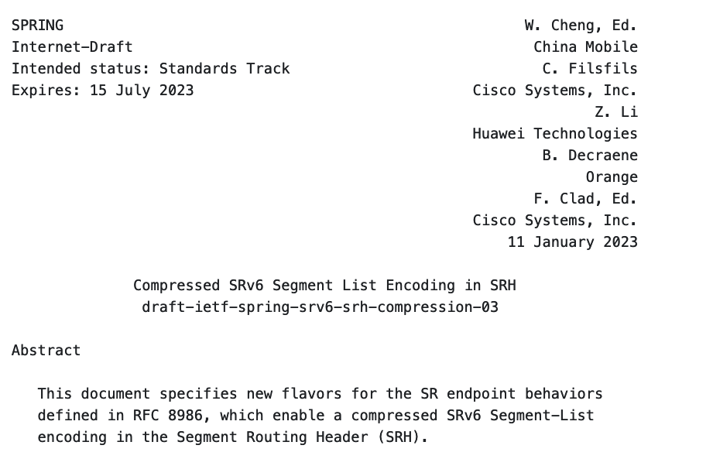
SRv6 uSID

Slide 21
SRV6 Encapsulation
SRv6 uSID format
SA:2001::1
DA:2001:db8:0:4:1:0:0:0
NH:RH
: 0100 :
=SRV6 uSID
Type:4(SRH)
NH:IPv4|SL:1
Segment List:
[0]: 2001:db8:0:5:45:0:0:0
[1]: 2001:db8:0:4:1:0:0:0
[2]: 2001:db8:0:3:48:0:0:0
[3]: 2001:db8:0:2:1:0:0:0
[4]: 2001:db8:0:1:42:0:0:0
16 bits here, but can be anything
SA:7.5.4.3
DA:11.6.19.71
Port:UDP
SRV6 uSID Container
UDP Header/Data
2001 :0db8 : 0100 : 0200 : 0300 : 0400 : 0500 : 0000
SRV6 uSID Encapsulation
SRv6 uSID
Block
uSID
1
uSID
2
uSID
3
uSID
4
uSID
5
EoC
6
SA:2001::1
DA:2001:db8:100:200:300:400:500::
NH:IPv4
32 bits here,
but can be anything
SA:7.5.4.3
DA:11.6.19.71
Port:UDP
UDP Header/Data
Notes:
Parent node: node where the segment was instantiated, and where it will be processed
Function could be the basic end-point behavior that I showed in the previous slides, or something much more sophisticated... even using arguments
Fliexible bit-length...
the only thing that matters to the rest of the network is that the parent node advertises the locator prefix, so that packets can be routed to it. What it then does with the packet, so the function, is purely local
Local address: address within the locator prefix, or assigned to an interface
conversely....

Slide 22
SRv6 uSID Possible Formats
FXXYY. XX= Block size; Y=uSID size
F1608
fcbb :0102 : 0304 : 0506 : 0708 : 0901 : 0b0c : 0d0e
uSID1
uSID2
uSID3
uSID14
SRv6 uSID Block
F4816
2001 :0db8 : aaaa : 0001 : 0002 : 0003 : 0004 : 0005
F3224
fcbb :bb00 : 0000 : 0100 : 0002 : 0000 : 0300 : 0004
Anything is possible
Notes:
Parent node: node where the segment was instantiated, and where it will be processed
Function could be the basic end-point behavior that I showed in the previous slides, or something much more sophisticated... even using arguments
Fliexible bit-length...
the only thing that matters to the rest of the network is that the parent node advertises the locator prefix, so that packets can be routed to it. What it then does with the packet, so the function, is purely local
Local address: address within the locator prefix, or assigned to an interface
conversely....

Slide 23
SRv6 uSID F3216
2001:db8:1::/48
2001:db8:2::/48
2001:db8:3::/48
2001:db8:4::/48
S
R1
R2
R3
R4
R
BGP:2001:db8:4:eeee::
SA:2001::1
DA:2001:db8:1:2:3:e000:4:eeee
NH:IPV4
SA:2001::1
DA:2001:db8:2:3:e000:4:eeee::
NH:IPV4
SA:2001::1
DA:2001:db8:3:e000:4:eeee::
NH:IPV4
SA:2001::1
DA:2001:db8:4:eeee::
NH:IPV4
Notes:
Parent node: node where the segment was instantiated, and where it will be processed
Function could be the basic end-point behavior that I showed in the previous slides, or something much more sophisticated... even using arguments
Fliexible bit-length...
the only thing that matters to the rest of the network is that the parent node advertises the locator prefix, so that packets can be routed to it. What it then does with the packet, so the function, is purely local
Local address: address within the locator prefix, or assigned to an interface
conversely....

Slide 24
1
SRv6 uSID More Than 6 SIDs?
2
100->200->300->400->500->600->700->800->900->a00->b00
3
Container 1
2001 : 0db8 : 0100 : 0200 : 0300 : 0400 : 0500 : 0600
4
Container 2
2001 : 0db8 : 0700 : 0800 : 0900 : 0a00 : 0b00 : 0000
5
SA:2001::1
NH:
DA:2001:db8:100:200:300:400:500:600
6
DA:2001:db8:200:300:400:500:600:0
DA:2001:db8:300:400:500:600:0::
DA:2001:db8:400:500:600:0::
DA:2001:db8:500:600:0::
DA:2001:db8:600:0::
DA:2001:db8:700:800:900:a00:b00::
DA:2001:db8:800:900:a00:b00::
DA:2001:db8:900:a00:b00::
DA:2001:db8:a00:b00::
DA:2001:db8:b00::
RH
IPv4
Shift & Forward
7
Type:4(SRH)
NH:IPv4|
Segment List:
[0]: 2001:db8:700:800:900:a00:b00::
SL:0
END of Container
-> is there SRH?
Decrement SL
Copy New SID (Container)
PSP
SL:1
8
9
SA:7.5.4.3
DA:11.6.19.71
Port:UDP
a
b
UDP Header/Data
Notes:
Parent node: node where the segment was instantiated, and where it will be processed
Function could be the basic end-point behavior that I showed in the previous slides, or something much more sophisticated... even using arguments
Fliexible bit-length...
the only thing that matters to the rest of the network is that the parent node advertises the locator prefix, so that packets can be routed to it. What it then does with the packet, so the function, is purely local
Local address: address within the locator prefix, or assigned to an interface
conversely....

Slide 25
Sets, Global ID Block (GIB), Local ID Block (LIB)
GIB
0x0001
Within a Block, SIDs are allocated: FCBB:BB00:XXXX::/48
SID can be:
Global: shortest path to a node – globally unique
Local: a local function – not globally unique
0xdfff
LIB
0xe000
0xffff

Slide 26
Wide LIB
When more than 8k local IDs are needed, use Wide LIB
WLIB provides 8 × 64k local IDs
WLIB is an extension to LIB
A (special) ID in the LIB references another ID table (WLIB)​
LIB IDs FFF0 to FFF7
E.g., FCBB:BB00:FFF0:XXXX::/64 is a local uSID of WLIB
LIB and WLIB can concurrently be used on a node
GIB
WLIB
0x0001
64K
0xE000
LIB
8K
0xFFF0
0xFFFF
0xFFFF

Slide 27
SRv6 uSID Configuration
Name to reference
segment-routing
srv6
locators
locator MAIN
micro-segment behavior unode psp-usd
prefix fcbb:bb00:1::/48
uSID
Locator Prefix

Slide 28
ver
tc
flow label
Flow Label
payload length
next header
hop limit
4
source address
IPv6 Header
What for?
Entropy encoding encap
5 Tuple Hash into flow label
Used for Hash on P routers
destination address
ver
hl
tos
length
id
flags
fragment offset
ttl
protocol
header checksum
IP Header
source IP address
destination IP address
source port
destination port
HASH
TCP data
sequence number
acknowledgment number
TCP Header
hlen
reserved
code bits
window
checksum
urgent
options

Slide 29
Flow Label
SA:2001::1
DA:fcbb:bb00:3:e002::
NH:IPv4. FL:0x7543
P3
SA:1.1.1.1
DA:2.2.2.2
Prot:TCP
SA:1.1.1.1
DA:2.2.2.2
Prot:TCP
TCP sPort; dPort
TCP sPort; dPort
PE1
P2
ECMP
FL used for hash
PE5
SA:2001::1
DA:fcbb:bb00:3:e002::
NH:IPv4. FL:0x1106
SA:3.3.3.3
DA:4.4.4.4
Prot:TCP
SA:3.3.3.3
DA:4.4.4.4
Prot:TCP
P4
TCP sPort; dPort
TCP sPort; dPort
Notes:
Simple move of LNX to node 4, change of some physical configas +some slides, visually not very nice…

Slide 30
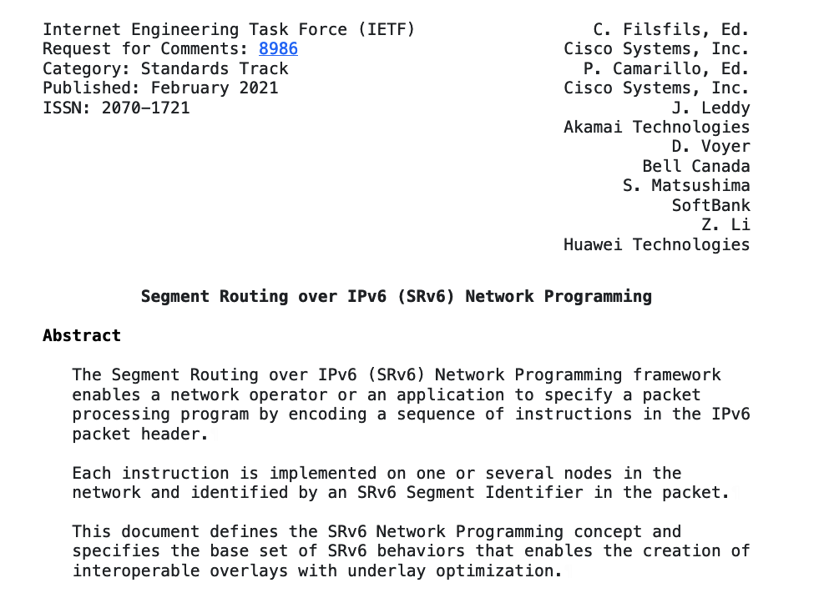
SRv6
Network Programming

Slide 31
END– Default endpoint (Node SID)
Decrement SL
Copy Active SID
Forward
SA:2001::1
DA:2001:db8:0:2:1::
NH:RH
SA:2001::1
DA:2001:db8:0:1:1::
NH:RH
R1
R2
Type:4(SRH)
NH:IPv4|SL:3
Segment List:
[0]:2001:db8:0:4:eeee::
[1]:2001:db8:0:3:e000::
[2]:2001:db8:0:2:1::
[3]:2001:db8:0:1:1::
Type:4(SRH)
NH:IPv4|SL:2
Segment List:
[0]:2001:db8:0:4:eeee::
[1]:2001:db8:0:3:e000::
[2]:2001:db8:0:2:1::
[3]:2001:db8:0:1:1::
Different Flavors:
End
End with PSP
End with USP
End with PSP & USP
End with USD
End with PSP & USD
End with USP & USD
End with PSP, USP & USD
End with NEXT-ONLY-CSID
End with NEXT-CSID
End with NEXT-CSID & PSP
End with NEXT-CSID & USP
End with NEXT-CSID, PSP & USP
End with NEXT-CSID & USD
End with NEXT-CSID, PSP & USD
End with NEXT-CSID, USP & USD
End with NEXT-CSID, PSP, USP & USD

Slide 32
uN=END with Next – Default endpoint (Node SID)
Decrement SL
Copy Active SID
Forward
SA:2001::1
DA:2001:db8:2::
NH:RH
SA:2001::1
DA:2001:db8:0:1::
NH:RH
R1
R2
Type:4(SRH)
NH:IPv4|SL:3
Segment List:
[0]:2001:db8:4:eeee::
[1]:2001:db8:3:e000::
[2]:2001:db8:2::
[3]:2001:db8:1::
Type:4(SRH)
NH:IPv4|SL:2
Segment List:
[0]:2001:db8:4:eeee::
[1]:2001:db8:3:e000::
[2]:2001:db8:2::
[3]:2001:db8:1::
Better way:
R1
R2
Shift & Forward
SA:2001::1
DA:2001:db8:1:2:3:e000:4:eeee
NH:IPV4
SA:2001::1
DA:2001:db8:2:3:e000:4:eeee
NH:IPV4

Slide 33
uA=END.X with Next – (Adjacency SID)
SA:2001::1
DA:2001:db8:4:eeee::
NH:IPV4
uA 2001:db8:3:e000::
R3
Ten0/0/0/0
R
R4
SA:2001::1
DA:2001:db8:3:e000:4:eeee::
NH:IPV4
Ten0/0/0/1
uA 2001:db8:3:e001::
Shift & Forward to SPECIFIC INTERFACE

Slide 34
uDX4=END.DX4, uDX6=END.DX6, uDX2=END.DX2
Endpoint with Decapsulation and Xconnect
Decapsulate and Forward to SPECIFIC INTERFACE
Same as Per CE Label Allocation
Must be last function in SID list
SA:2001::1
DA:2001:db8:4:eeee::
NH:IPV4
R4
Ten0/0/0/0
IPv4 Packet
IPv4 Packet

Slide 35
uDT4=END.DT4, uDT6=END.DT6
Endpoint with Decapsulation and Table Lookup
Decapsulate and Table Lookup (VRF)
Same as Per VRF Label Allocation (aggregate label)
Must be last function in SID list
SA:2001::1
DA:2001:db8:4:eeee::
NH:IPV4
R4
IPv4 Packet
IPv4 Packet

Slide 36
SRv6 functions: Steering and Services
Codename |  | Behavior
End | uN | Endpoint | [Node SID]
End.X | uA | Endpoint with Layer-3 cross-connect | [Adj SID]
End.B6.Insert | uB6.Insert | Endpoint bound to an SRv6 policy | [BSID]
End.B6.Encap | uB6.Encaps | Endpoint bound to an SRv6 encapsulation policy | [BSID]
End.DX6 | uDX6 | Endpoint with decapsulation and IPv6 cross-connect | [L3VPN Per-CE]
End.DX4 | uDX4 | Endpoint with decapsulation and IPv4 cross-connect | [L3VPN Per-CE]
End.DT6 | uDT6 | Endpoint with decapsulation and specific IPv6 table lookup | [L3VPN Per-VRF]
End.DT4 | uDT4 | Endpoint with decapsulation and specific IPv4 table lookup | [L3VPN Per-VRF]
End.DX2 | uDX2 | Endpoint with decapsulation and L2 cross-connect | [E-LINE]
End.DT2U/M | uDT2U/M | Endpoint with decapsulation and L2 unicast lookup / flooding | [E-LAN]
End.DTM | uDTM | Endpoint with decapsulation and MPLS table lookup | [Interworking]
H.Insert / H.Encaps |  | Headend with Insertion / Encapsulation of / into an SRv6 policy | [TiLFA]
H. Encaps.L2 |  | H.Encaps Applied to Received L2 Frames | [L2 Port Mode]
H.Encaps.M |  | H.Encaps Applied to MPLS Label Stack | [Interworking]

Slide 37
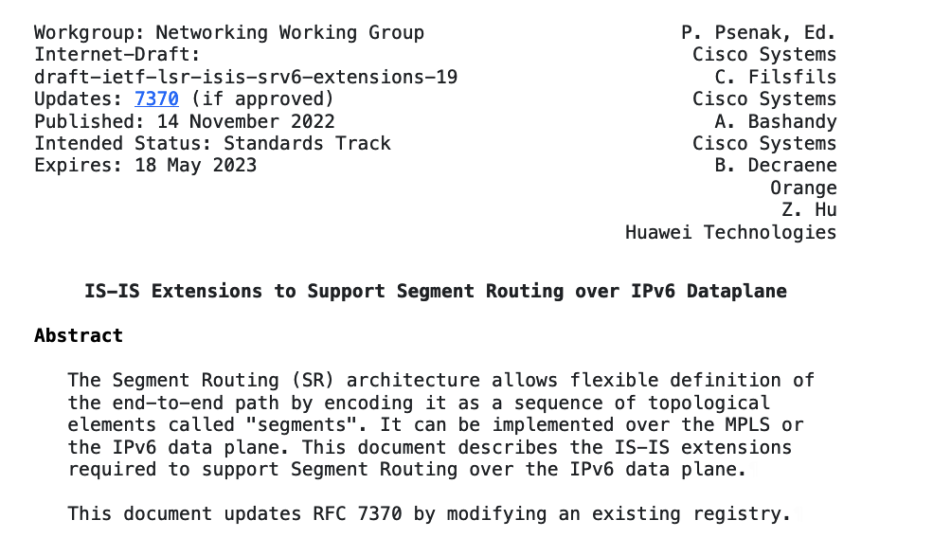
SRv6
ISIS Extensions

Slide 38
Functions might be signaled differently
Signalling | IGP | BGP-LS | BGP-IP/VPN
End, uN | Yes | Yes
End.X, uA | Yes | Yes
End.T | Yes | Yes
End.DX4,uDX4 |  | Yes | Yes
End.DX6,uDX6 | Yes | Yes | Yes
End.DX2,uDX2 |  | Yes | Yes
END.DT4,uDT4 |  | Yes | Yes
End.DT6,uDT6 | Yes | Yes | Yes
End.B |  | Yes
Signalling | IGP | BGP-LS | BGP-IP/VPN
H.insert |  | Yes
H.Encap |  | Yes
Locator – routing table

Slide 39
ISIS for SRv6
LSP (Link State Packet):
TLVs:
Hostname: r2
Lo0
fcbb:0:2::1/128
Interfaces: Hu0/0/0/0
Hu0/0/0/1
Lo0
uA:fcbb:0:2:e001::
uA:fcbb:0:2:e002::
Structure: BL=32;NL=16;FL=16;AL=0
Locator:
fcbb:0:2::/48
r2
r3
Structure: BL=32;NL=16;FL=16;AL=0
Hu0/0/0/1
uN:fcbb:0:2::
uA:fcbb:0:2:e002::
Neighbors: r1
r3
Structure: BL=32;NL=16;FL=0,AL=80
Structure: BL=32;NL=16;FL=16;AL=0
uA:fcbb:0:2:e001::
IP addresses: fcbb:0:2::1/128
2001:12::2/64
Structure: BL=32;NL=16;FL=16;AL=0
:
2001:12::2/64
Hu0/0/0/0
Locator: fcbb:0:2::/48
uN:fcbb:0:2::
Structure: BL=32;NL=16;FL=0,AL=80
r1
Capabilities: Algorithms ……
SIDs can insert
SIDs can decap
……….

Slide 40
ISIS LSP Example
IS-IS 1 (Level-2) Link State Database
LSPID LSP Seq Num LSP Checksum LSP Holdtime/Rcvd ATT/P/OL
r2.00-00 0x00000009 0x4f06 1145 /1200 0/0/0
Area Address: 49
NLPID: 0x8e
Hostname: r1
IPv6 Address: 2001::2
Metric: 10 MT (IPv6 Unicast) IPv6 fcbb:bb00:2::1/128
Prefix Attribute Flags: X:0 R:0 N:1 E:0 A:0
Metric: 1 MT (IPv6 Unicast) IPv6 fcbb:bb00:2::/48
Prefix Attribute Flags: X:0 R:0 N:0 E:0 A:0
MT: IPv6 Unicast 0/0/0
SRv6 Locator: MT (IPv6 Unicast) fcbb:bb00:2::/48 D:0 Metric: 0 Algorithm: 0
Prefix Attribute Flags: X:0 R:0 N:0 E:0 A:0
END SID: fcbb:bb00:2:: uN (PSP/USD)
SID Structure:
Block Length: 32, Node-ID Length: 16, Func-Length: 0, Args-Length: 0
Router Cap: 0.0.0.0 D:0 S:0
IPv6 Router ID: 2001::2
SR Algorithm:
Algorithm: 0
Algorithm: 1
SRv6: O:0
Node Maximum SID Depth:
SRH Max SL: 3
SRH Max End Pop: 3
SRH Max T.insert: 3
SRH Max T.encaps: 4
SRH Max End D: 4
Metric: 10 MT (IPv6 Unicast) IS-Extended r1.00
Local Interface ID: 6, Remote Interface ID: 6
Interface IPv6 Address: 2001:12::2
Neighbor IPv6 Address: 2001:12::1
END.X SID: fcbb:bb00:2:e001:: B:0 S:0 P:0 uA (PSP/USD) Alg:0
SID Structure:
Block Length: 32, Node-ID Length: 16, Func-Length: 16, Args-Length: 0
Total Level-2 LSP count: 1 Local Level-2 LSP count: 0
Locator
Capabilities
END
END.X
SID Structure

Slide 41
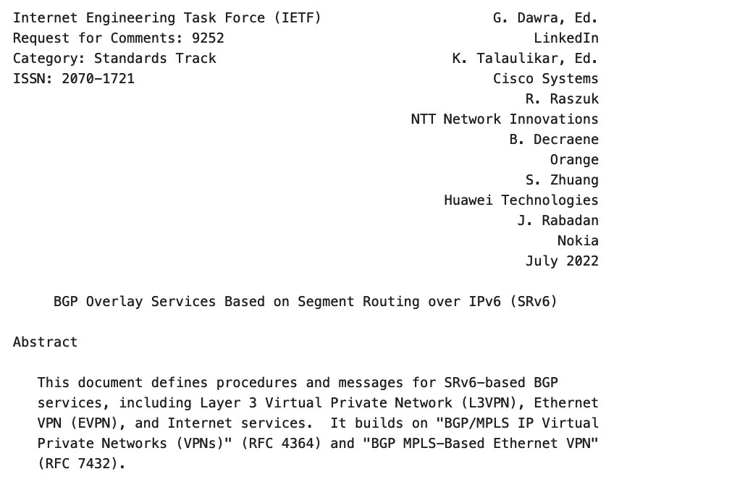
SRv6
BGP Overlay Services

Slide 42
BGP
No Changes Required!
VPNv4 :10.10.22.0/24
NH:2001::3
RD-1:1
RT -1:1
uDT4– fcbb:bb00:3:e002::
iBGP
IPv4 :10.10.22.0/24
NH:10.1.21.1
IPv4 :10.10.22.0/24
NH:10.3.22.22
2001::1
2001::3
eBGP
eBGP
IPv6
CE
1
3
CE
10.1.21.21
10.1.21.1
Locator – fcbb:bb00:3::/48
10.3.22.3
10.3.22.22
uDT4 – fcbb:bb00:3:e002::
Notes:
Simple move of LNX to node 4, change of some physical configas +some slides, visually not very nice…

Slide 43
L3 VPN Dataplane
SA:2001::1
DA:fcbb:bb00:3:e002::
NH:IPv4
SA:10.10.21.10
DA:10.10.22.10
NH:UDP
2001::1
UDP Header/Data
2001::3
SA:10.10.21.10
DA:10.10.22.10
NH:UDP
IPv6
SA:10.10.21.10
DA:10.10.22.10
NH:UDP
UDP Header/Data
UDP Header/Data
CE
1
3
CE
10.1.21.21
10.1.21.1
10.3.22.22
10.3.22.3
uDT 4– fcbb:bb00:3:e002::
Notes:
Simple move of LNX to node 4, change of some physical configas +some slides, visually not very nice…

Slide 44
EVPN
No Changes Required!
EVPN :EVI 7543
NH:2001::3
RD-1:1
RT -1:1
uDX2– fcbb:bb00:3:e002::
iBGP
2001::1
2001::3
IPv6
CE
EVI 7543
1
3
EVI 7543
CE
Locator – fcbb:bb00:3::/48
uDX2 – fcbb:bb00:3:e002::
Notes:
Simple move of LNX to node 4, change of some physical configas +some slides, visually not very nice…

Slide 45
EVPN Dataplane
SA:2001::1
DA:fcbb:bb00:3:e002::
NH:L2
L2 Frame
IPv6
L2 Frame
L2 Frame
CE
EVI 7543
1
3
EVI 7543
CE
Locator – fcbb:bb00:3::/48
uDX2 – fcbb:bb00:3:e002::
Notes:
Simple move of LNX to node 4, change of some physical configas +some slides, visually not very nice…

Slide 46
SRv6 uSID
Conclusion

Slide 47
SRv6 is Fully Standardized
Architecture
SR Architecture – RFC 8402
SRTE Policy Architecture – RFC 9256
Compressed SRv6 Segment List – WG Draft
Data Plane
SRv6 Network Programming – RFC 8986
IPv6 SR header – RFC 8754
Strong Cisco Commitment and Leadership
Editor of 96% IETF RFCs
Co-author of 100% IETF RFCs
Control Plane
SRv6 BGP Services – RFC 9252
SRv6 ISIS – RFC 9352
SR Flex-Algo – RFC 9350
Operation &
Management
SRv6 OAM – RFC 9259
Performance Management – RFC 5357

Slide 48
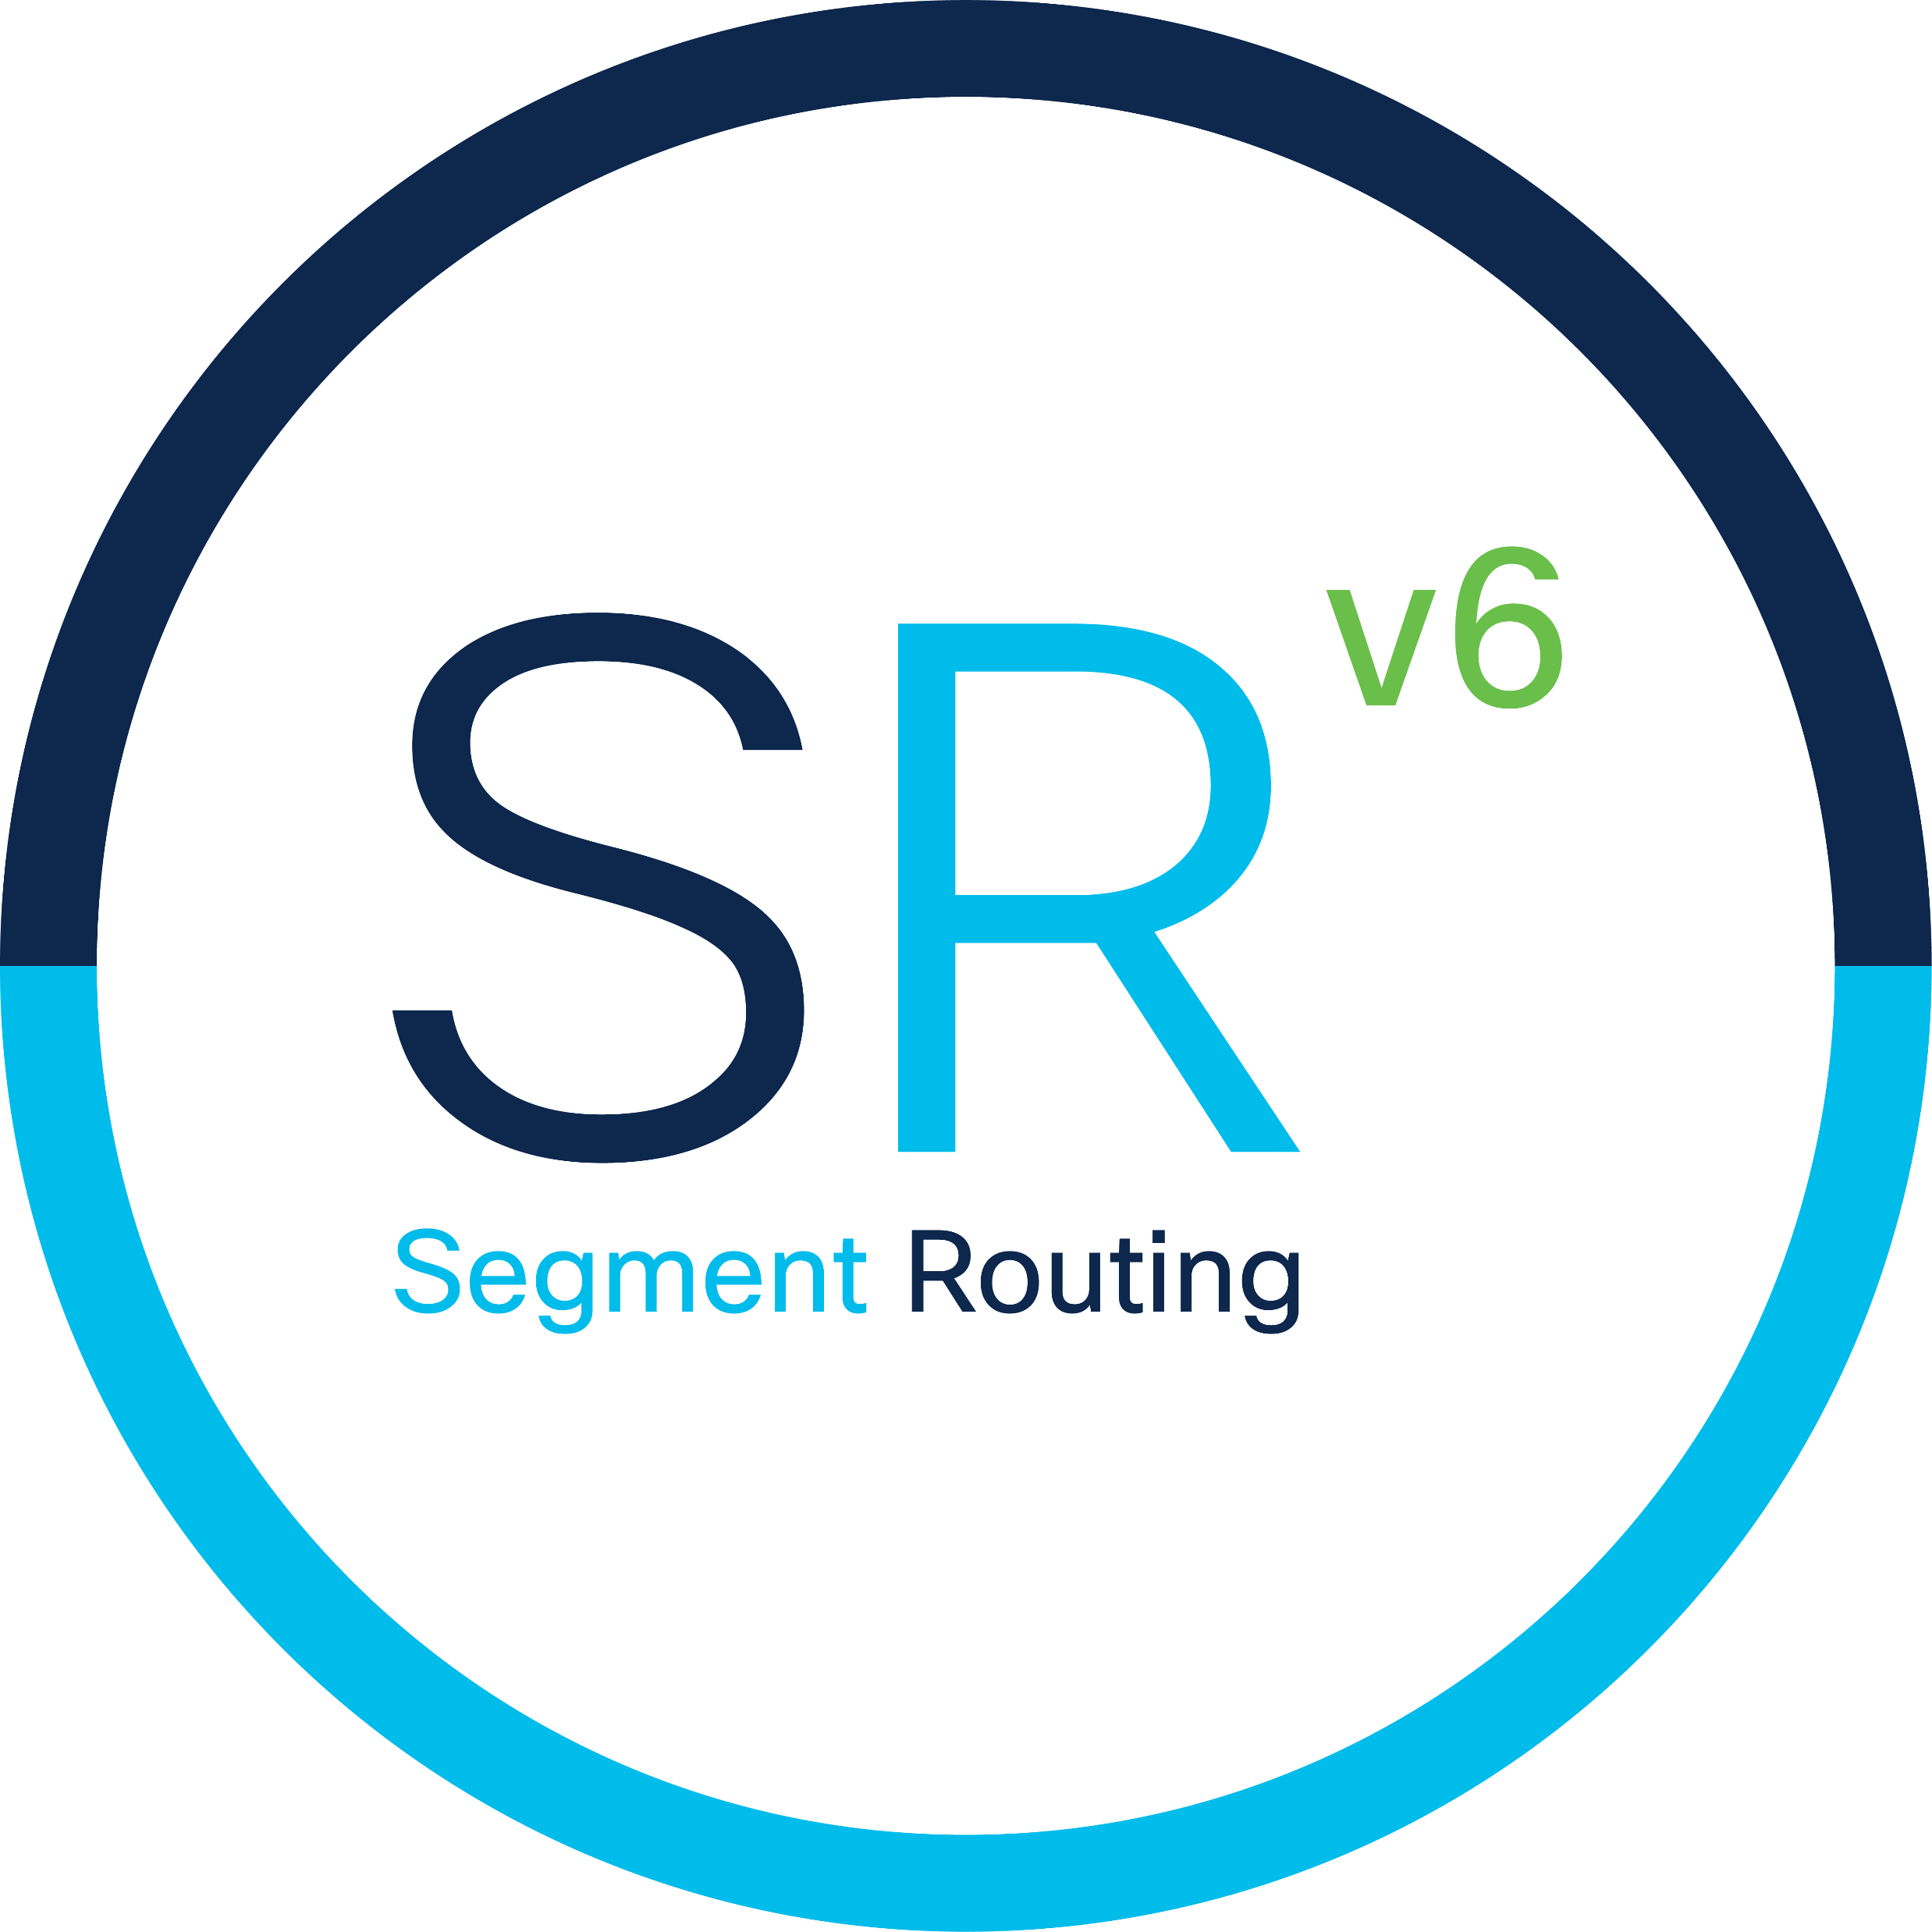
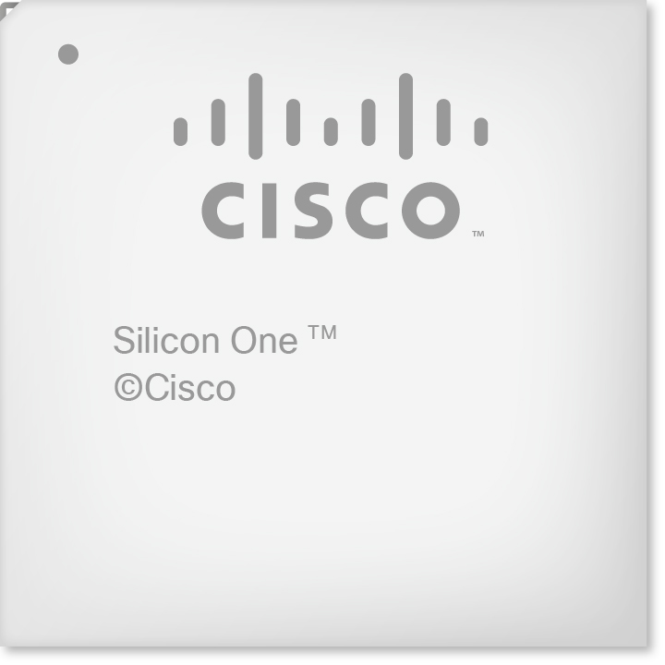
Rich SRv6 uSID Ecosystem
Open-Source Networking Stacks
Network Equipment Manufacturers
FRRouting
Merchant Silicon
Smart NIC
Open-Source Applications
Partners
BGP
Pyroute2
SERA

Slide 49
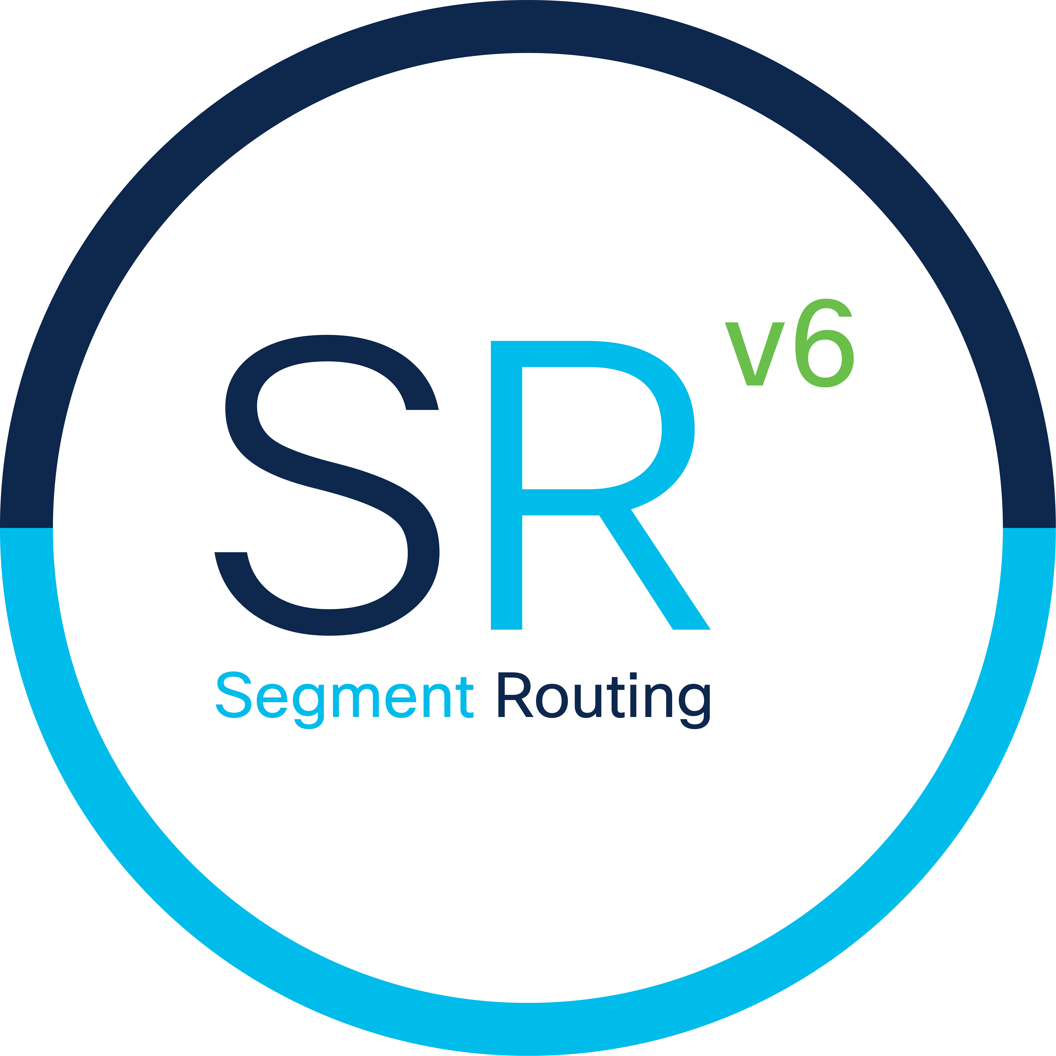
SRv6 … at Record-Speed
Americas
EMEA
APJC
142
160
96
Deployed
Active Testing
Deployment Planned
Notes:
As of Sep 2023:
Total: 398
18 Deployed
380 Planned
21ViaNet ; 2Connect ; Acxiom ; AEW Energie ; Airtel - Bharti Airtel ; AIS ; Alibaba ; Altibox ; Altice - Dominicana (Tricom) ; Altice - France (SFR) ; Altitude Infrastructure ; AM Wireless ; America Movil - Brazil (Embratel) ; America Movil - Mexico (Telmex) ; Aricent ; Armasuisse ; Arvig Communication Systems ; Asset Black ; AT&T ; AT&T Entertainment (DirecTV) ; AT&T India ; Atlantic Broadband ; Aureon ; Aussie Broadband ; Axiata - Indonesia (XL) ; Axiata - Malaysia (Celcom) ; Axiata - Sri Lanka (Dialog) ; Axtel ; Bank of America (BofA) ; Bank of Canada ; Barry Communications ; Beanfield Metroconnect ; Bell Canada ; Belwue ; BMIT ; Bouygues (Bytel) ; British Telecom (BT) ; Cabo Telecom ; Camworth ; Carolina Connect ; CAT Telecom ; Cedar Falls Utilities ; Celeste ; CESNET ; Charter ; China Mobile ; China Network Systems ; China Next Generation Internet (CERNET2) ; China Telecom ; China Unicom ; China Zheshang Bank (CZBank) ; Chinabank ; CHT - Chunghwa Telecom ; City of Buenos Aires ; Claranet ; Cogeco - Peer1 ; Cogeco Cable ; Cogent ; COLT ; Com4 AS ; Comcast ; Comnets Plus ; Consolidated Communications ; COX Communications ; CRIANN ; Crnogorski Telekom ; Ctrip Computer Technology ; Cyberlink ; CyrusOne ; Deutsche Telekom ; Discover Financial ; Dish Network ; Dutch Department of Defense ; Earthlink ; Eastern Telecom - Philippines ; EchoStar (Hughes) ; Edward Jones Investments ; Eir Communications ; Elbit Systems ; Elisa ; Entel ; EOLO ; Etisalat - Saudi Arabia (Mobily) ; Etisalat - UAE ; European Commission ; European Union ; EWW Gruppe ; Facebook ; Fibia ; Flextential ; FREE ; G.Network ; General Datatech (GDT) ; Gila River Communications ; Google ; Google - India ; Google - Marconi ; Government of Switzerland ; Guadalupe Valley Communications ; Hans Networks ; HKT - Hong Kong Telecom ; iBasis ; Iliad - Italy ; Iliad - Jaguar Networks ; InfoWest ; Inteliquent ; Intelsat ; Internet Initiative ; Internet Solutions ; Internet2 ; Itochu Techno-Solutions ; Jack Henry & Associates ; James Valley Telecommunications ; JPMorgan Chase ; JT Group ; Jupiter Telecommunications ; KazTransCom ; KDDI ; Kentik ; KT - Korea Telecom ; Liberty Global ; Lightstorm Telecom ; LINE ; Link Net ; Link3 Technologies ; Lumen (CenturyLink) ; Maha IT ; Maintel ; Maroc Telecom ; MediaCom ; MegaFon ; Megaport ; MetroNet (Metro Fibernet) ; Metrotel ; Microsoft ; Microsoft Azure Cloud ; Morgan Stanley ; MTel Tecnologia ; MTN - Nigeria ; MTN - South Africa ; MTN - Uganda ; NATO ; Naver ; NBB Bank (National Bank of Belgium) ; NBN ; NEC ; Net Brazil ; Net One ; NetEase Games ; Netfast ; Network Solutions Group ; NJEdge ; Nordvest Fiber ; NOS Comunicacoes ; Nsight ; NSS S.A. ; NTT America ; NTT Communications ; NTT Docomo ; NTT East ; NTT France (SASU) ; NTT Germany ; NTT Netherlands ; NTT Poland (ZOO) ; NYU Medical Center ; Obos Opennet ; Oi (Telemar) ; OKI Electric ; Ooredoo - Indosat ; OpenNet Norge ; Optage ; Orange - Spain ; Oriental Cable Network ; OSHEAN ; Otecel ; Over The Wire ; OVHCloud ; Pacnet Business Solutions ; PCCW ; PenTeleData ; People's Bank of China ; Ping An Insurance ; PLDT ; Proximus ; Qatar Petrolium ; Qtel ; Rakuten ; Reliance Jio ; RENCI ; Rogers Communications ; RUAG ; RWS Group ; SALT ; SAP ; SAP - America ; SAP - Saudi Arabia ; Scanplus GmbH ; Schwarz ; Serpro ; Shanghai Broadband Company ; Shanghai Mobile Communications ; Shanxi Telecom ; Shaw Communications ; Sinsidocom ; SK Broadband ; SK Telecom ; SKY - Arabia ; SKY - Italia ; SKY - UK ; Smals ; Smartfren Telecom ; SoftBank ; Sony Corporation ; SRG SSR ; StarHub ; STC - Saudi Telecom Company ; Summit Communications ; Sweden Department of Defense ; Swisscom ; Switch GmbH ; Switzerland Department of Defense ; Symphony & Earthlink ; Tata Communications ; Telco OI ; Tele2 ; Telecom Argentina ; Telecom Egypt ; Telefonica – Brazil(Vivo); Telefonica - Czech Republic (O2) ; Telefonica - UK (O2) ; Telemach ; Telia ; Telia Finland ; Telia Lietuva (Omnitel) ; Telia Norge ; Telkomcel ; Telstra ; Telstra - CEVA ; Teracom Training Institute ; Terago ; TIM - Brazil ; T-Mobile - Austria ; T-Mobile - Hungary ; T-Mobile - Netherlands ; T-Mobile - Poland ; T-Mobile - USA ; T-Mobile (Sprint) ; TPG Telecom (VHA) ; TraxComm ; Trecom ; T-Systems - Austria ; T-Systems - Hungary ; Turkcell ; Twitch ; Twitter ; uCloud ; UEN (Utah Education Network) ; Ulta ; Unisys ; UPC Austria ; UPC Netherland ; US Air Force ; US Marshalls Service ; US Postal Service ; Verizon ; Verizon - India ; Verizon Business ; Verizon Wireless ; Viasat ; Videotron ; Viettel ; Vision Net ; Vodacom ; Vodafone - Germany ; Vodafone - Group ; Vodafone - Idea (Aditya) ; Wasu Media ; Wave Broadband ; Wells Fargo - Wachovia ; WIA ; World Wide Technology (WWT) ; Wuhan Cable ; Yandex ; YouFibre ; Zain - Kuwait ;

Slide 50
Simplicity Always Prevails
LDP RSVP-TE
BGP 3108 MPLS UDP/VxLAN NSH
Furthermore, with more scale
and functionality

Slide 51
Notes:
Thank you very much, for watching this SRv6 usid introduction in 7.3.1 and I am already looking forward to show you some traffic engineering and layer 2 vpns which will be introduced in 7.3.2.
Good bye

