Slide 1
Operator perspective: introducing 400 ZR+
Valerija Kamchevska

Slide 2
How many identify as IP engineers?
How many identify as WDM engineers?
How many are doing ZR+ or planning to do it in the near future?

Slide 3
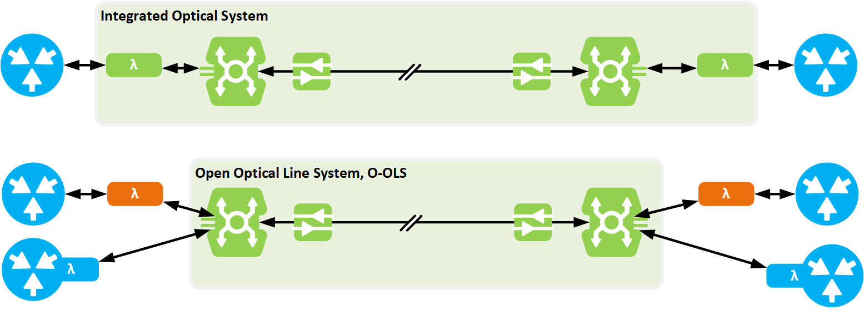
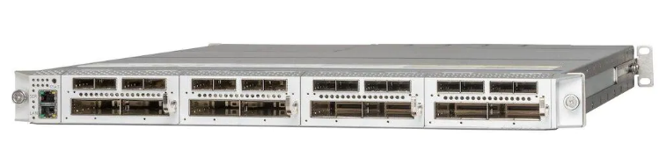
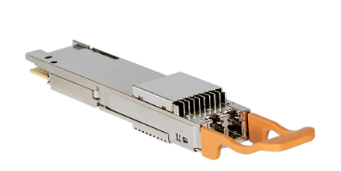
Benefits of IPoWDM with 400G ZR+
Optical Line System (OLS)
What is IPoWDM?
  Coloured interfaces in routers
  Remove the need for transponders
The benefits:
  64% CAPEX savings *
  76% OPEX savings *
Optical transponder shelf
QSFP DD
* https://acacia-inc.com/blog/arelion-and-cenic-implement-bright-400zr-coherent-pluggables-for-high-performance-and-more-cost-effective-and-efficient-networks/

Slide 4
Step 1: Go or no-go?
Technical considerations:
  Can your IP router host the ZR+?
  Are you running a software release in which the ZR+ is supported?
  Do you want to run this over your closed/open OLS?
Do people agree it is a good idea? Should you do it?
  WDM people are probably more concerned, as they are aware of what can go wrong
  If one doesn’t know the underlaying WDM topology one won’t know if one is configuring the same wavelength twice in one direction

Slide 5
Step 2: Planning
Where can you deploy it?
  In a closed system, one can simulate and verify the system performance in a vendor planning tool
  In an open system, neither vendor has the full picture, and the operator acts as the integrator
  We asked both our OLS and ZR+ vendor to simulate the performance
Link | Length | OLS vendor | ZR+ vendor | Use ZR+?​
1​ | 20 km | Yes​ | Yes​ | Yes​?
2 | 224 km | No​ | Yes​ | Maybe?​
3 | 320 km | No​ | Yes​ | Maybe​?
4 | 96 km | Yes​ | Yes​ | Yes​?
5 | 79 km | Yes​ | Yes​ | Yes​?
6​ | 132 km | No​ | Yes​ | Maybe?​
7 | 502 km | No​ | No​ | No​?
8 | 328 km | No​ | Yes​ | Maybe?​
9 | 174 km | Yes​ | Yes​ | Yes​?

Slide 6
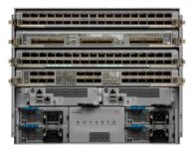
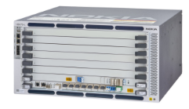
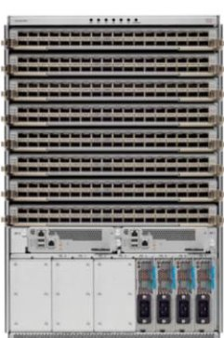
ZR+ field trial
Site 4
Nokia OT shelf
Tested three IP links
  Link 1: 20km, ROADM to ROADM
  Link 2: 132km, 1x ILA
  Link 3: 224km, 2x ILA
ZR+ hosted in Cisco IP routers
Nokia based OLS
Alongside a single native channel
Conclusions:
  Worked on all three links
  Measured performance was closer to the ZR+ vendor validation
  The laser is on by default, transmitting -10dBm at 193.1 THz
Nokia OLS shelf
ILA 3
Cisco IP routers
Site 3
Site 2
ILA 2
ILA 1
Site 1

Slide 7
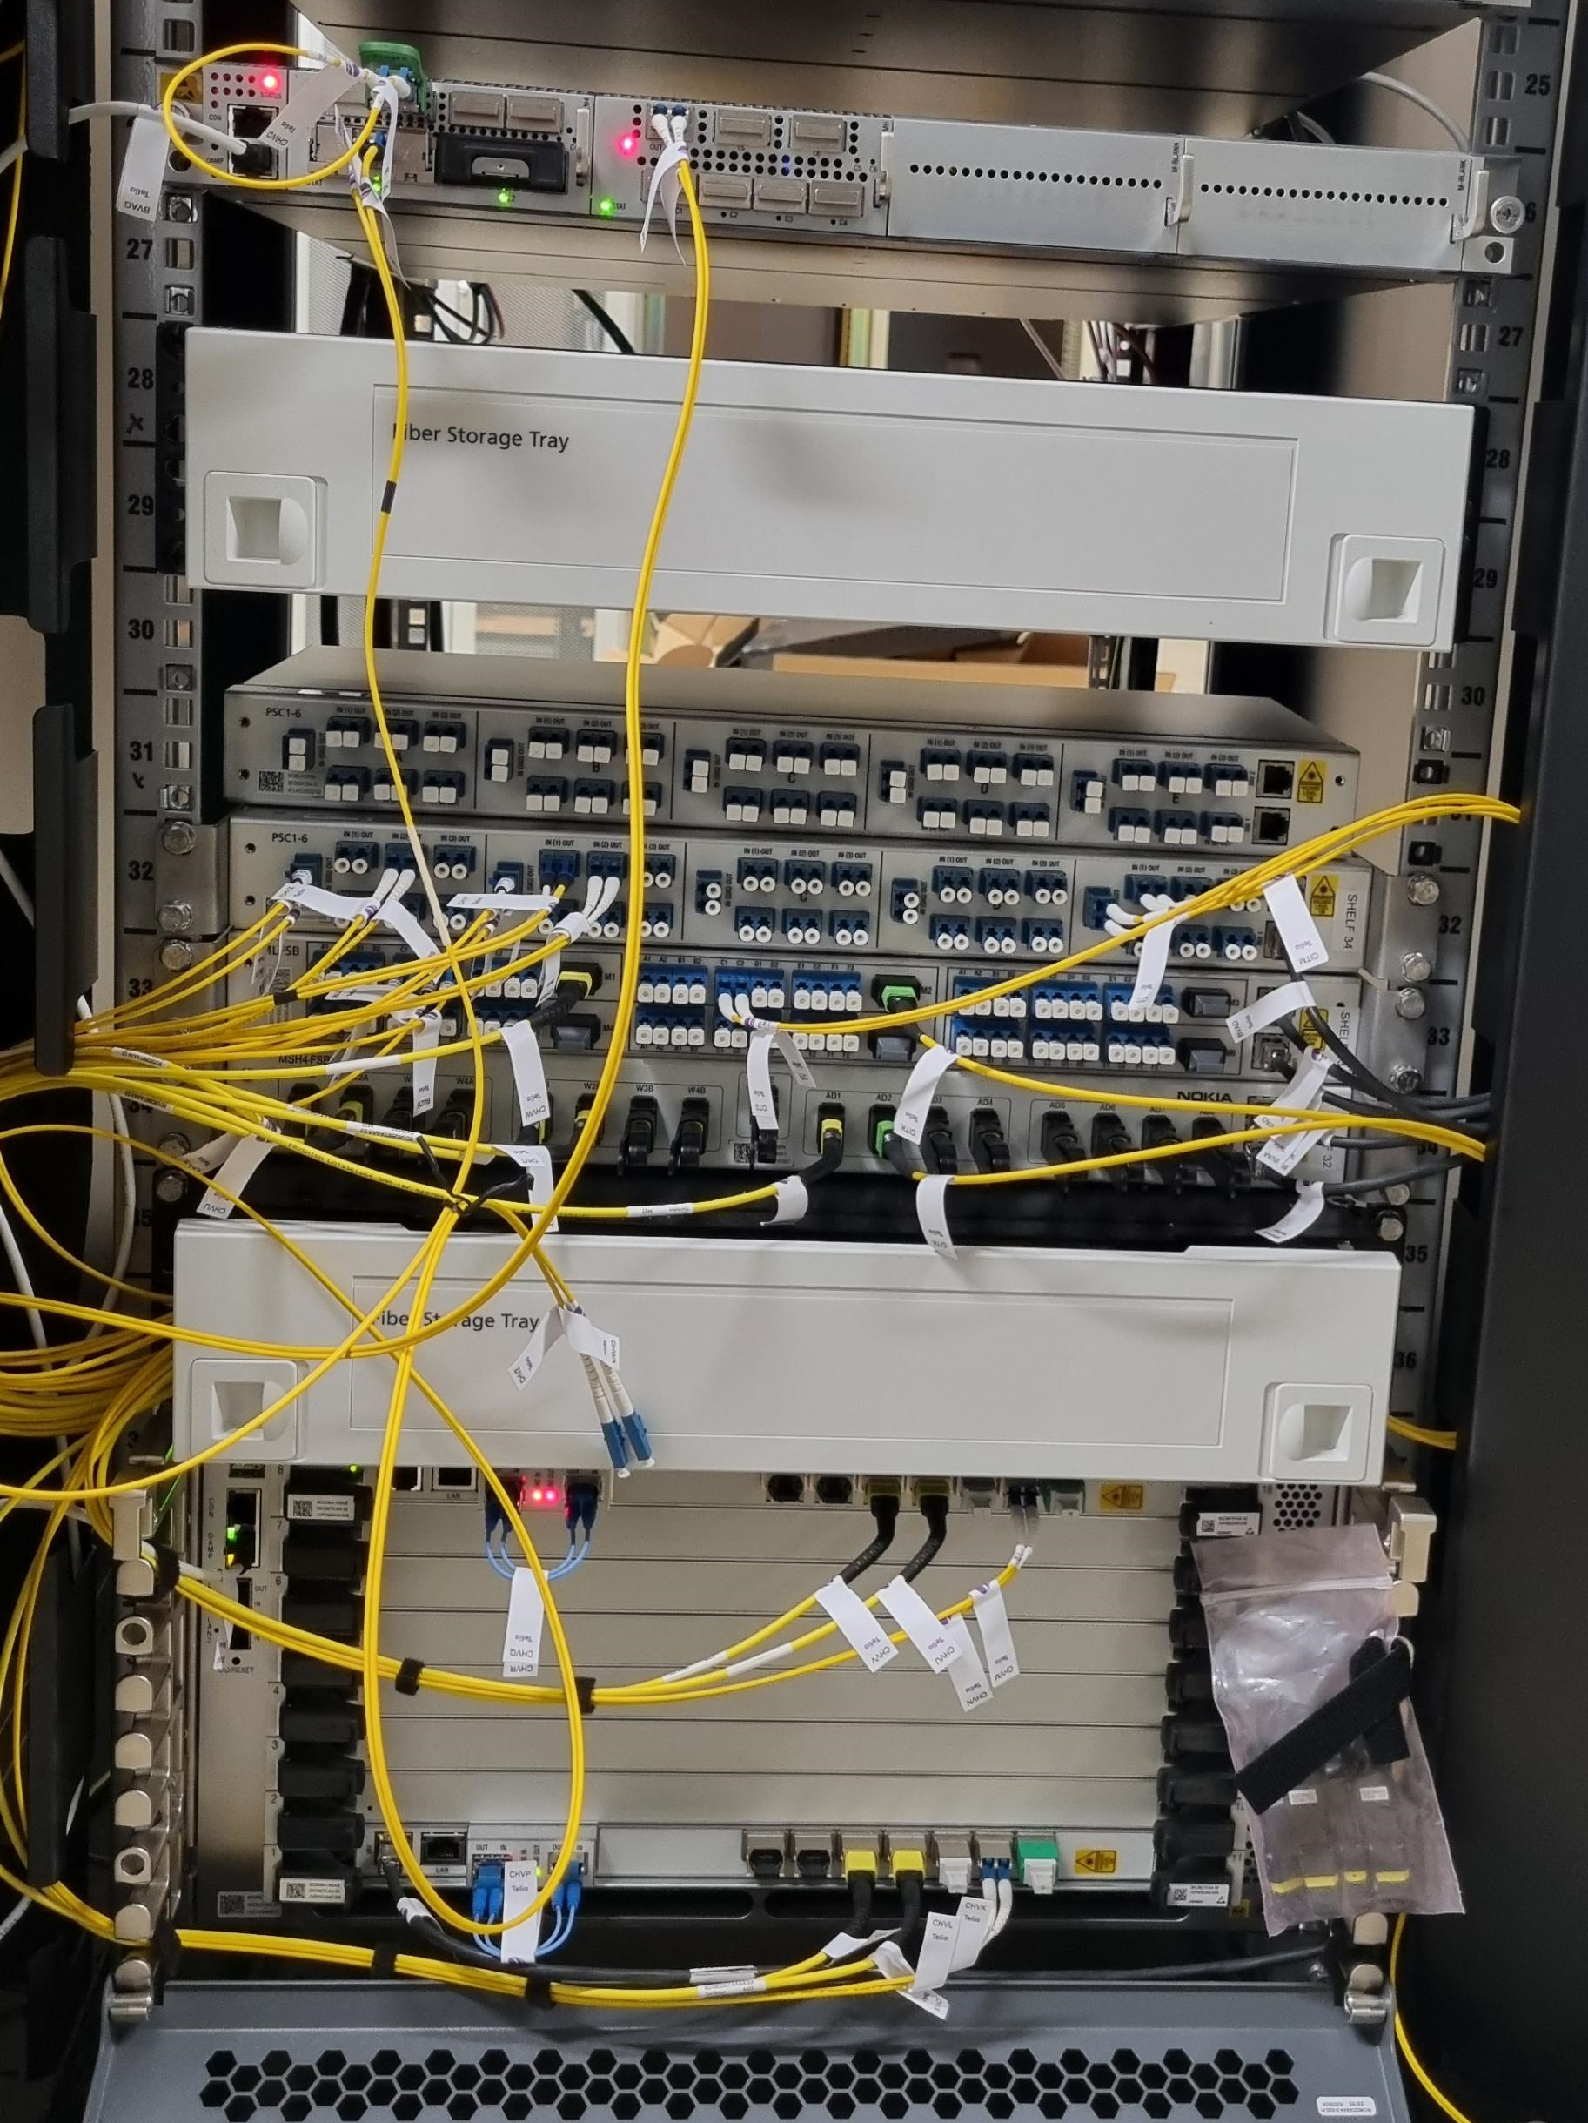
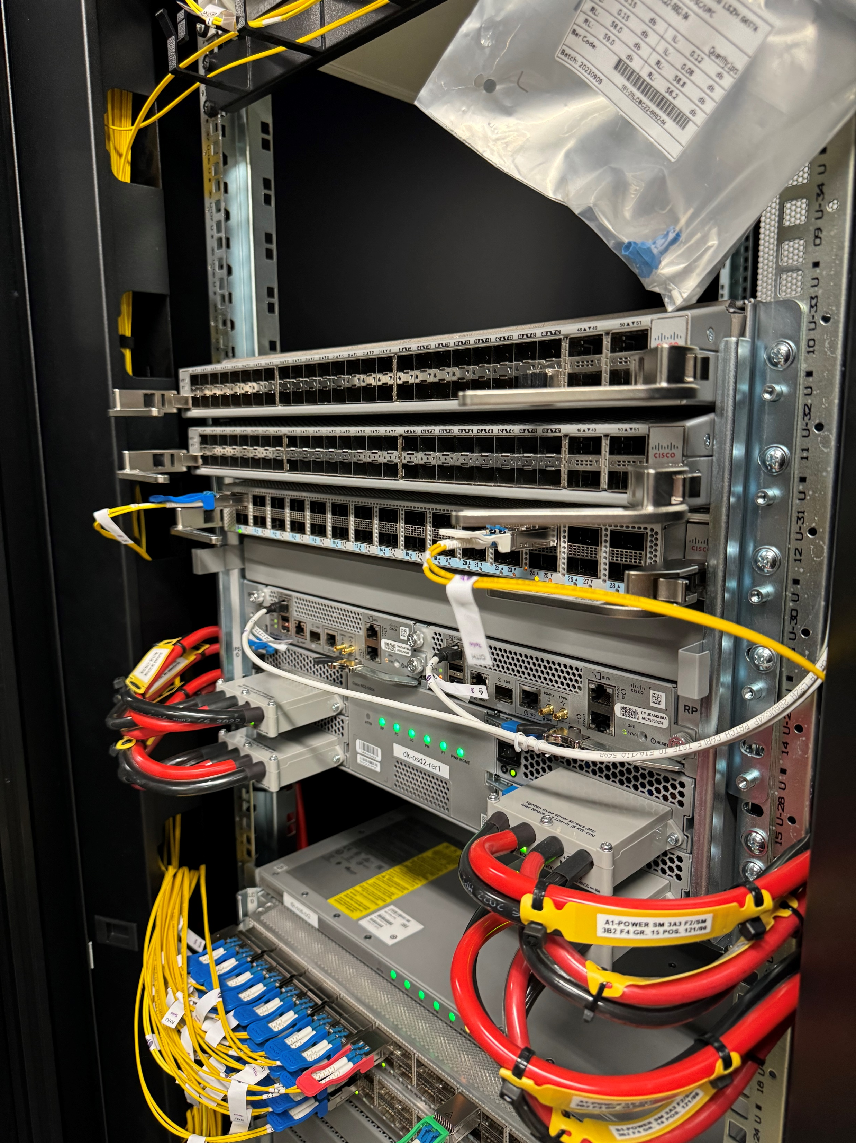
Step 3: More testing, processes and trainings
How do we put this into production?
  Who plans the ZR+?
  Who implements the ZR+?
  Who operates the ZR+?
  When to involve which vendor?
  Upskilling IP and WDM engineers
  Upskilling field technicians

Slide 8
Benefits: It is not only about the cost!
It is equally about breaking silos and building better networks!
Shortly after a basic WDM training for the IP people, an IP engineer identified a specific fault scenario in the WDM network that would have caused an incident in the IP network, that we weren’t aware of

Slide 9
Thanks

