Slide 1
DNS-OARC :
Community, Technical excellence and Peer networking in the DNS space
Phil Regnauld
DKNog 14, March 8th, 2024

Slide 2
OARC ?
DNS Operations, Analysis & Research Center
Started at ISC (Internet Software Consortium), 2003
Since incorporated as a 501(c)(3) / nonprofit
Initially a trust group and data sharing initiative
https://dns-oarc.net/

Slide 3
OARC Mission?
Promote and conduct research with operational relevance through data collection and analysis
Develop and maintain tools & services for the community
Enable knowledge transfer by organizing open workshops
Foster relationships among its community of members
Increase public awareness of the DNS's significance

Slide 4
OARC’s Members
Operators, incl. ccTLDs registries & registrars
Researchers & Universities
Developers

Slide 5
1. Data & Research
Nearing 1 PB of data – mix of DNS traces submitted by members, DITL data, historical zone files, …
Opportunity for researchers, vendors and operators to access unique datasets
DNS OARC is the place to share data during and after incidents have taken place
Post mortems, unusual traffic patterns
The “DNS autopsy room”

Slide 6
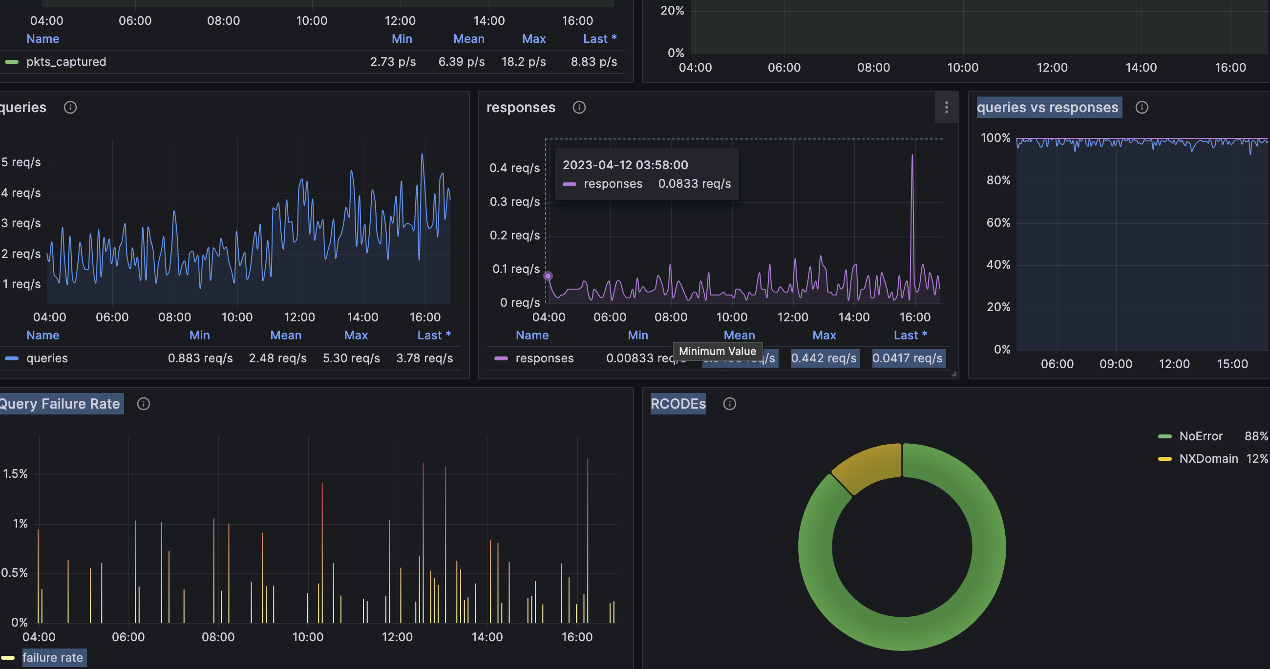
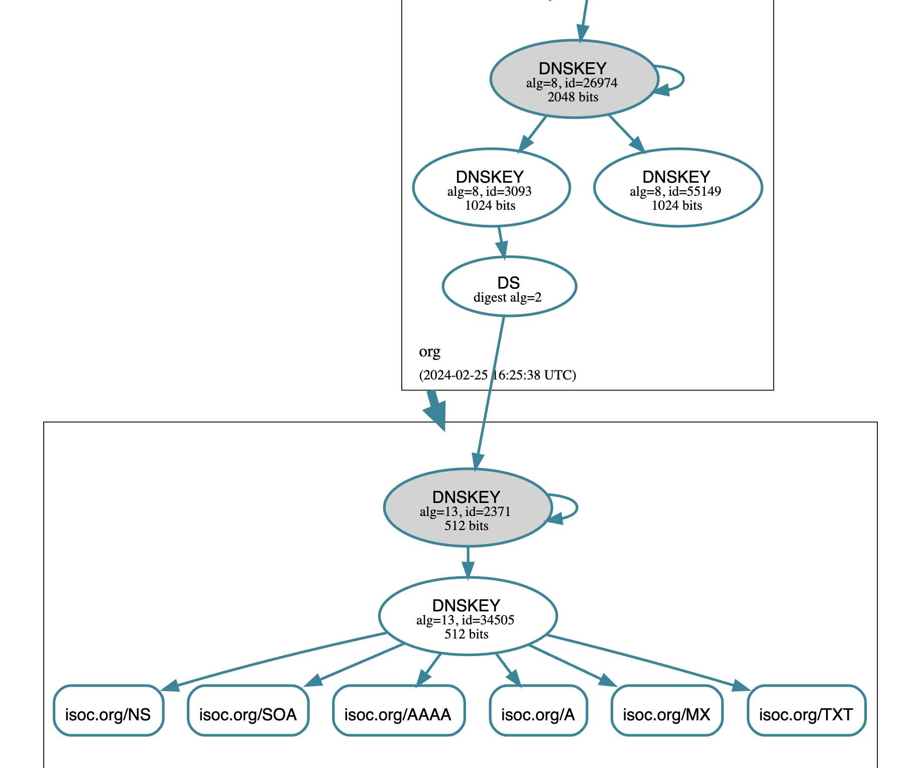
2. Tools & services
dsc / dnscap / dnsperf / dnsjit
CheckMyDNS
DNSViz

Slide 7
3. Conference & workshops
Often at intersection of DNS and networking
Where else would you learn that:
DNS isn’t ready for IPv6 (or is that the other way around ?)
Or, fragmentation is a bitch
DNS records stick around longer than TTL/cache time
Having 82 TXT records in your zone Apex is not a great idea ?
*XFR does not scale to millions of zones

Slide 8
3. Conference & workshops
OARC 41 Da Nang, Vietnam, co-located with ICANN IDS
OARC 42 Charlotte, NC
OARC 43 in … ?

Slide 9
4. Community
OARC is an open forum
Attending events is open to everyone
Most discussions are taking part on public lists/forum
Mattermost - https://chat.dns-oarc.net/
The place to discuss implementation & operational BCPs
Mutual assistance with operational issues
If you become a member ($)
Participating in its governance
Accessing data shared by other members

Slide 10
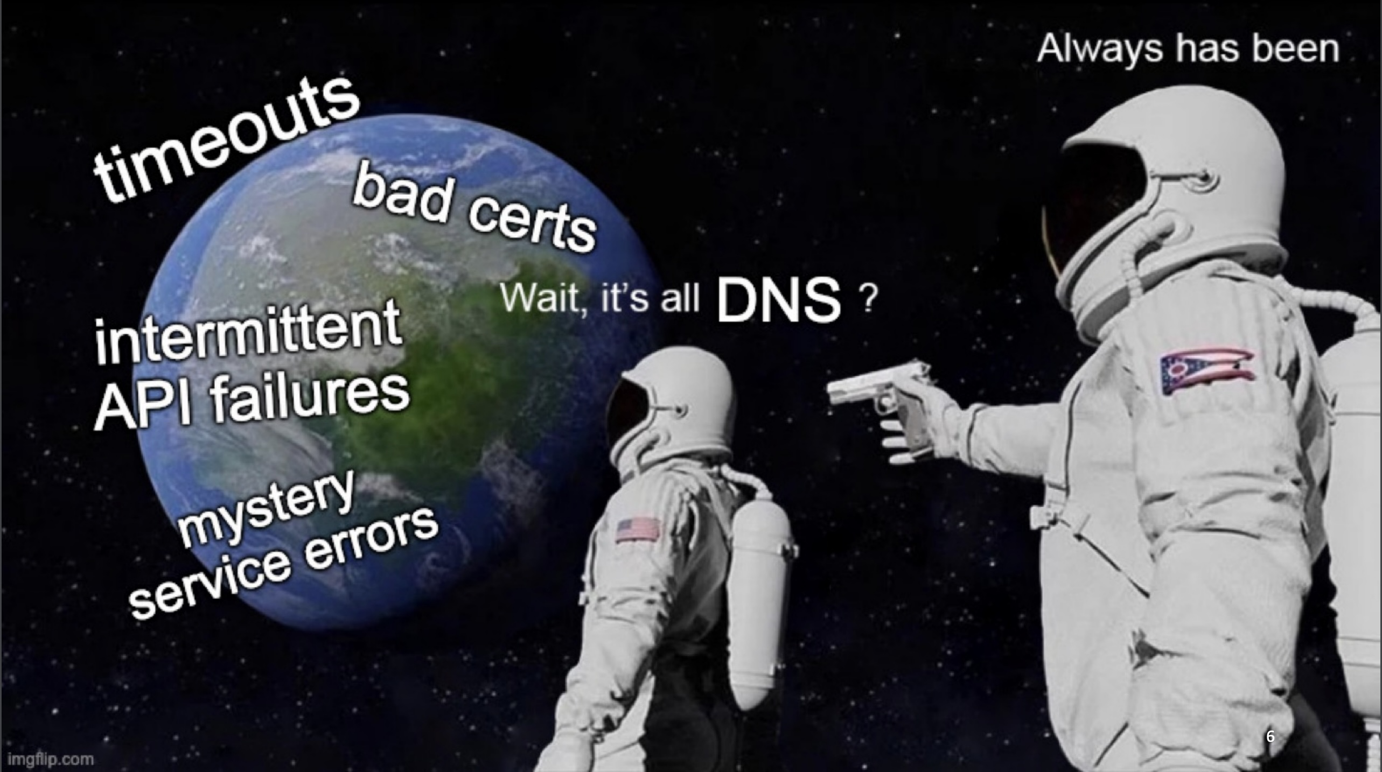
5. Public awareness

Slide 11
OARC Future
Work to make the data more widely available to collaborators
Data access services (API, data explorers)
Increase geographical diversity of participation
Outreach, Fellowships
More events in Europe

Slide 12
Questions ?
Happy International Women’s Day!

