Slide 1
DKNOG mentorship program

Slide 2
Why should you do it?
Career development
Changing jobs
Work-life balance
Company mergers
Technology
Conflicts
Exchange knowledge
Have an objective listener to mentor you

Slide 3
Overview of the program
For free
For people residing in DK (or nearby) to allow for in person meetings
The program language is English
Meant for anyone in the networking industry/academia, irrespective if you attended DKNOG

Slide 4
Timeline
5 months (April – September)
Meeting for 1h biweekly = 8 to 10 sessions in total
The events are recommended, but optional
Mentor-mentee meetings
Registration
opens
Registration
closes
Matching
finalized
Intro
meeting
Midway
event
Final
event
5th March
28th March
03 April
Beginning
of April
Beginning
of June
Beginning
of September

Slide 5
Matchmaking
Experience level
Mentee ambitions and mentor skills
Location

Slide 6
Expectations for mentees and mentors
Mentees are responsible for
driving the overall process
defining goals
arranging meetings
suggesting topics for discussion
Mentors are there to
be active listeners
ask the right questions
share their own experiences
help the mentee on their journey

Slide 7
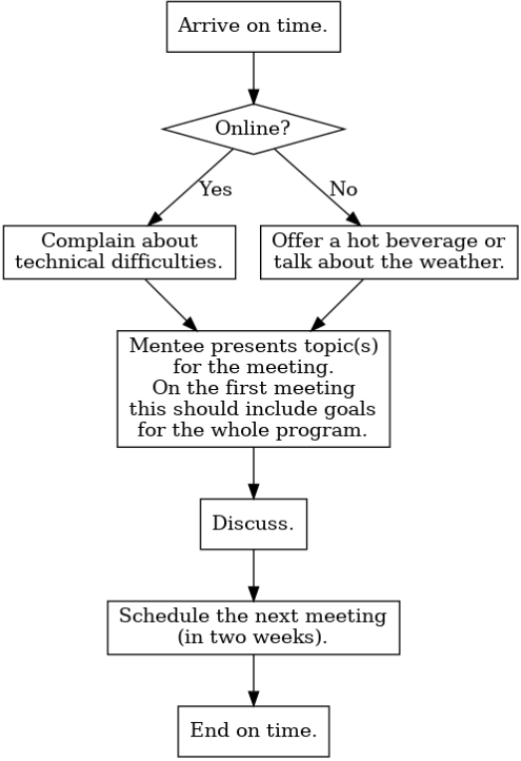
For both
We know what works in one meeting or with one person might not necessarily work with another
Don’t worry, we’ve got you covered

Slide 8
What did I learn from being mentee 3 times?
Switch off mail notifications on my phone after work time
We attend Science and Cocktails together
Just started!

Slide 9
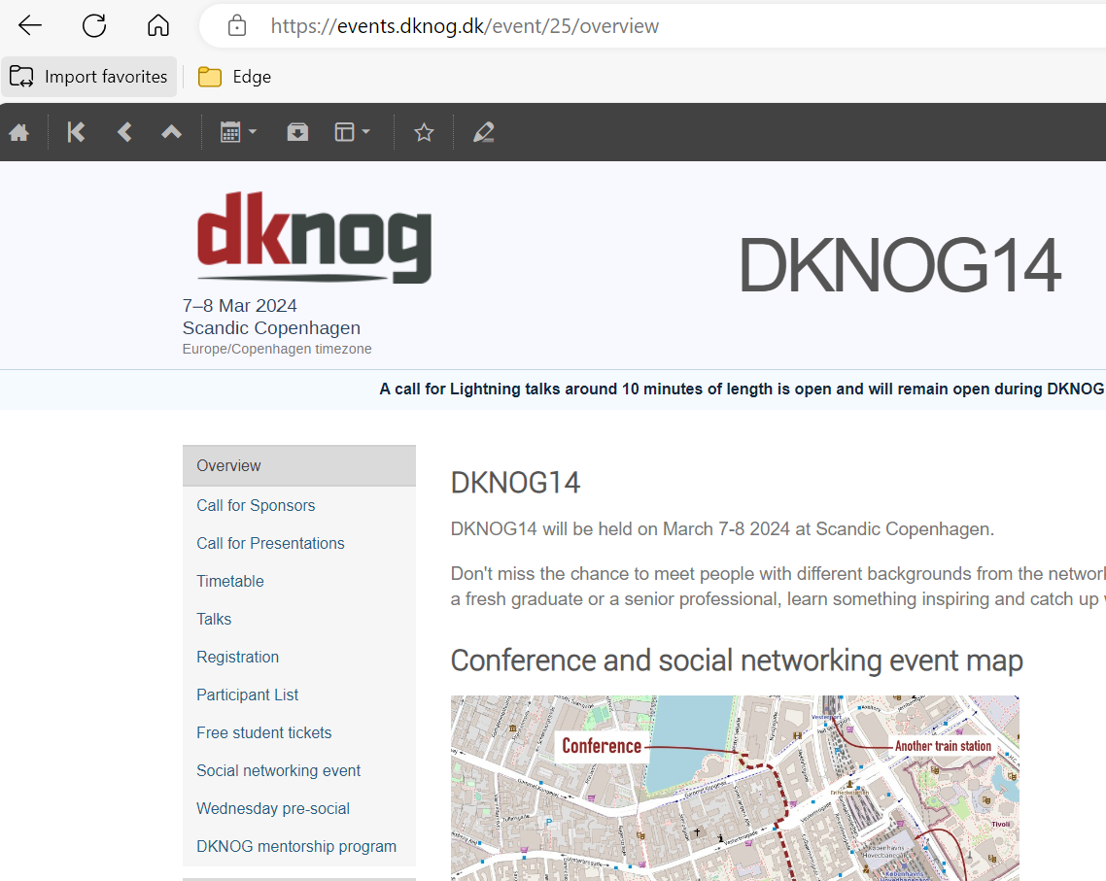
https://events.dknog.dk/e/mentorship

Slide 10
A mentor is someone who allows you to see the hope inside yourself
Oprah Winfrey

