Slide 1
Welcome!

Slide 2
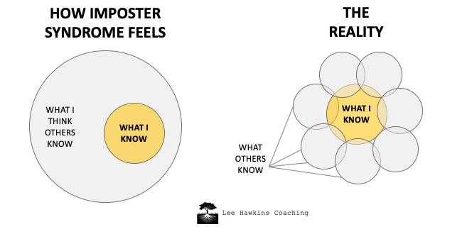
Imposter syndrome
Don’t feel intimidated
Yes, there are some really smart people here
Learn from them
Go ahead and ask your question.
The person next to you, will likely be grateful
We are all here to learn!

Slide 3
Be like Pacman

Slide 4
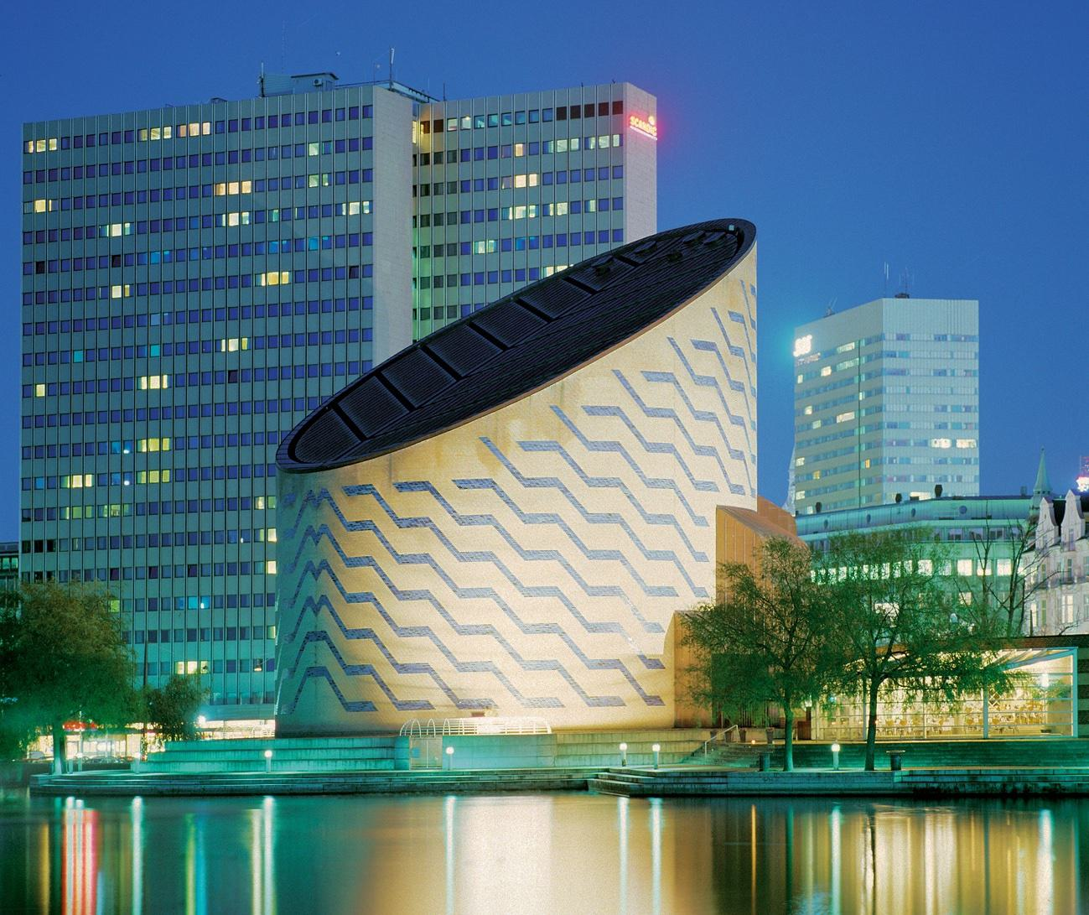
Social information
Sold out.
Check your registration page.
Email us if you know you can’t make it.
Email us to be added to the waiting-list.

Slide 5
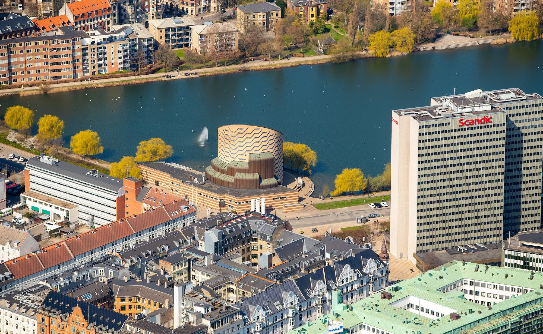
Social 18:00
You are here
Go here

Slide 6
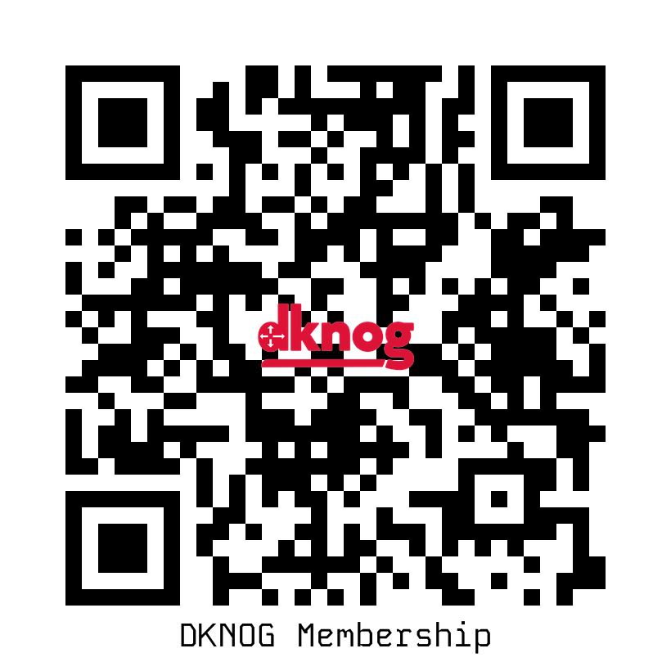
Become a member!
Did you remember to register as a member during the conference signup?
https://membership.dknog.dk/

Slide 7
Sponsors
Platinum

Slide 8
Sponsors
Gold

Slide 9
Sponsors
Silver

Slide 10
Sponsors
Associate
Coffee

Slide 11
Be like Pacman

