Slide 1
The RouteViews Project:
Update
Nina Bargisen <nina@routeviews.org>,
ZAPF8, Cape Town 14th November 2024

Slide 2
Background
RouteViews was first started in 1995
Now a growing network of 40+ collectors positioned strategically at Internet Exchange Points around the world
RouteViews collaborates with the Center for Applied Internet Data Analysis (CAIDA) working with NSF grants that support Designing a Global Measurement Infrastructure to Improve Internet Security, GMI3S (OAC-2131987), and an Integrated Library for Advancing Network Data Science, ILANDS (CNS-2120399).
RouteViews is supported with financial and in-kind donations by multiple organizations
RouteViews is based at the University of Oregon and operated by NSRC
NSRC supports the growth of global Internet infrastructure by providing engineering assistance, collaborative technical workshops, training, and other resources to university, research & education networks worldwide.
NSRC is partially funded by the IRNC program of the NSF ( OAC-2029309) and Google with other contributions from public and private organizations.
The University of Oregon is a public research institution in Eugene, Oregon, USA founded in 1876.

Slide 3
RouteViews Team Members
Hans Kuhn
Nina Bargisen
Owen Conway
Philip Smith

Slide 4
What is RouteViews
A tool that allows Internet network operators to look at the BGP table from different backbones and locations around the world to troubleshoot and to assess:
Reachability, hijacks, bugs, peer visibility, mass withdrawals, RPKI status,…
Operators who find it a valuable tool also peer to contribute to the value
RouteViews operates collectors strategically positioned at IXPs around the world.
It also hosts a few multi-hop collectors at UO for those operators who are not present at IXPs.

Slide 5
What is RouteViews
Many free and commercial tools used by network engineers every day include data from RouteViews
CAIDA ASRANK
CAIDA BGP Reader
HE BGP Tools
Kentik Market Intelligence
Kentik BGP monitoring
Catchpoint
BGPMon
And many more

Slide 6
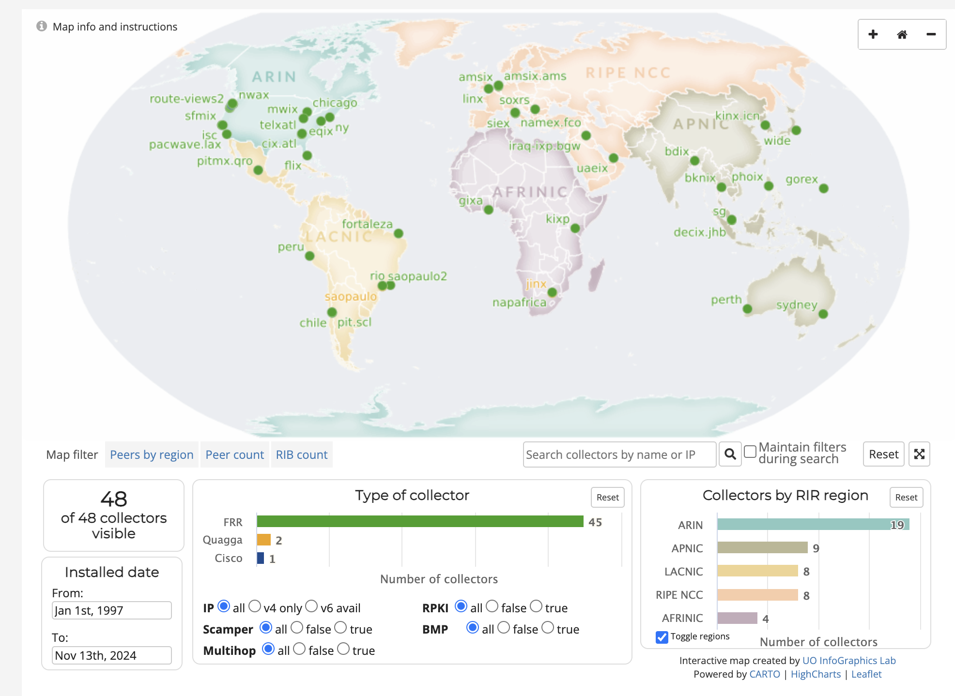
RouteViews Collector Map
http://www.routeviews.org/routeviews/index.php/map/

Slide 7
For network operators & researchers
USING ROUTEVIEWS

Slide 8
Using RouteViews
Network Operators use the live data to analyse how their routes appear on the Global Routing System
Researchers use the 27-year-old data archive to study trends, route hijacks, and changes such as:
Origin change
Next-hop change
New prefix / more specifics
New neighbours
Operator ASN appearing in a new transit path
Bogons

Slide 9
Use Cases – peering negotiation
Understanding your prospects connectivity can be key to a good negotiation
Who are the upstreams?
Who are the peers?
Who are the customers?
Let’s have a look at AS2018 as an example

Slide 10
Connected Networks: Multihop Collector
route-views2.routeviews.org> sh bgp sum
32 peers, multi-hop
IPv4 Unicast Summary (VRF default):
BGP router identifier 128.223.51.102, local AS number 6447 vrf-id 0 BGP table version 2376140
RIB entries 1842070, using 169 MiB of memory Peers 32, using 644 KiB of memory
Lots of full tables
Neighbor | V | AS | MsgRcvd | MsgSent | TblVer | InQ | OutQ | Up/Down | State/PfxRcd | PfxSnt | Desc
12.0.1.63 | 4 | 7018 | 278377 | 377 | 2376140 | 0 | 0 | 06:14:18 | 938553 | 0 | ATT
37.139.139.17 | 4 | 57866 | 281167 | 751 | 2376140 | 0 | 0 | 06:14:18 | 941733 | 0 | Fusix
45.61.0.85 | 4 | 22652 | 430462 | 754 | 2376140 | 0 | 0 | 05:30:45 | 943602 | 0 | FIBRENOIRE
62.115.128.137 | 4 | 1299 | 1145666 | 377 | 2376140 | 0 | 0 | 06:14:18 | 919817 | 0 | Telia
64.71.137.241 | 4 | 6939 | 222621 | 376 | 2376140 | 0 | 0 | 06:14:18 | 961672 | 0 | Hurricane Electric
77.39.192.30 | 4 | 20912 | 199676 | 2247 | 2376140 | 0 | 0 | 06:14:18 | 942334 | 0 | PANSERVICE
87.121.64.4 | 4 | 57463 | 124693 | 375 | 2376140 | 0 | 0 | 06:13:35 | 483102 | 0 | NETIXLTD
89.149.178.10 | 4 | 3257 | 301777 | 377 | 2376140 | 0 | 0 | 06:14:18 | 939075 | 0 | Tiscali
91.218.184.60 | 4 | 49788 | 280255 | 376 | 2376140 | 0 | 0 | 06:14:18 | 943183 | 0 | NEXTHOPNO
94.156.252.18 | 4 | 34224 | 365615 | 376 | 2376140 | 0 | 0 | 06:14:17 | 965856 | 0 | NETERRA
105.16.0.247 | 4 | 37100 | 304500 | 746 | 2376140 | 0 | 0 | 06:11:16 | 942394 | 0 | SEACOM
129.250.1.71 | 4 | 2914 | 267752 | 751 | 2376140 | 0 | 0 | 06:14:18 | 939523 | 0 | NTT-A
137.164.16.84 | 4 | 2152 | 219827 | 376 | 2376140 | 0 | 0 | 06:14:18 | 941035 | 0 | CENIC
140.192.8.16 | 4 | 20130 | 247609 | 751 | 2376140 | 0 | 0 | 06:14:18 | 964417 | 0 | DEPAULEDU
144.228.241.130 | 4 | 1239 | 4442 | 377 | 2376140 | 0 | 0 | 06:14:17 | 45863 | 0 | Sprint
147.28.7.1 | 4 | 3130 | 421 | 376 | 2376140 | 0 | 0 | 06:14:18 | 14 | 0 | RGnet, LLC

Slide 11
Connected networks: Multihop Collector
route-views3.routeviews.org# sh ip bg regexp _2018$
BGP table version is 12697779, local router ID is 128.223.51.108, vrf id 0
Default local pref 100, local AS 6447
Status codes: s suppressed, d damped, h history, * valid, > best, = multipath,
i internal, r RIB-failure, S Stale, R Removed
Nexthop codes: @NNN nexthop's vrf id, < announce-nh-self
Origin codes: i - IGP, e - EGP, ? - incomplete
RPKI validation codes: V valid, I invalid, N Not found
Network Next Hop Metric LocPrf Weight Path
N* 41.74.144.0/22 195.239.77.236 0 3216 2018 i
N* 109.233.62.1 0 29479 50304 2018 i
N* 195.239.252.124 0 3216 2018 i
N* 104.251.122.1 0 14315 2914 20080 2018 i
N* 158.106.197.135 0 46450 2914 20080 2018 i
N* 202.150.221.33 0 38001 2914 20080 2018 i
N* 89.149.178.10 10 0 3257 174 2018 2018 i
N* 190.15.124.18 0 61568 2018 i
N* 163.253.3.22 0 11537 2018 i
N* 205.171.200.245 0 0 209 3356 2914 20080 2018 i
N* 67.219.192.5 0 19653 2914 20080 2018 i
N* 203.62.187.103 0 9268 4764 3356 2914 20080 2018 i
N* 210.5.41.225 0 45352 2018 i
N* 64.71.137.241 0 6939 2018 i
N* 203.62.187.102 0 9268 4764 3356 2914 20080 2018 i
N*= 94.101.60.146 0 39120 2018 i
N*> 89.21.210.85 0 39120 2018 i
Connected ASNs
Prepends indicate upstream
Tier 1 network

Slide 12
Downstreams: Local Collector
route-views.napafrica.routeviews.org# sh ip bgp regexp ^2018(_.+)+$
BGP table version is 250650352, local router ID is 196.60.9.68, vrf id 0
Default local pref 100, local AS 6447
Status codes: s suppressed, d damped, h history, * valid, > best, = multipath,
i internal, r RIB-failure, S Stale, R Removed
Nexthop codes: @NNN nexthop's vrf id, < announce-nh-self
Origin codes: i - IGP, e - EGP, ? - incomplete
RPKI validation codes: V valid, I invalid, N Not found
Network Next Hop Metric LocPrf Weight Path
N*> 137.158.0.0/16 196.60.8.216 0 2018 36982 i
N*> 143.160.0.0/24 196.60.8.216 0 2018 8094 i
N*> 143.160.240.0/20 196.60.8.216 0 2018 8094 i
N*> 146.182.0.0/16 196.60.8.216 0 2018 37501 i
N*> 146.182.0.0/17 196.60.8.216 0 2018 37501 i
N*> 146.182.128.0/17 196.60.8.216 0 2018 37501 i
N*> 146.231.0.0/16 196.60.8.216 0 2018 37520 i
V*> 154.114.25.0/24 196.60.8.216 0 2018 36982 i
V*> 154.115.0.0/24 196.60.8.216 0 2018 6149 i
V*> 154.115.112.0/20 196.60.8.216 0 2018 36982 i
N*> 192.42.99.0/24 196.60.8.216 0 2018 37520 i
N*> 196.6.221.0/24 196.60.8.216 0 2018 8094 i
V*> 196.21.40.0/24 196.60.8.216 0 2018 37501 i
V*> 196.21.158.0/24 196.60.8.216 0 2018 37501 i
V*> 196.21.159.0/24 196.60.8.216 0 2018 37501 i
V*> 196.21.164.0/22 196.60.8.216 0 2018 8094 i
downstream ASNs

Slide 13
Make life easier for your NOC
Often customers and peers contact your noc with routing issues. Announcing your routes to RouteViews, helps your engineers to see your network from the rest of the Internet.
Example: You want to balance traffic between your upstreams but the deaggregation scheme is not working

Slide 14
Make life easier for your NOC
upstream
route-views3.routeviews.org# sh ip bg 220.239.64.0
BGP routing table entry for 220.239.64.0/20, version 10370995
Paths: (1 available, best #1, table default)
Not advertised to any peer
38001 7473 4804 4804
202.150.221.33 from 202.150.221.33 (10.11.33.29)
Origin IGP, valid, external, best (First path received), rpki validation-state: invalid
Community: 38001:100 38001:3003 38001:8003
Last update: Sun Nov 10 14:28:09 2024
route-views3.routeviews.org#
RPKI state

Slide 15
Make life easier for your NOC
upstream
route-views3.routeviews.org# sh ip bg 220.239.64.0/19
BGP routing table entry for 220.239.64.0/19, version 9454097
Paths: (25 available, best #24, table default)
Not advertised to any peer
9268 4764 1221 7474 4804, (aggregated by 4804 198.142.65.160)
203.62.187.103 from 203.62.187.103 (203.62.187.103)
Origin IGP, valid, external, atomic-aggregate, rpki validation-state: valid
Community: 0:2011 9268:2124
Last update: Mon Nov 4 04:04:03 2024
9268 4764 1221 7474 4804, (aggregated by 4804 198.142.65.160)
203.62.187.102 from 203.62.187.102 (203.62.187.102)
Origin IGP, valid, external, atomic-aggregate, rpki validation-state: valid
Community: 0:2011 9268:2124
Last update: Mon Nov 4 02:34:28 2024
route-views3.routeviews.org#

Slide 16
Make life easier for your NOC
Ups – we forgot to create new ROAs so networks are dropping the longer prefixes
Go fix

Slide 17
PEERING WITH ROUTEVIEWS
For Peering Coordinators

Slide 18
Peering with RouteViews
RouteViews has an Open peering policy
PeeringDB: https://www.peeringdb.com/asn/6447
We require all peers to have a PeeringDB entry
Our tools build peering options (for IXP based collectors) and configurations from PeeringDB
Peering:
Over IPv4 (for IPv4 prefixes) and IPv6 (for IPv6 prefixes)
We want to receive the entire BGP table (if operationally possible)
Please do not use “add-path” or send us bogon routes
We do not send you any prefixes (please don’t ask)

Slide 19
Peering with RouteViews
Presence in multiple IXP locations?
It can be interesting to peer; we will assess based on available capacity
Will we peer with everyone?
If you peer with IXP Route Servers, you will be peering with AS6447
We are more selective about bi-lateral and multi-hop peerings
We are interested in new, interesting, diverse peers all around the world

Slide 20
What’s happening at RouteViews
ROUTEVIEWS NEWS

Slide 21
RouteViews News
Collectors:
The majority use FRR¹ (either version 9.1 or 10)
One Cisco ASR1004 and one (still) using Quagga
Moving collectors from metal to VMs (easier deployment & management)
Location update:
Recent additions include CIX-ATL, PacWave LAX, Iraq IX, PIT Mexico & Santiago, DE-CIX Johor Bahru
Several new locations offered; resources required to fulfil those offers
¹FRRouting Project: https://frrouting.org/

Slide 22
RouteViews Development Projects
API
Allow programmatic access to live RouteViews data
(our collectors currently allow telnet access, which 1000s of automated scripts hammer on a daily basis)
LookingGlass
telnet access is unsustainable
Aim to making LookingGlass default access for each collector
telnet will remain available on one collector for legacy
BMP
Live feed from collectors for BGP data consumers

Slide 23
RouteViews Behind the Scenes Projects
Months of ongoing effort:
Upgrading archive infrastructure and storage
RouteViews stores BGP data from 1997 – around 50 TBytes (compressed)
Tooling
Automation tools for managing the whole infrastructure and deploying new peers
Collector OS (from CentOS to Ubuntu)
CentOS end-of-life – half the collectors still running CentOS
FRR performance
Standardising on two latest releases, upgrading from old releases
“Badly behaving peers” (aka slow peers)

Slide 24
RouteViews Future Planning
Collectors & hosts in new locations outside North America
Large IXPs with dense interconnection
Unique or specialist environments (eg R&E exchanges)
Scalable and diverse archiving
Improved community support
Running this infrastructure costs money!
We hugely appreciate our generous supporters
https://www.routeviews.org/routeviews/index.php/supporters/
Your suggestions are very welcome!

Slide 25
HOSTING ROUTEVIEWS
For potential hosts of collectors

Slide 26
Hosting RouteViews
RouteViews is interested in new locations
Especially in regions or economies we have no collector
Where there are IXPs with large numbers of peers (>100)
Hosting a RouteViews collector
Hosts can be IXPs themselves
Hosts can be members of IXPs
Hosts sponsor the IXP port and the (~10Mbps) transit required
Hosts sponsor the VM needed for the collector
Physical hardware is less preferred due to being harder to manage
VMs sometimes may not be possible due to operational requirements

Slide 27
Collector Specifications
Virtual Machine:
16GB RAM min (prefer 32GB)
100GB disk
4 vCPUs
1 transit interface (management and public CLI access, low traffic)
1 peering interface on the IX
Physical Hardware:
32GB – 64GB RAM
400GB – 1TB SSD
4+ CPUs
Ethernet port for transit interface (1Gbps is enough)
Ethernet port for IX peering (10Gbps is the standard now)

Slide 28
Collector Software
Ubuntu 24.04 is RouteViews standard OS
We require a minimal Ubuntu Server install
Our deployment scripts do the rest
Routing daemon we install is FRR
MRT¹ used for BGP RIBs (archived every 2 hours) and BGP updates (archived every 15 minutes)
¹ Multi-Threaded Routing Toolkit: https://datatracker.ietf.org/doc/html/rfc6396

Slide 29
Collector Host
Acknowledged on RouteViews website as a sponsor
Contact details kept up to date with RouteViews team
– An up-to-date PeeringDB entry helps

Slide 30
SUPPORTING ROUTEVIEWS
How you can help

Slide 31
Supporting RouteViews
The project was started in 1995 because network operators wished to see what their BGP announcements looked like from an external viewpoint
Thousands of network operators & researchers all around the world now rely on RouteViews
Many everyday tools we all rely on use RouteViews data
Please consider supporting RouteViews:
By peering with one of our collectors
By publicly acknowledging the value of the information we have collected
In any other way that helps keep this community service going

Slide 32
Thank you!

