Slide 1
Artificial Intelligence: A High Level Perspective
Geoff Bennett
Director, Solutions and Technology

Slide 2
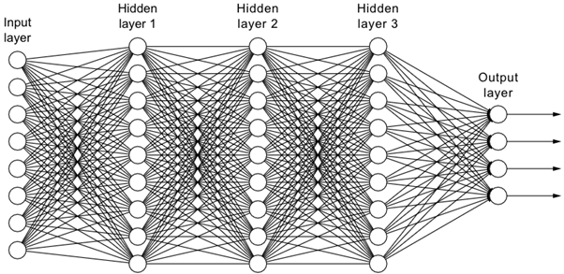
AI → Machine Learning → Neural Networks and Deep Learning
The AI can change its own code
Deep Learning refers to a neural network with multiple “hidden layers”
Origins usually traced to 1956
Machine Learning
Artificial Intelligence
Deep
Learning
Symbolic AI
Neural Networks are a tool for Machine Learning
Generative AI
A type of AI that can create new content like images, text, music, audio, and videos
In some applications Gen AI can act as a “natural language” front end to other tools – including Symbolic AI
Relies on explicit rules defined by human programmers
Has been used extensively in Computer Vision and Robotics

Slide 3
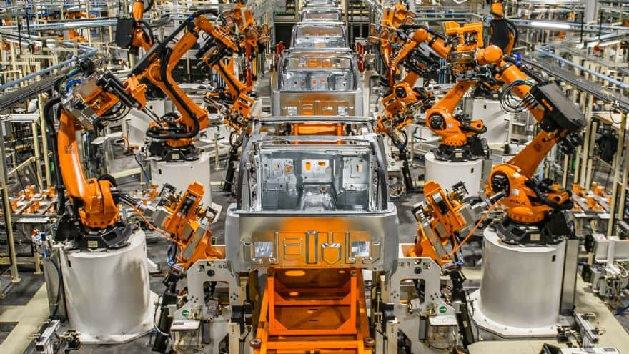
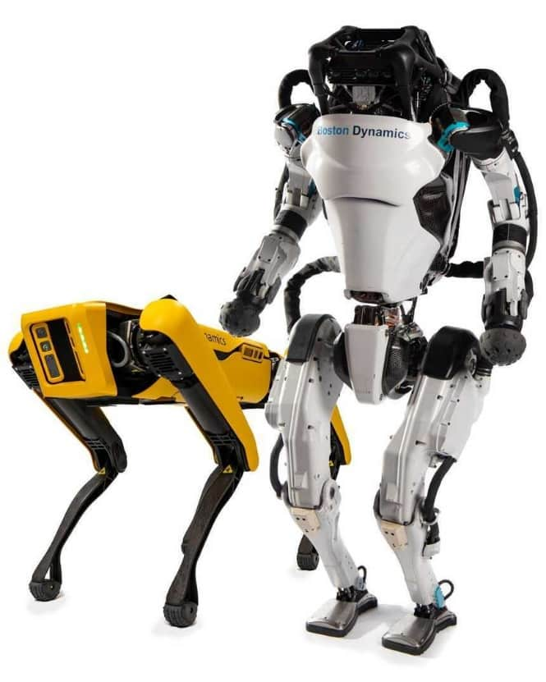
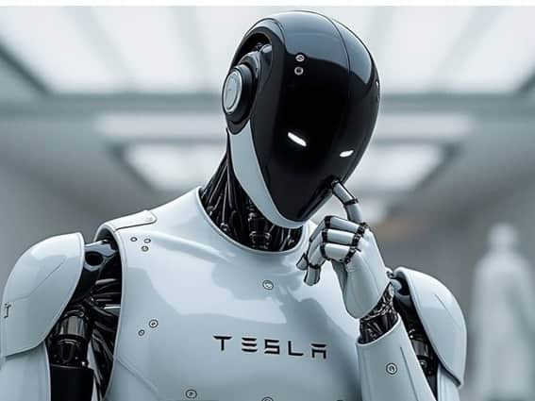
Symbolic AI vs Generative AI – A Robotics Comparison
Symbolic AI
Generative AI
These robots operate within a constrained 3D space
These robots operate much more autonomously
The human programmer must anticipate all possible outcomes and tell the AI what to do
The AI must be able to deal with situations that the human programmer had not anticipated

Slide 4
When and why did AI get so hot?

Slide 5
Author: LM Po
This is why we suddenly started to hear about AI
Read the full article here – highly recommended!

Slide 6
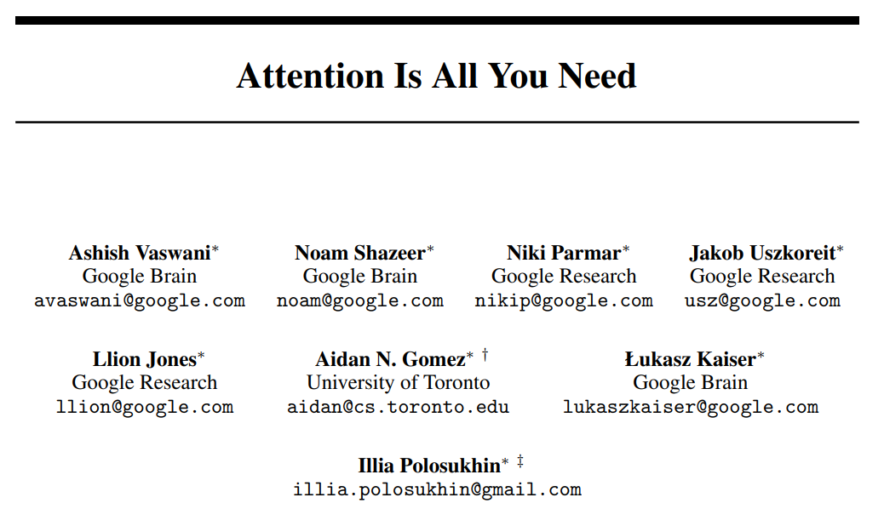
2017 Seminal Paper by Google
Introduced a new Deep Learning architecture called the Transformer
The previous hot technology was the Recurrent Neural Network, which was a breakthrough in its time, but it struggles with “long range dependencies” in language parsing.
Transformers use Attention Mechanisms that allow the AI to operate on blocks of text in parallel, and associate different parts of the text even if it’s widely separated.
This is why chatbots suddenly became “useable”
Drawbacks of Transformers
Requires very large training data set
Requires a lot of training processing
“Quadratic complexity” of the attention phase (limits context)
Initially struggled with reasoning
We will see why this is important later
What Could Succeed a Transformer Approach?
Many researchers are looking at alterations of RNNs – e.g. linear RNN
Also looking at “attentionless” Transformers
Meta’s Megalodon may be the first challenger
The AI you are using is probably based on a Transformer architecture

Slide 7
How does Generative AI work?
Note: Superficial explanation with the goal of helping you understand why AI training takes so much power, and how that situation might change with technology evolution

Slide 8
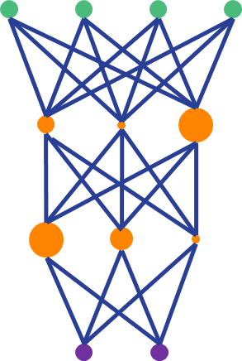
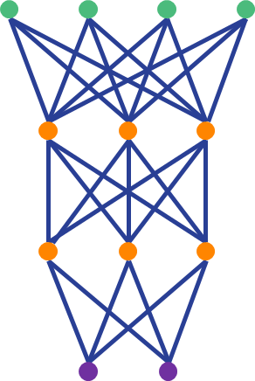
How does Generative AI work? High Level View
Training
PRUNE FOR PERFORMANCE
CREATE
TRAIN
FINE-TUNE
Inference
A Machine Learning model
Enormous amounts of training data
PRUNE FOR SIZE
GPT4: 3 months
25,000 Nvidia A100 GPUs*
50 GWh
= 4,000 US homes for 1 year
FREEZE, DEPLOY, USE
Reinforcement Learning from Human Feedback (RLHF) is a fine tuning technique used to “align model with human values and intentions”
Inference uses a tiny fraction of the power vs Training, and happens in seconds
*Each A100 costs between $8k and $20k

Slide 9
Example of model metrics – how big are AI models?
TEXT to TEXT
ChatGPT
Generative Pretrained Transformer
The Model
Uses a Large Language Model
GPT | GPT2 | GPT3 | GPT4
117M | 1.5B | 175B | 1.76T
ChatGPT will try to predict the next word based on probabilities…
in | 4.5%
during | 3.5%
before | 3.2%
after | 3.1%
at | 2.9%
Number parameters in the model
“NANOG93 is being held”
Prompt length is increasing
ChatGPT does not always select highest ranked word – it will randomize the result
Enhances creativity
GPT | GPT2 | GPT3 | GPT4
512 | 1024 | 4,096 | 128k
Max input tokens* in the prompt
Some of the “magic” behind ChatGPT is a temperature setting – the higher the temperature the more creative (ie. random) the results
*Tokens are a unit of measurement of words in the prompt – and it’s not a 1:1 relationship. Each model is trained on a much larger token vocabulary

Slide 10
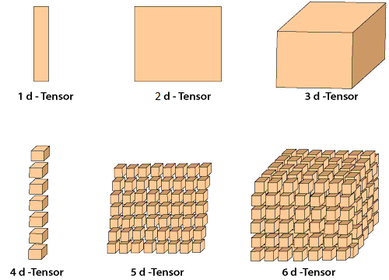
Examples of AI data structures
The fact that these are tensors will become more important later
The Artificial Neural Network
Text-based AI (e.g. GPT3)
Each node in a hidden layer represents a tensor
tokens → vectors
…
Input tokens are created from the prompt you enter
-0.12
0.15
0.88
0.35
0.27
0.24
-0.92
0.55
0.11
0.87
0.71
0.84
0.23
0.19
-0.17
Assembles vectors into matrices
NAN OG 93
Tensors are like matrices, but can have any number of dimensions
The probabilites are stored as tensors in the hidden layers
a.k.a. vector
a.k.a. matrix
GPT-4 has 120 layers
Image-based AI
Uses 3D tensor
2 dimensions for pixel coordinates
1 dimension for color value
Output tokens create the answer that you are given
Video-based AI adds time dimension

Slide 11
How do we use AI models?
Standalone AI tools
Designed to work independently with minimal setup
Accessed directly through website or app
1
Tools with integrated AI
2
Software tools with built-in AI enhancements
Copilot
Custom AI Solution
3
An AI solution developed for a specific problem or application
Examples of
Compound AI systems
Medical
Legal
Industrial
Agricultural

Slide 12
What is a Compound AI System?
Take a simple example…I ask a generic AI “How many vacation days do I have left?”
This will almost certainly be wrong – because the AI doesn’t know who I am, or have access to Infinera’s Time Off database. It is hallucinating an answer.
Generic AI Answer: 10 days
✗
In a Compound AI system we can give a generic LLM, like Gemini, Claude, or ChatGPT, access to a specialized or proprietary database of knowledge
RAG is like “phone a friend”
Generic AI
Question: “I’m Geoff Bennett, how many vacation days do I have left?”
15
Retrieval Augmented Generation (RAG) is an example of a Compound AI System, and it’s often used in Custom AI solutions
Answer: “You have 15 vacation days remaining this year, Geoff”
✓
?
Builds a query
Time Off Database

Slide 13
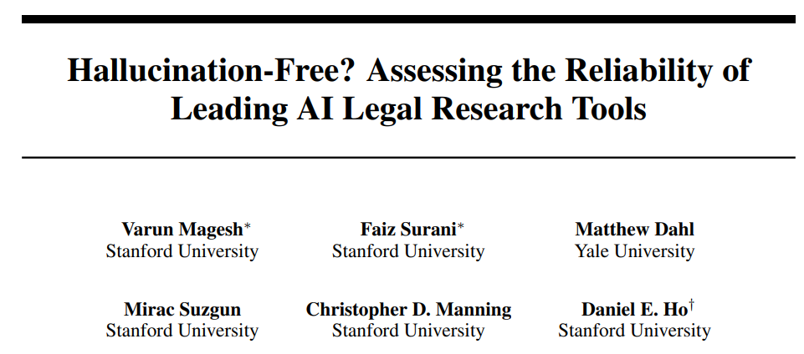
Custom AI: Examples in Legal Research
What sort of things can a specialized Legal AI do for lawyers and paralegals?
https://www.lexisnexis.com/community/pressroom/b/news/posts/lexisnexis-launches-lexis-ai-a-generative-ai-solution-with-hallucination-free-linked-legal-citations
The best tools on the market claim to be “hallucination-free”
Natural speech search
Document drafting
Summarization
Document upload
Contractual Advice
https://casetext.com/blog/cocounsel-harnesses-gpt-4s-power-to-deliver-results-that-legal-professionals-can-rely-on/
“While hallucinations are reduced relative to general-purpose chatbots (GPT-4), we find that the AI research tools made by LexisNexis (Lexis+ AI) and Thomson Reuters (Westlaw AI-Assisted Research and Ask Practical Law AI) each hallucinate between 17% and 33% of the time.”
https://dho.stanford.edu/wp-content/uploads/Legal_RAG_Hallucinations.pdf
Hallucinations are when the AI just “makes stuff up”

Slide 14
A Hallucination Example: Images
The result was…
The prompt was:
“show a group of wristwatches on display. All of them show the time as 12:03.”
Why did AI get the time wrong?
Because watches are usually photographed with the hands at 10 and 2
Apparently it’s because of aesthetics
Keeps hands clear of logo and date window
Looks like a smile ☺
So most of the training examples will show watches set to this time

Slide 15
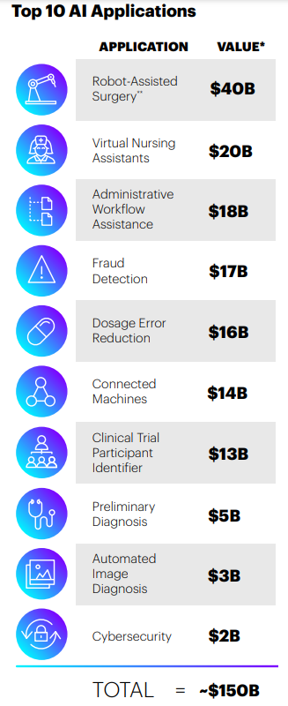
Custom AI: Examples in Medicine
Reducing human workload
AI-assisted robotic surgery
HIPPAA-compliant medical scribe
Da Vinci 5 Robotic Surgeon
Shorter recovery times thanks to smaller incisions
AI Diagnostic Medicine
FDA-approved AI tool created to detect diabetic retinopathy
It can take 15 years to train a human surgeon
Babylon Health says its AI can appropriately triage 85% of patients
AI-assisted drug development
AI image scanning to reduces time to treatment for stroke patients
New drug development:
Reduce costs
Reduce risks
Enable “orphan drugs”
The potential to save $150 billion per year in US healthcare market
90% of new drug candidates fail during development
2024 Nobel Prize for Chemistry
Accenture. ARTIFICIAL INTELLIGENCE: Healthcare’s New Nervous System

Slide 16
The “once in a lifetime” opportunity with AI cannot be missed
Hyperscalers are willing to throw hundreds of billions of dollars into making their AI better
Key question: How do we make AI “better”?

Slide 17
The Drive For Better AI: We can view this two ways…
Absolute
Relative
Google wants a better AI than Microsoft, Meta and Amazon
Specialized Medical AI
My AI has to be good enough to beat a human surgeon or diagnostic consultant
Microsoft wants a better AI than Google, Meta and Amazon
.
.
.
Legal AI
Meta wants a better AI than Google, Microsoft and Amazon
My AI has to be good enough so that it does not make stuff up!
Amazon wants a better AI than Google, Microsoft and Meta

Slide 18
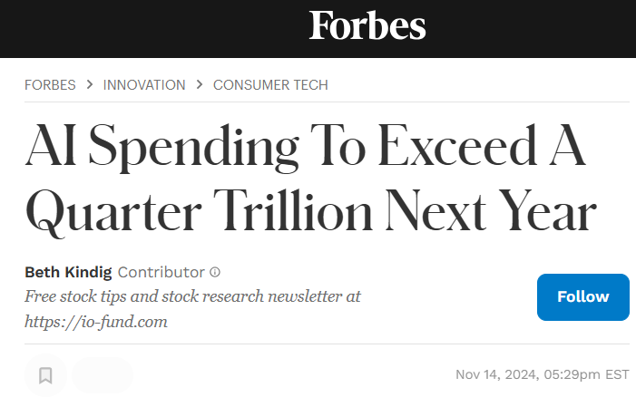
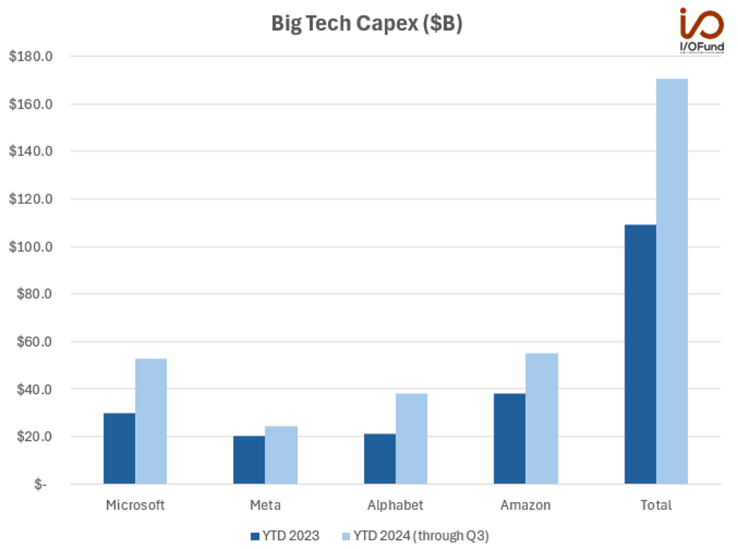
“Big 4” AI Investments and Revenues
Source: Forbes
Why are they throwing so much $$$ at AI?
“Microsoft on track for $10bn in annual revenue from AI inference in 2024”
“Google Cloud enjoys an AI-fueled growth spurt in Q3 2024”
“AI Powers Meta’s Strong Q3 Growth: Profits Soar”
“Amazon sales soar with boost from artificial intelligence and advertising”
Oracle goes all in on AI – seen as a neutral operator
January 2025 Stargate
$100B→$500B for new mega AI data centers

Slide 19
Training better AI models

Slide 20
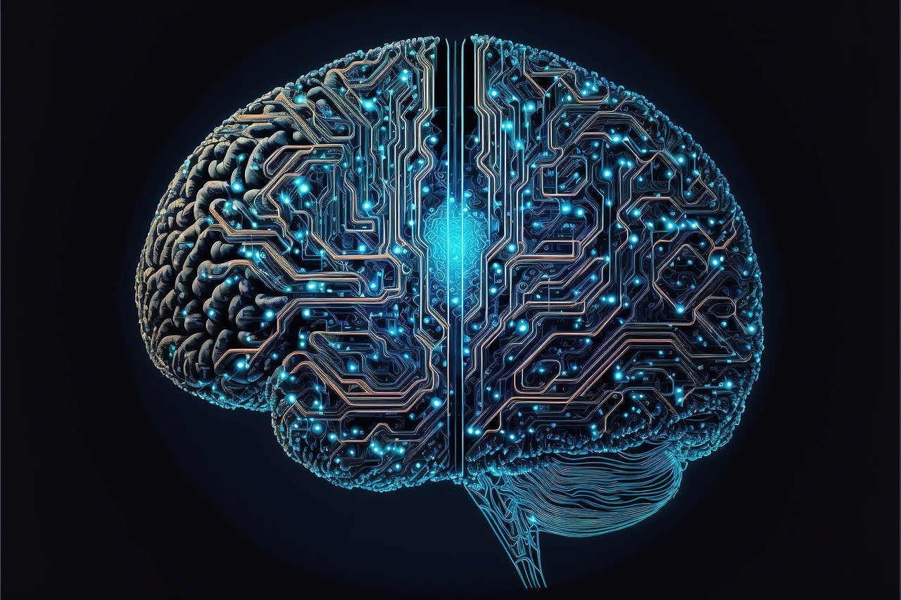
High Level Direction for AI
“thousands of days away”
Sam Altman - OpenAI
We are here
12-24 months?
Artificial Narrow Intelligence
Artificial General Intelligence
Artificial Super Intelligence
AI that can be as good as the best human brains within a narrow range of tasks
AI that can be as good as the best human brains at any task it is given
AI that would surpass human intelligence in all areas

Slide 21
How do we make the model “better”?
1
Fine Tuning
What “tone” would I like the model to use in responses?
Fine tuning is performed after Training and before Inference (e.g. RLHF)
Retrieval Augmented Generation (RAG)
Give the LLM an external source of information in order to augment your prompt
Give the LLM a “long term memory”
RAG is performed during Inference
Geoff Bennett is 6’6” tall
We have a pretrained model
But it makes “mistakes” or generates hallucinations
Customer Service ChatBot that retains customer history over multiple sessions
MS Copilot private access to company confidential internal documents
It’s basically ”frozen”

Slide 22
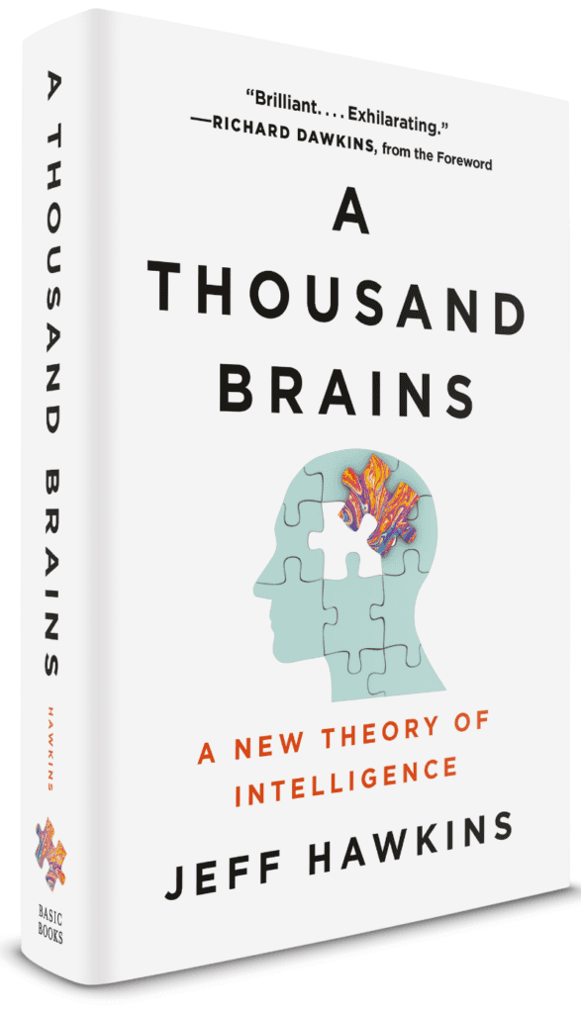
How do we make the model “better”?
2
Continual Learning Challenges
Significant Inference compute required
Edge Data Centers may not have this available
Requires wide variety of new data
This may not be possible
If good data not available, we will encounter hallucinations
Why can’t we “unfreeze” the model to let it learn from experience?
Continual Learning
AI guru, Jeff Hawkins does not believe that current ANNs are capable of effective continual learning
This is a goal for next gen AI models…but…
We have a pretrained model
It’s basically ”frozen”

Slide 23
How do we make the model “better”?
3
Inference Time Compute
This will be a big deal in 2025 and beyond
Allow the AI to run Inference for 15X longer
Let the model think for longer during Inference
Does that sound like a bad trade?
Is like Training the model for 10X longer
Well it’s not…
Take 7.5 seconds to respond…
…is like taking 2.5 years to train
We have a pretrained model
It’s basically ”frozen”
Presentation by OpenAI’s Noam Brown on Inference Time Compute

Slide 24
How do we make the model “better”?
4
Source: OpenAI - Scaling Laws for Neural Language Models
TODAY: The only way we know how to do this is by increasing three primary scaling factors that are fundamental to current AI models
Data Set Size
Parameters
Compute
But scaling these means…
This is a direct consequence of the Transformer architecture
…Scaling Compute
More Compute = More Electrical Power

Slide 25
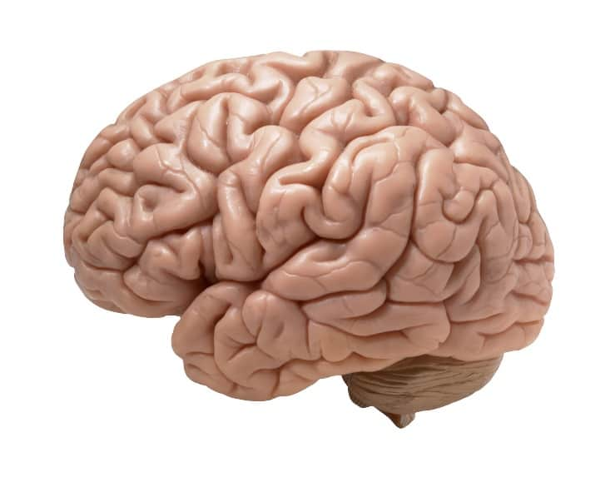
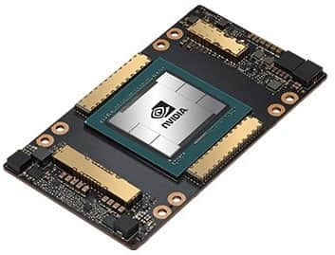
Can we claim that AI training is power-efficient?
CO2 footprint: It matters where we train the models
368g
20 W
46X more CO₂
gCO2eq/kWh
Nvidia A100 SXM
700 W TDP
8g
European Environment Agency: “Greenhouse gas emission intensity of electricity generation in Europe” 14 Jun 2024
GPT-4
25,000 A100s running for 100 days
50 GWh
4,000 US homes for 1 year
1.8 trillion parameters
13 trillion tokens in data set
234,000 times the energy used by one brain

Slide 26
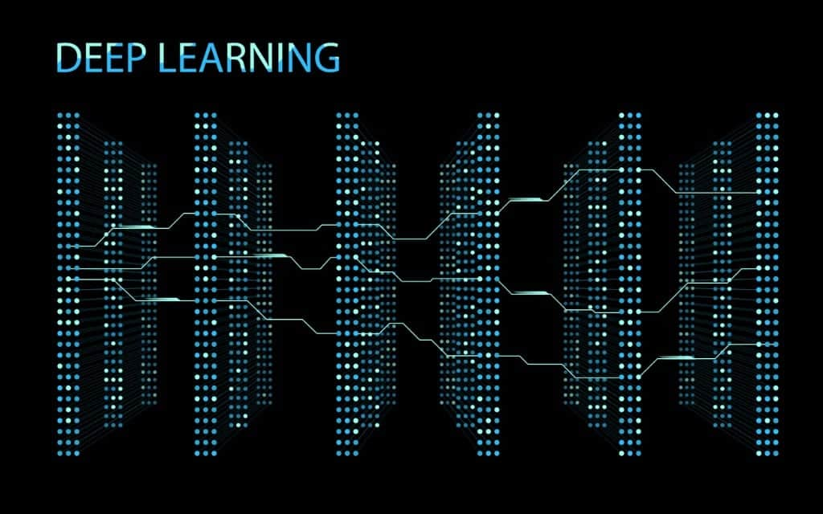
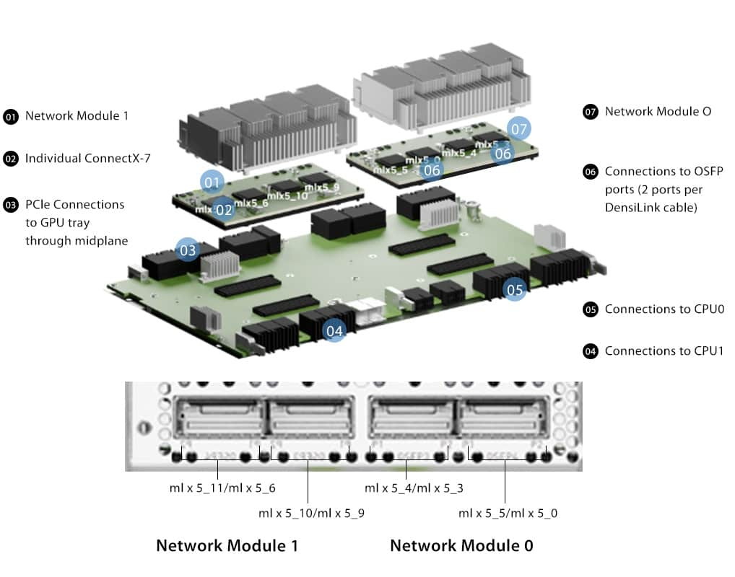
Why are these AI implementations so inefficient?
Many AI problems are examples of sparse computations
1
In a sparse computation many of these tensors would have a value of zero
The human brain has evolved to be able to ignore most of the sensory inputs it receives
Matrix multiplication on a zero value tensor is always zero
This is how we deal with sparse computation problems
The transform is executed anyway, but the compute power is effectively wasted
Local memory too small for the model
2
Data must be distributed around the board
NVidia H100
Efficiency drops as data transfers take time to complete

Slide 27
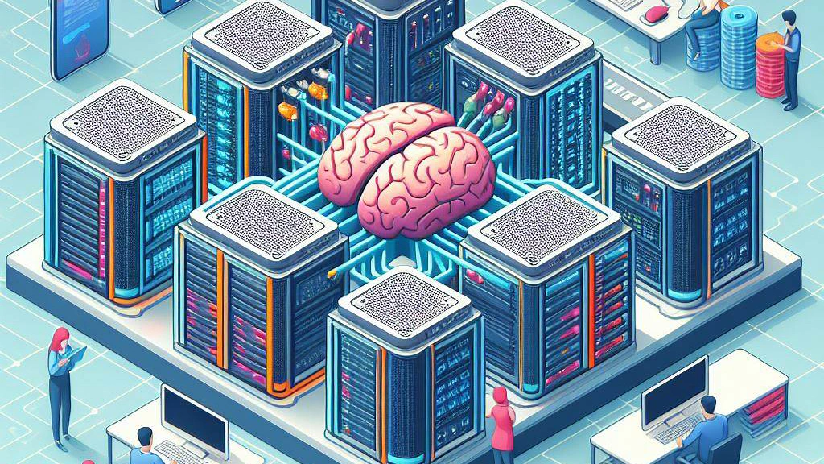
Enhancing AI compute efficiency in the future
Spiking neural networks
Create neural networks that more closely mimic the operation of human neurons
Neither of these approaches is commercially viable yet
Neuromorphic processor
So what hardware do we use today? It’s GPUs.

Slide 28
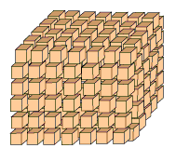
TODAY: Why GPUs are favored for AI processing
Multicore processors are best for parallel processing
A deep learning model will comprise large numbers of tensors
Core
Core
Core
A modern CPU might have around 8 very complex cores, with multiple threads for each core
Core
Core
Core
Core
Core
Transformers process the tensors, which means a lot of matrix arithmetic
A modern GPU might have thousands of more simple cores
Nvidia H100
14,592 CUDA cores
528 Tensor cores
per-GPU
Matrix arithmetic responds well to parallel processing
Why GPUs are used for AI
Nvidia has 70-95% market share for AI processing
2H24 estimate by Mizuho Securities
Interesting videos
Why Nvidia seems to have an AI monopoly

Slide 29
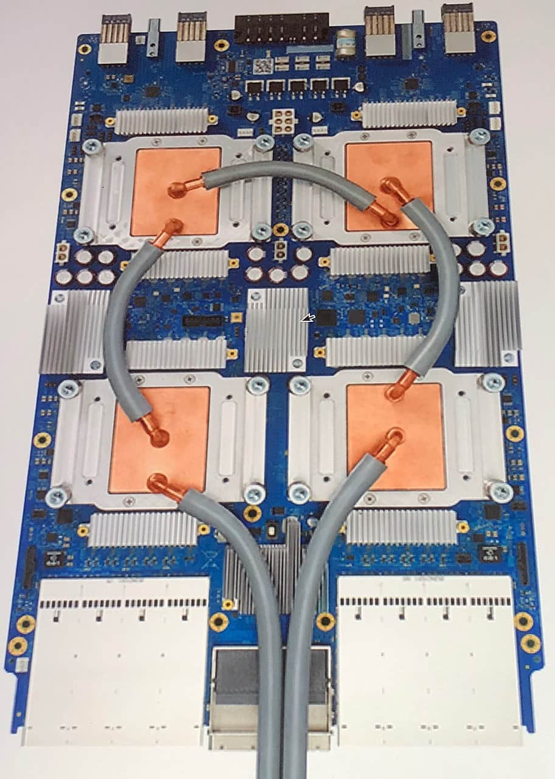
BUT…it may not be that simple
Google has developed a Tensor Processing Unit (TPUv4/5)
The logical argument is:
GPUs happen to be better at AI processing because they have large numbers of core. But imagine if you designed an AI processor from scratch, with only AI in mind
And it’s not even that simple either!
GPUs may be better…
CPUs may be better…
TPUs may be better…
E.g. General purpose but scale issues
E.g. natural language processing
E.g. facial recognition
…for training fully connected neural networks
…for training recurrent neural networks
…for training convolutional neural networks
Today’s training engine is tomorrow’s inference engine
There are 2 points of view
Is the best engine for training also the best engine for inference?
Infrastructure must be purpose-built, and these two phases do not share a purpose.
?

Slide 30
An Incomplete List of Companies Developing AI Chips
GH200
SN40L
Bow IPU
Gaudi 3
WFE-3
M2000
MI350
LPU
Inference Eng
Sohu
Trillium
M4
Dojo
Trainium 2
Artemis
All of these companies and more think they can do better than NVidia
NorthPole
Maia 100
ACCEL**
Rebel

Slide 31
What about Inference?

Slide 32
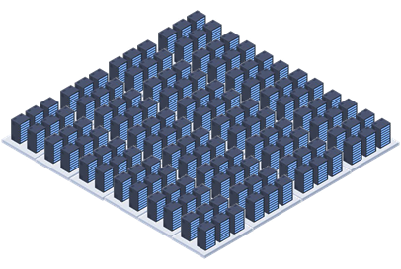
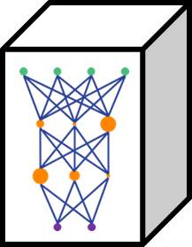
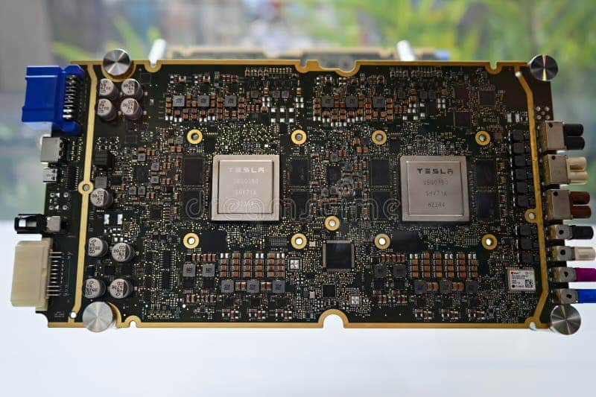
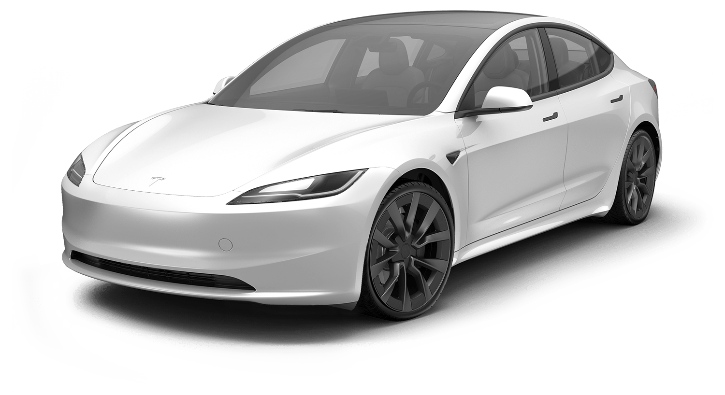
Training vs Inference
Deployment Options include…
Trained Model
Inference
2
1
A large model deployed for a single enterprise
A Training Data Center needs tens (hundreds) of thousands of GPUs running for months to train a model
A large model deployed to serve a large number of users
4
Training
3
A small model deployed on an autonomous device
A very small model deployed on a phone

Slide 33
Getting Better AI Results After Training
Proprietary or Confidential Data
RAG
Retrieval Augmented Generation
1
Create AI solutions with specialized knowledge
Medical
Legal
Industrial
Agricultural
In RAG the AI “reaches in” to a closed data set in order to produce better results in Inference
Context-Specific Data
Context Windows
The trend is to move towards “infinite and persistent” context windows
2
“Here are 6, peer-reviewed papers about AI context windows. Summarize each one in 100 words or less.”
Imagine a call center bot that remembers every interaction with you
FROZEN
Think for longer
15X increase in Inference time is equivalent to 10X increase in Training time
Today they have the ability to think about what they say before they show it to us.
Inference Time Compute
Let the AI think for a bit longer
3
Initially LLMs literally predicted the next letter in the sequence.
Will require a lot more Inference compute power
Start with Inference time of 0.5s and Training time of 3 months

Slide 34
The growth of electrical power demands for AI

Slide 35
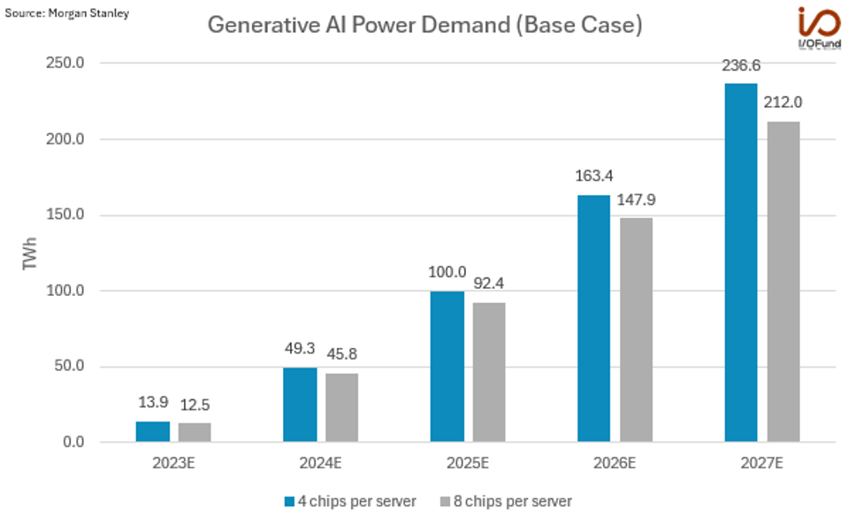
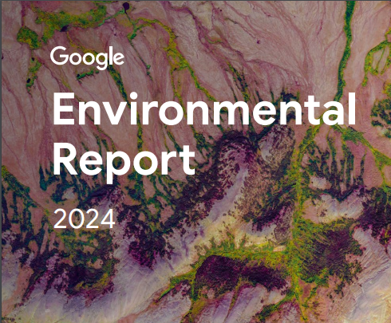
Growth of Data Center Electrical Power Demands
Companies are caring less and less how they get the power
This forecast may be a huge underestimate
48% increase in CO₂ emissions in past 5 years
5X increase in 3 years
<15 TWh
2023
46 TWh
2024
We’ve already seen a 3X increase in the past 12 months!
In 2020 Microsoft committed to being carbon negative by 2030
2024 Sustainability Report shows a 29.1% increase in CO₂ since 2020

Slide 36
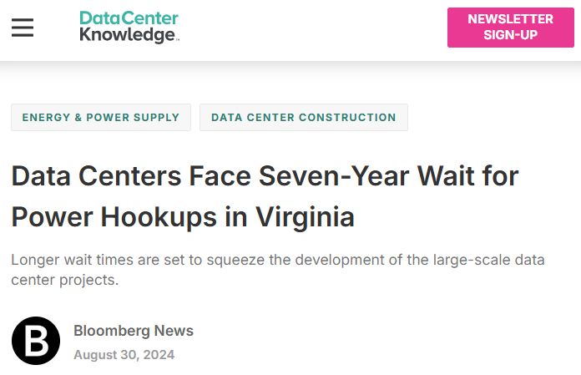
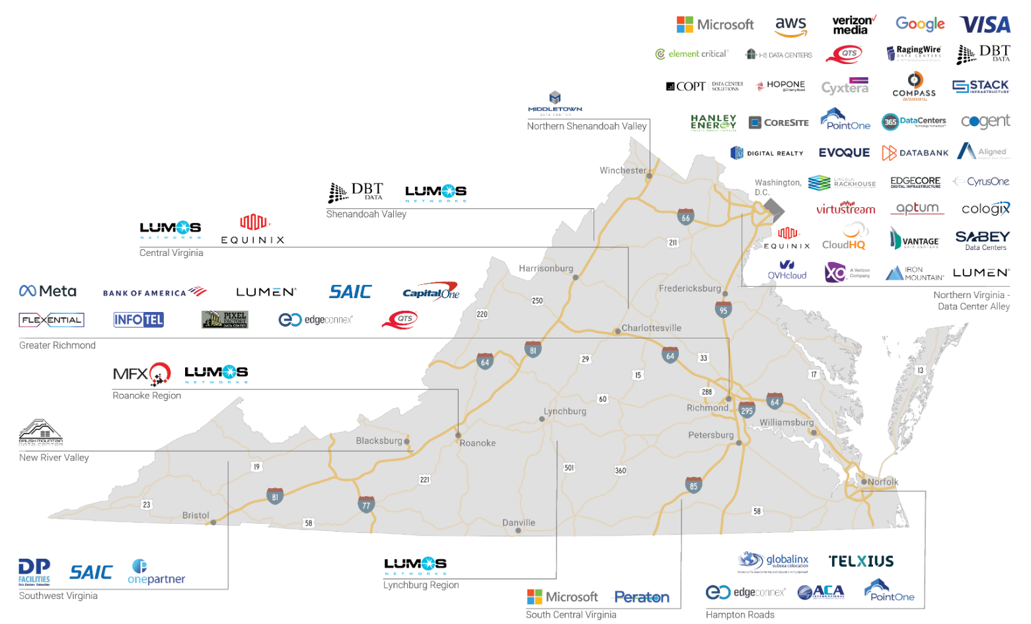
The Challenges of Data Center Success: Virginia
11 GW of new data center capacity by 2030 in Northern Virginia alone
40% of VA’s peak demand today
Virginia Data Center Market
TREND: BYOP
(Bring Your Own Power)
What is needed in VA?
10-15GW of firm generation capacity
Why is this a challenge?
It can take 3-4 years to approve a new gas-fired generating plant (e.g. 1 GW)
Market prices are too low for developers to build the required capacity
30% CAGR since 2014
Total of 4 GW today

Slide 37
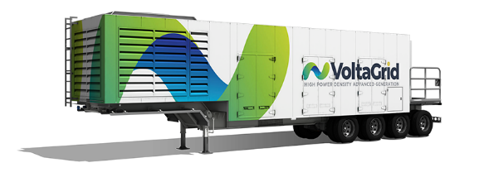
Is Gigawatt-Scale BYOP Viable? Let’s look at xAI’s Colossus in Memphis
100,000 H100s will require 150 MW
Local grid supply*:
8 MW
Today
100,000
H100 GPUs
*As of August 2024
X14
35 MW
Smog levels in Shelby County have exceeded recommended levels for the past 3 years
Natural gas powered mobile generators
Tomorrow
200,000
H100 GPUs
X4
64 MW
50 MW*
MLGW has agreed to upgrade site to:
*At a cost of $760,000 to local taxpayers
xAI has committed to fund a 150 MW, $24M new substation
The grid is already overloaded*
But…where does the power actually come from?
*Not a direct quote
Article: “xAI cluster is now the most powerful AI training system in the world”

Slide 38
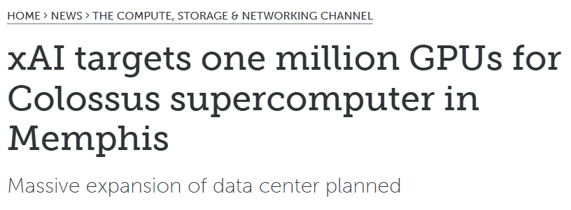
Breaking News – xAI to expand Colossus to 1 million nodes!
One million GPUs represents 27% of Nvidia’s 2023 shipments
Where are they going to get 10X (1,500 MW) the power?

Slide 39
An International Example: Singapore
26
Operational Submarine Cables
>95% of Singapore’s electricity is generated with Natural Gas
3
Major Cable Landing Stations
Ideally we need Green Energy
Ideally we need more diversity
Subsea hub ➔ Data Centers
Singapore is one of the most important subsea hubs in the world today
87 Data Center facilities with 6,933,008 ft² and consuming 1,026 MegaWatts

Slide 40
Singapore and Power – Challenges and Opportunities
Malaysia Generation Mix 2023
Johor Bahru may become the largest DC market in SE Asia in the next 2 years
As a result…
2019
Singapore issues moratorium on new Data Center builds because of power shortages
Singapore is trying to recover momentum
But…by efficiency vs new capacity
DC growth in Malaysia while international traffic is moved over the Straits of Johor
Malaysia has a goal to boost Renewables from 27% to 37% by 2030
What can we learn from Singapore?
Plentiful (Green) Power is essential
Proximity to a Hub may be useful
Don’t become
complacent
For Malaysia

Slide 41
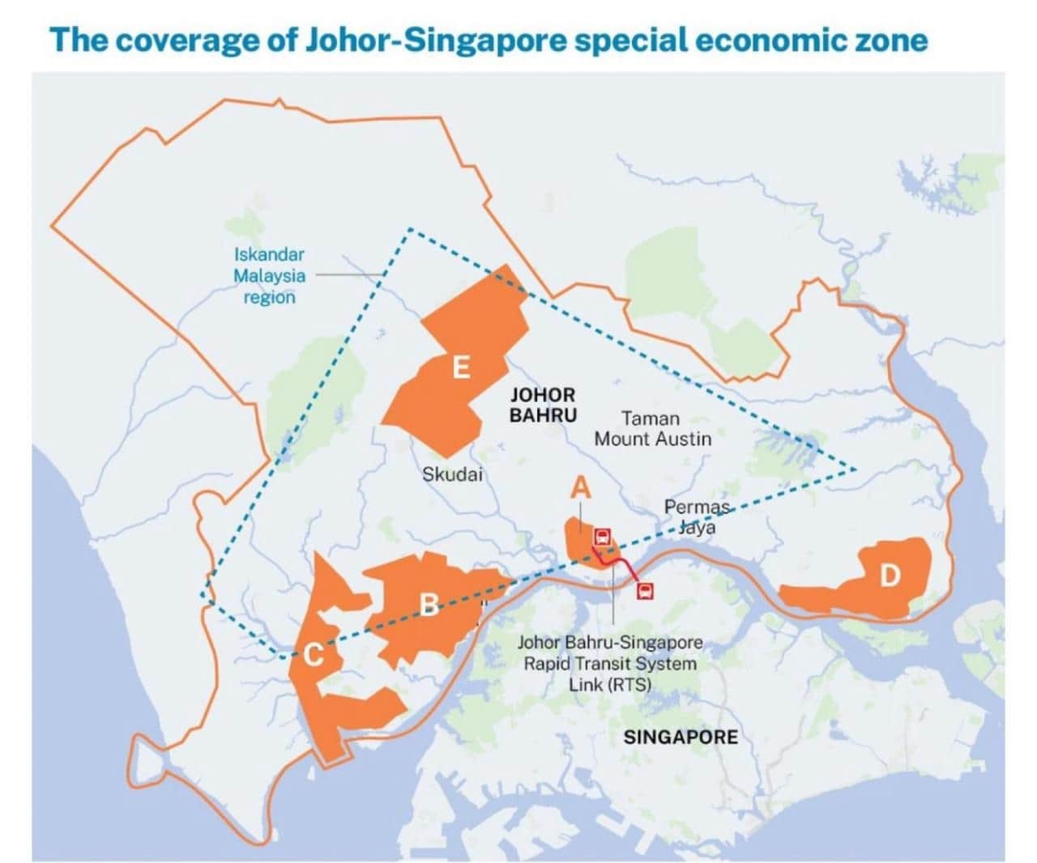
Singapore and Malaysia have had a somewhat lively history
Independence in 1965
Disputes over water
Disputes over islands
Disputes over port boundaries
But the Data Center opportunity is pushing them towards more cooperation
At this point Singapore is <1 km from Malaysia, but…
Currently a 2 hour drive, including a customs post at the causeway bridge
After the agreement it will be a 10 minute metro train ride
But this is Johor Bahru in Malaysia, where there is space, power and water for mega data centers
This is Singapore, where the subsea cables terminate

Slide 42
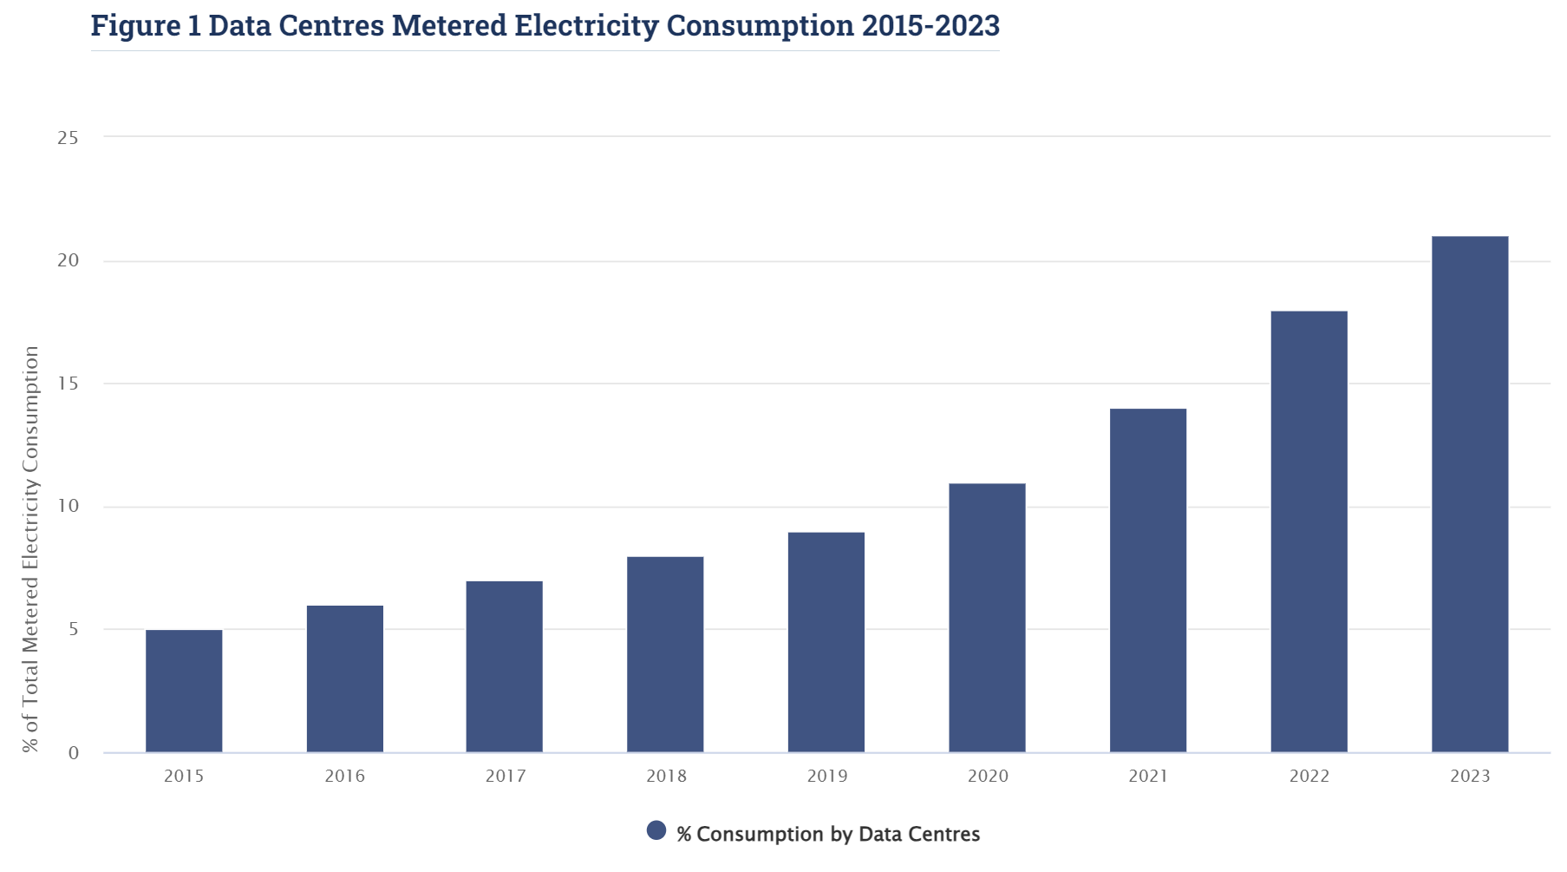
Ireland – The Next Singapore?
Data Centers account for 21% of Ireland’s electrical consumption - predicted to rise to >30% by 2026
Source: CSO
2015: 5%
2023: 21%
>50% of Ireland’s electricity still generated by fossil fuels

Slide 43
How Could We Power AI Data Centers?

Slide 44
Renewables are great…but not for AI Data Centers
But they don’t work well for me…
CO₂
+
Existing “green” Data Centers use power from reliable energy sources to supplement Wind and Solar
CO₂
Wind and solar have major advantages:
Gigwatt-Scale AI Data Center
Reliable Power Sources
Low CO₂
Cheap
Safe
Quick to deploy
While there is often “local resistance” it’s not on the scale of nuclear
Hard to deploy GW-scale solar and wind
Colocation with Data Center challenging
Solar and wind are intermittent – and gas will usually provide the base load
“Follow the sun” approaches for solar will lead to greater consumption of water
And this requires connection to the regional power grid
Regional Power Grid
Gigawatt-scale grid connections may involve a multi-year waiting time
*Check this out when you have time…
What is the Duck Curve?

Slide 45
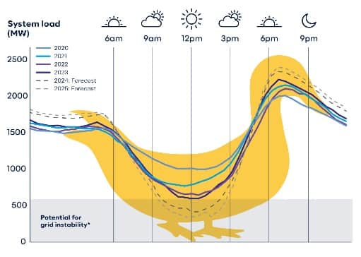
What About Batteries?
This data stops in 2018
2022: $129 per kWh
2024: $78 per kWh1
Battery technology is specifically intended to “flatten the duck curve”
It has fallen by 99%
Edwards & Sanborn Solar and Energy Storage Project in California
Link
4,660 acres $→$ 3,530 football fields
Solar Panel Waste
$20-30
Cost to recycle a panel
<$2
Send to landfill
864 MW of solar PV
3,287 MWh of battery storage
The largest grid scale battery in the world could only power a Gigawatt-scale data center for 3 hours!
The largest in Europe for only 40 minutes!
Lithium Battery Recycling
What % are recycled today?
Between 5% and 59%*
*Difficult to find accurate estimate because it is unregulated

Slide 46
Next Generation Geothermal
Focus on promoting new geothermal
International Energy Agency Report:
Future of Geothermal Energy 2024
The ground below the earth’s surface is hot because of the radioactive decay of natural elements like uranium and thorium
In some places around the world this heat is easier to get to – Conventional Geothermal
The Future of Geothermal Energy
(US-specific report)
Enhanced Geothermal Systems use fracking techniques to open up many more locations
Enhanced Geothermal Pros
Potentially low CO₂*
24/7/365 operation
Small footprint
Skillsets match Oil/Gas industry
Enhanced Geothermal Cons
Potential emissions
Potential waste production
Potential for seismic disturbances
Most designs are “megawatt” scale
Potentially need lots of water
New EGS systems are unproven
Conventional Geothermal provides less than 1% of global energy today – because it tends to be used in the “easiest” geothermal locations
United States, Iceland, Indonesia, Turkey, Kenya, Italy
Potential to create 100 GW of new geothermal generation within 50 years
Total cost of $600-900M
*Geothermal may release CO₂ from underground. This can be removed before release, but the USA is not a Kyoto treaty signatory so it is unclear if CO₂ emissions would be monitored or enforced for EGS plants.

Slide 47
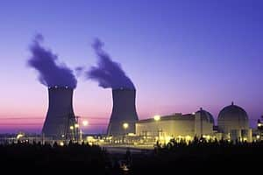
A Reality Check for Large Scale Nuclear
Vogtle 3 and 4
Hinckley Point C
Flamanville 3
Georgia, USA
4.5 GW Power Output
Westinghouse AP1000 PWR
Original timeframe of 2017 slipped to 2024
Costs have risen from $14B to $37B (over 2.6X)
Somerset, UK
3.2 GW Power Output
Framatome EPR1750 PWR
Original timeframe of 2025 has now slipped to 2029-31
Costs have risen from $12B to $56B (over 4X)
Normandy, France
1.65 GW Power Output
Areva EPR1750 PWR
Original timeframe of 2012 has now slipped to 2024
Costs have risen from $3.4B to $19.6B (almost 6X)
Fun fact – where do all these reactors get their fuel from?
From Russia with love ☺

Slide 48
The nuclear part’s not the only problem…
No mega-project comes in on-time and on-budget anymore, right?
China: 3 Gorges Dam
4.4X over budget
USA, Boston: The Big Dig
8.5X over budget
Venice, Italy: MOSE
4.7X over budget
1959-73
And it doesn’t even need to be on Earth to over-run!
But it turns out we were never that good at project estimates!
1883-????
Sydney, Australia: The Opera House
14.6X over budget
Low Earth Orbit: The ISS
$17B → $160B
Barcelona, Spain: La Sagrada Familia
Nobody even knows!

Slide 49
The Hyperscalers’ Plans for Power – BYOP* *(Bring your own power)
SMR = Small Modular Reactor
Short Term
Long Term
Purchased 900 MW Data Center next to Susquehanna Nuclear Plant
SMR plans in 3 US locations (inc. VA and WA)
Anchor investor
Geothermal investments
October 2024: Google announced agreement with Kairos Power for SMRs
September 2024: Microsoft sign agreement to reactivate reactor at Three Mile Island
CEC and SMR deal with OPG
Nuclear Fusion deal with Helion
&
Talking about a 130k Nvidia cluster
“Intention to build Gigawatt-scale AI data centers powered by Small Modular Nuclear Reactors”
Plan to build Data Center near nuclear facility blocked by discovery of rare bees
August 2024: Agreement with Sage Geosystems for Geopressurized Geothermal System

Slide 50
Selection of Companies Building SMRs
10+ Years
Operational
Under Construction
Licensed*
*In at least one country
Seeking License*
*In at least one country
PWR: Rolls Royce
HTGR: Grid connection 2021
PWR: China National Nuclear Corporation
MSR: Thorium Reactor
PWR: Korea Atomic Energy Research Institute
PWR: Holtec
OKBM Afrikantov
PWR: Akademik Lomonosov
May 2020
LFR: Atomenergoprom
In Design
PWR: Nuscale
Glossary
PWR: Comisión Nacional de Energía Atómica
HTGR: High Temp Gas-Cooled Reactor
PWR: Pressurized Water Reactor
MSR: Molten Salt Reactor
LFR: Lead-cooled Fast Reactor
2X
PWR: OKBM Afrikantov

Slide 51
What is the Status of Small Modular Reactors?
Key Finding
Small modular reactors still look to be too expensive, too slow to build, and too risky to play a significant role in transitioning from fossil fuels in the coming 10-15 years.
Regulators, utilities, investors and government officials should embrace the reality that renewables, not SMRs, are the near-term solution to the energy transition.
Comments:
The “energy transition” for the rest of the world is not the same as the immediate need by hyperscalers for Data Center power sources.
Cash-rich hyperscalers could be ideal to push SMRs to completion and open up this technology for the rest of the world.

Slide 52
Three Steps to Nuclear Powered Data Centers
1
2
3
Grab any spare capacity on existing nuclear facilities before the competition does!
Restart any mothballed nuclear facilities you can
Build new, large-scale nuclear plants – if you remember how to do it.
Holtec Pallisades, Michigan
May be the first to restart in USA
USA has set new goals
Susquehanna
Develop new types of reactors – such as SMRs
Three Mile Island
11 nuclear plants shut down prematurely
26 GW of clean energy lost
Very long term – hope that somebody figures out nuclear fusion
Extend the life of nuclear plants that were scheduled to close
"no [economically] sensible way of bringing the plants back,"
Nadia Jakobi
CFO E.ON
In 2022 the DoE warned that “25% of US nuclear plants are at economic risk of closure”
Map of at-risk nuclear plants
U.S. Nuclear Plant Shutdowns, State Interventions, and Policy Concerns
Three Mile island was mothballed for economic reasons with options to restart
Germany’s reactors were shut down “permanently” for political reasons
The USA has a goal to deploy 35 GW of new nuclear power by 2035
Then 15 GW of new nuclear power per year by 2040

Slide 53
Nuclear Energy: Non-Problems and Real Problems
Non-Problems
Real Problems
Safety
Capital Cost
Bombs
Time to Deploy
Waste
Public Fears
LCOE*
Forgotten Skills
*LCOE = Levelized Cost of Energy

Slide 54
And let’s not forget the consumption of water…
Producing the GPU chips
8.3 tonnes of Ultra Pure Water per GPU
100,000 GPUs in Colossus DC
830,000 tonnes
Training the Model (Source: Statista)
4,800,000 tonnes in Iowa
15,000,000 tonnes in Washington
Image source
?
Using the Model (Inference)
500 ml per 50 questions
10 million questions per day
36,500 tonnes per year
Source: “How much water does AI consume? The public deserves to know”
Shaolei Ren: Associate Professor of Electrical and Computer Engineering, University of California, Riverside

Slide 55
Will AI and Robots take my job?
Also…what should I advise my children/siblings/friends to study to protect their careers against the coming AI overlords?

Slide 56
Predicted in 1964 by…
Heartless CEO Wallace V. Whipple automates his family-owned factory and lays off 61,000 of his workers
The plot is not very realistic – because some of his Execs disagree on moral grounds
And the workers completely fail to see the “opportunities” presented to them for more leisure time
Series 5, Episode 33

Slide 57
Top 65 Jobs Safest from AI & Robot Automation
Link to full report
36/65 of these professions are in healthcare

Slide 58
Other Similar Reports:
Click on images for copies of reports – none of these require registration or payment
Multiple OECD reports on AI and the workplace
Including…

Slide 59
Let’s see an OpenAI Customer Story
Source: OpenAI and Wikipedia
February 2024
10% of Klarna workforce replaced by AI agents
AI agents doing the work of 700 people
Klarna is a Swedish financial services company, offering “buy now pay later” services for online transactions
66% of Klarna’s customer service interactions
Customer Satisfaction scores on par with humans
25% drop in repeat enquiries
Resolution time drops from 11 mins to 2 mins
2023 Revenue $2.12B
5,000 employees
Credited with driving $40M profit improvements
Klarna has had a rollercoaster series of highs and lows in the past 15 years
2021: Europe's most valuable private tech company, at $45.6 billion
One year later the valuation dropped to $6.7B
But, even in Sweden, none of that $40M goes to the 700 people laid off

Slide 60
AI Replacing Software Developers
Source: Gartner Group
Order of replacement danger
Algorithms and data structures
React.js developers
Freelancers
The biggest productivity gains will come with code assistants – where humans and AI work together
Problems that can be broken down into small chunks
Where libraries already do most of the work
Projects that are always different and need creative & flexibility

Slide 61
3 Stages of Replacement of Surgeons
1
Human brains, human hands
2
Human brains, robot hands
3
AI brains, robot hands
We will be able to produce thousands of these per year – and they are all better than the best human surgeon in the world
15 years to train a surgeon

Slide 62
2025 AI Predictions

Slide 63
So many predictions – so let’s look for patterns
From IBM’s YouTube Channel
6 AI trends you’ll see more of in 2025
What’s next for AI in 2025
Agentic AI
Inference Time Compute
Very Large Models
Very Small Models
More advanced use cases
Near-infinite memory
Human in the loop augmentation
AI models will become more capable and useful
Agents will change the shape of work
AI companions will support you in your everyday life
AI will become more resource‑efficient over time
Measurement and customization will be keys to building AI responsibly
AI will accelerate scientific breakthroughs
Generative virtual playgrounds
Large language models that “reason”
It’s boom time for AI in science
AI companies get cozier with national security
Nvidia sees legitimate competition
You could argue that Agents already “happened” in 2024

Slide 64
Most people agree – AI Agents will be hot in 2025
RAG is like “phone a friend”
If we got a question on Motor Racing, would we phone a friend who’s an expert on Classical Music?
Remember the example I gave of Compound AI?
RAG
LLM
Different Databases
Different Tools
Agentic AI
In a RAG system a human programmer tells the AI to check a given database
A
B
C
D
Receive query and evaluate it – in whatever form (text, image, voice)
Check with LLM on the best Database or tool to use
E.g. LLM suggests Database C is best
Incorporate data into prompt and evaluate response
But if we asked about the weather for our proposed vacation the AI would not be able to get the answer from the Time Off Database

Slide 65
Let me try to summarize

Slide 66
Disclaimer: The following slide is the personal opinion of Geoff Bennett

Slide 67
A Visual Summary
Bwahaha! I told you…property is theft, dude!
Isn’t this great?
Wait…who buys all our stuff?
AI provides massive productivity boost
But we all lose our jobs
Huzzah for us!
☹
Pierre-Joseph Proudhon
1809-1865
Once in a lifetime AI opportunity
Need better AI
“Better” means more processing power
Nuclear seems like a great option
But we forgot how to build nuclear stuff!
Some of us
them
Bwahahah! Let’s go to Mars!
You guys are losers!
Absolute
Relative
Which implies more electrical power
Bwahaha! We still know how, comrade!
What’s happening today
We were only kidding – carry on burning that coal!
Pesky corporate sustainability goals!
But renewables aren’t a great fit for AI Data Centers
>80% of solar panels are made in China
Consequences

Slide 68
Thank you! Geoff Bennett gbennett@infinera.com

