Slide 1
Artificial Intelligence: A High Level Perspective on Environmental Aspects
Geoff Bennett
Director, Solutions and Technology

Slide 2
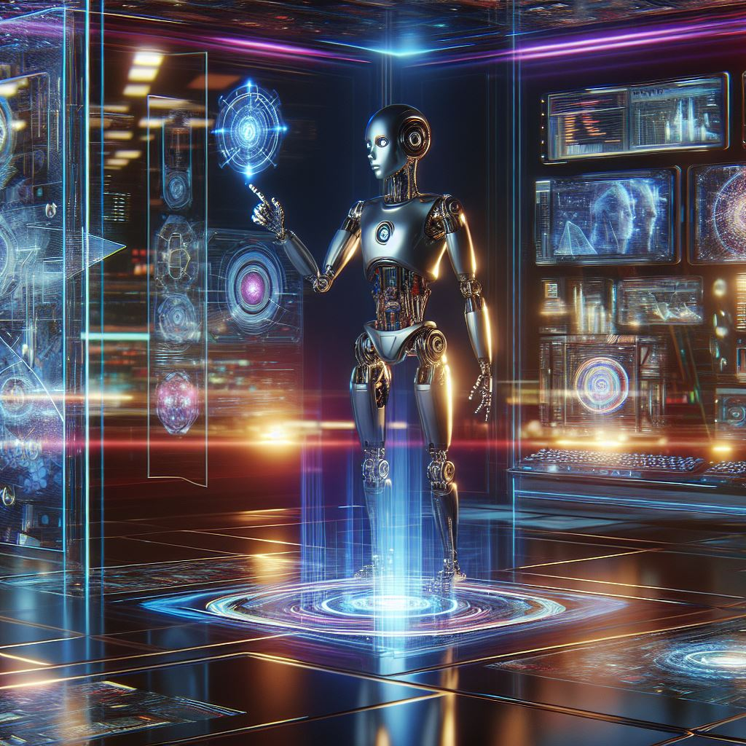
Copilot: “Bullet point summary of how AI will benefit mankind”
Personalized Medicine
Early Disease Detection
Robotic Surgeries
Drug Discovery
Climate Change Mitigation
Resource Management
Wildlife Conservation
Healthcare
Environment
Personalized Learning
Intelligent Tutoring Systems
Administrative Efficiency
Increased Productivity
Job Creation
Enhanced Decision-Making
Education
Economic
Autonomous Vehicles
Efficient Public Transport
Smart Traffic Management
Smart(er) Homes
Personal Assistants
Entertainment
Transportation
Daily Life
Explore this link to find more specific examples

Slide 3
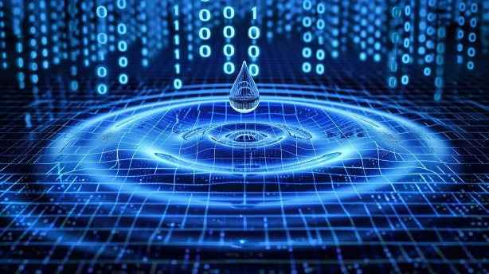
This is the focus of my presentation
Will AI really be good for the environment?
The Good News?
“AI will be help rather than hindrance in hitting climate targets, Bill Gates says”
“Can the climate survive the insatiable energy demands of the AI arms race?”
Link to story
Link to story
“Growth in global electricity demand is set to accelerate in the coming years as power-hungry sectors expand”
Link to story
Data Center Water Usage: A Comprehensive Guide
The world’s electricity consumption is forecast to rise at its fastest pace in recent years, growing at close to 4% annually through 2027
Growth in water consumption of data centres needs more attention
Why circular water solutions are key to sustainable data centres

Slide 4
But why do we seem to be rushing headlong into an AI future?
The “once in a lifetime” AI opportunity
…and…
Why companies are building huge AI data centers
Here’s a clue ☺

Slide 5
Yes…but why now?

Slide 6
Author: LM Po
This is why we suddenly started to hear about AI
Read the full article here – highly recommended!

Slide 7
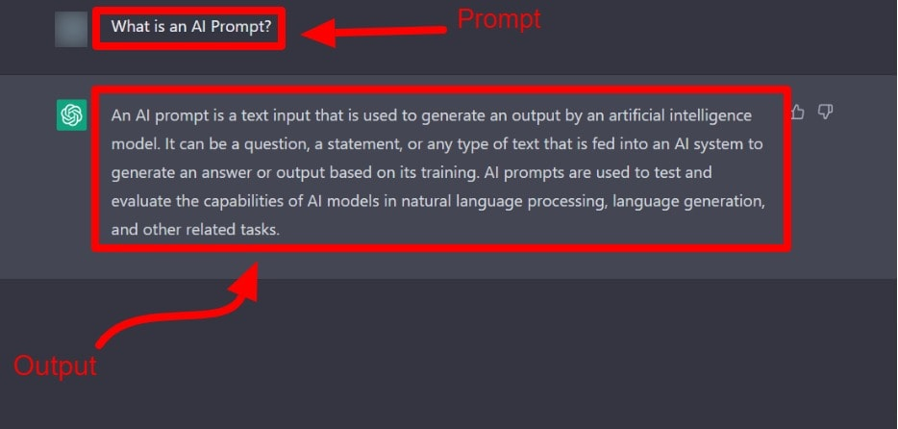
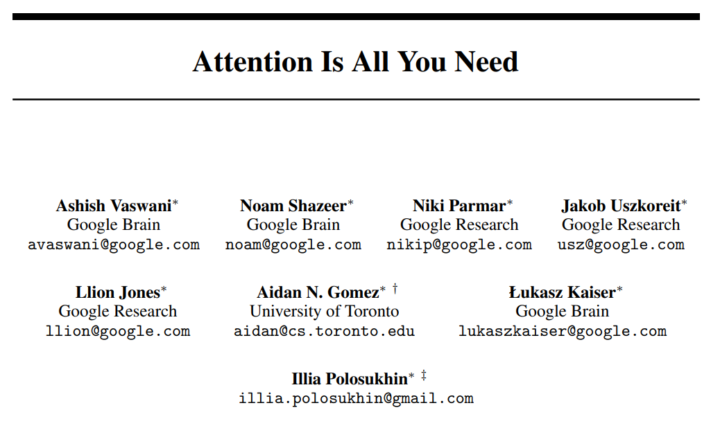
2017 Seminal Paper by Google
Introduced a new Deep Learning architecture called the Transformer
Transformers change an input sequence into an output sequence.
They do this by learning context and tracking relationships between sequence components using Attention Mechanisms.
By predicting the next word, AI chatbots started to really seem “intelligent”
The AI you are using is probably based on a Transformer architecture

Slide 8
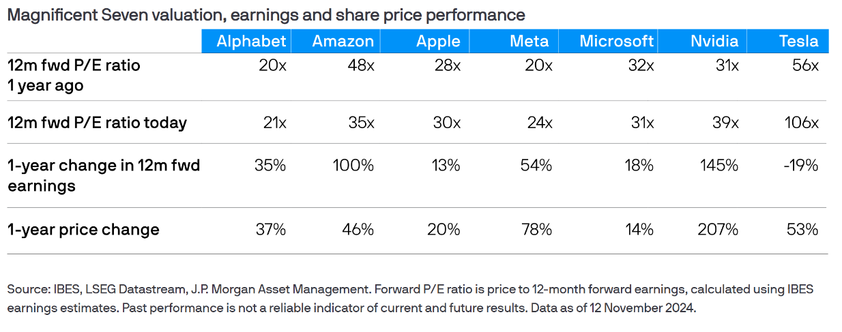
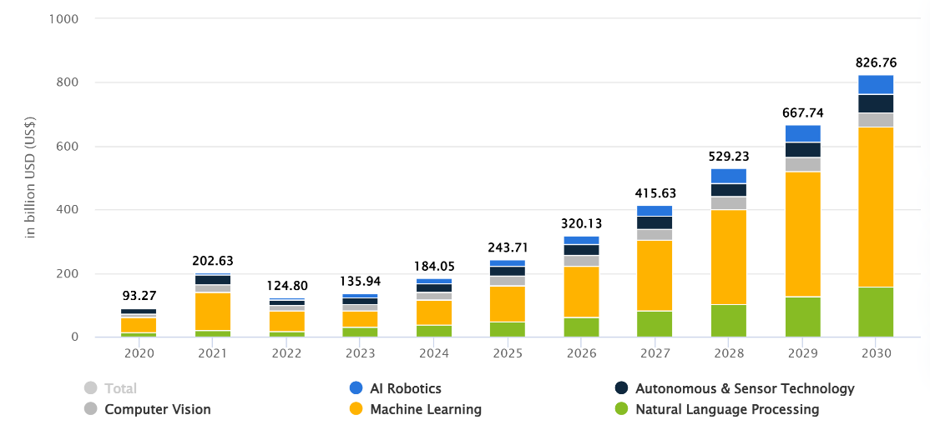
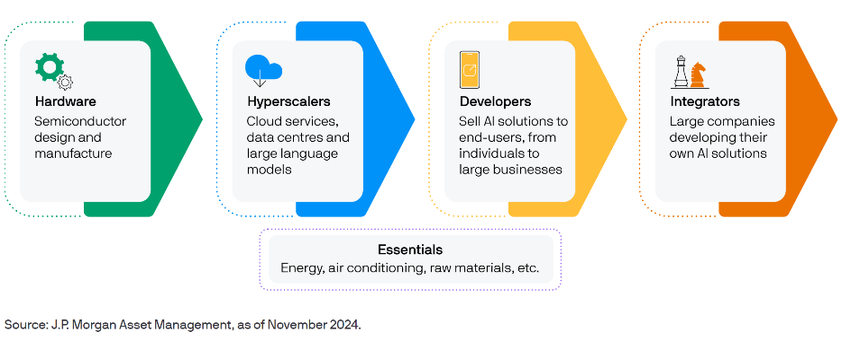
The Once-In-A-Lifetime AI Opportunity - $$$
Growing valuations
How did we get to the doorstep of the next leap in prosperity?
In three words: deep learning worked.
In 15 words: deep learning worked, got predictably better with scale, and we dedicated increasing resources to it.
Sam Altman, OpenAI
AI Revenue Forecast (Source: Statista)
Emerging AI Ecosystem

Slide 9
The Drive For Better AI: We can view this two ways…
Absolute
Relative
Google wants a better AI than Microsoft, Meta and Amazon
Specialized Medical AI
My AI has to be good enough to beat a human surgeon or diagnostic consultant
Microsoft wants a better AI than Google, Meta and Amazon
In regulated industries we can enforce standards
.
.
.
Legal AI
Meta wants a better AI than Google, Microsoft and Amazon
My AI has to be good enough so that it does not make stuff up!
Amazon wants a better AI than Google, Microsoft and Meta

Slide 10
It’s Getting Harder to Make Transformers Better
High Computational Cost
Large Training Data Sets
Transformers lead to specific Scaling Laws – and the only solution is to use more compute power for longer
Quadratic Complexity
Inability for Continuous Learning
+
Once trained, LLM parameters remain fixed, so model cannot learn during Inference phase
If you have an existing context window limit of C
…and you would like to extend this by N tokens…
Lack of Explainability
…you will need CN + N² more memory
Transformer LLMs are basically a “black box” – difficult in applications that emphasize transparency and safety
Known as Quadratic Complexity
There are tuned or enhanced algorithms, like Flash Attention, that are designed to mitigate Quadratic Complexity
Check out: A Look Back and a Glimpse Ahead At Transformers in AI

Slide 11
Source: OpenAI - Scaling Laws for Neural Language Models
The Computation Cost of Transformers
Data Set Size
Parameters
Compute
Can only scale…
But scaling these means…
Direct consequence of the Transformer architecture
More Compute = More Electrical Power

Slide 12
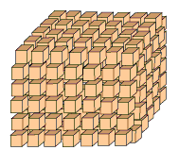
Why GPUs became a favored option for AI processing
A deep learning model will comprise large numbers of tensors
Multicore processors are best for parallel processing
Core
Core
Core
A modern CPU might have around 8 very complex cores, with multiple threads for each core
Core
Core
Core
Core
Core
Transformers process the tensors, which means a lot of matrix arithmetic
A modern GPU might have thousands of more simple cores
Nvidia H100
14,592 CUDA cores
528 Tensor cores
per-GPU
Matrix arithmetic responds well to parallel processing
Why GPUs are used for AI
Nvidia has 70-95% market share for AI processing
2H24 estimate by Mizuho Securities
Interesting videos
Why Nvidia seems to have an AI monopoly

Slide 13
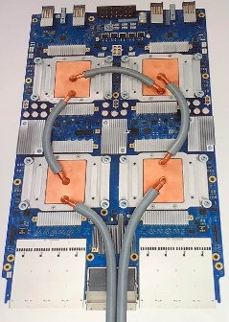
Hardware For AI Training: CPU, GPU, TPU, NPU???
Disclaimer: The real differences for TPUs and NPUs are very subjective. Explanations are often quite poor.
CPU may not have enough parallel processing to excel in AI training
GPU has lots of cores, but also has “baggage” left over from Games graphics processing
GPU uses a lot of power – not optimized for tablets, phones, IoT devices
CPU
GPU
TPU
NPU
Google seems to be the main user of this term
Core
Core
Core
Nvidia H100
14,592 CUDA cores
528 Tensor cores
per-GPU
Core
Core
Core
Core
Core
A modern CPU might have around 8 very complex cores, with multiple threads for each core
A modern GPU might have thousands of more simple cores
A TPU is like a GPU, but with all the legacy baggage stripped out and optimized for either Training or Inference
A NPU is a dedicated AI Inference chip that is optimized for power and size

Slide 14
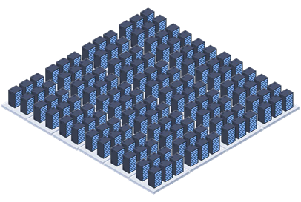
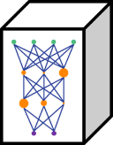
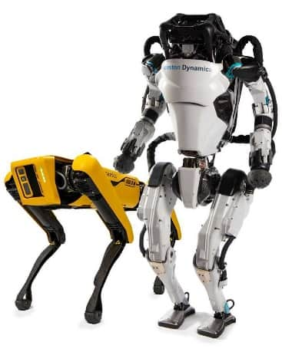
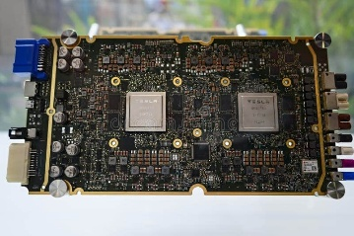
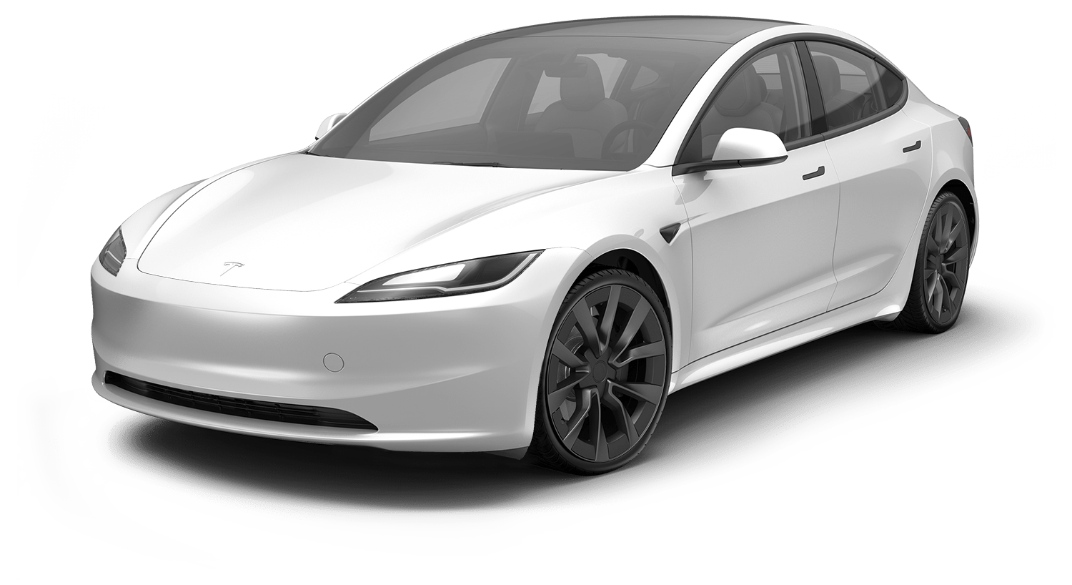
Deployment: Training vs Inference
Trained Model
Deployment Options include…
Inference
2
1
A large model deployed for a single enterprise
A Training Data Center needs tens (hundreds) of thousands of GPUs running for months to train a model
Training does not require a lot of network capacity outside the Data Center – tends to be location insensitive
Large model to serve large number of users from “local” Data Center
4
3
Training
A small model deployed on an autonomous device
A very small model deployed on a phone

Slide 15
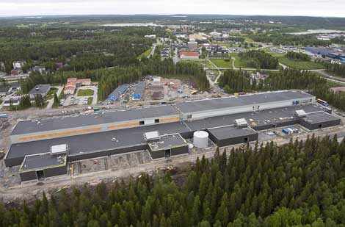
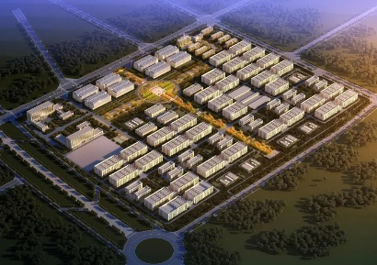
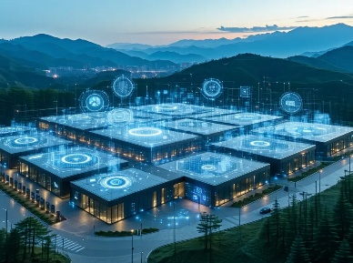
Note: These examples are to show the headlong rush to mega scale data centers is real. The actual ranking of current future data centers is not clear cut – especially in China, where past claims have been challenged.
Data Centers Are Getting Bigger!
2013
Then…largest DC in Europe
2025
Largest DC in the World
2028
Largest DC Announced
Meta’s Lulea Data Center
China Telecom IMIP
Jeollanam-do Province
South Korea
AI is resetting the expectation of what a “large Data Center” is
30 MW*
150 MW
3,000 MW
84,000 m²
*267,471 MWh of electricity annually and withdraws 25.4 million litres of water
Source: Baxtel
1,000,000m²
Note – China occupies the first 7 places in at least one Data Center Top 10 list
$35B Investment
Source: Capacity

Slide 16
So we will be building a lot of BIG Data Centers
What resources do they consume?

Slide 17
Do Data Centers Use A Lot of Water?

Slide 18
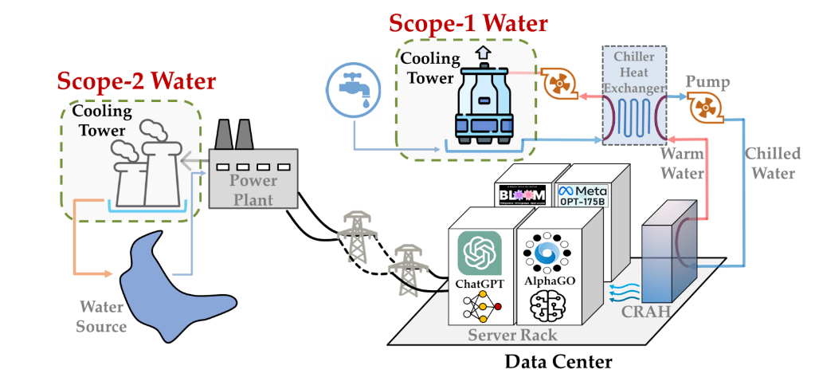
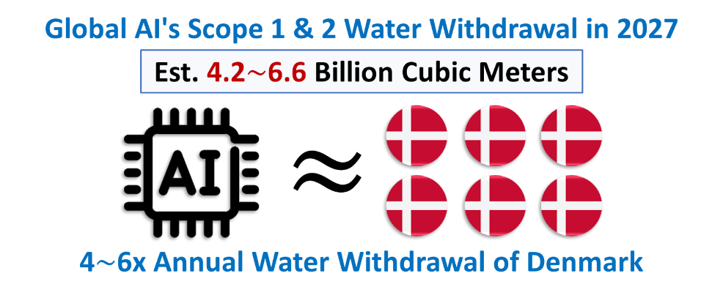
AI Data Center Water Use
Image source
Scope 1 water consumption
Primarily in cooling the Data Center
Scope 2 water consumption
Water used in generating the power
Source: IEEE Spectrum
Nuclear uses the most water of any electricity generation technology
And this is already causing issues in France…
Climate change, water scarcity jeopardizing French nuclear fleet
Source: “How much water does AI consume? The public deserves to know”
Shaolei Ren: Associate Professor of Electrical and Computer Engineering, University of California, Riverside

Slide 19
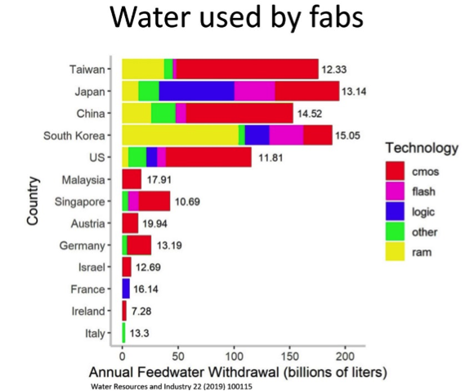
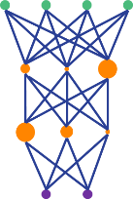
Water Consumption In The AI Supply Chain
Producing the GPU chips
8.3 tonnes of Ultra Pure Water per GPU
100,000 GPUs in Colossus DC
830,000 tonnes
Water Supply Challenges for the Semiconductor Industry
Training the Model (Source: Statista)
Link to article
4,800,000 tonnes in Iowa
15,000,000 tonnes in Washington
?
Using the Model (Inference)
The water challenge for semiconductor manufacturing: What needs to be done?
500 ml per 50 questions
10 million questions per day
36,500 tonnes per year
Link to article
Sustainable Water Management and Energy Use in Semiconductor Manufacturing:
The Path for India's Leadership
Link to article
Source: “How much water does AI consume? The public deserves to know”
Shaolei Ren: Associate Professor of Electrical and Computer Engineering, University of California, Riverside

Slide 20
A Few Basics About Our Electricity

Slide 21
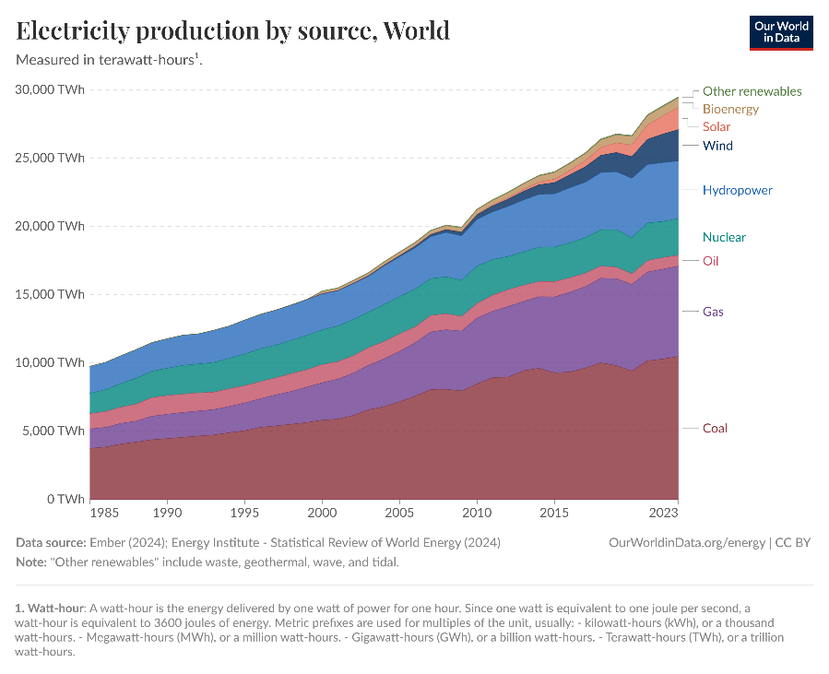
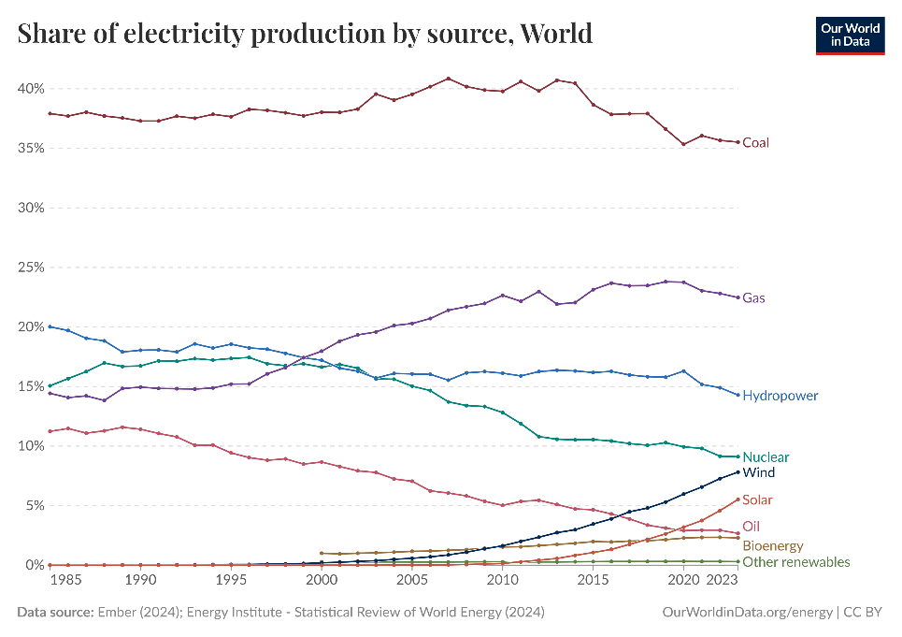
How Does The World Generate Electricity?
In 1985 fossil fuels accounted for 63% of power generation
In 2023 fossil fuels accounted for 61% of power generation*
*2023 data includes 2.3% bioenergy, and some forms have significant CO2 footprint
Energy consumption is rising
Little or no progress on decarbonization
This is a good thing! Energy = Prosperity
Don’t feel guilty that this is chart is rising…
…we need to be far more focused on how we generate this power

Slide 22
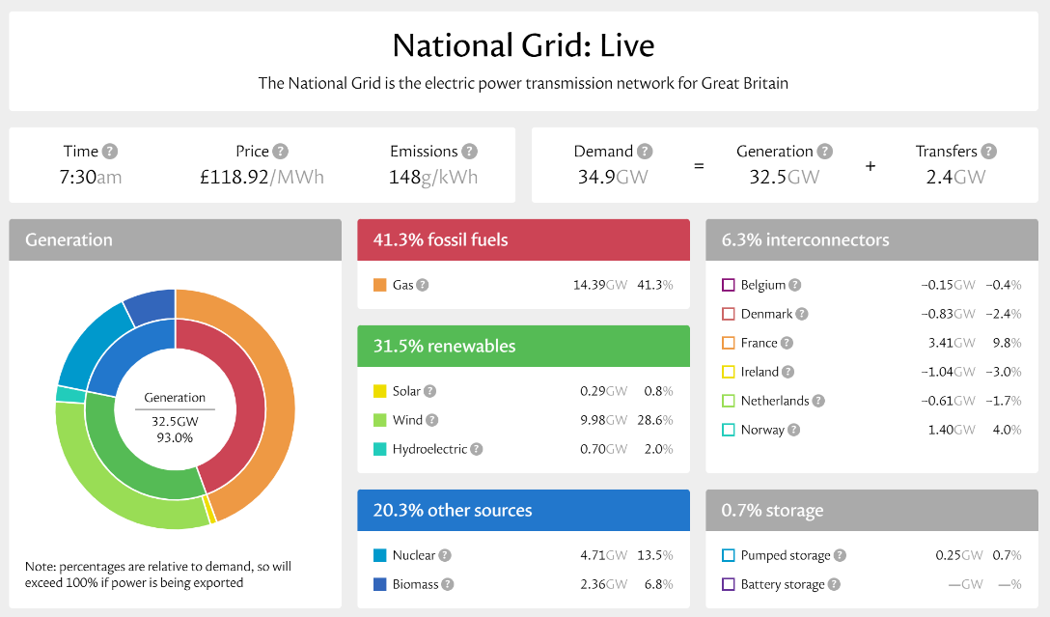
The Power Generation Mix: UK Example
Check out the full dashboard
The UK gets its electricity from a range of sources
UK became 1st G7 country to phase out coal fired generation
Natural gas is the biggest contributor today
Renewables are coming on stream
Nuclear is having “issues”
UK buys a lot of electricity from Europe
1882
1933
1952
1962
1986
1991
2019
2023
Bankside B is first oil fired power station
Holborn Viaduct first coal fired power station for public use
Calder Hall first nuclear plant
UK-France Interconnector
UK’s first wind farm
More electricity generated from non-CO₂ sources than fossil fuels
First grid-connected solar farm
UK creates world’s first National Grid
(132 kV)
1953
275 kV Supergrid
Link to document

Slide 23
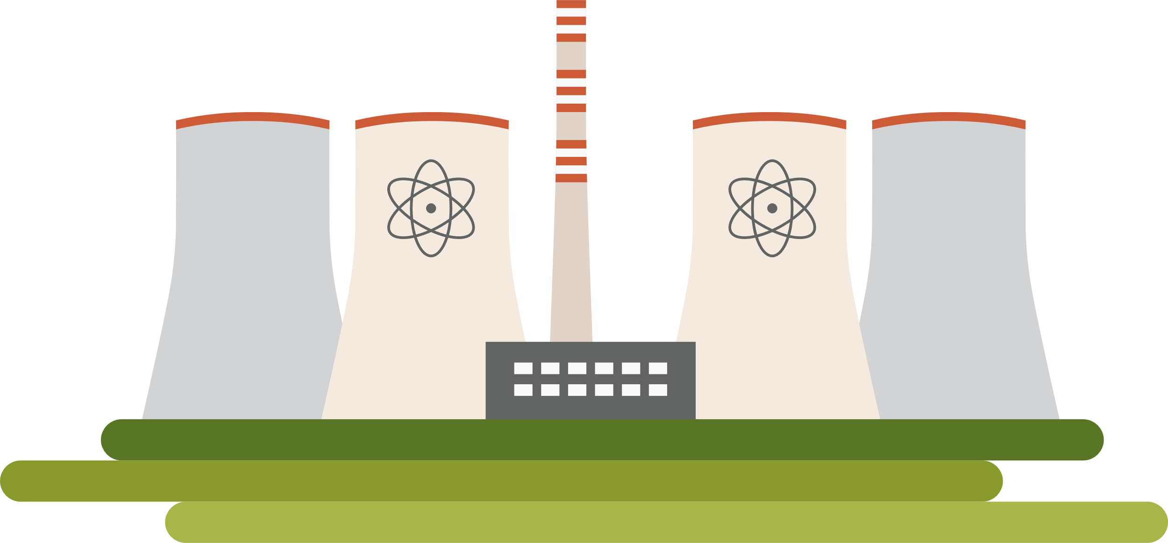
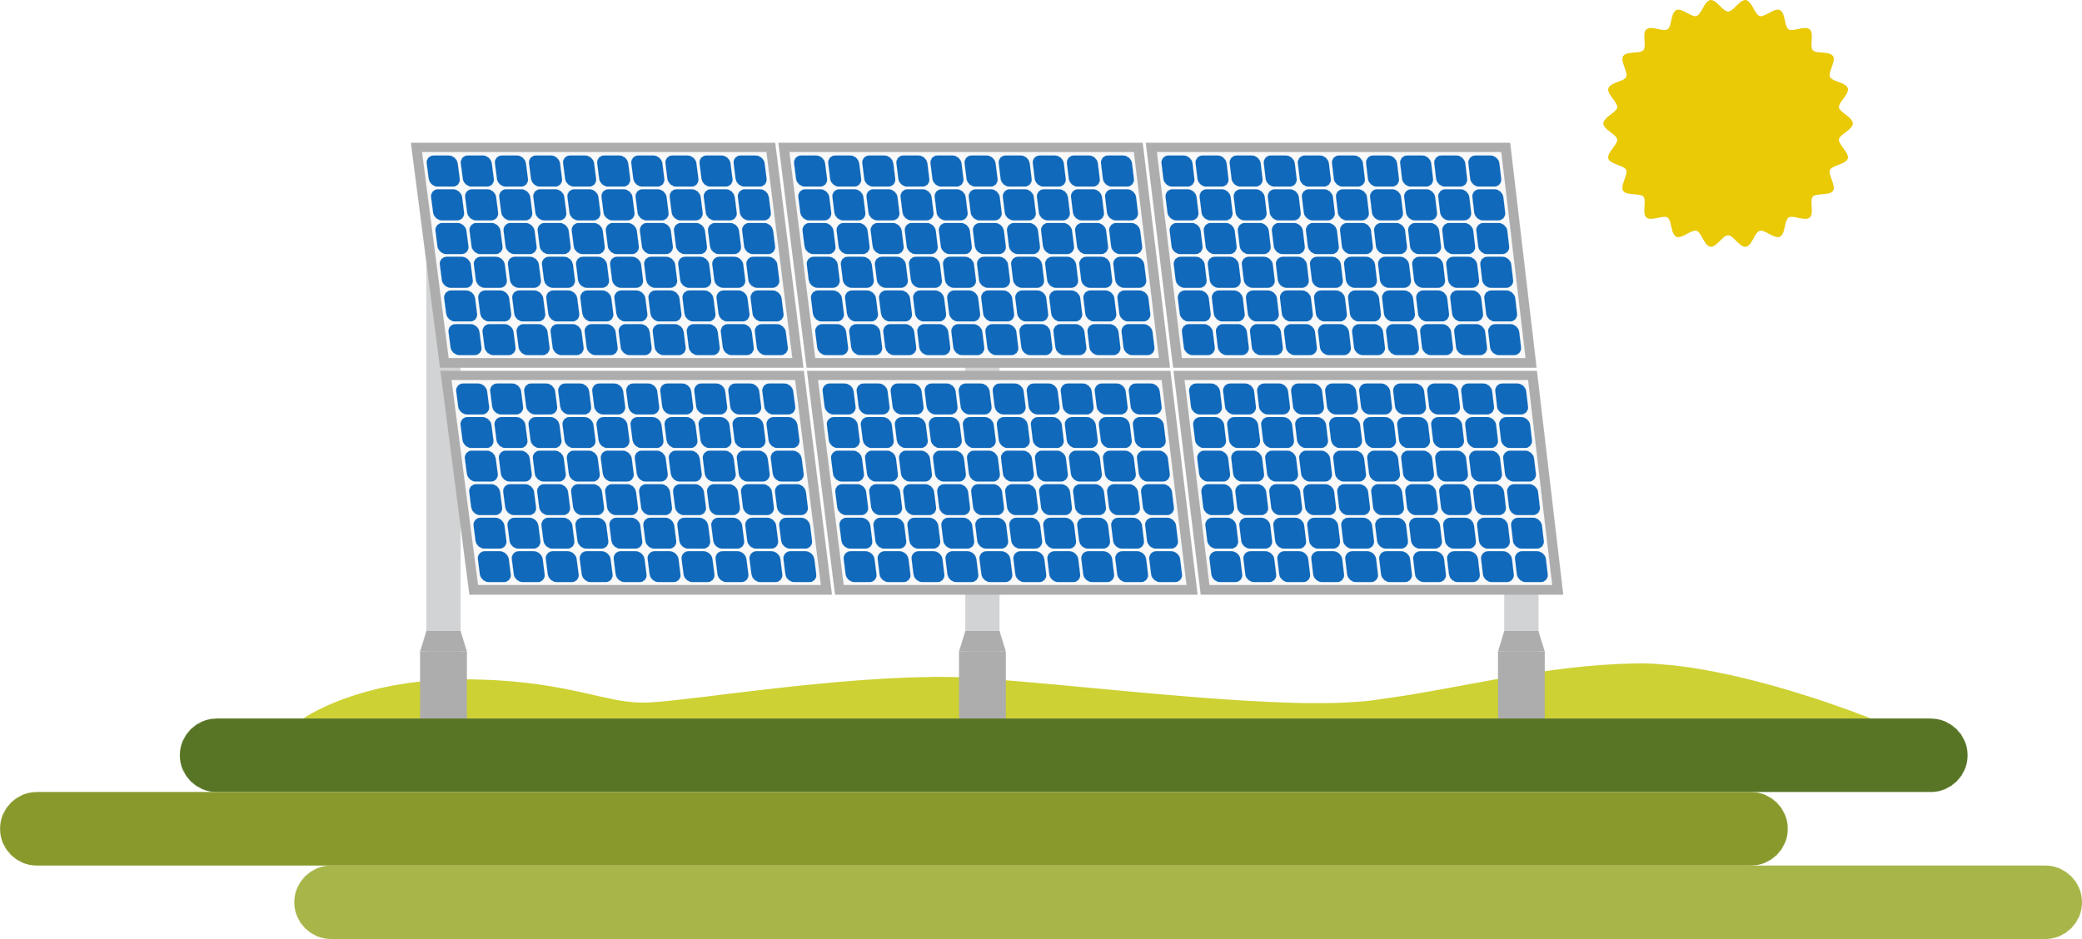
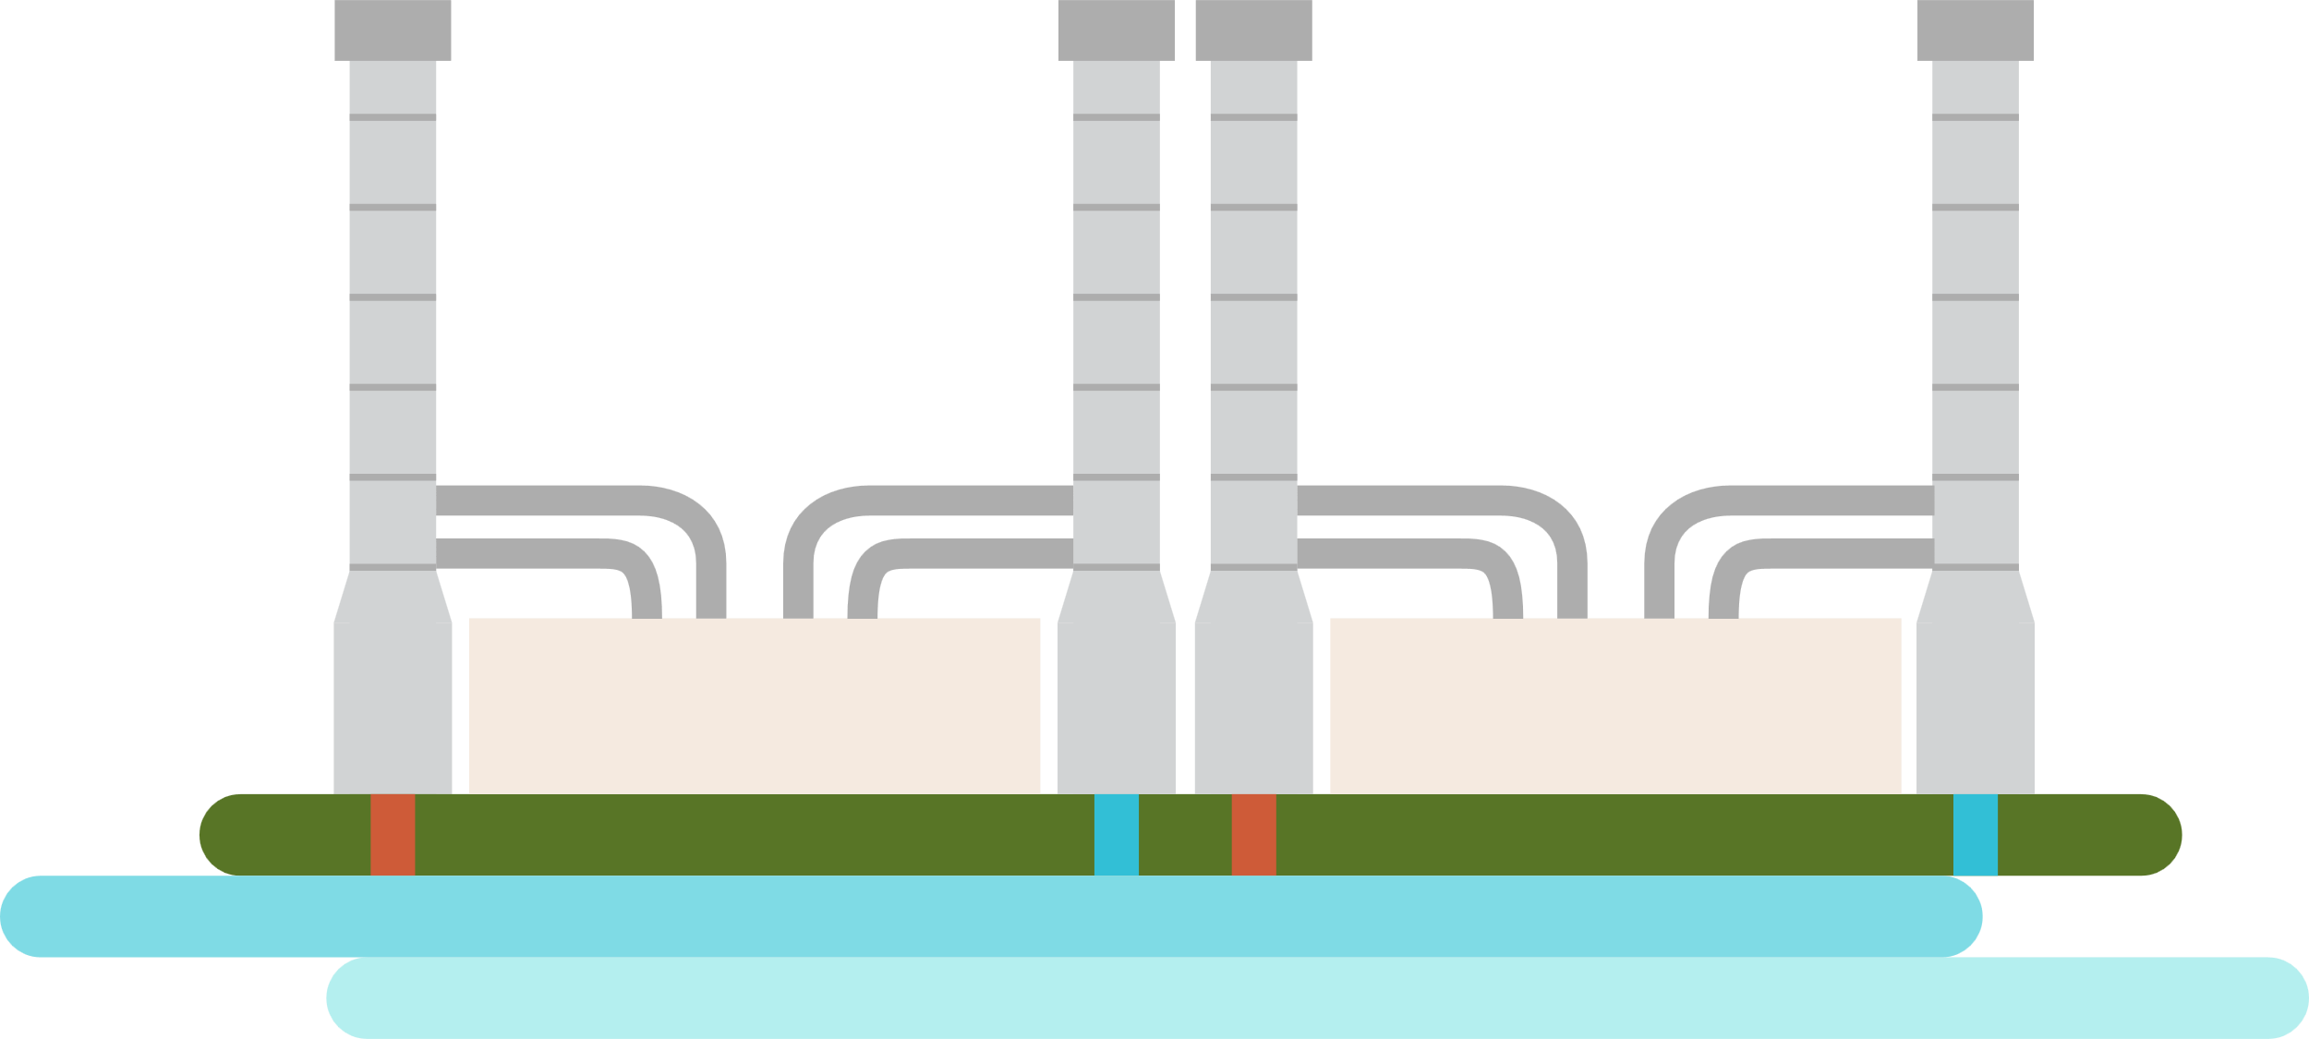
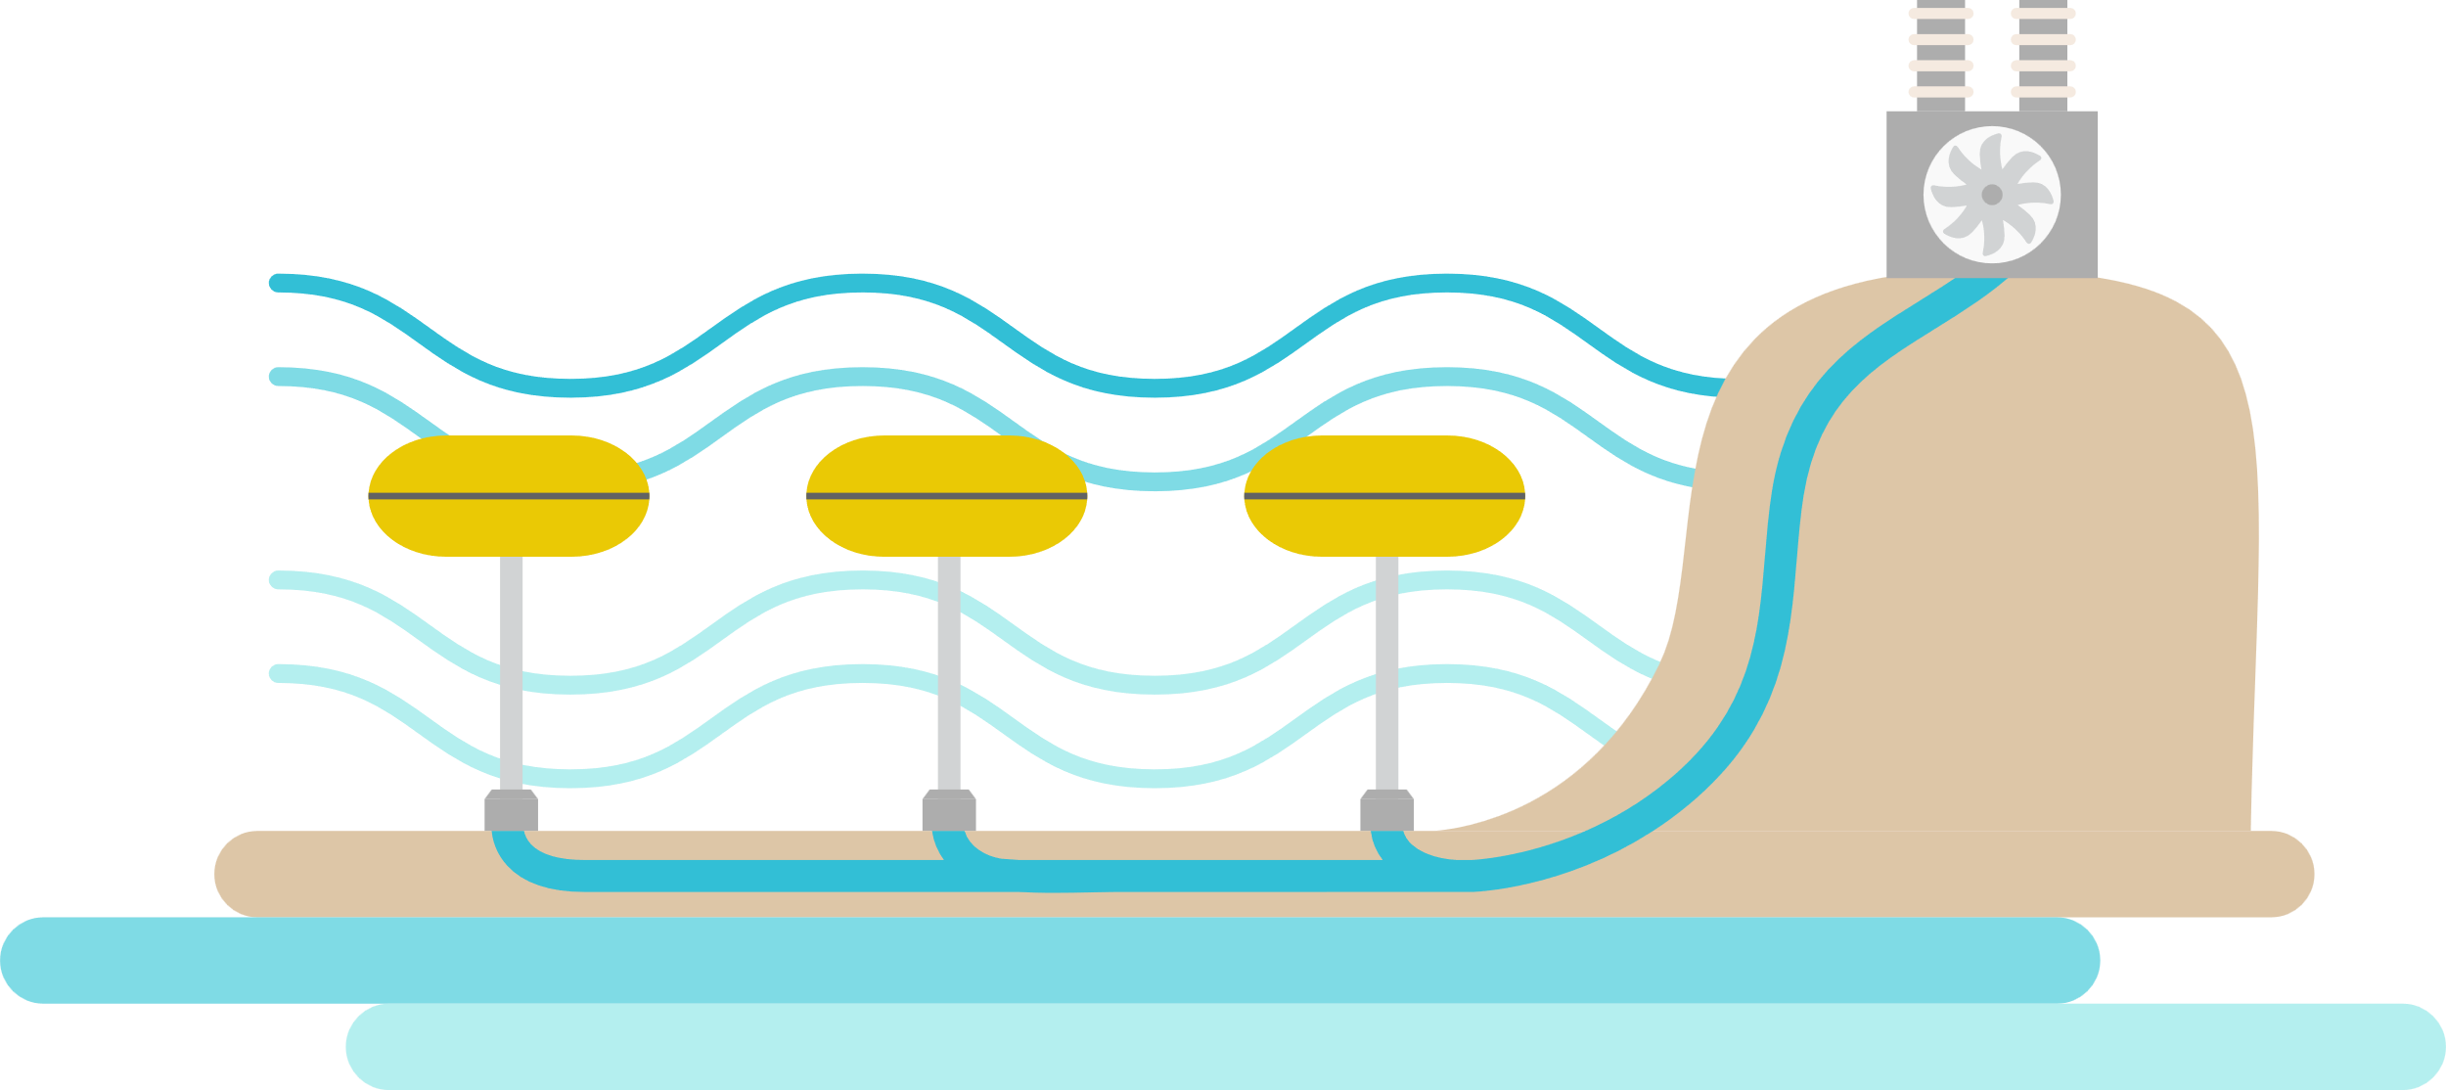
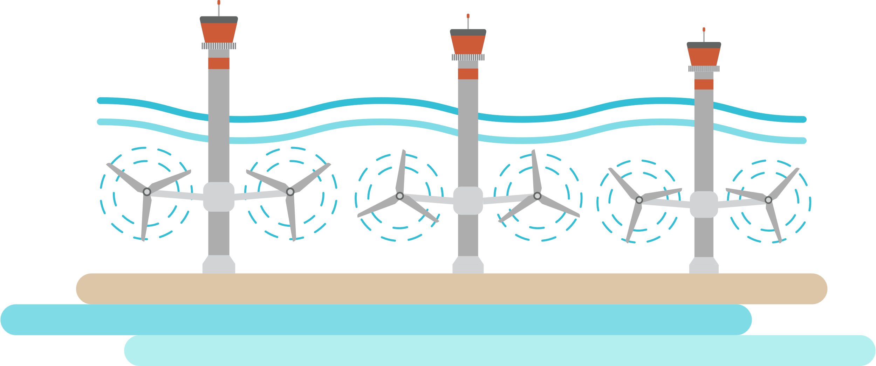
Regional or National Grids are Crucial
Coal
Think about grid in same way as the internet – a cloud…maybe ☺
The Grid is fed from power stations
And needs different voltage levels for efficient transmission/distribution
Regular customer – like cities and farms – use Distribution Grid
Renewable installations usually feed into the Distribution Grid
Storage systems also have 2-way connection to Distribution Grid
Very high demand users will connect directly to the HV transmission grid
Data Center may have local Solar, Wind and Battery Storage
Needs Grid connection for reliability against intermittent renewables
Gas
Extra High Voltage
AC or HVDC
265-275 kV
Nuclear
Co-located Solar, Wind, Battery
Hydro
High Voltage
110kV upwards
Data Center
Transmission Grid
AI Data Centers can “pop up” in a matter of months with high demand on Day 1
Distribution Grid
Hydro
Geothermal
Low Voltage
50kV
A new city needs high capacity grid connection, but takes decades to grow in demand
Solar
Many power grids around the world are already under strain, and Gigawatt scale Data Centers are making the situation far worse
Tidal
Wave
City
Wind
Location-Specific Power Sources
Battery
Rural
Pumped
Hydro

Slide 24
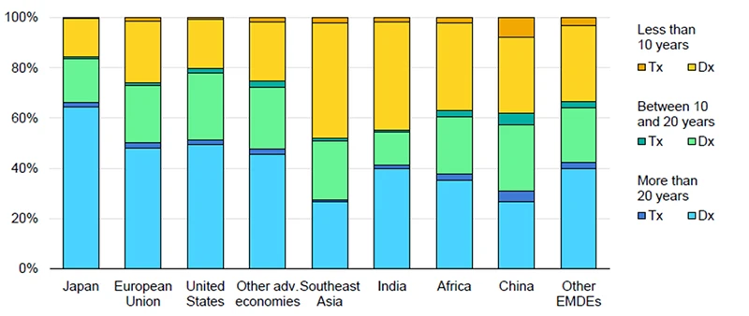
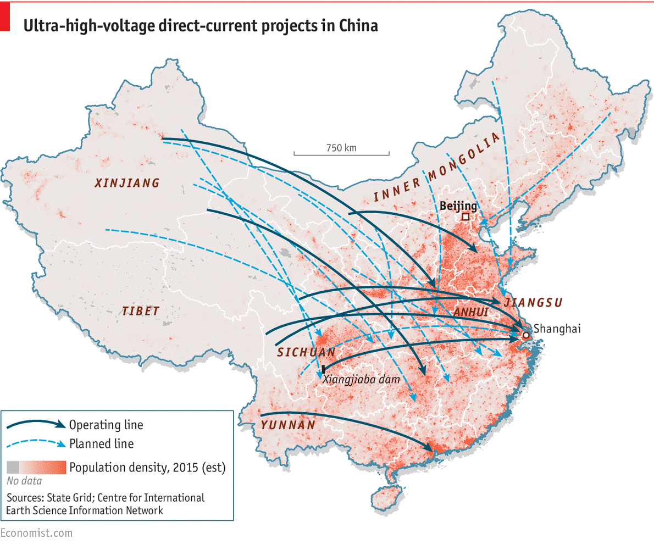
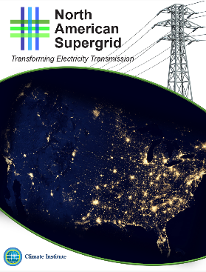
Power Grids Are Under Pressure
But somebody is investing heavily…
Age of Power Grids
China started in 2011
Twelfth Five Year Plan
Japan, EU and USA have the oldest Power Grids
2017: Proposal for North American Supergrid
April 2025: China has completed
38 Ultra High Voltage lines
18 of these are AC
20 are DC
Carry power from Solar, Wind, Coal, Hydro and Nuclear
On average Europe’s power grids are >40 years old
Renewables are putting significant strain on today’s grid infrastructure in Europe
Hypothetical US network following railroad Rights of Way

Slide 25
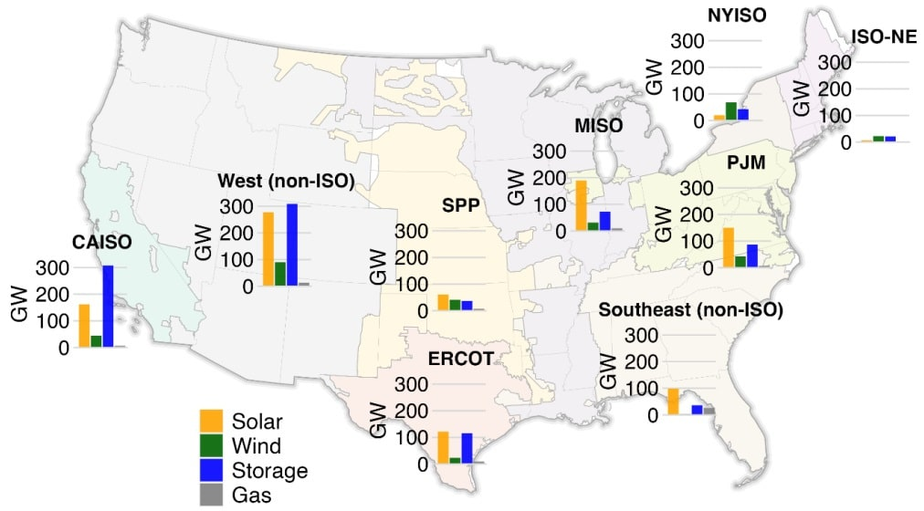
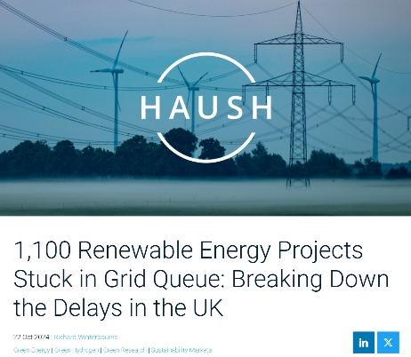
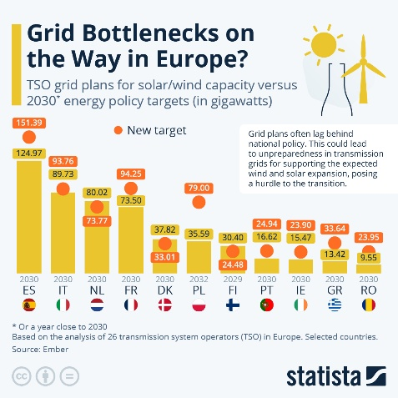
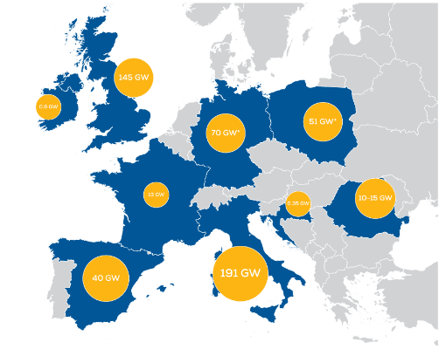
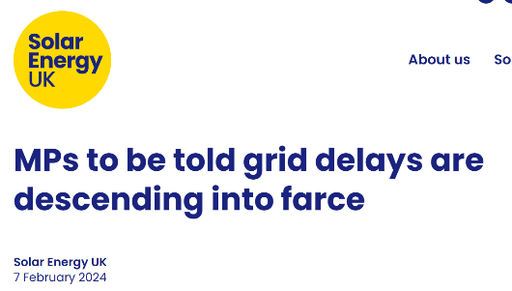
Many Countries Experiencing Grid Congestion Issues
Link to article
Link to article
Size of grid connection queues across USA
Link to article
Size of wind farm connection queues across Europe
Link to article
Link to article
Link to article

Slide 26
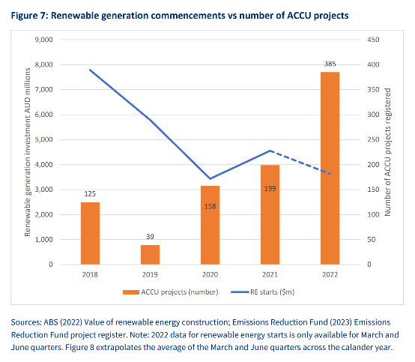
It’s OK – I ticked the box to offset my carbon footprint 😇
Australia’s experience – Carbon Credit Schemes increasing while Renewable Energy projects decreasing
Clean Energy Agreements
Why use “real” clean energy when you can buy “virtual” clean energy?
Link to report
Millions of carbon credits are generated by overestimating forest preservation
Link to report
ACCU = Australian Carbon Credit Units
Issues in the domestic market…
Link to report
Study analyses major carbon offset projects, and finds that – of a potential 89 million credits – only 5.4 million (6%) were linked to additional carbon reductions through tree conservation.
…and with big corporations
The Problem With “Green” Energy Certificates
Link to article
Link to report
Problem: Carbon credit schemes are poorly regulated and, in a hugely shocking revelation, it seems that humans can be rather unscrupulous
Problem: Companies are trading in Clean Energy Contracts as a quick fix – allowing them to delay or avoid taking effective energy decisions

Slide 27
Let’s pause for some case studies

Slide 28
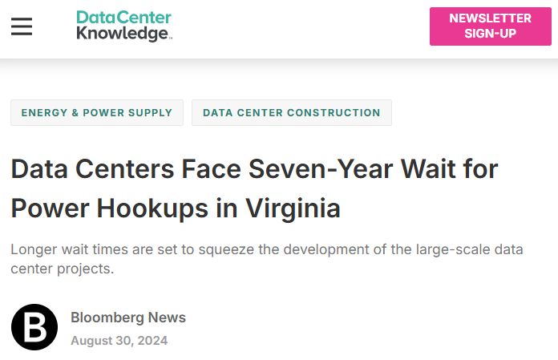
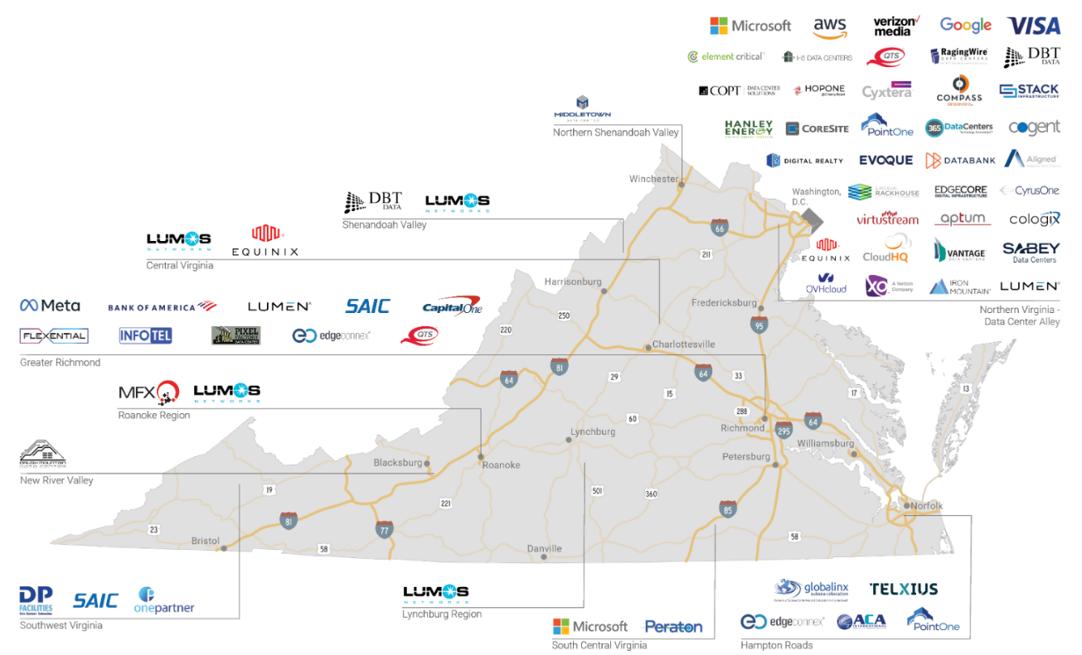
The Challenges of Data Center Success: Virginia
What do they need?
11 GW of new data center capacity by 2030 in Northern Virginia alone
40% of VA’s peak demand today
Virginia Data Center Market
TREND: BYOP
(Bring Your Own Power)
How do they get there?
10-15GW of firm generation capacity
Why is this a challenge?
It can take 3-4 years to approve a new gas-fired generating plant (e.g. 1 GW)
Market prices are too low for developers to build the required capacity
Wasted effort if you can’t connect to the grid!
30% CAGR since 2014
Total of 4 GW today
Free Market Challenges!

Slide 29
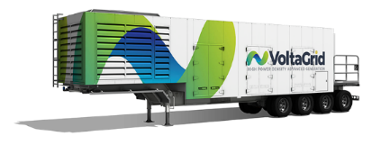
Is Gigawatt-Scale BYOP Viable? Let’s look at xAI’s Colossus in Memphis
100,000 H100s will require 150 MW
Local grid supply*:
8 MW
Today
100,000
H100 GPUs
*As of August 2025
X14
35 MW
Smog levels in Shelby County have exceeded recommended levels for the past 3 years
Natural gas powered mobile generators
Tomorrow
200,000
H100 GPUs
X4
64 MW
50 MW*
MLGW has agreed to upgrade site to:
*At a cost of $760,000 to local taxpayers
xAI has committed to fund a 150 MW, $24M new substation
The grid is already overloaded*
But…where does the power actually come from?
*Not a direct quote
Article: “xAI cluster is now the most powerful AI training system in the world”

Slide 30
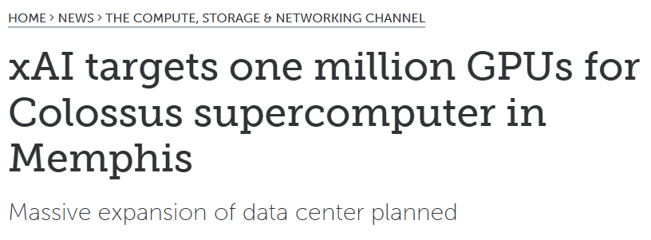
Breaking News – xAI to expand Colossus to 1 million nodes!
One million GPUs represents 27% of Nvidia’s 2023 shipments
Where are they going to get 10X (1,500 MW) the power?

Slide 31
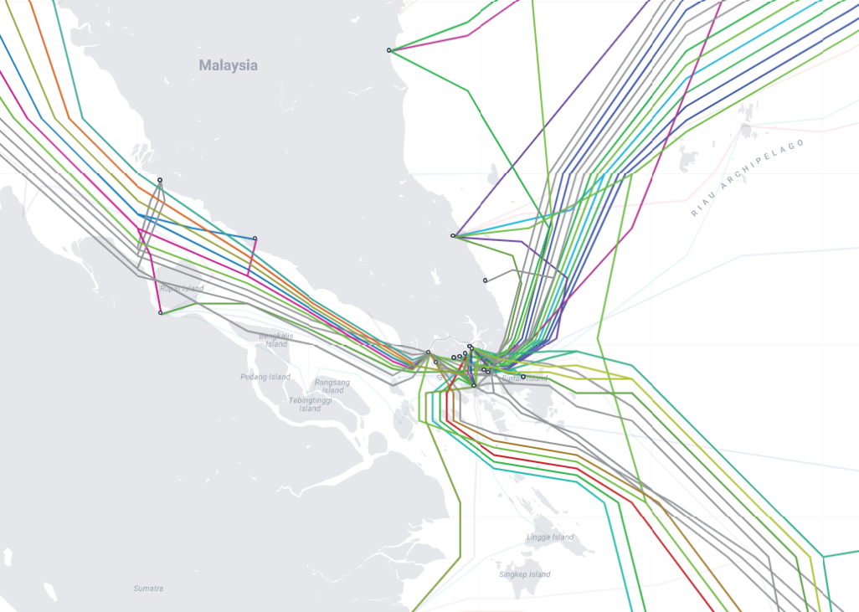
An International Example: Singapore
26
Operational Submarine Cables
>95% of Singapore’s electricity is generated with Natural Gas
3
Major Cable Landing Stations
Ideally we need Green Energy
Ideally we need more diversity
Subsea hub ➔ Data Centers
Singapore is one of the most important subsea hubs in the world today
87 Data Center facilities with 6,933,008 ft² and consuming 1,026 MegaWatts

Slide 32
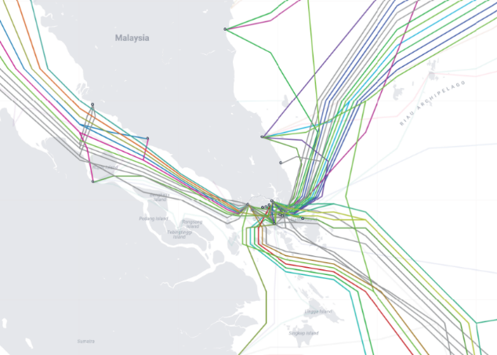
Singapore and Power – Challenges and Opportunities
Malaysia Generation Mix 2023
Johor Bahru may become the largest DC market in SE Asia in the next 2 years
2019
Singapore issues moratorium on new Data Center builds because of power shortages
As a result…
Singapore is trying to recover momentum
But…by efficiency vs new capacity
DC growth in Malaysia while international traffic is moved over the Straits of Johor
Malaysia has a goal to boost Renewables from 27% to 37% by 2030
What can we learn from Singapore?
Plentiful (Green) Power is essential
Proximity to a Hub may be useful
Don’t become
complacent
For Malaysia

Slide 33
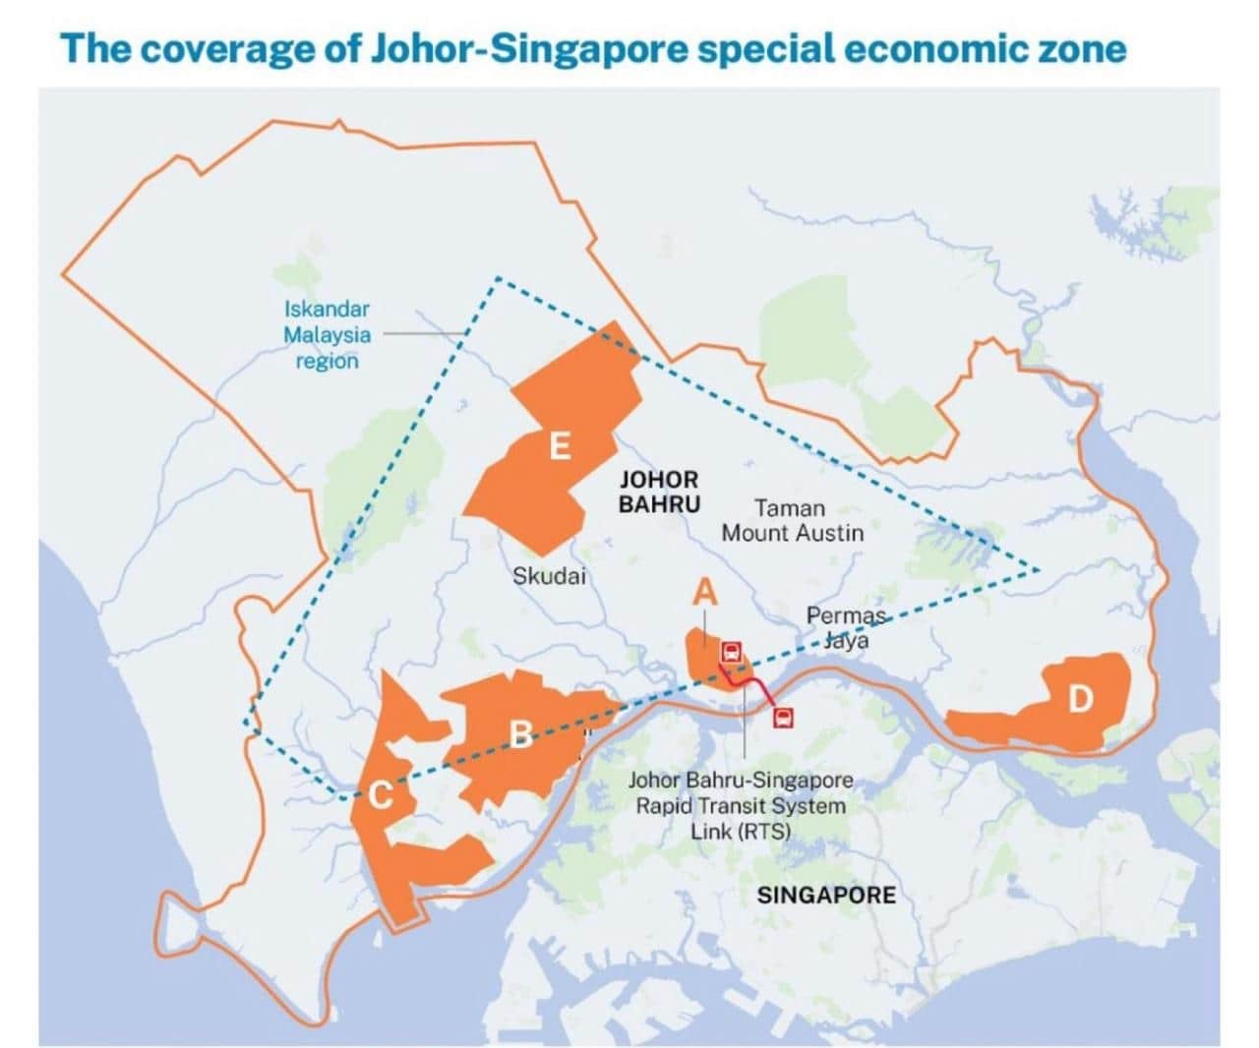
Singapore and Malaysia have had a somewhat lively history
But the Data Center opportunity is pushing them towards more cooperation
Independence in 1965
Disputes over water
Disputes over islands
Disputes over port boundaries
At this point Singapore is <1 km from Malaysia, but…
Currently a 2 hour drive, including a customs post at the causeway bridge
After the agreement it will be a 10 minute metro train ride
But this is Johor Bahru in Malaysia, where there is space, power and water for mega data centers
This is Singapore, where the subsea cables terminate

Slide 34
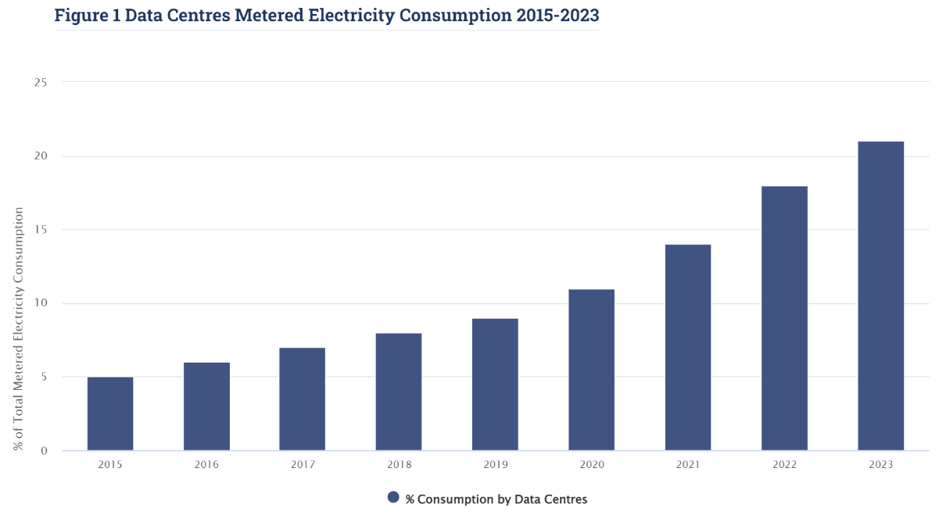
Ireland – Is The Party Over?
Data Centers account for 21% of Ireland’s electrical consumption - predicted to rise to >30% by 2026
Source: CSO
2015: 5%
2023: 21%
>50% of Ireland’s electricity still generated by fossil fuels

Slide 35
How Do We Power AI Data Centers?

Slide 36
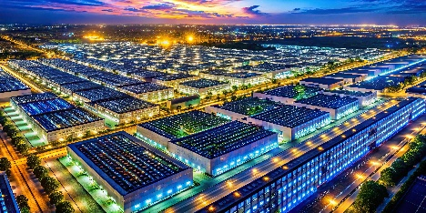
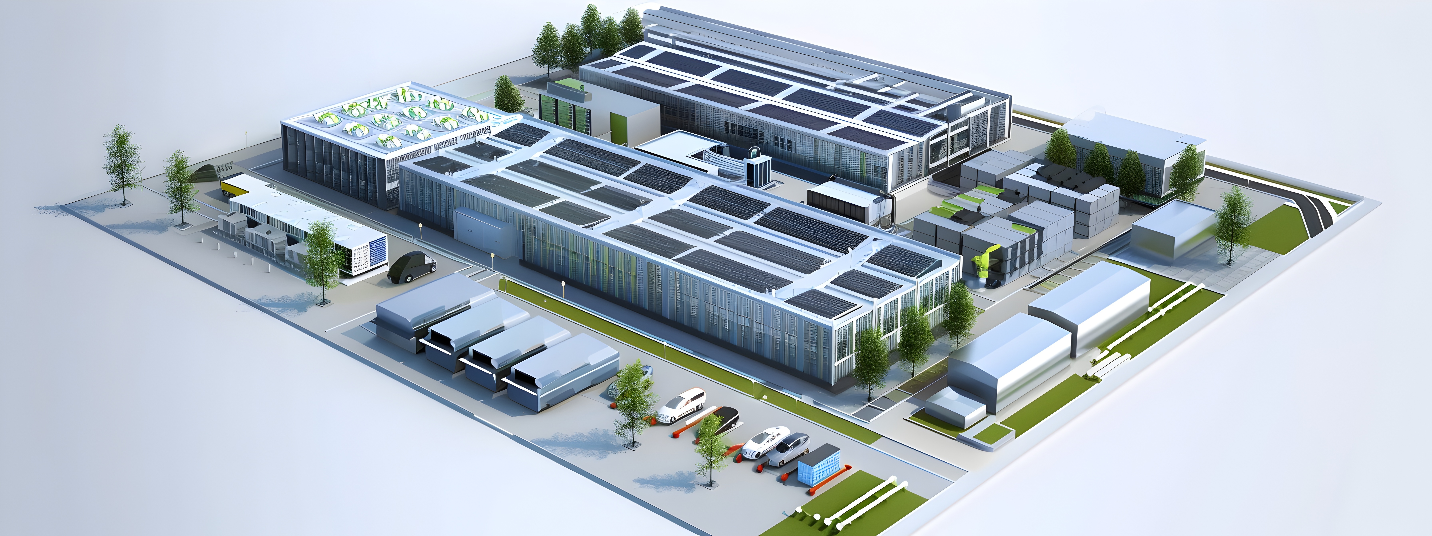
What do AI data center operators really need?
City examples that can be powered with 1 GW*
2
24/7/365 Energy Supply
Dublin
Nice
Islamabad
Amsterdam
Cologne
Oslo
Cartagena
Southampton
Liverpool
Forth Worth
Jacksonville
Austin
San Jose
Coal
Solar
Wind
Gas
Intermittent Power Sources
1
Gigawatt Scale
Nuclear
Hydro
Geothermal
*Assumes a population of around 1 million
24/7/365 Power Sources
Tidal
Wave
3
Compact Installation
Location-Specific Power Sources
4
Low CO₂ Emission (has become “optional”)
Google
Goal: “Carbon neutral by 2030”
Reality: 48% increase in CO₂ emissions since 2020
Microsoft:
Goal: “Remove all MSFT CO₂ emissions by 2050”
Reality: 29.1% increase in CO₂ since 2020
Co-locate power and Data Center
Avoid grid connection?
Source: Hyperscalers versus the sustainability pushback

Slide 37
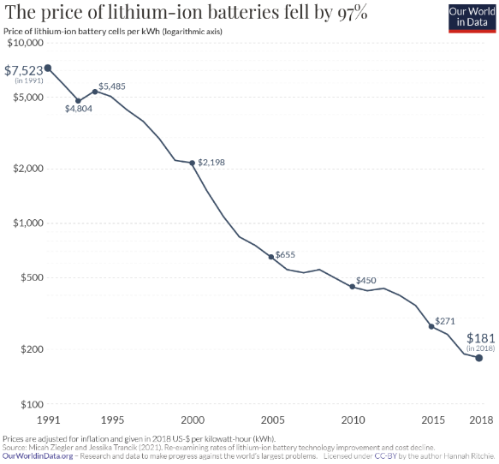
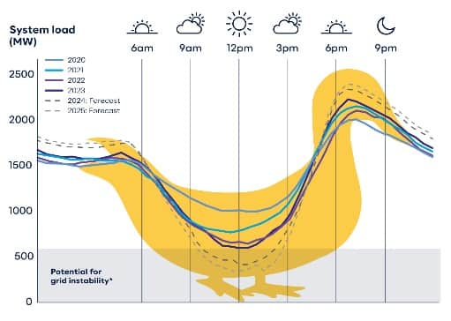
What About Batteries?
This data stops in 2018
2022: $129 per kWh
2025: $78 per kWh
Battery technology is specifically intended to “flatten the duck curve”
Edwards & Sanborn Solar and Energy Storage Project in California
Fallen by 99%
Link
Solar Panel Waste
4,660 acres $→$ 3,530 football fields
$20-30
Cost to recycle a panel
<$2
Send to landfill
864 MW of solar PV
3,287 MWh of battery storage
Lithium Battery Recycling
The largest grid scale battery in the world could only power a Gigawatt-scale data center for 3 hours!
The largest in Europe for only 40 minutes!
What % are recycled today?
Between 5% and 59%*
*Difficult to find accurate estimate because it is unregulated

Slide 38
…Two Potential Winners
Power Options for AI Data Centers
Gigawatt Scale
24/7/365
Assume >50% CF
Compact
Assume <5m² per MWh
Low CO₂
_{Assume <50g per kWh}
✗
✗
✗
✗
✗
✗
Coal
Natural Gas
Nuclear
Hydro
Geothermal
TYPE | POWER OUTPUT
Hydro | 22,500 MW
Wind | 20,000 MW
Natural Gas | 8,600 MW
Nuclear | 7,900 MW
Coal | 6,720 MW
Solar | 5,000 MW
Geothermal | 1,590 MW
Wave | 77 MW
Tidal | 254 MW
✗
✗
✗
✗
✗
✗
Tidal
Wave
Solar
Wind
g CO2 equivalent per kWh
Link
Link
Link
List of largest power stations

Slide 39
Materials Use By Power Generation Type
Manufacturing Materials
Water Consumption
Nuclear and Geothermal clear winners
Nuclear and Geothermal amongst the highest
Link: Figure 10.C

Slide 40
Focus on promoting new geothermal
International Energy Agency Report:
Future of Geothermal Energy 2025
Geothermal
The Future of Geothermal Energy
(US-specific report)
The ground below the earth’s surface is hot because of the radioactive decay of natural elements like uranium and thorium
In some places around the world this heat is easier to get to – Conventional Geothermal
Enhanced Geothermal Systems use fracking techniques to open up many more locations
Enhanced Geothermal Pros
Potentially low CO₂*
24/7/365 operation
Small footprint
Skillsets match Oil/Gas industry
Enhanced Geothermal Cons
Potential emissions
Potential waste production
Potential for seismic disturbances
Most designs are “megawatt” scale
Potentially need lots of water
New EGS systems are unproven
Conventional Geothermal provides less than 1% of global energy today – because it tends to be used in the “easiest” geothermal locations
United States, Iceland, Indonesia, Turkey, Kenya, Italy
Potential to create 100 GW of new geothermal generation within 50 years
Total cost of $600-900M
*Geothermal may release CO₂ from underground. This can be removed before release, but the USA is not a Kyoto treaty signatory so it is unclear if CO₂ emissions would be monitored or enforced for EGS plants.

Slide 41
And what you’ve all been waiting for…
Nuclear
Because nuclear seems like the perfect solution to power AI Data Centers
Or does it? 😁

Slide 42
and lost a generation of experience
Nuclear may have a few…issues…
Vogtle 3 and 4
Hinckley Point C
Flamanville 3
Previous reactor start 1973
Previous reactor start 1988
Previous reactor start 1991
Georgia, USA
4.5 GW Power Output
Westinghouse AP1000 PWR
Original timeframe of 2017 slipped to 2025
Costs have risen from $14B to $37B (over 2.6X)
Somerset, UK
3.2 GW Power Output
Framatome EPR1750 PWR
Original timeframe of 2025 has now slipped to 2029-31
Costs have risen from $12B to $56B (over 4X)
Normandy, France
1.65 GW Power Output
Areva EPR1750 PWR
Original timeframe of 2012 has now slipped to 2025
Costs have risen from $3.4B to $19.6B (almost 6X)
Fun fact: where do all these reactors get their fuel from?
From Russia with love ☺

Slide 43
The nuclear part’s not the only problem…
No mega-project comes in on-time and on-budget anymore, right?
China: 3 Gorges Dam
4.4X over budget
USA, Boston: The Big Dig
8.5X over budget
Venice, Italy: MOSE
4.7X over budget
1959-73
And it doesn’t even need to be on Earth to over-run!
But it turns out we were never that good at project estimates!
1883-????
Sydney, Australia: The Opera House
14.6X over budget
Low Earth Orbit: The ISS
$17B → $160B
Barcelona, Spain: La Sagrada Familia
Nobody even knows!

Slide 44
The Hyperscalers’ Plans for Power: BYOP* *(Bring your own power)
SMR = Small Modular Reactor
Short Term
Long Term
Purchased 900 MW Data Center next to Susquehanna Nuclear Plant
SMR plans in 3 US locations (inc. VA and WA)
Anchor investor
Geothermal investments
October 2025: Google announced agreement with Kairos Power for SMRs
September 2025: Microsoft sign agreement to reactivate reactor at Three Mile Island
CEC and SMR deal with OPG
Nuclear Fusion deal with Helion
&
Talking about a 130k Nvidia cluster
“Intention to build Gigawatt-scale AI data centers powered by Small Modular Nuclear Reactors”
Plan to build Data Center near nuclear facility blocked by discovery of rare bees
August 2025: Agreement with Sage Geosystems for Geopressurized Geothermal System

Slide 45
What is a Small Modular Reactor?
Source IAEA
The SMR Booklet 2022
Conventional Nuclear Reactor
700 MW-1.6 GW
The idea is to build SMRs in factories on a production line
Power a city or Mega Data Center
Reduce cost and time to build while improving quality
Small Modular Nuclear Reactor
<700 MW
Power a town or regular Data Center
Small enough for co-location to avoid grid connection delays
Micro Reactor
10 MW
Power a factory or small Data Center
If you need more power or resilience, just deploy more SMRs
In a world of “joined up” thinking you would…
Gosh, I wonder if that’s what’s happening with SMRs in the real world
…choose 1 or 2 designs…
…test them carefully…
…crank them out

Slide 46
10+ Years
Selection of Companies Building 60+ SMR Designs
Operational
Under Construction
Licensed*
*In at least one country
Seeking License*
*In at least one country
PWR: Rolls Royce
HTGR: Grid connection 2021
PWR: China National Nuclear Corporation
MSR: Thorium Reactor
PWR: Korea Atomic Energy Research Institute
PWR: Holtec
OKBM Afrikantov
PWR: Akademik Lomonosov
May 2020
LFR: Atomenergoprom
In Design
PWR: Nuscale
Glossary
PWR: Comisión Nacional de Energía Atómica
HTGR: High Temp Gas-Cooled Reactor
PWR: Pressurized Water Reactor
MSR: Molten Salt Reactor
LFR: Lead-cooled Fast Reactor
2X
PWR: OKBM Afrikantov

Slide 47
Nuclear Waste: It’s a choice, not an inevitability
Nuclear waste is highly regulated and is the easiest form of industrial waste to detect and measure
All of the high level waste produced 70 years of global commercial nuclear power fit into a space the size of a football stadium piled 14 feet deep
Note: Always show nuclear waste in corroding barrels, preferably with glowing green ooze leaking out
1
2
Reprocess the >95% of useable nuclear fuel in “spent” fuel rods
3
✓
Use a fast neutron reactor to process new fuel during normal operation
Onkalo spent nuclear fuel repository
Store it as glass in geologically stable repositories
About 20 FNRs operating since the 1950s
Management of Spent Fuel from Nuclear Power Reactors

Slide 48
Wait! Isn’t Nuclear Power Dangerous?
Link to article
Cumulative Reactor Years of Operation
1
Following the Fukushima accident in 2011 German leaders committed to phasing out nuclear power by 2022/23
1,100
$12B
60
*
Reactor Years of Operation (x1000)
0
The number of incremental deaths per year in Germany from air pollution caused by coal and gas
Annual social cost of reactor closures
But they had to extend the use of coal, and buy Russian gas
Link to article
Number of deaths from the 3 major nuclear accidents
*Higher estimates exist, but are highly disputed
“We calculate a mean value of 1.84 million human deaths prevented by world nuclear power production from 1971 to 2009”
Organizations arguing that nuclear power is dangerous
Myth buster: Nuclear energy is a dangerous distraction
Is Nuclear Power Bad for the Environment?
6 reasons why nuclear energy is not the way to a green and peaceful world
In the UK, 6,000 people die each year in home accidents
Link to paper

Slide 49
Three Steps For Hyperscalers To Take Now!
1
2
3
Grab any spare capacity on existing nuclear facilities before the competition does!
Restart any mothballed nuclear facilities you can
Build new, large-scale nuclear plants – if you remember how to do it.
Holtec Pallisades, Michigan
May be the first to restart in USA
USA has set new goals
COP28 Nuclear Expansion Goals
Susquehanna
Develop new types of reactors – such as SMRs
Three Mile Island
11 nuclear plants shut down prematurely
26 GW of clean energy lost
Very long term – hope that somebody figures out nuclear fusion
Extend the life of nuclear plants that were scheduled to close
"no [economically] sensible way of bringing the plants back,"
Nadia Jakobi
CFO E.ON
In 2022 the DoE warned that “25% of US nuclear plants are at economic risk of closure”
Map of at-risk nuclear plants
U.S. Nuclear Plant Shutdowns, State Interventions, and Policy Concerns
Three Mile island was mothballed for economic reasons with options to restart
Germany’s reactors were shut down “permanently” for political reasons
The USA has a goal to deploy 35 GW of new nuclear power by 2035
Then 15 GW of new nuclear power per year by 2040
Free Market Challenges!

Slide 50
We could assume that…
The AI hyperscalers have insane amounts of money to spend on AI Data Center construction
Nuclear Power is…
But producing general purpose clean energy is not the AI Hyperscalers’ goal
If there’s no way to power them…why build them?
…too expensive, and takes too long to build…
…it has a bad image and people will try to block it
Nuclear is not just the best option, it’s really the only option
Nuclear Power may not be the right option to produce general purpose clean energy
The dream of cheap, clean, safe and abundant nuclear energy may finally be realized for the whole world

Slide 51
“An imbalance between rich and poor is the oldest and most fatal ailment of all republics.”
Isn’t this great?
Wait…who buys all our stuff?
AI provides massive productivity boost
But we all lose our jobs
Plutarch
CE46-120
Huzzah for us!
☹
Once in a lifetime AI opportunity
Need better AI
“Better” means more processing power
Nuclear seems like a great option
But we forgot how to build nuclear stuff!
Some of us
them
Bwahahah! Let’s go to Mars!
You guys are losers!
Absolute
Relative
Which implies more electrical power
Bwahaha! We still know how, comrade!
What’s happening today
We were only kidding – carry on burning that coal!
Pesky corporate sustainability goals!
But renewables aren’t a great fit for AI Data Centers
>80% of solar panels are made in China
Consequences

Slide 52
Thank You

