Slide 1
Prelude to a BGP hijack?

Slide 2
What happened?
Our upstream IP-transit provider alerted us.
An AS-SET in the RIPE DB suddenly showed up referencing our AS-number

Slide 3
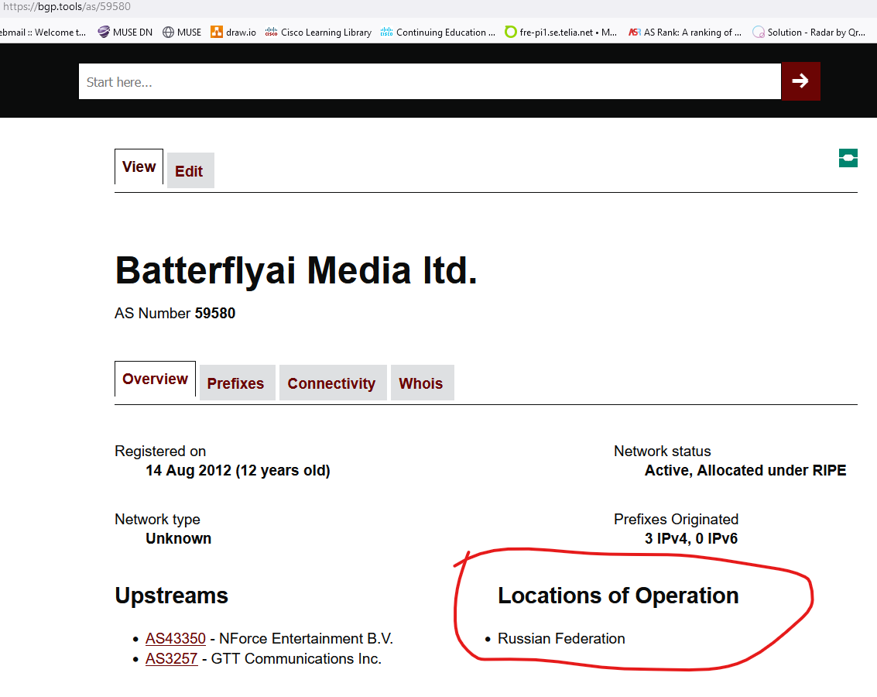

Slide 4
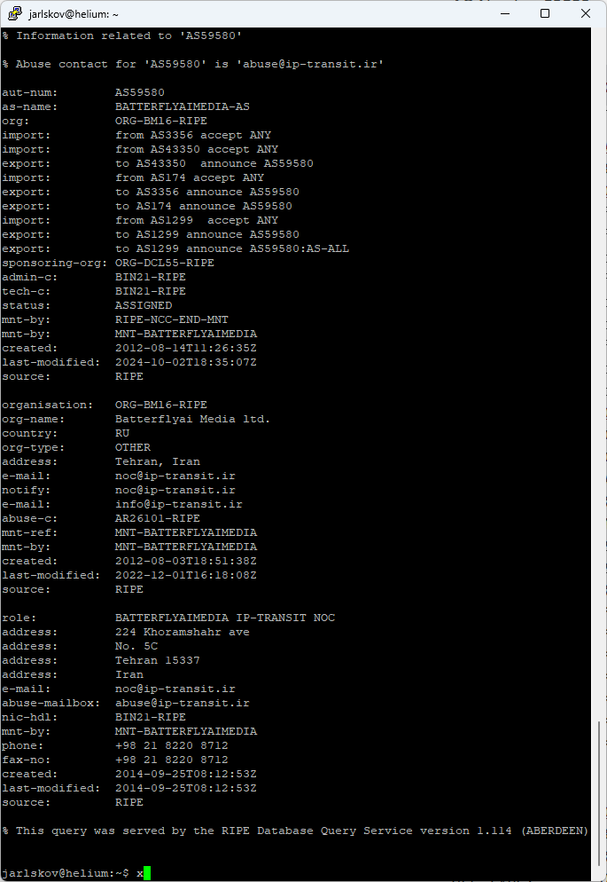
Clearly presenting the AS-set to their upstream:
Russia or Tehran, IR?

Slide 5
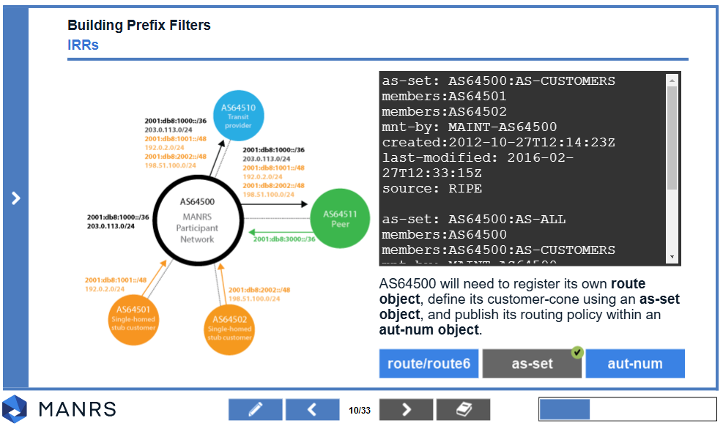
What is an AS-SET anyway?
Just a list of AS’s
Can be used for anything:
AS’s present at my IXP.
AS’s I have a BGP-session with somewhere.
AS’s whose sales-people bought me a beer at the latest conference.
Most common recommended usage:
IP-transit providers filtering BGP-announcements from their customers

Slide 6
IP Transit filtering
ROA – Route Origin Authorisation
Only validates the originating ASN
Easily spoofed
RPSL-based filtering
Based on AS-Set, route(6) and aut-num objects
Best practice (MANRS)
Equal AS-path length
Tier 1 upstream provider
Another Tier 1
RPSL-based filtering
Telia SE
AS3301
ROA VALID
Spoofed BGP announcement
Attacker AS
Spoofed AS3301

Slide 7
What to do?
Equal AS-path length
ASPA was designed specifically against this
Autonomous System Provider Authorization (ASPA)
In short: “Who are my allowed upstreams?”
https://datatracker.ietf.org/doc/draft-ietf-sidrops-aspa-verification/
https://datatracker.ietf.org/doc/draft-ietf-sidrops-aspa-profile/
Still being worked on in IETF – “Real Soon Now[tm]”
While waiting
Monitor who are referencing you in IRR DBs.
Tier 1 upstream provider
Another Tier 1
RPSL-based filtering
Telia SE
AS3301
ASPA INVALID
ROA VALID
Spoofed BGP announcement
Attacker AS
Spoofed AS3301

Slide 8
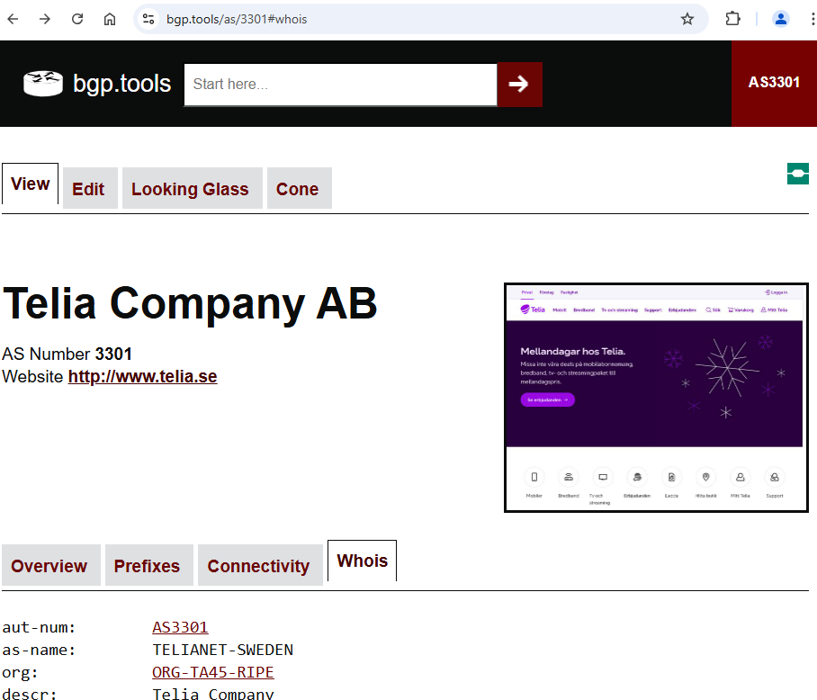
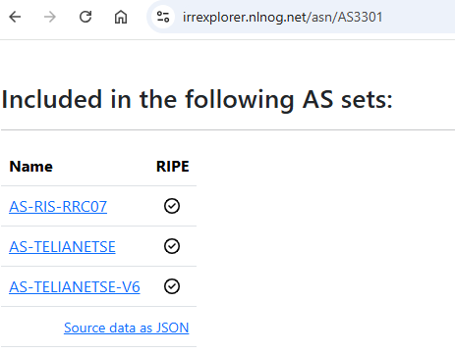
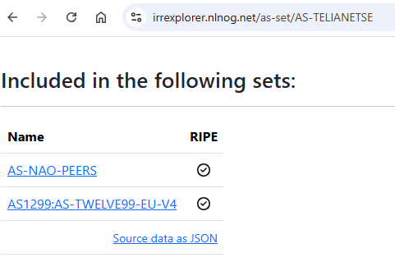
Monitoring IRRs
Search for your ASN / AS-Set
E.g. bgp.tools, ”Whois” tab
irrexplorer.nlnog.net
Follow the chain of references

