Slide 1
Prelude to a BGP hijack?
Improper uses of AS-sets?
Lasse Jarlskov
Lasse.jarlskov@teliacompany.com

Slide 2
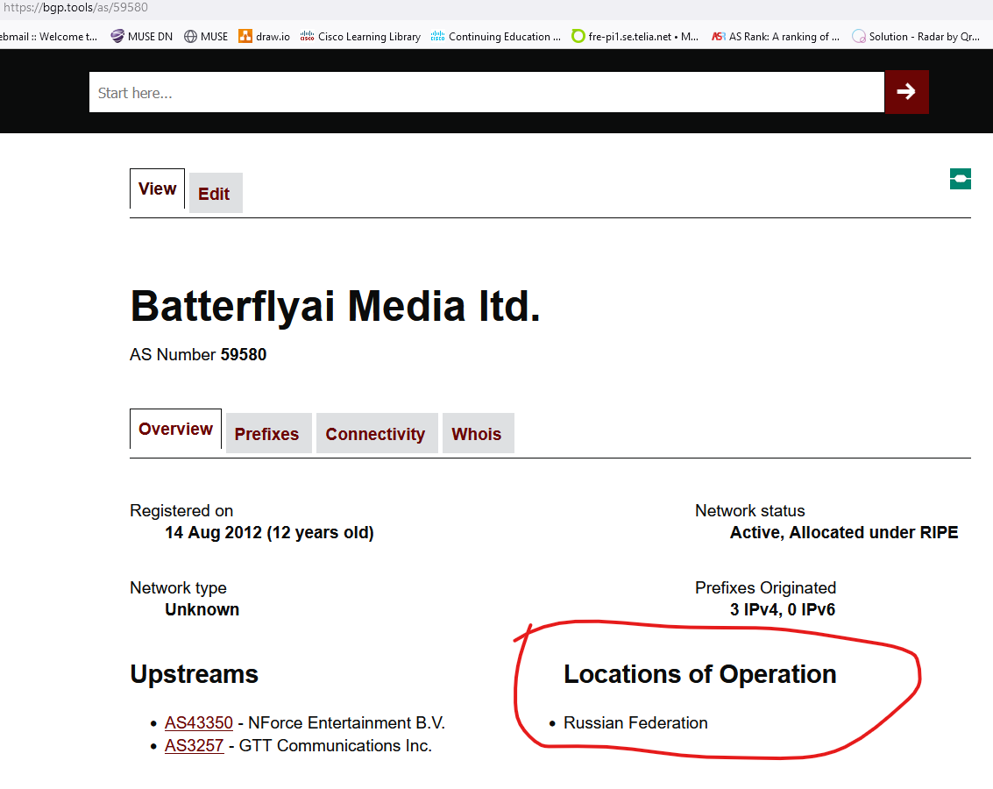
What happened?
Our upstream IP-transit provider alerted us.
An AS-SET in the RIPE DB suddenly showed up referencing our AS-number

Slide 3
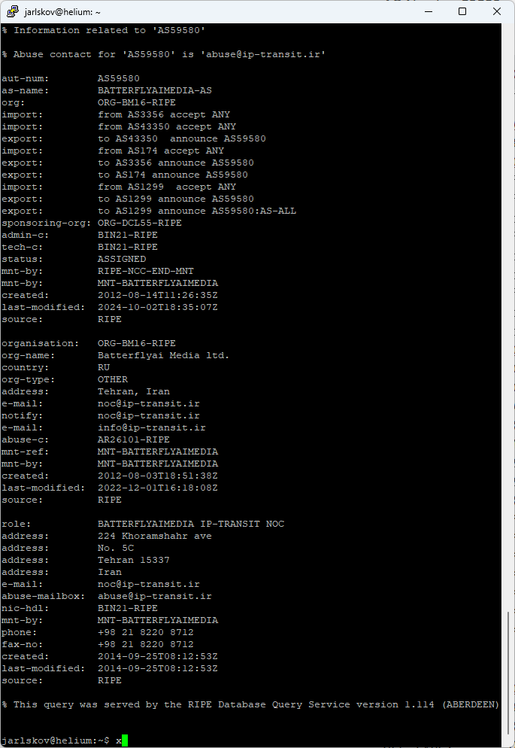
Who dis?
Clearly presenting the AS-set to their upstream:
Russia or Tehran, IR?

Slide 4
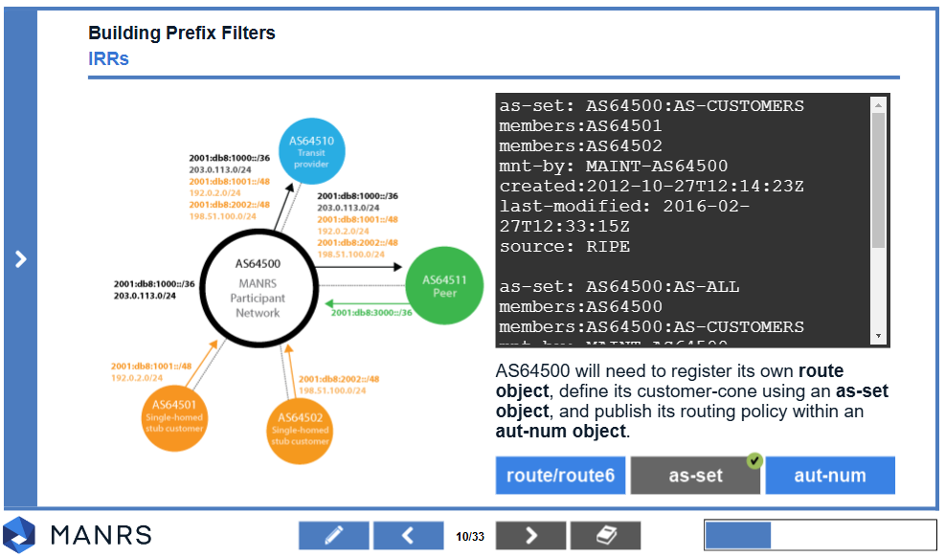
What is an AS-SET anyway?
Just a list of AS’s
Can be used for anything:
AS’s present at my IXP.
AS’s I have a BGP-session with somewhere.
AS’s whose sales-people bought me a beer at the latest conference.
Most common recommended usage:
IP-transit providers filtering BGP-announcements from their customers
Example from MANRS:

Slide 5
IP Transit filtering
ROA – Route Origin Authorisation
Only validates the originating ASN
Easily spoofed
RPSL-based filtering
Based on AS-Set, route(6) and aut-num objects
Best practice (MANRS)
Equal AS-path length
Tier 1 upstream provider
Another Tier 1
RPSL-based filtering
Telia SE
AS3301
ROA VALID
Spoofed BGP announcement
Attacker AS
Spoofed AS3301

Slide 6
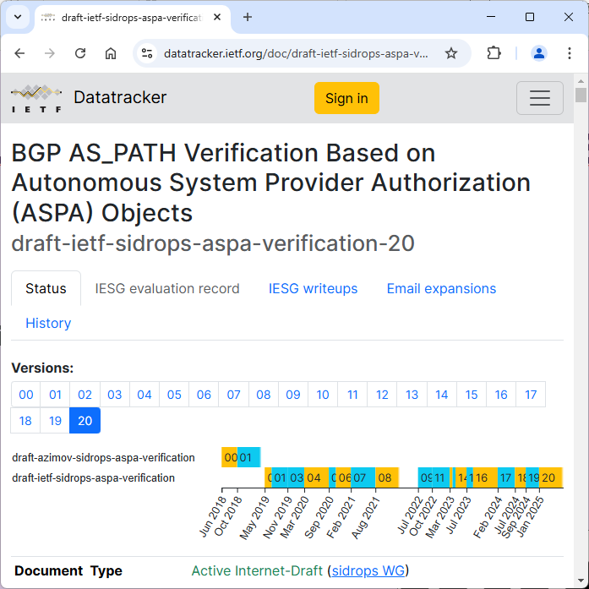
What can we do about fraudulent AS-sets?
ASPA
Autonomous System Provider Authorization
Currently going through IETF
Not ready yet
Monitoring IRR’s
IRRexplorer
BGP.tools
Etc.

Slide 7
What to do? ASPA
Equal AS-path length
ASPA was designed specifically against this
Autonomous System Provider Authorization (ASPA)
In short: “Who are my allowed upstreams?”
https://datatracker.ietf.org/doc/draft-ietf-sidrops-aspa-verification/
https://datatracker.ietf.org/doc/draft-ietf-sidrops-aspa-profile/
Still being worked on in IETF – “Real Soon Now[tm]”
While waiting
Monitor who are referencing you in IRR DBs.
Tier 1 upstream provider
Another Tier 1
RPSL-based filtering
Telia SE
AS3301
ASPA INVALID
ROA VALID
Spoofed BGP announcement
Attacker AS
Spoofed AS3301

Slide 8
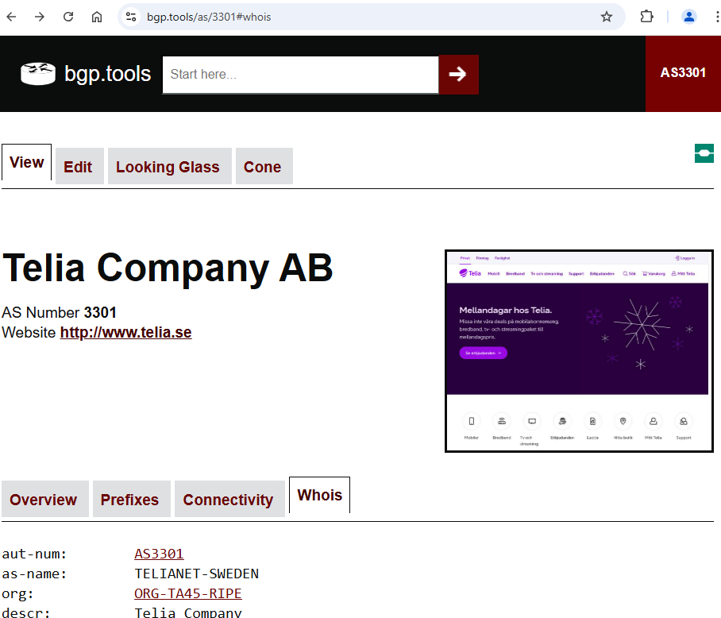
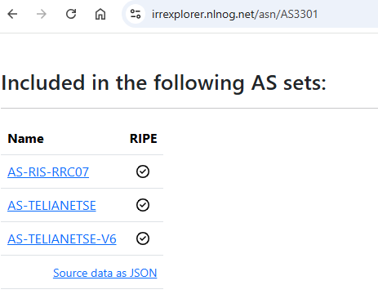
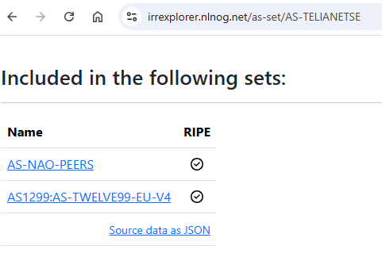
What to do – right now? Monitoring IRRs
Search for your ASN / AS-Set
E.g. bgp.tools, ”Whois” tab
irrexplorer.nlnog.net
Follow the chain of references
Some automated monitoring tools, can provide automated alerts for long reference chains

Slide 9
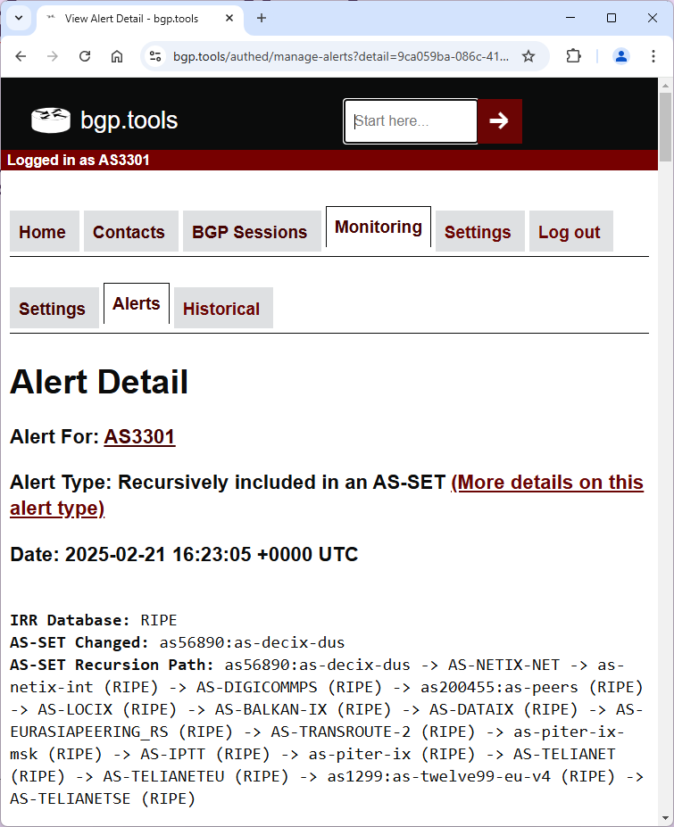
Recursive monitoring
Many many many AS-sets with questionable semantic meaning
E.g. Telia does not peer at DECIX Düsseldorf

Slide 10
What can we do about fraudulent AS-sets?
ASPA
Autonomous System Provider Authorization
Currently going through IETF
Not ready yet
Monitoring IRR’s
Why would you need a “Peering” AS-set?
Are you sure your “Peering” AS-set actually only contains your peers?

Slide 11
What are the ASPA components?
draft-ietf-sidrops-aspa-profile (how to encode ASPA objects in DER)
draft-ietf-sidorps-aspa-verification (how to apply ASPA to BGP)
draft-ietf-sidrops-aspa-slurm (defining local overrides)
draft-ietf-sidrops-8210bis (RPKI-To-Router specification)

Slide 12
Soon: IETF SIDROPS WGLC
WGLC = Working Group Last Call (“speak now or silent forever”)
Operators must be able to test the system end-to-end
Publish ASPA in test environment of RIR
Run a validator to fetch it
Feed it via RTR to a router
See on the router which routes are rejected/accepted
Use SLURM to locally override above results
The ASPA drafts are interconnected, they form a ‘cluster’

Slide 13
Already today lots of software!
OpenBGPD
BIRD
Rpki-client
Routinator
Rtrlib
StayRTR
Next year: Cisco? Juniper? Huawei?
ASK YOUR VENDOR!

