Slide 1
SR BGP and Egress Peer Engineering (EPE)
Joachim Jerberg Jensen, CCIE-SP #42403
Solutions Architect – joajense@cisco.com
March 2025

Slide 2
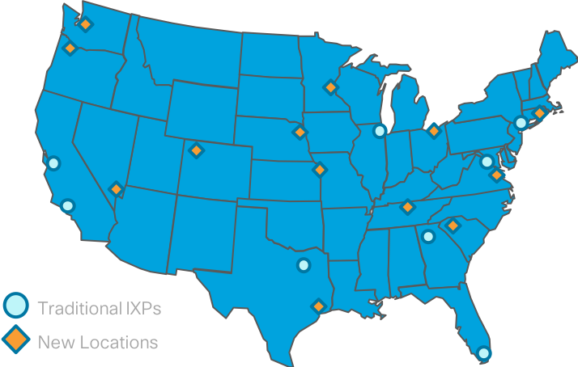

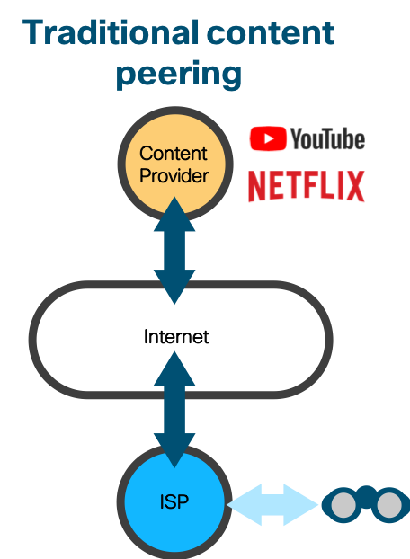
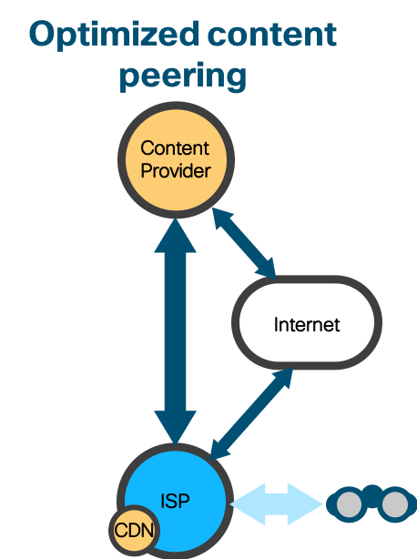
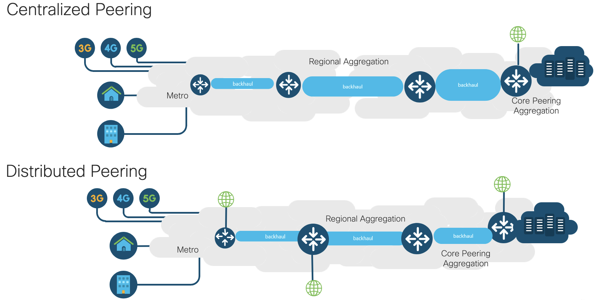
Peering Trends - New paradigm, new requirements
Traffic moving closer to users (MEC, CDN)
+80% of Traffic is video
Subscriber BW growing at 31% CAGR
Stricter peering SLAs with move to SaaS
Increased Peering Distribution

Slide 3


Optimization and SLAs drive Peering Engineering
Todays topic
  Egress
  Ingress
Best network exit path that is both cost-efficient and provides good user experience metrics (cost, link utilization & traffic loss, SLA’s/latency, disjointness etc.)
Optimal path across SP network for ingress traffic from peering location to SP end users
SP WAN
Optimal exit link chosen:
  Low cost (private peer)
  Low utilization link
  SLA’s
Optimal exit link chosen:
  SLA’s (Latency, disjointness etc.)
  Cost

Slide 4
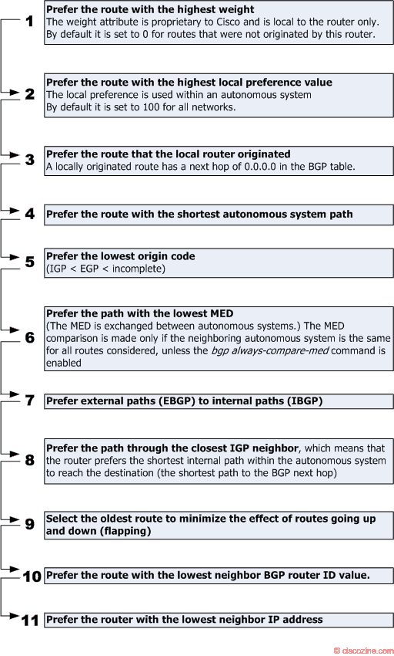
BGP Path Selection Criteria
BGP route selections can be tricky to manipulate
(Cold/Hot potato)
What if you want different egress routing behaviour depending on:
What PE you are at, and what specific prefix you target?
Latency?
Load on the links?
Co$t of the links and peerings? (Local, IXP, Transit)
Disjointness for specific customer SLA’s?
Or obtain:
Maximum load sharing (unequal?) of your egress traffic?
Better control of traffic to BGP peered CDNs? (Netflix, Google Caches)
Notes:
Cold potato routing – send traffic to the most optimal exit – usually achieved by tuning BGP Local Preference
Hot potato routing – send traffic to the nearest exit – usually achieved by setting the same Local Preference and ignoring AS Path for BGP best path, so that the exit is picked by lowest IGP metric

Slide 5
Egress Peer Engineering (Centralized)
Egress Peer Engineering problem statement:
“A centralized controller should be able to instruct an ingress PE or a content source within the domain to use a specific egress PE and a specific external interface/neighbor to reach a particular destination.”
draft-filsfils-spring-segment-routing-central-epe
Conceptually Introduced by Cisco at NANOG6, first draft from May 2014.
Become RFC 9087 in Aug 2021 - Segment Routing Centralized BGP Egress Peer Engineering
Leverage defined concepts of RFC8402 (Segment Routing Architecture), BGP Peering Segments

Slide 6
Egress Peer Engineering (Centralized)
Egress Peer Engineering (EPE) require no change in the existing BGP network design
EPE functionality is only required border router and EPE controller
(SR-PCE)
The SR-PCE collects topology information (w. BGP-LS), including the EPE information, and uses that information to compute and implement *per-flow* traffic steering
Per-flow Policy state is only created on the ingress node
Segment Routing based
This may theoretically be *any* XR router
Virtual recommended for production.
Manual configuration is also an option

Slide 7
Segment Routing
Basic Operation and Segment Types
Source Routing: The source chooses a path and encodes it in the packet header as an ordered list of segments.
A packet injected anywhere with top label 65 will reach Z
Segment: An identifier for any type of instruction i.e. "go to node C using the shortest path"
65
Nodal/Prefix Segment: label allocated from the SR registry to each node. Globally significant. For example Z is given label 65.
A
B
C
D
A
B
C
D
9001
Z
Z
M
N
O
P
M
N
O
P
Adjacency Segment: Node automatically allocates a local label for each adjacency. Locally significant. For example Label 9001 allocated for adjacency O.
A packet injected at node C with label 9001 is forced through datalink CO

Slide 8
Segment Routing Label Usage
72
72
9001
9001
9001
65
65
65
Packet to Z
Packet to Z
Packet to Z
72
72
A
B
C
D
A
B
C
D
9001
Z
Z
65
M
N
O
P
M
N
O
P
65
Packet to Z
65
65
Packet to Z
Packet to Z
Any explicit path can be expressed i.e. ABCOPZ

Slide 9


BGP SR Peering Segments [RFC 8402]
PeerNode SID 15300
PeerAdj SID 15200
AS 100
PeerAdj SID 15201
AS 500
AS 200
ASBR
PeerSet SID 15400
Allows overriding default forwarding behavior to EBGP peers by using a specific local SID as the last SID in the SR SID list
PeerNode SID “go to this peer” - allows balancing traffic out multiple interfaces to the same peer
PeerAdj SID “go to this link” - allows sending traffic out specific peer interfaces
PeerSet SID. “go over a set of peers/links” Allows sending traffic out multiple interfaces to peers on the same or different nodes
SID’s can be configured locally on the ASBR’s for persistent values
AS 600

Slide 10
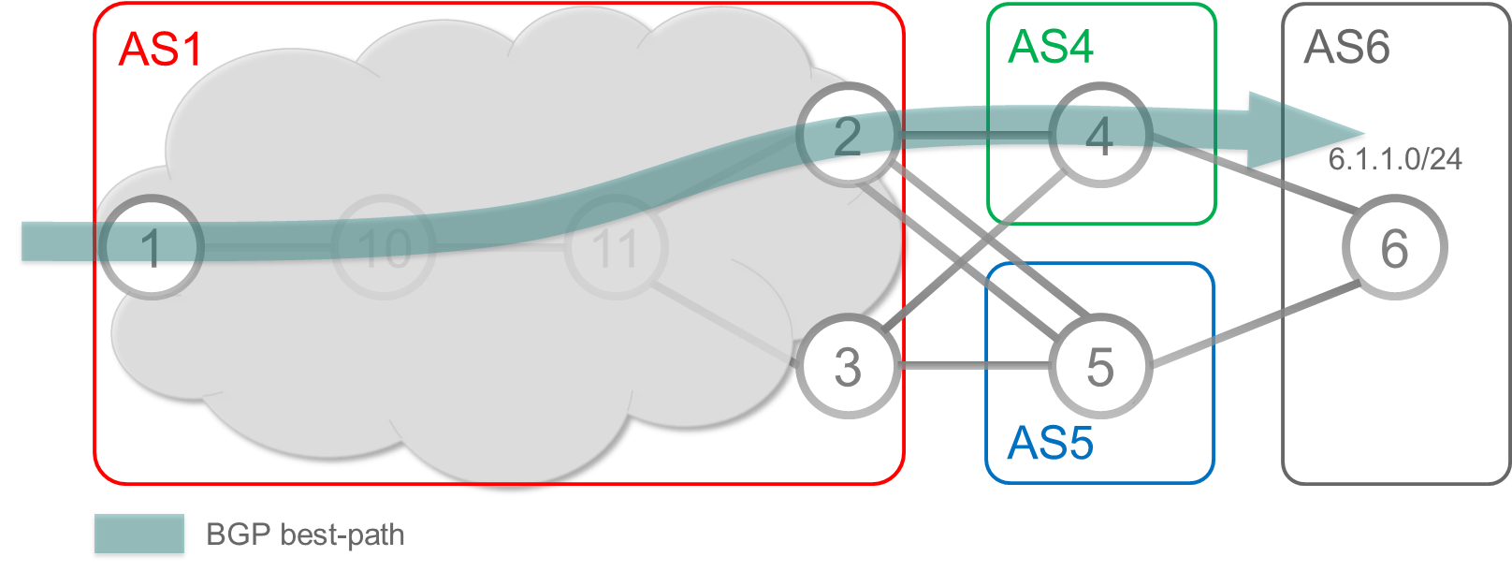
Example Reference Topology
AS1 has an ingress Node1 and two egress Node2 and Node3
AS6 advertises a BGP prefix 6.1.1.0/24 to AS4 and AS5
AS1 peers with AS4 (Node4) and AS5 (Node5)
Node1’s BGP best path to BGP destination 6.1.1.0/24 in AS6 is via egress Node2 and Node4 (AS4)

Slide 11

Egress Peer Engineering – Yes.. SR is enabled…
RP/0/0/CPU0:xrvr-1#traceroute 1.1.1.3
Type escape sequence to abort.
Tracing the route to 1.1.1.3
1 99.1.10.10 [MPLS: Label 16003 Exp 0] 9 msec 9 msec 9 msec
2 99.10.11.11 [MPLS: Label 16003 Exp 0] 19 msec 9 msec 19 msec
3 99.3.11.3 9 msec 9 msec 9 msec
Traceroute from 1 to 3
AS1
AS4
AS6
2
4
Segment
Routing
1
10
11
6
AS5
3
5
16003
Payload
router isis 1
interface Loopback0
address-family ipv4 unicast
prefix-sid absolute 16003

Slide 12

EPE configuration example
router bgp 1
bgp router-id 1.1.1.2
address-family ipv4 unicast
!
neighbor 1.1.1.5
remote-as 5
ignore-connected-check
egress-engineering
description eBGP peer xrvr-5
update-source Loopback0
address-family ipv4 unicast
route-policy bgp_in in
route-policy bgp_out out
!
neighbor 99.2.4.4
remote-as 4
egress-engineering
description eBGP peer xrvr-4
address-family ipv4 unicast
route-policy bgp_in in
route-policy bgp_out out
!
!
!
AS1
AS4
AS6
Node5
loopback
eBGP
2
4
1
10
11
6
eBGP
AS5
3
5
Link to Node4
Single-hop eBGP
Multi-hop eBGP

Slide 13

Advertising BGP Peering SIDs in BGP-LS
RP/0/0/CPU0:xrvr-10#show bgp link-state link-state [E][B][I0x0][N[c1][b0.0.0.0][q1.1.1.2]][R[c5][b0.0.0.0][q1.1.1.5]][L[i1.1.1.2][n1.1.1.5]]/664 detail
BGP routing table entry for [E][B][I0x0][N[c1][b0.0.0.0][q1.1.1.2]][R[c5][b0.0.0.0][q1.1.1.5]][L[i1.1.1.2][n1.1.1.5]]/664
NLRI Type: Link
Protocol: BGP
Identifier: 0x0
Local Node Descriptor:
AS Number: 1
BGP Identifier: 0.0.0.0
BGP Router Identifier: 1.1.1.2
Remote Node Descriptor:
AS Number: 5
BGP Identifier: 0.0.0.0
BGP Router Identifier: 1.1.1.5
Link Descriptor:
Local Interface Address IPv4: 1.1.1.2
Neighbor Interface Address IPv4: 1.1.1.5
Versions:
Process bRIB/RIB SendTblVer
Speaker 5 5
Flags: 0x04000001+0x00000000;
Last Modified: Oct 6 20:14:51.140 for 1d00h
<continue...>
“Protocol ID” field
BGP-LS carries internal topology information as well as external connectivity (EPE) information
Egress Peer Engineering enabled egress nodes automatically advertise their BGP Peering SIDs in BGP-LS
  Each EPE egress node must have a BGP-LS session directly to the Controller or via a RR
Controller can use the BGP-LS information to compute and implement per-flow traffic steering
“Identifier” field
AS1
AS4
AS6
“AS Number” TLV
BGP-LS
“BGP-LS ID” TLV
2
4
“BGP Router-ID” TLV
“AS Number” TLV
6
“BGP-LS ID” TLV
AS5
“BGP Router-ID” TLV
3
5
SR-PCE
EPE Controller
BGP session local address
BGP session peer address
Peer Node SID 30035
Note: An IOS XR router is acting as “Controller” for illustration purposes

Slide 14
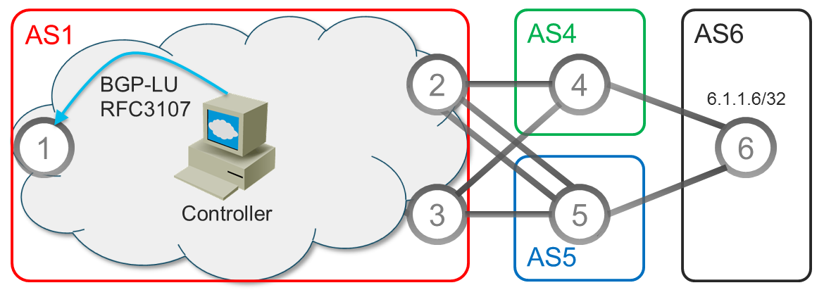
Controller and BGP LU – Could be PCEP, NETCONF
Use low-latency path for Mr. Important NET Eng.
Controller sends a more preferred BGP-LU update to ingress node 1
NLRI: the destination prefix to Mr. Important NET Engineer, 6.1.1.6/32
Nhop: the selected egress border router. Which is node 3, and via link to R5
Label: the selected egress peer node SID—30035
AS path: reflecting the valid AS path selected to reach the destination

Slide 15
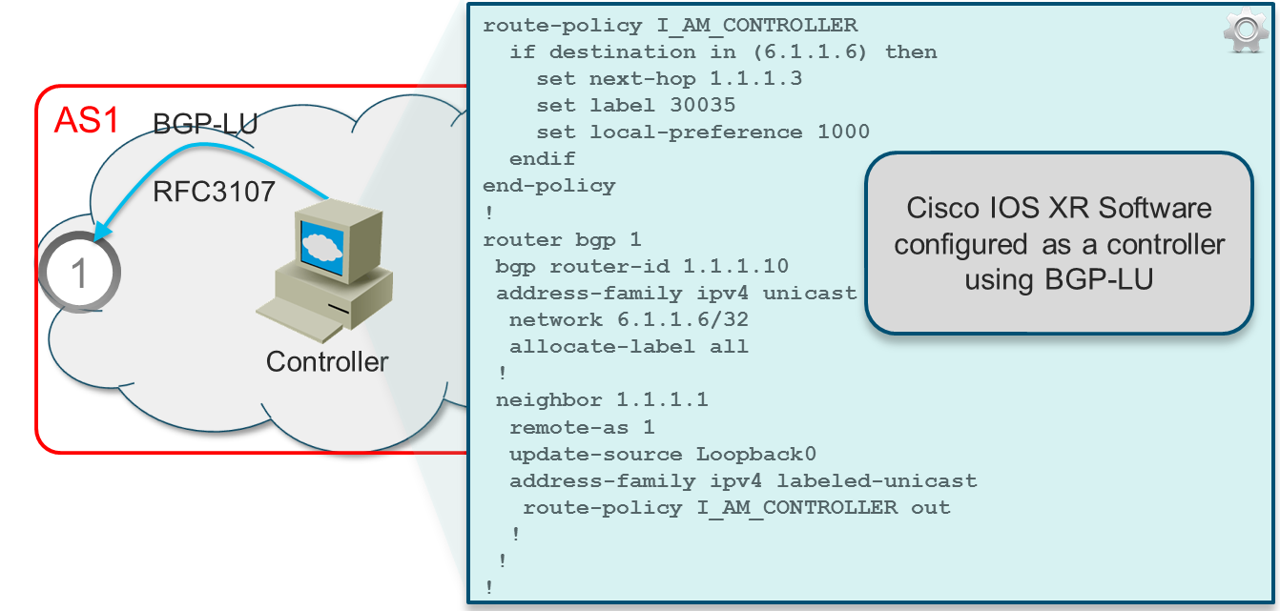
Configuring the EPE Controller
Route policy is being used to define the next hop, local preference and label value for the given destination
This information is advertised to node 1 with the use of BGP-LU

Slide 16
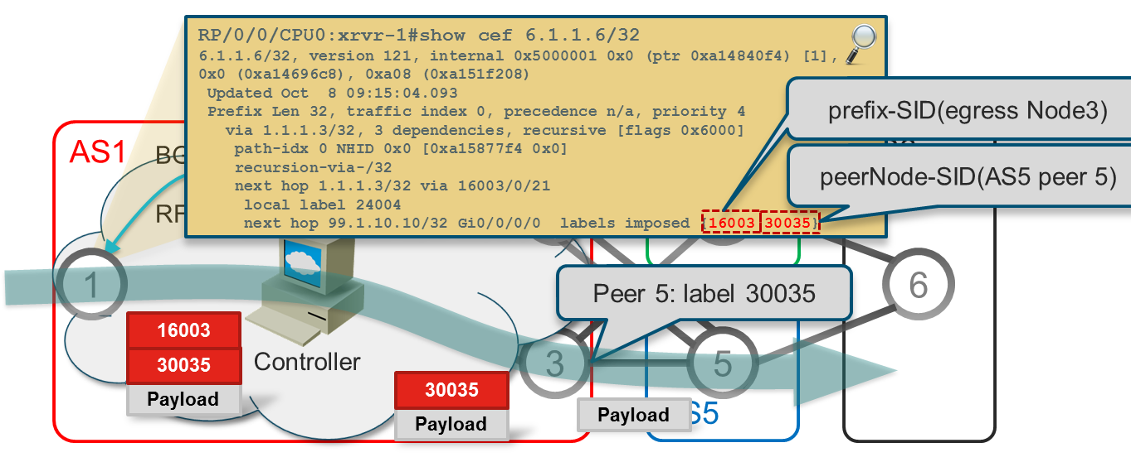
Egress Peer Engineering with controller
Ingress node 1 pushes the label stack on packets to 6.1.1.6/32
{prefix-SID(egress Node3); peerNode-SID(AS5 peer 5)}={16003; 30035}
Traffic steering on node 1 is per BGP destination
Example: for traffic destined to 6.1.1.6/32, impose {16003; 30035}

Slide 17
Got it?
Other EPE Use Cases

Slide 18





Use case: Combine EPE with additional SR-TE
Problem: Engineering the best network exit path that is cost-efficient while providing special user experience metrics (latency, link utilization, disjoint & traffic loss).
Optimal exit link chosen:
  Low cost (private peer)
  Low utilization link
Advertising:
10.0.0.0/24
Transit
NCS 5501
NCS 5502
NCS Pyke J+
NCS 5504
NCS 5502
NCS Oldcastle J+
SP Network
Advertising:
10.0.0.0/24
Private Peer
92%
load

Slide 19
Use case: PeerSet for maximum load balance
Balance traffic to three peers even if normal BGP best path selection and forwarding would only select a single peer. Per-Flow load balancing is based on hashing criteria, SR retains ECMP across entire network
Anycast SID
AS 1001
PeerSet SID: 15001
10.0.0.0/24
16004
Ingress
Traffic
Loopback1 172.16.1.1
SID: 17001
AS 1002
16001
10.0.0.0/24
AS 1003
NCS 5501
NCS 5502
NCS Pyke J+
16005
10.0.0.0/24
NCS 5504
NCS 5502
NCS Oldcastle J+
Pop {15001} and forward
Pop {16001}
Pop {17001}
Push {17001,16001,15001}
DSTIP: 10.0.0.1
SID: 15001
DSTIP: 10.0.0.1
SID: 16001
SID: 15001
DSTIP: 10.0.0.1
SID: 17001
SID: 16001
SID: 15001
DSTIP: 10.0.0.1

Slide 20
Use case EPE and Weighted ECMP
Local SR Policy configured at HE
*or*
SR PCE advertised SR Policy via PCEP / BGP
SR Policy (color, endpoint) @ HE X
e.g. (green, 1.1.1.5) @ Node (1)
Go to Node 5 (following IGP SPT) and exit via BGP peer adjacency 24001 to ISP A
Policy P(green, 1.1.1.5)
Binding-SID 4001
SID List <16005, 24001> Weight: 80%
SID List <16004, 24003> Weight: 20%
SR PCE
ISP C
Premium Content
EPE
24003
2
3
4
Go to Node 4 (following IGP SPT) and exit via BGP peer adjacency 24003 to ISP C
EPE
24000
EPE enabled on external peering links
UCMP across SID lists using different weights
SR-MPLS
ISP B
1
6
5
EPE
24001
IMPORTANT property:
The SR Policy endpoint (e.g. (5)) is decoupled from the target node specified in SID list (e.g. (4))
ISP A
Premium Content

Slide 21
SR Policy – Degradation Starts
External logic can be used to modify (re-configure) or re-advertise SR Policy
e.g.
adjusting weights of SID lists
Policy P(green, 1.1.1.5)
Binding-SID 4001
SID List <16005, 24001> Weight: 60%
SID List <16004, 24003> Weight: 40%
SR PCE
ISP C
Premium Content
EPE
24003
2
3
4
Modified weights allow less traffic (from 80% to 60%) to be directed to ISP A and more traffic (from 20% to 40%) towards ISP C
SR-MPLS
EPE
24000
ISP B
1
6
5
EPE
24001
Node (5) experiences partial failure of bundle to ISP A
X
IMPORTANT property:
Only SR Policy is re-advertised
NO re-advertisement of end-user prefixes is required
ISP A
Premium Content

Slide 22
Use case: EPE for Cache Farm BW optimized peering
a.a.a.0/24
BGP
X
Y
Z
IP dest a.a.a.x
A
50%
93%
90%
WAN
172.1.X.X
101
102
103
RT1
RT2
B
loop0
200
loop0
202
Telemetry:
BW utilization
Responce time
Paket drop
IP dest a.a.a.x
101
RT3
RT4
loop0
202
loop0
204
IP dest a.a.a.x
101
200
MPLS
MPLS
Cache RIB’s
172.0.1.1
Telemetry
MPLS
MPLS
MPLS
MPLS
Cache RIB’s
172.0.2.1
Cache topo
Cache
Cache
EPE-SID
Cache
To a.a.a.a/24
Use 101/200
Cache Ctrl
Cache
Node-SID
API
IGP topology
YANG
YANG
BGP Local-RIB
YANG
YANG
172.0.1.1
172.0.2.1
External influence

Slide 23




Use case: EPE for DDoS Traffic Steering
DDoS Detection
Egress Peer Engineering direct DDoS traffic to a specific end node and specific DDoS destination interface without the complexities of using VRFs to separate dirty/clean traffic.
no IP lookup is performed between the ingress node and egress DDoS “dirty” interface.
BGP Flowspec redirects traffic to a next-hop IP pointing to a pre-configured “DDoS” SR-Policy.
Transit 1
Transit 2
Peer 1
BGP Flowspec Rules
RR
Scrubbers
SID: 16441
EPE SID: 28000
SP Network
EPE SID: 28001

