Slide 1
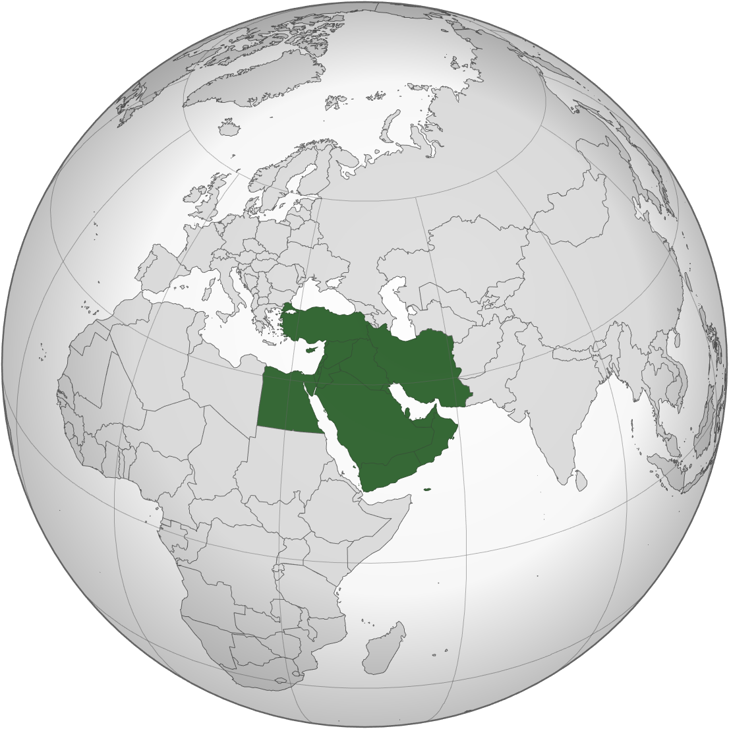
IXP+ based observations on peering and routing changes after Middle East cable outages.
Kaj Kjellgren, DKNOG 2026, Köpenhamn
Authors:
Bernd Spiess, DE-CIX
Kaj Kjellgren, DE-CIX

Slide 2
DE-CIX is the world's #1 Cloud & Internet Exchange operator, and the world's largest carrier-neutral interconnection ecosystem
60
Internet & Cloud
Exchanges
50+
Cloud service providers
600+
metros
1,000s
of data centers
4,000+
connected
networks
185+
Tbits capacity
North America
  Chicago, Dallas, Houston,
  Mexico City, New York, Phoenix, Queretaro, Richmond, Seattle
Asia Pacific
  Brunei, Chennai, Delhi, Hyderabad, Jakarta, Johor Bahru, Kuala Lumpur, Kolkata, Manila, Mumbai, Osaka, Penang, Singapore, Tokyo
South America
  Sao Paulo, Rio de Janeiro
EMEA
  Amsterdam, Aqaba, Athens, Baghdad, Barcelona, Berlin, Bucharest, Copenhagen, Doha, Dubai, Dusseldorf, Esbjerg, Frankfurt, Hamburg, Helsinki, Istanbul, Karachi, Kinshasa, Kristiansand, Lagos, Leipzig, Lisbon, Madrid, Marseille, Munich, Oslo, Palermo, Prague, Riyadh*, Ruhr region, Sofia, Stockholm*, Warsaw
* Coming soon

Slide 3
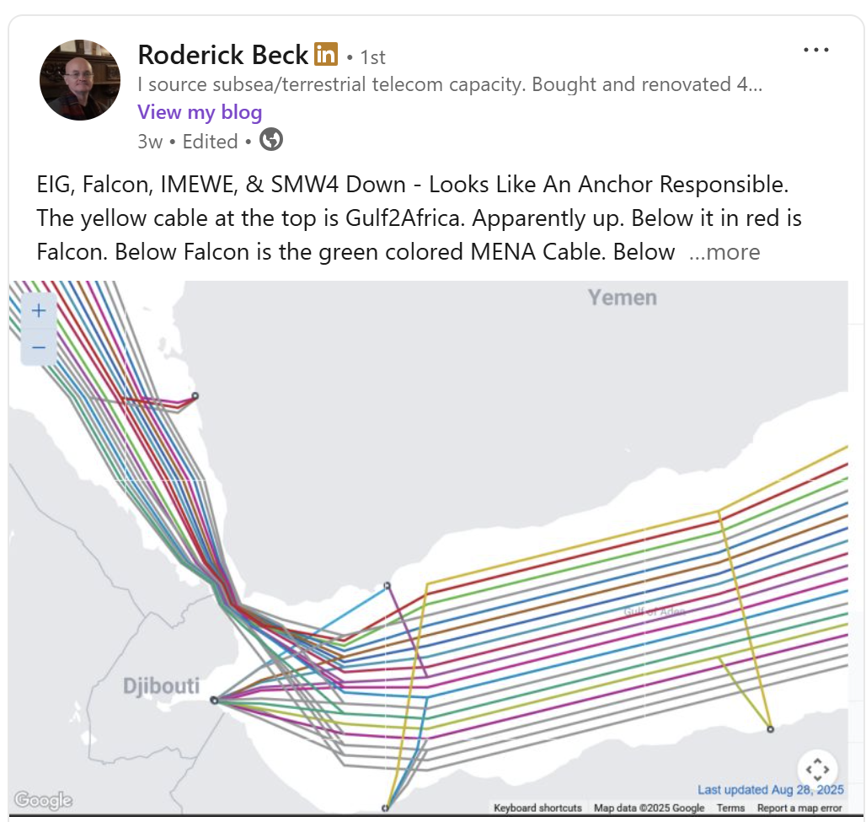
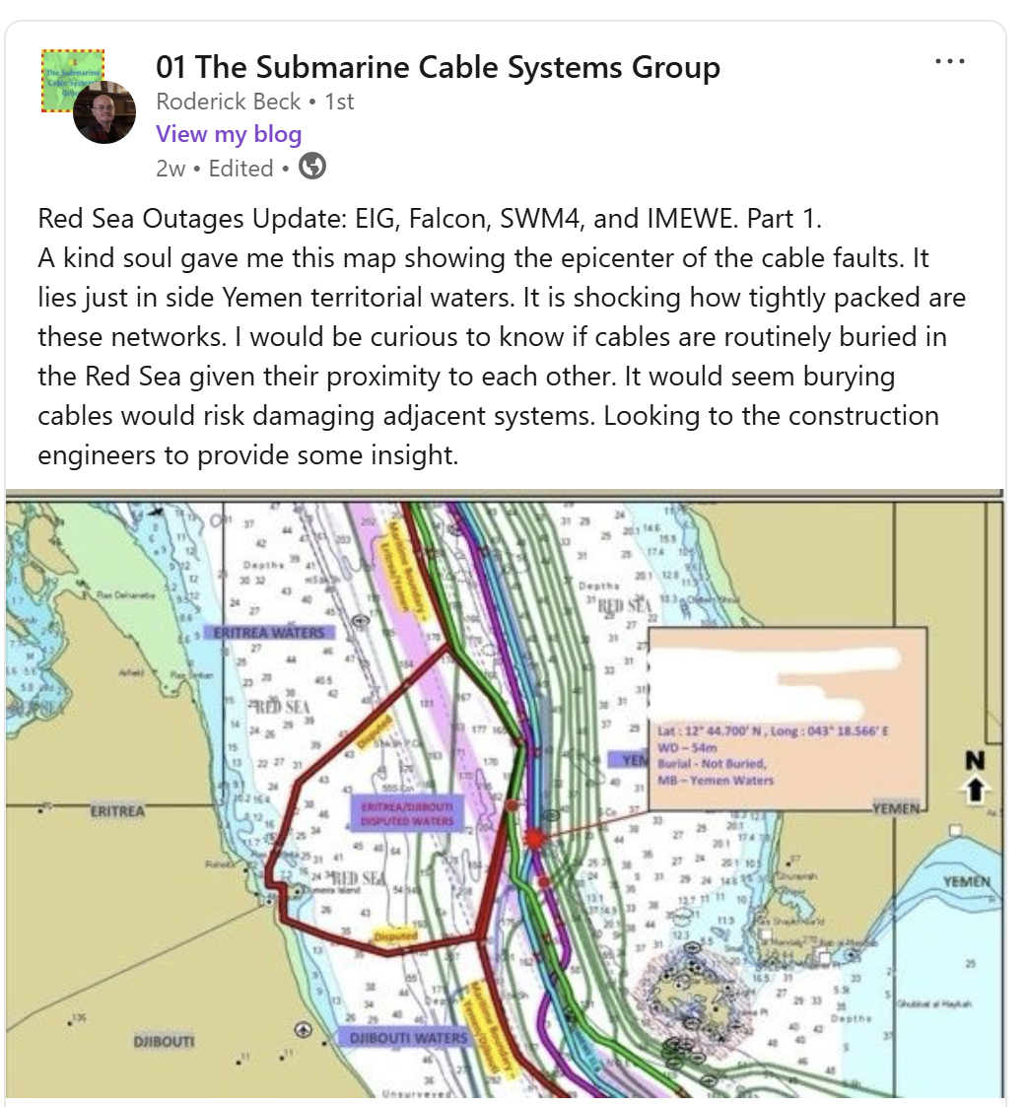
1) Which cable outages did we look at?
On 6´th of September we saw these:
https://www.linkedin.com/in/roderick-beck-94868948/recent-activity/all/
Notes:
Densly packed cables, shallow and a lot of boattraffic.

Slide 4
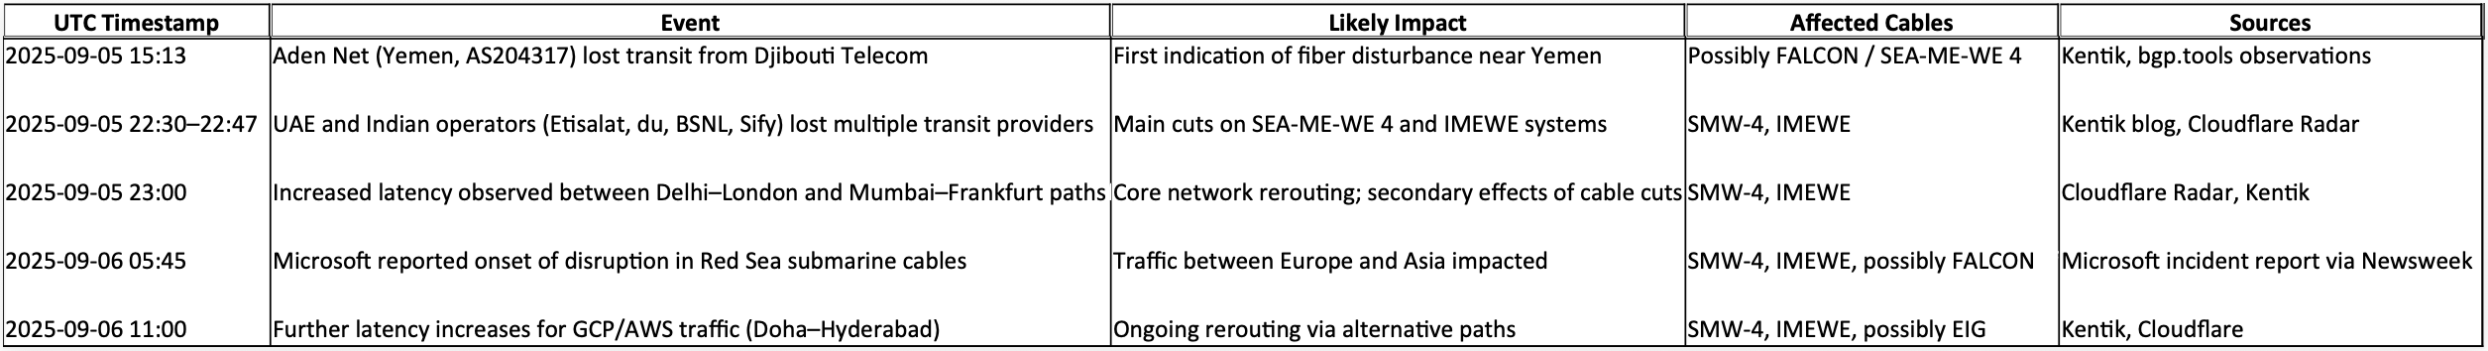
1) Which cable outages did we look at?
After digging through blogs and news-coverage, a rough timeline (might) be concluded:
Notes:
Unclear if Falcon has been fixed or not.
The Hooti rebels makes it hard to work there.

Slide 5
What to expect?
What not to expect...
  Yes:
  Insights from the IXPs we operate
  Conclusions of collected data from RIPE Atlas
  Statistics from colleague IXPs
  And maybe some general comments on this topic
  No:
  The Perfect Solution(tm)

Slide 6
Assumption #1
01
We thought there must be a big change in IXP traffic…

Slide 7
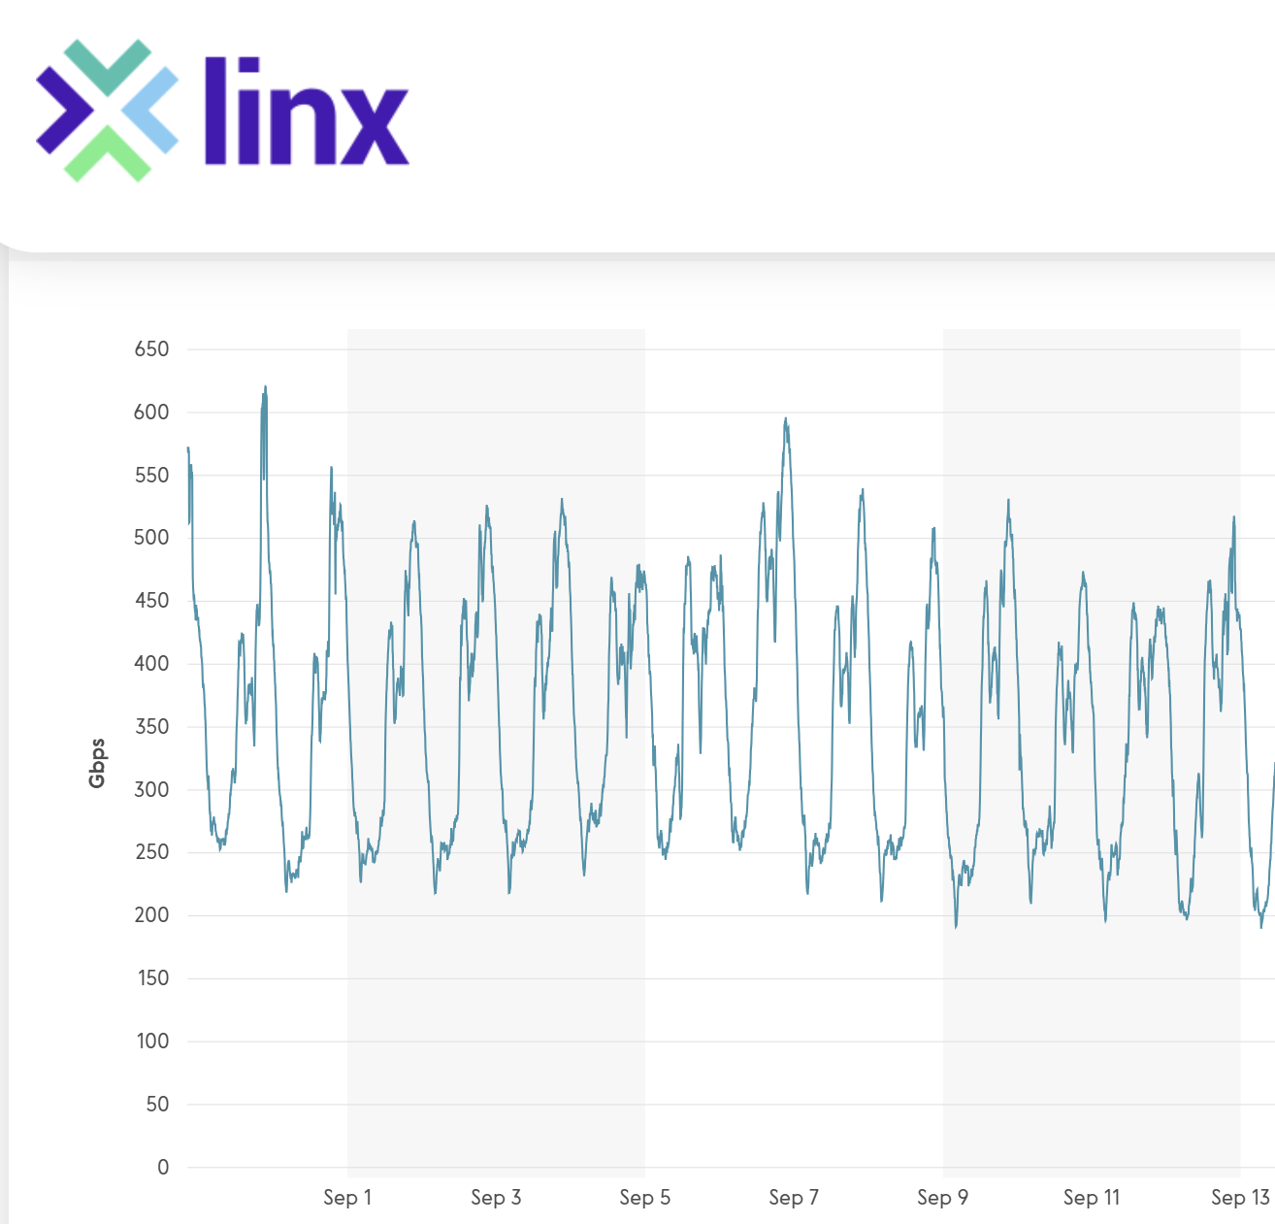
So, let's have a look:
LINX Jeddah (until13/9)
  Nothing spectacular
6.9. + ca. 1 week
https://portal.linx.net/services/lans-snmp/jed1, 29.9.2025

Slide 8
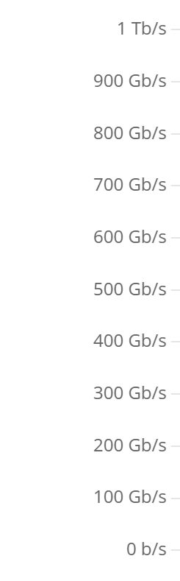
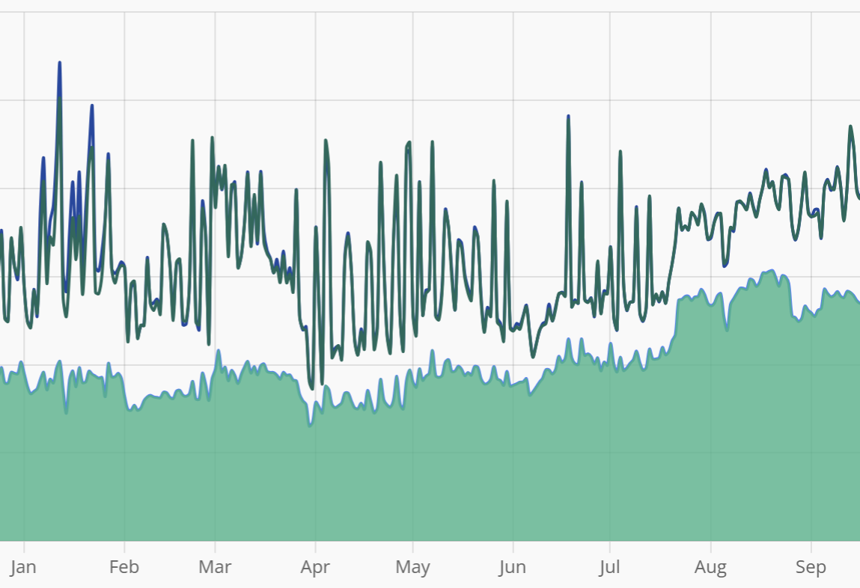
How about...
SAIX Jeddah +
Riyadh
(until 13/9)
  Nothing spectacular
https://www.saix.sa/en/services/statistics/, 29.9.2025

Slide 9
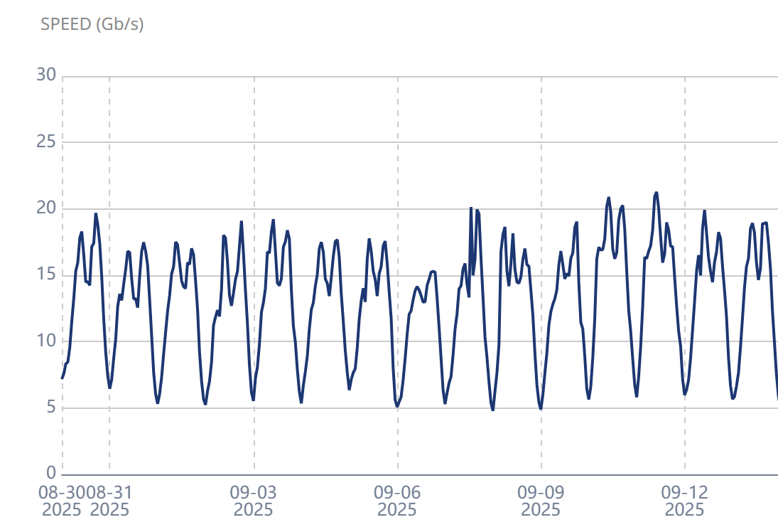
Well... here then?
Equinix Muscat (until 13/9)
  Nothing spectacular
https://www.equinix.com/products/interconnection-services/internet-exchange, 29.9.2025

Slide 10
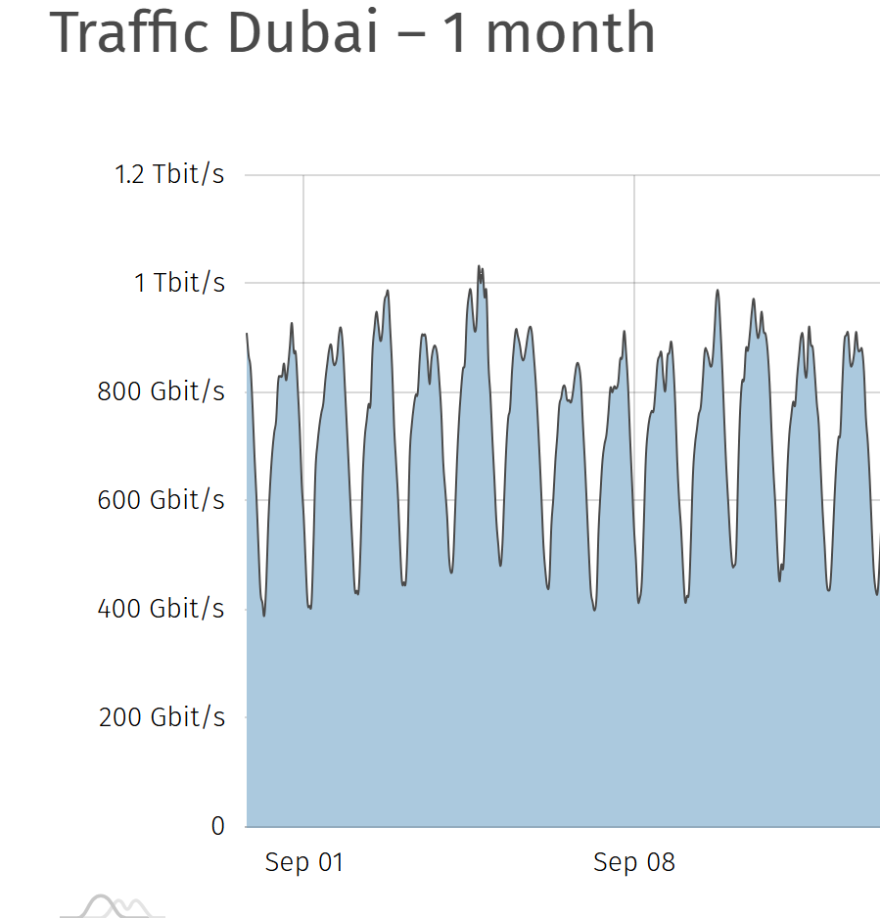
So, what about here?
UAE-IX (until 13/9)
  Nothing spectacular
https://www.uae-ix.net/en/location/traffic-statistics, 29.9.2025

Slide 11
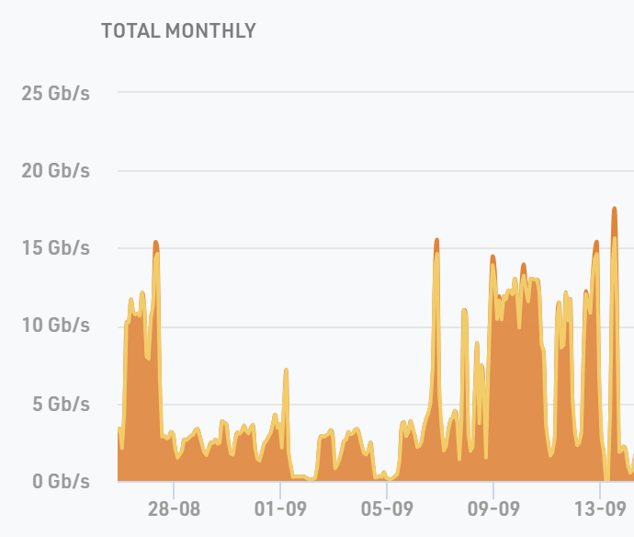
Aha, here's something:
AMS-IX Djibouti
(until 13/9)
  Yes – something interesting for sure

Slide 12
Well, not really what we expected?
  So, (almost) nothing happened?
  Is that it?

Slide 13
Meanwhile in FRA…
02
We thought … well I don't know what we thought…

Slide 14
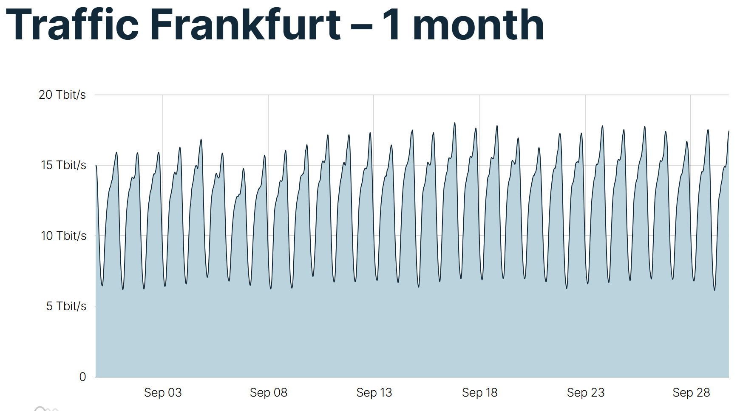
Do we see something in Frankfurt?
  well, yes, maybe?
Notes:
Traffic-dip... But slow pick-up over many days.

Slide 15
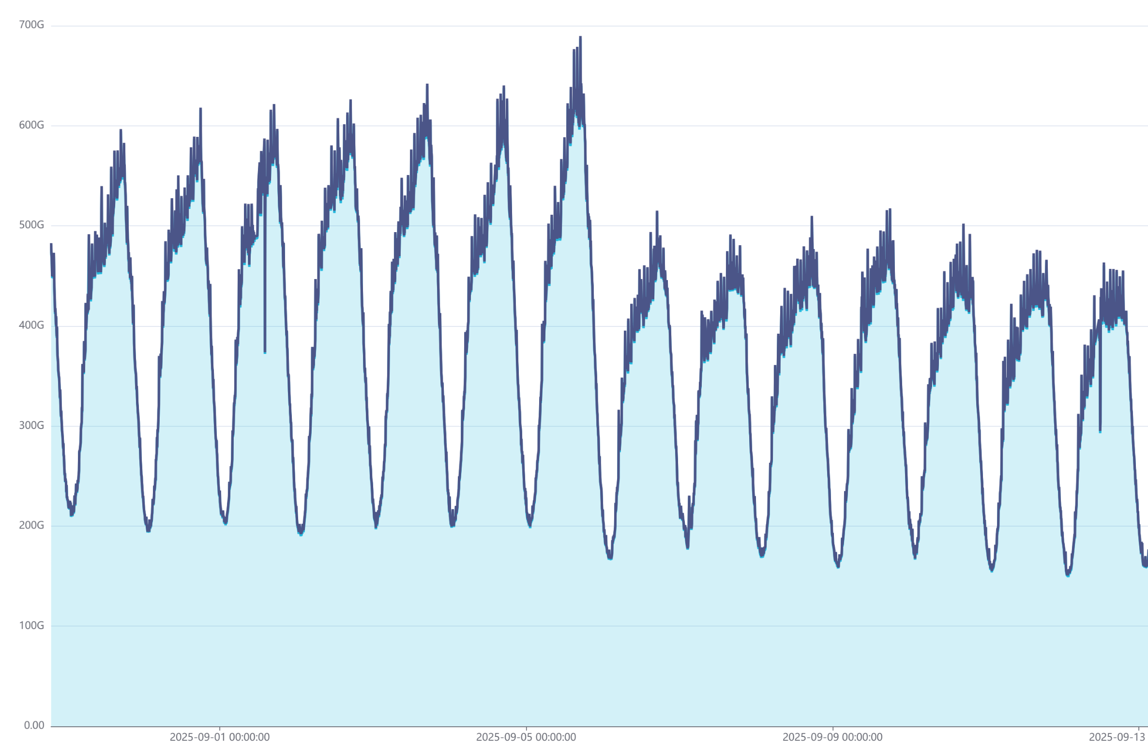
Again: Do we see something in Frankfurt?
  well, yes, maybe?
  oh yes, customer #1

Slide 16
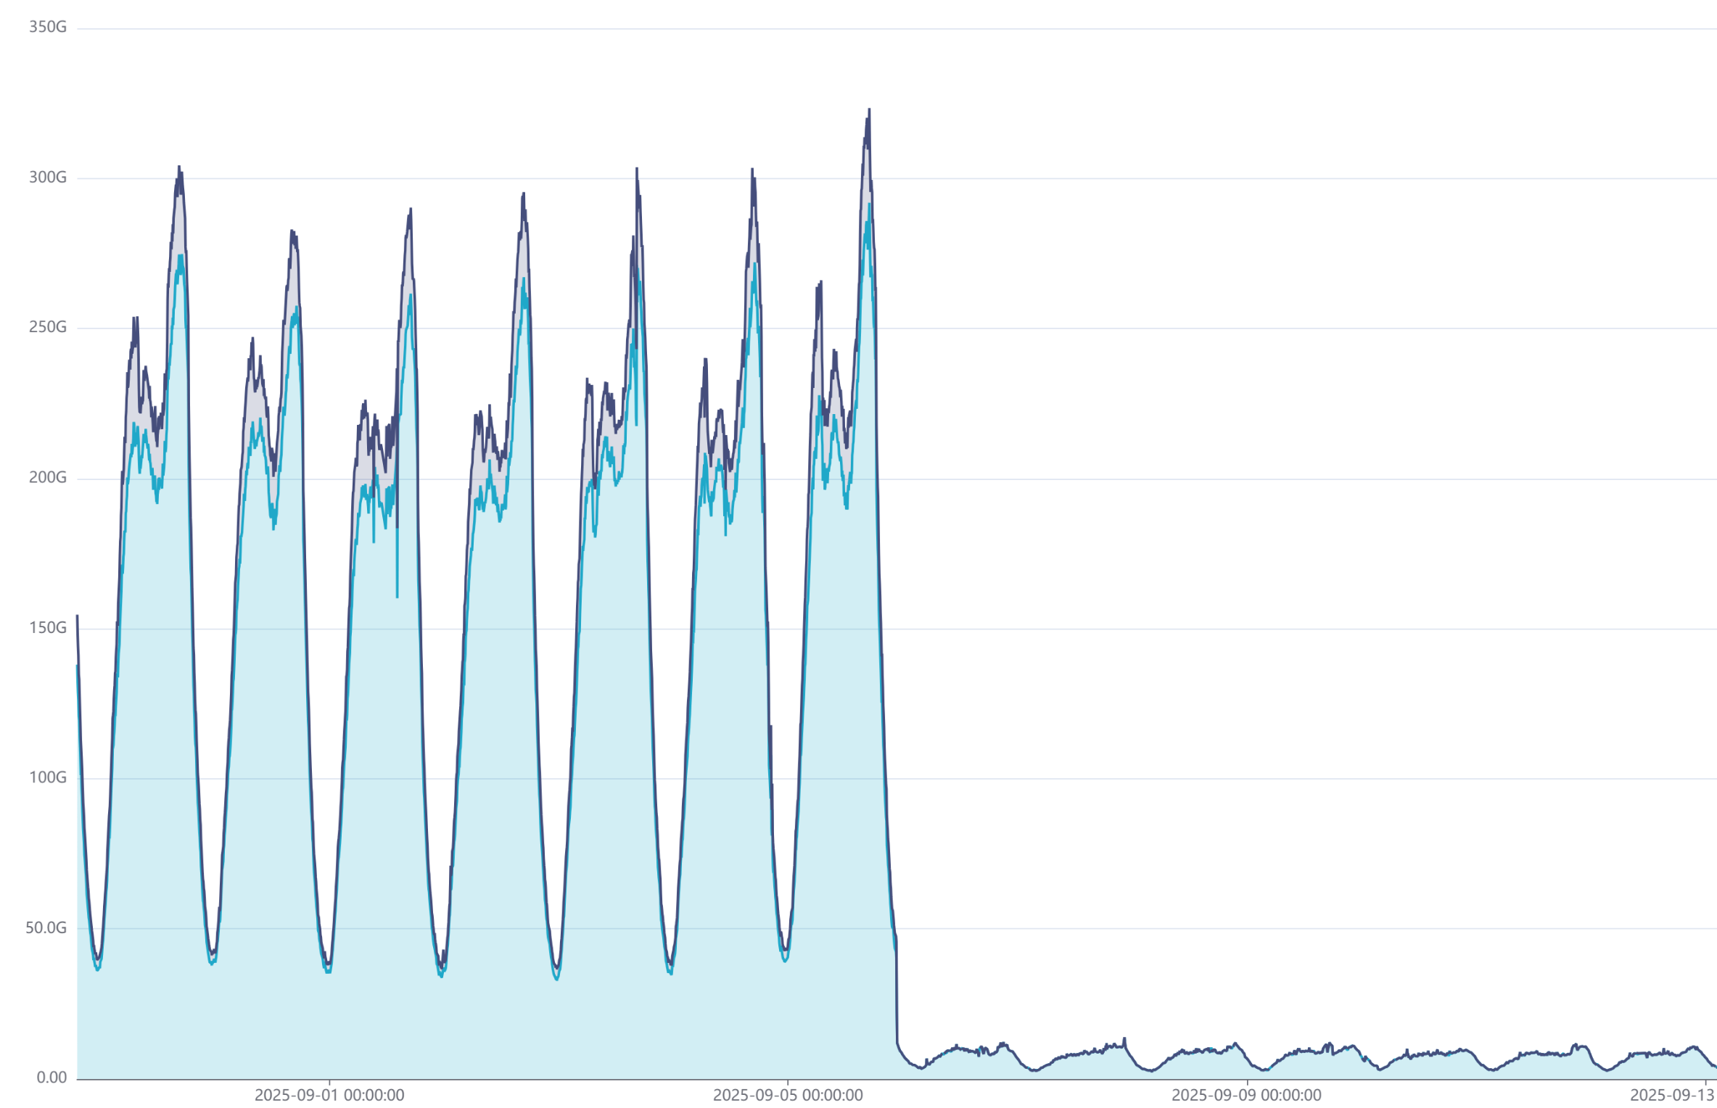
Do we see something in Frankfurt?
  well, yes, maybe?
  oh yes, customer #2

Slide 17
Conclusion on Frankfurt?
  Lost traffic
  Some traffic went away
  Some other traffic came in
Notes:
This points towards a config-error in the routing setup..

Slide 18
Meanwhile in MRS…
03
Aha, so that is where some of it went

Slide 19
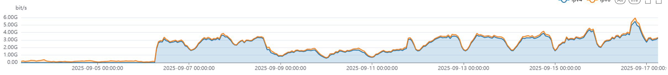
Marseille
  Traffic shift from one of the content networks
  from FRA to MRS to a specific Middle East Operator:
Frankfurt
Marseille
Assumed reason: re-balance traffic from broken capacities to Frankfurt
onto working ones in Marseille
Notes:
Note that the traffic-shift is gradual and not instant. Indicates manual intervention.

Slide 20
Notes:
Many networks took more then a day to reroute.
13-50% delayed switchover depending on which location.
Again, points to manual reconfig.

Slide 21
Maybe we didn't look deep enough…
04
Let's extend the time window:

Slide 22
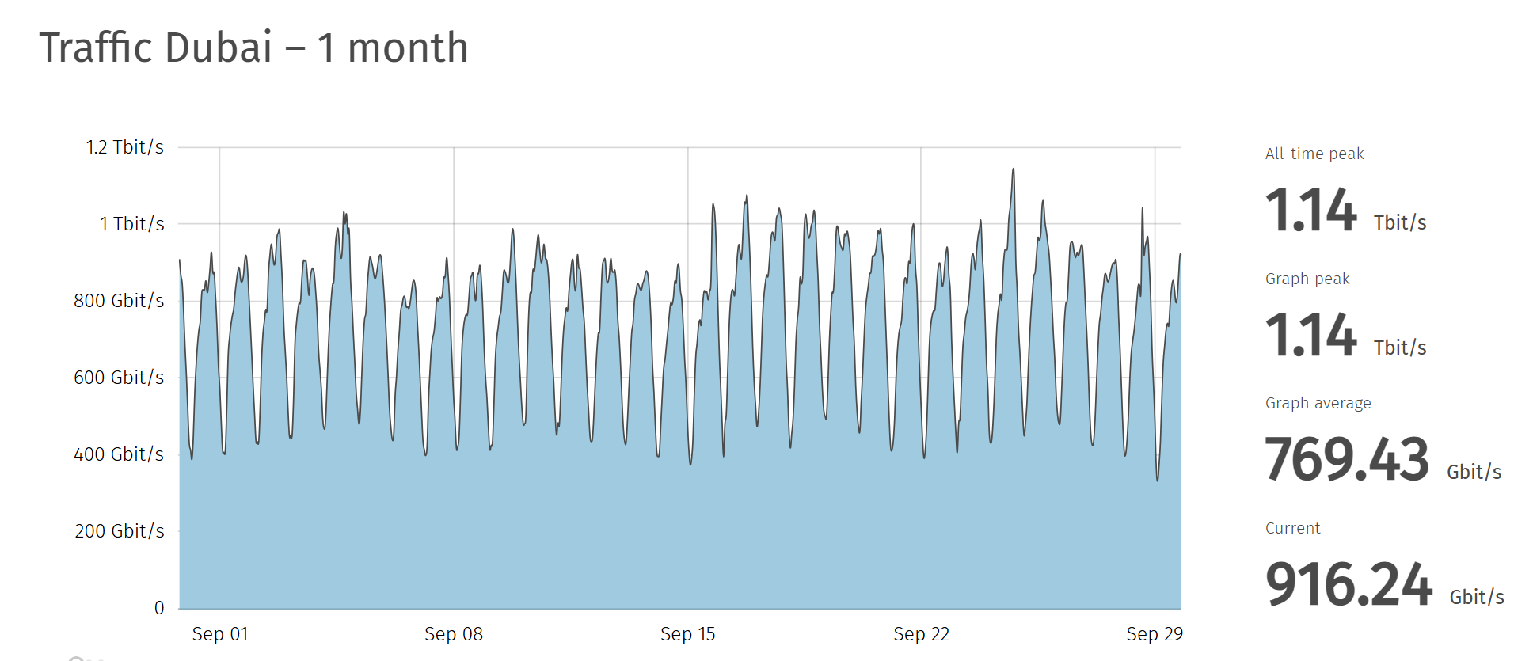
How about the 2'nd half of September?
https://www.uae-ix.net/en/location/traffic-statistics, 29.9.2025
Notes:
Why, oh why, did traffic that should have been local from the start all of a sudden become... Local? We see a delay of the traffic-pciup with up to a week. This indicates manual reconfig.

Slide 23
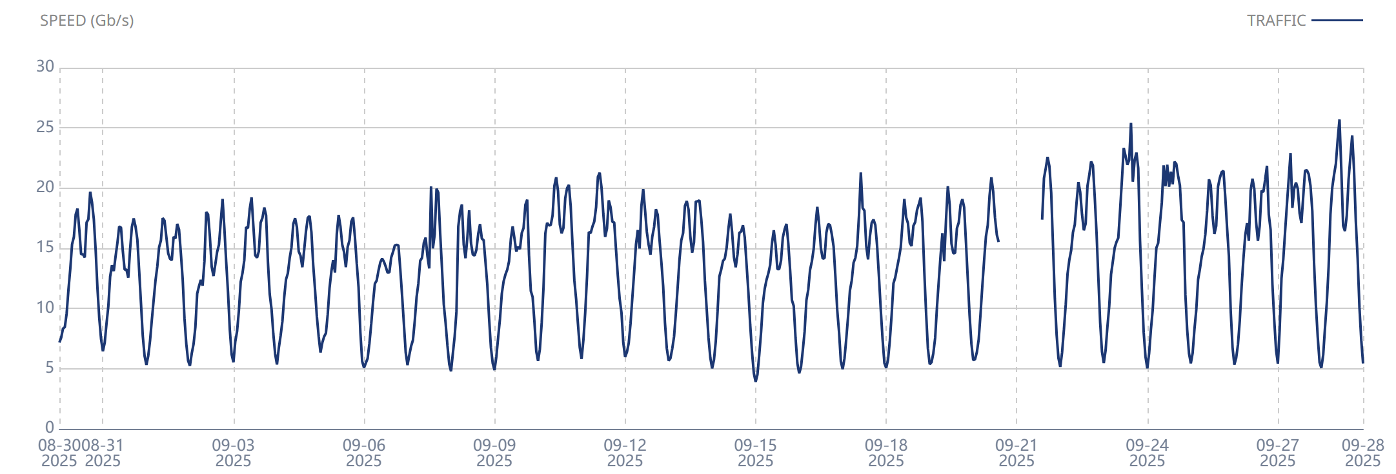
How about the 2'nd half of September?
Equinix Muscat
https://www.equinix.com/products/interconnection-services/internet-exchange, 29.9.2025
Notes:
Same thing in Muscat

Slide 24
Conclusion on Middle East?
  Did some IXP need a bit of time?
  A general Trend: no
Notes:
But there are exceptions.

Slide 25
interesting observations...
05

Slide 26
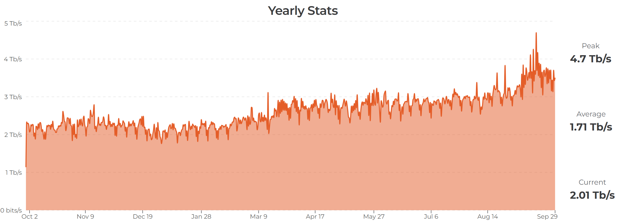
Meanwhile in India
  ExtremeIX
https://extreme-ix.org/resources/traffic-stats, 29.6.2025
Notes:
Increased their local traffic when the fiber broke down.

Slide 27
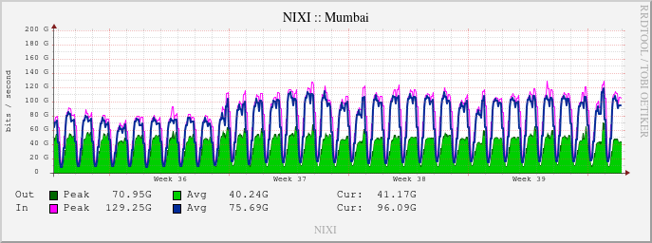
Meanwhile in India
  Nixi
http://180.179.222.83/statistics/infrastructure/4/bits, 29.6.2025
Notes:
Increased their local traffic when the fiber broke down.

Slide 28
Conclusion on India?
  …something is seen … ?
Notes:
Increased their local traffic when the fiber broke down. Again, it should have been local from the start.

Slide 29
so where did ME “stall”:
06
Looking at limitations
Notes:
The fiber-break did in fact make ME lose traffic, but not in the way expected.

Slide 30
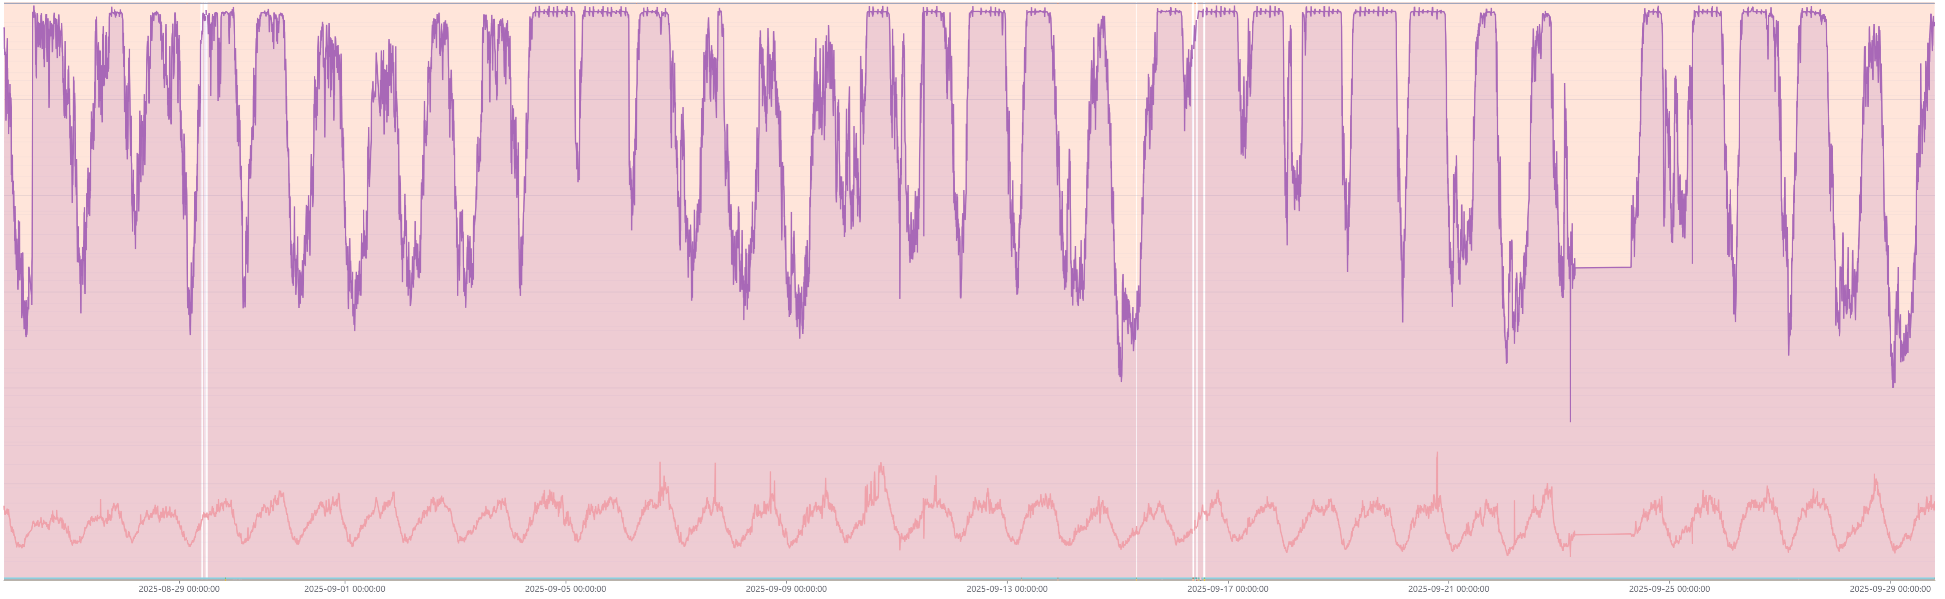
Looking at Limitations when traffic shifts occurs
  Quoting Cisco: a link > 70% load is a dead link
  100% load is not your friend
  No, you can´t do anything useful here:
Notes:
This is from one IX in the ME. And no, we won‘t say which one since it doesn‘t matter. The importatn point is that it got saturated.
It is a general problem in the region that you try to fill your links as much as possible before upgrading. This leaves NO safety for mishaps as cable-breaks.
This is not to point fingers, the fibers and capacity in ME are expensive and decisions typically needs to be “anchored“ trough management in more complicated way then in Europe.

Slide 31
What did the routing do?
07
Latency Results vs. Peering/BGP configs

Slide 32
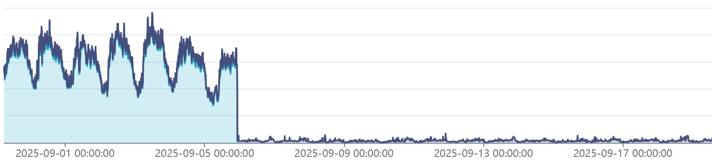
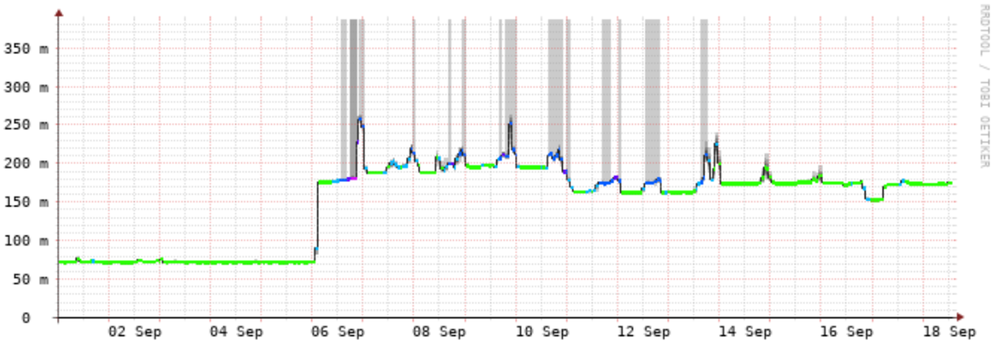
Routing vs. Latency:
Peering traffic at UAE-IX
  A random Example
  One big network in Saudi Arabia to one big network in UAE:
  Why put traffic from Dubai via Europe if Europe cables are hit?
Notes:
Why would the latency increase when cables to EUROPE goes down? This indicates broken routing for sure.

Slide 33
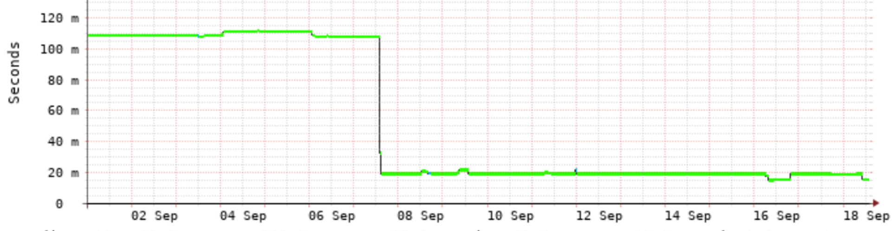
Routing vs. Latency:
  Another random Example – showing the reverse:
  Another big network in Saudi Arabia to one big network in UAE:
  Interesting: a bit of a delay of 1 day…
Notes:
Even stranger. Why would latency IMPROVE when cables to Europe goes down? This indicates traffic that should be local from the start finaly getting local.
How can this happen? One likely explanation: You don‘t do routing decisions at all, you just let BGP do its thing.
Which means that if prefix-lengt is the same, no local-pref or meds are used... It will come down to the age of the session.
The AS-path is very short since seacables, no matter how long, are only one hop.
(7 steps down in the BGP-decision list)

Slide 34
How about hyperscalers?
08

Slide 35
Hyperscalers:
  Finally got some data from some of them…
  …but it will take some time to compile
Notes:
Still hard to get info from them. And not for lack of trying...

Slide 36
How about Operators?
09

Slide 37
Operators
  (Still) working on getting their statements
Notes:
Still hard to get info from them. And not for lack of trying...

Slide 38
Conclusion?
10

Slide 39

BGP Best Path selection
Steg | Cisco IOS/XR/NX-OS | Arista EOS | Juniper JunOS | Nokia SR OS
1 | Highest Weight | Highest Weight | – | –
2 | Highest Local Preference | Highest Local Preference | Highest Local Preference | Highest Local Preference
3 | Locally originated | Locally originated | Locally originated | Locally originated
4 | Shortest AS_PATH | Shortest AS_PATH | Shortest AS_PATH | Shortest AS_PATH
5 | Lowest Origin type | Lowest Origin type | Lowest Origin type | Lowest Origin type
6 | Lowest MED | Lowest MED | Lowest MED | Lowest MED
7 | eBGP over iBGP | eBGP over iBGP | eBGP over iBGP | eBGP over iBGP
8 | Lowest IGP cost to next hop | Lowest IGP cost | Lowest IGP metric | Lowest IGP metric
9 | Oldest path | Oldest path | – | –
10 | Lowest Router ID | Lowest Router ID | Lowest Router ID | Lowest Router ID
11 | Lowest Neighbor IP | Lowest Neighbor IP | Lowest Neighbor IP | Lowest Neighbor IP
Notes:
Here‘s the theory. It seems there hasn‘t been any deliberate routeselection, instead it is proabable that we end up in the bottom-part of the Best Path Selection.

Slide 40
Conclusions:
  Make sure your routing policy is keeping local things local
  Don't let the timestamp/router-id decide the routing
  Have redundancy local
  (but not in the subsea cable next to the first one)
  Leave headroom on your critical links and peers
Notes:
This is why it is relevant for us here in the Nordics as well. Good routing-hygiene IS important.
Trombones are nice instruments... But not a good way of routing. Sweden had a masterclass in this some years back. And also Brazil/Chile to/from Miami.
Use Local-pref, prepends, meds etc to make sure traffic takes the intended route.
Breaks like this one affects traffic-patterns globaly, so that is why we need to consider sudden shifts in traffic everywhere.

Slide 41
Conclusions:
  Automate your failovers as much as possible (and test)
  Learn from this (and past) incidents and improve
  Make sure to send competent engineers to the NOG's
  And... we need more data to get better answers for more cases

Slide 42
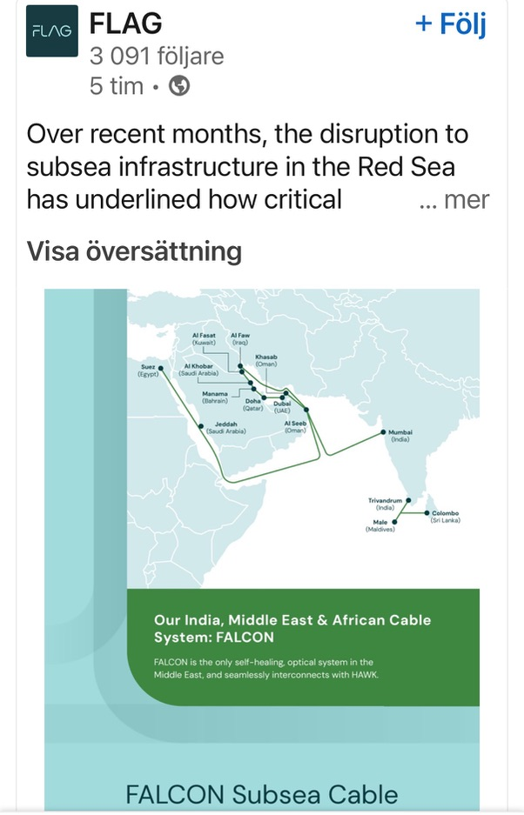
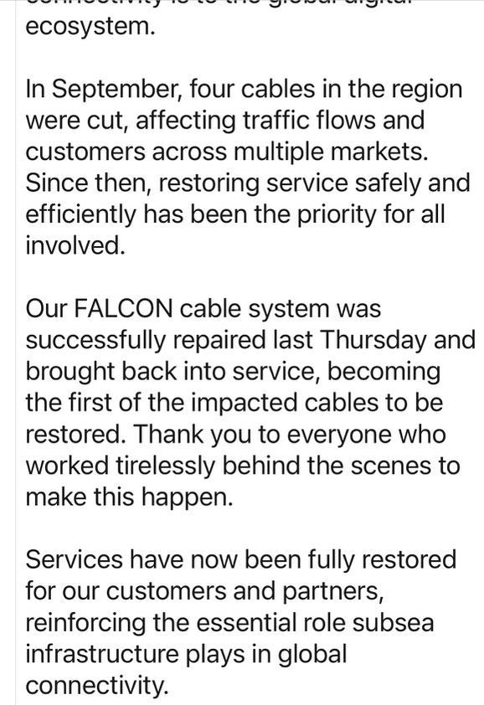
Side Quest: Are the seacables fixed yet (months after)?
20:th February 2026
But when trying to find the post in LinkedIn now, it is gone.
Zero answers from FLAG when asking about it as well
No information to be found about the other affected cables (EIG, IMEWE and SMW4)
Notes:
And with everything going on in the region right now we can probably assume it might take a while longer.

Slide 43
Thank You
Kaj Kjellgren
Senior Peering Consultant @ DE-CIX
https://www.linkedin.com/in/kajkjellgren/

