Slide 1


SOVEREIGNTY FOR WHOM?
Between digital (in)dependence and big tech expansionism
Sofie Flensburg
Signe Sophus Lai
DKNOG16, Match 6, 2026

Slide 2
DIGITAL SOVEREIGNTY
IN RESEARCH TERMS?
Notes:
What does digital sovereignty mean in research terms?

Slide 3
INFRASTRUCTURAL DEPENDENCIES

Slide 4
INFRASTRUCTURAL
POWER

Slide 6
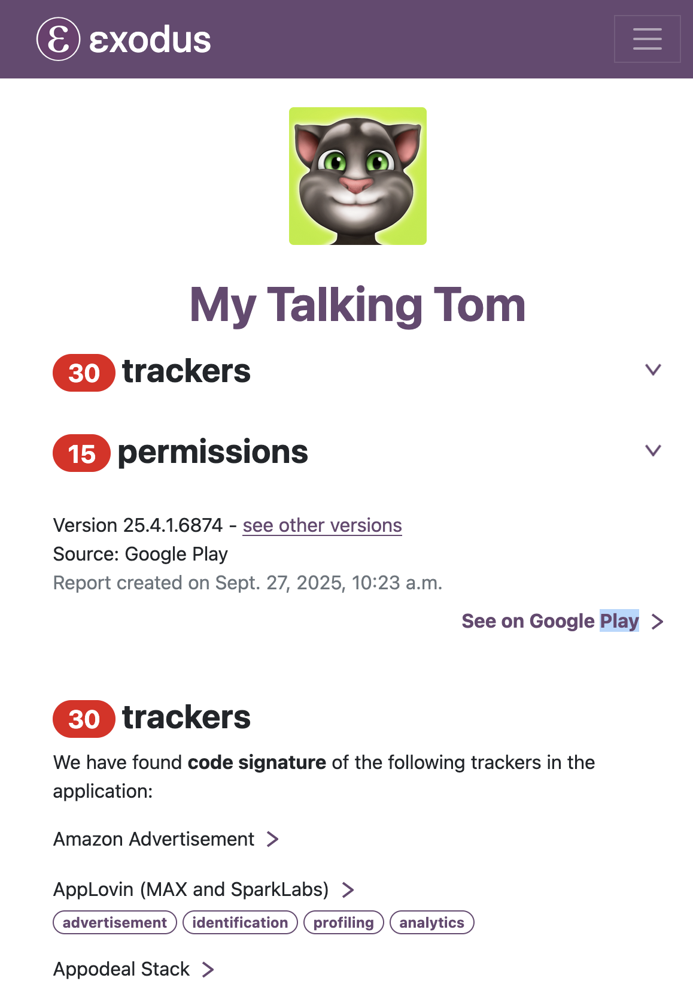
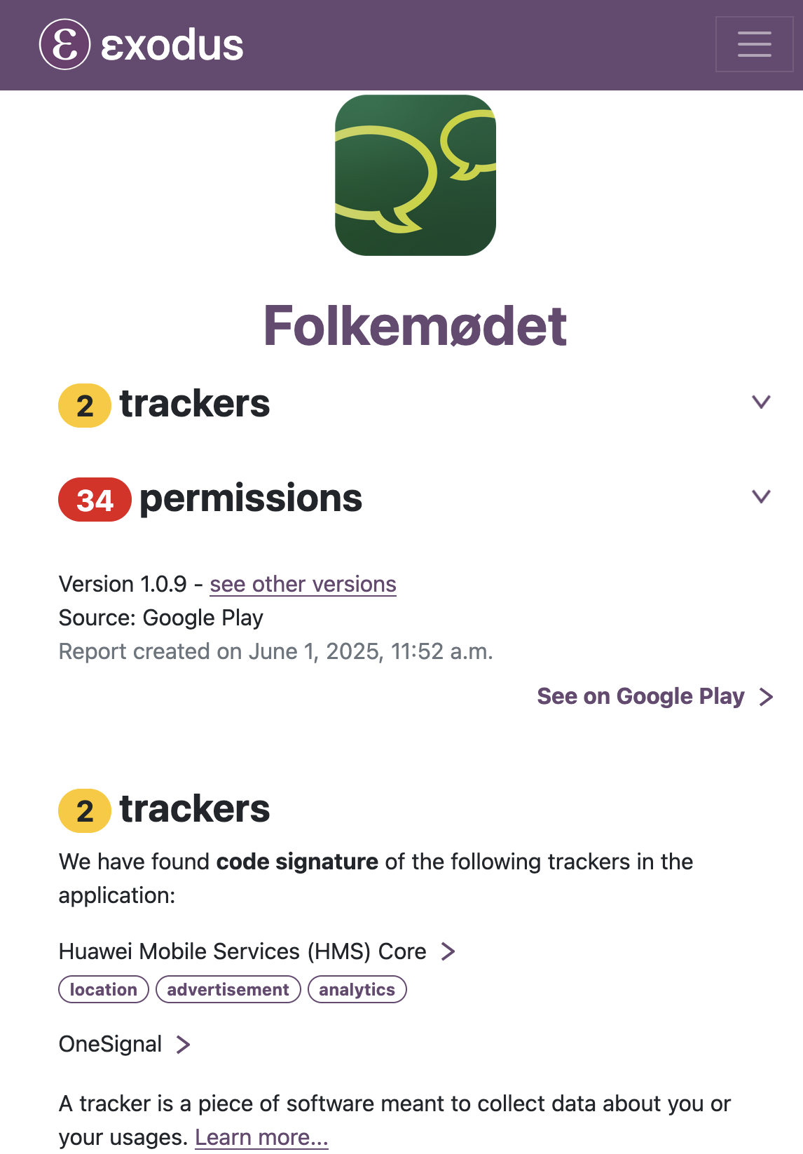
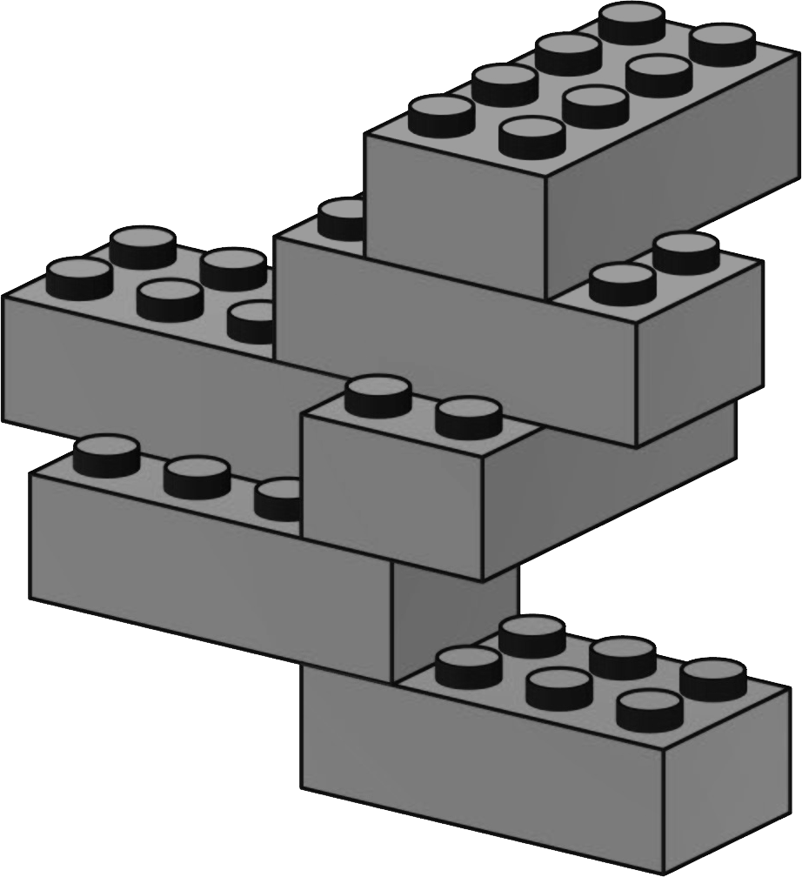
BROKERS OF [IN]DEPENDENCE

Slide 7
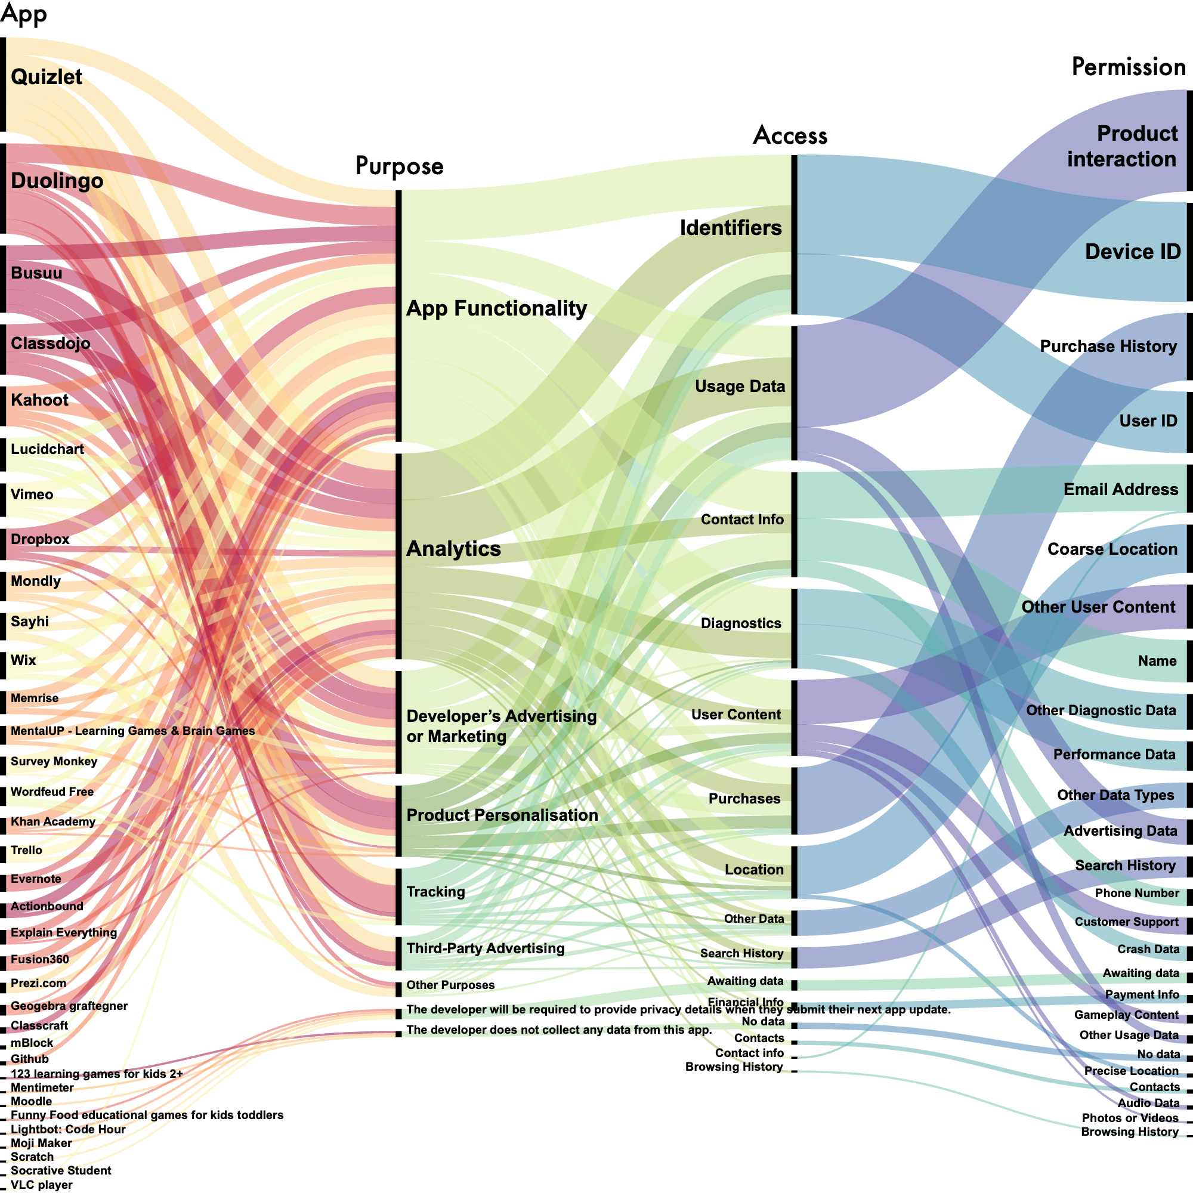
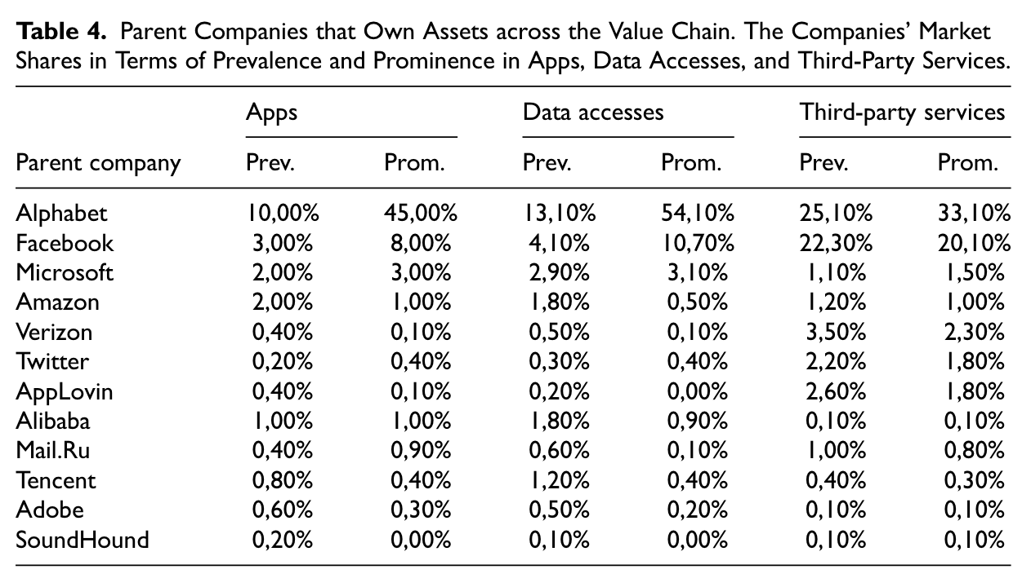

BROKERS OF [IN]DEPENDENCE
(Lai & Flensburg, 2020; 2021; 2022; Flensburg & Lai, 2023, Lai, Flensburg & Andelsman, 2024; Lomborg, Sick, Flensburg & Lai, 2024)

Slide 8
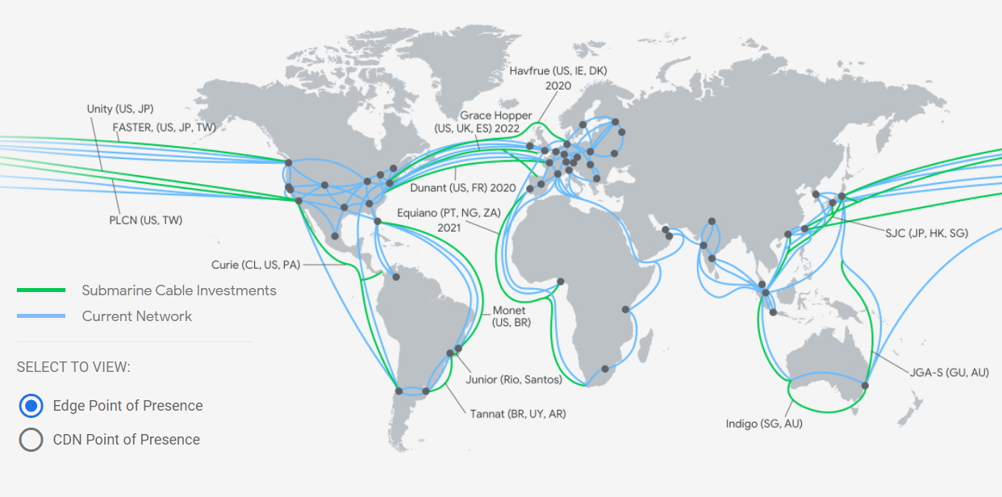
LANDLORDS OF [IN]DEPENDENCE
(Flensburg & Lai, 2021; in press; Lai & Flensburg, 2023; Lai, Flensburg & Sick, forthcoming)

Slide 9
LANDLORDS OF [IN]DEPENDENCE
(Flensburg & Lai, 2021; in press; Lai & Flensburg, 2023; Lai, Flensburg & Sick, forthcoming)

Slide 10
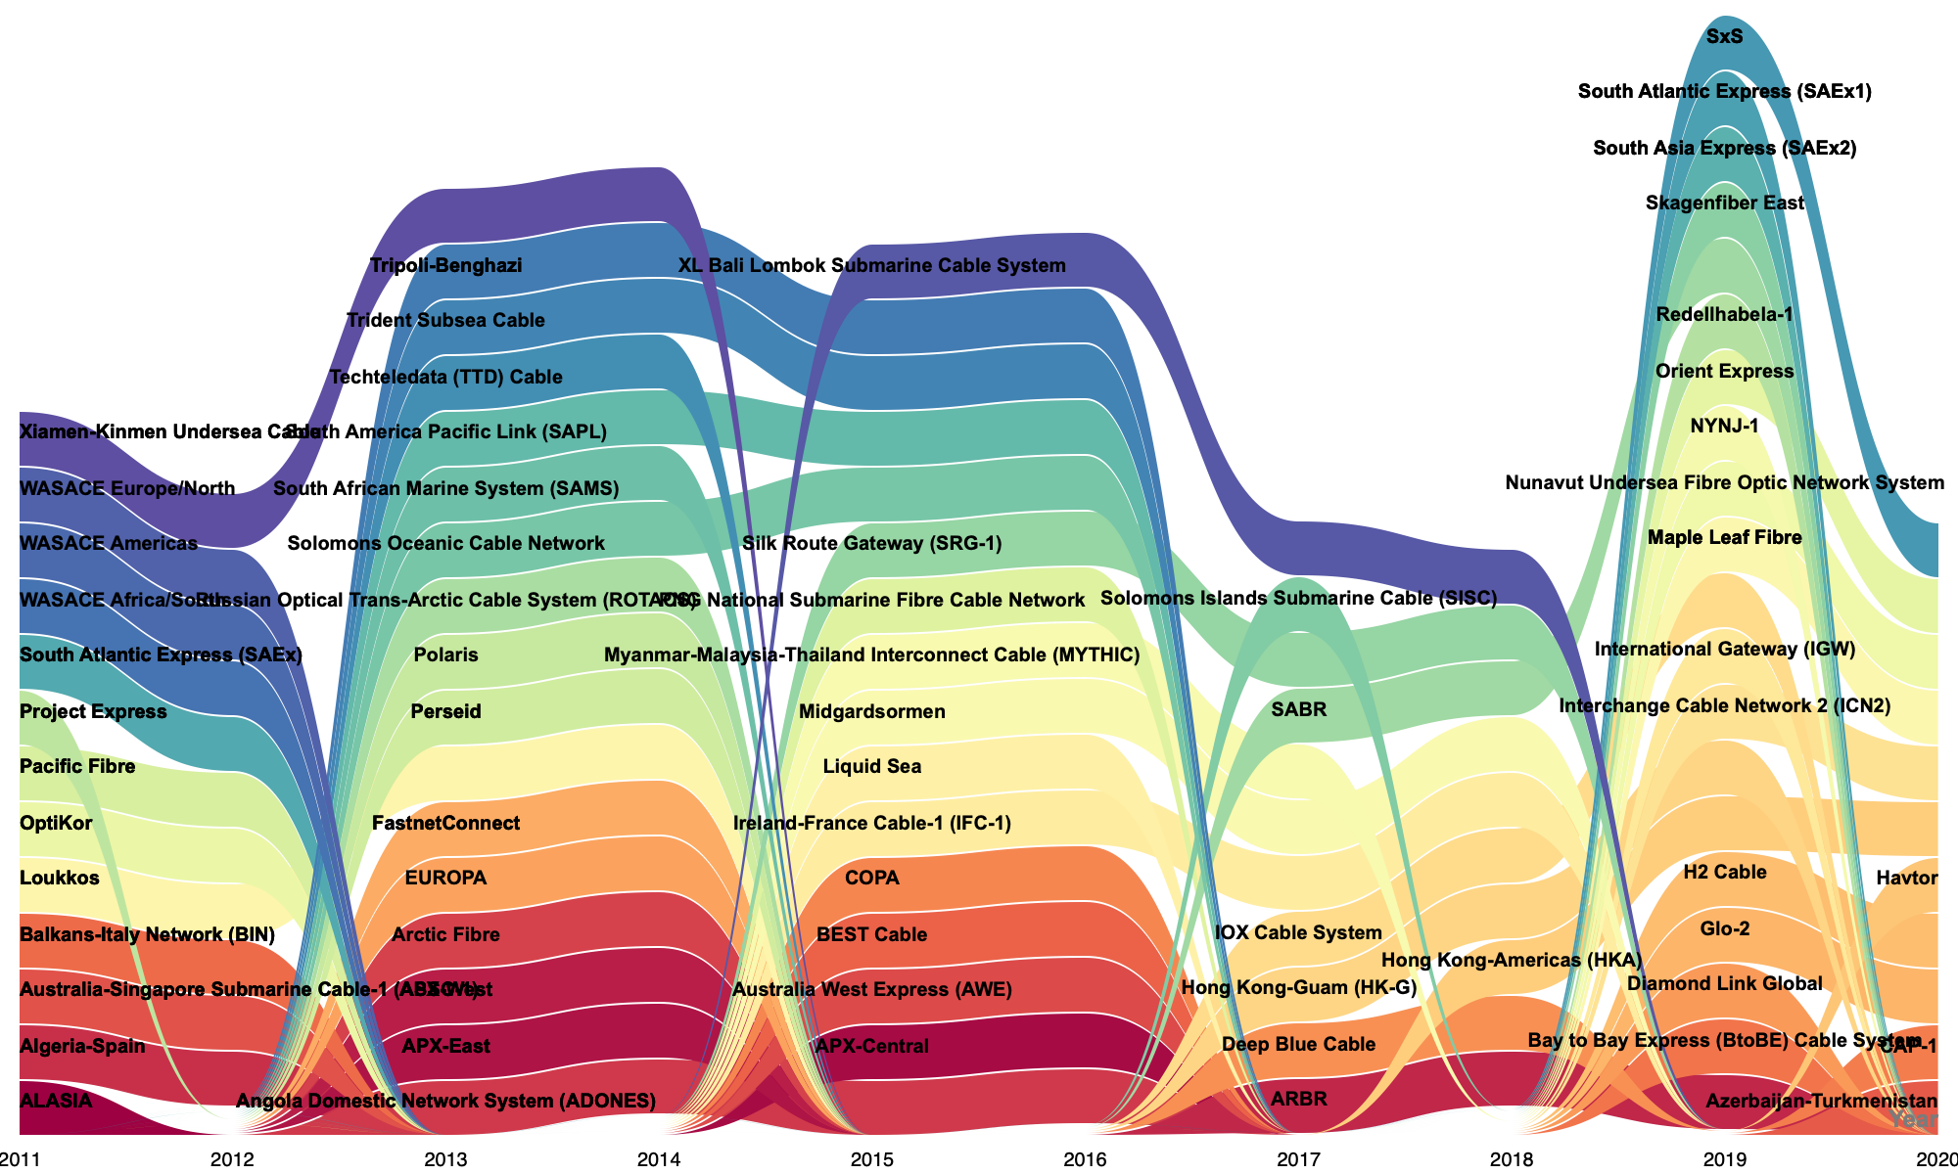
LANDLORDS OF [IN]DEPENDENCE
(Flensburg & Lai, 2021; in press; Lai & Flensburg, 2023; Lai, Flensburg & Sick, forthcoming)

Slide 11
MONITORING
DIVERSITY
LEGITIMACY
OF DEPENDENCIES

Slide 12

THANK YOU FOR YOUR TIME
signe.lai@hum.ku.dk
sofie.Flensburg@hum.ku.dk

