Slide 1
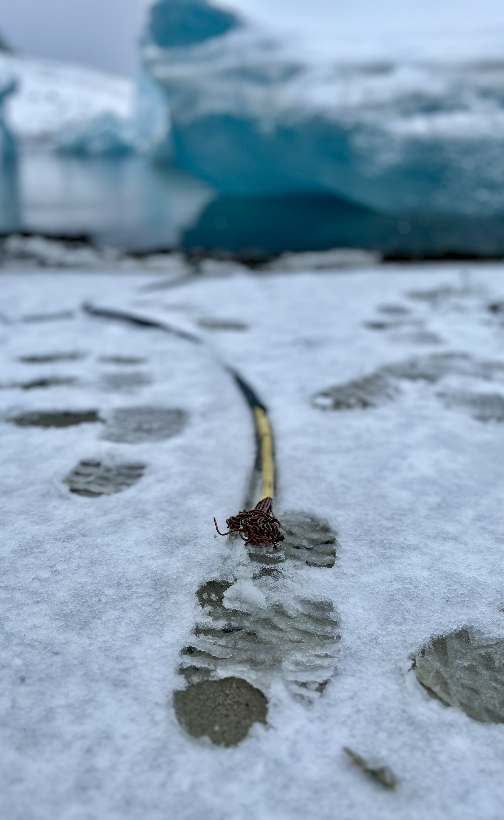


SOVEREIGNTY FOR WHOM?
Between digital (in)dependence and big tech expansionism
Sofie Flensburg
Signe Sophus Lai
DKNOG16, Match 5, 2026

Slide 2
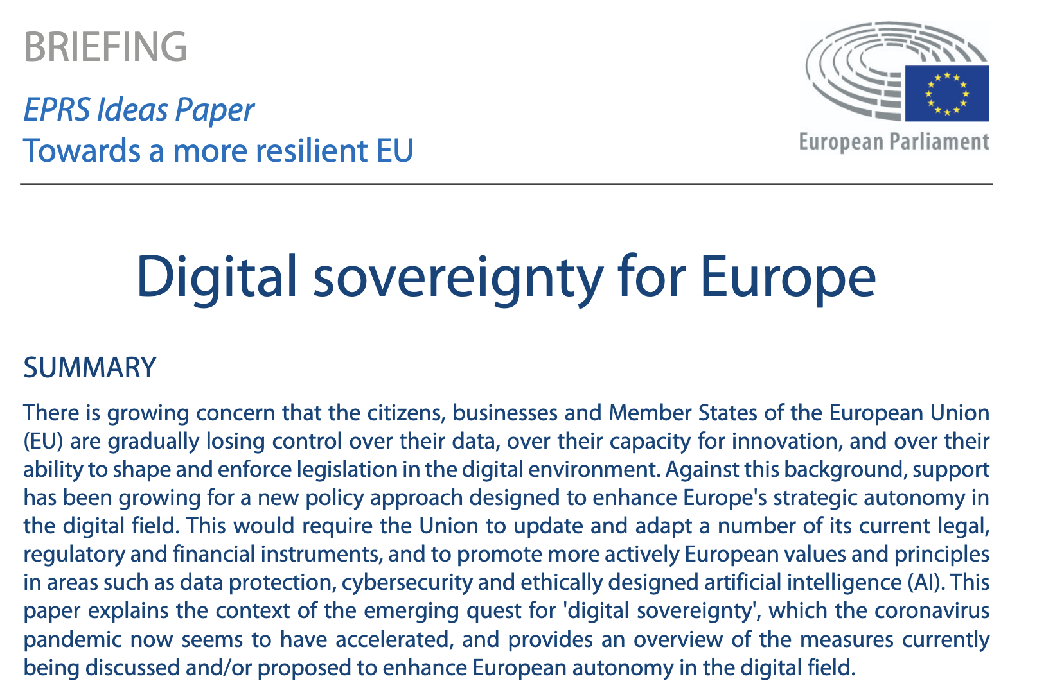
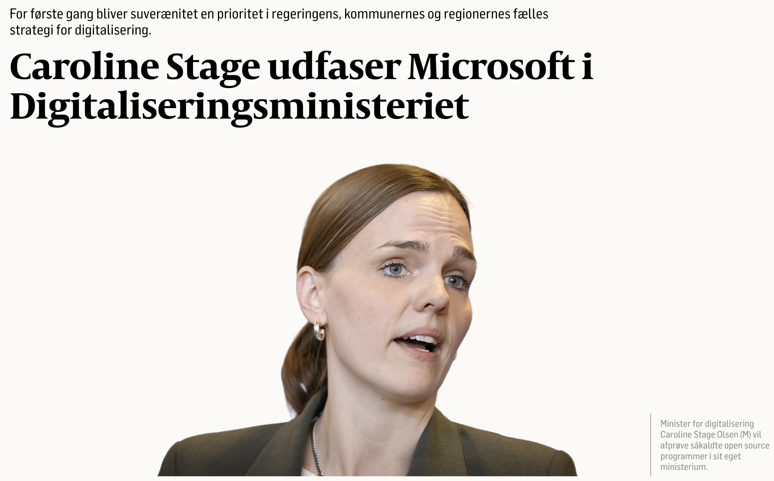
Politiken: https://politiken.dk/viden/tech/art10437680/Caroline-Stage-udfaser-Microsoft-i-Digitaliseringsministeriet
Europarlamentet: https://www.europarl.europa.eu/RegData/etudes/BRIE/2020/651992/EPRS_BRI(2020)651992_EN.pdf

Slide 3
DIGITAL SOVEREIGNTY IN RESEARCH TERMS?

Slide 4
INFRASTRUCTURAL DEPENDENCIES

Slide 5
INFRASTRUCTURAL POWER

Slide 6
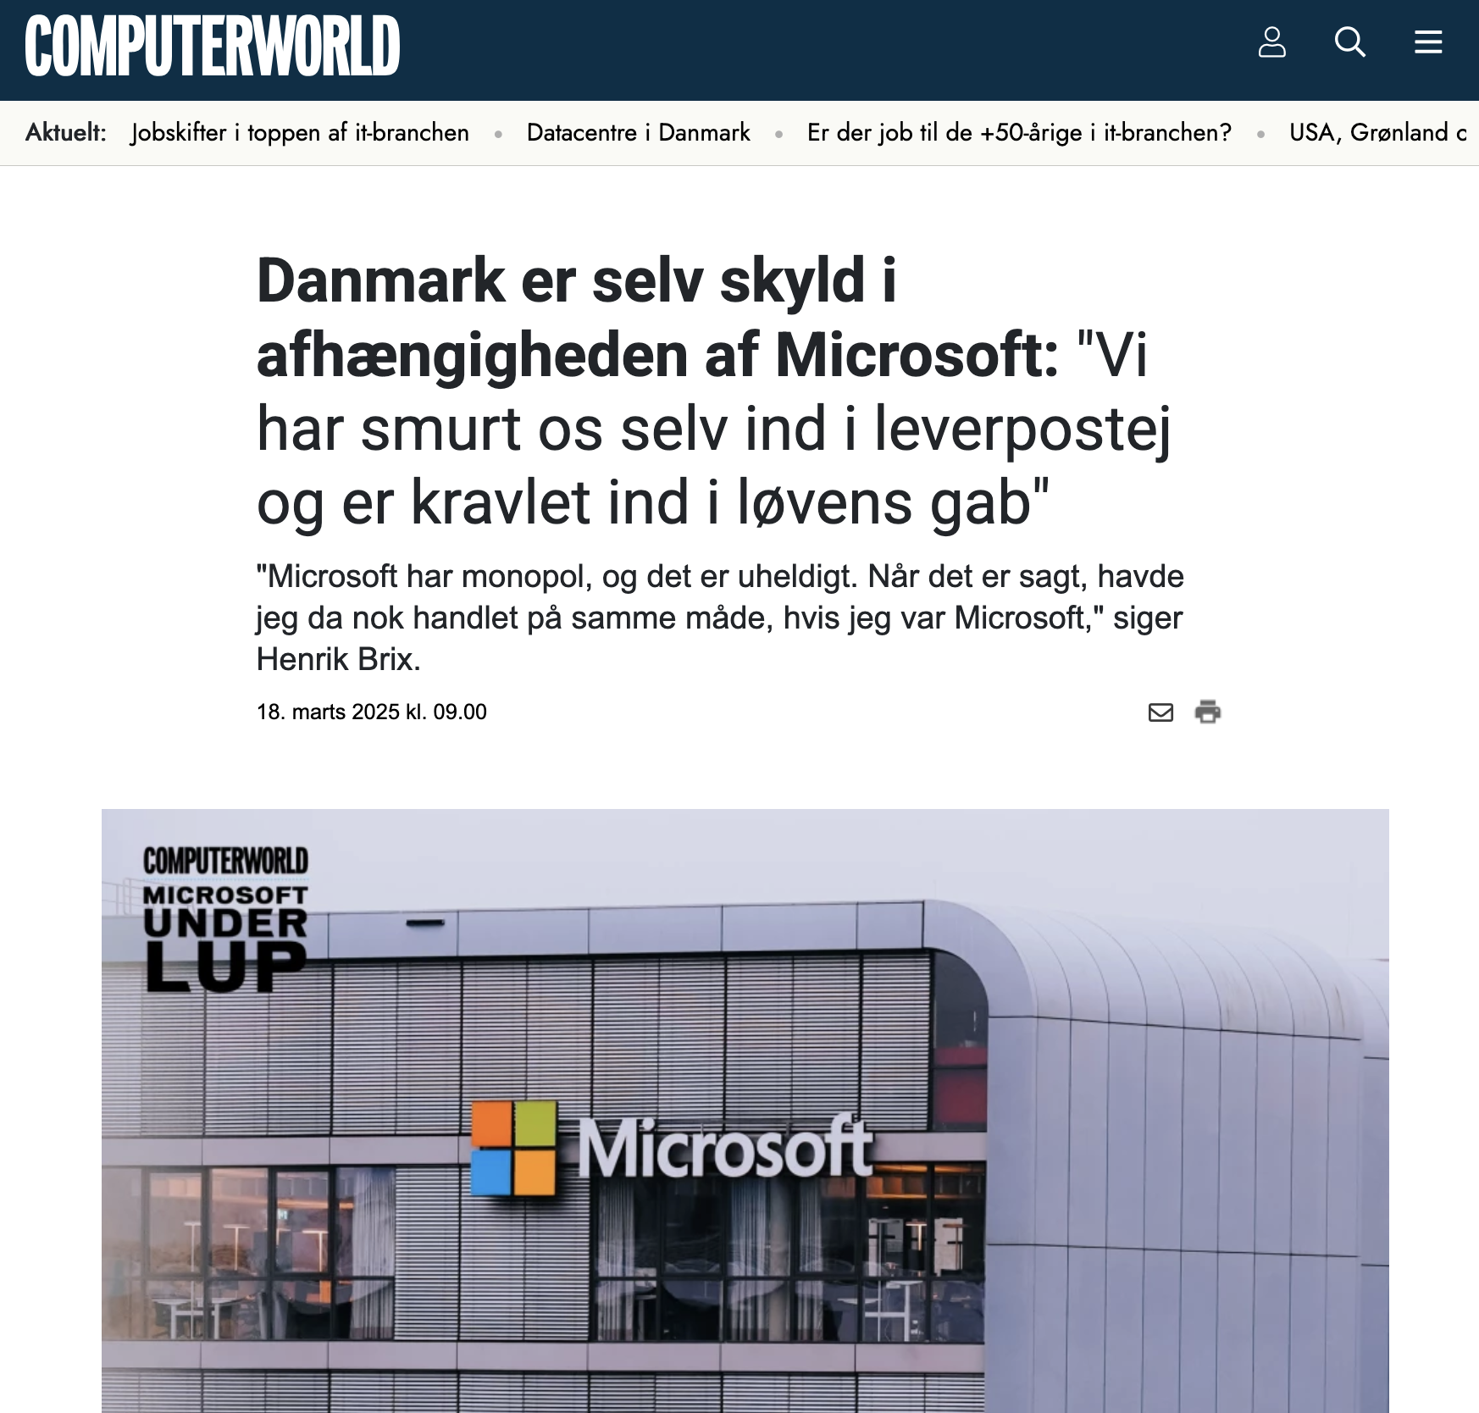
Computerworld: https://www.computerworld.dk/art/290733/danmark-er-selv-skyld-i-afhaengigheden-af-microsoft-vi-har-smurt-os-selv-ind-i-leverpostej-og-er-kravlet-ind-i-loevens-gab

Slide 7
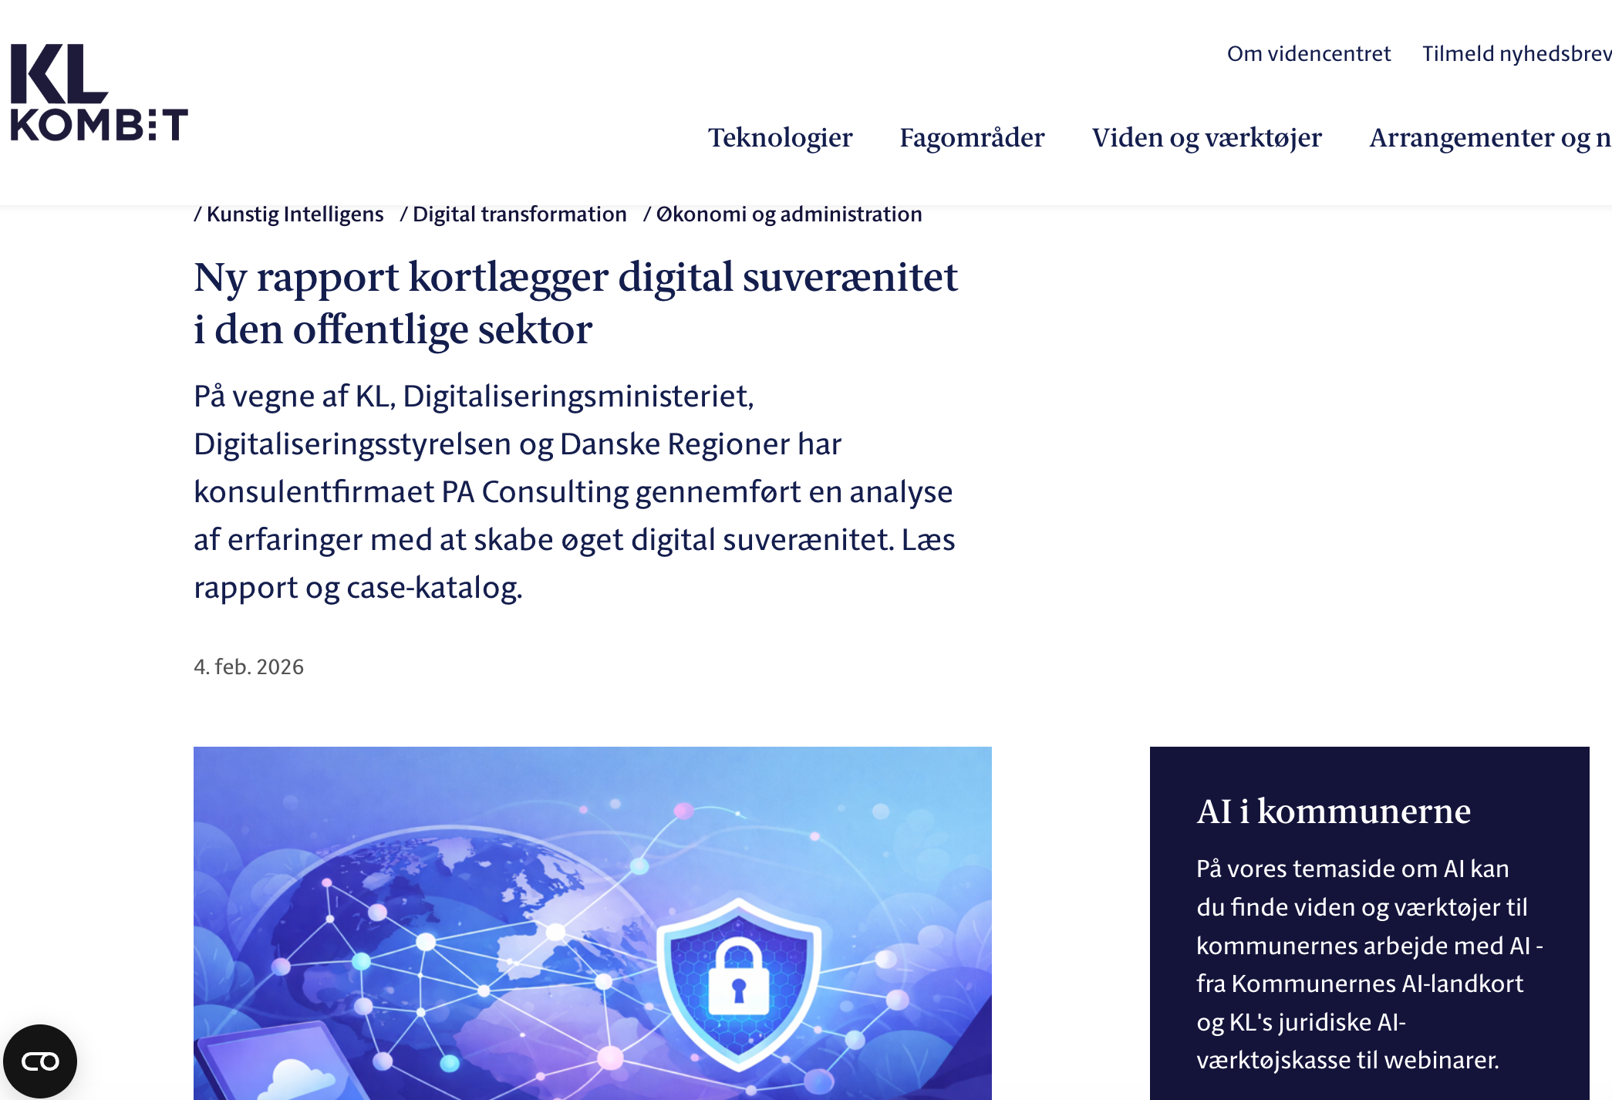
KL:
https://www.kl.dk/videncenter/nyheder/2026/ny-rapport-kortlaegger-digital-suveraenitet-i-den-offentlige-sektor

Slide 8
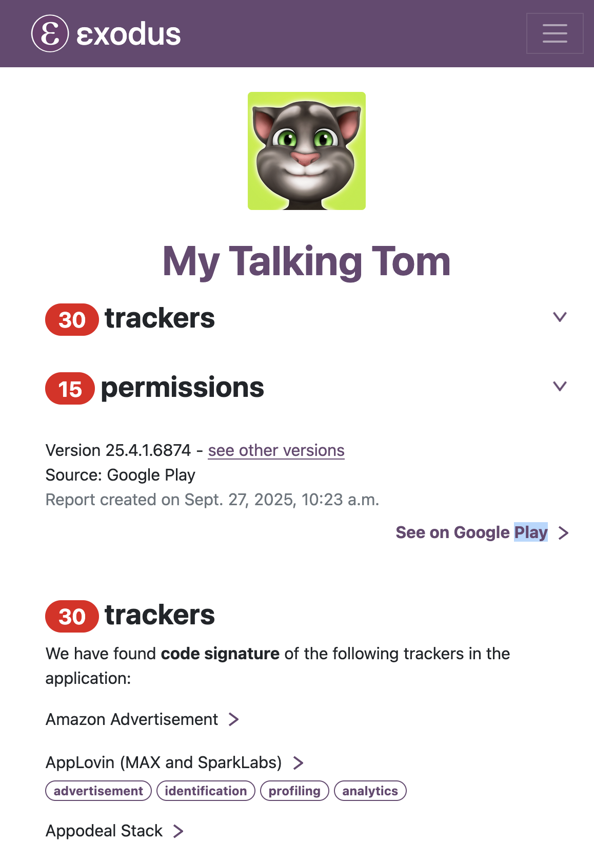
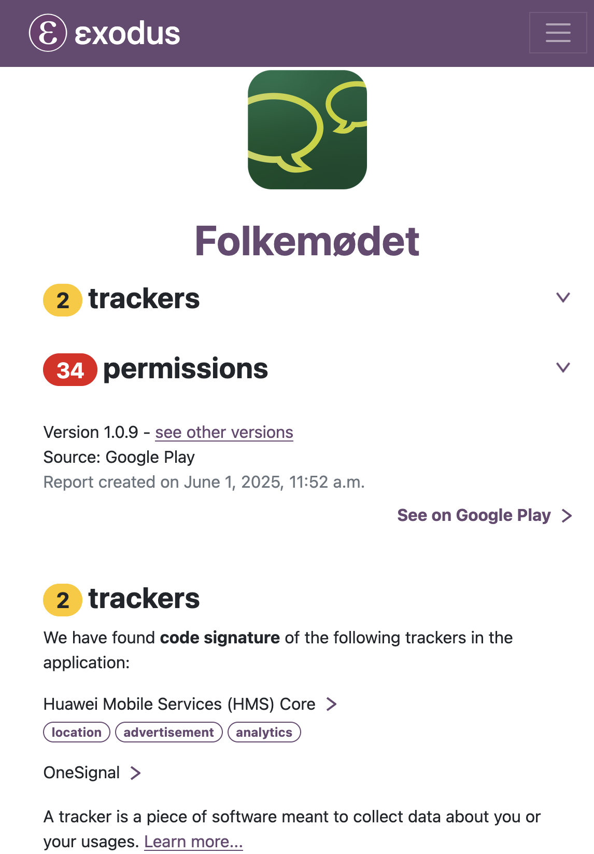

BROKERS OF [IN]DEPENDENCE

Slide 9
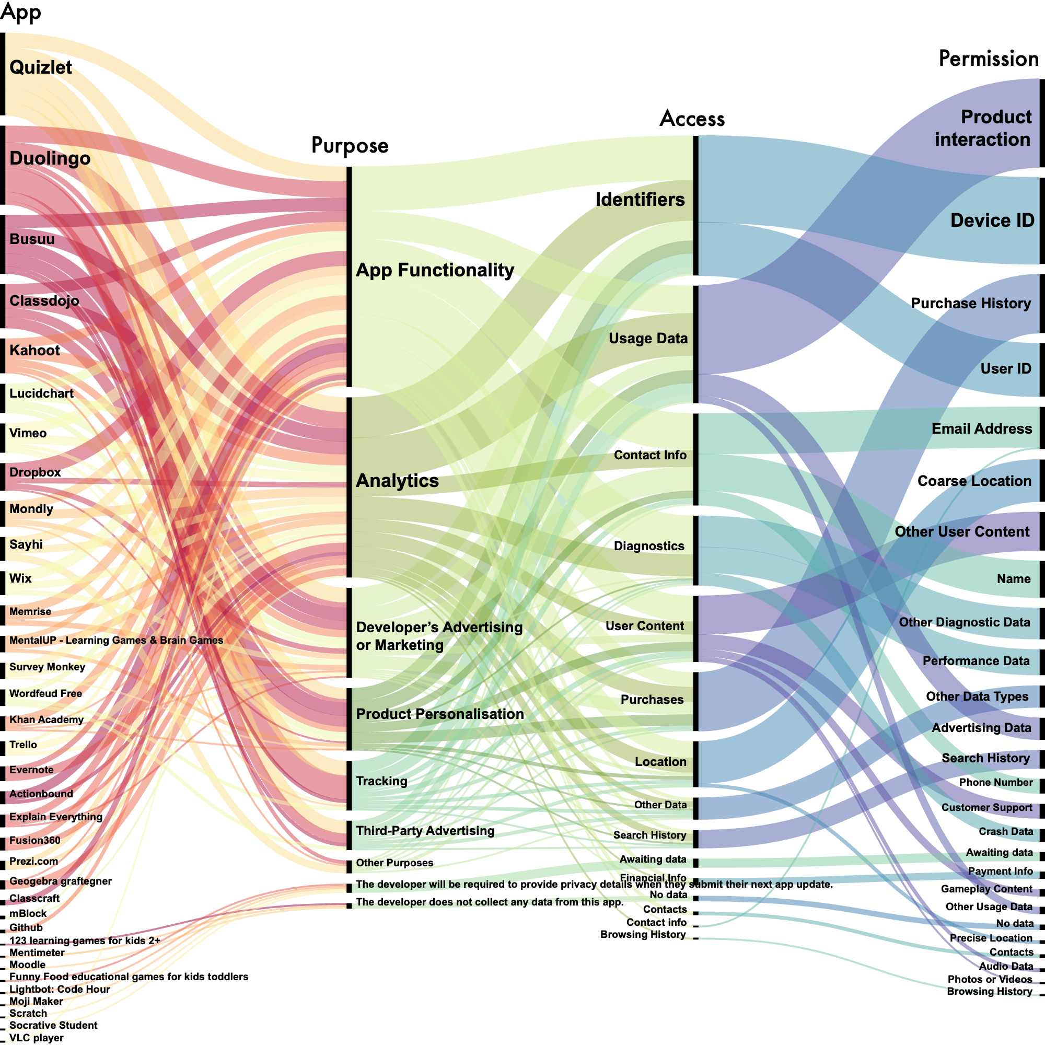
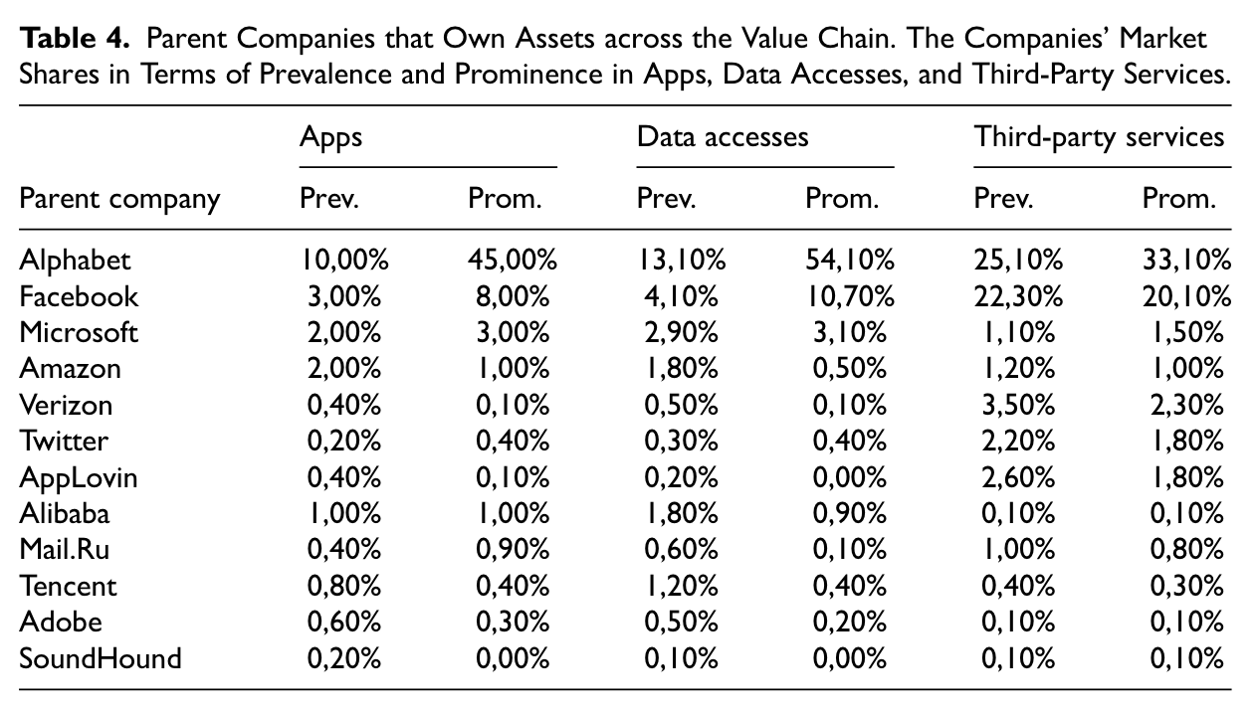

BROKERS OF [IN]DEPENDENCE
(Lai & Flensburg, 2020; 2021; 2022; Flensburg & Lai, 2023, Lai, Flensburg & Andelsman, 2024; Lomborg, Sick, Flensburg & Lai, 2024)

Slide 10



BROKERS OF [IN]DEPENDENCE

Slide 11
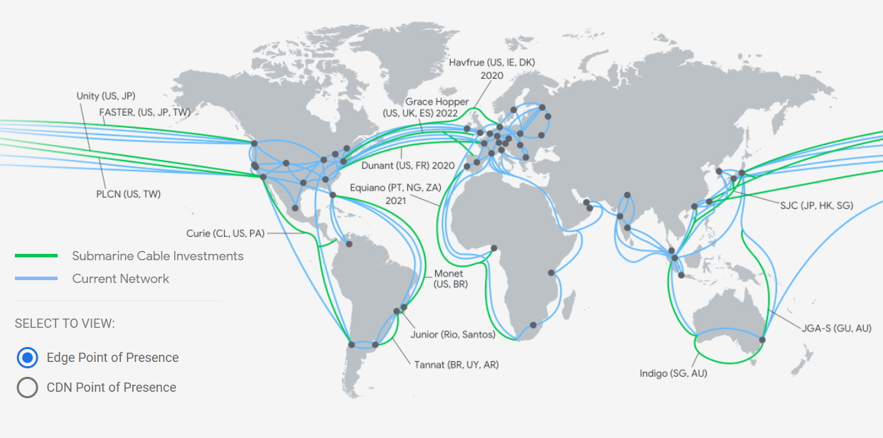
LANDLORDS OF [IN]DEPENDENCE
(Flensburg & Lai, 2021; 2025; Lai & Flensburg, 2023; Lai, Flensburg & Sick, 2026)

Slide 12
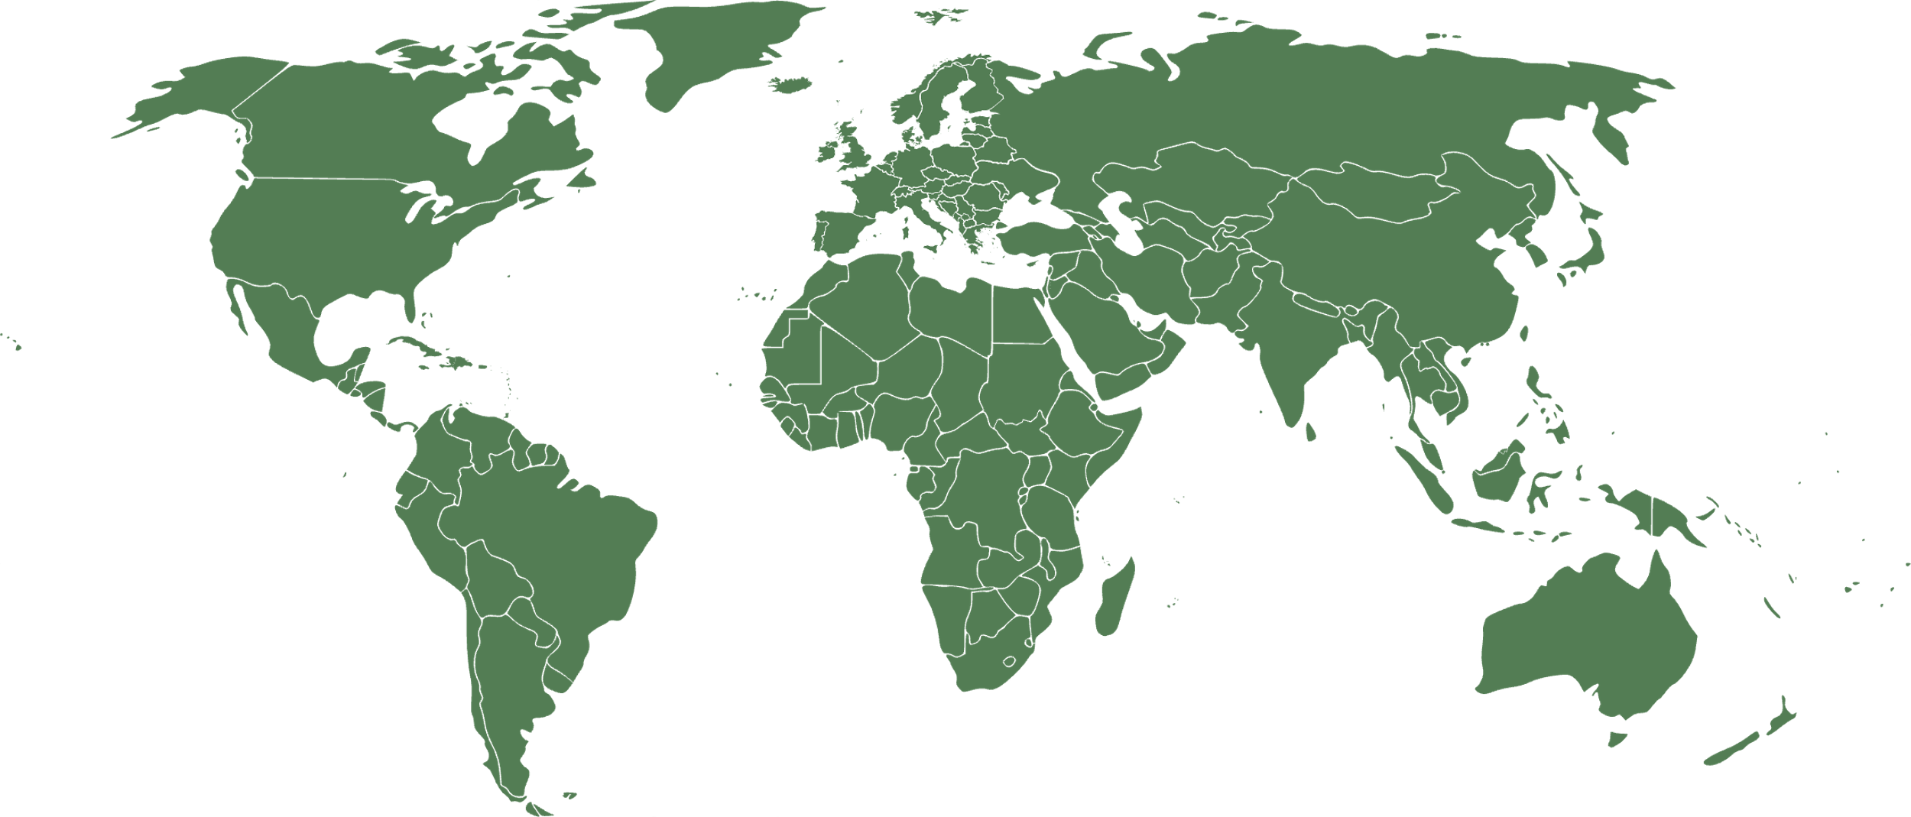












2011
Cable count
13
Balkans-Italy Network (BIN)
Project Express
Loukkos
Algeria- Spain
ALASIA
Xiamen-Kinmen Undersea Cable
Pacific Fibre
WASACE
Australia-Singapore Submarine Cable-1 (ASSC-1)
South Atlantic Express (SAEx)
OptiKor

Slide 13
2012
Cable count
11
Balkans-Italy Network (BIN)
Loukkos
Algeria- Spain
Xiamen-Kinmen Undersea Cable
Pacific Fibre
WASACE
Australia-Singapore Submarine Cable-1 (ASSC-1)
South Atlantic Express (SAEx)
OptiKor

Slide 14













2013
Cable count
17
Russian Optical Trans-Arctic Cable System (ROTACS)
Arctic Fibre
FastnetConnect
APX-East
Loukkos
Tripoli-Benghazi
EUROPA
Xiamen-Kinmen Undersea Cable
South America Pacific Link (SAPL)
Solomons Oceanic Cable Network
Angola Domestic Network System (ADONES)
APX-West
Trident Subsea Cable
Techteledata (TTD) Cable
South African Marine System (SAMS)

Slide 15
2014
Cable count
17
Russian Optical Trans-Arctic Cable System (ROTACS)
Arctic Fibre
FastnetConnect
APX-East
Loukkos
Tripoli-Benghazi
EUROPA
Xiamen-Kinmen Undersea Cable
South America Pacific Link (SAPL)
Solomons Oceanic Cable Network
Angola Domestic Network System (ADONES)
APX-West
Trident Subsea Cable
Techteledata (TTD) Cable
South African Marine System (SAMS)

Slide 16









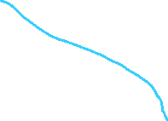
2015
Cable count
16
COPA
Ireland-France Cable-1 (IFC-1)
Midgardsormen
Tripoli-Benghazi
Silk Route Gateway (SRG-1)
BEST Cable
Myanmar-Malaysia-Thailand Interconnect Cable (MYTHIC)
PNG National Submarine Fibre Cable Network
South America Pacific Link (SAPL)
Solomons Oceanic Cable Network
Angola Domestic Network System (ADONES)
Liquid Sea
Australia West Express (AWE)
XL Bali Lombok Submarine Cable System
Trident Subsea Cable
APX-Central

Slide 17
2016
Cable count
16
COPA
Ireland-France Cable-1 (IFC-1)
Midgardsormen
Tripoli-Benghazi
Tripoli-Benghazi
Silk Route Gateway (SRG-1)
BEST Cable
Myanmar-Malaysia-Thailand Interconnect Cable (MYTHIC)
PNG National Submarine Fibre Cable Network
South America Pacific Link (SAPL)
Solomons Oceanic Cable Network
Angola Domestic Network System (ADONES)
Liquid Sea
Australia West Express (AWE)
XL Bali Lombok Submarine Cable System
Trident Subsea Cable
APX-Central

Slide 18





2017
Cable count
11
Ireland-France Cable-1 (IFC-1)
Midgardsormen
Tripoli-Benghazi
Hong Kong-Guam (HK-G)
Deep Blue Cable
Silk Route Gateway (SRG-1)
Myanmar-Malaysia-Thailand Interconnect Cable (MYTHIC)
South America Pacific Link (SAPL)
Solomons Islands Submarine Cable (SISC)
XL Bali Lombok Submarine Cable System
SABR
IOX Cable System
ARBR

Slide 19
2018
Cable count
10
Ireland-France Cable-1 (IFC-1)
Midgardsormen
Hong Kong-Americas (HKA)
Tripoli-Benghazi
Hong Kong-Guam (HK-G)
Deep Blue Cable
Silk Route Gateway (SRG-1)
South America Pacific Link (SAPL)
XL Bali Lombok Submarine Cable System
SABR
IOX Cable System
ARBR

Slide 20












2019
Cable count
20
Skagenfiber East
Nunavut Undersea Fibre Optic Network System
Diamond Link Global
Maple Leaf Fibre
NYNJ-1
SxS
Hong Kong-Americas (HKA)
Hong Kong-Guam (HK-G)
Bay to Bay Express (BtoBE) Cable System
Orient Express
South Atlantic Express (SAEx1)
Glo-2
H2 Cable
Interchange Cable Network 2 (ICN2)
SABR
IOX Cable System
ARBR
South Asia Express (SAEx2)

Slide 21

2020
Cable count
11
Nunavut Undersea Fibre Optic Network System
Havtor
Azerbaijan-Turkmenistan
Maple Leaf Fibre
SxS
Hong Kong-Americas (HKA)
Orient Express
CAP-1
Glo-2
H2 Cable
Interchange Cable Network 2 (ICN2)

Slide 22
2011-2020
Cable count
64
(Flensburg & Lai, 2021; in press; Lai & Flensburg, 2023; Lai, Flensburg & Sick, forthcoming)

Slide 23
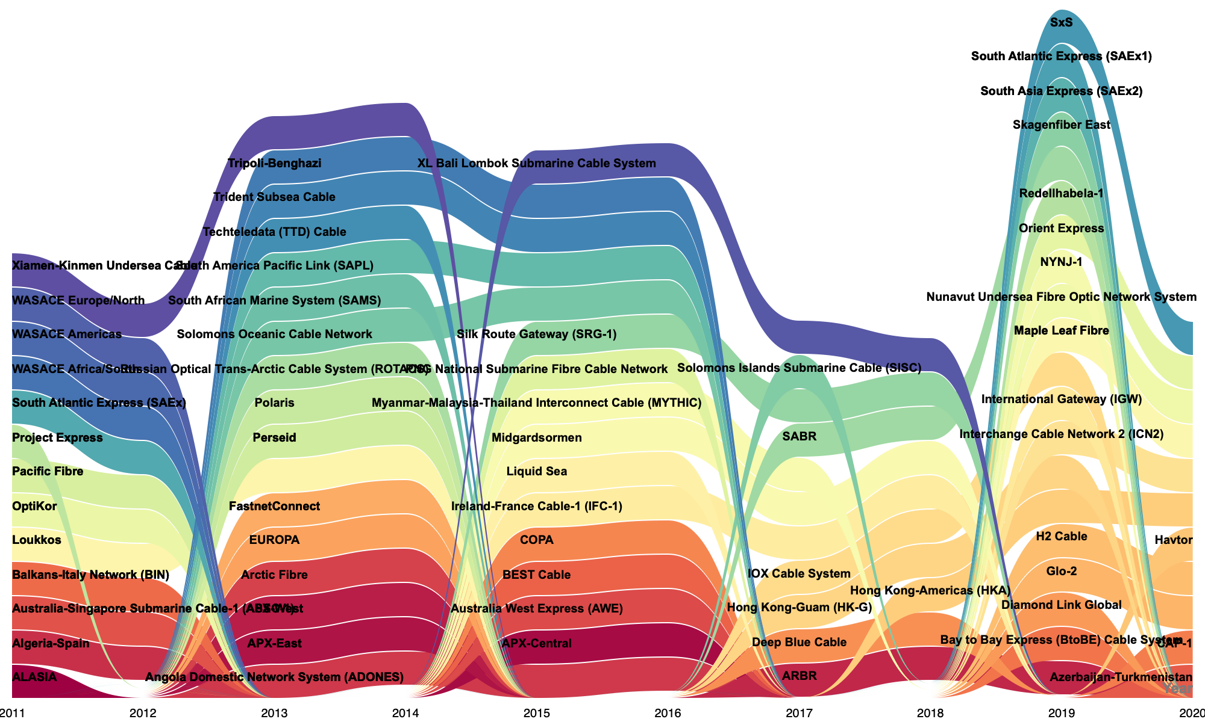
LANDLORDS OF [IN]DEPENDENCE
(Flensburg & Lai, 2021; in press; Lai & Flensburg, 2023; Lai, Flensburg & Sick, forthcoming)

Slide 24
WHODUNIT
causes of death
funding deficit
geopolitics
unknown
afterlives
abandonment
takeover
obsolescence

Slide 25
ANCHORING TECHNOPOLITICS MEASURES
OF DIGITAL SOVEREIGNTY

Slide 26
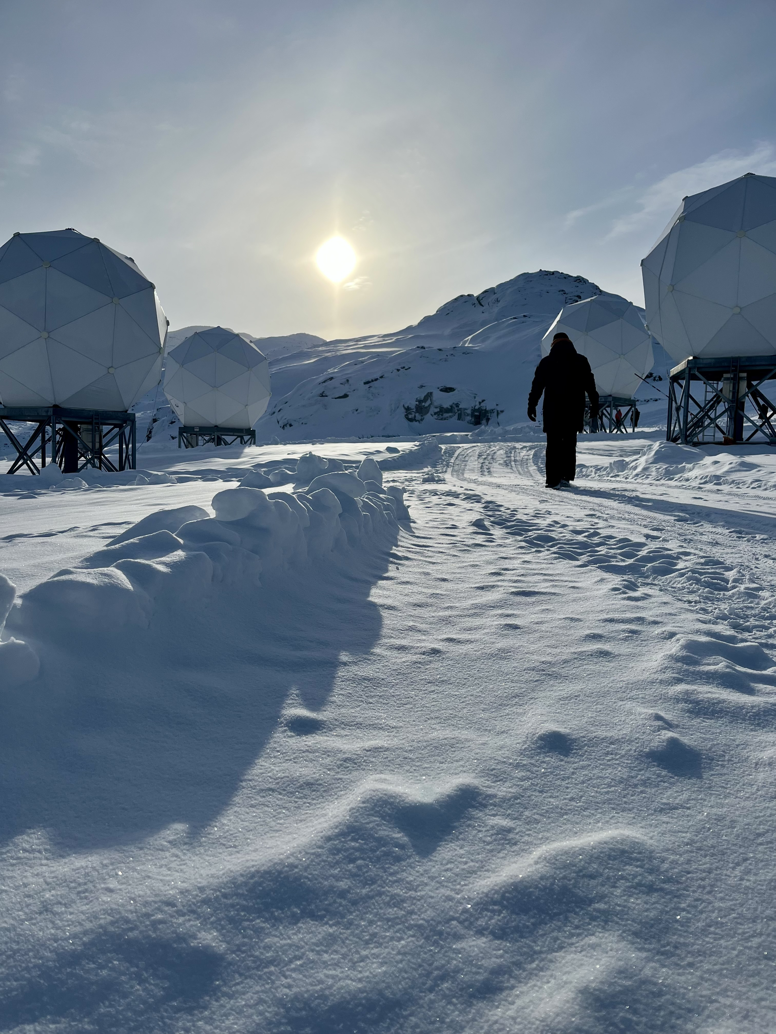
THANK YOU FOR YOUR TIME
signe.lai@hum.ku.dk
sofie.flensburg@hum.ku.dk

