Slide 1
Welcome!

Slide 2
Welcome!
30% are here for the first time
DKNOG is an open and inclusive forum.
Networking²
Ask your neighbour/neighbour.
Slack / IRC channel
IRC: #dknog on OFTC (irc.oftc.net)
Slack: Sign up at slack.dknog.dk

Slide 3
Practical information
https://dknog16.dknog.dk
Schedule
Slides
Recordings will be posted next week.
Surveys
Social information
Participant list
Photographer
Coffee

Slide 4

Sponsors
Platinum

Slide 5



Sponsors
Gold

Slide 6








Sponsors
Silver

Slide 7





Sponsors
Coffee
Associate

Slide 9
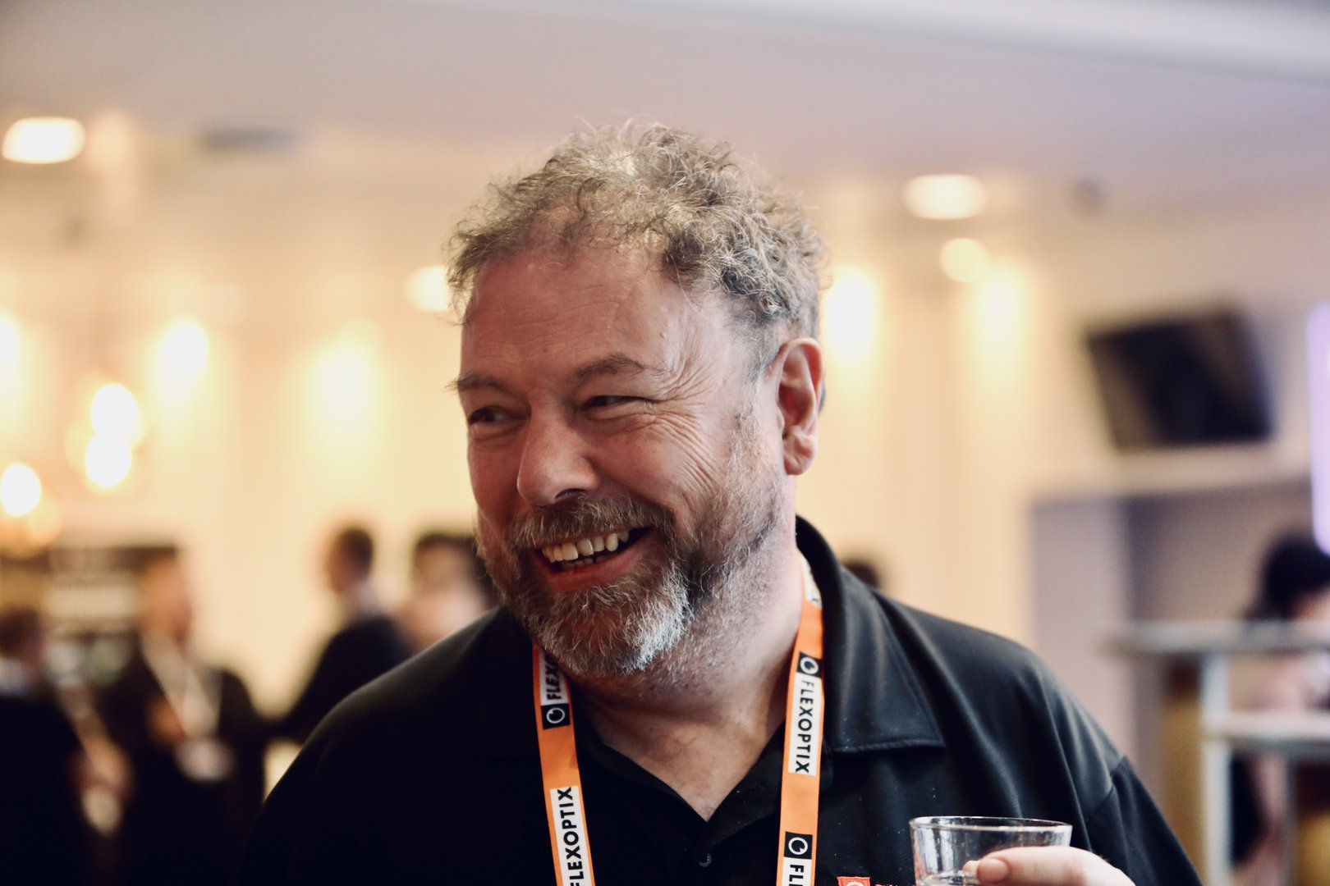
Fearghas McKay

Slide 10
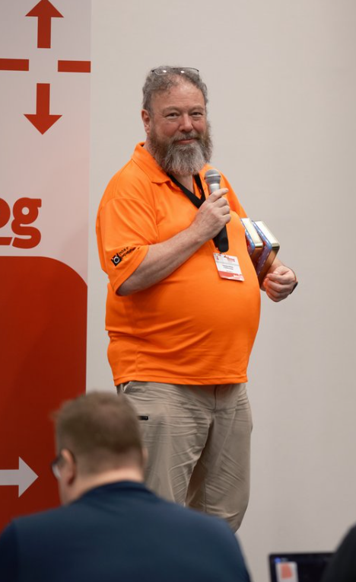
Fearghas McKay

Slide 11
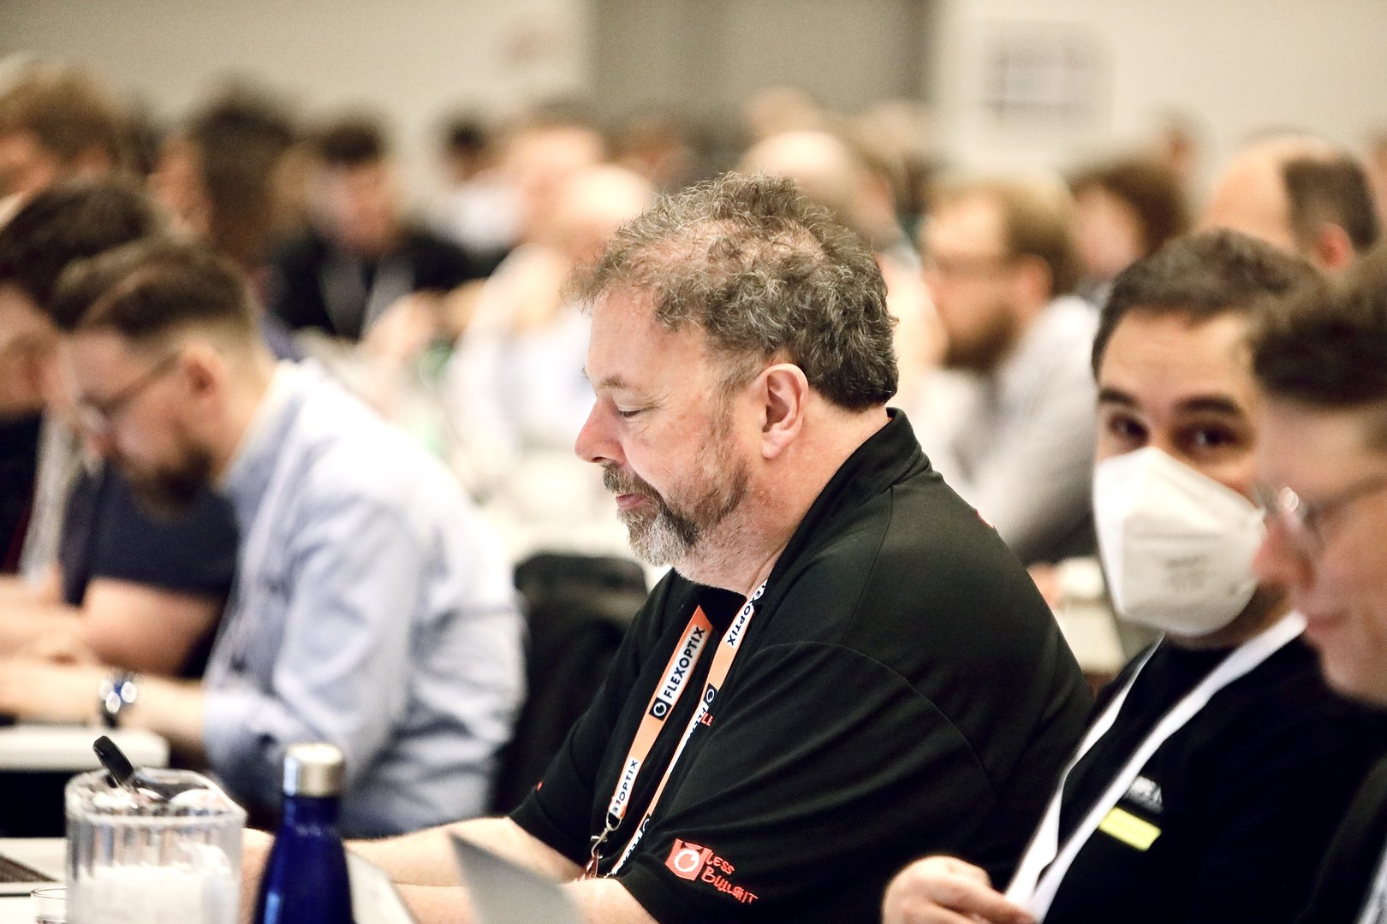
Fearghas McKay

Slide 12
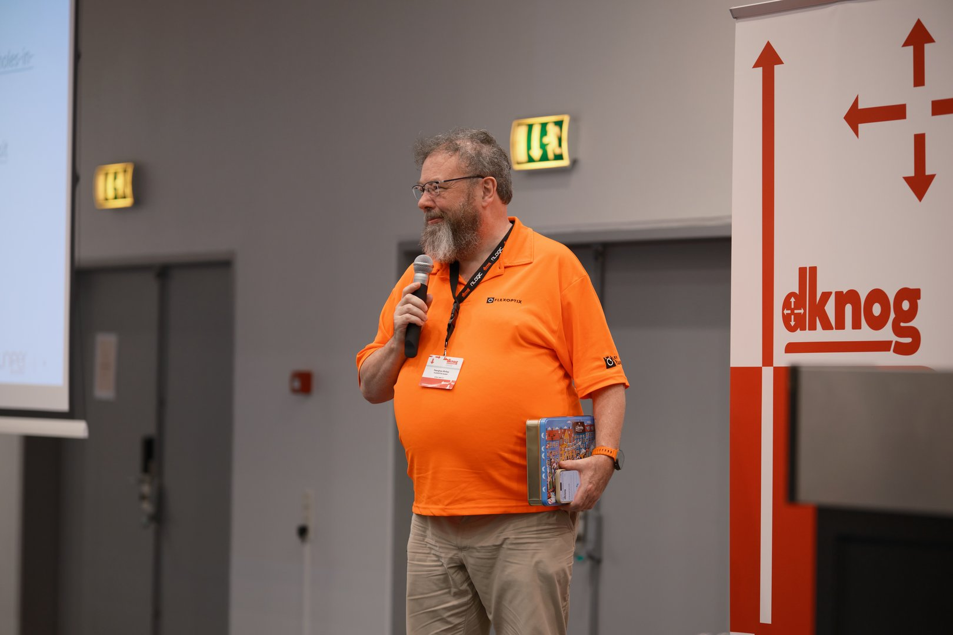
Fearghas McKay

Slide 13
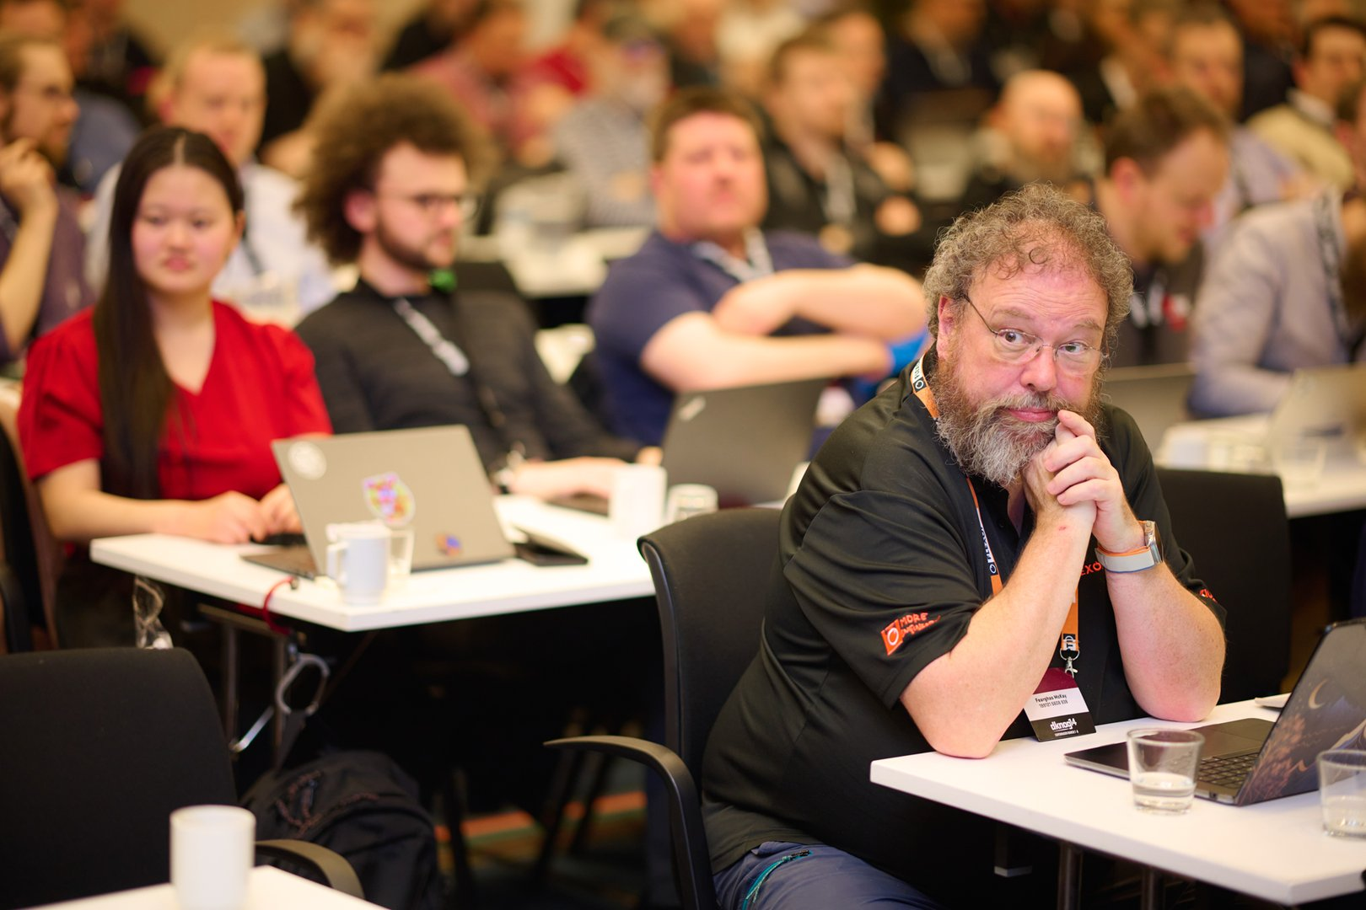
Fearghas McKay

Slide 14
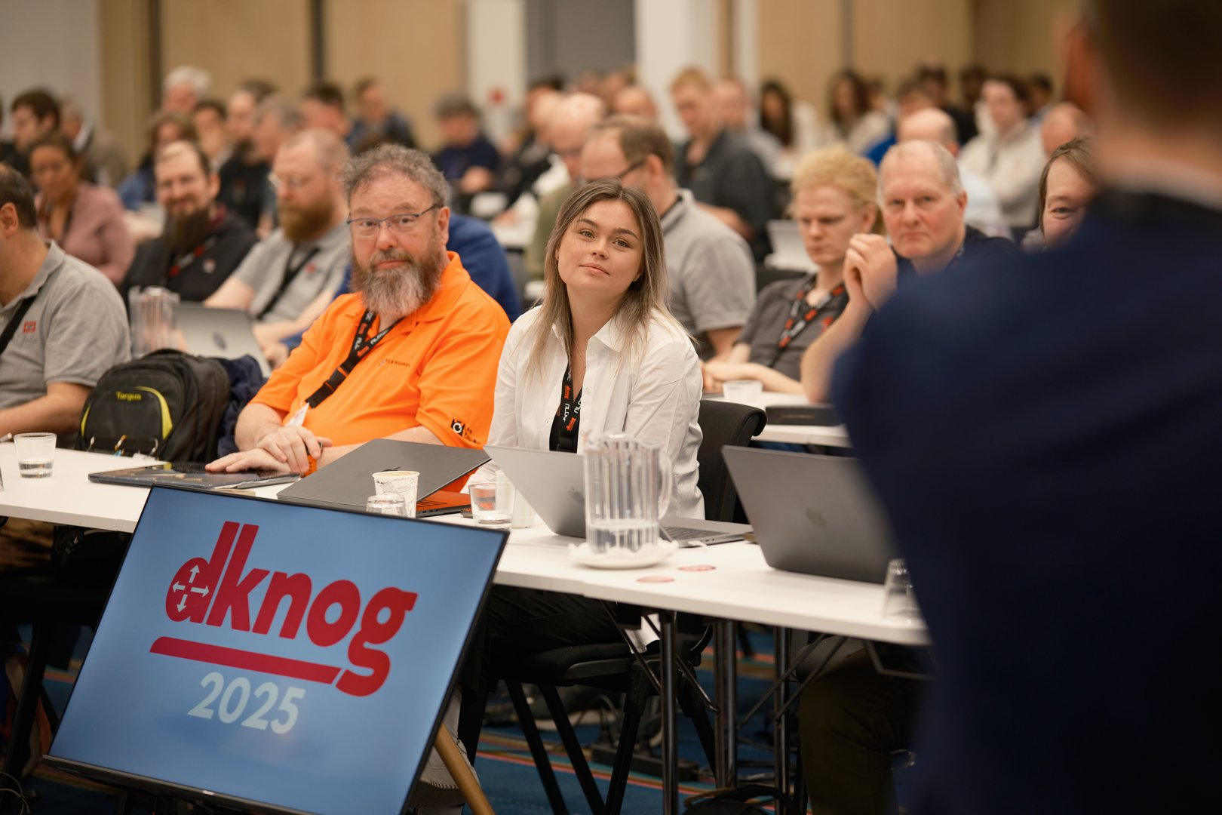
Fearghas McKay

Slide 15
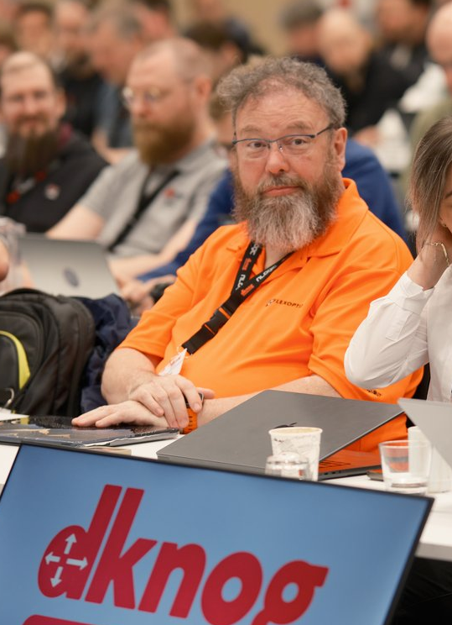
Fearghas McKay
To fearghas (verb):
To bring two people together, who were not aware that they would both benefit from meeting.
Example:
I knew noone at the conference, but then I was fearghased up with some really interesting people.

Slide 16

Be like Pacman
Fearghas

