Slide 1
Slack / IRC channel
IRC: #dknog on OFTC (irc.oftc.net)
Slack: Sign up at slack.dknog.dk
Join the chat

Slide 2
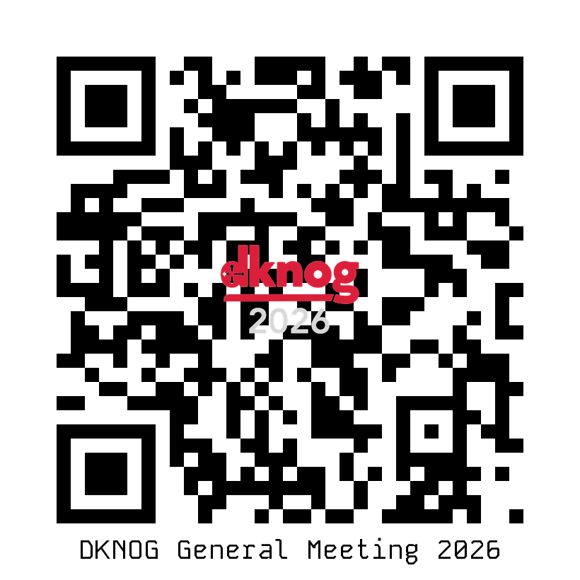
DKNOG General Meeting Save the date: May 27th

Slide 3
Remember to fill out the surveys
Rate talks, and give feedback to make DKNOG better!
https://events.dknog.dk/event/35/surveys/

Slide 4
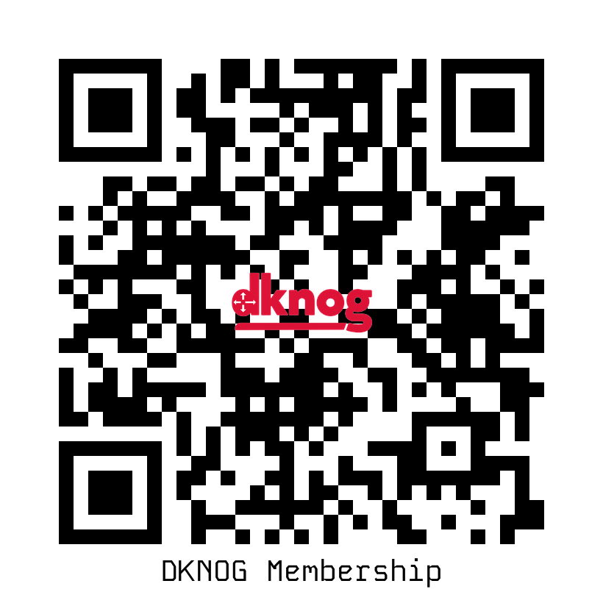
Forgot to register during sign-up?
Join our association

Slide 5
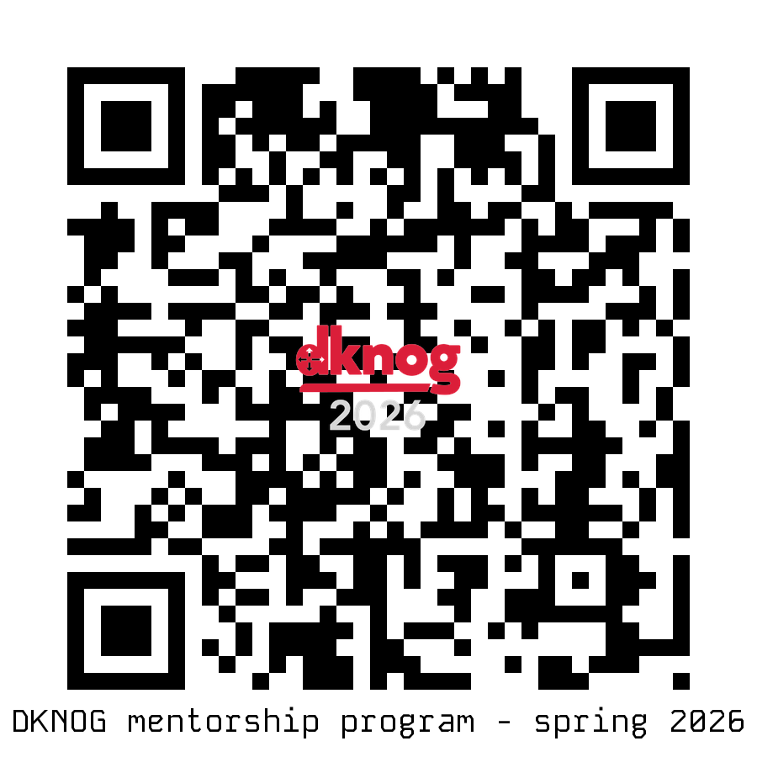
Interested in our mentorship program?

Slide 6
Thursday's social
18:00 at CPH Conference @ DGI Byen
Tietgensgade 65

