Slide 1
Announcements

Slide 2
Announcements
General meeting 2026
Mentorship program
DKNOG BOFs

Slide 3
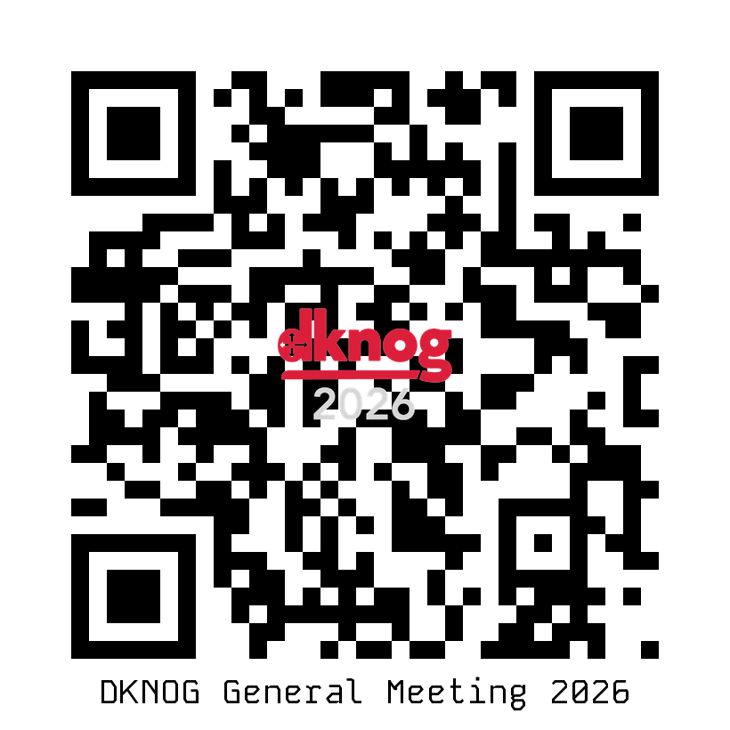
General Meeting 2026
DKNOG is driven by member engagement
Please get involved
You don’t have to be a board member to contribute
General Meeting 2026
Wednesday May 27, 2026, 6:00 PM
GlobalConnect office and online
https://events.dknog.dk/e/gm2026
Slack channel: #volunteers

Slide 4
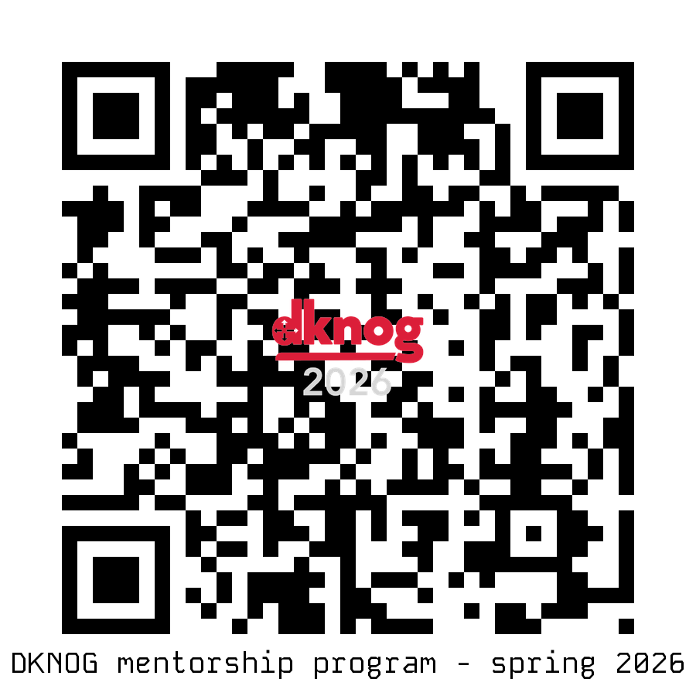
Mentorship program
Spring 2026 – 5th time
20+ mentorships so far
Many signed up several times
Mentor/mentee pairings at all levels
Sign up
https://events.dknog.dk/e/mentorship-2026

Slide 5
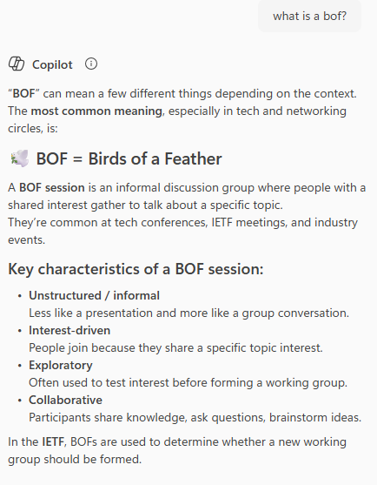
Announcing: DKNOG BoFs
Quarterly series
BoF – ”Birds of a Feather”
Informal gathering to discuss a specific topic
2026
Q1: DKNOG16
Q2: BoF: Coding for the network engineer
Q3: BoF: Practical AI
Q4: <Suggest your topic>
2027
Q1: DKNOG17
Q2: …
Seeking:
Hosts
Large meeting room: 20-40 people
Sponsors
Provide pizzas, sodas, snacks etc.
Topics / presenters
What do you want to discuss?
dknog@dknog.dk
Sign up now!
DKNOG BoF: Coding for the network engineer
Saturday May 30th 10-15
Copenhagen
<Link goes here>

Slide 6
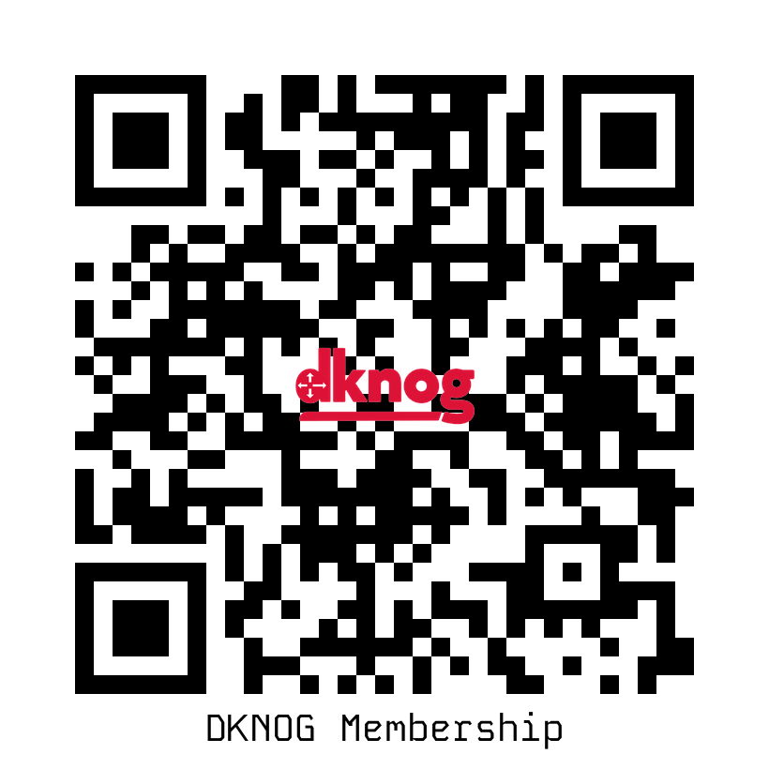
Become a member!
Did you remember to register as a member during the conference signup?
https://membership.dknog.dk/

Slide 7
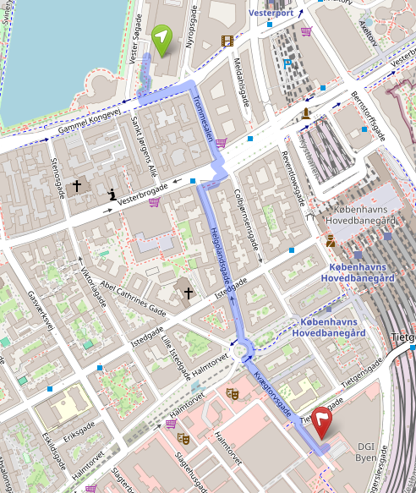
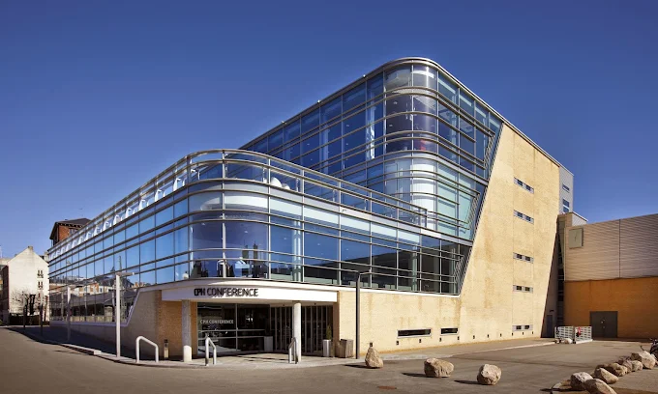
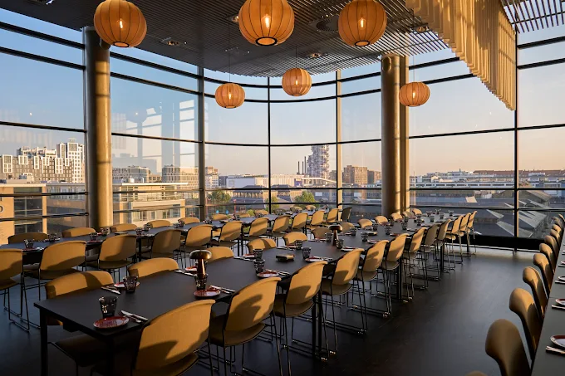
Social 18:00
Dinner and fun!
CPH Conference @ DGI Byen
Tietgensgade 65,
1704 Copenhagen V

