Slide 1
Automate what makes sense
Data, principles and practice
Or The Gentle Art of doing something that is ”Safe”, “Correct” and “Done”
Brian Jeggesen
brian@netcue.io

Slide 2
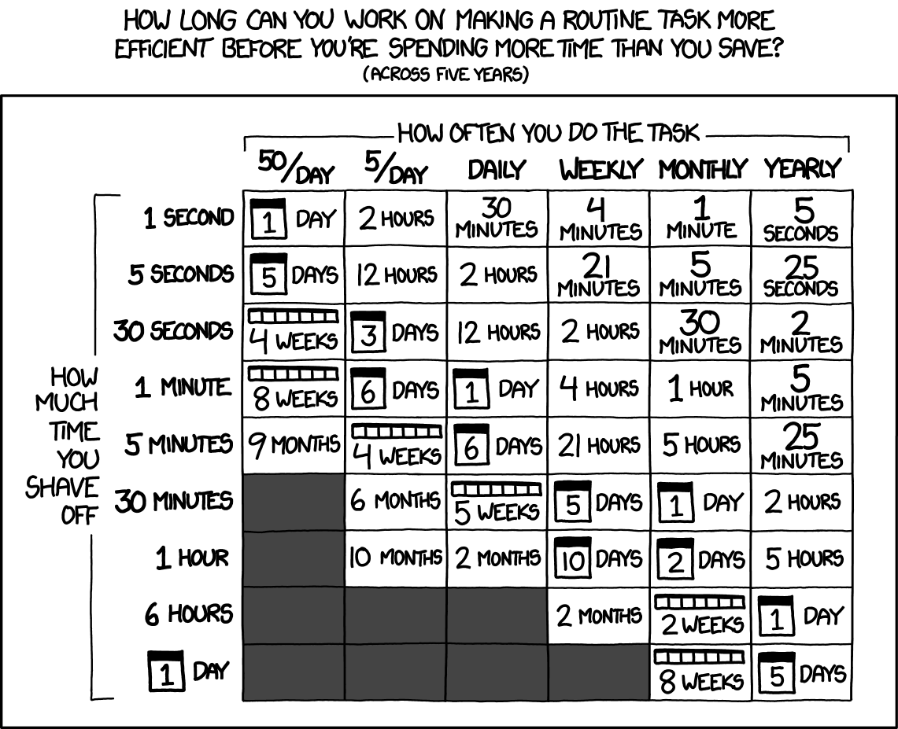
A broken scorecard
Image credits xkcd.org

Slide 3
A broken scorecard
“Don't forget the time you spend finding the chart to look up what you save.
And the time spent reading this reminder about the time spent.
And the time trying to figure out if either of those actually make sense.”
Image credits xkcd.org

Slide 4
The language gap
To change the scorecard, we identify the differences

Slide 5
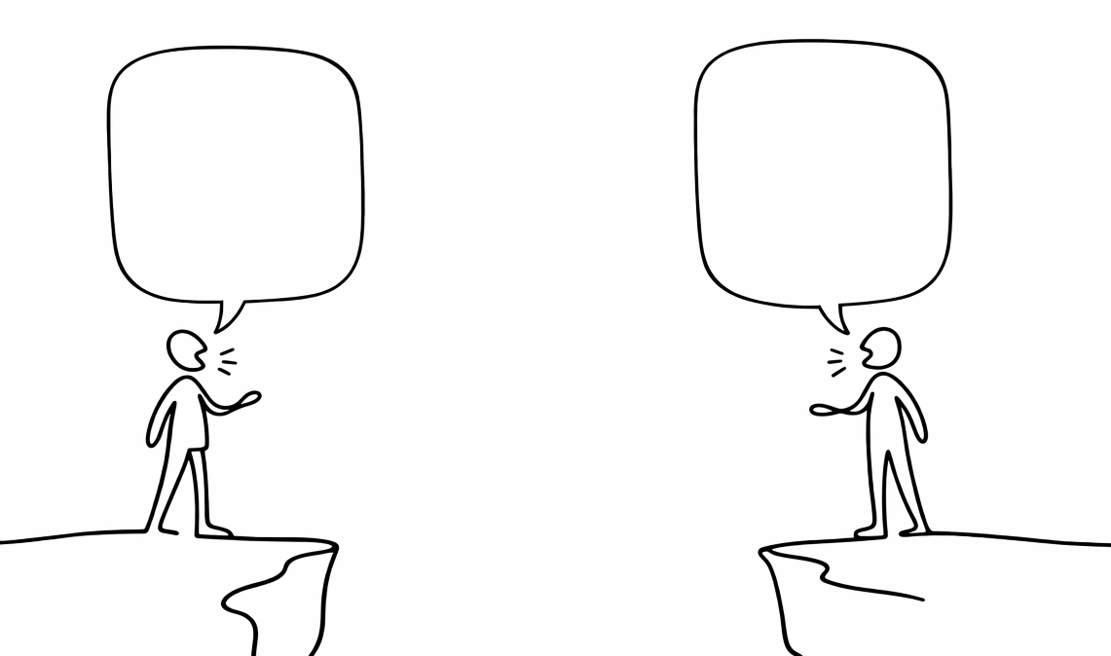
The language gap
conf t
Interface gi0/1
encap dot1q 100
ip add 192.0.2.1 255.255.255.0
no shut
name: interface
Interface: GigabitEthernet0/1
dot1q: 100
ipv4: 192.0.2.1/24
enabled: true

Slide 6
The language gap
Config steps
Stateful
Tribal knowledge
Design docs
Diagrams
Breakfix
Declarative
Deterministic
Idempotent
CI/CD
Git

Slide 7
Trust failure
Every workaround is invisible debt

Slide 8
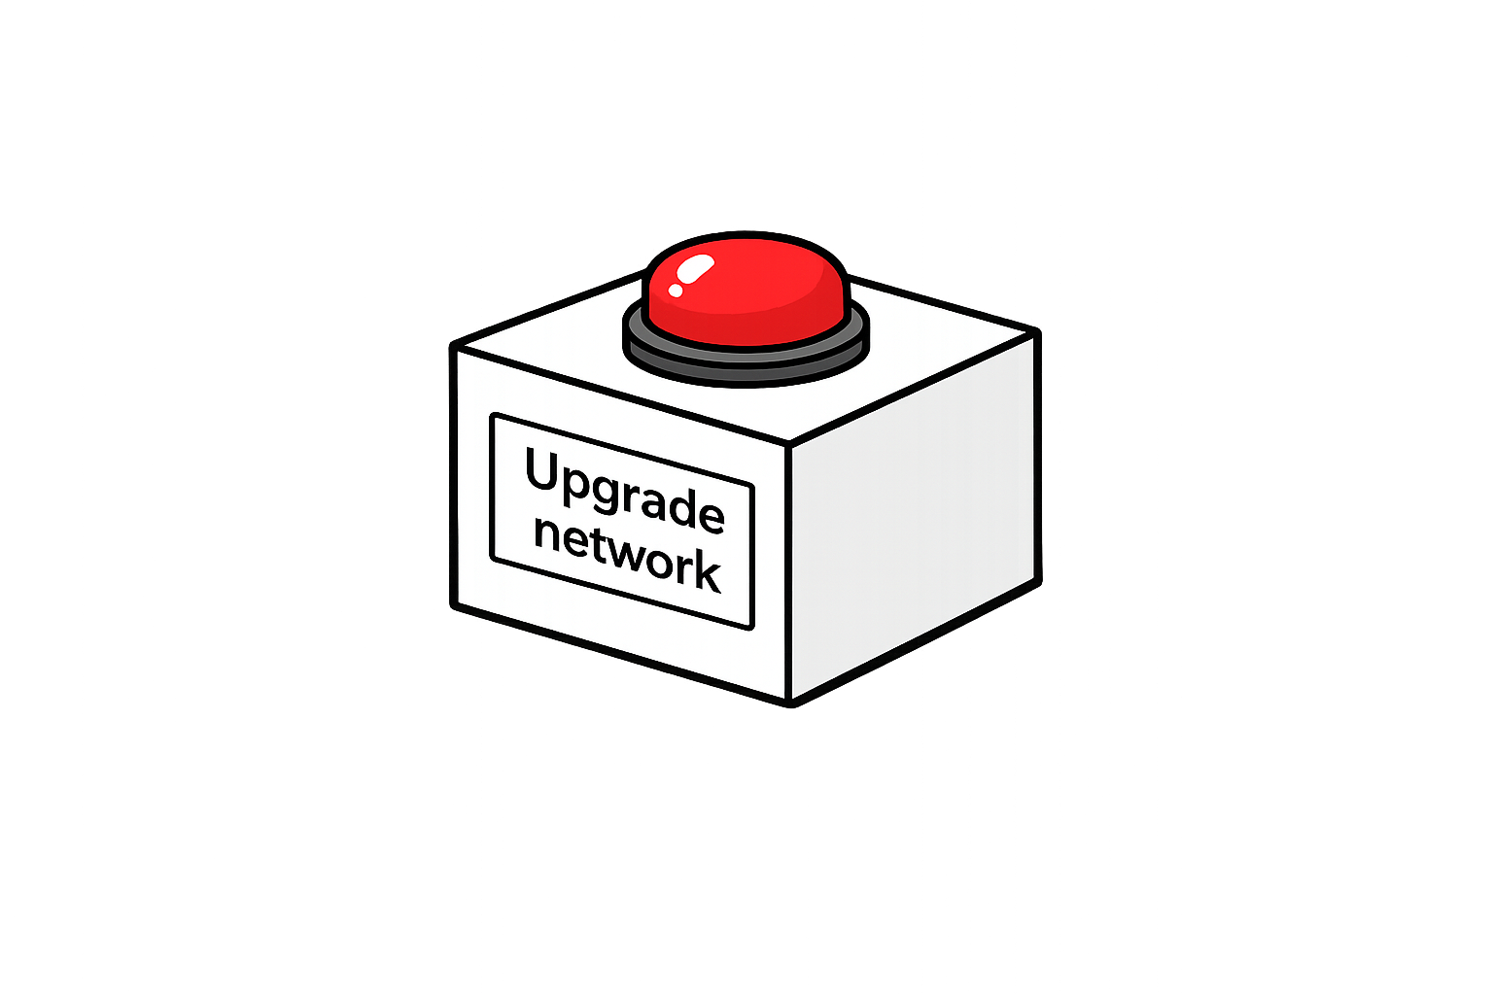
Trust failure

Slide 9
There is no shortcut
Teach network engineers to code
&
Teach developers how to network

Slide 10

Also not a shortcut

Slide 11
Trust is an engineering problem
…so let’s solve it like one

Slide 12
The Trust Bundle
Preview – dry-run / planned diff / versioned
Constraints - guardrails / invalid states impossible
Control – blast radius / staged rollout / circuit breaker
Proof – pre/post verification / meassureable success
Traceability – who / what / when / why
Evidence – outcomes / scorecards / runs

Slide 13
Sort the House
Call it what it is
System of record
Intended state
Observed state

Slide 14


Vocabulary
Networkautomation.forum
Intended State
Orchestrator
Executor
Collector
Observability

Slide 15
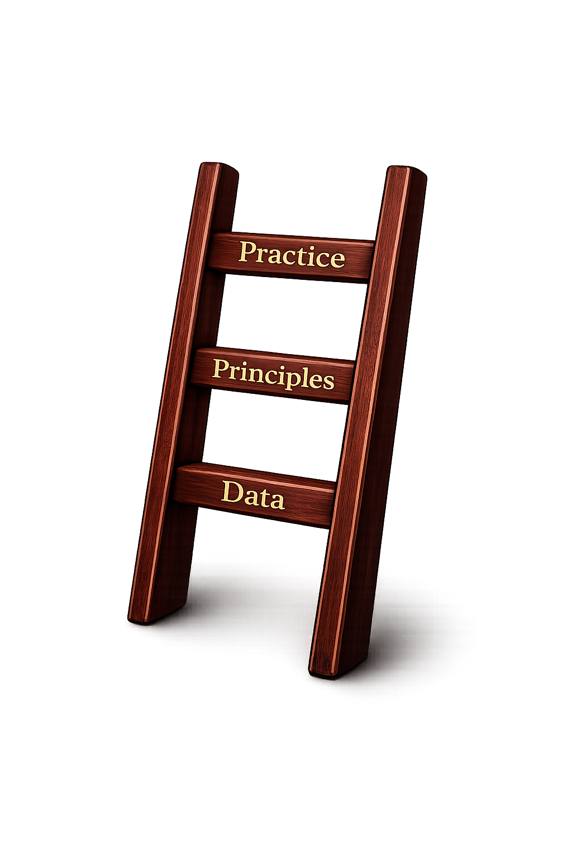
The ladder

Slide 16

One Paved Road

Slide 17
Automate what makes sense
What really makes sense
Brian Jeggesen
brian@netcue.io

