Slide 1
Thanks for coming!

Slide 2
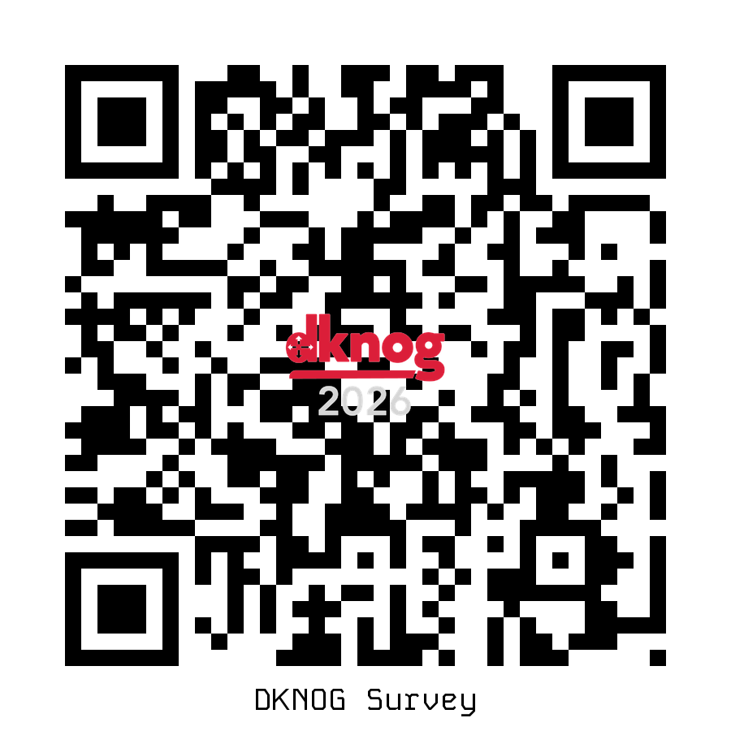
Did you enjoy yourself?
30% are here for the first time
Tell us how we did.
  Survey: https://events.dknog.dk/event/35/surveys/
  RIPE: https://ripe-ncc.typeform.com/NOGparticipant

Slide 3

Sponsors
Platinum

Slide 4



Sponsors
Gold

Slide 5








Sponsors
Silver

Slide 6





Sponsors
Coffee
Associate

Slide 8
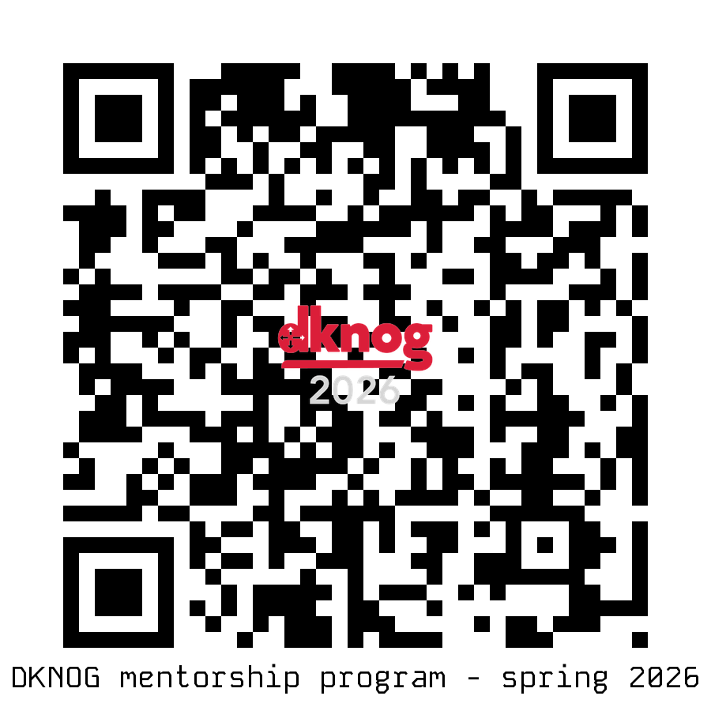
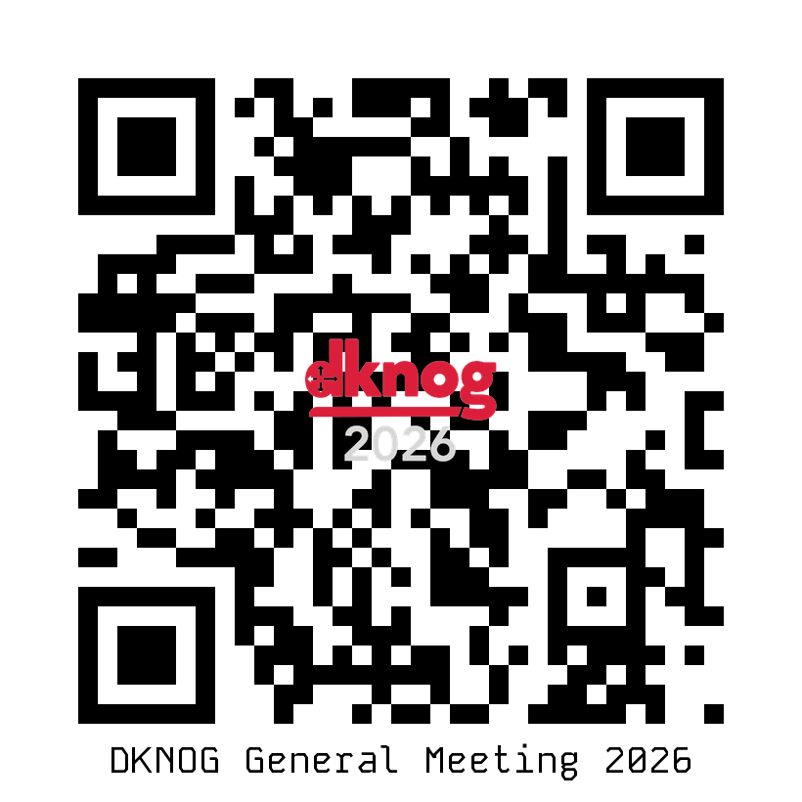
What to do until next year?
DKNOG BOF1: Coding for the network engineer
  Saturday May 30th 10-15
  <insert link here>
Mentorship program:
  https://events.dknog.dk/e/mentorship-2026
General meeting – May 27th:
  https://events.dknog.dk/e/gm2026
Slack / IRC channel
  IRC: #dknog on OFTC (irc.oftc.net)
  Slack: Sign up at slack.dknog.dk
https://events.dknog.dk/e/bof1

Slide 9
DKNOG 17
March 4-5 2027
See you next year!

