Slide 1
Skillsets in A Software-Defined, Disaggregated Machine Learning
Kireeti Kompella
CTO, Engineering
Juniper Networks
March 2019

Slide 2
Introduction

Slide 3
Distributed/Centralized
Networking is inherently distributed
How did you react when SDN was
“unveiled” with the pronouncement:
Now, networking is centralized!
Surprise: “Has the world gone mad?”
Resistance: “This is just stupid”
Indifference: “Whatever”
Joy: “At last!”
Zen calm: “Breathe …”
My initial reaction: Rebellion — “this goes against everything I’ve learned”

Slide 4
A Learning Moment
But then, (not soon, not calmly, but eventually) the thought comes: let’s look at this objectively
There are functions that could (should) be centralized
There are functions that may be centralized
Others that must be distributed, even localized
We see it today in the “battle” between cloud and edge compute

Slide 5
Cloud Edge Compute
Centralize
The pendulum keeps swinging!
Path
Computation
PCE
Centralize
Image Modeling: Massive data crunching
CP
DP
RSVP-TE
FRR
Distribute
Partially
Distributed
Distributed
Object/Face Recognition

Slide 6
Seize the Opportunity
Don’t learn only when forced to
Actively create opportunities to learn
Learning should be a welcome challenge
Learning keeps you engaged
Two lessons here:
New ideas to absorb
Changes to adapt to
Software: in a network near you
More: you have to play with it!
If you can, your life gets easier …
If you can’t …
Machine Learning:
coming to a network near you!
Human Learning must win!
You may not have a choice :) :)

Slide 7
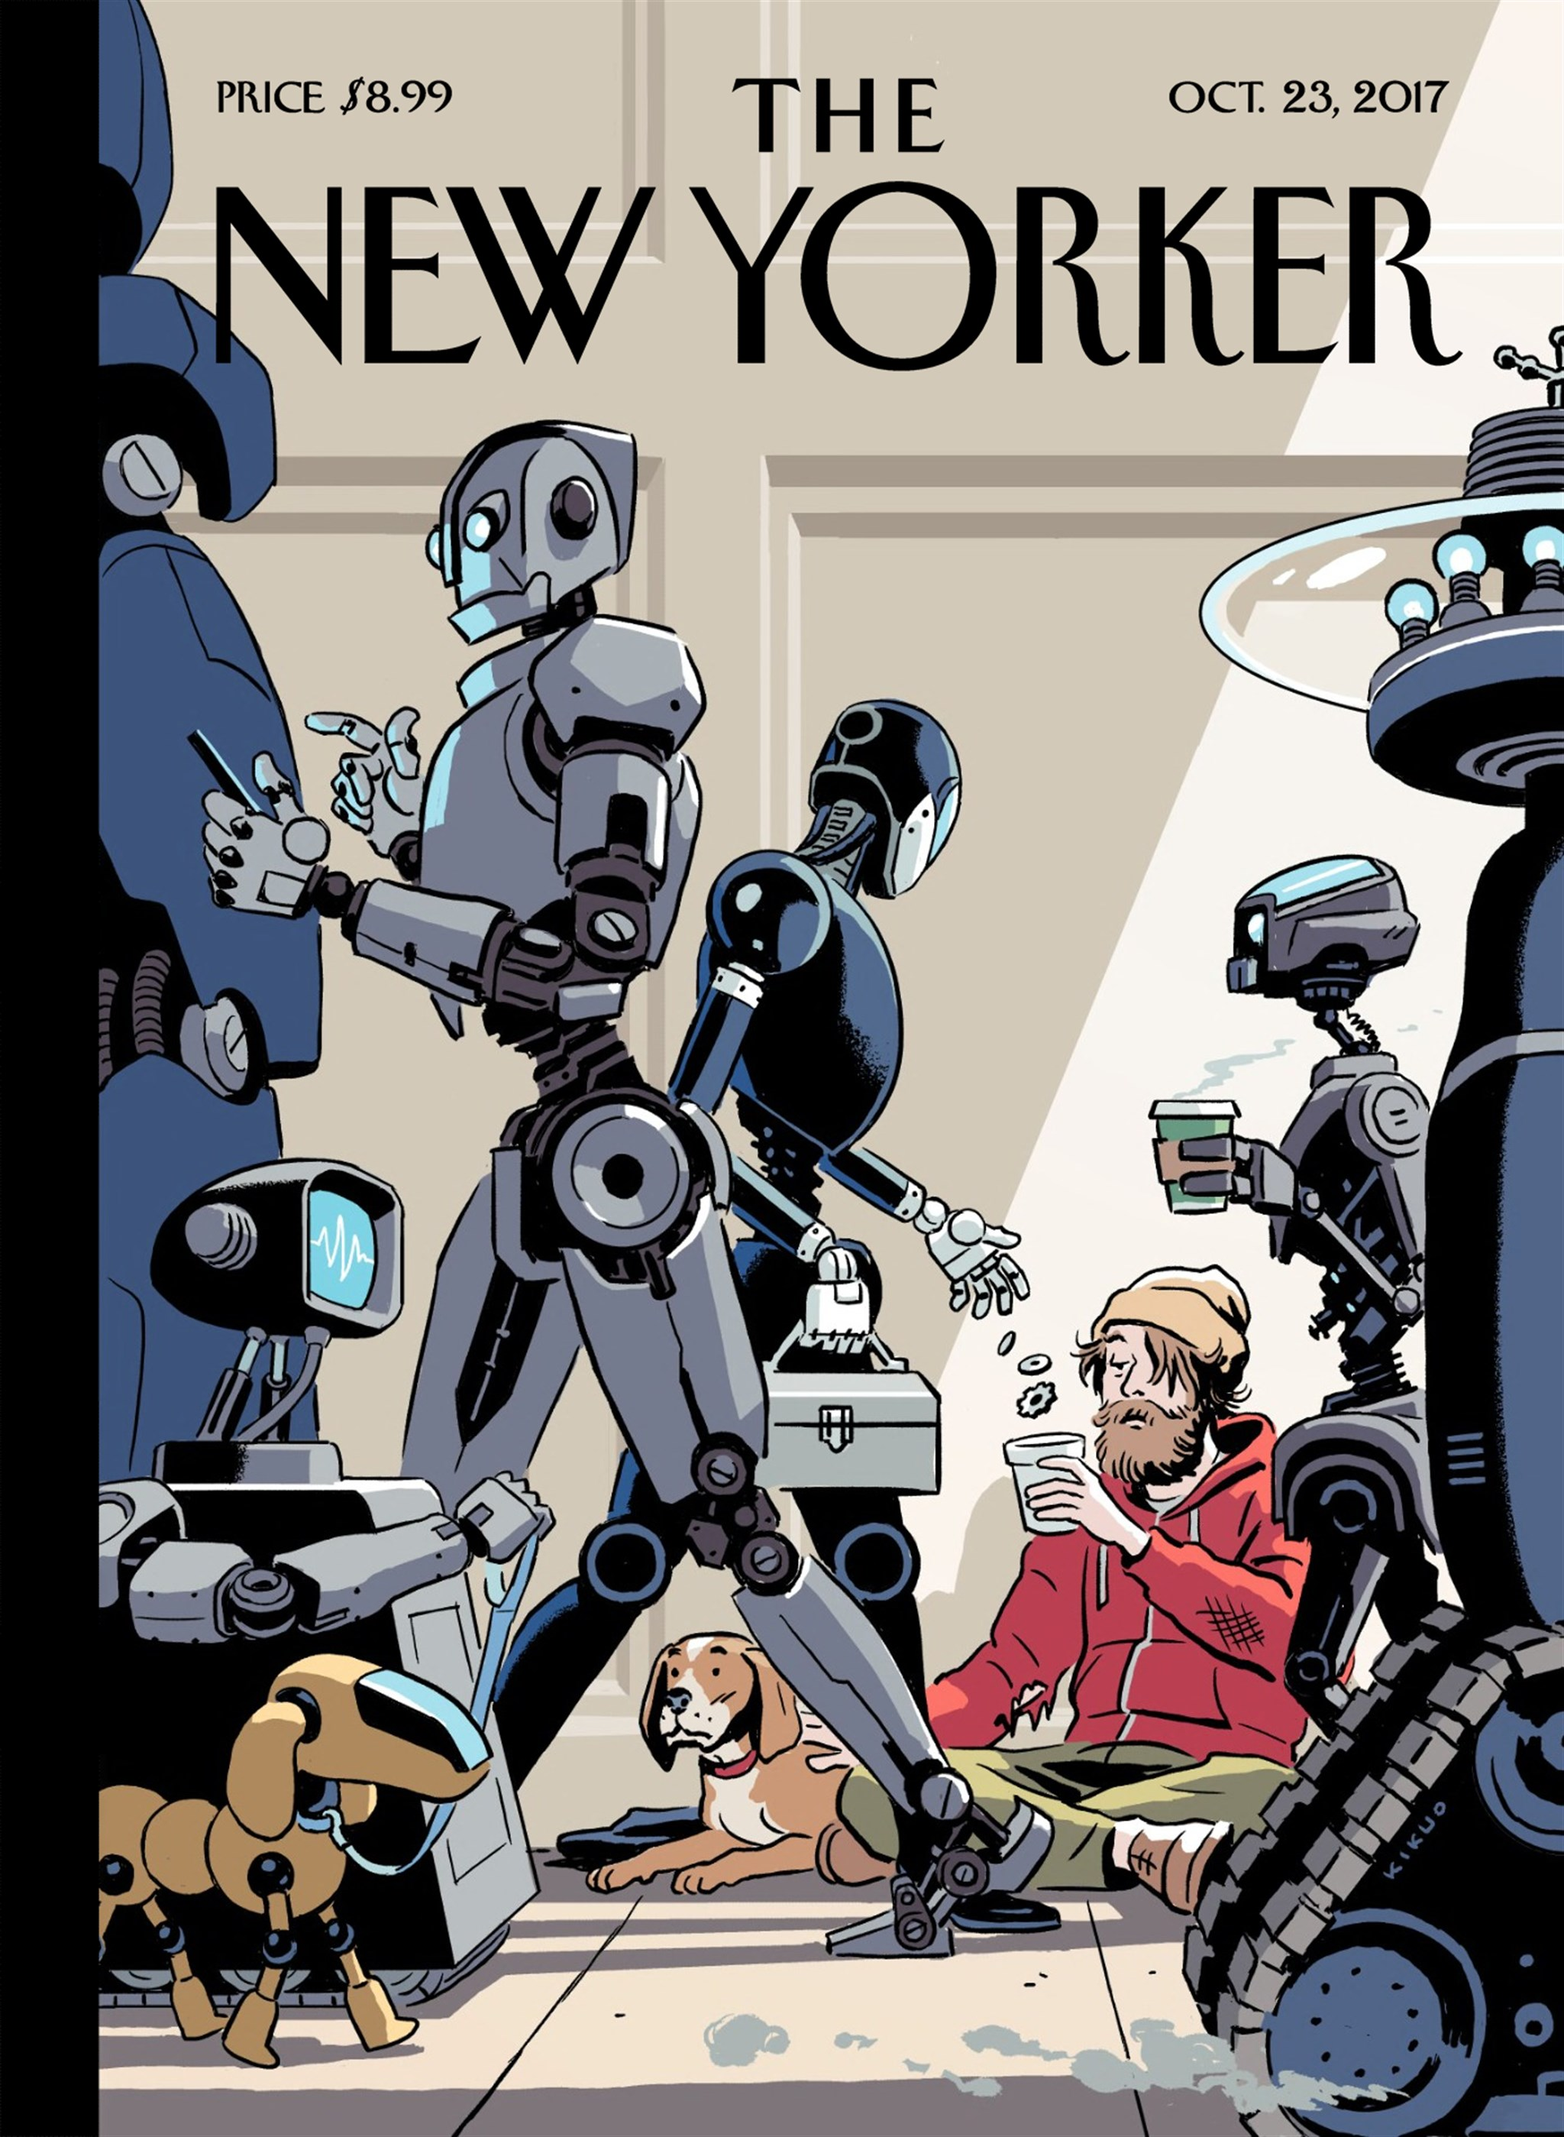
Situation Analysis
“Tech Support,” the New Yorker, 2017
Will robots replace all manufacturing jobs? All physical jobs? All cognitive jobs?
“The Rise of the Robots,” Martin Ford
Are humans still relevant to job scene? If so, what skills do we need going forward?
“21 Lessons for the 21st Century”, Yuval Harari
Specifically, what skills do network operators need? How do we acquire these skills? How do we train the next generation of netops?

Slide 8
Basics – these don’t go away!
Networking Theory & Algorithms
Protocols & Parameters
Devices & their quirks
Network OSs & their quirks
Network services
This all we know (and )!

Slide 9
SDN/Software/ Programmable Everything

Slide 10
Software: It Makes the Hardware Go
Software
Hardware

Slide 11
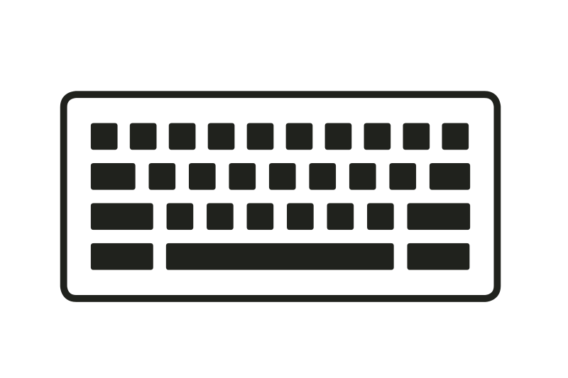
Systems: Black Box
CLI
(better)
Wonderful;
very secure;
rather boring
Ah, entryways: what have we here?

Slide 12
Programmable Network Software
API
Mgmt Plane
Control Plane
Data Plane
APIs offer a good compromise between DIY open source and black-box closed source

Slide 13
Programmable Management
Configuration is no longer CLI-centric – it’s API-centric
netconf, RESTconf, OpenConfig
Telemetry is no longer SNMP-based – it’s real-time, streaming
OpenNTI, OpenConfig, streaming syslogs: visualize things!
Automation frameworks have come to network management
Chef, Puppet, Ansible, PyEZ, RubyEZ
IFTT programming for simple rule-based EDI
Network bots with customizable playbooks (more later)

Slide 14
Programmable Control Plane
Many network OSs have APIs
The Junos Extension Toolkit (JET) has been around for a long time
Very powerful SDK for writing new control plane “apps”
Was used to write a PCE client on the router (before Juniper shipped their own)
“Programmable” rpd (routing protocol daemon) allows you to (for example) change BGP path selection algorithms/metrics
Potential for other behavior changes (e.g., the IGP)

Slide 15
Programmable Data Plane
OpenFlow was big not so long ago
“OpenFlow = SDN”
“The Future of Networking; the Past of Protocols”
P4 is the Next Big Thing
Much more powerful, more pragmatic
Other infrastructures for programming the data plane exist
Juniper has our own – “Advanced Forwarding Toolkit”
AFT will be the interface between CP and DP in new systems
Potential for offering an API to change forwarding behavior

Slide 16
Writing Software
Writing and changing control plane programs/apps is not for everyone: “with great power comes great responsibility”
Again, there’s the challenge of maintaining and supporting it
Writing/changing data plane behavior perhaps more so
Mgmt Plane
Control Plane
Data Plane
API
Easier
Riskier
API
API

Slide 17
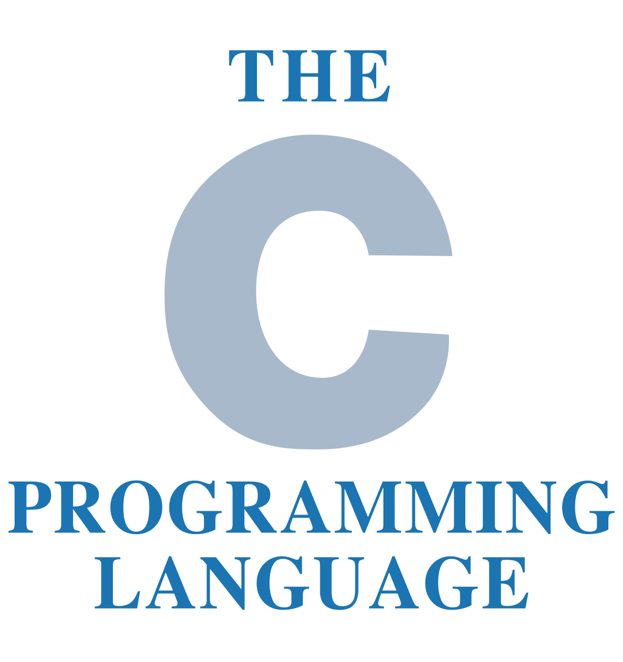
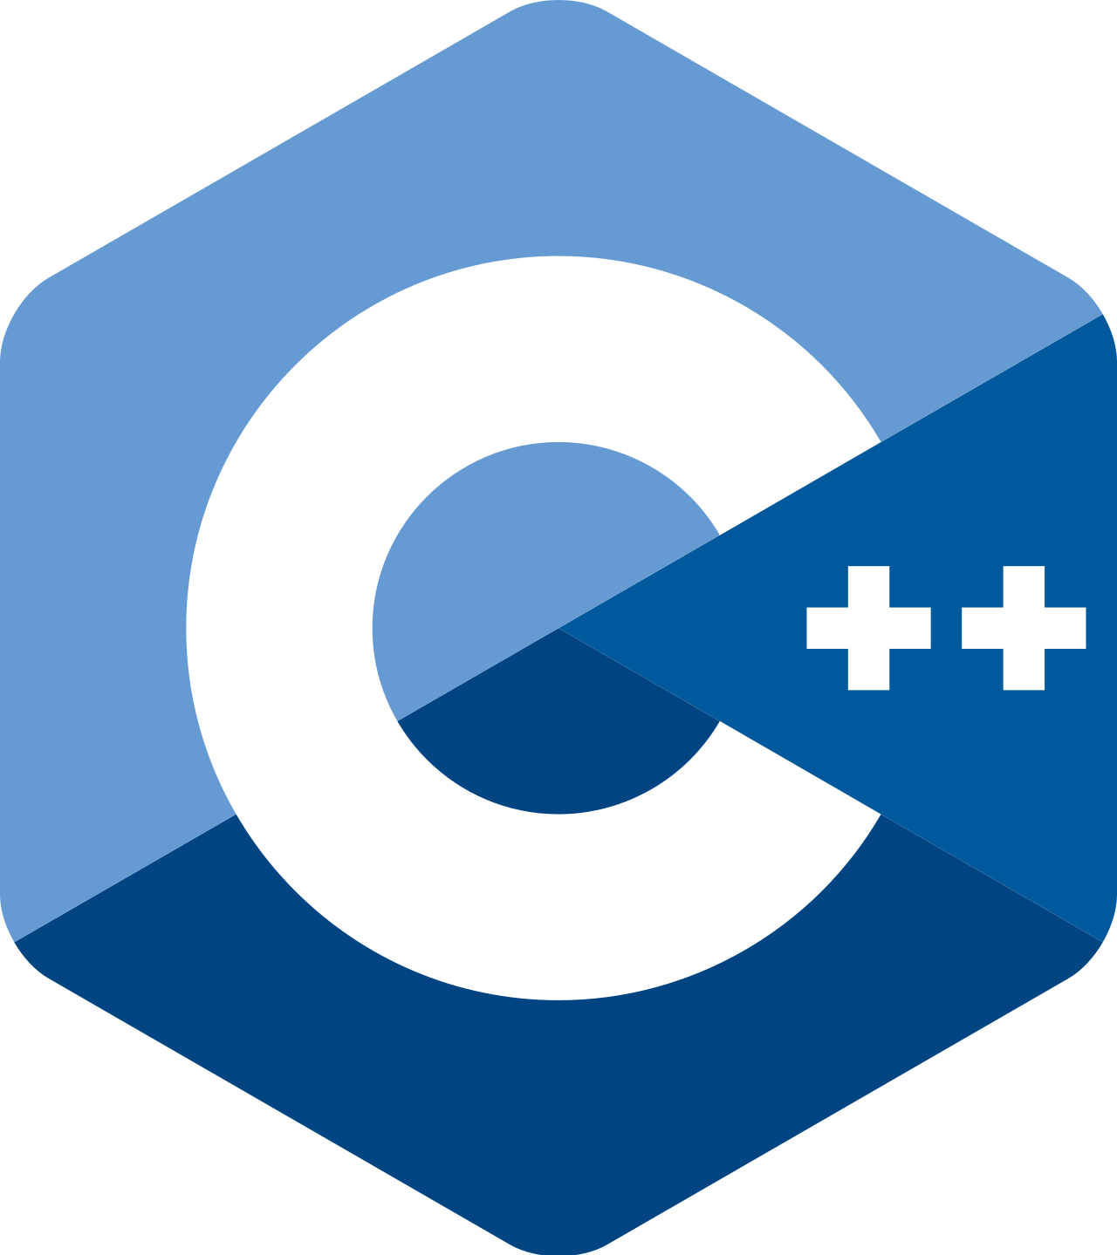
Programming Languages
PyEZ
RubyEZ
What about a “Domain-Specific Language”?

Slide 18
Scripting
Short, easy-to-understand programs
Generally simpler tasks in a more contained environment
Management plane operations can often be scripted
If written modularly, can form “lego” blocks
Very important tool in tool chest
PyEZ and RubyEZ are libraries for easier management
Frameworks like Chef, Puppet, Ansible, SaltStack also allow scripting for configuration management and automation

Slide 19
DSLs
Domain-specific languages are tailor-made for a specific domain
Constrains the field of play
Can get straight to the point
Two examples:
SLAX for commit scripts, event scripts, op scripts
Playbooks for network bots (HealthBot, PeerBot, …)

Slide 20
Automation
Usual target of scripting
Mundane, repetitive tasks ➔ scripts
Dangers
Bounds — guard rails
Human-driven
Event-driven
Good place to be!

Slide 21
Disaggregation

Slide 22
monolithic system → Composable UNITS
Mgmt Plane
From Different Vendors!
Control Plane
Data Plane

Slide 23
Skillsets for Disaggregation
Mgmt Plane
From Different Vendors!
Control Plane
Integration
& Testing
Data Plane

Slide 24
Not Just a CAPEX Play
even
Much of the rationalization for disaggregation seems to be around CapEx
But it may not win from a TCO point-of-view
However, it offers a degree of freedom, flexibility and customization that is hard to get from a single vendor
Think NFV-style, but with either physical or virtual network functions
But hiring the right folks, developing their skillsets, and putting in the work is necessary to reap the benefits
Outsourcing the integration and testing may not give full benefits

Slide 25
MACHINE LEARNING

Slide 26
Machine Learning
Machine Learning is a major change in paradigm
Instead of painstakingly giving a literal-minded computer explicit instructions …
… you give it (hundreds of) millions of samples of training data
… and it teaches itself what to do
A sample is a <situation, answer>
e.g., <image, whether or not this is a cat>
This is Supervised Learning
There is also unsupervised
and “semi-supervised” learning
And many other types of AI/ML

Slide 27
Living & Working with AI/ML
ML brings with it many viewpoints, many reactions
What is its impact on jobs? On society? On the human race?
Will AI/ML allow humans to reach their full potential?
Or take away their meaning in life?
What kind of AI/ML should we be researching?
Do we need the “Three Laws of AI” (à la Asimov)?
Is the genie out of the bottle? How should we proceed?

Slide 28
Know Your Enemy (friend/slave/tool/…)
Amazingly powerful
Limitations
Opaque & un-understandable — Explainable AI?
Blind, goal-seeking — Ethical AI?
No “common sense” — but will that change?
Easy to fool — adversarial techniques
Three-year-olds can do much better in most things
Many styles of ML; many, many ML algorithms; many, many toolkits; many, many parameters/hyperparameters
Lots of Black Magic!

Slide 29
Usable ML
If you write ML applications, make them usable
Allow non-specialists to modify their behavior
Give users feedback on what’s going on
If you are a (power) user of ML, insist on:
Transparency, debuggability
Tweakability
You don’t want to start from scratch
at the same time, you don’t want to be stuck with what you’re given

Slide 30
Control Loops
ML makes “self-driving” possible
This means control loops
“Autonomous X” means a transfer of autonomy of controlling X from human to machine
Sometimes, a partial transfer of autonomy is dangerous
Who’s in charge? Can the change of control be done seamlessly?
In networking, though, this is indeed possible

Slide 31
Self-Driving Network™ Five steps towards the long term vision
YOU SHOULD BE HERE
All processes with closed loop automation
YOU ARE HERE
EDI
Automatic service placement
Self Healing
Intelligent Peering
?
SELF-DRIVING NETWORKSTM
OR HERE
?
Health Monitoring Capacity planning
Resource monitoring
Security
5
AUTONOMOUS
PROCESSES
?
Streaming telemetry
Telemetry collectors
prpd
4
ANALYTICS
NETCONF/YANG
Automation frameworks
JET API
OpenConfig.
ZTP
3
FINE GRAINED
MONITORIZATION
Minimal human intervention
Intent based declaration
Autonomous vs. automated
Fully Event driven
2
CLI
SNMP
AUTOMATED
NETWORKS
Network decisions powered by analytics
Deeper insight
Visualization
Automated response to most events
MANUAL
NETWORKS
1

Slide 32
So, Software-Defined, (Disaggregated) Machine Learning?
Yes, it can be done – it’s being done

Slide 33
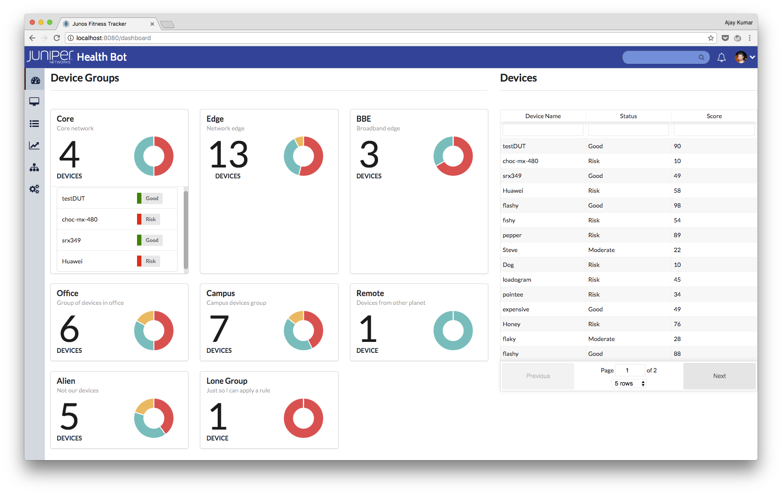
Enabling customizable closed autonomous loops
Playbooks
Define
1
n
Human
Playbook
GUI access
Playbook
Playbook
m
Machine
Programmatic access
3rd party analytics apps
Visualize
MGD
Act
5
Netconf
REST API
Python
…
7
User Defined Functions/Actions
API Server
Store
3rd party provisioning
Rules Engine
3
Notifications: slack, email, web hook,…
Time series DB
Notify
6
Analyze
Kafka publish
4
Kafka pipeline
Ingest layer
Telemetry Infra
JTI
OC
Net- conf
CLI
Sys log
SNMP
Collect
2

Slide 34
Conclusion
Life is exciting again!
So much to absorb, assimilate, integrate
New capabilities: programmatic network layers
New modes of operation (scripting → automation → EDI → SDN2)
ML brings new capabilities, new challenges and new techniques
Learning is a must (and a privilege!)

Slide 35
Thank You!

