Slide 1
DKNOG General Meeting 2019
IRC channel: #DKNOG
Server: irc.oftc.net
https://dknog.dk/about/irc-channel-guidelines/
Join the fun.

Slide 2
Report from the board

Slide 3
The past year we …
Registered the DKNOG association as a legal entity.
CVR-number
Got our own bank account
now we’re finally completely independent from PROSA.
Signed with an accountant to fullfil legal requirements
Quarterly VAT-reports
Annual financial statements
Had an AWESOME DKNOG9!

Slide 4
DKNOG 9 in review
Same venue and format as DKNOG8
Park Inn by Radisson
Two-day single-track format
Broke attendee records – again!
Great participant feedback
This year we gave away ten free student tickets.
Separate organizers committee and programme committee.
Huge thanks to all the volunteers making DKNOG 9 happen!

Slide 5
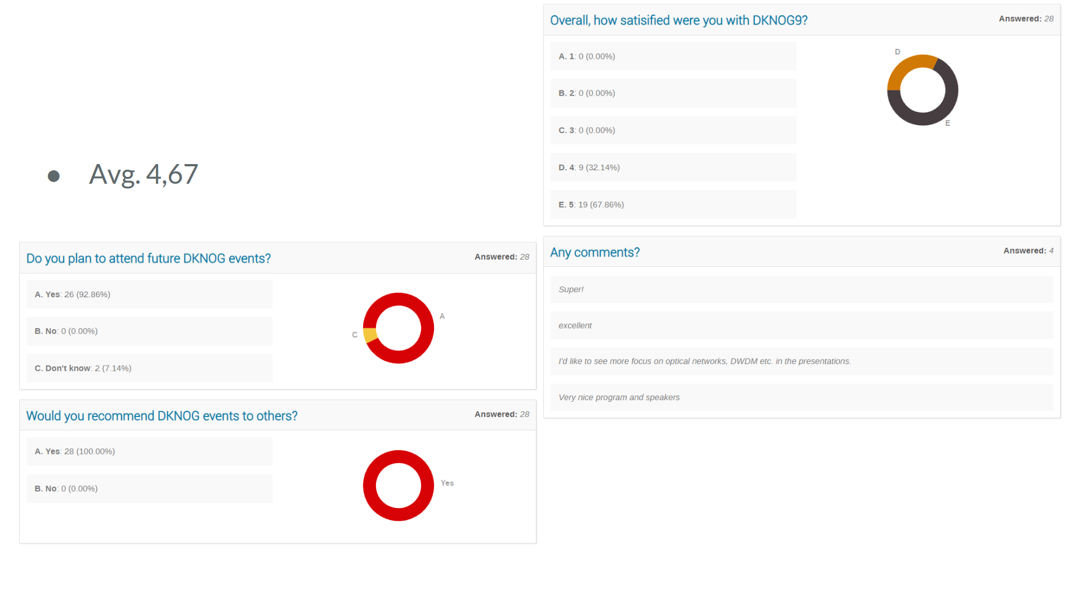
Overall feedback DKNOG9

Slide 6
Financial report

Slide 7
DKNOG9 cashflow
Income |  | Expenses
Ticket sales | 118.347,64 | Hotel incl. streaming | 297.402,50
Sponsorships | 500.465,70 | Social | 129.500,00
Missing payments | 60.625,00 | Other | 48.925,40
 |  | VAT payment | 39.442,00
Total | 618.813,34 | Total | 515.269,90
Result | 103.543,44

Slide 8
IRC channel: #DKNOG
Server: irc.oftc.net
https://dknog.dk/about/irc-channel-guidelines/
Join the fun.

