Slide 1
Kea - Modern DHCP
Peter Davies
DKNOG
https://www.isc.org

Slide 2
ISC DHCP
Kea
Photo by Amir-abbas Abdolali on Unsplash
Notes:
History - New Kea server was originally part of the BIND 10 project. was intended to be part of an application suite, including DNS as well as DHCP.
This project was all about the open REST API. Also, db backends.
To answer why we have two servers now, look at the requirements.

Slide 3
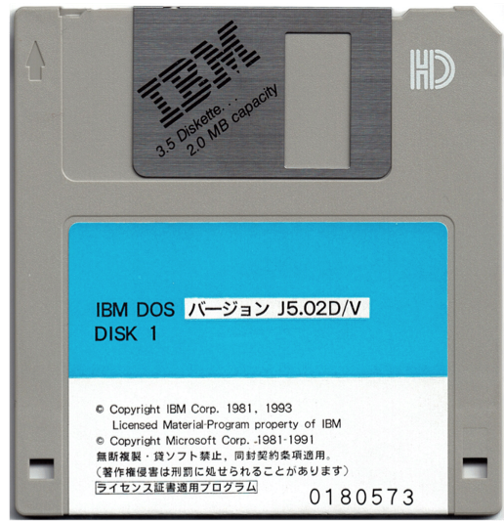
When ISC DHCP was developed
Networks were static
No shortage of addresses
DHCPv6 hadn’t been invented
Everything was wired
No cellphones, no laptops
Client devices were provisioned centrally, by scanning a bar code
Notes:
ISC DHCP is about 30 years old. First commit in 1995??
When ISC DHCP was Developed:
Networks were fairly static
Hundreds, maybe thousands of devices – but typically only one device per user
No shortage of addresses
relatively few servers, very static
bringing up a new server was a big deal
DHCPv6 hadn’t been invented
Everything was plugged into 10b-T
Client devices were provisioned centrally, by scanning a bar code
dhcp server configuration was manual
It may have been a bother, but it was definitely feasible to manage manually
Servers used bootp

Slide 4
Modern Networks
BYOD, roaming, WIFI
Cattle not pets
Clouds, fabric, NFV, SDN, Devops, continuous provisioning
Containers
Automation
Photo by Ari Spada on Unsplash
Notes:
Networks have changed substantially since then
Devices are more mobile - BYOD, roaming, WIFI
Many devices per user
May interfaces per server, many addresses per server
Applications are deployed in clouds (servers are now cattle not pets)
Network Function Virtualization (SDN, NFV, whatever the buzzword, it is not about a vendor product, it is about building blocks of network functions)
Containers (software is likely to be deployed in containers)
Automation (everything has to be automate-able, in order to scale up and down, be deployed rapidly)
You are challenged to keep up with the rapid pace of change, and you need tandardized provisioning methods, formats, and tools

Slide 5
ISC DHCP
Proprietary format configuration file
Local lease database
Designed to be restarted with every configuration change.
OMAPI was added on
DHCPv6 was added on
Notes:
Self-contained – local proprietary format configuration file
Local lease database
Many features added over time
Fixed option inheritance, flexible classification language
Designed to be started with the running config file. OMAPI was added on
DHCPv6 was added on. For example, when you boot up ISC DHCP it allocated memory for all of its addresses in advance -
Most changes required restarting the server.
OMAPI allowed you to add sub-classes without restarting, which encouraged a lot of people to rely heaviliy on complex client classification schemes to permit on-line configuration changes.
It is very difficult to reverse-engineer an ISC DHCP configuration file – to determine what the original administrator was trying to accomplish with classification.
In DHCP 4.3.0 we added a number of DHCPv6 features, but considering this hadn’t been invented when ISC DHCP was first written, there are some features we couldn’t and won’t be able to add.

Slide 6
Modern Network Services
Standardized formats & tooling
Everything needs a web api
Plan for automated, continuous provisioning
Deploy capacity quickly with VMs
Extensible, programmable
Notes:
We tried to address the requirements of modern networks with Kea
Standardized formats for configuration
Kea assumes you will be doing continuous provisioning, and provides several features to facilitate that
Where ISC DHCP had OMAPI, Kea has a REST ful api
Deploy capacity quickly with VMs
Extensible, programmable

Slide 7
‘Modern’ Kea features
Open, JSON file format
Local and remote access
Configuration DB, host DB for controlled automated provisioning, scalability
Designed for v6 - HA for v6 as well as v4
Extensible with hooks
Notes:
Kea features that are better suited for modern networks include
Open, std configuration file format
Separate leases file, can be remote
Designed for v6 - HA for v6 as well as v4
Configuration DB for controlled automated provisioning, scalability
Extensible with hooks

Slide 8
Local & Remote access
REST API
local - on machine
JSON over http(s)
JSON over UNIX socket)
ctrl-agent
{
“command”: “list-commands”,
“service”: [ “dhcp6” ]
}
JSON in, JSON out
Many available tools
jq
jsonlint.com
jsonviewer.stack.hu
Command
{
"arguments": [
"build-report",
"config-get",
. . .
],
"result": 0
}
Response
Notes:
In contrast to the OMAPI interface in ISC DHCP Kea has a rich and powerful mgmt interface.
You can use socat tool (available in all Linux distros) to talk to Kea over local unix socket if you want to keep the mgmt interface local and secure (you can ssh into the boxt first). You can set up a CA that will expose one or more Kea servers via easy to use remote REST API interface. The interface is super easy to use. The command box above shows how to send a command.
You just specify what (list-commands) and who (“dhcp6”). The response will come from the right server. Commands can take tons of parameters, but this gives the overview.

Slide 9
Standard format ≠ Standard data model
YANG models not standardized for DHCP servers, may not be possible
Kea has YANG/Netconf integration via Sysrepo, immature
Notes:
Note that Kea has a standard format for configuration.
This is not the same thing as a standard data model.
YANG models have become popular for routers, fixed networking equipment, but they are not ready yet for applications such as DHCP servers.
Kea has YANG/Netconf integration via Sysrepo, immature

Slide 10
The backend concept
DHCPv4, DHCPv6 server
CSV, MySQL, PGSL, Cassandra
Leases (addresses, prefixes)
Host reservations (per host details)
Options
Pools
Subnets
Shared networks
Option definitions
Global parameters
Lease backend
MySQL, PGSL
Hosts backend
Configuration backend
MySQL
Notes:
The backend concept allows you to separate the data from the dhcp server which is processing that data.
leases change most frequently (1000s times/sec in large networks)
Why might you need to look at active leases? forensics, mostly. you can also INSERT a lease
HOST reservations are changing less frequently (customers are added or removed).
Host reservations are not only for servers.
If you need to specify individual subscribers, say because you are offering a premium service on a per-subscriber basis, you would want to use host reservations. You might want to provision that database directly from some other system that manages subscriber levels, and Kea can read from that.
Network configuration changes more slowly (new subnets are added infrequently). We’ll talk about the configuration backend a bit more.
We support 3 backend options, in addition to the local CSV file option.
We have the most options for the Lease backends. This is where Kea records the active leases.
Host reservations are supported on MySQL and Postgresql.
The configuration backend is supported for MYSQL only.

Slide 11
Backend options
SQL data can be modified any time
No restart
Adapt your provisioning systems to write directly to the database ………or
Use the API (some of these require premium hooks libraries)
Notes:
Users can fiddle with the data directly if they want to (changes to host reservations, leases are picked up instantly, no need to restart or reload). If they DON’T want to, we provide easy to use APIs. For leases, this is implemented in the Lease_CMDS hook, which is in the open source.
We support 3 backend options, in addition to the local CSV file option.
We have the most options for the Lease backends. This is where Kea records the active leases.
Host reservations are supported on MySQL and Postgresql.
The configuration backend is supported for MYSQL only.

Slide 12
Configuration Backend
DHCPv4, DHCPv6 server
MySQL
Manage configuration in DB. Both Pull and Push supported (configurable refresh interval)
Co-locate or remote
Multiple Kea servers can share one MySQL DB
Works when DHCP servers are on-line or off-line
Notes:
I wanted to say here that to use CB kea has to be pointed towards a MySQL database. That DB doesn’t have to be local. This gives various perks and tradeoffs. You can point multiple Keas to the same DB (more on that later), you can have dedicated Kea instance just to manage configuration with “worker” instances to handle the traffic (similar to hidden master in DNS). Also, you can tweak the configuration when the servers are not working. You just need running MySQL.
PULL with configurable refresh interval: config-fetch-wait-time

Slide 13
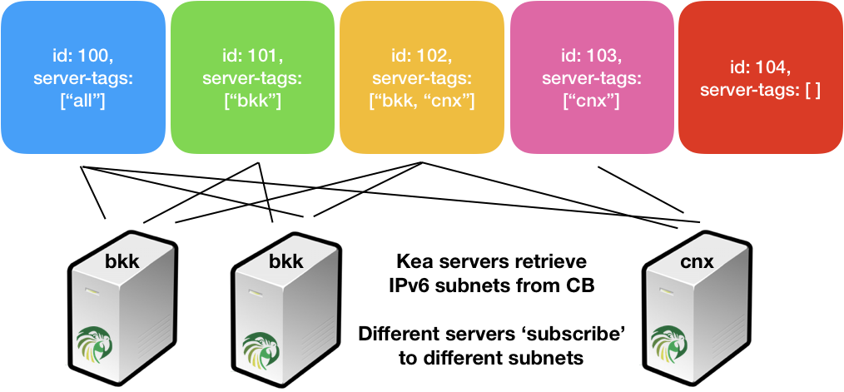
Server Tags
Notes:
After you add configuration elements to the configuration database, you can tag them with server tags.
Server tags indicate which servers should receive these configuration elements.
For example, you may have global options that all servers share, but some pools or subnets that are only used by one or two servers.

Slide 14
sample /etc/kea/kea-dhcp6.conf configuration file
“Dhcp6": {
"config-control": {
"config-databases": [{
"type": "mysql",
"name": "kea",
"user": “kea",
"password": "secret1",
"host": "192.0.2.1",
"port": 3302
}],
"config-fetch-wait-time": 20
},
"hooks-libraries": [{
"library": "/opt/kea/hooks/libdhcp_mysql_cb.so"
}, {
"library": “/opt/kea/hooks/libdhcp_cb_cmds.so"
}],
...
}
DB credentials
refresh interval
CB hook, tells Kea to look at the DB for configuration
CB commands hook, tells Kea to expose REST api

Slide 15
Uses for Configuration DB
Sharing configuration
Frequently changing configuration (options, pools, subnets, shared networks)
Automated deployment
Large configuration (100+ subnets)
Large scale deployments
Notes:
The configuration backend is a powerful feature.
Sharing configuration, one common example of a case in which you want a pair of servers to share configuration is in using Kea’s High Availability Feature. For this you configure a pair of servers, one primary and one backup that need to have the same configuration. When you update the primary, the backup server is also automatically brought up to date.
Frequently changing configuration (options, pools, subnets, shared networks)
Automated deployment. To roll out a new Kea server you have to do very minimal configuration of the network interfaces and the location of the configuration backend, and it will pull down most of its configuration.
Large configuration (100+ subnets)
Large scale deployments

Slide 16
Kea Hooks
DHCP message processing
lookup
User Check
Address Assignment
lookup
Host DB
Active Leases
lookup
Lease DB
KEA Functions
External systems
Notes:
These are the basic functions of a DHCP server.
Kea has open interfaces that enable you to hook in external systems at every step.
For example, during the initial message processing, you can consult an external database to determine if a user is ‘known’ or ‘unknown’ and, perhaps, assign the unknown users to a public wifi network.
During address selection, you can, if you want, consult an external Radius database and have that supply the address for the client. (We don’t recommend this in the usual case, but it is possible.)
Finally, you can write leases to an external database, where you can also add and delete leases with, for example, SQL inserts.

Slide 17
Kea Hooks
You can create a hook library to do almost anything, including writing the response packet
Hook point example: discover packet received, <hook> <return>
ISC Standard open source libraries: Lease Commands, High Availability, Flexible options
Premium libraries: Subnet Mgmt, Host Commands, RADIUS, Configuration backend
Notes:
ISC has some ‘standard’ hooks, but you can create a hook library to do almost anything, including writing the response packet
Hook point example: discover packet received, <hook> <return>
Open source: Lease Commands, High Availability, Flexible/computed options
Premium: Subnet Mgmt, Host Commands, RADIUS, Configuration backend

Slide 18
Kea vs ISC DHCP
 | ISC DHCP | Kea
Performance | OK (with ramdisk tricks) | Multi-threading is in development - prospect of 1000’s of LPS
Management | OMAPI (custom C interface) | JSON over REST API/http, JSON over Unix socket
HA | DHCPv4 failover | HA for DHCPv4 and DHCPv6, multiple options for DB clustering
Extensibility | Shell scripts (out only), configuration language | JSON everywhere, Hooks (C++), stable API
Configuration | Custom complex syntax (almost programming language) | JSON with optional DB storage for some elements
Leases information | Custom | CSV, MySQL, PgSQL, Cassandra
Hosts information | Custom config | JSON, MySQL, PgSQL
Notes:
This slide basically should answer why we’re no longer developing ISC DHCP. A bit of a background (“started in 1995, no IPv6, no conpcet of mobility, large networks were 100 or so desktop computers and 16MB of ram was a lot”). The code is very convoluted and hard to extend. Tricks done to save couple bytes of memory. Refactoring the code would require almost rewriting from scratch. And that’s what we decided to do.
Emphasise that all the data and storage formats are easily exchangable (you can use existing tools, e.g. mysql, pgsql clients, JSON processors, etc.), HA much simpler than failover, works with v4 and v6, ability to have more than just a pair of 2 servers (backup servers).

Slide 19
Why use Kea?
Access to data - Database backends
JSON configuration - many tools Change configuration without restart
REST API
Hooks
Photo by Kelly Sikkema on Unsplash
Notes:
in summary – why might you prefer Kea?
It is going to be supported a lot longer – ISC DHCP is in maintenance mode
If you want access to your network data, you can get it from Kea
Kea is easier to configure, is designed for continuous re-configuration,
and it is possible to automate some of those configuration changes, using Kea hooks modules and api.

Slide 20
Price of Modernity
Overhead of maintaining databases
(and for development, of maintaining separate database interfaces)
Direct SQL manipulation is tricky
Splitting state across the network introduces contention
Network and application access delays
Notes:
Just so you don’t think everything is going to be easy now, there are some costs associated with a more modern architecture.
Overhead of maintaining databases
(and for development, of maintaining separate database interfaces)
Direct SQL manipulation is tricky
Splitting state across the network introduces contention
Network and application access delays

Slide 21
Migrating to Kea
Painful, but possible
Migration Assistant available (for ISC DHCP users)
Configuration only, not leases
ISC webinar https://www.isc.org/presentations/
NANOG’76 talk https://pc.nanog.org/static/published/meetings//NANOG76/daily/day_2.html#talk_1998
Notes:
I won’t kid you, migrating from ISC DHCP to Kea won’t be easy if you have a large configuration file, particularly if a predecessor of yours created it and you aren’t really familiar with what it is doing.
We have recently released a migration assistant, which is a utility that will help you do a partial machine translation of your ISC DHCP configuration to a Kea configuration.
This tool translates configuration, but does not migrate leases.

Slide 22
Where is Kea popular?
Service Provider networks
Access providers (Cable, Fiber)
Greenfield deployments
IPv6 networks
Community Fibre Presentation at UKNOF
https://indico.uknof.org.uk/event/47/contributions/685/
Notes:
Service Provider networks
Access providers (Cable, Fiber)
Greenfield deployments
IPv6 networks

Slide 23
2020 Roadmap
1.7.x
New Open source hook module – Flex Options
BOOTP
Prometheus exporter
Dashboard
1.8.x
Performance improvements
Multi-threading
Notes:
2020 roadmap
Performance improvements
Multi-threading
BOOTP

Slide 24
Stork Dashboard
Configuration inspection
subnets, pool, shared networks (per server, aggregated list)
filtering/search mechanism
Focus on features Grafana can’t easily do
Display pool utilization (total, pool, reserved, in use)
HA/Failover status
Health status:
CPU/mem utilization
Uptime, time since reconfig, version
# of queries
Response time
May 2020

Slide 25
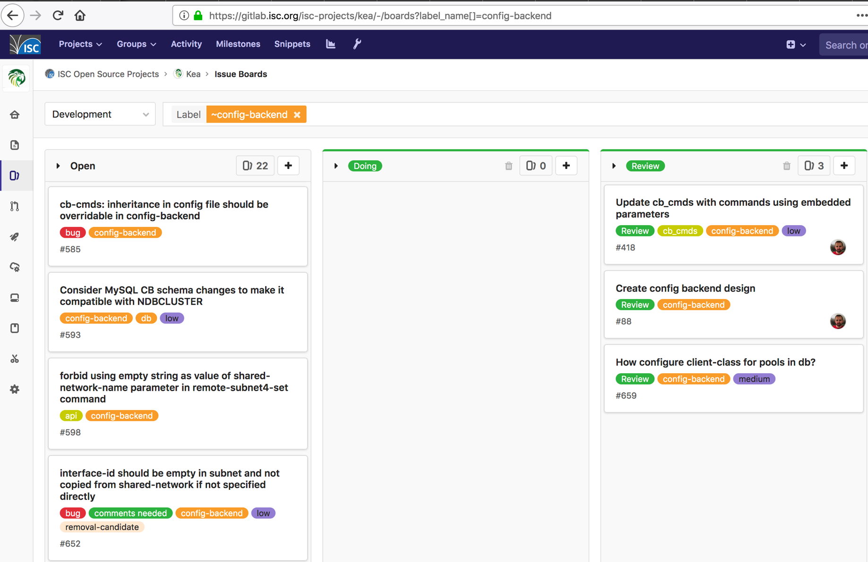
gitlab.isc.org
https://gitlab.isc.org/isc-projects/kea/

Slide 26
References
Website: isc.org/kea/
Project site: gitlab.isc.org/isc-projects/kea
Documentation: https://kea.readthedocs.io
https://kb.isc.org/docs/kea-performance-optimization
https://kb.isc.org/docs/kea-dhcpv6-design-considerations
https://kb.isc.org/docs/understanding-client-classification
Upcoming APNIC Kea webinar: tinyurl.com/apnic-kea
My email: peterd@isc.org

Slide 27
DHCPv6 quirks
Relays
MAC vs DUID
Prefix Delegation

Slide 28
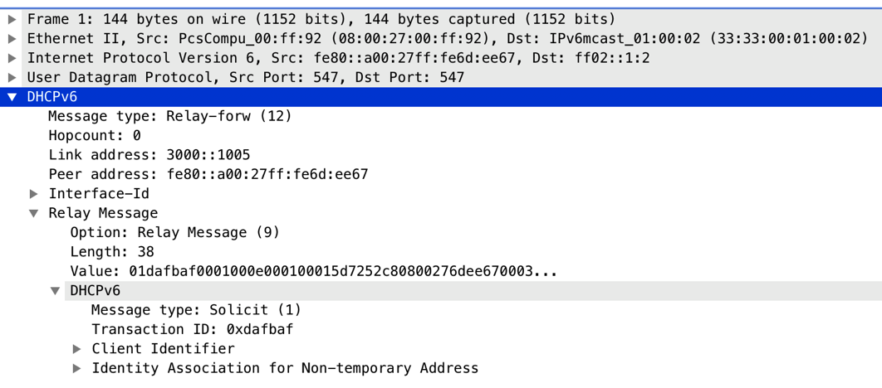
Relayed DHCPv6 traffic
Relay-Forward
Server
Client
Solicit
Relay Agent
Solicit
https://www.cloudshark.org/captures/ed586947ac56
(single relay)
https://www.cloudshark.org/captures/a93239e296bc
(two relays)
Up to 8 relays
Usually 1
CMTS
Each relay adds extra encapsulation layer

Slide 29
DUIDs

Slide 30
MAC vs DUID
IPv6 got rid of the MAC address as client identifier
This was a big mistake!
IPv6 uses DUIDs - unique identifier, one of 4 types:
LLT (MAC + time)
EN (Enterprise-id)
LL (MAC)
UUID
Kea has a solution:
RFC6939 (client-link-layer address option)
Extract MAC address from 5 different sources, configurable
See https://kea.readthedocs.io/en/v1_6_0/arm/dhcp6-srv.html#mac-hardware-addresses-in-dhcpv6 for details
Notes:
DUID - unique identifier, one of 4 types:
LLT (MAC + time)
EN (Enterprise-id)
LL (MAC)
UUID
Solved late 1990s problem - unreliable NICs
Brought a lot of new ones
Don’t know device’s DUID until its first boot
Not printed on the box
When you clone VM, you may get the same DUID
Dual boot device (win/linux or PXE) has different DUIDs
Kea has a solution to that problem:
RFC6939 (client-link-layer address option)
Extract MAC address from 5 different sources, configurable
See https://kea.readthedocs.io/en/v1_6_0/arm/dhcp6-srv.html#mac-hardware-addresses-in-dhcpv6 for details
Option 79 – the link layer or MAC address, can be added by the Relay. This is not enabled ‘out of the box’ but can be added. This is the main way to do RFC6939

Slide 31
Prefix Delegation
Dynamic
Static reservations
Managed host reservations in SQL db
Assign prefixes via RADIUS
Notes:
Prefix delegation is a powerful feature in IPv6, you should use it.
You can delegate various size prefixes – such as a /24, /48 or /60
Ways to implement prefix delegation
Dynamic assignment- Configure a pool in Kea, and it will dynamically compute and reserve enough addresses for each prefix required
Create static host reservations for prefixes (in JSON)
Manage status host reservations in SQL db
Assign prefixes via RADIUS

Slide 32
Hooks vs. Hook Libraries
Hook
points
Hook
libraries
External
system
request
High Availability
Kea2
packet processing
User Check
Classing
Host Commands
Flex Options, Subnet Cmds
Allocation Engine
Radius, config DB
response
Lease Commands
Notes:
draft of a new slide – attempting to explain that Kea has a set of fully supported hook points

